Slide 1

Music Store Analysis
SQL project

Slide 2
Overview :
The primary objective of this project is to help the music store management enhance their business growth by helping them optimize their inventory to ensure each store has the right selection of music in stock, reducing lost sales and customer frustration.
Using SQL queries we will Identify popular music genre trends among customer segments and analyze purchase patterns to understand how customer demographics or playlist characteristics influence music taste.

Slide 3
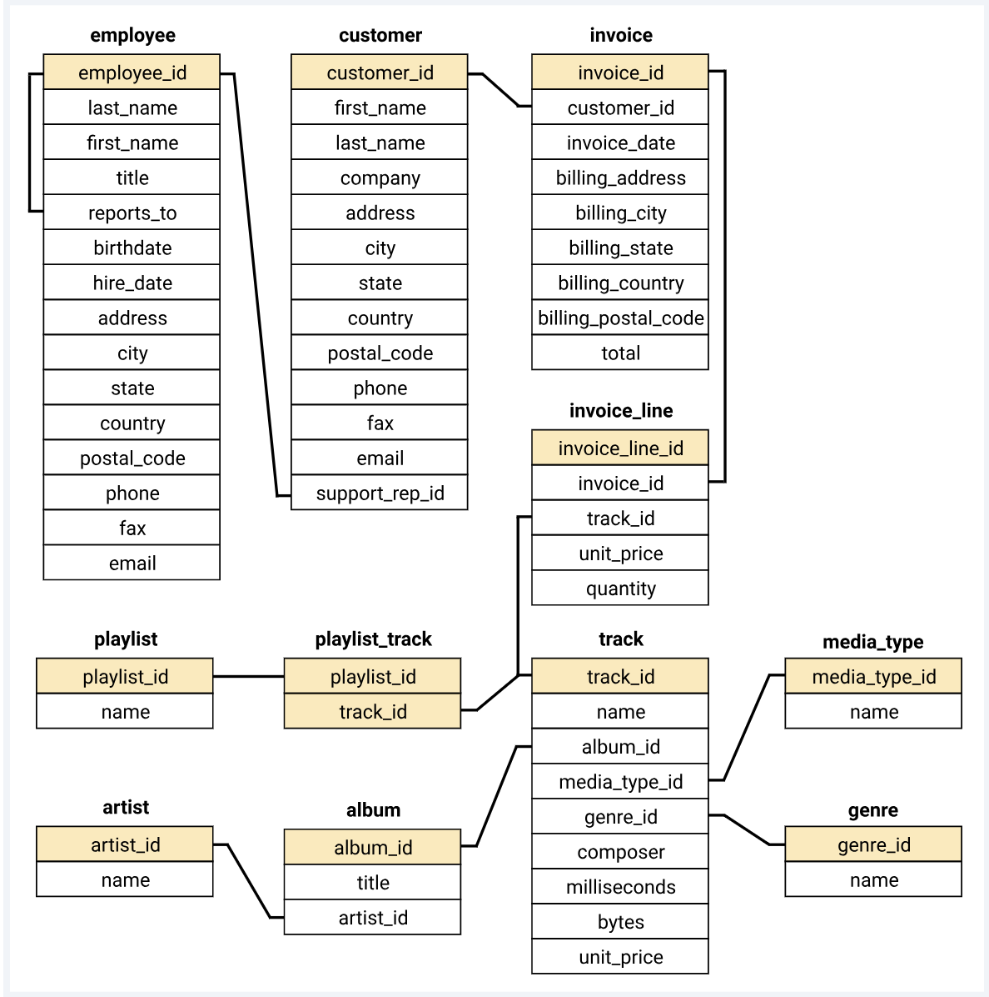
DATABASE SCHEMA

Slide 4
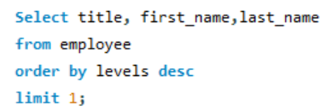

QUESTION 1
Who is the senior most employee based on job title?
OUTPUT:

Slide 5
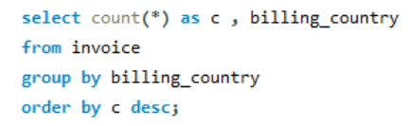
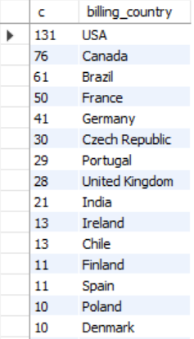
QUESTION 2
Which countries have the most sales?
OUTPUT:

Slide 6
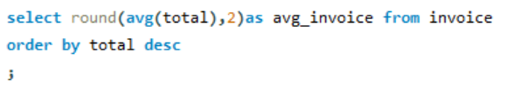

QUESTION 3
What is the average invoice value?
OUTPUT:

Slide 7
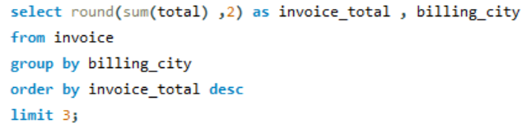
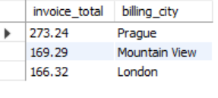
QUESTION 4
What are the top 3 cities with highest sales?
OUTPUT:

Slide 8
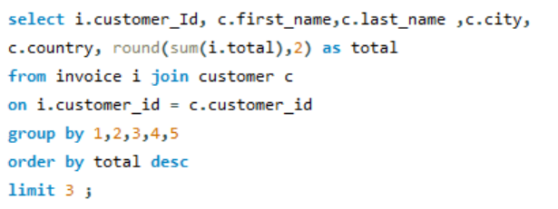
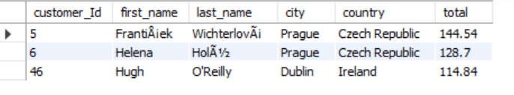
QUESTION 5
TOP 3 Customers based on sales amount
OUTPUT:

Slide 9
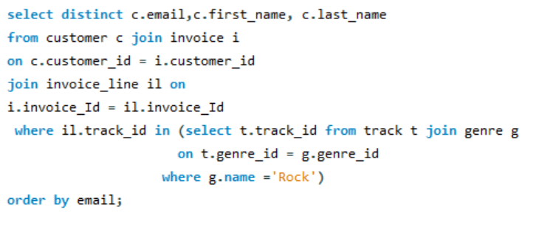
QUESTION 6
Write query to return email, first name, last name & genre of all rock music listeners order by email alphabetically

Slide 10
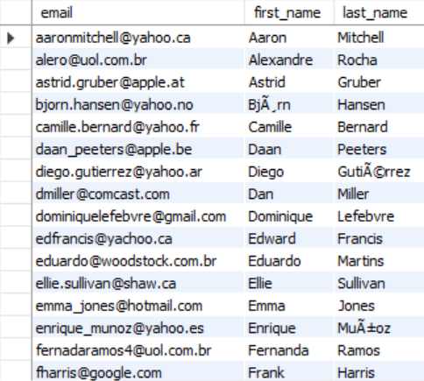
OUTPUT:

Slide 11
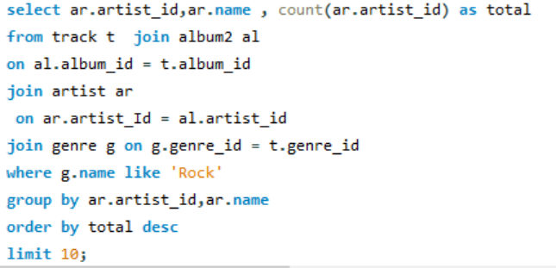
QUESTION 7
Invite artists who have written most rock music in our dataset. Return artist name and total track count of top 10 rock bands

Slide 12
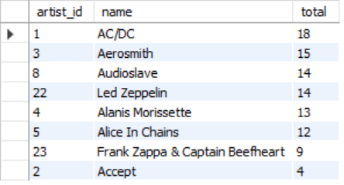
OUTPUT:

Slide 13
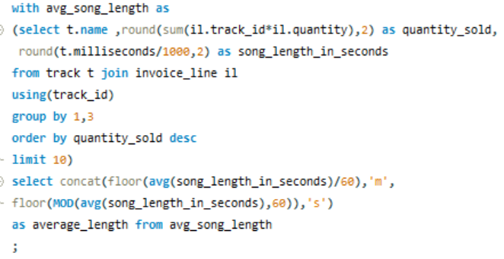

QUESTION 8
What is average song length of Top 10 songs based on sales?
OUTPUT:

Slide 14
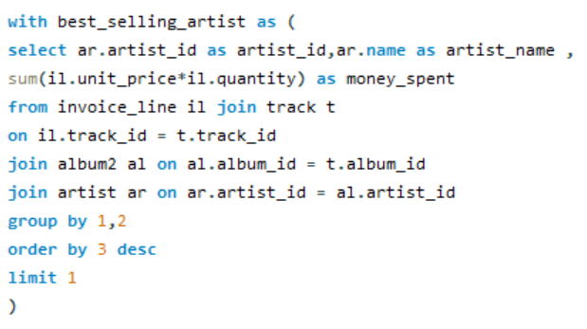
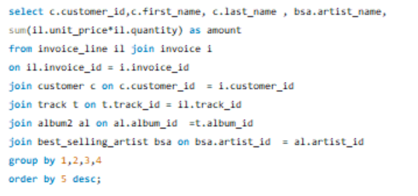
QUESTION 9
Find how much amount is spent by each customer on highest earning artist? Return customer name, artist name and total spent

Slide 15
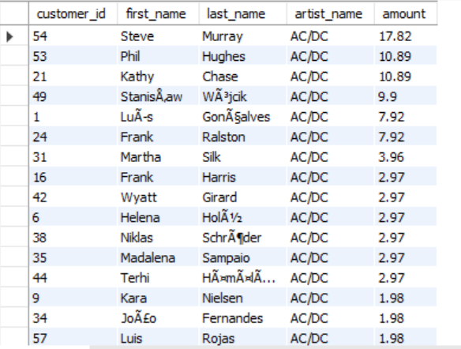
OUTPUT:

Slide 16
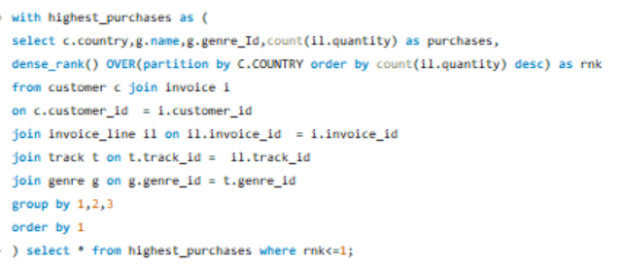
QUESTION 10
We want to find out the most popular music Genre for each country. We determine the most popular genre as the genre with the highest amount of purchases.

Slide 17
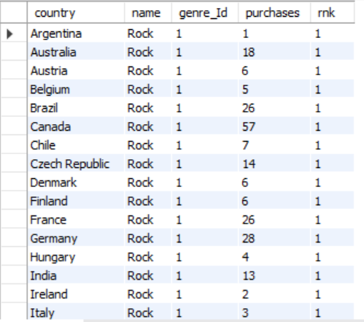
OUTPUT:

Slide 18
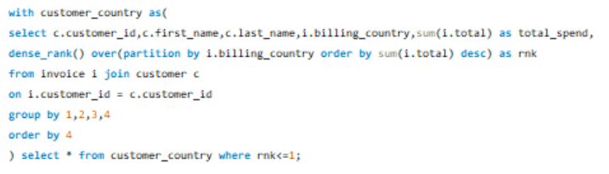
QUESTION 11
Q11: Write a query that determines the customer that has spent the most on music for each country.

Slide 19
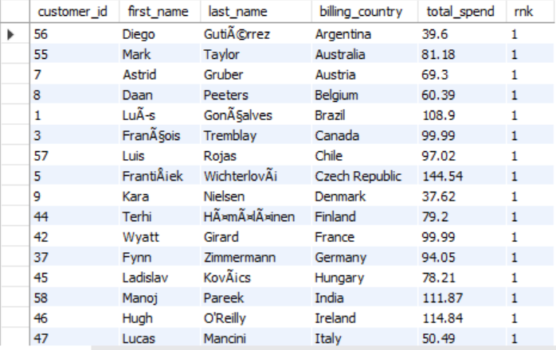
OUTPUT:

Slide 20
Insights
USA has the highest amount of purchases
Average invoice value is ~ $ 8
Prague, Mountain View & London have the highest sales.
Store’s Top 3 customers are from Prague & Dublin.
Artists with highest sales are AC/DC, Aerosmith & Audioslave.
Rock is the most popular genre and has the highest sales.
Average song length for Top 10 selling songs is 5 min 18 sec

Slide 21
Thanks for playing!

