Slide 1

Intro to CSS

Slide 2
Cascading Style Sheets
Cascading Style Sheets (CSS) is a style sheet language used for describing the presentation of a document written in a markup language like HTML. CSS is a cornerstone technology of the World Wide Web, alongside HTML and JavaScript.
Not a programming language
Stylesheet/Styling language
Used for website layout and design

Slide 3
Methods of adding CSS
There are three methods for styling:
Inline CSS
Internal CSS
External CSS

Slide 4
CSS Selectors
a { background-color : yellow ; }
1 2 3 4 5 6 7
Selector 5. Value
Declaration start 6. Declaration separator
Property 7. Declaration End
Separator

Slide 5
Colours in CSS
body {
color: red;
background-color: coral;
}
h1 {
color: #00ff00;
}
p {
color: rgb(0,0,255);
}
Colour names
HTML5 colour names
Hexa decimal
RGB

Slide 6
Fonts
Google fonts
Web Safe fonts
Importing
https://www.w3schools.com/cssref/css_websafe_fonts.asp
https://fonts.google.com/

Slide 7
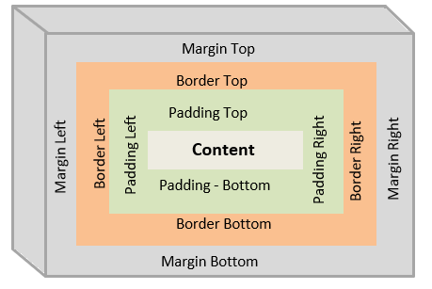
Box Model

Slide 8
Margin and Padding
Margin
https://www.w3schools.com/css/css_margin.asp
Padding
https://www.w3schools.com/css/css_padding.asp

Slide 9
Ping me at
Github
https://github.com/Viz38
Phone
8848752606

