Slide 1
Nba 3-Point Shots
Analysis of 2016-2017 Regular Season

Slide 2
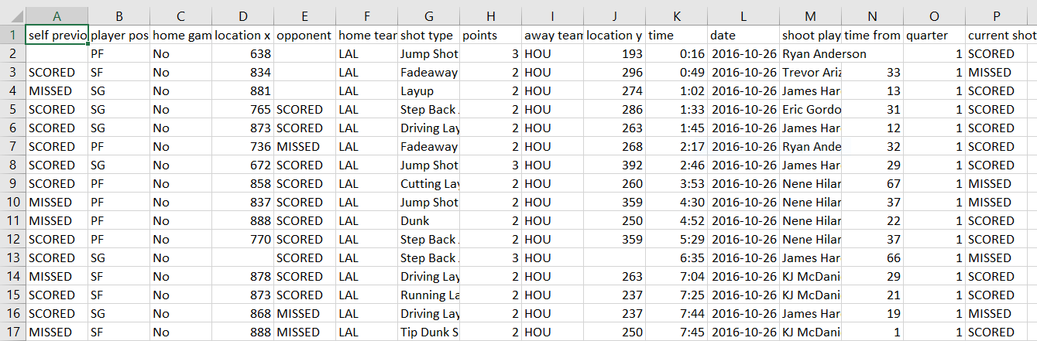
Data
NBA Shot logs of every shot of the regular season for every NBA team
This is all in multiple spreadsheets, do I need to make one .csv file?
Has player name, team name, an shot location (x, y co-ordinates)
NBA shot types by team (length of field goals and percentages)
NBA shot types by plater (length of field goals and percentages)

Slide 3
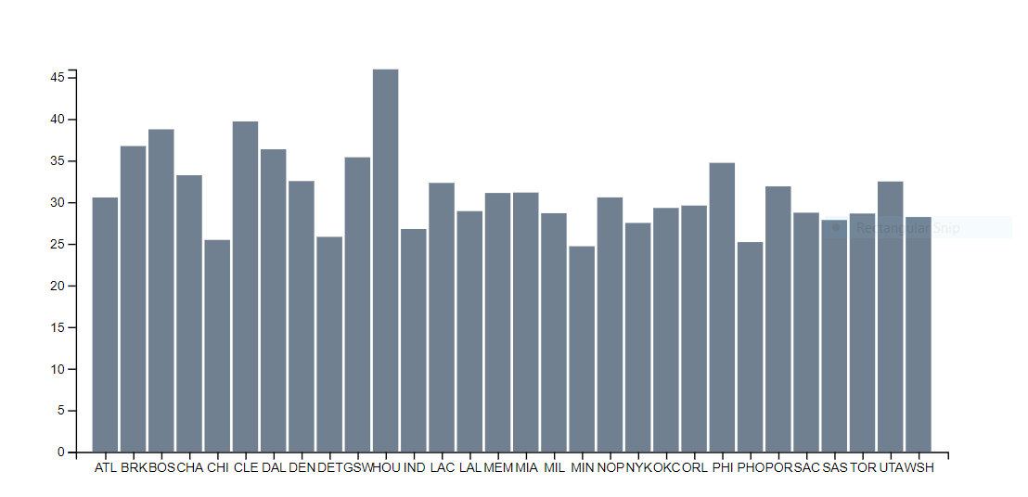
Visualization 1
A breakdown of all 32 NBA teams and their 3-pt Field Goal attempts
Each bar will have an on-click feature that will allow the user to select on of the teams
This will give a breakdown of each team’s players and their respective 3-pt field goal attempts
I was also thinking of having a scatter plot here instead, showing 3-pt field goal attempts vs. win percentage for each team, but I wanted to have a bar-chart.

Slide 4
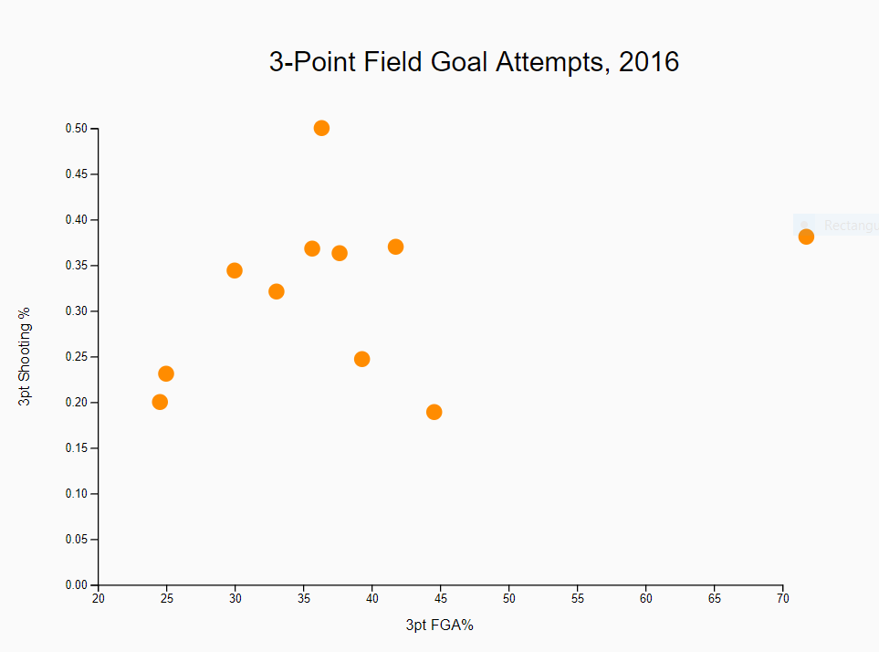
Visualization 2
This is a breakdown of each team’s players and their individual 3-pt field goal attempts vs. 3-pt field goal average
Here there will also be an “on-click” feature where once a point is selected, representing the specific player, the shot chart at the bottom of the page will update accordingly

Slide 5

Visualization 3
NBA 2016-2017 Shot chart of made/missed field goals for each player as selected in the previous visualization.
Maybe have a hover effect over each point to indicate distance, or date, or opponent, etc.)

Slide 6
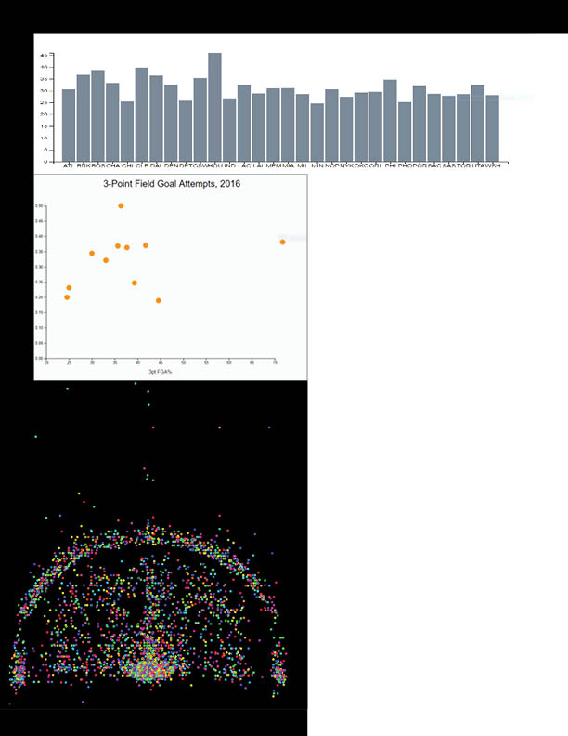
Current status
I now have to code everything
Having decided the layout, it is now just a matter of:
1. creating the visualizations so that they are connected
2. figure out how to properly use the shot log data

