Slide 1
Problem #72 Leetcode
Edit Distance
By: Victor Marchesi

Slide 2
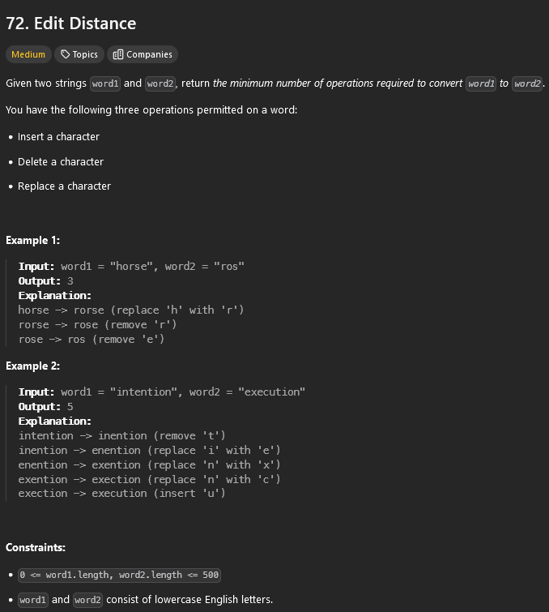
Problem Description
Find the minimum number of operations to turn Word1 into Word2.
Recommended to use Dynamic Programming by implementing the Levenshtein-distance algorithm.

Slide 3
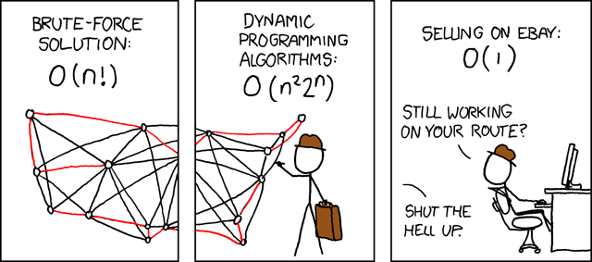
Dynamic Programing: Short Description
Dynamic programming (DP) can be applied when the problem exhibits the same subproblems solved multiple times (saves previous solutions) and the solution to the problem can be built from the solutions of its subproblems.
Common applications include shortest path algorithms, knapsack problems, and sequence alignment.

Slide 4
Levenshtein Distance: What is it?
Search description: In information theory, linguistics, and computer science, the Levenshtein distance is a string metric for measuring the difference between two sequences.

Slide 5
Levenshtein Distance: How does it work?
Generally you use:
Insertion: Adding a character to string A.
Deletion: Removing a character from string A.
Replacement: Replacing a character in string A with another character.
Each choice has a cost of one.

Slide 6
Levenshtein Distance: Board Example
For example, if you have a word1 as “vegan” and word2 as “beef”. What is the minimum number of steps to do modify word1 into word2?
word1 = vegan
word2 = beef

Slide 7
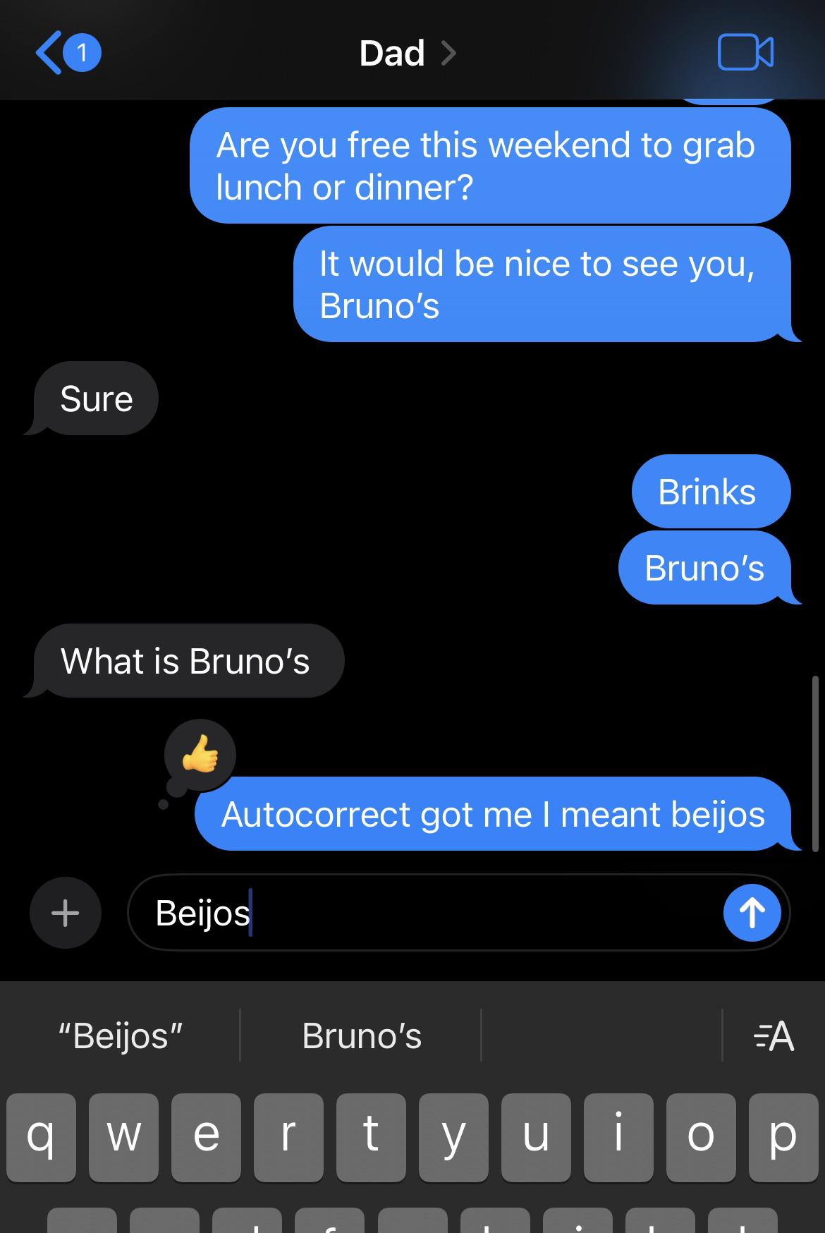
Levenshtein Distance: What uses this?
Autocorrect Algorithms [1]
Data cleaning
Used to reduce redundancy/find similar records. [1]
Data clustering and classification
Clustering groups with similar records, and classification assigns them predefined labels. [1]

Slide 8
Problem Description
Again
Find the minimum number of operations to turn Word1 into Word2.
Recommended to use the Levenshtein-distance algorithm

Slide 9
Levenshtein Distance: Leet code explanation
Suppose we want to convert String A: “horse” into String B: “ros”. We need to find the minimum operations required.
horse → rorse (substitute "r" for "h")
rorse → rose (delete "r")
rose → ros(delete "e")
In this case, it took three operations, so the Levenshtein distance between “horse” and “ros” is 3 [1].

Slide 10
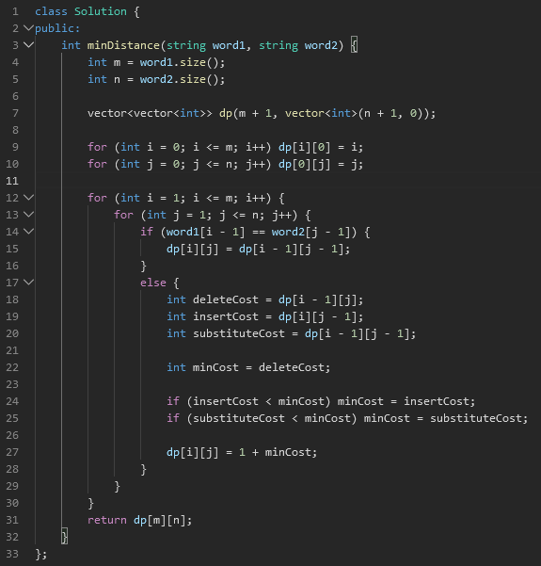
My solution to Problem #72 Edit Distance
Solution run through on Github:
https://github.com/Vizemo/4883-Prog-Tech-Marchesi/tree/main/Assignments/P01

Slide 11
Time and Space Complexity Summary
Time Complexity: O(m x n)
Filling the DP table requires comparing each character in “word1” with each character in “word2”.
Space Complexity: O(m x n)
The DP table has dimensions (m + 1) x (n + 1), where each cell stores the minimum edit distance for substring pairs.
Note: Here, m and n are the lengths of word1 and word2, respectively.

Slide 12
References
"Introduction to Levenshtein Distance," GeeksforGeeks, Feb. 2023. [Online]. Available: https://www.geeksforgeeks.org/introduction-to-levenshtein-distance/. [Accessed: Nov. 11, 2024].
"Levenshtein Distance." Wikipedia, Apr. 2023. [Online]. Available: https://en.wikipedia.org/wiki/Levenshtein_distance. [Accessed: Nov. 11, 2024].

