Slide 1
Split vs Stratification/Intersection

Slide 2
A dataset can have many attributes (columns)
ECO_ID_U | ECO_CODE | ECO_NAME | WWF_MHTNAM | RealmMHT | geometry
10184 | AT1313 | Masai Xeric Grasslands And Shrublands | Deserts and Xeric Shrublands | AT13
10122 | AT0705 | East Sudanian Savanna | Tropical and Subtropical Grasslands, Savannas and Shrublands | AT7
10147 | AT0901 | East African Halophytics | Flooded Grasslands and Savannas | AT9
10132 | AT0715 | Somali Acacia-Commiphora Bushlands And Thickets | Tropical and Subtropical Grasslands, Savannas and Shrublands | AT7

Slide 3
Split: Divide the dataset by one of the attributes (columns)
ECO_ID_U | ECO_CODE | ECO_NAME | WWF_MHTNAM | RealmMHT | geometry
10184 | AT1313 | Masai Xeric Grasslands And Shrublands | Deserts and Xeric Shrublands | AT13
10122 | AT0705 | East Sudanian Savanna | Tropical and Subtropical Grasslands, Savannas and Shrublands | AT7
10147 | AT0901 | East African Halophytics | Flooded Grasslands and Savannas | AT9
10132 | AT0715 | Somali Acacia-Commiphora Bushlands And Thickets | Tropical and Subtropical Grasslands, Savannas and Shrublands | AT7

Slide 4
The result of split is a new feature for each class
WITHOUT SPLIT:
Feature 1: Terrestrial habitats
WITH SPLIT:
Feature 1: Deserts and Xeric Shrublands
Feature 2: Tropical and Subtropical Grasslands, Savannas and Shrublands
Feature 3: Flooded Grasslands and Savannas

Slide 5
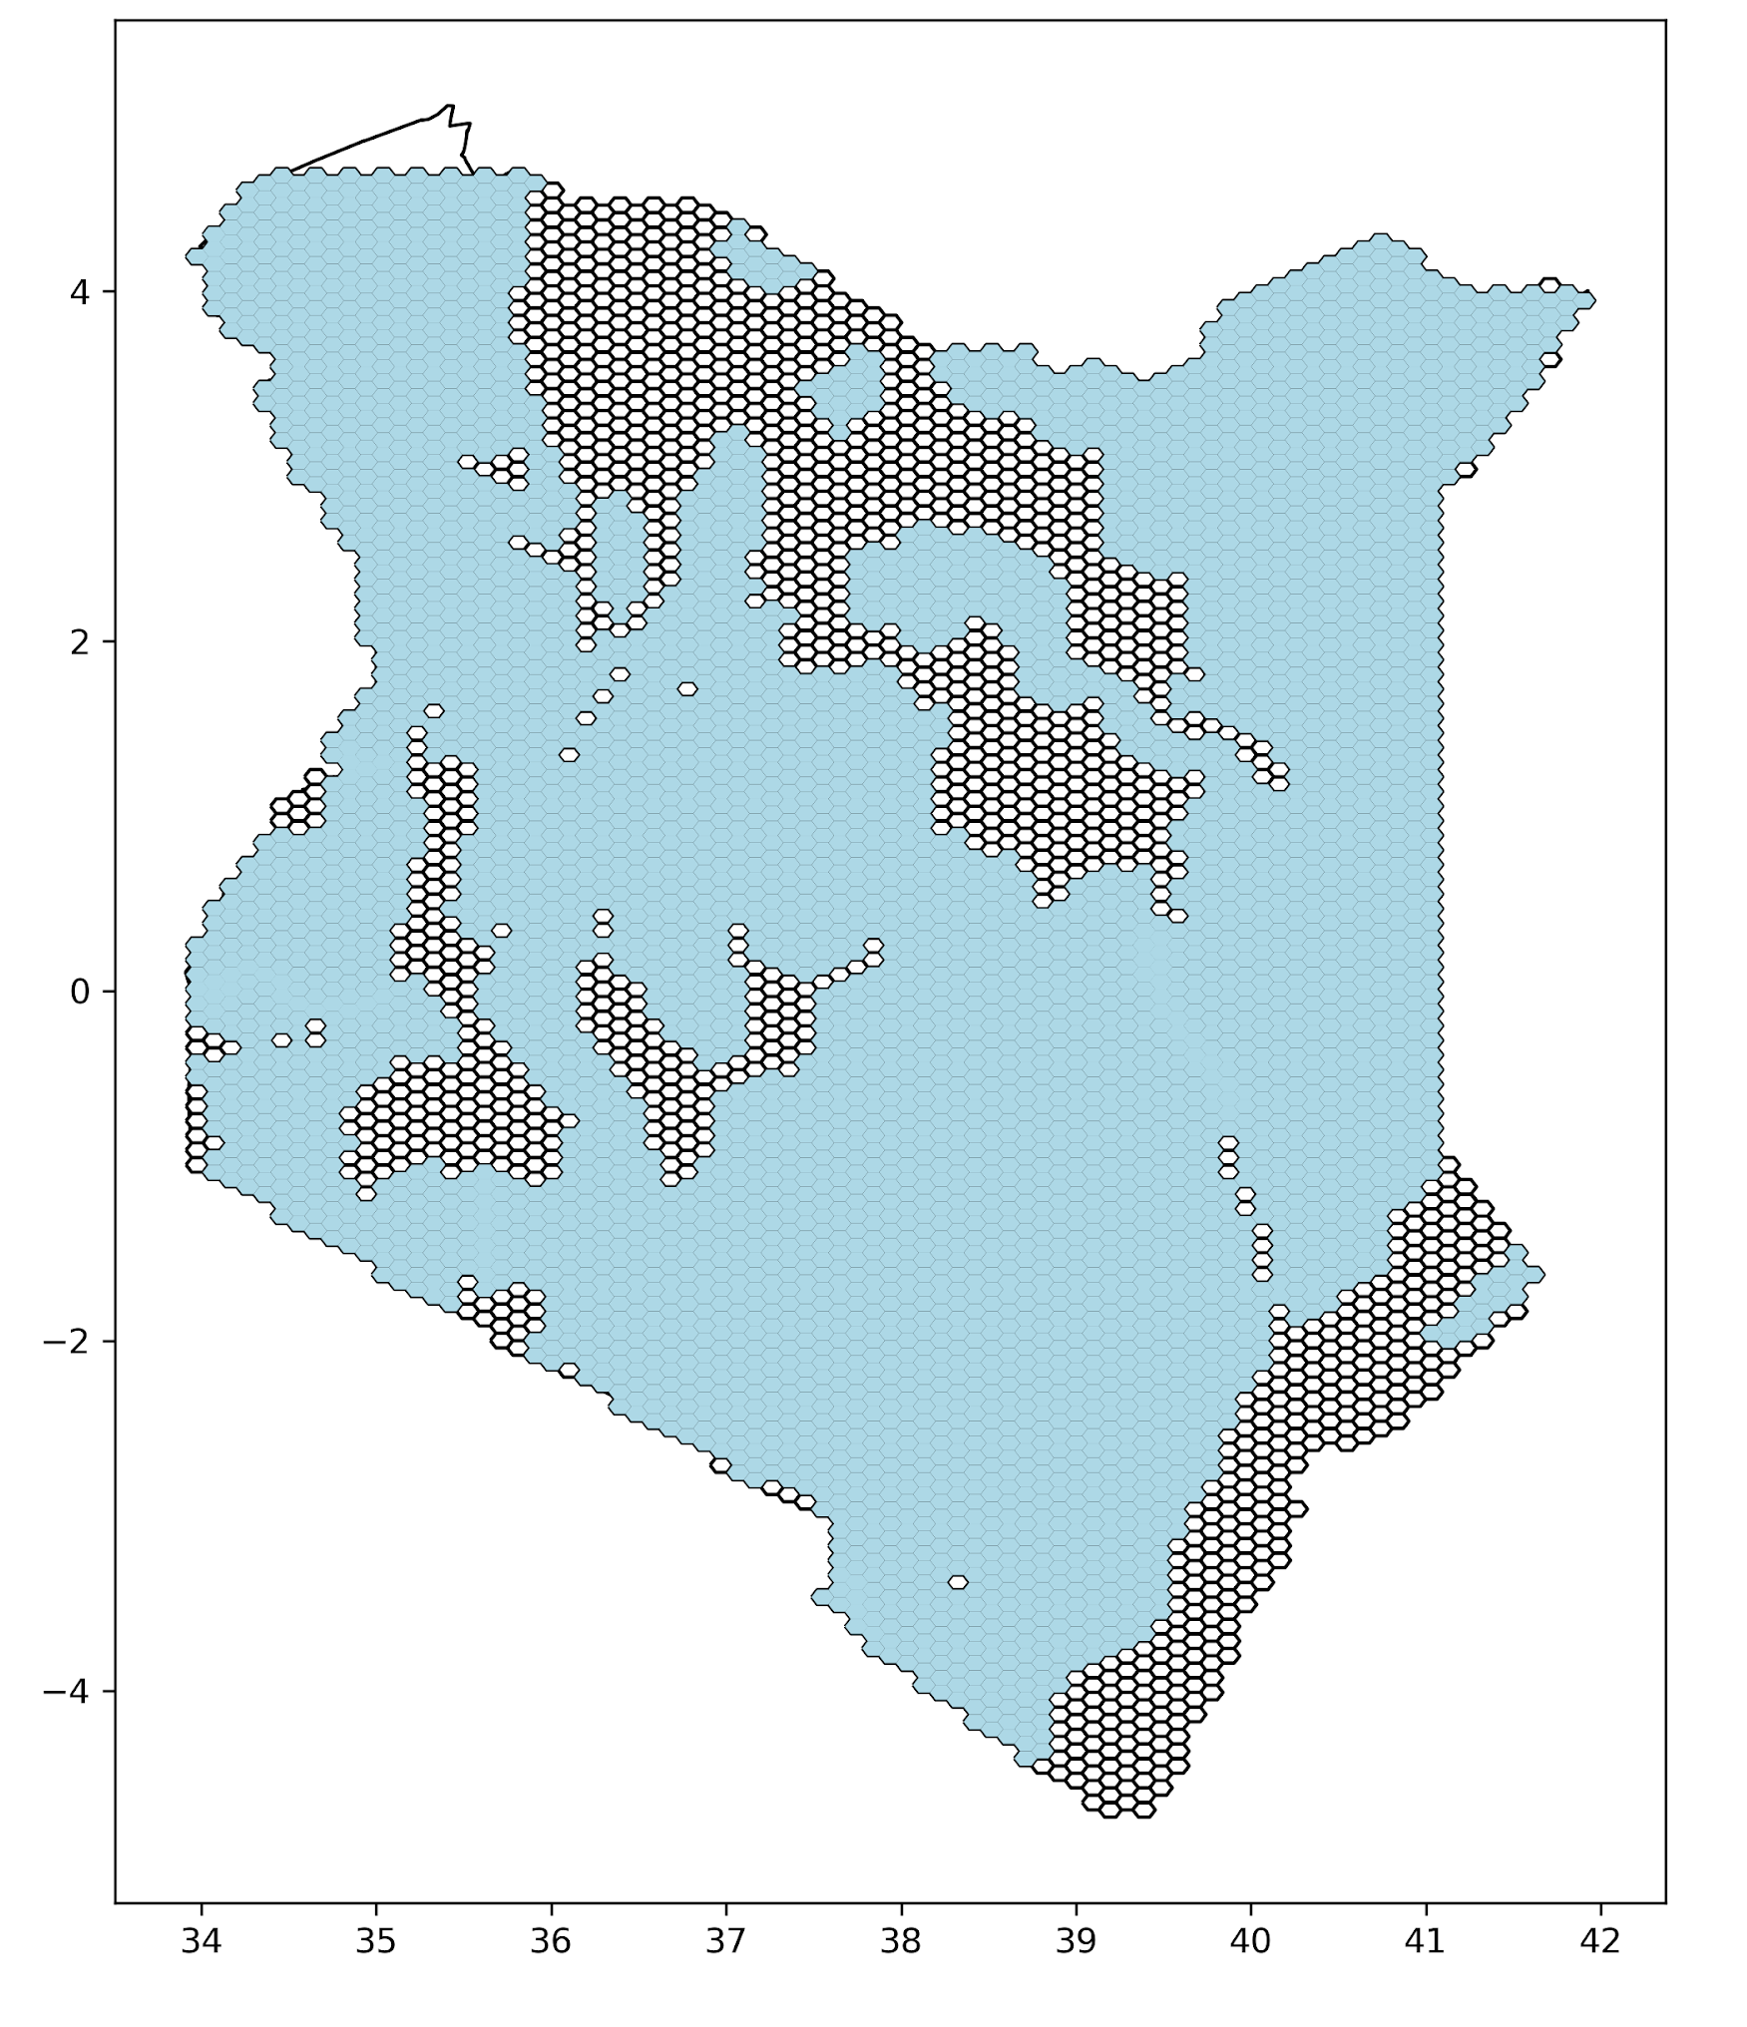
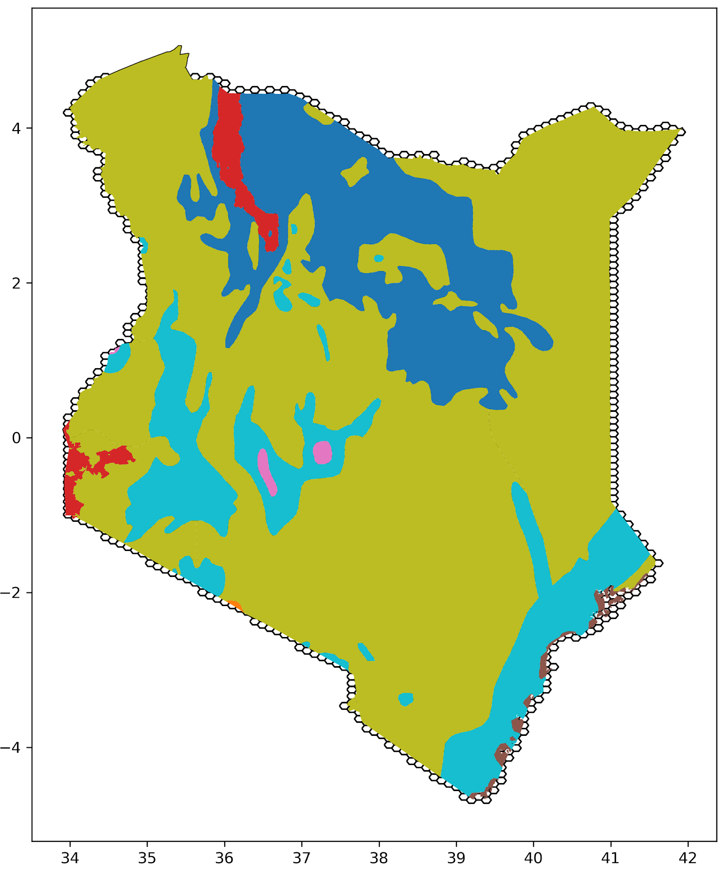
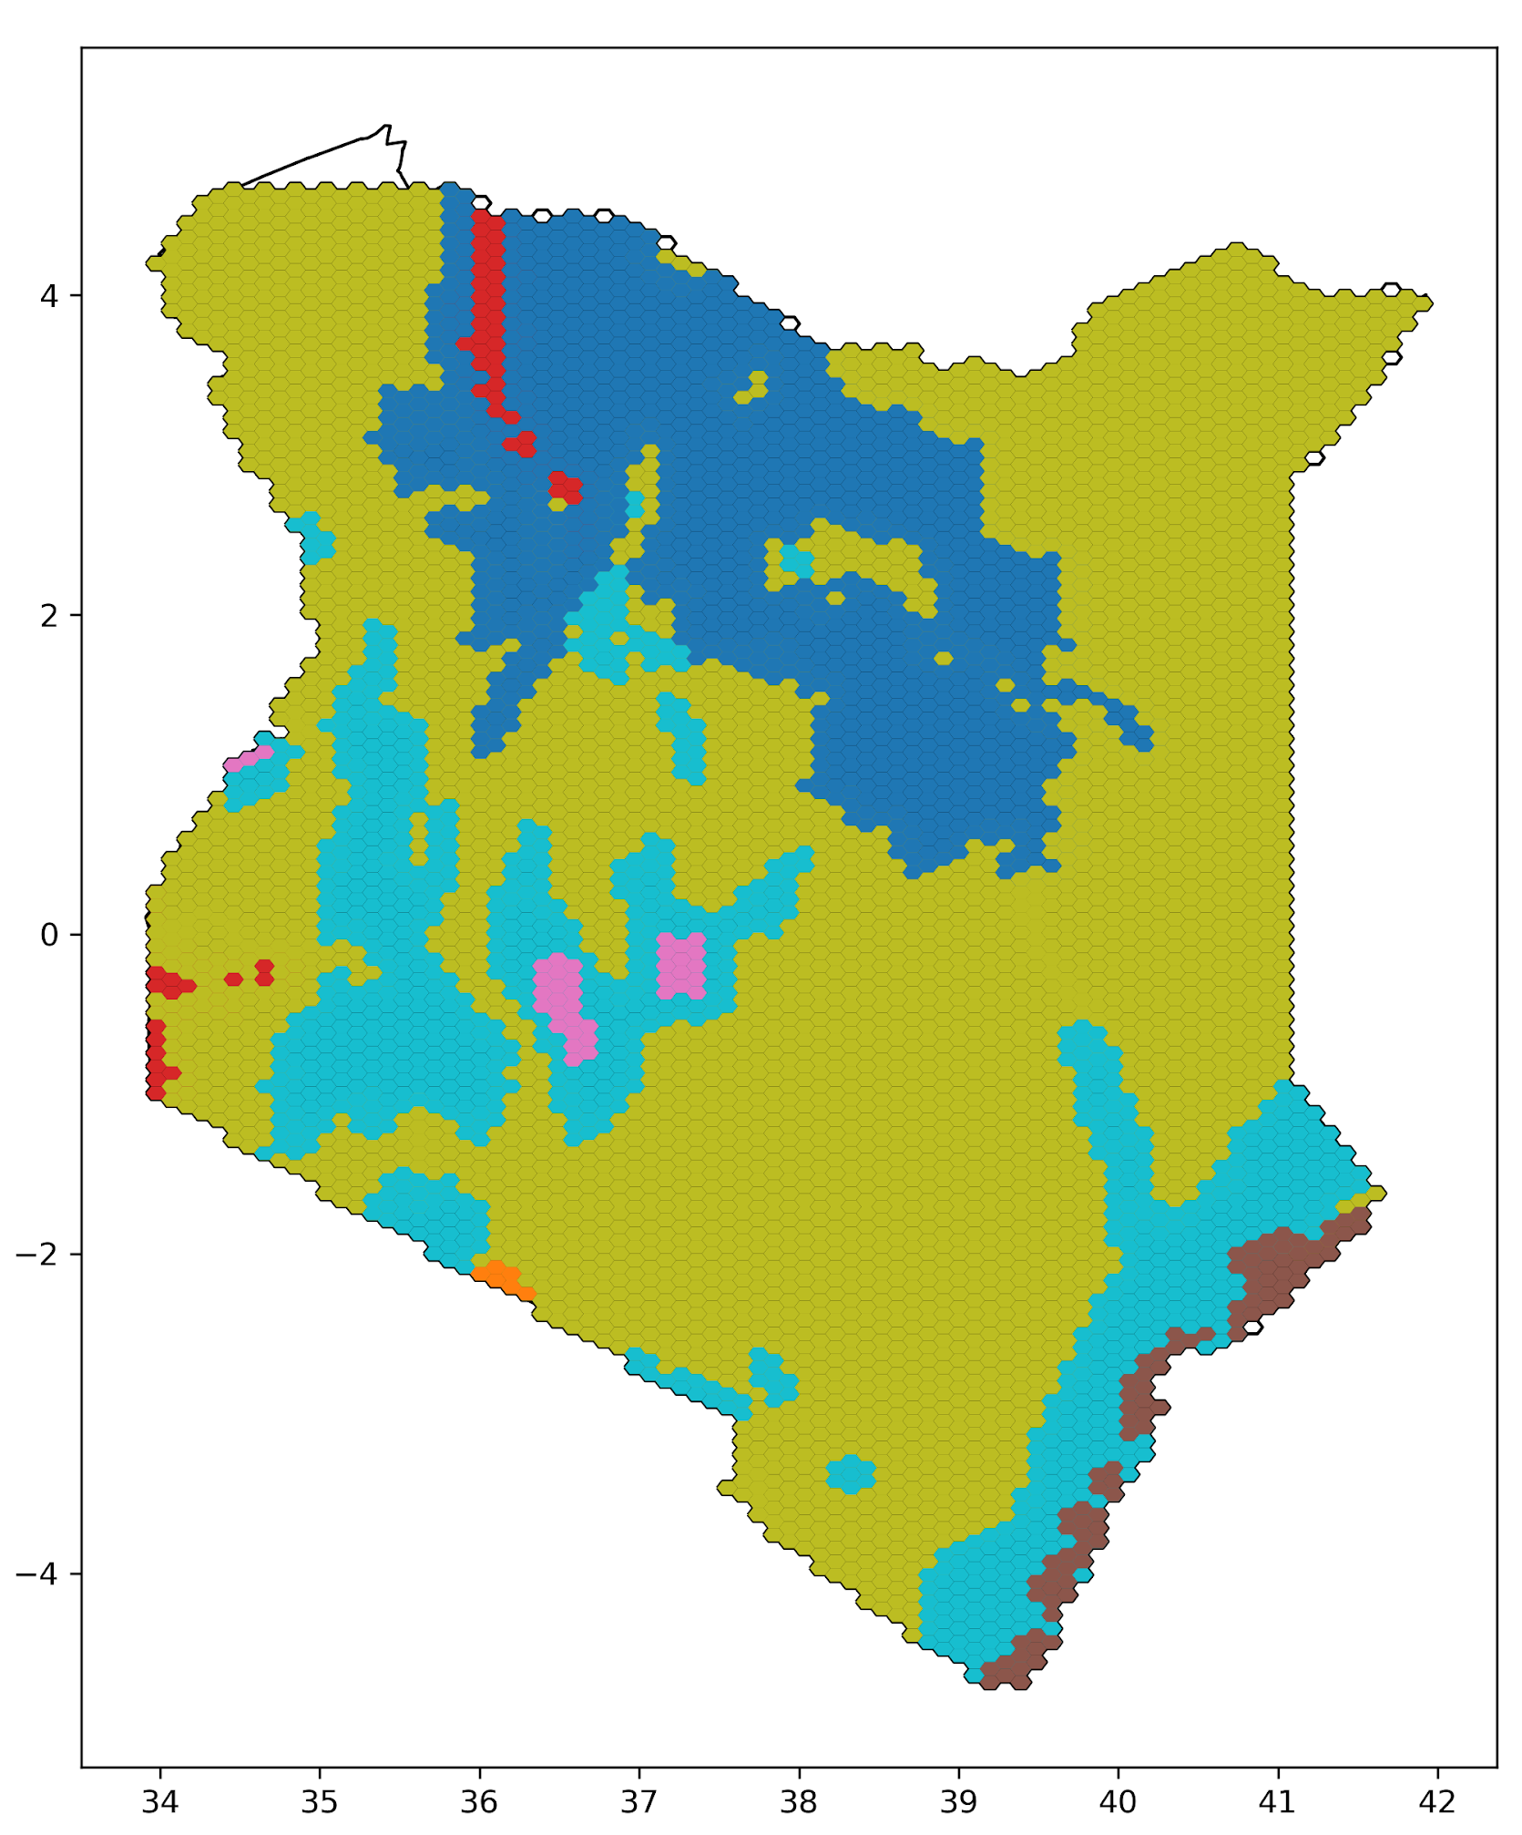
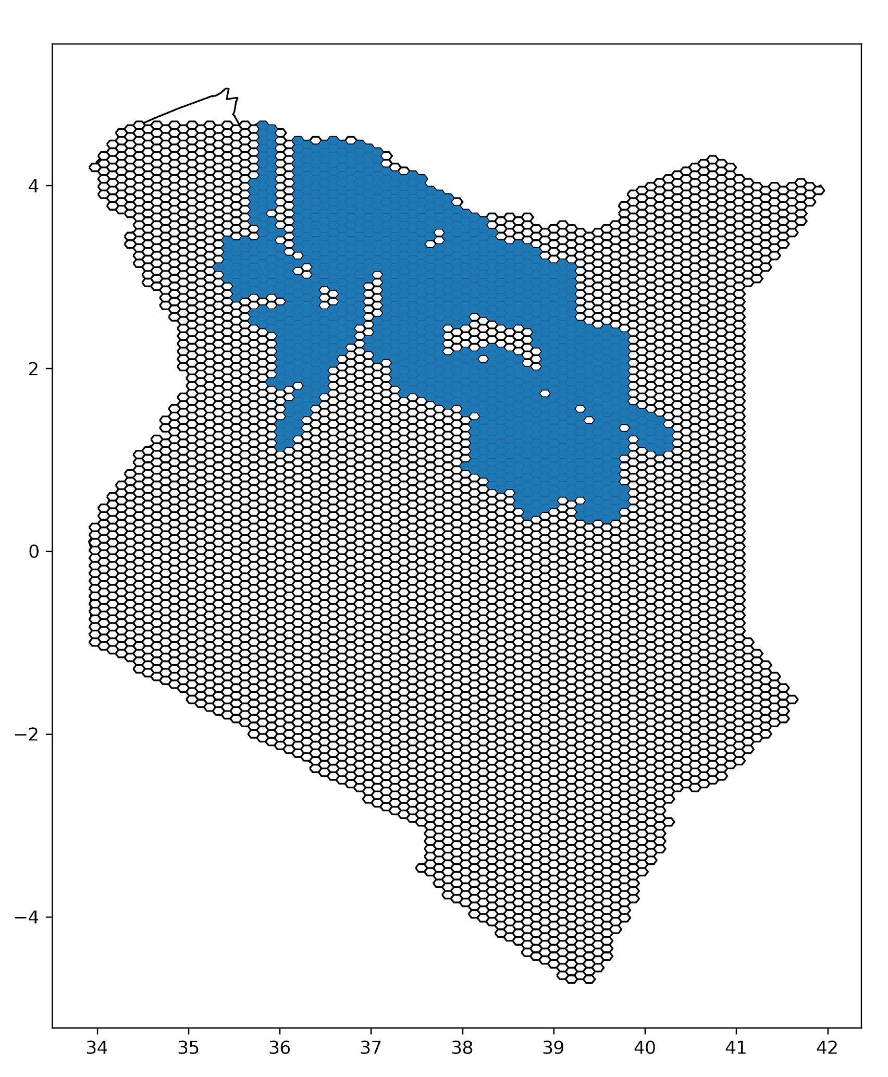
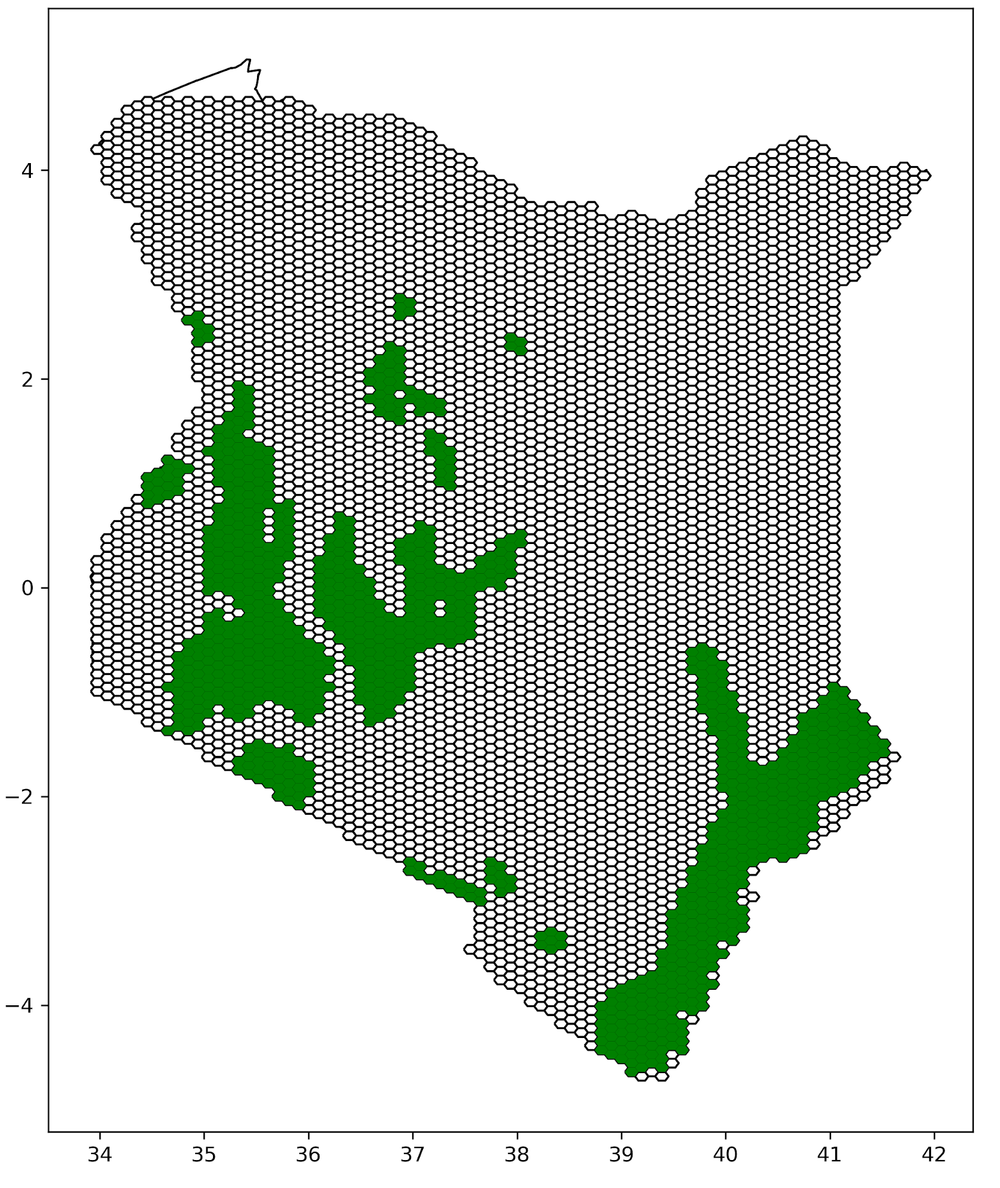
Example of split with real data
Savanna
Desert
Forest
Landscape/ Bioregional layer
Landscape layer in grid (threshold applied)
Split layer:
New features

Slide 6
Stratification: Split a dataset by attributes and intersect with another feature
ECO_ID_U | ECO_CODE | ECO_NAME | WWF_MHTNAM | RealmMHT | geometry
10184 | AT1313 | Masai Xeric Grasslands And Shrublands | Deserts and Xeric Shrublands | AT13
10122 | AT0705 | East Sudanian Savanna | Tropical and Subtropical Grasslands, Savannas and Shrublands | AT7
10147 | AT0901 | East African Halophytics | Flooded Grasslands and Savannas | AT9
10132 | AT0715 | Somali Acacia-Commiphora Bushlands And Thickets | Tropical and Subtropical Grasslands, Savannas and Shrublands | AT7
ASSESSMENT | ID_NO | BINOMIAL | PRESENCE | YEAR | geometry
115130419.0 | 15951.0 | Panthera leo | 4 | 2016
115130419.0 | 15951.0 | Panthera leo | 1 | 2016
115130419.0 | 15951.0 | Panthera leo | 4 | 2016
115130419.0 | 15951.0 | Panthera leo | 4 | 2016
+

Slide 7
The result of stratification is one feature for each combination of class + input feature
+
WITHOUT STRATIFICATION:
Feature 1: Deserts and Xeric Shrublands
Feature 2: Tropical and Subtropical Grasslands, Savannas and Shrublands
Feature 3: Flooded Grasslands and Savannas
Feature 4: Lion
WITH STRATIFICATION:
Feature 1: Deserts and Xeric Shrublands + LION
Feature 2: Tropical and Subtropical Grasslands, Savannas and Shrublands + LION
Feature 3: Flooded Grasslands and Savannas + LION

Slide 8
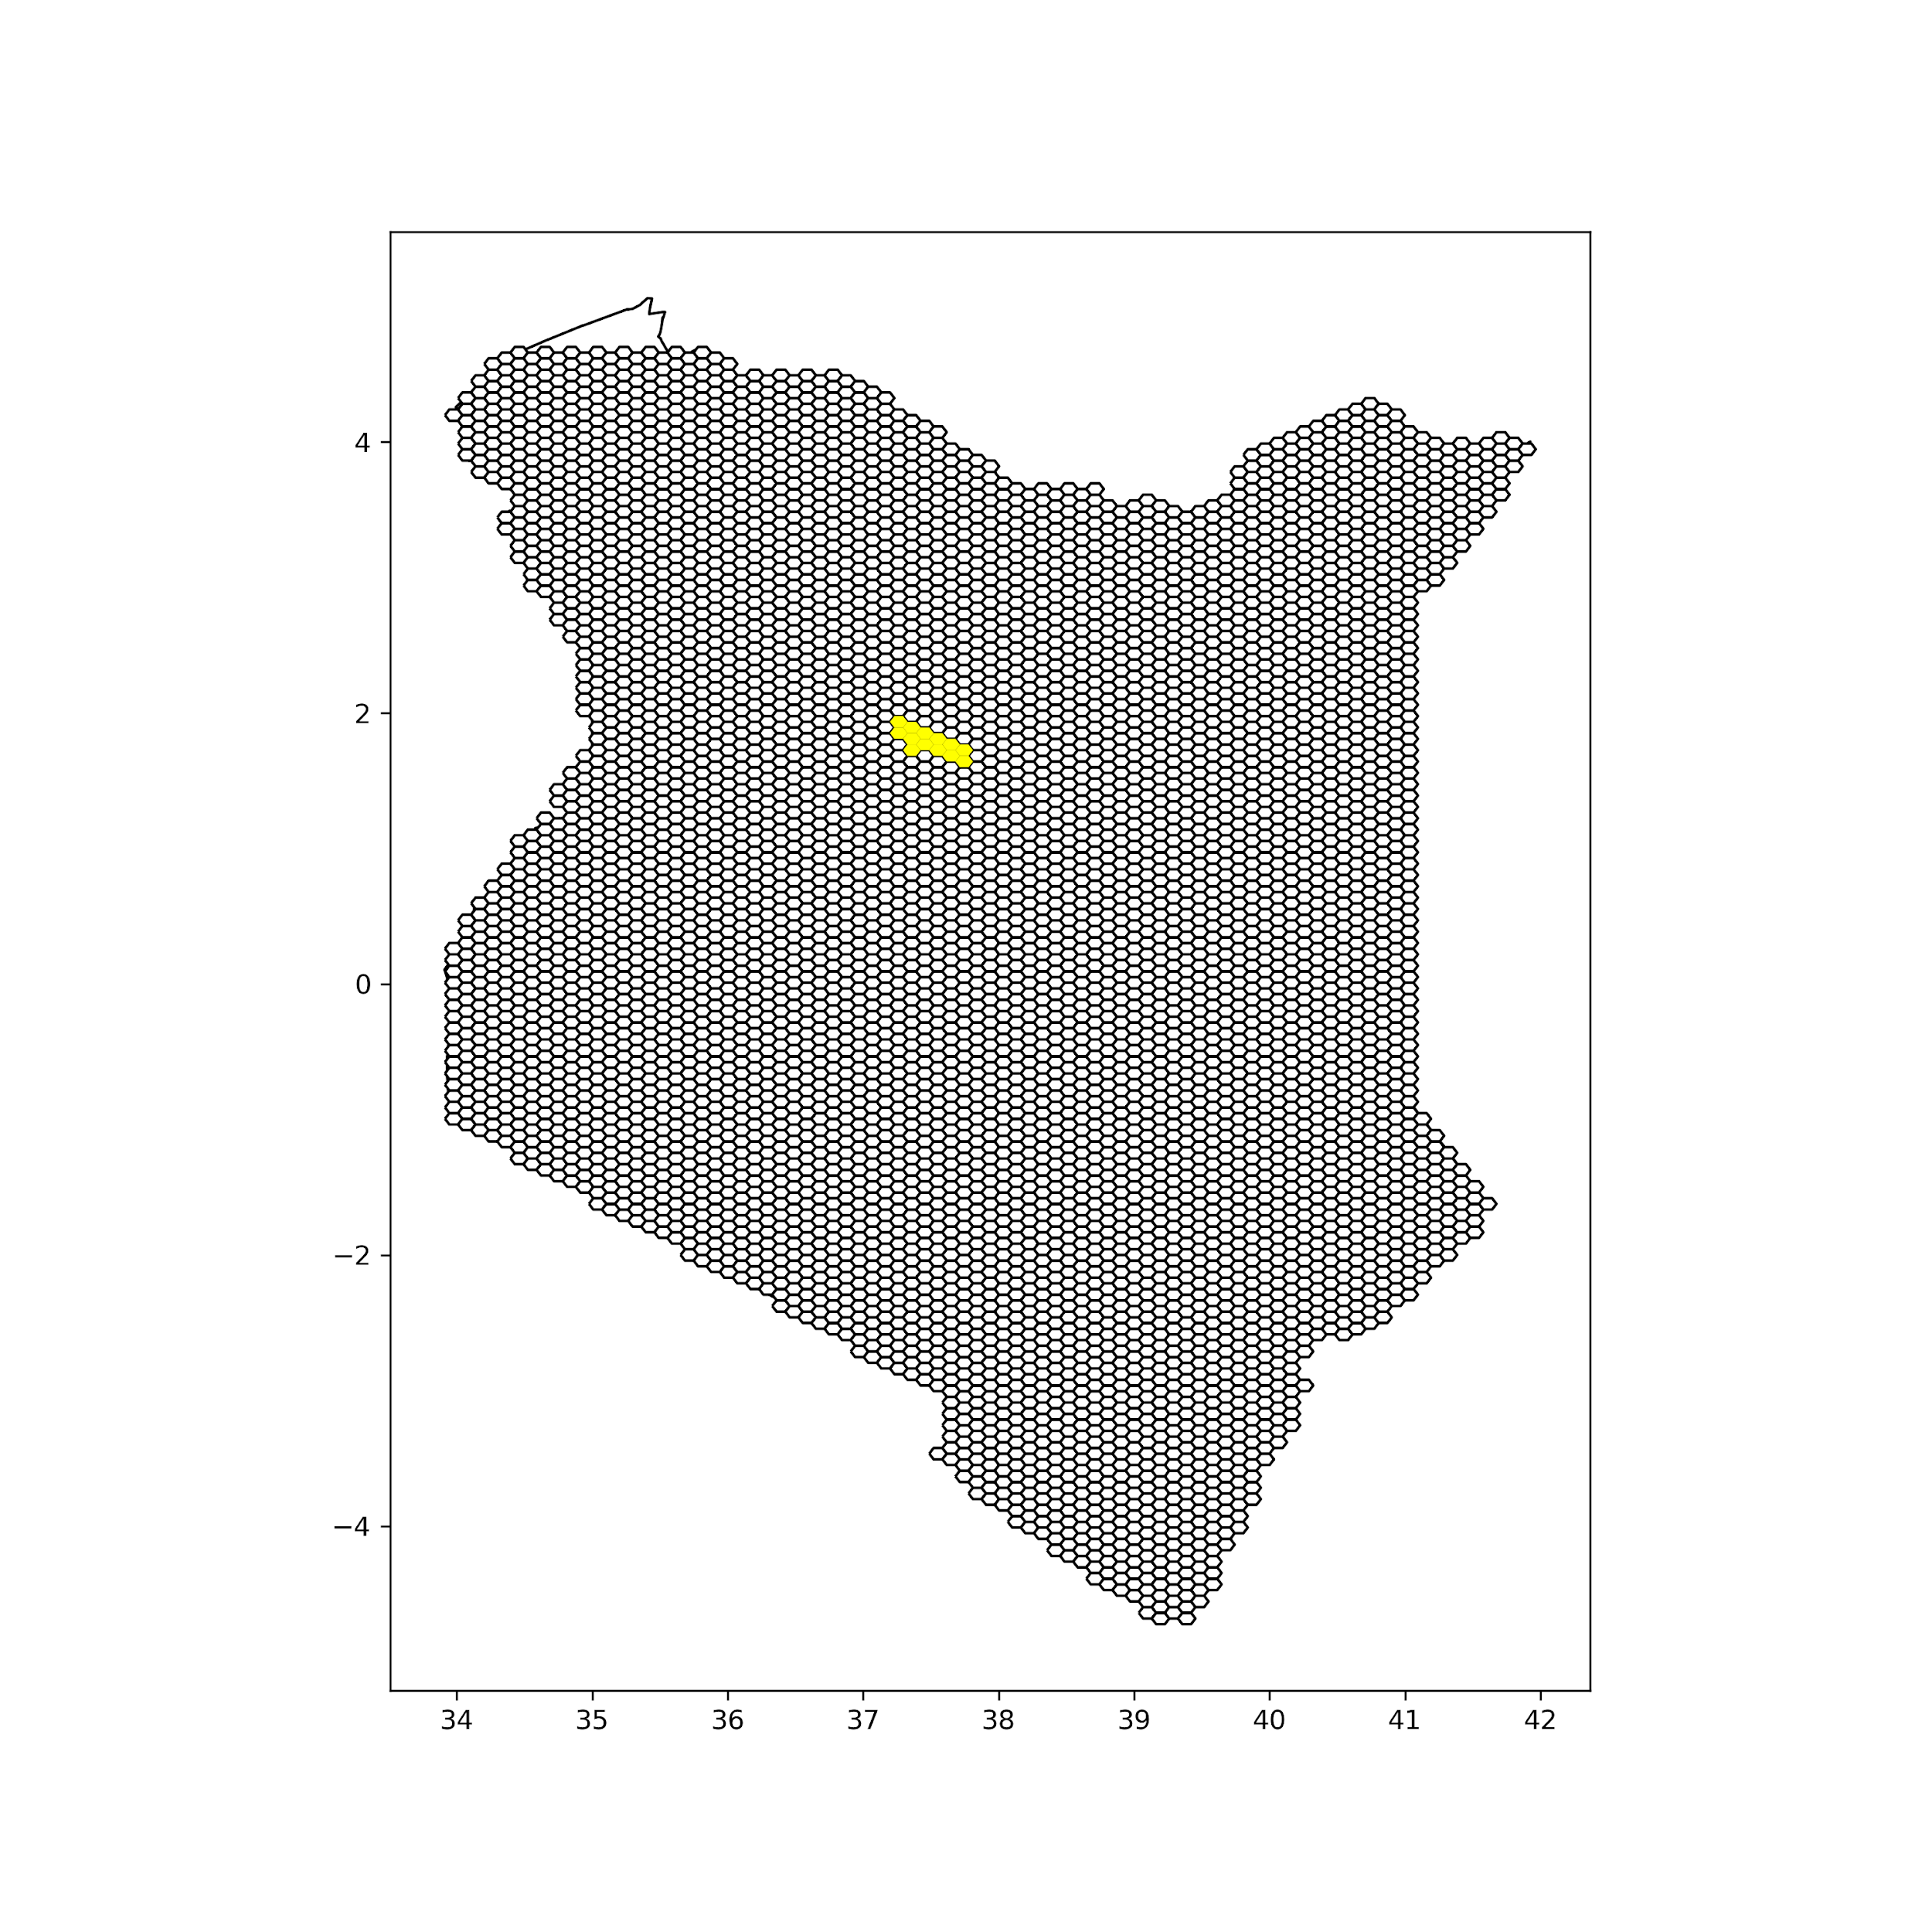
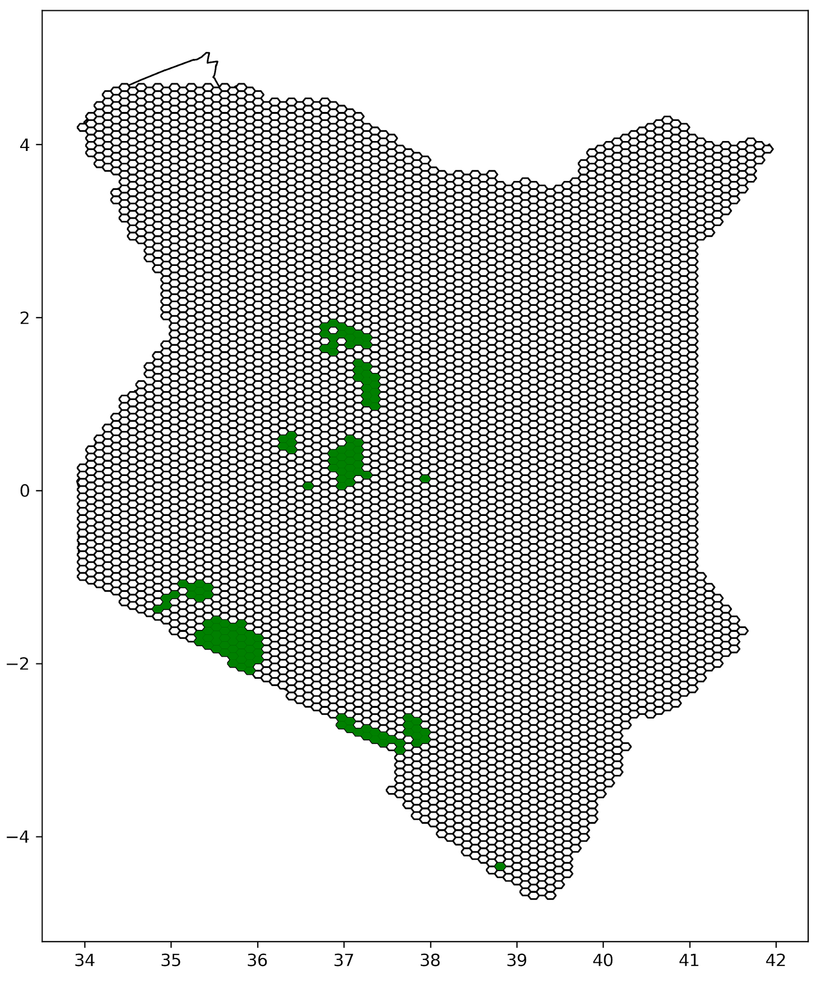
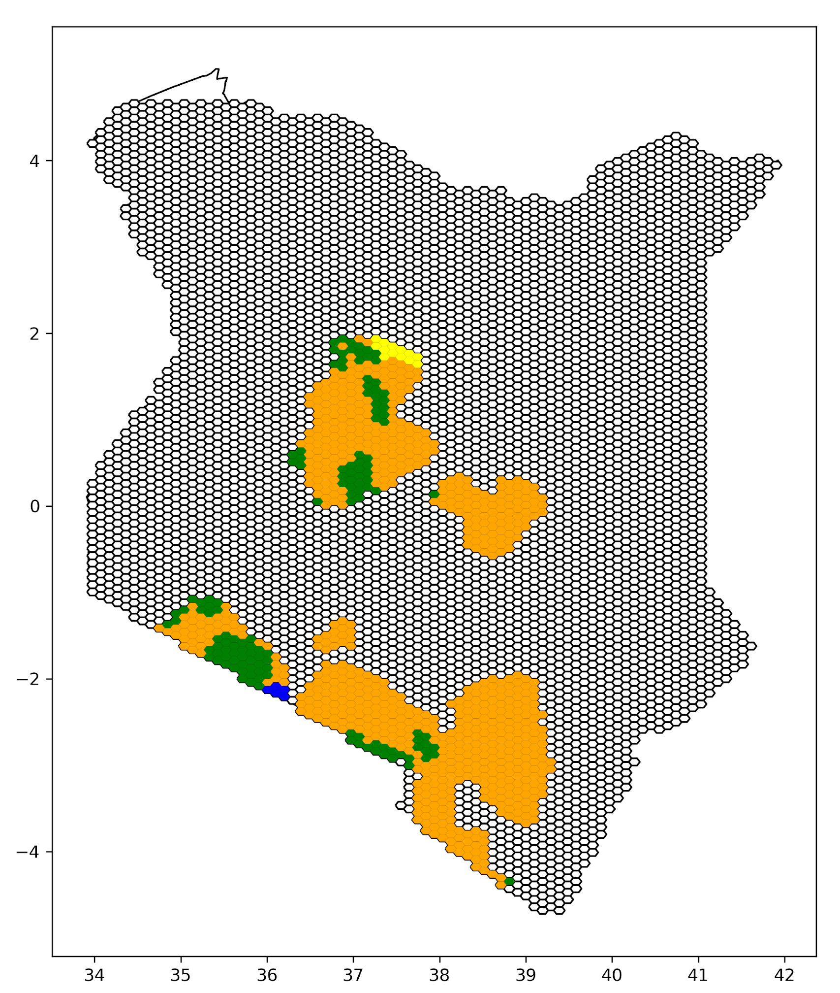
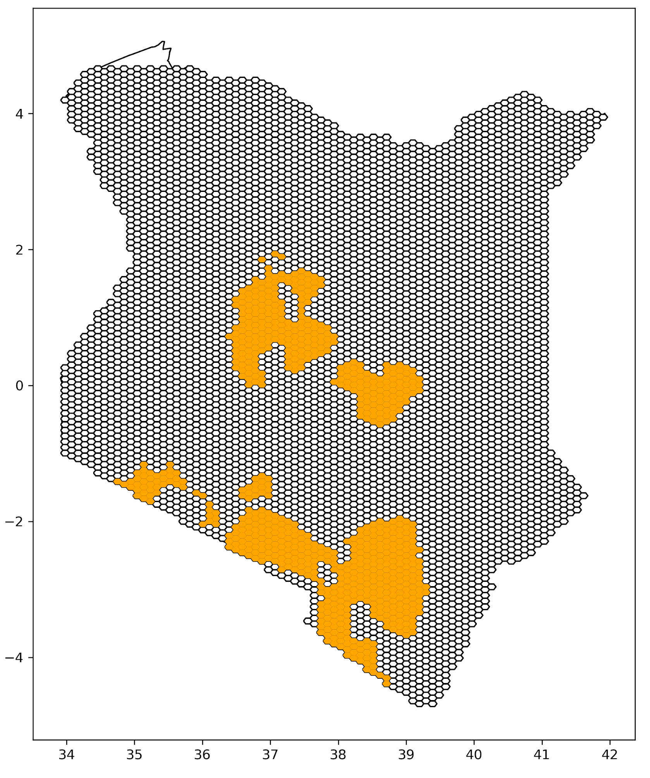
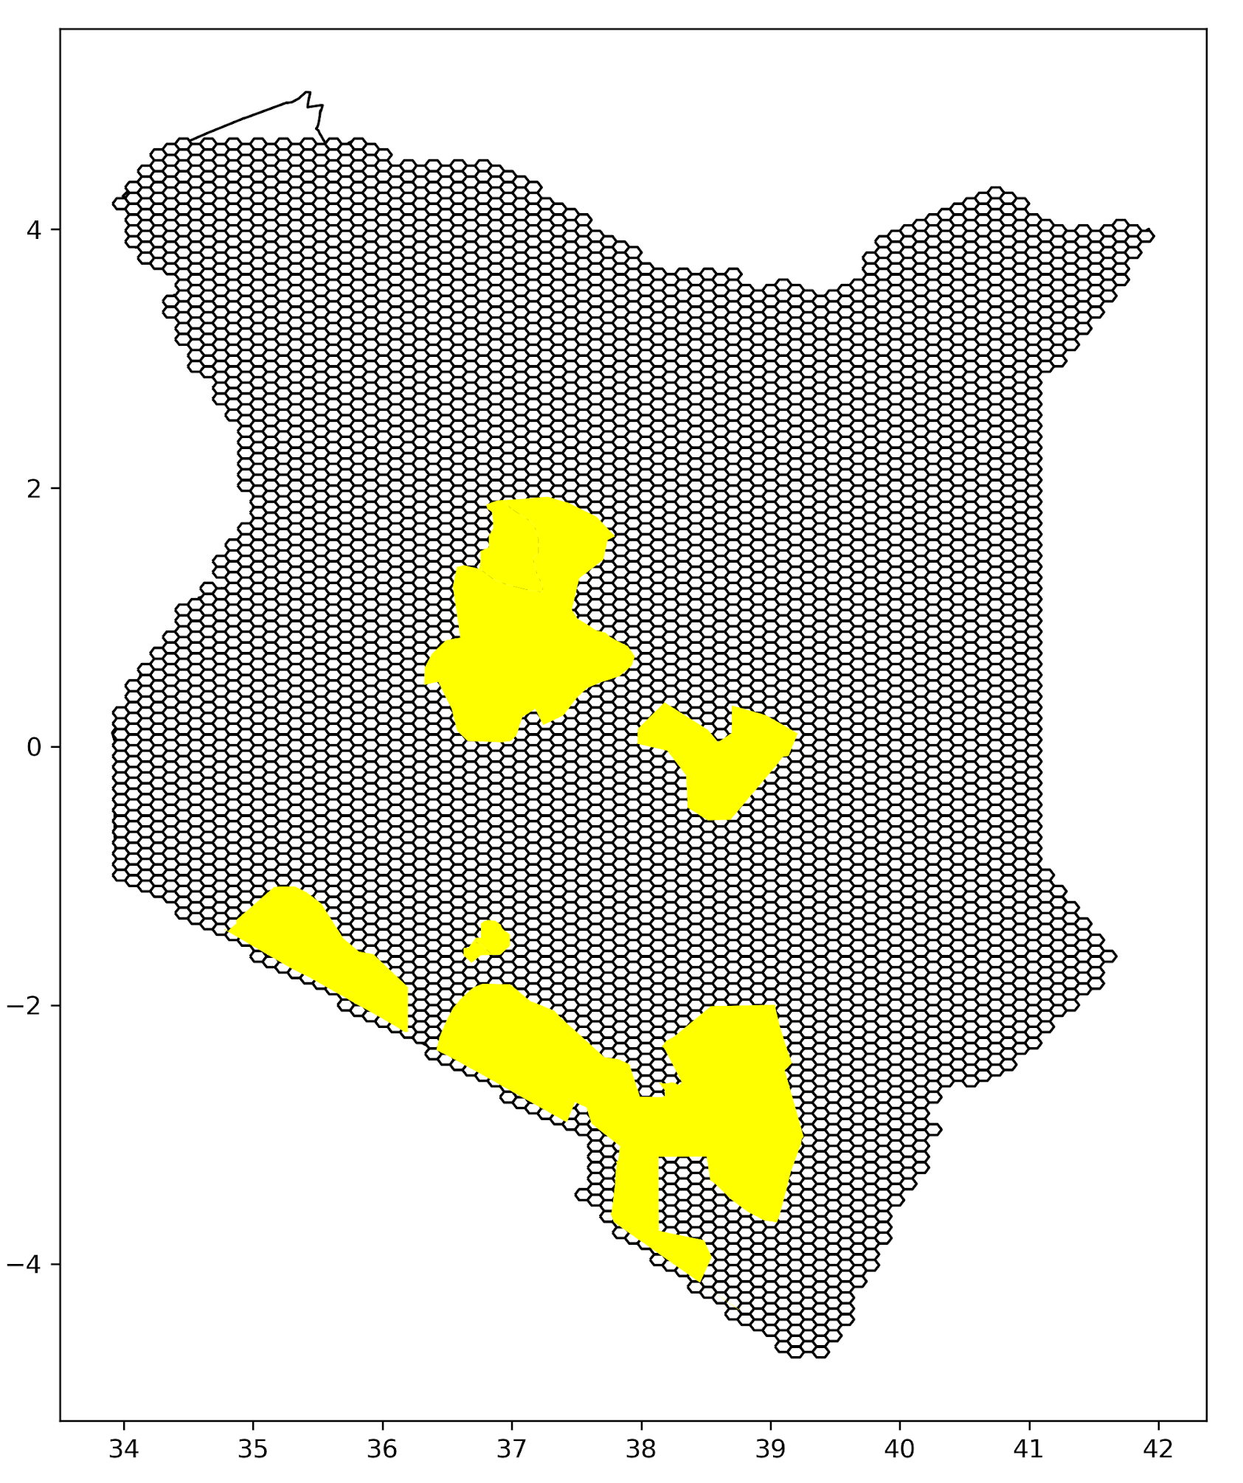
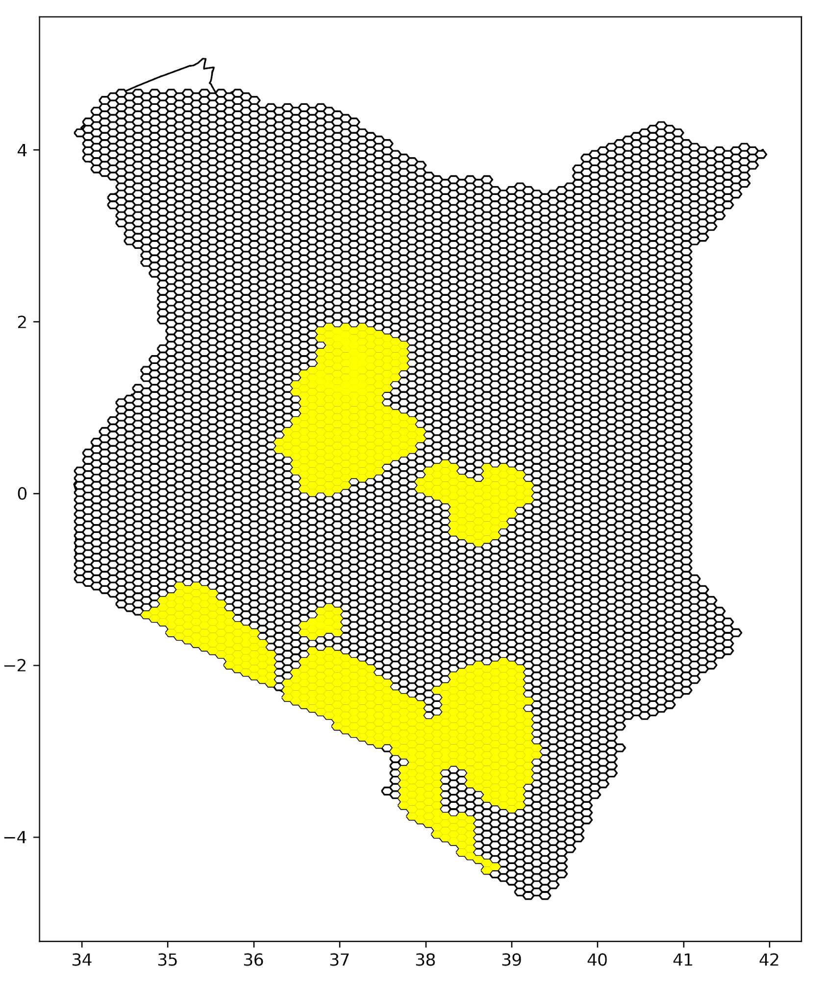
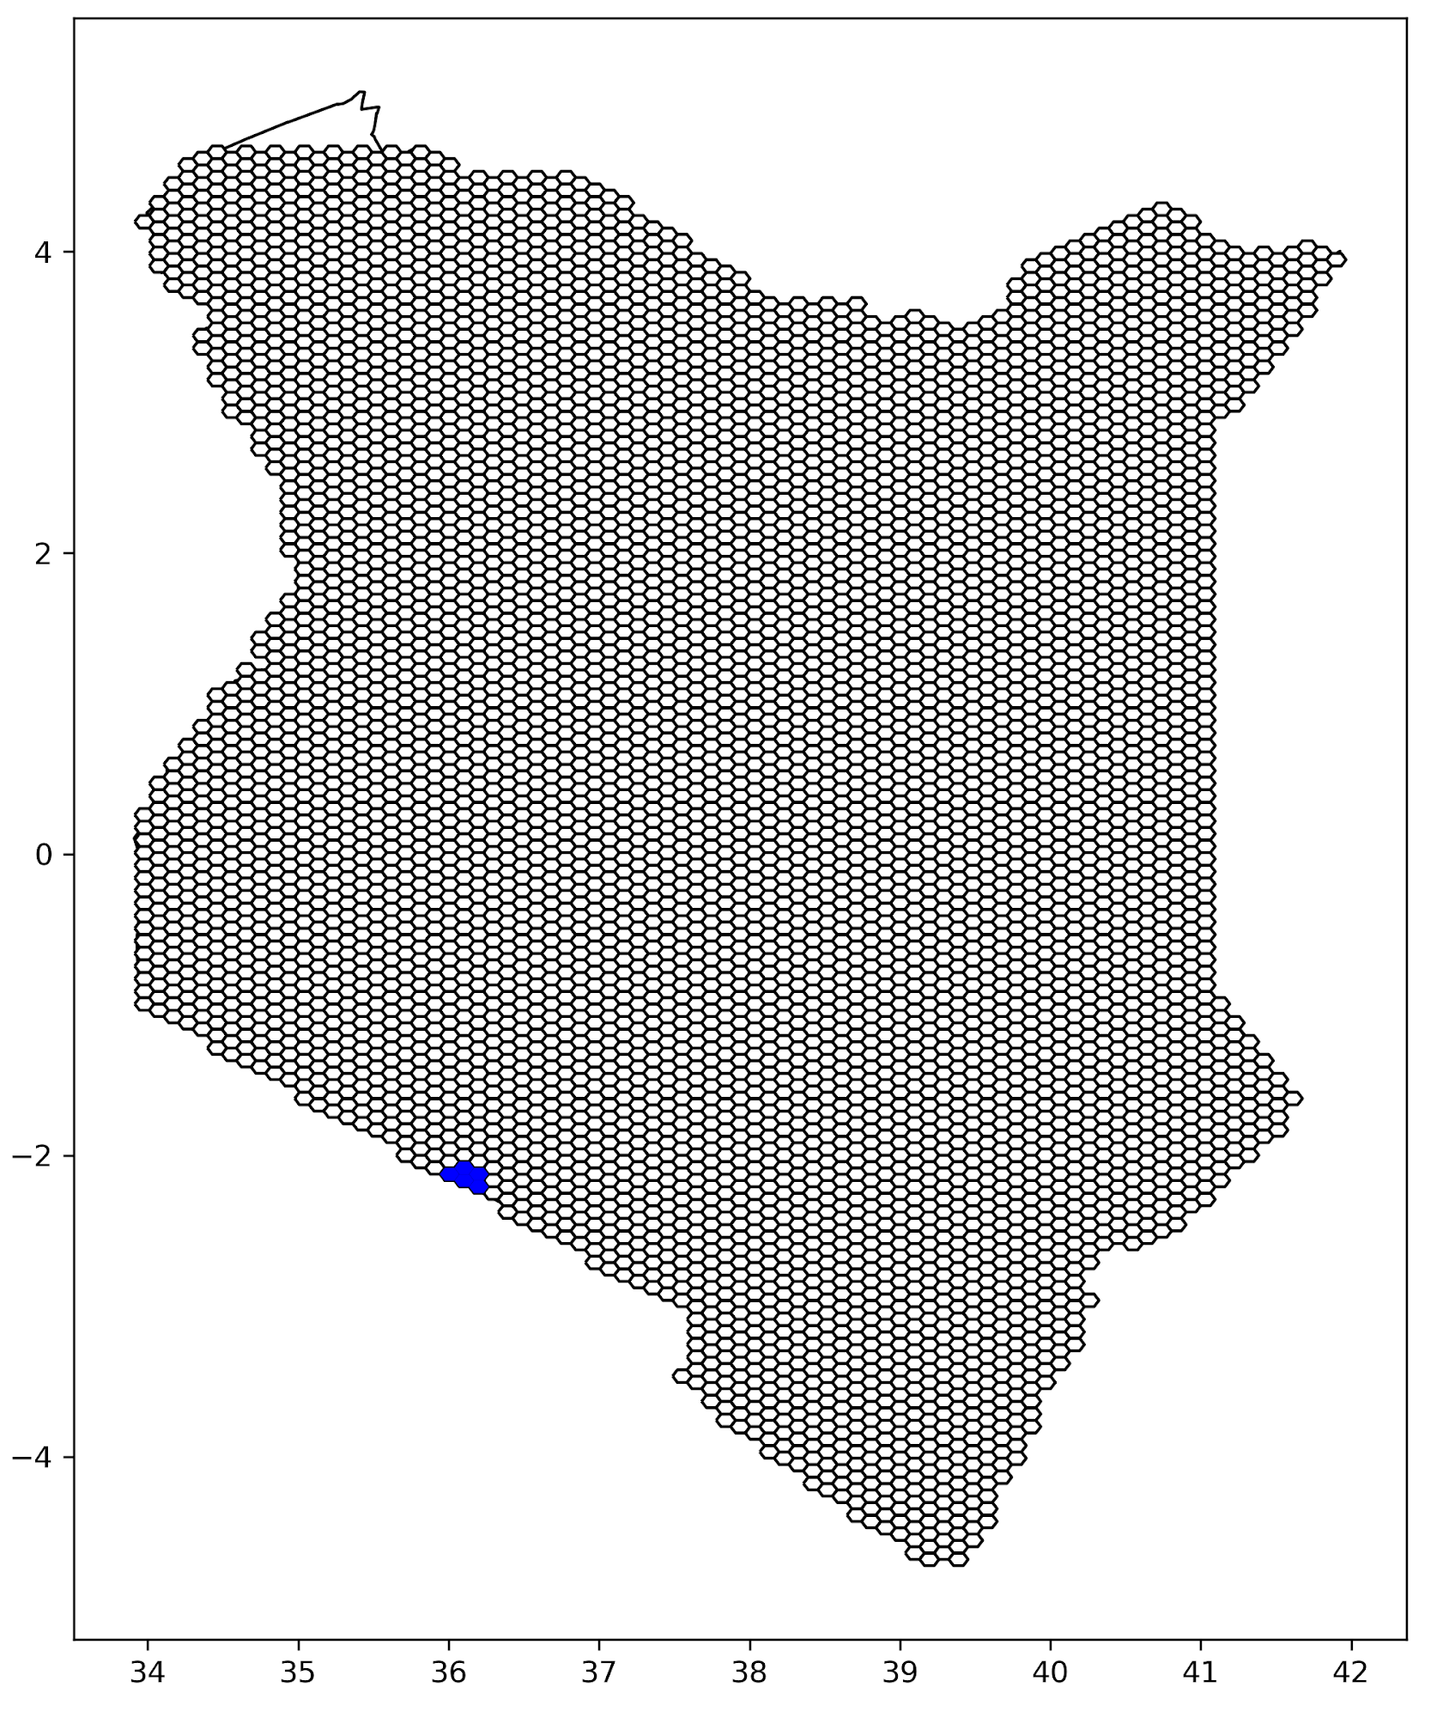
Example of stratification with real data
Lions in Desert
Landscape/Bioregional
New features
Join with PU grid
Lions in Forest
Species
Lions in Savanna
Join with PU grid
Lions intersected with habitats
Lions in
grasslands

Slide 9
Steps
Split:
Landscape:
  Read in terrestrial/marine landscape dataset
  Select column to split by
  Spatial join with PU grid and keep only one value per PU (majority of area)
  Separate the dataset into different features
Stratification
Landscape:
  Read in terrestrial/marine landscape dataset
  Select column to split by
  Spatial join with PU grid and keep only one value per PU (majority of area)
Species
  Read species dataset
  Spatial join with PU grid
Join by PUid the landscape and species layer
Separate the joined layer into different features, each with landscape + species

