Slide 1
Hadoop Architecture and Ecosystem
Unit-2

Slide 2
Introduction
Hadoop is a framework that allows us to store and process large datasets.
Two major problems in dealing with BIG DATA
• Storage
• Processing
Storage problem resolved by HDFS,
All big amount of data that we are dumping gets distributed over different machine. These machines are interconnected.
Processing problem resolved by mapReduce ,
Hadoop runs applications using the MapReduce algorithm, where the data is processed in parallel with others.
In short, Hadoop is used to develop applications that could perform complete statistical analysis on huge amounts of data.

Slide 3
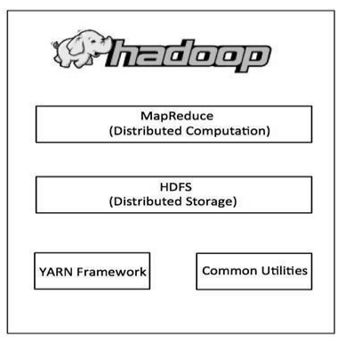
Hadoop is an Apache open-source framework written in java that allows distributed processing of large datasets across clusters of computers using simple programming models.
The Hadoop framework application works in an environment that provides distributed storage and computation across clusters of computers. .
Hadoop is designed to scale up from single server to thousands of machines, each offering local computation and storage.

Slide 4
At its core, Hadoop has two major layers namely,
Processing/Computation layer (MapReduce)
Storage layer (Hadoop Distributed File System)
MapReduce is a parallel programming model for writing distributed applications devised at Google for efficient processing of large amounts of data (multi-terabyte data-sets), on large clusters (thousands of nodes) of commodity hardware in a reliable, fault-tolerant manner.
The MapReduce program runs on Hadoop which is an Apache open-source framework.
The Hadoop Distributed File System (HDFS) is based on the Google File System (GFS) and provides a distributed file system that is designed to run on commodity hardware.
It has many similarities with existing distributed file systems. However, the differences from other distributed file systems are significant. It is highly fault-tolerant and is designed to be deployed on low-cost hardware. It provides high throughput access to application data and is suitable for applications having large datasets

Slide 5
Apart from the above-mentioned two core components, Hadoop framework also includes the following two modules
Hadoop Common − These are Java libraries and utilities required by other Hadoop modules.
Hadoop YARN − this is a framework for job scheduling and cluster resource management.
YARN stands for yet another Resource Negotiator. It manages and schedules the resources, and decides what should happen in each data node.
The central master node that manages all processing requests is called the Resource Manager. The Resource Manager interacts with Node Managers; every slave data node has its own Node Manager to execute tasks.

Slide 6
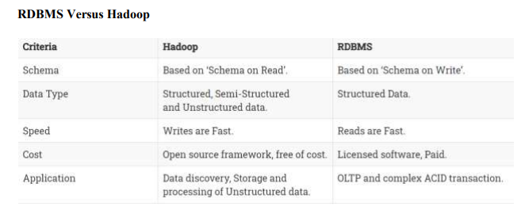

Slide 7
How Does Hadoop Work?
It is quite expensive to build bigger servers with heavy configurations that handle large scale processing, but as an alternative, you can tie together many commodity computers with single CPU, as a single functional distributed system and practically, the clustered machines can read the dataset in parallel and provide a much higher throughput.
Moreover, it is cheaper than one high-end server.
Hadoop runs code across a cluster of computers. This process includes the following core tasks that Hadoop performs:
• Data is initially divided into directories and files. Files are divided into uniform sized blocks of 128M and 64M (preferably 128M).
• These files are then distributed across various cluster nodes for further processing.
• HDFS, being on top of the local file system, supervises the processing.
• Blocks are replicated for handling hardware failure.
• Checking that the code was executed successfully.
• Performing the sort that takes place between the map and reduce stages.
• Sending the sorted data to a certain computer.
• Writing the debugging logs for each job

Slide 8
Why is Hadoop Important?
Ability to store and process huge amounts of any kind of data, quickly. With data volumes and varieties constantly increasing, especially from social media and the Internet of Things (IoT), that's a key consideration.
• Computing Power :Hadoop's distributed computing model processes big data fast. The more computing nodes you use, the more processing power you have.
• Fault Tolerance: Data and application processing are protected against hardware failure. If a node goes down, jobs are automatically redirected to other nodes to make sure the distributed computing does not fail. Multiple copies of all data are stored automatically.
• Flexibility: Unlike traditional relational databases, you don’t have to preprocess data before storing it. You can store as much data as you want and decide how to use it later. That includes unstructured data like text, images and videos.
• Low Cost: The open-source framework is free and uses commodity hardware to store large quantities of data.
• Scalability: You can easily grow your system to handle more data simply by adding nodes. Little administration is required.

Slide 9
What are the Challenges of Using Hadoop?
• MapReduce programming is not a good match for all problems. It’s good for simple information requests and problems that can be divided into independent units, but it's not efficient for iterative and interactive analytic tasks. MapReduce is file-intensive. Because the nodes don’t intercommunicate except through sorts and shuffles, iterative algorithms require multiple map-shuffle/sort-reduce phases to complete. This creates multiple files between MapReduce phases and is inefficient for advanced analytic computing.
• There’s a widely acknowledged talent gap. It can be difficult to find entry-level programmers who have sufficient Java skills to be productive with MapReduce. That's one reason distribution providers are racing to put relational (SQL) technology on top of Hadoop. It is much easier to find programmers with SQL skills than MapReduce skills and, Hadoop administration seems part art and part science, requiring low-level knowledge of operating systems, hardware and Hadoop kernel settings.
• Data security. Another challenge centers around fragmented data security issues, though new tools and technologies are surfacing. The Kerberos authentication protocol is a great step toward making Hadoop environments secure.
• Full-fledged data management and governance. Hadoop does not have easy-to-use, fullfeature tools for data management, data cleansing, governance and metadata. Especially lacking are tools for data quality and standardization.

Slide 10
Benefits of Hadoop for Big Data
Resilience — Data stored in any node is also replicated in other nodes of the cluster. This ensures fault tolerance. If one node goes down, there is always a backup of the data available in the cluster.
Scalability — Unlike traditional systems that have a limitation on data storage, Hadoop is scalable because it operates in a distributed environment. As the need arises, the setup can be easily expanded to include more servers that can store up to multiple petabytes of data.
Low cost — As Hadoop is an open-source framework, with no license to be procured, the costs are significantly lower compared to relational database systems. The use of inexpensive commodity hardware also works in its favor to keep the solution economical.
Speed — Hadoop’s distributed file system, concurrent processing, and the MapReduce model enable running complex queries in a matter of seconds.
Data diversity — HDFS has the capability to store different data formats such as unstructured (e.g. videos), semi-structured (e.g. XML files), and structured.

Slide 11
The Hadoop Ecosystem Supplementary Components
Hadoop Ecosystem is a platform or a suite which provides various services to solve the big data problems.
It includes Apache projects and various commercial tools and solutions.
There are four major elements of Hadoop
i.e. HDFS, MapReduce, YARN, and Hadoop Common.
Most of the tools or solutions are used to supplement or support these major elements. All these tools work collectively to provide services such as absorption, analysis, storage and maintenance of data etc.
The following are a few supplementary components that are extensively used in the Hadoop ecosystem.

Slide 12
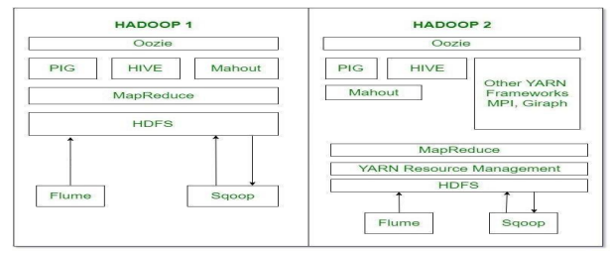
Oozie is basically Work Flow Scheduler. It decides the particular time of jobs to execute according to their dependency.
Pig, Hive and Mahout are data processing tools that are working on the top of Hadoop.
Sqoop is used to import and export structured data. You can directly import and export the data into HDFS using SQL database.
Flume is used to import and export the unstructured data and streaming data.

Slide 13
HDFS: Hadoop Distributed File System
YARN: Yet Another Resource Negotiator
MapReduce: Programming based Data Processing
Spark: In-Memory data processing
PIG, HIVE: Query based processing of data services
HBase: NOSQL Database
Mahout, Spark MLLib: MachineLearning algorithm libraries
Solar, Lucene: Searching and Indexing Zookeeper: Managing cluster Oozie: Job Scheduling

Slide 14
Apache Spark
It’s a platform that handles all the process consumptive tasks like batch processing, interactive or iterative real-time processing, graph conversions, and visualization, etc.
It consumes in memory resources hence, thus being faster than the prior in terms of optimization.
Spark is best suited for real-time data whereas Hadoop is best suited for structured data or batch processing, hence both are used in most of the companies interchangeably.

Slide 15
PIG
Pig was basically developed by Yahoo which works on a pig Latin language, which is Query based language similar to SQL.It is a platform for structuring the data flow, processing and analyzing huge data sets.
Pig does the work of executing commands and in the background, all the activities of MapReduce are taken care of. After the processing, pig stores the result in HDFS.Pig Latin language is specially designed for this framework which runs on Pig Runtime. Just the way Java runs on the JVM. Pig helps to achieve ease of programming and optimization and hence is a major segment of the Hadoop Ecosystem.
HIVE
With the help of SQL methodology and interface, HIVE performs reading and writing of large data sets. However, its query language is called as HQL (Hive Query Language).It is highly scalable as it allows real-time processing and batch processing both.
Also, all the SQL datatypes are supported by Hive thus, making the query processing easier.Similar to the Query Processing frameworks, HIVE too comes with two components: JDBC Drivers and HIVE Command Line.JDBC, along with ODBC drivers work on establishing the data storage permissions and connection whereas HIVE Command line helps in the processing of queries.

Slide 16
Hbase
It’s a NOSQL database which supports all kinds of data and thus capable of handling anything of Hadoop Database. It provides capabilities of Google’s BigTable, thus able to work on Big Data sets effectively.
At times where we need to search or retrieve the occurrences of something small in a huge database, the request must be processed within a short quick span of time. At such times, HBase comes handy as it gives us a tolerant way of storing limited data.
Mahout
Mahout, allows Machine Learnability to a system or application. Machine Learning, as the name suggests helps the system to develop itself based on some patterns, user/environmental interaction or on the basis of algorithms.
It provides various libraries or functionalities such as collaborative filtering, clustering, and classification which are nothing but concepts of Machine learning. It allows invoking algorithms as per our need with the help of its own libraries.

Slide 17
Solr, Lucene
These are the two services that perform the task of searching and indexing with the help of some java libraries, especially Lucene is based on Java which allows spell check mechanism, as well. However, Lucene is driven by Solr.
Zookeeper
There was a huge issue of management of coordination and synchronization among the resources or the components of Hadoop which resulted in inconsistency, often. Zookeeper overcame all the problems by performing synchronization, inter-component based communication, grouping, and maintenance.
Oozie
Oozie simply performs the task of a scheduler, thus scheduling jobs and binding them together as a single unit. There is two kinds of jobs.i.e., Oozie workflow and Oozie coordinator jobs. Oozie workflow is the jobs that need to be executed in a sequentially ordered manner whereas Oozie Coordinator jobs are those that are triggered when some data or external stimulus is given to it.

Slide 18
Hadoop Cluster
A Hadoop cluster is a collection of independent components designed specifically for storing and analyzing large amounts of unstructured data in a distributed computing environment.
The clusters run on the Hadoop open source software and are usually referred to as “share nothing” systems because nothing is shared between the Hadoop cluster nodes except for the network that connects them.
Naturally, one machine in the cluster is designated as a master
The rest of the machines in the cluster act as workers
Hadoop clusters are highly resilient, with every bit of data stored in one node replicated into other nodes in the cluster to prevent data loss.

Slide 19
Hadoop Cluster Architecture
Hadoop is a master-slave model made up of three components.
Within a Hadoop cluster, one machine in the cluster is designated as the NameNode and another machine as the JobTracker, these are the masters.
The rest of the machines in the cluster are DataNodes and TaskTrackers, these are the slaves.
The masters coordinate the roles of many slaves.

Slide 20
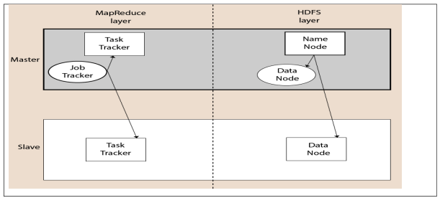

Slide 21
Master Node — The master node in a Hadoop cluster is responsible for storing data in the Hadoop Distributed Filesystem (HDFS). It also executes the computation of the stored data using MapReduce, which is the data processing framework.
Within the master node, there are three additional nodes: NameNode, Secondary NameNode, and JobTracker.
NameNode handles the data storage function with HDFS and Secondary NameNode keeps a backup of the NameNode data.
JobTracker monitors the parallel processing of data using MapReduce.
Slave/Worker Node — The slave/worker node in a Hadoop cluster is responsible for storing data and performing computations. The slave/worker node is comprised of a TaskTracker and a DataNode. The DataNode service communicates with the Master node in the cluster.
Client Nodes — The client node is responsible for loading all the data into the Hadoop cluster. It submits MapReduce jobs and outlines how the data needs to be processed, then retrieves the output once the job is complete

Slide 22
Advantages of a Hadoop Cluster
Hadoop clusters are highly scalable, allowing users to easily add additional cluster nodes to increase throughput. Known to boost the speed of data applications, Hadoop is also highly resistant to failure as each piece of data is copied onto other cluster nodes. If the one node fails, then the copy of the data on the other node in the cluster can be used for analysis.
Hadoop clusters are great for the deployment and management of cloud data processing services. With the ability to easily scale resources when needed, the software can streamline the efforts of many companies in various industries.

Slide 23
Hadoop Daemons
The Hadoop Daemons arethe processes that run in the background. These 4 daemons run for Hadoop to be functional. T
he Hadoop Daemons are:
a) Namenode – It runs on master node for HDFS.
b) Datanode – It runs on slave nodes for HDFS.
c) Resource Manager – It runs on YARN master node for MapReduce.
d) Node Manager – It runs on YARN slave node for MapReduce.
Whenever the client wants to perform any processing on its data in the Hadoop cluster, then it first stores the data in Hadoop HDFS and then writes the MapReduce program for processing the Data.

Slide 24
The Hadoop MapReduce works as follows:
1. Hadoop divides the job into tasks of two types, that is, map tasks and reduce tasks. YARN scheduled these tasks (which we will see later in this article). These tasks run on different DataNodes.
2. The input to the MapReduce job is divided into fixed-size pieces called input splits.
3. One map task which runs a user-defined map function for each record in the input split is created for each input split. These map tasks run on the DataNodes where the input data resides.
4. The output of the map task is intermediate output and is written to the local disk.
5. The intermediate outputs of the map tasks are shuffled and sorted and are then passed to the reducer.
6. For a single reduce task, the sorted intermediate output of mapper is passed to the node where the reducer task is running. These outputs are then merged and then passed to the user- defined reduce function.

Slide 25
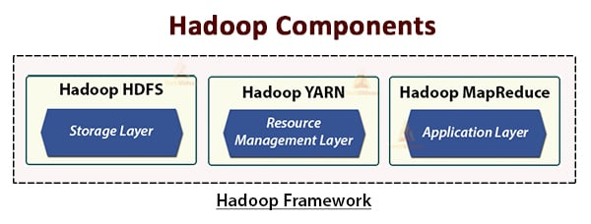
Hadoop Architecture
The Hadoop architecture comprises three layers. They are:
Storage layer (HDFS)
Resource Management layer (YARN)
Processing layer (MapReduce)

Slide 26
1. HDFS
HDFS is the Hadoop Distributed File System, which runs on inexpensive commodity hardware. It is the storage layer for Hadoop. The files in HDFS are broken into block-size chunks called data blocks.
These blocks are then stored on the slave nodes in the cluster. The block size is 128 MB by default, which we can configure as per our requirements.
Like Hadoop, HDFS also follows the master-slave architecture. It comprises two daemons- NameNode and DataNode. The NameNode is the master daemon that runs on the master node. The DataNodes are the slave daemon that runs on the slave nodes.

Slide 27
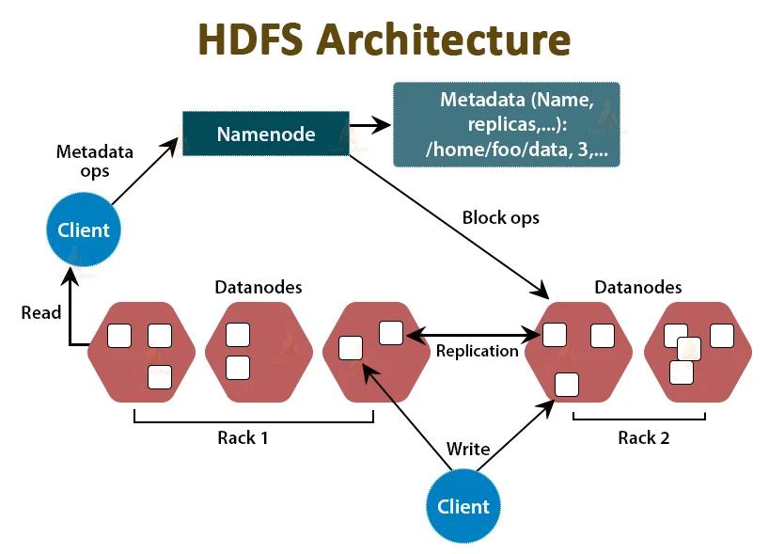

Slide 28
NameNode
NameNode stores the filesystem metadata, that is, files names, information about blocks of a file, blocks locations, permissions, etc. It manages the Datanodes.
DataNode
DataNodes are the slave nodes that store the actual business data. It serves the client read/write requests based on the NameNode instructions.
DataNodes stores the blocks of the files, and NameNode stores the metadata like block locations, permission, etc.

Slide 29
2. MapReduce
It is the data processing layer of Hadoop. It is a software framework for writing applications that process vast amounts of data (terabytes to petabytes in range) in parallel on the cluster of commodity hardware.
The MapReduce framework works on the <key, value> pairs.
The MapReduce job is the unit of work the client wants to perform. MapReduce job mainly consists of the input data, the MapReduce program, and the configuration information. Hadoop runs the MapReduce jobs by dividing them into two types of tasks that are map tasks and reduce tasks. The Hadoop YARN scheduled these tasks and are run on the nodes in the cluster.
Due to some unfavorable conditions, if the tasks fail, they will automatically get rescheduled on a different node.
The user defines the map function and the reduce function for performing the MapReduce job.
The input to the map function and output from the reduce function is the key, value pair.
The function of the map tasks is to load, parse, filter, and transform the data. The output of the map task is the input to the reduce task. Reduce task then performs grouping and aggregation on the output of the map task.

Slide 30
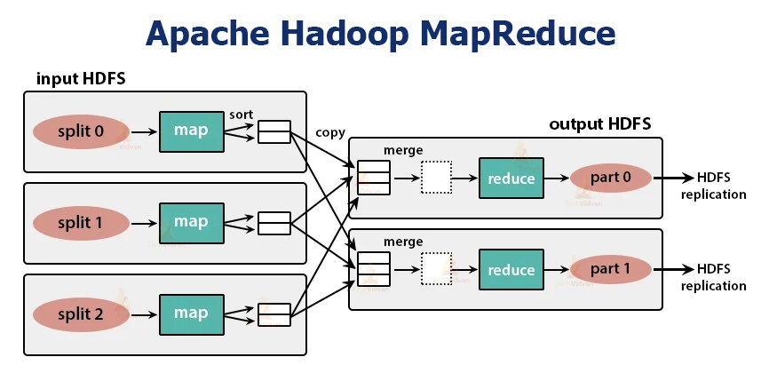

Slide 31
The MapReduce task is done in two phases-
1. Map phase
2. Reduce phase:
1. Map phase
a. RecordReader
Hadoop divides the inputs to the MapReduce job into the fixed-size splits called input splits or splits. The RecordReader transforms these splits into records and parses the data into records but it does not parse the records itself. RecordReader provides the data to the mapper function in key-value pairs.
b. Map
In the map phase, Hadoop creates one map task which runs a user-defined function called map function for each record in the input split. It generates zero or multiple intermediate key-value pairs as map task output.
The map task writes its output to the local disk. This intermediate output is then processed by the reduce tasks which run a user-defined reduce function to produce the final output. Once the job gets completed, the map output is flushed out.

Slide 32
c. Combiner
Input to the single reduce task is the output from all the Mappers that is output from all map tasks. Hadoop allows the user to define a combiner function that runs on the map output.
Combiner groups the data in the map phase before passing it to Reducer. It combines the output of the map function which is then passed as an input to the reduce function.
d. Partitioner
When there are multiple reducers then the map tasks partition their output, each creating one partition for each reduce task. In each partition, there can be many keys and their associated values but the records for any given key are all in a single partition.
Hadoop allows users to control the partitioning by specifying a user-defined partitioning function. Generally, there is a default Partitioner that buckets the keys using the hash function.

Slide 33
2. Reduce phase:
The various phases in reduce task are as follows:
a. Sort and Shuffle:
The Reducer task starts with a shuffle and sort step. The main purpose of this phase is to collect the equivalent keys together. Sort and Shuffle phase downloads the data which is written by the partitioner to the node where Reducer is running.
It sorts each data piece into a large data list. The MapReduce framework performs this sort and shuffles so that we can iterate over it easily in the reduce task.
The sort and shuffling are performed by the framework automatically. The developer through the comparator object can have control over how the keys get sorted and grouped.

Slide 34
b. Reduce:
The Reducer which is the user-defined reduce function performs once per key grouping. The reducer filters, aggregates, and combines data in several different ways. Once the reduce task is completed, it gives zero or more key-value pairs to the OutputFormat. The reduce task output is stored in Hadoop HDFS.
c. OutputFormat
It takes the reducer output and writes it to the HDFS file by RecordWriter. By default, it separates key, value by a tab and each record by a newline character.

Slide 35
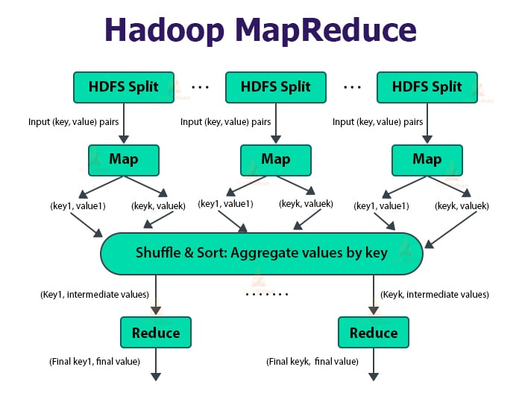

Slide 36
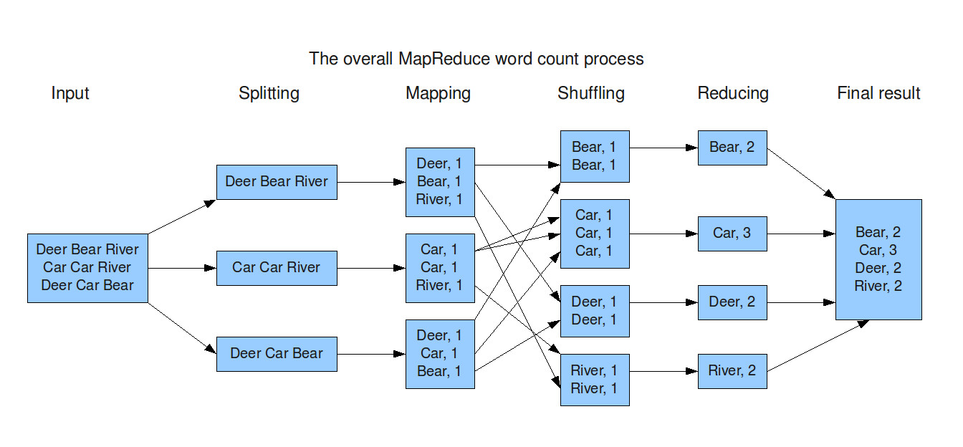
Example of Map reduce-word count problem

Slide 37
3. YARN
YARN stands for Yet Another Resource Negotiator. It is the resource management layer of Hadoop. It was introduced in Hadoop 2.
YARN is designed with the idea of splitting up the functionalities of job scheduling and resource management into separate daemons. The basic idea is to have a global ResourceManager and application Master per application where the application can be a single job or DAG of jobs.
YARN consists of ResourceManager, NodeManager, and per-application ApplicationMaster.

Slide 38
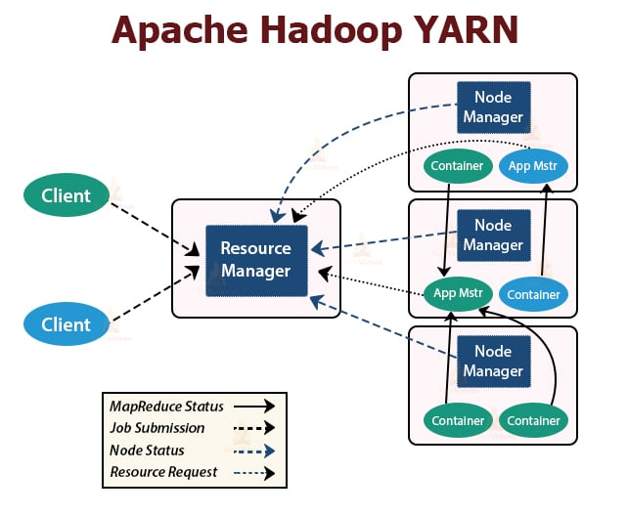

Slide 39
1. ResourceManager
It arbitrates resources amongst all the applications in the cluster.
It has two main components that are Scheduler and the ApplicationManager.
a. Scheduler
The Scheduler allocates resources to the various applications running in the cluster, considering the capacities, queues, etc.
It is a pure Scheduler. It does not monitor or track the status of the application.
Scheduler does not guarantee the restart of the failed tasks that are failed either due to application failure or hardware failure.
It performs scheduling based on the resource requirements of the applications.
b. ApplicationManager
They are responsible for accepting the job submissions.
ApplicationManager negotiates the first container for executing application-specific ApplicationMaster.
They provide service for restarting the ApplicationMaster container on failure.
The per-application ApplicationMaster is responsible for negotiating containers from the Scheduler. It tracks and monitors their status and progress.

Slide 40
2. NodeManager:
NodeManager runs on the slave nodes. It is responsible for containers, monitoring the machine resource usage that is CPU, memory, disk, network usage, and reporting the same to the ResourceManager or Scheduler.
3. ApplicationMaster:
The per-application ApplicationMaster is a framework-specific library. It is responsible for negotiating resources from the ResourceManager. It works with the NodeManager(s) for executing and monitoring the tasks.

Slide 41
Storing and Querying Data.
Storing and Querying Data in Hadoop and Spark
In the Hadoop ecosystem, storing and querying data efficiently is crucial for handling large-scale datasets. Below is an overview of how data storage and querying work in both Hadoop and Spark.
1. Storing Data
Data storage in Hadoop is primarily handled by HDFS (Hadoop Distributed File System), while Spark relies on both HDFS and other distributed storage systems.
A. Hadoop Distributed File System (HDFS)
• HDFS is a distributed storage system that stores data across multiple machines in a Hadoop cluster.
• It follows a Master-Slave Architecture:
o NameNode (Master) manages metadata (directory structure, file permissions, and block locations).
o DataNodes (Slaves) store actual data blocks.
• Files are divided into blocks (default 128MB or 256MB) and replicated across multiple nodes for fault tolerance.
• HDFS supports batch processing and is optimized for large files (not small files).

Slide 42
B. Other Storage Options in Hadoop and Spark
Apache HBase: A NoSQL database for real-time read/write access to large datasets.
Apache Hive: A data warehouse that stores structured data and allows SQL-like querying.
Apache ORC and Parquet: Columnar storage formats that optimize storage and query performance.
Amazon S3, Google Cloud Storage, and Azure Blob Storage: Cloud-based storage options that integrate with Hadoop and Spark

Slide 43
2. Querying Data
Querying data in the Hadoop ecosystem can be done using different tools depending on the use case:
A. Querying in Hadoop
Apache Hive
SQL-like querying language called HiveQL.
Converts queries into MapReduce, Tez, or Spark jobs.
Best suited for batch processing of structured data.
Apache Pig
A high-level scripting language (Pig Latin) for data transformation.
Converts Pig scripts into MapReduce jobs.
Apache HBase
NoSQL database with fast read/write operations.
Supports key-value lookups but does not support SQL natively.

Slide 44
B. Querying in Spark
Spark SQL
Allows querying structured data using SQL and DataFrames.
Supports JDBC/ODBC for database connectivity.
Can read from multiple sources: HDFS, Hive, Parquet, JSON, and relational databases.
RDD (Resilient Distributed Dataset) Queries
Provides transformations (map, filter, reduceByKey) for querying unstructured data.
Less optimized than DataFrames or Spark SQL but gives more control.
DataFrames and Datasets
More efficient than RDDs.
Uses Catalyst Optimizer for query optimization.
Spark Streaming
Allows querying real-time data streams from Kafka, Flume, and other sources.

Slide 46
• HDFS is the core storage system in Hadoop, but other storage solutions like HBase, ORC, and Parquet are also used.
• Querying in Hadoop is mainly done through Hive, Pig, and HBase.
• Spark SQL and DataFrames provide an efficient way to query data with better performance than traditional MapReduce.

Slide 47
What is Distributed File System?
A distributed file system (DFS) is a file system that is distributed on various file servers and locations. It permits programs to access and store isolated data in the same method as in the local files. It also permits the user to access files from any system.
It allows network users to share information and files in a regulated and permitted manner. Although, the servers have complete control over the data and provide users access control.
DFS's primary goal is to enable users of physically distributed systems to share resources and information through the Common File System (CFS).
It is a file system that runs as a part of the operating systems. Its configuration is a set of workstations and mainframes that a LAN connects. The process of creating a namespace in DFS is transparent to the clients.
DFS has two components in its services, and these are as follows:
Local Transparency-
Redundancy
.

Slide 48
History of Distributed File System
The DFS's server component was firstly introduced as an additional feature. When it was incorporated into Windows NT 4.0 Server, it was called "DFS 4.1". Later, it was declared a standard component of all Windows 2000 Server editions. Windows NT 4.0 and later versions of Windows have client-side support.
Linux kernels 2.6.14 and later include a DFS-compatible SMB client VFS known as "cifs". DFS is available in versions Mac OS X 10.7 (Lion) and later.

Slide 49
Features
Redundancy:
It is achieved via a file replication component.
In the case of failure or heavy load, these components work together to increase data availability by allowing data from multiple places to be logically combined under a single folder known as the "DFS root".
It is not required to use both DFS components simultaneously; the namespace component can be used without the file replication component, and the file replication component can be used between servers without the namespace component.

Slide 50
Distributed File System Replication
Initial versions of DFS used Microsoft's File Replication Service (FRS), enabling basic file replication among servers. FRS detects new or altered files and distributes the most recent versions of the full file to all servers.
Windows Server 2003 R2 developed the "DFS Replication" (DFSR). It helps to enhance FRS by only copying the parts of files that have changed and reducing network traffic with data compression. It also gives users the ability to control network traffic on a configurable schedule using flexible configuration options.

Slide 51
Transparency
There are mainly four types of transparency. These are as follows:
1. Structure Transparency
The client does not need to be aware of the number or location of file servers and storage devices. In structure transparency, multiple file servers must be given to adaptability, dependability, and performance.
2. Naming Transparency
There should be no hint of the file's location in the file's name. When the file is transferred form one node to other, the file name should not be changed.
3. Access Transparency
Local and remote files must be accessible in the same method. The file system must automatically locate the accessed file and deliver it to the client.
4. Replication Transparency
When a file is copied across various nodes, the copies files and their locations must be hidden from one node to the next.

Slide 52
Scalability
The distributed system will inevitably increase over time when more machines are added to the network, or two networks are linked together. A good DFS must be designed to scale rapidly as the system's number of nodes and users increases.
Data Integrity
Many users usually share a file system. The file system needs to secure the integrity of data saved in a transferred file. A concurrency control method must correctly synchronize concurrent access requests from several users who are competing for access to the same file. A file system commonly provides users with atomic transactions that are high-level concurrency management systems for data integrity.

Slide 53
High Reliability
The risk of data loss must be limited as much as feasible in an effective DFS. Users must not feel compelled to make backups of their files due to the system's unreliability. Instead, a file system should back up key files so that they may be restored if the originals are lost. As a high-reliability strategy, many file systems use stable storage.
High Availability
A DFS should be able to function in the case of a partial failure, like a node failure, a storage device crash, and a link failure.
Ease of Use
he UI of a file system in multiprogramming must be simple, and the commands in the file must be minimal.
Performance
The average time it takes to persuade a client is used to assess performance. It must perform similarly to a centralized file system.

Slide 54
Working of Distributed File System
There are two methods of DFS in which they might be implemented, and these are as follows:
1. Standalone DFS namespace
2. Domain-based DFS namespace
Standalone DFS namespace
It does not use Active Directory and only permits DFS roots that exist on the local system. A Standalone DFS may only be acquired on the systems that created it. It offers no-fault liberation and may not be linked to other DFS.
Domain-based DFS namespace
It stores the DFS configuration in Active Directory and creating namespace root at domainname>dfsroot> or FQDN>dfsroot>.

Slide 55
Applications
Hadoop
Hadoop is a collection of open-source software services. It is a software framework that uses the MapReduce programming style to allow distributed storage and management of large amounts of data. Hadoop is made up of a storage component known as Hadoop Distributed File System (HDFS). It is an operational component based on the MapReduce programming model.
NFS (Network File System)
A client-server architecture enables a computer user to store, update, and view files remotely. It is one of various DFS standards for Network-Attached Storage.
SMB (Server Message Block)
IBM developed an SMB protocol to file sharing. It was developed to permit systems to read and write files to a remote host across a LAN. The remote host's directories may be accessed through SMB and are known as "shares".
NetWare
It is an abandon computer network operating system that is developed by Novell, Inc. The IPX network protocol mainly used combined multitasking to execute many services on a computer system.
CIFS (Common Internet File System)
CIFS is an accent of SMB. The CIFS protocol is a Microsoft-designed implementation of the SIMB protocol.

Slide 56
Advantages
There are various advantages of the distributed file system. Some of the advantages are as follows:
1. It allows the users to access and store the data.
2. It helps to improve the access time, network efficiency, and availability of files.
3. It provides the transparency of data even if the server of disk files.
4. It permits the data to be shared remotely.
5. It helps to enhance the ability to change the amount of data and exchange data.

Slide 57
Disadvantages
There are various disadvantages of the distributed file system. Some of the disadvantages are as follows:
In a DFS, the database connection is complicated.
In a DFS, database handling is also more complex than in a single-user system.
If all nodes try to transfer data simultaneously, there is a chance that overloading will happen.
There is a possibility that messages and data would be missed in the network while moving from one node to another.

Slide 58
APACHE SPARK
Apache Spark is an open-source, distributed processing system used for big data workloads. It utilizes in-memory caching, and optimized query execution for fast analytic queries against data of any size.
It provides development APIs in Java, Scala, Python and R, and supports code reuse across multiple workloads—batch processing, interactive queries, real-time analytics, machine learning, and graph processing.
You’ll find it used by organizations from any industry, including at FINRA, Yelp, Zillow, DataXu, Urban Institute, and CrowdStrike.

Slide 59
How does Apache Spark work?
Hadoop MapReduce is a programming model for processing big data sets with a parallel, distributed algorithm. Developers can write massively parallelized operators, without having to worry about work distribution, and fault tolerance.
However, a challenge to MapReduce is the sequential multi-step process it takes to run a job. With each step, MapReduce reads data from the cluster, performs operations, and writes the results back to HDFS. Because each step requires a disk read, and write, MapReduce jobs are slower due to the latency of disk I/O.
Spark was created to address the limitations to MapReduce, by doing processing in-memory, reducing the number of steps in a job, and by reusing data across multiple parallel operations. With Spark, only one-step is needed where data is read into memory, operations performed, and the results written back—resulting in a much faster execution.
Spark also reuses data by using an in-memory cache to greatly speed up machine learning algorithms that repeatedly call a function on the same dataset.
Data re-use is accomplished through the creation of DataFrames, an abstraction over Resilient Distributed Dataset (RDD), which is a collection of objects that is cached in memory, and reused in multiple Spark operations. This dramatically lowers the latency making Spark multiple times faster than MapReduce, especially when doing machine learning, and interactive analytics.

Slide 60
Difference between Hadoop and spark
 | Hadoop | Spark
Architecture | Hadoop stores and processes data on external storage. | Spark stores and process data on internal memory.
Performance | Hadoop processes data in batches. | Spark processes data in real time.
Cost | Hadoop is affordable. | Spark is comparatively more expensive.
Scalability | Hadoop is easily scalable by adding more nodes. | Spark is comparatively more challenging.
Machine learning | Hadoop integrates with external libraries to provide machine learning capabilities. | Spark has built-in machine learning libraries.
Security | Hadoop has strong security features, storage encryption, and access control. | Spark has basic security. IT relies on you setting up a secure operating environment for the Spark deployment.

Slide 61
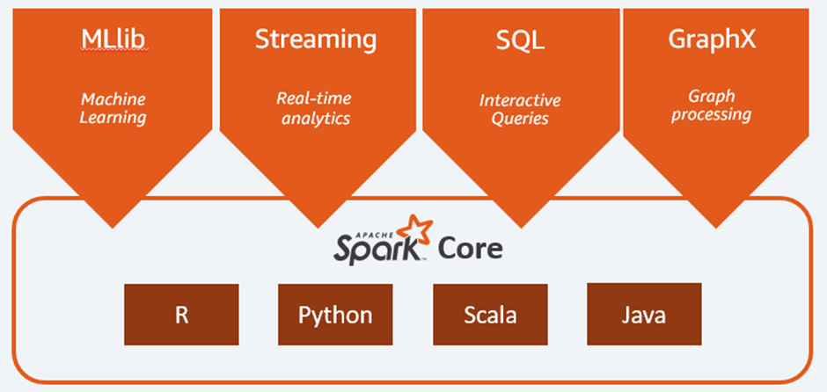
What are Apache Spark Workloads?
The Spark framework includes:
Spark Core as the foundation for the platform
Spark SQL for interactive queries
Spark Streaming for real-time analytics
Spark MLlib for machine learning
Spark GraphX for graph processing

Slide 62
Spark Core
Spark Core is the foundation of the platform. It is responsible for memory management, fault recovery, scheduling, distributing & monitoring jobs, and interacting with storage systems. Spark Core is exposed through an application programming interface (APIs) built for Java, Scala, Python and R. These APIs hide the complexity of distributed processing behind simple, high-level operators.
MLlib
Machine Learning
Spark includes MLlib, a library of algorithms to do machine learning on data at scale. Machine Learning models can be trained by data scientists with R or Python on any Hadoop data source, saved using MLlib, and imported into a Java or Scala-based pipeline. Spark was designed for fast, interactive computation that runs in memory, enabling machine learning to run quickly. The algorithms include the ability to do classification, regression, clustering, collaborative filtering, and pattern mining.

Slide 63
Spark Streaming
Real-time
Spark Streaming is a real-time solution that leverages Spark Core’s fast scheduling capability to do streaming analytics. It ingests data in mini-batches, and enables analytics on that data with the same application code written for batch analytics. This improves developer productivity, because they can use the same code for batch processing, and for real-time streaming applications. Spark Streaming supports data from Twitter, Kafka, Flume, HDFS, and ZeroMQ, and many others found from the Spark Packages ecosystem.
Spark SQL
Interactive Queries
Spark SQL is a distributed query engine that provides low-latency, interactive queries up to 100x faster than MapReduce. It includes a cost-based optimizer, columnar storage, and code generation for fast queries, while scaling to thousands of nodes. Business analysts can use standard SQL or the Hive Query Language for querying data. Developers can use APIs, available in Scala, Java, Python, and R. It supports various data sources out-of-the-box including JDBC, ODBC, JSON, HDFS, Hive, ORC, and Parquet. Other popular stores—Amazon Redshift, Amazon S3, Couchbase, Cassandra, MongoDB, Salesforce.com, Elasticsearch, and many others can be found from the Spark Packages ecosystem.

Slide 64
GraphX
Graph Processing
Spark GraphX is a distributed graph processing framework built on top of Spark. GraphX provides ETL, exploratory analysis, and iterative graph computation to enable users to interactively build, and transform a graph data structure at scale. It comes with a highly flexible API, and a selection of distributed Graph algorithms.

Slide 65
Applications
Financial Services
Spark is used in banking to predict customer churn, and recommend new financial products. In investment banking, Spark is used to analyze stock prices to predict future trends.
Healthcare
Spark is used to build comprehensive patient care, by making data available to front-line health workers for every patient interaction. Spark can also be used to predict/recommend patient treatment.
Manufacturing
Spark is used to eliminate downtime of internet-connected equipment, by recommending when to do preventive maintenance.
Retail
Spark is used to attract, and keep customers through personalized services and offers.

Slide 66
Apache Spark - RDD Resilient Distributed Datasets
Resilient Distributed Datasets (RDDs) are the primary data structure in Spark. RDDs are reliable and memory-efficient when it comes to parallel processing. By storing and processing data in RDDs, Spark speeds up MapReduce processes.

Slide 67
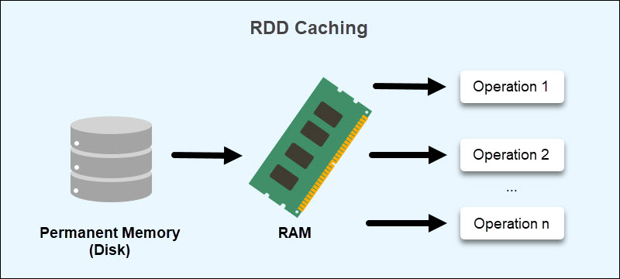
Why Do We Need RDDs in Spark?
RDDs address MapReduce's shortcomings in data sharing. When reusing data for computations, MapReduce requires writing to external storage (HDFS, Cassandra, HBase, etc.). The read and write processes between jobs consume a significant amount of memory.
Furthermore, data sharing between tasks is slow due to replication, serialization, and increased disk usage.
RDDs aim to reduce the usage of external storage systems by leveraging in-memory compute operation storage. This approach improves data exchange speeds between tasks by 10 to 100 times.
Speed is critical when working with large data volumes. Spark RDDs make it easier to train machine learning algorithms and handle large amounts of data for analytics.

Slide 68
How Does RDD Store Data?
An RDD stores data in read-only mode, making it immutable. Performing operations on existing RDDs creates new objects without manipulating existing data.
RDDs reside in RAM through a caching process. Data that does not fit is either recalculated to reduce the size or stored on a permanent storage. Caching allows retrieving data without reading from disk, reducing disk overhead.
RDDs further distribute the data storage across multiple partitions. Partitioning allows data recovery in case a node fails and ensures the data is available at all times.
Spark's RDD uses a persistence optimization technique to save computation results. Two methods help achieve RDD persistence:
cache()
persist()
These methods provide an interactive storage mechanism by choosing different storage levels. The cached memory is fault-tolerant, allowing the recreation of lost RDD partitions through the initial creation operations.

Slide 69
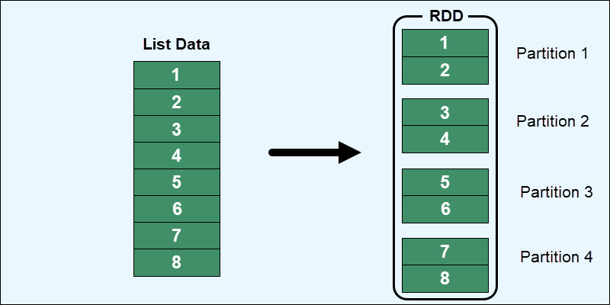

Slide 70
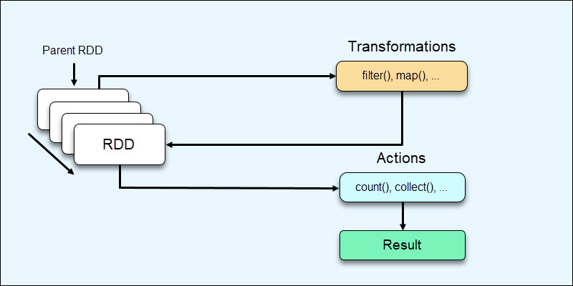
Spark RDD Operations
RDDs offer two operation types:
1. Transformations are operations on RDDs that result in RDD creation.
2. Actions are operations that do not result in RDD creation and provide some other value.
Transformations perform various operations and create new RDDs as a result. Actions come as a final step after completed modifications and return a non-RDD result (such as the total count) from the data stored in the Spark Driver.

Slide 71
Advantages and Disadvantages of RDDs
The advantages of using RDDs are:
Data resilience. The self-recovery mechanism ensures data is never lost, regardless of whether a machine fails.
Data consistency. Since RDDs do not change over time and are only available for reading, data consistency maintains throughout various operations.
Performance speeds. Storing data in RAM whenever possible instead of on disk. However, RDDs maintain the possibility of on-disk storage to provide a massive performance and flexibility boost.

Slide 72
The disadvantages when working with Resilient Distributed Datasets include:
No schematic view of data. RDDs have a hard time dealing with structured data. A better option for handling structured data is through the DataFrames and Datasets APIs, which fully integrate with RDDs in Spark.
Garbage collection. Since RDDs are in-memory objects, they rely heavily on Java's memory management and serialization. This causes performance limitations as data grows.
Overflow issues. When RDDs run out of RAM, the information resides on a disk, requiring additional RAM and disk space to overcome overflow issues.
No automated optimization. An RDD does not have functions for automatic input optimization. While other Spark objects, such as DataFrames and Datasets, use the Catalyst optimizer, for RDDs, optimization happens manually.

