Slide 1

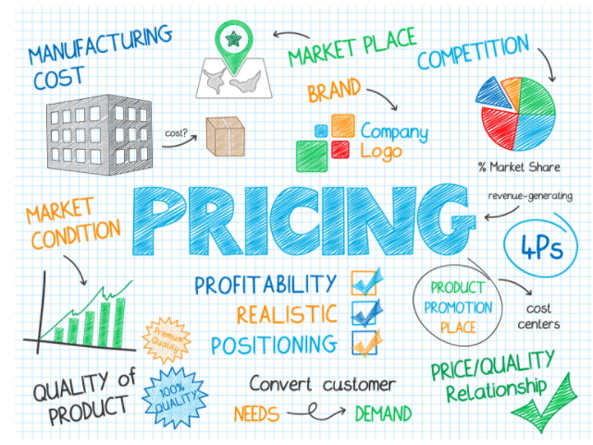

MSC3182
SOCIAL ENTREPRENEURSHIP
Lesson 6
PRICING

Slide 2

PRICING
Price too high – Customers may not buy
If too low – may not able to recover the COST

Slide 3
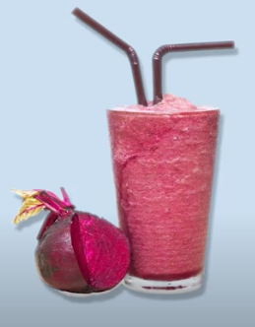
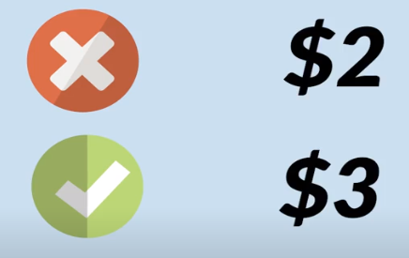


PRICING – Smoothie Business
What would happen if priced WRONGLY

Slide 4

FIXING PRICE
HOW TO FIX A PRICE?
The price of your product or service should be below the customers highest willingness to pay

Slide 5

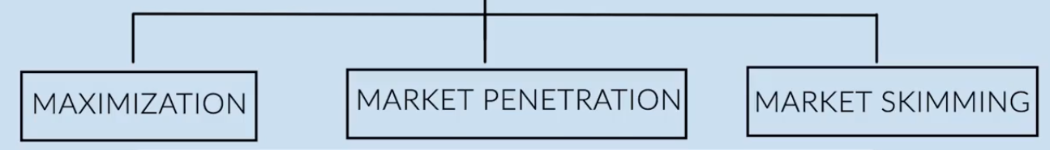
PRICISING STRATEGY

Slide 6
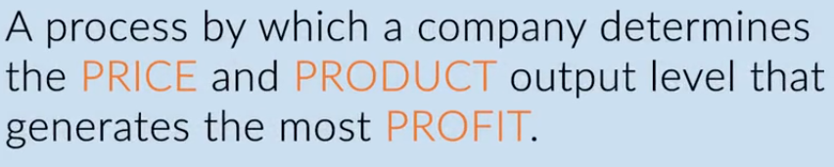
PRICISING STRATEGY
When all customer segments have similar willingness to pay and when optimal short term and long term prices are equal.

Slide 7

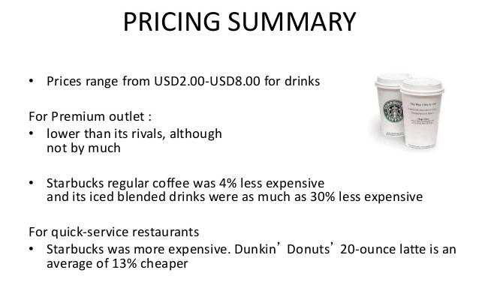
PRICISING STRATEGY
Highly popularized coffees are priced at premium to maximize profit

Slide 8

PRICISING STRATEGY
Strategy is to price the product low to maximize the broad adoption of the product

Slide 9

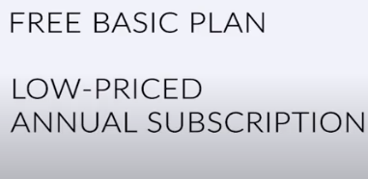
PRICISING STRATEGY
Cloud base team collaboration tool
Slack is essentially a chat room for your whole company, designed to replace email as your primary method of communication and sharing.
SLACK PRICISING STRATEGY

Slide 10

PRICISING STRATEGY

Slide 11

PRICISING STRATEGY
Latest models are priced at highest
Older models are lowest to cater the other customer segments

Slide 12
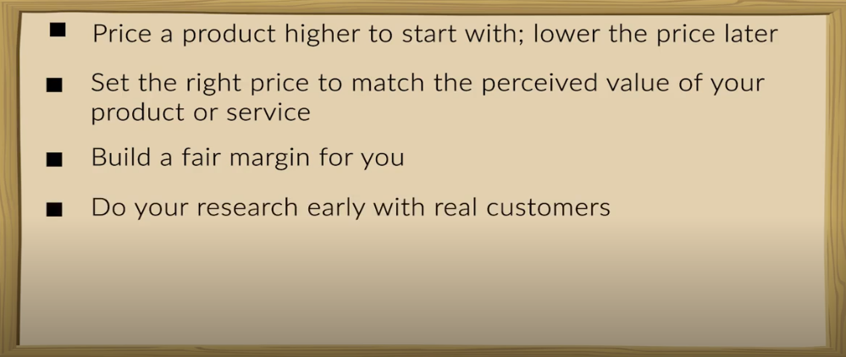



PRICISING STRATEGY

Slide 13
CONCLUSION
As pricing is dependent on number of factors
No one pricing strategy works for all products
Stick to best fit for your product

