Slide 1



MSC3182
SOCIAL ENTREPRENEURSHIP
Lesson 7
SHARED LEADERSHIP

Slide 2
OVERVIEW OF LEADERSHIP
You have your product/service offering in place now, you also have an inkling of the funds that you will require to set your venture in motion and from where to source those funds.
But who will take care of all these aspects?
Can you do it alone?
Obviously not!
You need people, you need a team, and you need to manage that team.

Slide 3
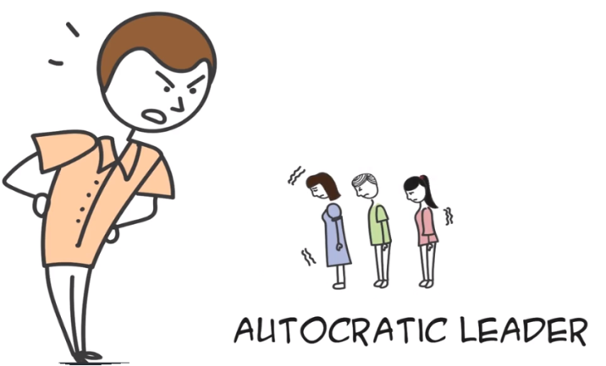
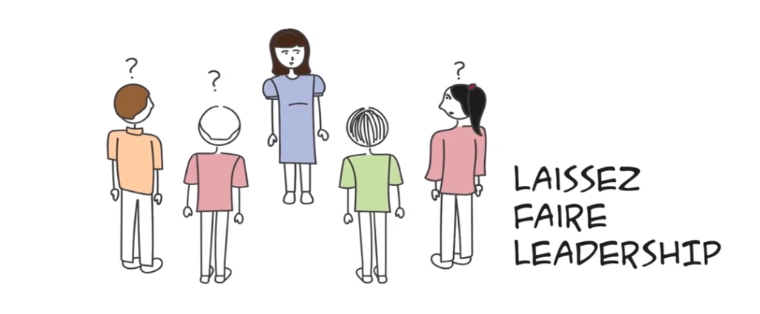
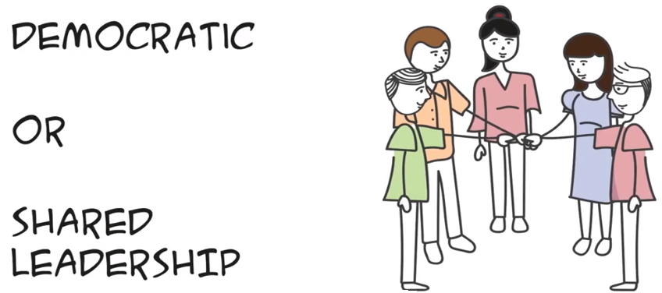
LEADERSHIP STYLES
Autocratic style leadership
Democratic or shared leadership
Laissez faire leadership

Slide 4
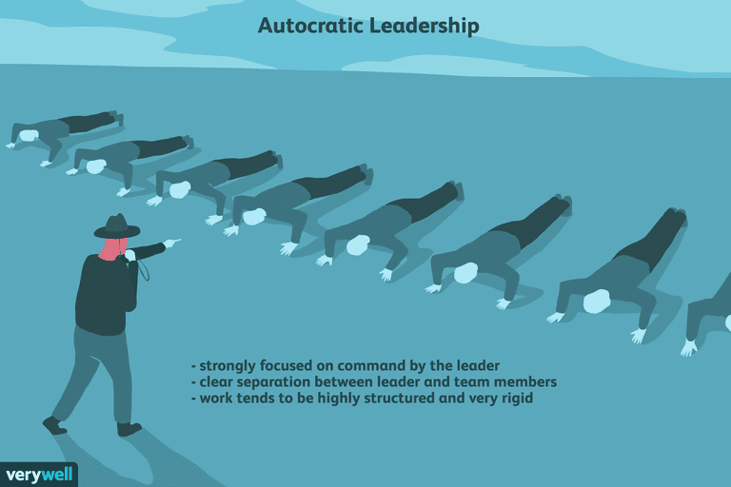
LEADERSHIP STYLES - Autocratic leadership
A leadership style characterized by individual control over all decisions and little input from group members.
They typically make choices based on their ideas and judgments and rarely accept advice from followers.

Slide 5
LEADERSHIP STYLES - Autocratic leadership
Characteristics of Autocratic Leadership
Some of the primary characteristics of autocratic leadership include:
Little or no input from group members
Leaders make almost all of the decisions
Group leaders dictate all the work methods and processes
Group members are rarely trusted with decisions or important tasks
Work tends to be highly structured and very rigid
Creativity and out-of-the box thinking tend to be discouraged
Rules are important and tend to be clearly outlined and communicated

Slide 6
LEADERSHIP STYLES - Autocratic leadership
Benefits of Autocratic Leadership
The autocratic leadership style can be useful in the following instances:
It can be effective in small groups where leadership is lacking.
It can also be used well in cases where a great deal of pressure is involved.
Manufacturing and construction work can also benefit from the autocratic style.
In these situations, it is essential that each person have a clearly assigned task, a deadline, and rules to follow.
Autocratic leaders tend to do well in these settings because they ensure that projects are finished on time and that workers follow safety rules to prevent accidents and injuries.

Slide 7
LEADERSHIP STYLES - Autocratic leadership
Downside of Autocratic Leadership
Some common problems with autocratic leadership:
This style tends to discourage group input
Autocratic leadership can also impair the morale of the group in some cases.
Negative emotions, dissatisfaction among the team members
Lack the sense of ownership and belonging

Slide 8

LEADERSHIP STYLES - Democratic leadership
Also known as participative leadership or shared leadership, is a type of leadership style in which members of the group take a more participative role in the decision-making process.
This type of leadership can apply to any organization, from private businesses to schools to government.

Slide 9
LEADERSHIP STYLES - Autocratic leadership
Some of the primary characteristics of democratic leadership include:
Group members are encouraged to share ideas and opinions, even though the leader retains the final say over decisions.
Members of the group feel more engaged in the process.
Creativity is encouraged and rewarded.
Allow things to happen in consensus and sense of ownership among the team
Teams members are happy and trust within them
Ideal leadership for success of an entrepreneurial venture

Slide 10
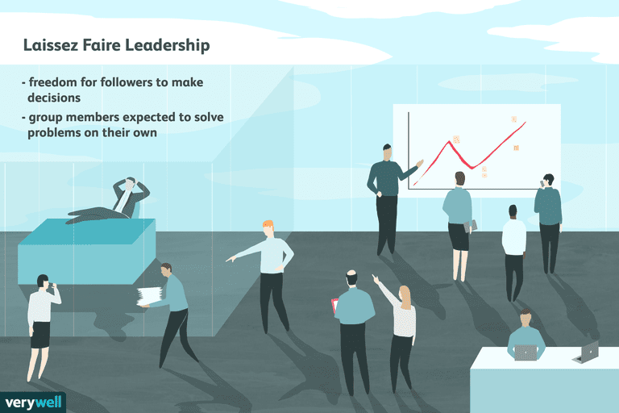
LEADERSHIP STYLES - Laissez-faire leadership
Also known as delegative leadership, is a type of leadership style in which leaders are hands-off and allow group members to make the decisions.
Researchers have found that this is generally the leadership style that leads to the lowest productivity among group members.

Slide 11
LEADERSHIP STYLES - Autocratic leadership
Laissez-faire leadership is characterized by:
Very little guidance from leaders
Complete freedom for followers to make decisions hich in turn leads to chaos as there is no structures where tasks are executed.
Leaders provide the tools and resources needed
Group members are expected to solve problems on their own
Power is handed over to followers, yet leaders still take responsibility for the groups decisions and actions

Slide 12
LEADERSHIP STYLES - Autocratic leadership
Downsides of Laissez-Faire Leadership:
Lack of role awareness.
Poor involvement with the group.
Low accountability.
Passivity and avoidance.

Slide 13






LEADERSHIP STYLES – which best suits an entrepreneur venture
Lead roles are assigned based on the experience and expertise of each person
Main aspect is to take the entire team to achieve a common goal
Driving Principles are

Slide 14
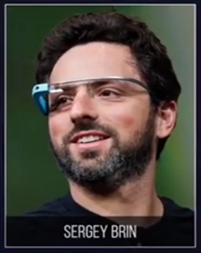
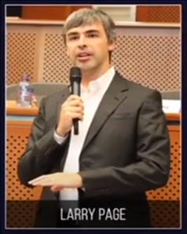



SHARED LEADERSHIP - EXAMPLES
Common interest
Common Passion
Common Ideology

Slide 15





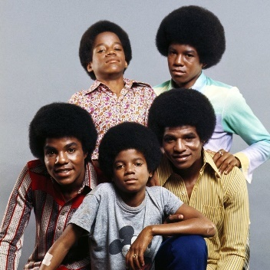

SHARED LEADERSHIP - EXAMPLES
Jacksons
Motherson—the company he set up between a son and his mother with a capital of around ₹1,000

Slide 16





HOW TO FIND CO-FOUNDER?
LOOK FOR PEOPLE WITHIN YOUR NETWOR WITH SIMILAR BACKGROUNDS

Slide 17
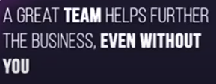





WHY TEAM IS NECESSARY?
YOU WILL BUILD A JOB FOR YOURSELF
WHEN HIRING – REFER TO

Slide 18
CONCLUDING REMARKS
Leadership style is different from entrepreneurial style
When a business is started, you put together a team and lead it towards a goal and there comes the leadership style to adopt
For more information, watch SHARED LEADERSHIP AND TEAM BUILDING VIDEO –under Lesson 7 TEAM
Visit https://www.verywellmind.com/what-is-autocratic-leadership-2795314

Slide 19

HIRING

Slide 20

HIRING STRATEGY
Can not afford a costly hiring mistake
Adding a wrong person to a team hurts

Slide 21





HIRING STRATEGY – Co-founder

Slide 22





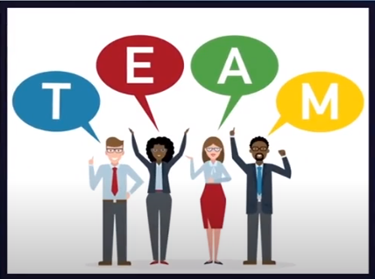
HIRING STRATEGY – Co-founder

Slide 23












HIRING STRATEGY – Team
WHY
Job Description (JD)

Slide 24







HIRING STRATEGY – Team
Hiring is an exciting phase in an entrepreneurship
Because – it is a sign that your

Slide 25

CONCLUSION
Finding a right team of people who share your passion, commitment and vision is an entrepreneurial dream come tyre

