Slide 1
Charge Coupled Devices (CCD)
By: Sameeha and Shahma

Slide 2
What is a CCD?
A charge-coupled device (CCD) is a light sensitive integrated circuit that captures images by converting photons to electrons.
A CCD sensor breaks the image element into pixels. Each pixel is converted into an electrical charge whose intensity is related to the intensity of light captured by that pixel.

Slide 3
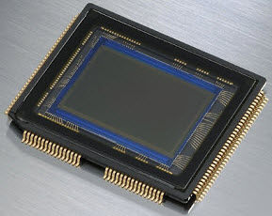
Charge Coupled Device

Slide 4
For many years, CCDs were the sensors of choice in a wide range of devices, but they're steadily being replaced by image sensors based on complementary metal-oxide-semiconductor.

Slide 5
History of CCD
The CCD was invented in 1969 at Bell Labs, now part of Nokia, by George Smith and Willard Boyle. However, the researcher's efforts were focused primarily on computer memory and it wasn't until the 1970s that Michael F. Tompsett, also with Bell Labs, refined the CCD's design to better accommodate imaging.
After that, the CCD continued to be improved by Tompsett and other researchers, leading to enhancements in light sensitivity and overall image quality. The CCD soon becoming the primary technology used for digital imagery.

Slide 6
What does a ccd do?
Small, light-sensitive areas are etched into a silicon surface to create an array of pixels that collect the photons and generate electrons.
The number of electrons in each pixel is directly proportional to the intensity of light captured by the pixel.
After all the electrons have been generated, they undergo a shifting process that moves them toward an output node, where they're amplified and converted to voltage.

Slide 7
Applications
In the past, CCDs could deliver much better quality images than other types of sensors, including those based on CMOS technology. As a result, they were used in a wide range of devices, including scanner, barcode readers, microscopes, medical equipment and astronomical telescopes.
The devices also found use in machine vision for robots, optical character recognition (OCR), processing satellite photographs and radar imagery, especially in meteorology.
In addition, CCDs were used in digital cameras to deliver better resolution than older technologies.

Slide 8
THANK YOU

