Slide 1
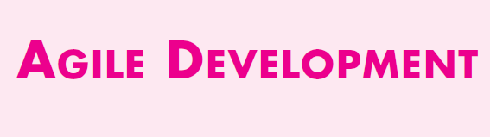

Slide 2
WHAT IS AGILITY
An agile team is a nimble team able to appropriately respond to changes.
Change is what software development is very much about.
Agility can be applied to any software process.
However, to accomplish this, it is essential that the process be designed in a way that allows the project team to adapt tasks and to streamline them, conduct planning in a way that understands the fluidity of an agile development approach, eliminate all but the most essential work products and keep them lean, and emphasize an incremental delivery strategy that gets working software to the customer as rapidly as feasible for the product type and operational environment

Slide 3
AGILITY AND COST OF CHANGE
The conventional wisdom in software development (supported by decades of experience) is that the cost of change increases nonlinearly as a project progresses (Figure 3.1, solid black curve).
It is relatively easy to accommodate a change when a software team is gathering requirements (early in a project).
The costs of doing this work are minimal, and the time required will not adversely affect the outcome of the project.
Proponents of agility argue that a well-designed agile process “flattens” the cost of change curve (Figure 3.1, shaded, solid curve), allowing a software team to accommodate changes late in a software project without dramatic cost and time impact.

Slide 4
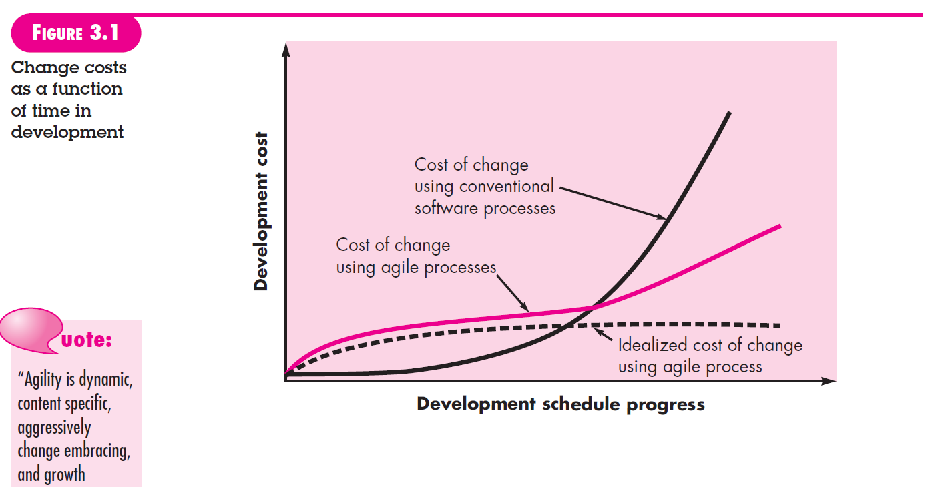

Slide 5
WHAT IS AN AGILE PROCESS
An agile software process must adapt incrementally. To accomplish incremental adaptation, an agile team requires customer feedback (so that the appropriate adaptations can be made).
An effective catalyst for customer feedback is an operational prototype or a portion of an operational system. Hence, an incremental development strategy should be instituted.

Slide 6
AGILITY PRINCIPLES
Defines 12 agility principles for those who want to achieve agility:
Our highest priority is to satisfy the customer through early and continuous delivery of valuable software.
2. Welcome changing requirements, even late in development. Agile processes harness change for the customer’s competitive advantage.
3. Deliver working software frequently, from a couple of weeks to a couple of months, with a preference to the shorter timescale.
4. Business people and developers must work together daily throughout the project.
5. Build projects around motivated individuals. Give them the environment and support they need, and trust them to get the job done.

Slide 7
6. The most efficient and effective method of conveying information to and within a development team is face-to-face conversation.
7. Working software is the primary measure of progress.
8. Agile processes promote sustainable development. The sponsors, developers, and users should be able to maintain a constant pace indefinitely.
9. Continuous attention to technical excellence and good design enhances agility.
10. Simplicity—the art of maximizing the amount of work not done—is essential.
11. The best architectures, requirements, and designs emerge from self–organizing teams.
12. At regular intervals, the team reflects on how to become more effective, then tunes and adjusts its behavior accordingly.

Slide 8
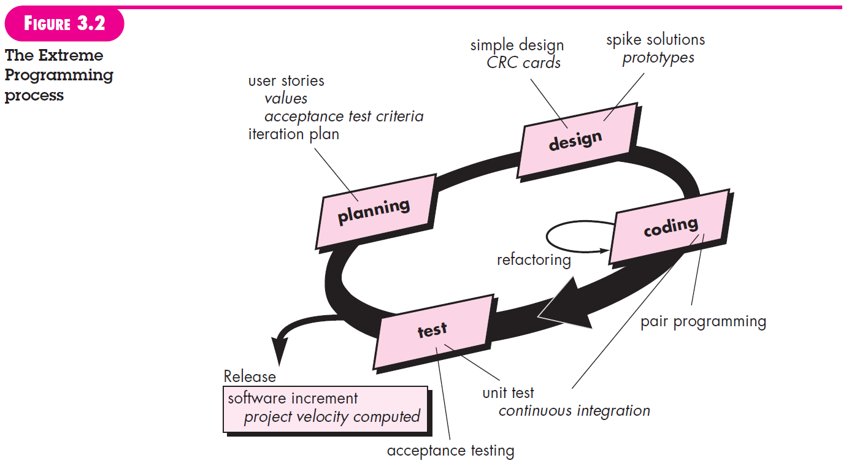
EXTREME PROGRAMMING(XP)

Slide 9
The XP Process
PLANNING. The planning activity (also called the planning game) begins with listening—a requirements gathering activity that enables the technical members of the XP team to understand the business context for the software and to get a broad feel for required output and major features and functionality.
Listening leads to the creation of a set of “stories” (also called user stories) that describe required output, features, and functionality for software to be built.
Each story is written by the customer and is placed on an index card. The customer assigns a value (i.e., a priority) to the story based on the overall business value of the feature or function.
Members of the XP team then assess each story and assign a cost—measured in development weeks—to it. If the story is estimated to require more than three development weeks, the customer is asked to split the story into smaller stories and the assignment of value and cost occurs again.
It is important to note that new stories can be written at any time.

Slide 10
After the first project release (also called a software increment) has been delivered, the XP team computes project velocity.
Stated simply, project velocity is the number of customer stories implemented during the first release.
Project velocity can then be used to (1) help estimate delivery dates and schedule for subsequent releases and
(2) determine whether an overcommitment has been made for all stories across the entire development project. If an overcommitment occurs, the content of releases is modified or end delivery dates are changed.

Slide 11
DESIGN. XP design rigorously follows the KIS (keep it simple) principle. A simple design is always preferred over a more complex representation.
The design of extra functionality (because the developer assumes it will be required later) is discouraged.
XP encourages the use of CRC cards as an effective mechanism for thinking about the software in an object-oriented context.
CRC (class-responsibility collaborator) cards identify and organize the object-oriented classes that are relevant to the current software increment.
If a difficult design problem is encountered as part of the design of a story, XP recommends the immediate creation of an operational prototype of that portion of the design.

Slide 12
Called a spike solution, the design prototype is implemented and evaluated.
The intent is to lower risk when true implementation starts and to validate the original estimates for the story containing the design problem.
XP encourages refactoring—a construction technique that is also a method for design optimization.
Refactoring is the process of changing a software system in such a way that it does not alter the external behavior of the code yet improves the internal structure.
It is a disciplined way to clean up code [and modify/simplify the internal design] that minimizes the chances of introducing bugs.

Slide 13
CODING. After stories are developed and preliminary design work is done, the team does not move to code, but rather develops a series of unit tests that will exercise each of the stories that is to be included in the current release (software increment).
Once the unit test has been created, the developer is better able to focus on what must be implemented to pass the test. Nothing extraneous is added (KIS).
Once the code is complete, it can be unit-tested immediately, thereby providing instantaneous feedback to the developers.
A key concept during the coding activity (and one of the most talked about aspects of XP) is pair programming.
XP recommends that two people work together at one computer workstation to create code for a story. This provides a mechanism for real time problem solving (two heads are often better than one) and real-time quality assurance (the code is reviewed as it is created).

Slide 14
As pair programmers complete their work, the code they develop is integrated with the work of others.
In some cases this is performed on a daily basis by an integration team.
In other cases, the pair programmers have integration responsibility.
This “continuous integration” strategy helps to avoid compatibility and interfacing problems and provides a “smoke testing” environment that helps to uncover errors early.

Slide 15
TESTING. The unit tests that are created should be implemented using a framework that enables them to be automated (hence, they can be executed easily and repeatedly).
This encourages a regression testing strategy whenever code is modified (which is often, given the XP refactoring philosophy).
XP acceptance tests, also called customer tests, are specified by the customer and focus on overall system features and functionality that are visible and reviewable by the customer.
Acceptance tests are derived from user stories that have been implemented as part of a software release.

