Slide 1
Introduction

Slide 2
What is an Operating System?
A program that acts as an intermediary between a user of a computer and the computer hardware
Operating system goals:
Execute user programs and make solving user problems easier
Make the computer system convenient to use
Use the computer hardware in an efficient manner

Slide 3
Computer System Structure
Computer system can be divided into four components:
Hardware – provides basic computing resources
CPU, memory, I/O devices
Operating system
Controls and coordinates use of hardware among various applications and users
Application programs – define the ways in which the system resources are used to solve the computing problems of the users
Word processors, compilers, web browsers, database systems, video games
Users
People, machines, other computers

Slide 4
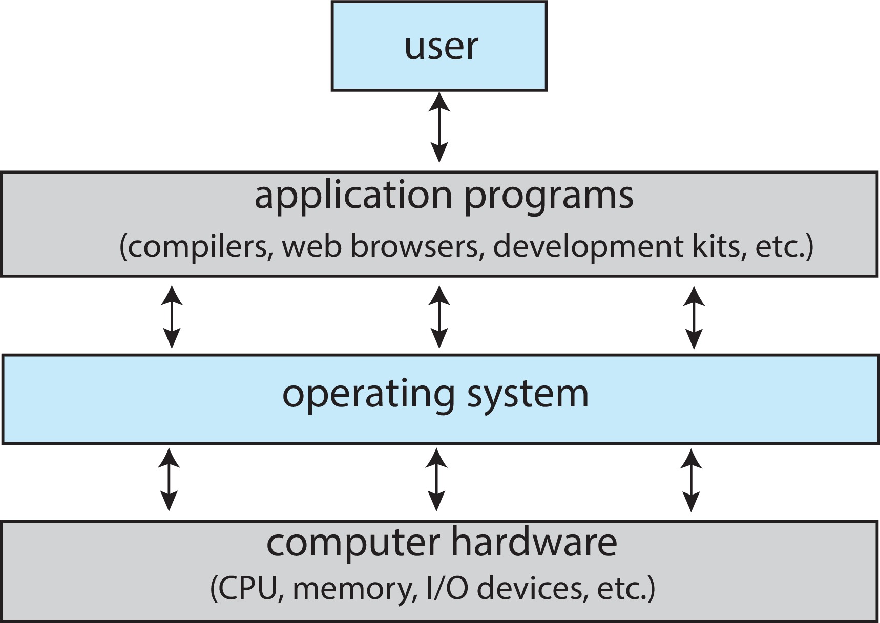
Abstract View of Components of Computer

Slide 5
What Operating Systems Do
Depends on the point of view
Users want convenience, ease of use and good performance
Don’t care about resource utilization
But shared computer such as mainframe or minicomputer must keep all users happy
Operating system is a resource allocator and control program making efficient use of HW and managing execution of user programs
Users of dedicate systems such as workstations have dedicated resources but frequently use shared resources from servers
Mobile devices like smartphones and tables are resource poor, optimized for usability and battery life
Mobile user interfaces such as touch screens, voice recognition
Some computers have little or no user interface, such as embedded computers in devices and automobiles
Run primarily without user intervention

Slide 6
Operating System Definition
No universally accepted definition
“Everything a vendor ships when you order an operating system” is a good approximation
But varies wildly
“The one program running at all times on the computer” is the kernel, part of the operating system
Everything else is either
A system program (ships with the operating system, but not part of the kernel) , or
An application program, all programs not associated with the operating system
Today’s OSes for general purpose and mobile computing also include middleware – a set of software frameworks that provide additional services to application developers such as databases, multimedia, graphics

Slide 7
Multiprogramming (Batch system)
Single user cannot always keep CPU and I/O devices busy
Multiprogramming organizes jobs (code and data) so CPU always has one to execute
A subset of total jobs in system is kept in memory
One job selected and run via job scheduling
When job has to wait (for I/O for example), OS switches to another job

Slide 8
Multitasking (Timesharing)
A logical extension of Batch systems– the CPU switches jobs so frequently that users can interact with each job while it is running, creating interactive computing
Response time should be < 1 second
Each user has at least one program executing in memory  process
If several jobs ready to run at the same time  CPU scheduling
If processes don’t fit in memory, swapping moves them in and out to run
Virtual memory allows execution of processes not completely in memory

Slide 9
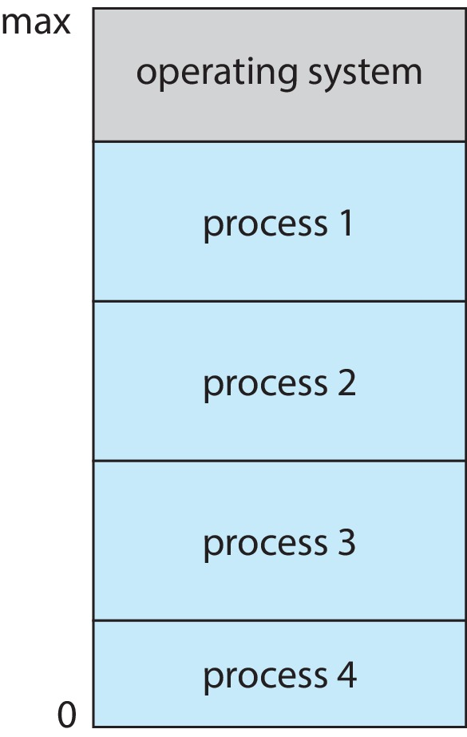
Memory Layout for Multiprogrammed System

Slide 10
Process Management
A process is a program in execution. It is a unit of work within the system. Program is a passive entity; process is an active entity.
Process needs resources to accomplish its task
CPU, memory, I/O, files
Initialization data
Process termination requires reclaim of any reusable resources
Single-threaded process has one program counter specifying location of next instruction to execute
Process executes instructions sequentially, one at a time, until completion
Multi-threaded process has one program counter per thread
Typically system has many processes, some user, some operating system running concurrently on one or more CPUs
Concurrency by multiplexing the CPUs among the processes / threads

Slide 11
Process Management Activities
The operating system is responsible for the following activities in connection with process management:
Creating and deleting both user and system processes
Suspending and resuming processes
Providing mechanisms for process synchronization
Providing mechanisms for process communication
Providing mechanisms for deadlock handling

Slide 12
Memory Management
To execute a program all (or part) of the instructions must be in memory
All (or part) of the data that is needed by the program must be in memory
Memory management determines what is in memory and when
Optimizing CPU utilization and computer response to users
Memory management activities
Keeping track of which parts of memory are currently being used and by whom
Deciding which processes (or parts thereof) and data to move into and out of memory
Allocating and deallocating memory space as needed

Slide 13
File-system Management
OS provides uniform, logical view of information storage
Abstracts physical properties to logical storage unit - file
Each medium is controlled by device (i.e., disk drive, tape drive)
Varying properties include access speed, capacity, data-transfer rate, access method (sequential or random)
File-System management
Files usually organized into directories
Access control on most systems to determine who can access what
OS activities include
Creating and deleting files and directories
Primitives to manipulate files and directories
Mapping files onto secondary storage
Backup files onto stable (non-volatile) storage media

Slide 14
Mass-Storage Management
Usually disks used to store data that does not fit in main memory or data that must be kept for a “long” period of time
Proper management is of central importance
Entire speed of computer operation hinges on disk subsystem and its algorithms
OS activities
Mounting and unmounting
Free-space management
Storage allocation
Disk scheduling
Partitioning
Protection

Slide 15
Caching
Important principle, performed at many levels in a computer (in hardware, operating system, software)
Information in use copied from slower to faster storage temporarily
Faster storage (cache) checked first to determine if information is there
If it is, information used directly from the cache (fast)
If not, data copied to cache and used there
Cache smaller than storage being cached
Cache management important design problem
Cache size and replacement policy

Slide 16
I/O Subsystem
One purpose of OS is to hide peculiarities of hardware devices from the user
I/O subsystem responsible for
Memory management of I/O including buffering (storing data temporarily while it is being transferred), caching (storing parts of data in faster storage for performance), spooling (the overlapping of output of one job with input of other jobs)
General device-driver interface
Drivers for specific hardware devices

Slide 17
Protection and Security
Protection – any mechanism for controlling access of processes or users to resources defined by the OS
Security – defense of the system against internal and external attacks
Huge range, including denial-of-service, worms, viruses, identity theft, theft of service
Systems generally first distinguish among users, to determine who can do what
User identities (user IDs, security IDs) include name and associated number, one per user
User ID then associated with all files, processes of that user to determine access control
Group identifier (group ID) allows set of users to be defined and controls managed, then also associated with each process, file
Privilege escalation allows user to change to effective ID with more rights

Slide 18
Distributed Systems
Collection of separate, possibly heterogeneous, systems networked together
Network is a communications path, TCP/IP most common
Local Area Network (LAN)
Wide Area Network (WAN)
Metropolitan Area Network (MAN)
Personal Area Network (PAN)
Network Operating System provides features between systems across network
Communication scheme allows systems to exchange messages
Illusion of a single system

