Slide 1
Animation
Animation is a method of photographing successive drawings, models, or even puppets, to create an illusion of movement in a sequence. Because our eyes can only retain an image for approx. 1/10 of a second, when multiple images appear in fast succession, the brain blends them into a single moving image. In traditional animation, pictures are drawn or painted on transparent celluloid sheets to be photographed. Early cartoons are examples of this, but today, most animated movies are made with computer-generated imagery or CGI.

Slide 2
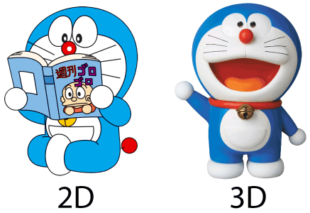
Example:

Slide 3
Application of Computer Animation
Special Effects (Movies, TV)
❖ Video Games
❖ Virtual Reality
❖ Simulation, Training, Military
❖ Medical
❖ Robotics
❖ Visualization
❖ Communication

Slide 4
Types of Animation:
Traditional Animation: This is one of the oldest forms of animation in film. It’s sometimes called cel animation. As mentioned above, in traditional animation, objects are drawn on celluloid transparent paper. In order to create the animated sequence, the animator must draw every frame. It’s the same mechanism as a flipbook, just on a grander scale
2D Animation (Vector-based): Images with familiar formats like JPG, GIF, BMP, are pixel images. These images cannot be enlarged or shrunk without affecting image quality. Vector graphics don’t need to worry about resolution. Vectors are characterized by pathways with various start and end points, lines connecting these points to build the graphic. Shapes can be created to form a character or other image. Vector-based animation uses mathematical values to resize images, so motion is smooth.
3D Animation: In 3D animated movies, the animator uses a program to move the character’s body parts around. They set their digital frames when all of the parts of the character are in the right position. They do this for each frame, and the computer calculates the motion from each frame.

Slide 5
Motion Graphics: Motion Graphics are pieces are digital graphics that create the illusion of motion usually for ads, title sequences in films, but ultimately exist to communicate something to the viewer. They’re often combined with sound for multimedia projects.
They’re a type of animation used mostly in business, usually with text as a main player. Below are a few examples of motion graphic animation, using the top trends of today.
Stop Motion: Stop Motion encompasses claymation, pixelation, object-motion, cutout animation, and more. But the basic mechanics are similar to the traditional style like a flipbook. However, instead of drawings, stop motion adjusts physical objects in each frame.
If moved in small increments, captured one frame at a time, the illusion of motion is produced.

Slide 6
Methods/Techniques:
1.Frame by Frame (Traditional Method): Earlier, in traditional method, animation was done by hands because of the absence of the computer-aided drawing facilities
2.Procedural: In Procedural method, set of rules are used to animate the objects. Animator defines or specify the initial rules and procedure to process and later runs simulations.
3.Behavioral: According to this method/technique, to a certain extent the character or object specifies/determines it’s own actions which helps / allows the character to improve later, and in turn, it frees the animator in determining each and every details of the character’s motion.
4.Key Framing: A key frame in computer animation is a frame where we define changes in an animation. According to key framing, a storyboard requirement is must as the animatordraws the major frames of animation from it.

Slide 7
5.Motion Capture: This method of animation uses the live action/motion footage of a living human character which is recorded to the computer via video cameras and markers and later, that action or motion is used/applied to animate the character which gives the real feel to the viewers as if the real human character has been animated
6.Dynamics: In this method, simulations are used in order to produce a quite different sequence while maintaining the physical reality.

Slide 8
Software for Animation
• Blender
• 3D Studio Max
• Animation: Master
• Adobe Animate
• Motion capture
• Adobe Flash

