Slide 1
COLOR MODELS
IN
COMPUTER GRAPHICS
Prepared by :- Dhruv Patel

Slide 2
COLOR MODELS
A color model is a specification of a 3D color co-ordinate system and a visible subset in the co-ordinate System within all colors in a particular color range lie.
There are main four types of color models:-
(1) RGB
(2) CMY
(3) CMYK
(4) YIQ
This four models are hardware oriented color models.

Slide 3
But these models are not easy to use because they does not relate directly to intuitive color notations of hue,saturation and brightness.
Therefore another class of color model has been developed.
These includes :- HSV
HLS
HVC
The human eye can perceive about 382000(!) different colors.
The distance between two color in the color cube is not a measure.
Cont…

Slide 4
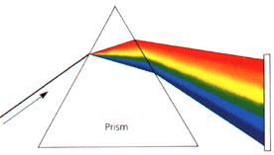
Physical properties of light
White light consists of a spectrum of all visible colors.
All kinds of light can be described by the energy of each wavelength.

Slide 5
Cont…
Most light we see is not just a single wavelength, but a combination of many wavelengths like below. This profile is often referred to as a spectrum, or spectral power distribution.

Slide 6
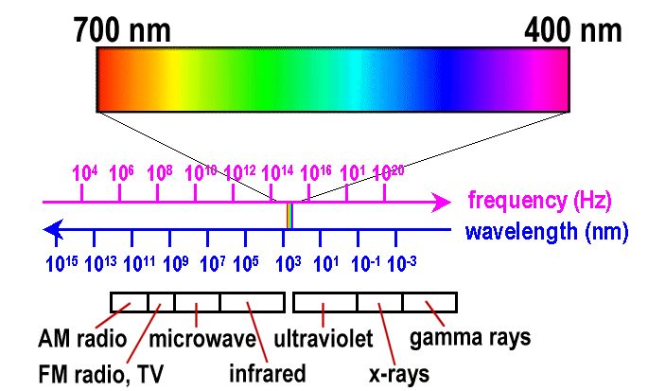
Cont…
Frequency:
Red: 3.8x10¹⁴ hertz
Violet: 7.9x10¹⁴ hertz
Wavelength:
Red: 700 nm
Violet: 400 nm

Slide 7
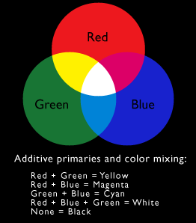
Additive color mixing
When we combine
Red(two-thirds),
Green(two-third),
Blue(one-third)
then we can get WHITE
color.
But we can absorbs CMY
color from this RGB color
then we can get BLACK
color

Slide 8
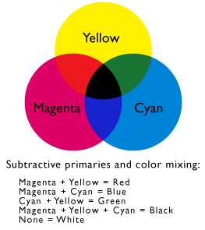
Subtractive color mixing
When we combine
CYAN,
MAGENTA,
YELLOW
then we can get BLACK
color.
But we can absorbs RGB
color from this CMY color
then we can get WHITE
color.

Slide 9
Intuitive color concept
Color mixing created by an artist.
Shades, tints and tones in scene can be produced by mixing color pigments (hues) with white and black pigments.
Shades:
Add black pigment to pure color
The more black pigment, the darker the shade
Tints:
Add white pigment to the original color
Making it lighter as more white is added
Tones:
Produced by adding both black and white pigments

Slide 10
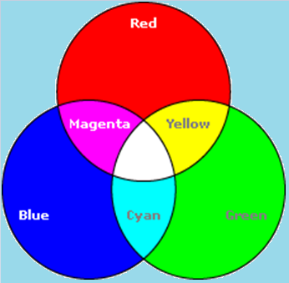
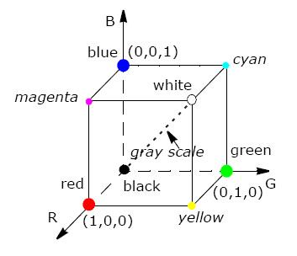
RGB (Red,Green,Blue) color model
The RGB color model used in color CRT monitors.
In this model,
Red,Green and Blue are added together to get the resultant color WHITE.

Slide 11
Cont…
Each color point within the bounds of the cube is represented as the triple (R,G,B).where value for R,G,B are assigned in the range from 0 to 1.
Here RGB color place together at 120 degree.
RED + GREEN + BLUE = WHITE(contribute)
All other colors are generated from these three primary colors.

Slide 12
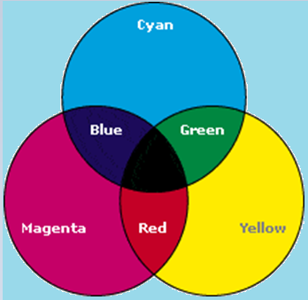
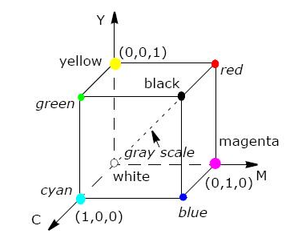
CMY (Cyan,Magenta,Yellow) color model
The CMY color model used in color printing devices.
In this model,
Cyan,Magenta and Yellow are added together to get the resultant color BLACK.

Slide 13
Cont…
Each color point within the bounds of the cube is represented as the triple (C,M,Y).where value for C,M,Y are also assigned in the range from 0 to 1.
Here CMY color also place together at 120 degree.
CYAN+ MAGENTA + YELLO = BLACK(contribute)
All other colors are generated from these three primary colors.

Slide 14
RGB vs CMY
If the intensities are represented as 0≤r,g,b≤1 and 0≤c,m,y≤1 then the relation between RGB and CMY can be described as:

Slide 15
CMYK (Cyan,Magenta,Yello,Black) color model
For printing & art industry the CMY model is not enough.
So,Fourth primary color K is added to CMY model.
K stands for BLACK color.

Slide 16
YIQ (Luminance,Inphase,Quadrature) color model
The YIQ color model is a recoding of RGB color model.
YIQ color model is used for television broadcasting.
The
Y-channel contains luminance information(sufficient for Black & White television sets)
And
I-channel & Q-channel contains color information.
For recoding RGB to YIQ , HSV & HLS color models are used.
Inphase = RED – YELLOW
Quadrature = BLUE – YELLOW

Slide 17
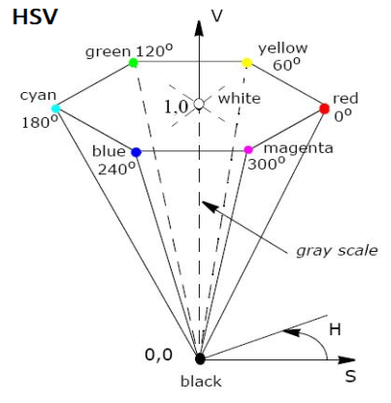
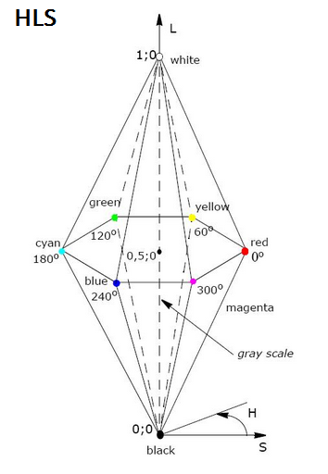
HSV (Hue,Saturation,Value) & HLS (Hue,Lightness,Saturation) color model
HSV and HLS are the two most common cylindrical-coordinate representations of points in an RGB color model.
HSV is described by a hexacone derived from the RGB cube.

Slide 18
Cont…
Hue means color is mapped into 0-360’.The wavelength of Hue is 128.
Saturation is defined into 0-1.In this the amount of WHITE color is 130.
Value is defined into 0-1.In this the amount of BLACK
color is 23

Slide 19
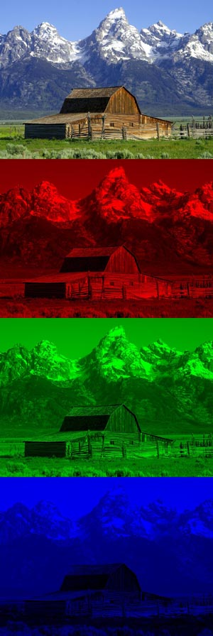


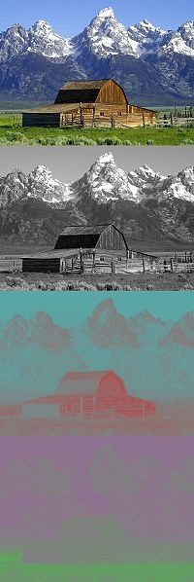


Comparison
RGB
CMY
CMYK
YIQ
HSV
HLS

Slide 20


