Slide 1

ROBOTICS
Robot Actuators and Drive Systems

Slide 2
Content
Robot Systems
• Industrial robots drive chain
• Servo drives
• Position transducers
• Clutches
• Power transmission systems
• Storage
• Overall design

Slide 3
Robot Systems
External
Sensors
Environment
Robot
Control
Drive
chain
Robot
Segments
End-
Effectors
Object
Periphery
Internal
Sensors

Slide 4
Industrial robots drive chain
Generation
the trajectory
Robot
Control
Servo-
Amplifier
Servo-
Actuator
Coupling
Transmission
Tachometer-
generator
Storage
Positioning
system
Segment

Slide 5
Servo Drives
Drive principle | Scope | Benefits | Disadvantages
Pneumatic | Passive Elements, Auxiliary devices | Cheap Low weight | Compressibility of the air
Hydraulics | Manipulators with very high load capacity and very large working space | High Dynamics High-power Weight ratio | Necessary Directions: Pump, hoses, Servo Valves "Dirty" Maintenance Low efficiency Warming
Electric | Standard for Industrial robot | High Dynamics Very generally favorable opportunity High performance Relationship High Speed Ratio | Necessary gear transmission Warming

Slide 6
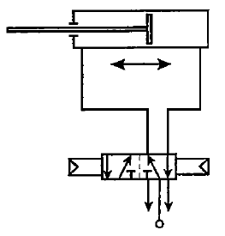
Pneumatic drives
Cheap
Simple construction
Low weight
Clamp movement
Point-to-point movement (stop)
Control ► scheme difficult
Low Positioning
(Compressibility of the air)
Expensive energy
Pneumatic working cylinder
Pneumatic valve

Slide 7
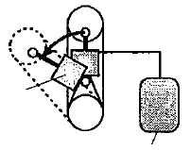
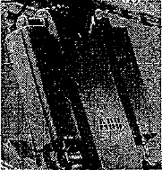
Pneumatic Actuators - usage
A pneumatic cylinder is used as a counterbalance to the individual robot axes.
Source: ABB
Pneumatic
Cylinder
Energy
Example, an IR

Slide 8
Hydraulic drives
High energy concentration
Small size
Low weight
No gear needed
Leaks are detrimental
Costs (+ power unit oil reservoir 100-150 liters)
Friction
Heat
Difficult interpretation of the regulator
Long ranges (over 3m)
Large payload masses (over 150 kg)
Typical oil pressure ≈ 60 bar
Seal

Slide 9
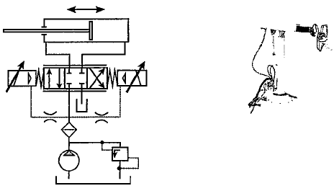
Hydraulic Actuators - cylinder drive
Working cylinder
Hydraulic pipes
Servo valve
Filter
Pressure relief valve
Oil tank
Pump

Slide 10
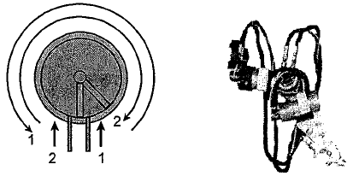
Hydraulic Actuators - rotary wing drive
1 Wing 270º - 300º 2 Wing 100º - 135º
Oil pressure

Slide 11
Electric Drives
Servomotor type | Max. Performance | Features
Step Motor | 1 kW | Open control circuit Heating during standstill Poor dynamics
DC-Brush | 5 kW | Good controllability by armature current High starting torque Wear by brushing
DC-Brushless | 10 kW | Maintenance Communication by resolvers, Hall-Effect or the optical sensor High power with the permanent magnet
AC-Synchronous | 20 kW
AC-Asynchronous | 80 kW | Maintenance Very robust High Speed Expensive control

Slide 12

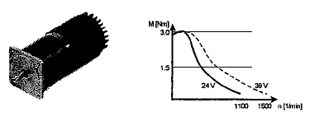
Step Motor
Block scheme:
Open loop
Step Motor Amplifier Pulse Generator Nominal-Position
Diagram:

Slide 13
Stepper Motor - Features
Open loop and speed control loop.
Relatively cheap.
By turning the control pulse to a drive axle increment (micro step).
Per rotation are more than 10,000 increments (micro-steps).
Magnetic rigidity is low in the positioning.
As drive system with the furnace control circuit is not damped and therefore inclined to impulse vibration.
Mechanical vibrations or of control (closed-loop damped).
Power-weight ratio is the lowest of all electric motors.

Slide 14
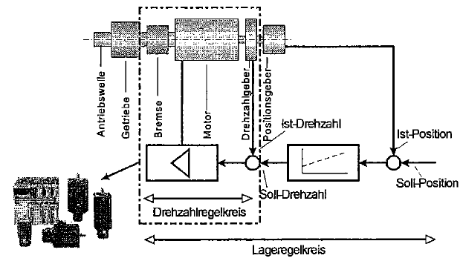
DC- or AC-Motor
Block scheme:
Nominal speed
Speed control loop
Position control loop

Slide 15
DC-motor features (direct current)
→ Mechanical or electronic Commutation
→ Low torque, high speed
→ Transmission is usually necessary
- Backlash, friction losses
→ Constant velocity at different loads
→ Measurement system is required
→ Simple speed control
→ Dominating the first electrically driven robots
→ Mechanical commutation limits the maximum current transfer
→ Service cycle of the brush is approximately 30,000 hours
→ These engines are increasingly being replaced by AC motors

Slide 16
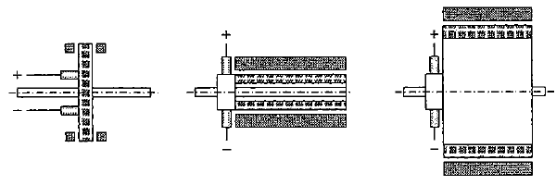
DC-Motor Construction
Ring motor Stabanker motor Moment motor
Low moment
High rotational speed
High positioning accuracy
Narrow execution
Robust
Small moment of inertia
Very high speed
High torque at lower rotational speed
Suitable as “Direct drive“ Motor
High dimensions
High weight

Slide 17
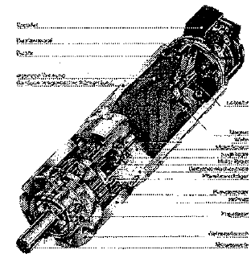
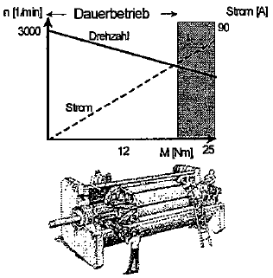
DC-Brush Motor
DC motor (with brushes) + gear + sensor
Diagram:
Input power: 90 V
(12, 24, 36 90 V)

Slide 18
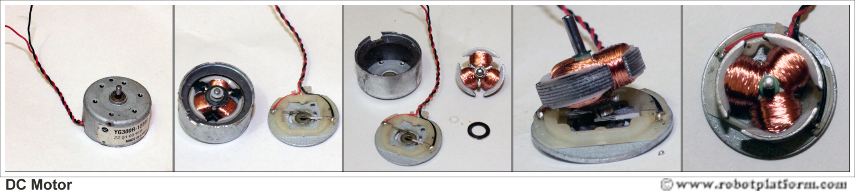
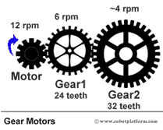

Slide 19
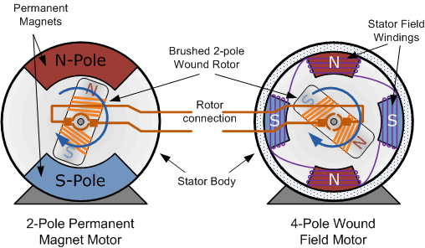
Conventional (Brushed) DC Motor

Slide 20
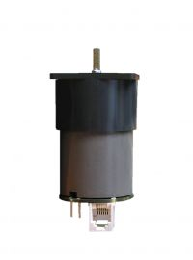
Example:
Gearmotor - Brushed geared DC motor GM45 R=642.6 MV1 with Hall sen
Brushed geared DC motor with a GM300AR1 reducer
Position sensor (optionaly): hall type
Supply voltage: from 12-24V DC
Rated rev-per-min: from 4 to 130 min-1
Rated torque: from 0.30 to 1.3Nm
Maximum toque: 1.6Nm
Maximum current: 700mA
Maximum output power: 3W
Temperature working range: from -22°C to +85°C
Gear Type: Conventional evolute gears
Housing type: plastic
Gear ratio: from 47 to 642 (6 gear box combinations)
Estimated life time: 1000 hours
Output shaft dia: Ø4mm
Storage temperature range: -55C~ 85C
ROHS compliant

Slide 21
DC-Brush Motor:
http://upload.wikimedia.org/wikipedia/commons/7/73/Ejs_Open_Source_Direct_Current_Electrical_Motor_Model_Java_Applet_%28_DC_Motor_%29_80_degree_split_ring.gif
Simple two-pole DC motor Rotation:
http://en.wikipedia.org/wiki/File:Electric_motor.gif

Slide 22
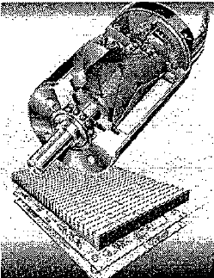
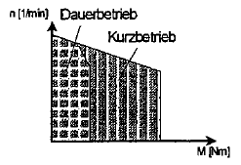
DC-Motor (electronically commutated)
Better torque characteristics
- higher power
- higher speed
- maintenance-free
Chart:

Slide 23
AC-Motor (alternating current)
Synchronous motor
- Exchange of usual Keramikoxid-magnet by the permanent magnet (Somarium-cobalt, neodymium-ferrite-boronic) with higher power density.
- The advanced power semiconductor technology (IGBT Insulated Gate - Bipolar Transistor) has improved the dynamics and controllability.
- Power up to 10-20 kW, speed 3000 min ˉ ¹.
Asynchronous motor
- More robust than synchronous motor
- Higher power density as a synchronous motor
- By the excitation of the magnetic field, these motors can in large area at the constant output power and at the nominal rotational speeds.
- This provides significant advantage over the synchronous motor.
- Power to 80 kW, speed up to 10000 min ˉ ¹.
TEMPUS IV Project: 158644 – JPCR
Development of Regional Interdisciplinary Mechatronic Studies - DRIMS
ROBOTICS

Slide 24
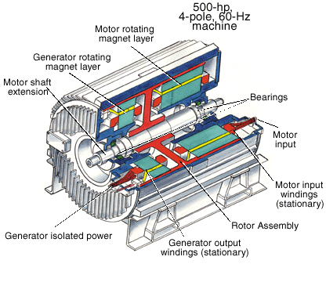
AC synchronous motor construction

Slide 25
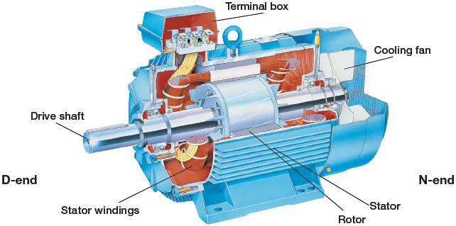
Asynchronous Motors
More on: http://www.ctiautomation.net/About-Motors.htm

Slide 26
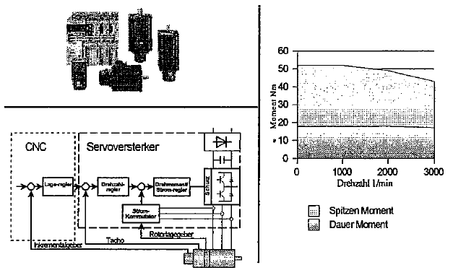
AC-Motor
Diagram:
Block diagram:

Slide 27
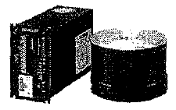
DD-Motor (direct drive)
Free gear
Maintenance-free
Low friction
High precision positioner
High repeatability
high load capacity
high torque
computer-controlled
Application for small robots for assembly purposes
Strong reaction of the mechanical system on the engine

Slide 28
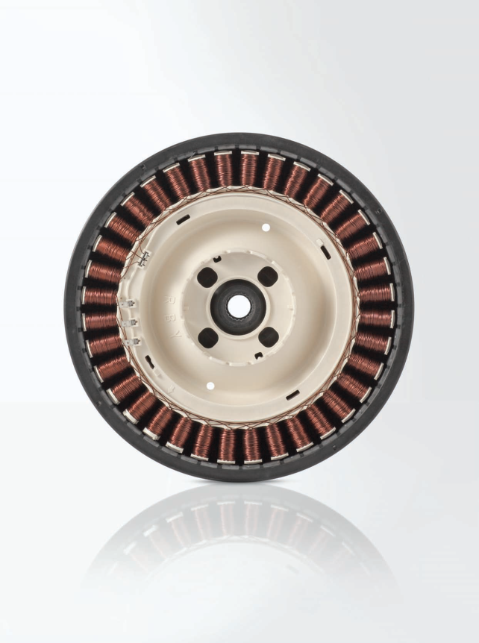
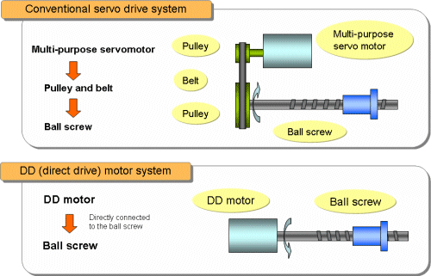

Slide 29
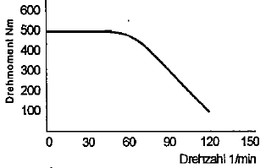
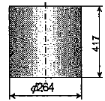
DD-Motor (direct drive)
Diagram:
rotation moment Nm
rotation speed 1/min
J = 0.46 kgm²
Resolution: 425984 steps/rotation
m = 75 kg
Repeating precision: ±5”
Precision: ±45”
Measuring system:
Resolver
Incremental rotary encoder

Slide 30
Comparison:
Direct drive - Conventional drive
 | Direct drive | conventional drive
Positioning accuracy | Very good for high-resolution measurement system | Extremely low-backlash gear required
maintenance costs | maintenance-free | Regular oil changes on the gear needed.
Motor moment of inertia | Jm << Jf | Jm + Jg >> Jf m – Motor g – gears f – foreign load
stiffness | An elastic coupling eliminated, high stiffness can be achieved by technical regulation measures. | Additional elastic coupling due to the gear
parameter fluctuations | large1 : 4 | low1 : (1.1 to 2)
warming | Powerful (standstill) | small

Slide 31
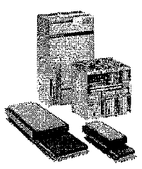

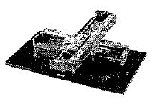
Linear AC-Motor
Asynchronous and synchronous motors
- High-speed rail (up to 3 m / s)
- High rail accuracy
- Very high acceleration (up to 200 m / s ²)
- Encapsulated design
- Pointed force: 12000 N
- Replacement of screw jacks

Slide 32
Assessment criteria
GEAR | ROBOTER
game synchronous stiffness | positioning vibration behavior
Mass moment of inertia construction volume efficiency | Cycle time, accuracy vibrations, construction
lifetime | Price, long-term accuracy
noise | motion noise
price | robot price

Slide 33
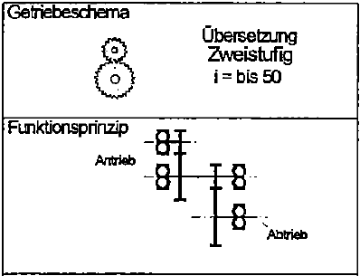
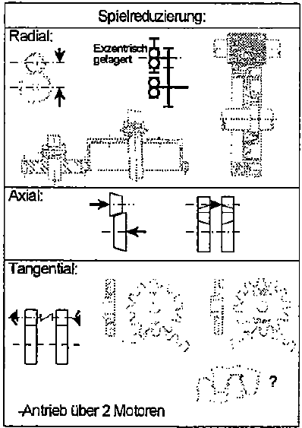
Spur gear
backlash reduction:
transmission scheme
Translation
two-stage
i= to 50
functional principle
drive
drive
Features:
Involutes gearing
Parallel shafts
Small-step translation
Small areas of intervention
Drive over two engines

Slide 34
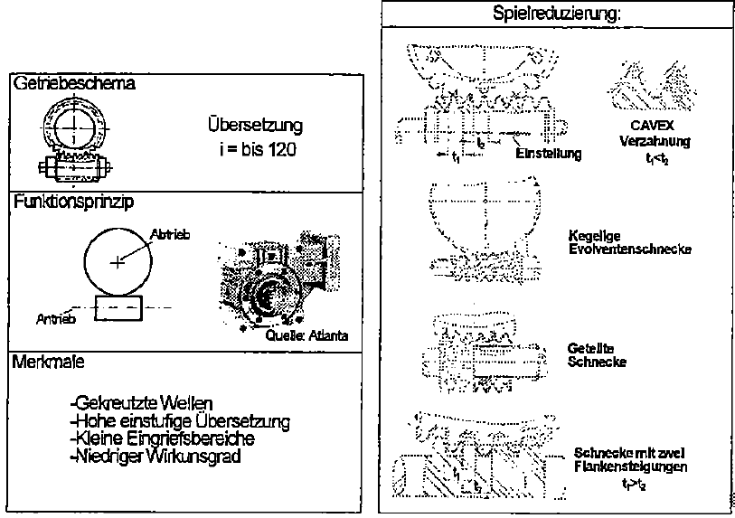
Auger transmission
backlash reduction:
transmission scheme
Translation
i= to 120
Gearing
t1 < t2
functional principle
drive
conical evolvent screw
drive
Features:
crossed shafts
high single-Translation
small areas of intervention
low efficiency
Asked screw
Screw with
two edge gradients
t1 > t2

Slide 35
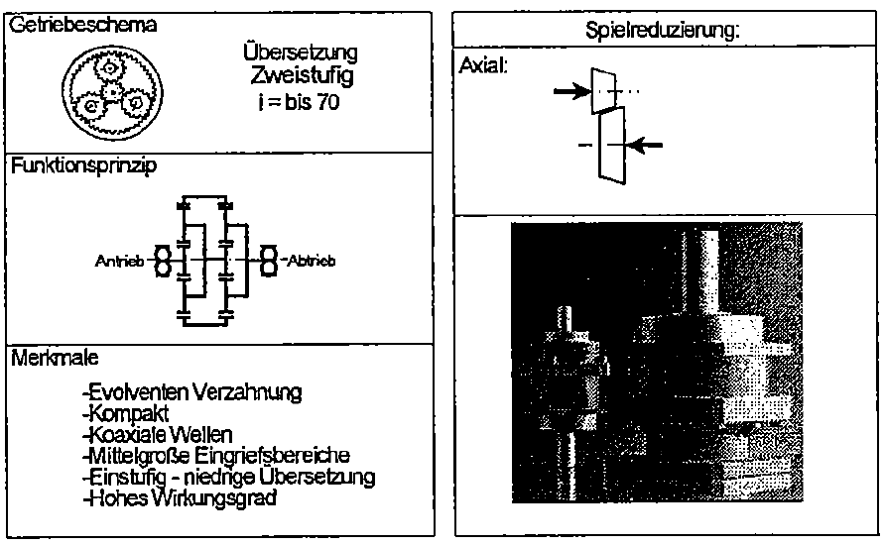
Planet drives
transmission scheme
backlash reduction:
Translation
Two-stage
i= to 70
functional principle
drive
drive
Features:
- involutes gearing
- compact
- coaxial shafts
- medium-sized e areas of intervention
- Stage - Low over implementation
- high efficiency

Slide 36
Planetary gear
eccentric gearing
  Akim
  Stäubli
  Cyclo
  Dojen
Harmonic Drive Gears

Slide 37
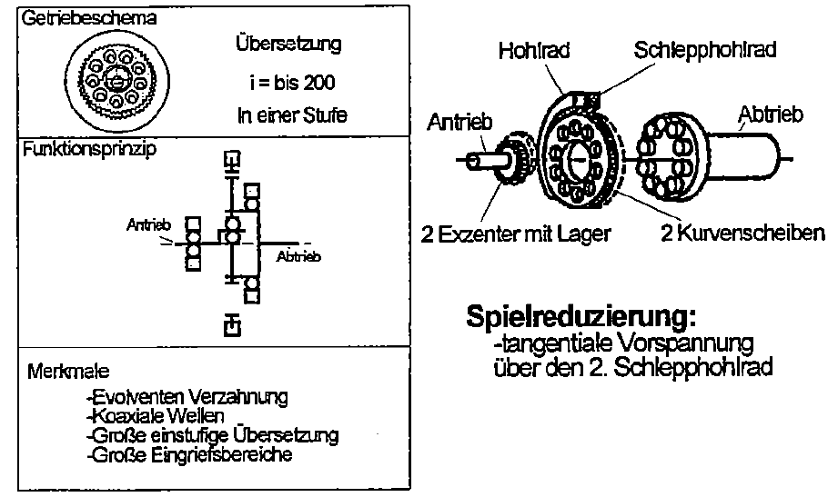
Akim
transmission scheme
Translation
i = to 200
In one stage
Towing ring gear
Ring gear
drive
drive
functional principle
drive
2 excenter with bearing
2 cam discs
drive
Backlash reduction:
Tangential preloading
over the 2 trailing ring gear
Features:
involute gearing
coaxial shafts
large one-stage translation
large engaging areas

Slide 38
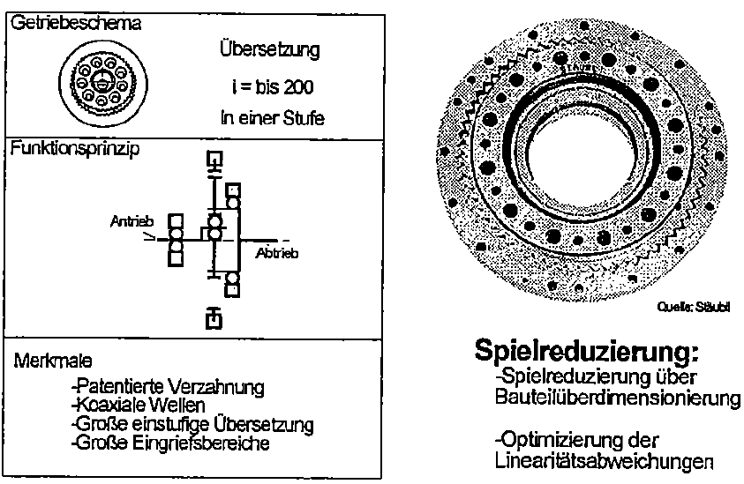
Stäubli JCS
transmission scheme
Translation
i = to 200
in one stage
functional principle
drive
drive
Features:
- patented gearing
- coaxial shafts
- Large one-step translation
- Large areas of intervention
Backlash reduction:
- Backlash reduction over component sizing
Optimization of linearity deviations

Slide 39
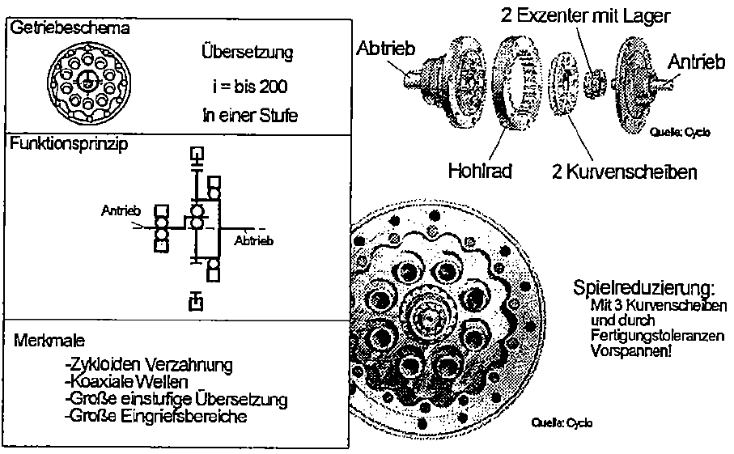
Cyclo
2 excenter with bearing
transmission scheme
Translation
i = to 200
in one stage
drive
drive
functional principle
gear
Two cam disks
drive
drive
Backlash reduction:
With 3 cam disks and preloading due to manufacturing tolerances!
Features:
- cycloidal gearing
- coaxial shafts
- Large one-step translation
- Large areas of intervention

Slide 40
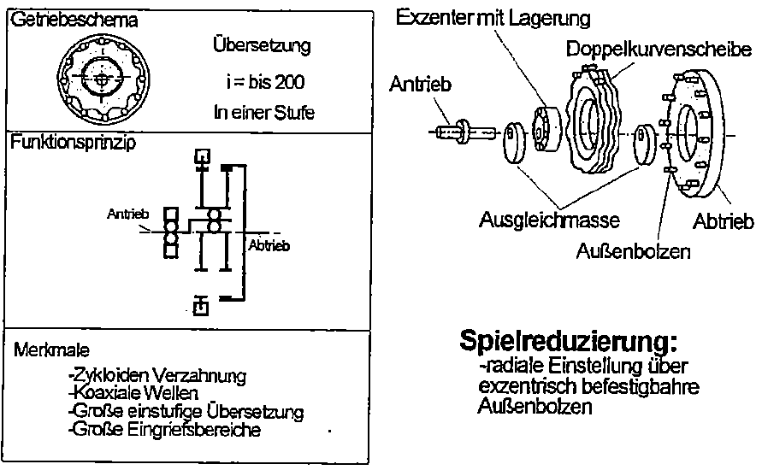

Dojen
transmission scheme
Exzenter with bearing
Translation
i = to 200
in one stage
Double cam disc
drive
functional principle
drive
drive
balancing mass
drive
outer bolts
Features:
- cycloidal gearing
- coaxial shafts
- Large one-step translation
- Large areas of intervention
Backlash reduction:
- radial adjustment through eccentric fastenable outer bolts

Slide 41
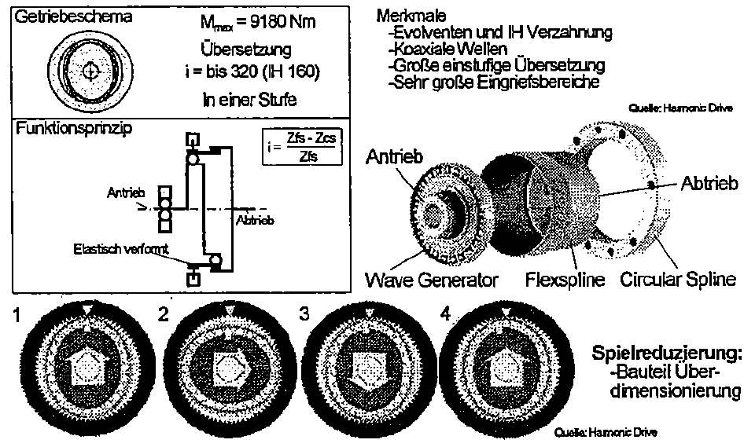

Harmonic-Drive
transmission scheme
Features:
- evolvent and IH gearing
- coaxial shafts
- Large one-step translation
- Large areas of intervention
Translation
i = to 320 (IH 160)
in one stage
functional principle
drive
drive
drive
drive
Backlash reduction:
- Backlash reduction over component sizing

Slide 42
Literature:
Paul E. Sandin: Robot Mechanisms and Mechanical Devices Illustrated, Chapter 1 Motor and Motion Control Systems, pp. 3-33; McGraw-Hill, 2003.

