Slide 1
METHODOLOGY

Slide 2
Leaf image is loaded and given as input
Analyze the image
The digital image is broken down into various subgroups called Image segments
Extract significant features from the image
Recognize and detect the disease

Slide 3
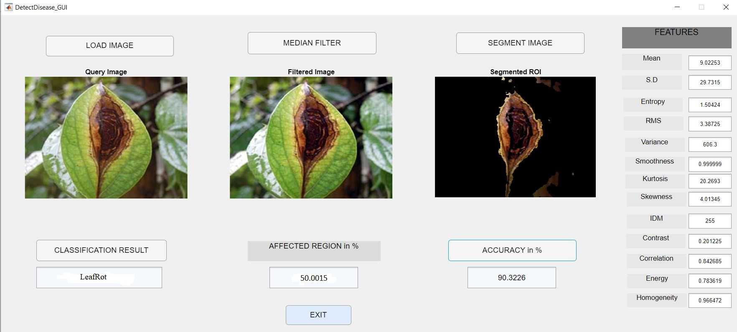

Slide 4
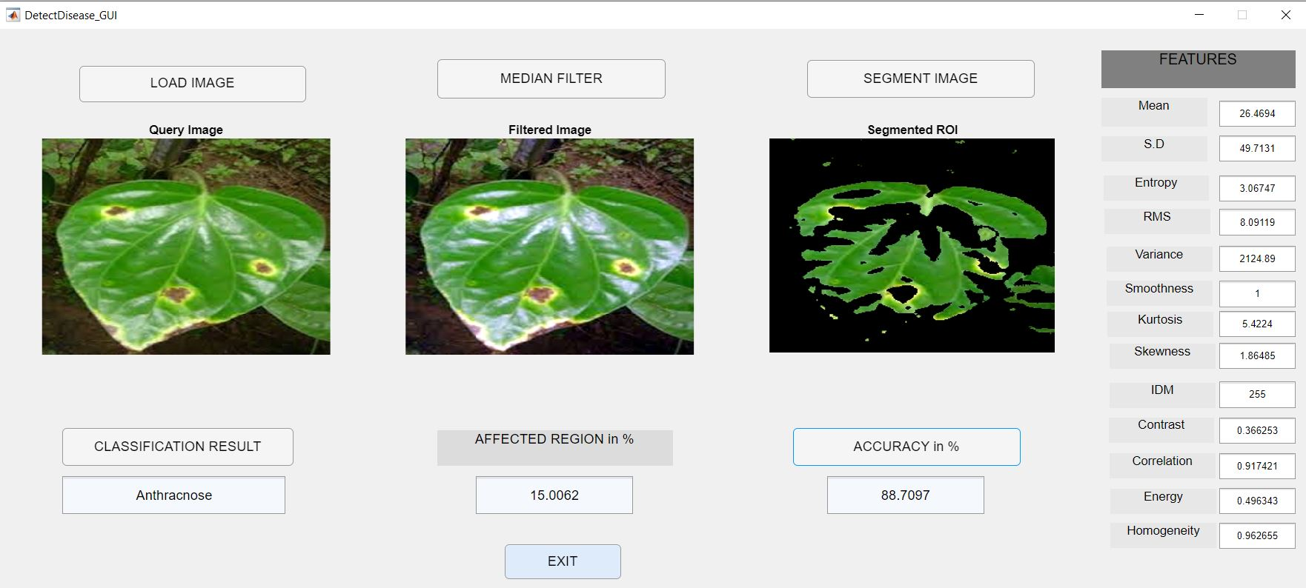
OUTPUT

Slide 5
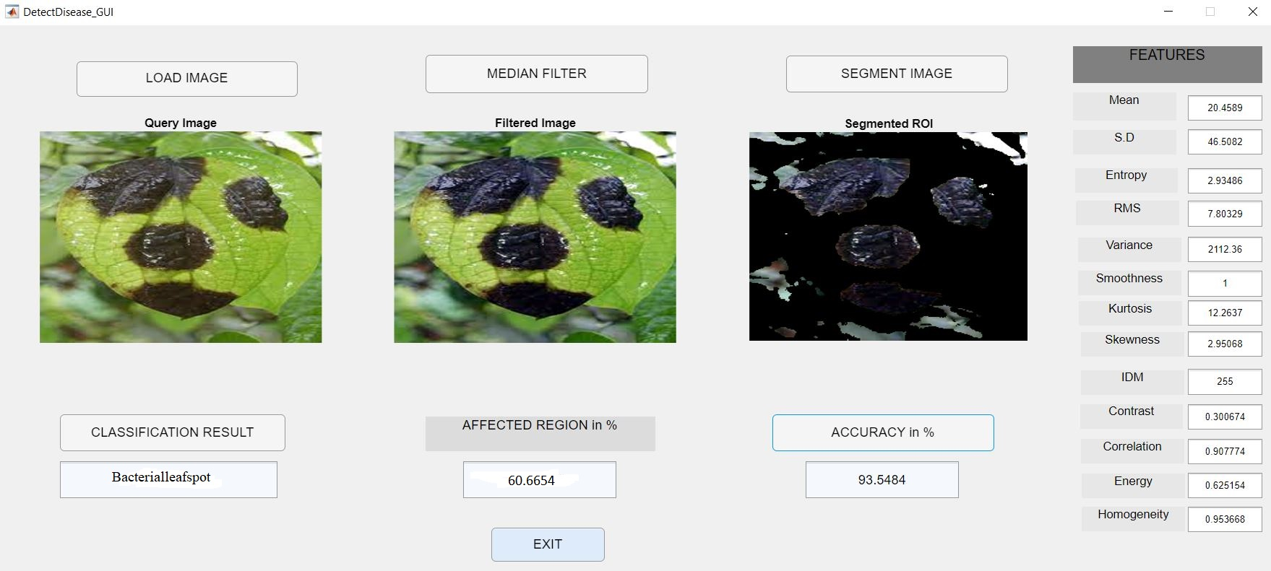

Slide 6
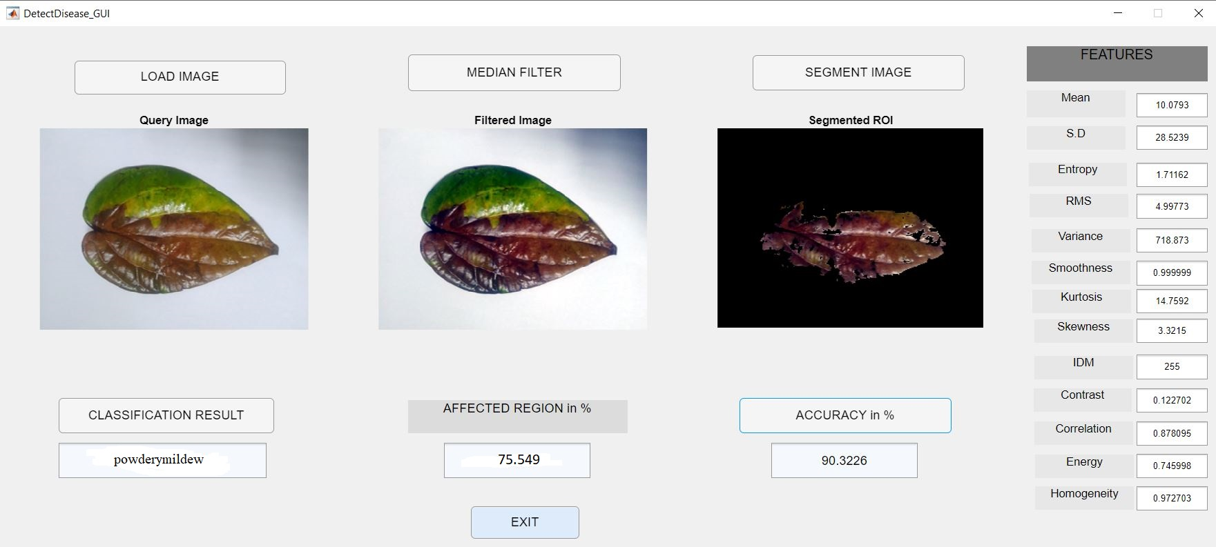

Slide 7
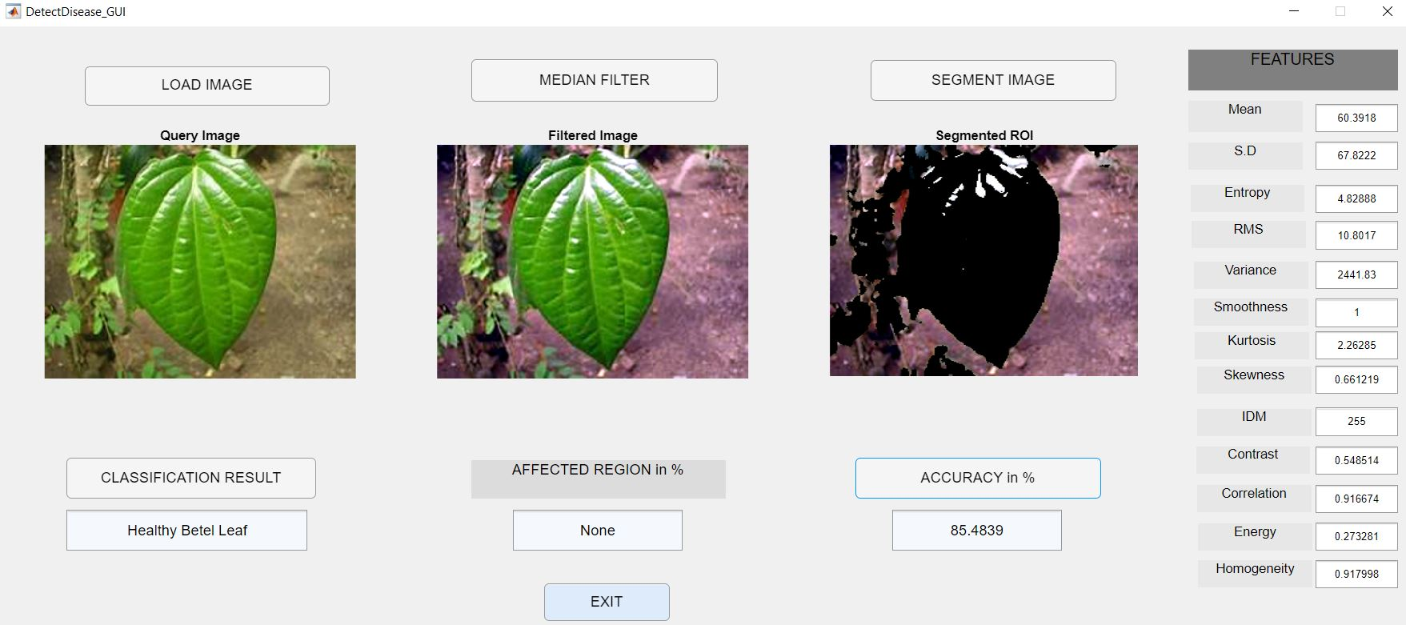

Slide 8
CONCLUSION
The world is looking forward towards the technology dependent generation.
We are always hearing news about the farmers who are using expensive fertilizers for controlling the various leaf diseases.
It will be a wastage if the fertilizers are used without identifying the diseases. Here we have proposed a system to identify disease in some leaves.
We used SVM classifier. We identified four diseases and they are Bacterial leaf spot, Anthracnose , Betel Leaf Rot and powdery mildew.
So,we can reduce the wastage of money and human effort.
Here we got the maximum accuracy of 80% to 96%. It can be improved by increasing the images for each disease.

Slide 9
FUTURE SCOPE
By using the proposed computerized method we can identify the diseases without failure.
So that we can reduce the usage of fertilizers by identifying the diseases and Increase the Yield.
We identified four diseases and they are Bacterial leaf spot, Anthracnose , Betel Leaf Rot and powdery mildew.
Further we can Detect several Diseases using different Algorithms.
The accuracy of the system can be increased by increasing the number of data base images.

