Slide 1
VLAN CREATION:
ESW1#show vlan-switch
VLAN Name Status Ports
---- ------------------------------- --------- -------------------------------
1 default active Fa1/0, Fa1/1, Fa1/2, Fa1/3
Fa1/4, Fa1/5, Fa1/6, Fa1/7
Fa1/8, Fa1/9, Fa1/10, Fa1/11
Fa1/12, Fa1/13, Fa1/14, Fa1/15
Fa2/0, Fa2/1, Fa2/2, Fa2/3
Fa2/4, Fa2/5, Fa2/6, Fa2/7
Fa2/8, Fa2/9, Fa2/10, Fa2/11
Fa2/12, Fa2/13, Fa2/14, Fa2/15
10 VLAN0010 active
11 VLAN0011 active
12 VLAN0012 active
13 VLAN0013 active

Slide 2
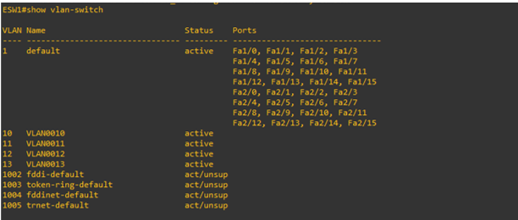
1002 fddi-default act/unsup
1003 token-ring-default act/unsup
1004 fddinet-default act/unsup
1005 trnet-default act/unsup
Console window of Ethernet Switch (ESW1)
ESW1(vlan)#vlan 10 VLAN 10 added:
Name: VLAN0010
ESW1(vlan)#vlan 11 VLAN 11 added:
Name: VLAN0011
ESW1(vlan)#vlan 12 VLAN 12 added:
Name: VLAN0012
ESW1(vlan)#vlan 13 VLAN 13 added:
Name: VLAN0013
ESW1(vlan)#exit APPLY completed.
Exiting....

Slide 3
VLAN 10 CONFIGURIATIONS:
ESW1#configure
Configuring from terminal, memory, or network [terminal]?
Enter configuration commands, one per line. End with CNTL/Z.
ESW1(config)#interface fastEthernet 1/0
ESW1(config-if)#swi
ESW1(config-if)#switchport mode acc
ESW1(config-if)#switchport mode access
ESW1(config-if)#swi
ESW1(config-if)#switchport access vlan 10
ESW1(config-if)#exi
ESW1(config)#interface fastEthernet 1/1
ESW1(config-if)#swi
ESW1(config-if)#switchport mode acc
ESW1(config-if)#switchport mode access
ESW1(config-if)#swi
ESW1(config-if)#switchport access vlan 10
ESW1(config-if)#exi
ESW1(config)#interface fastEthernet 1/2
ESW1(config-if)#swi
ESW1(config-if)#switchport mode acc
ESW1(config-if)#switchport mode access
ESW1(config-if)#swi
ESW1(config-if)#switchport access vlan 10
ESW1(config-if)#exi
ESW1(config)#interface fastEthernet 1/3

Slide 4
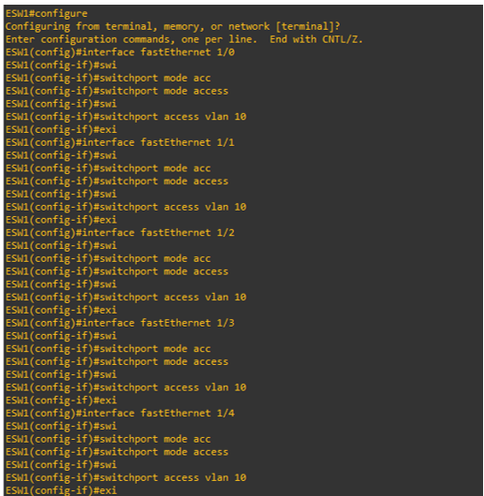
VLAN 10 CONFIGURIATIONS:
ESW1(config-if)#swi
ESW1(config-if)#switchport mode acc
ESW1(config-if)#switchport mode access
ESW1(config-if)#swi
ESW1(config-if)#switchport access vlan 10
ESW1(config-if)#exi
ESW1(config)#interface fastEthernet 1/4
ESW1(config-if)#swi
ESW1(config-if)#switchport mode acc
ESW1(config-if)#switchport mode access
ESW1(config-if)#swi
ESW1(config-if)#switchport access vlan 10
ESW1(config-if)#exi

Slide 5
VLAN 11 CONFIGURIATIONS:
ESW1(config)#interface fastEthernet 1/5
ESW1(config-if)#swi
ESW1(config-if)#switchport mode acc
ESW1(config-if)#switchport mode access
ESW1(config-if)#swi
ESW1(config-if)#switchport access vlan 11
ESW1(config-if)#exi
ESW1(config)#interface fastEthernet 1/6
ESW1(config-if)#swi
ESW1(config-if)#switchport mode acc
ESW1(config-if)#switchport mode access
ESW1(config-if)#swi
ESW1(config-if)#switchport access vlan 11
ESW1(config-if)#exi
ESW1(config)#interface fastEthernet 1/7
ESW1(config-if)#swi
ESW1(config-if)#switchport mode acc
ESW1(config-if)#switchport mode access
ESW1(config-if)#swi
ESW1(config-if)#switchport access vlan 11
ESW1(config-if)#exi
ESW1(config)#interface fastEthernet 1/8
ESW1(config-if)#swi

Slide 6
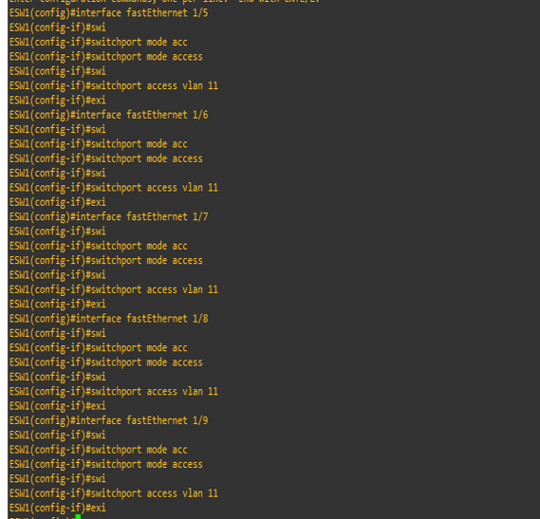
ESW1(config-if)#switchport mode acc
ESW1(config-if)#switchport mode access
ESW1(config-if)#swi
ESW1(config-if)#switchport access vlan 11
ESW1(config-if)#exi
ESW1(config)#interface fastEthernet 1/9
ESW1(config-if)#swi
ESW1(config-if)#switchport mode acc
ESW1(config-if)#switchport mode access
ESW1(config-if)#swi
ESW1(config-if)#switchport access vlan 11
ESW1(config-if)#exi
VLAN 11 CONFIGURATIONS:

Slide 7
VLAN 12 CONFIGURATIONS:
ESW1(config)#interface fastEthernet 1/10
ESW1(config-if)#swi
ESW1(config-if)#switchport mode acc
ESW1(config-if)#switchport mode access
ESW1(config-if)#swi
ESW1(config-if)#switchport access vlan 12
ESW1(config-if)#exi
ESW1(config)#interface fastEthernet 1/11
ESW1(config-if)#swi
ESW1(config-if)#switchport mode acc
ESW1(config-if)#switchport mode access
ESW1(config-if)#swi
ESW1(config-if)#switchport access vlan 12
ESW1(config-if)#exi
ESW1(config)#interface fastEthernet 1/12
ESW1(config-if)#swi
ESW1(config-if)#switchport mode acc
ESW1(config-if)#switchport mode access
ESW1(config-if)#swi
ESW1(config-if)#switchport access vlan 12
ESW1(config-if)#exi
ESW1(config)#interface fastEthernet 1/13
ESW1(config-if)#swi
ESW1(config-if)#switchport mode acc

Slide 8
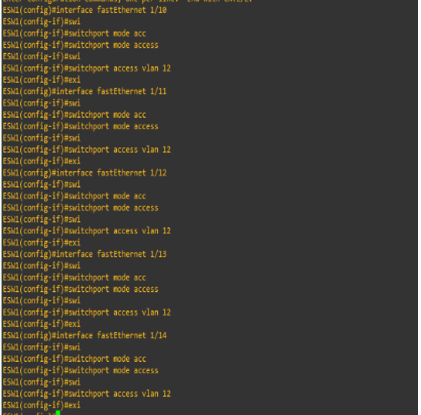
ESW1(config-if)#switchport mode access
ESW1(config-if)#swi
ESW1(config-if)#switchport access vlan 12
ESW1(config-if)#exi
ESW1(config)#interface fastEthernet 1/14
ESW1(config-if)#swi
ESW1(config-if)#switchport mode acc
ESW1(config-if)#switchport mode access
ESW1(config-if)#swi
ESW1(config-if)#switchport access vlan 12
ESW1(config-if)#exi
VLAN 12 CONFIGURATIONS

Slide 9
VLAN 13 CONFIGURATIONS:
ESW1(config)#interface fastEthernet 2/0
ESW1(config-if)#swi
ESW1(config-if)#switchport mode acc
ESW1(config-if)#switchport mode access
ESW1(config-if)#swi
ESW1(config-if)#switchport access vlan 13
ESW1(config-if)#exi
ESW1(config)#interface fastEthernet 2/1
ESW1(config-if)#swi
ESW1(config-if)#switchport mode acc
ESW1(config-if)#switchport mode access
ESW1(config-if)#swi
ESW1(config-if)#switchport access vlan 13
ESW1(config-if)#exi
ESW1(config)#interface fastEthernet 2/2
ESW1(config-if)#swi
ESW1(config-if)#switchport mode acc
ESW1(config-if)#switchport mode access
ESW1(config-if)#swi
ESW1(config-if)#switchport access vlan 13
ESW1(config-if)#exi
ESW1(config)#interface fastEthernet 2/3
ESW1(config-if)#swi
ESW1(config-if)#switchport mode acc

Slide 10
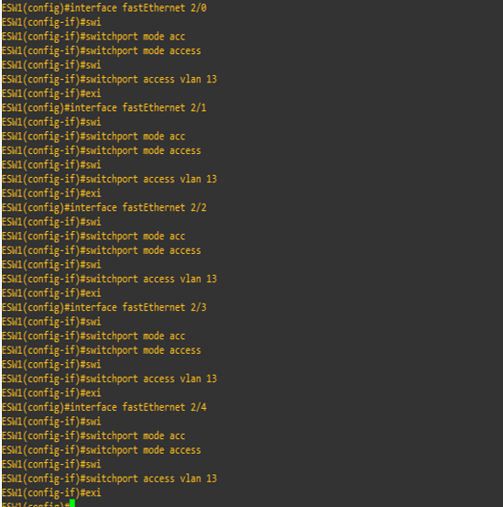
ESW1(config-if)#switchport mode access
ESW1(config-if)#swi
ESW1(config-if)#switchport access vlan 13
ESW1(config-if)#exi
ESW1(config)#interface fastEthernet 2/4
ESW1(config-if)#swi
ESW1(config-if)#switchport mode acc
ESW1(config-if)#switchport mode access
ESW1(config-if)#swi
ESW1(config-if)#switchport access vlan 13
ESW1(config-if)#exi
VLAN 13 CONFIGURATIONS

Slide 11
ESW1#show vlan-s
VLAN Name Status Ports
---- -------------------------------- --------- -------------------------------
1 default active Fa1/15, Fa2/5, Fa2/6, Fa2/7
Fa2/8, Fa2/9, Fa2/10, Fa2/11
Fa2/12, Fa2/13, Fa2/14, Fa2/15
10 VLAN0010 active Fa1/0, Fa1/1, Fa1/2, Fa1/3
Fa1/4
11 VLAN0011 active Fa1/5, Fa1/6, Fa1/7, Fa1/8
Fa1/9
12 VLAN0012 active Fa1/10, Fa1/11, Fa1/12, Fa1/13
Fa1/14
13 VLAN0013 active Fa2/0, Fa2/1, Fa2/2, Fa2/3
Fa2/4

Slide 12
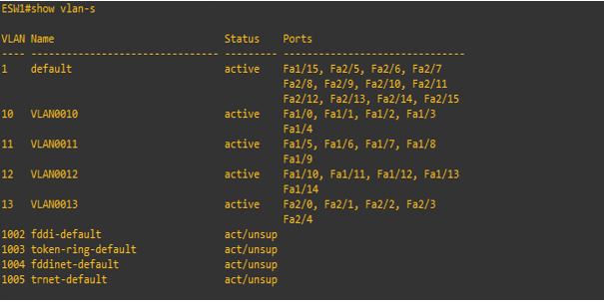
Console window of Ethernet Switch (ESW1) :- 2
1002 fddi-default act/unsup
1003 token-ring-default act/unsup
1004 fddinet-default act/unsup
1005 trnet-default act/unsup
The figure shows that the PCs 1,2,3,4,5 are
assigned to VLAN 10 .
The PCS 6,7,8,9,10 are assigned to VLAN 11 &
The PCS 11,12,13,14,15 are assigned to VLAN 12 &
The PCS 16,17,18,19,20 are assigned to VLAN 13

Slide 13
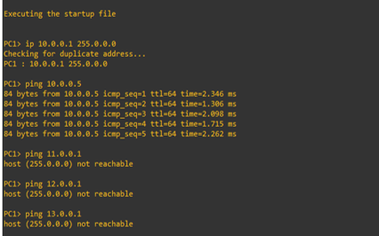
Output Analysis:
System Communication Visual-1.
Here we are able to send message to PC1 whose ip address is 10.0.0.1 to PC5 whose ip address is 10.0.0.5 , which is within the network as VLAN 10. But when we try to send the message to PC6 , it’s showing host not reachable since PC6 belongs to different Network VLAN 11. Similarly when we try to send the message to PC11 & PC16 , it’s showing host not reachable since they belongs to different Network VLAN 12 & VLAN 13 respectively

Slide 14
From the above Visual we can see that the data can be shared only with the PC’s which are in same VLAN.
For Example:
Let us consider that the VLAN 10 belongs to Bank A.
Here let PC1, PC2 Belongs to the head office (Main Branch) whereas PC3 & PC4 & PC5 belong to the Subordinate branches. The Data’s of the bank can be Shared & Accessed by its Main and Subordinate branches as they are in the Vlan. Since they belong to the same Vlan the data’s can be shared among them. Here the Vlan Provides additional Safety and Security for the data of the bank where no other third party members (Hackers) can Steal or Access the data (Unauthorized Access is not possible).This the Aim of the project.

Slide 15
From above output analysis we can observe that:
When the ping command is executed we can see that the first thing is the server’s host name. This will confirm you have an active connection to the server. Next are the number of bytes being sent to the server. The next four lines indicate the response time from the server. You’ll see how many bytes of data were sent back, as well as how many milliseconds the response took to return. TTL means “time to live.” This information shows you the total routers the packet will travel through before stopping.
Ping is a computer network administration utility used to test the reachability of a host on an
Internet Protocol (IP) network and to measure the round-trip time for messages sent from the
originating host to a destination computer
Analysis from System Communication Visual 1:
Cmd: ping 10.0.0.5
Success looks like a standard ping response, failure yields the message "Packet needs to be fragmented but DF set."

Slide 16
Ping statistics for 10.0.0.5:
Firstly, it tells us that 84 bytes were sent and that 84 bytes were received. And if we look at this, the 84 bytes that were sent was the echo request and the 84 bytes received was the echo reply. The second thing it tells us is that you've got a reply from the client or from the device being pinged.
Packets: Sent – 5 , Received – 5 , Lost – 0 <0% loss>
Approximate round trip time in milli seconds:
Minimum – 1.306 ms , Maximum – 2.346 , Average – 2.2 ms
The ping command shows that the minimum RTT is 1.306 ms , means that the minimum time required for the
packet to travel from this user to the destination network
device 10.0.0.5 and back again is 1.306 ms and the maximum time required for the packet to travel from this user
to the destination network device 10.0.0.5 and back again is 2.346 ms.
So, the average time required for the packet to travel from this user to the destination network device 10.0.0.5 and
back again is 2.2 ms.

Slide 17
Sequence Number:
The sequence number is called the ICMP sequence and that number increments for every PING that's received, that number increments and you will get consecutive numbers.
TTL:
The next field is the TTL (Time To Live), and that would be set to something like 255. Every packet on the network has a time to circulate, once the time expires the packet evaporates from the network.
Time:
The last field in the report is the time, and this is the response time to send the packet to the workstation, and receive the reply.
This will show us how fast the network is and the time will often be in milliseconds (can move to seconds if the network is slow).
Round Trip Time (RTT);
Round Trip Time (RTT) is the length time it takes for a data packet to be sent to a destination plus the time it takes for an acknowledgment of that packet to be received back at the origin.

Slide 18
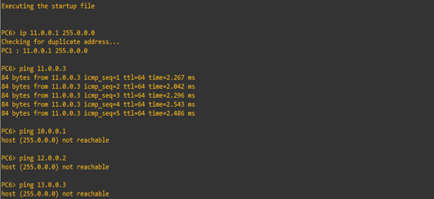
System Communication Visual-2.
Here we are able to send message to PC6 whose ip address is 11.0.0.1 to PC8 whose ip address is 11.0.0.3 , which is within the network as VLAN 11. But when we try to send the message to PC1 , it’s showing host not reachable since PC1 belongs to different Network VLAN 10. Similarly when we try to send the message to PC12 & PC18 , it’s showing host not reachable since they belongs to different Network VLAN 12 & VLAN 13 respectively.

Slide 19
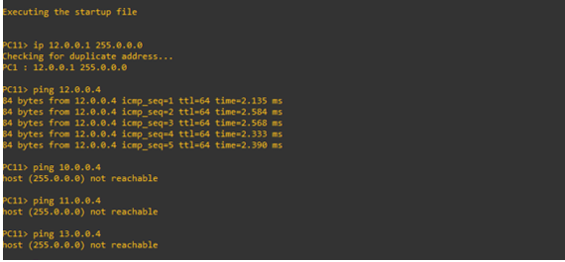
System Communication Visual-3.
Here we are able to send message to PC11 whose ip address is 12.0.0.1 to PC14 whose ip address is 12.0.0.4 , which is within the network as VLAN 12. But when we try to send the message to PC4 , it’s showing host not reachable since PC4 belongs to different Network VLAN 10. Similarly when we try to send the message to PC9 & PC19 , it’s showing host not reachable since they belongs to different Network VLAN 11 & VLAN 13 respectively.

Slide 20
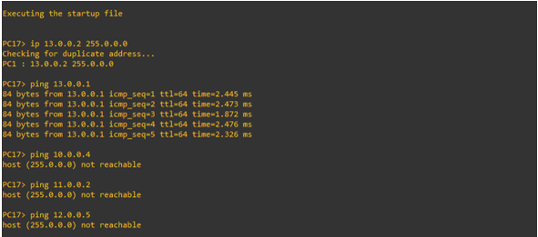
System Communication Visual-4
Here we are able to send message to PC17 whose ip address is 13.0.0.2 to PC16 whose ip address is 13.0.0.1 , which is within the network as VLAN 12. But when we try to send the message to PC4 , it’s showing host not reachable since PC4 belongs to different Network VLAN 10. Similarly when we try to send the message to PC7 & PC15 , it’s showing host not reachable since they belongs to different Network VLAN 11 & VLAN 12 respectively.

Slide 21
CONCLUSION:
We can observe that the data packets are transferred only the intended devices because we created VLAN in the switches. Thus we reduced the traffic load in the network because data will not be shared through the entire network. Since data is not shared through the whole network, we are providing additional security to the data in the network.
VLAN allows different computers and devices to be connected virtually to each other as if they were in a LAN sharing a single broadcast domain.VLAN is helpful for organizational use mainly because it can be used to segment a larger network into smaller segments.VLANs can limit user access to to a certain VLAN, which then allows only authorized users to have access to networks with highly sensitive information.VLANs can help reduce IT cost, improve network security and performance, provide easier management, as well as ensuring network flexibility.
LIMITATIONS AND FUTURE SCOPE : Static routing is implemented in this project which means that the administrator has to configure the network manually and the path between two routers cannot be updated automatically. This might become a burden to the network admin when the size of the network increases. I feel that the future direction can be the implementation of Dynamic routing in which the routing paths between the routers are updated automatically.

