Slide 1

TeachMate: AI-Powered Role-Based LMS
An intelligent ecosystem designed for technical & vocational excellence.
Vivek Kumar B.Tech (CSE)
Prince Tomer B.Tech (CSE)
Galgotias University, Greater Noida, India
01

Slide 2






Addressing Educational Gaps
Static Frameworks
Individual Velocity
Transitioning from basic content libraries to active, role-based personalization.
Adapting curriculum delivery to match diverse learning speeds and strategies.
Immediate Intervention
Predictive Insights
Converting platform interactions into models for student success forecasting.
Utilizing NLP and real-time alerts to provide support exactly when needed.
02

Slide 3

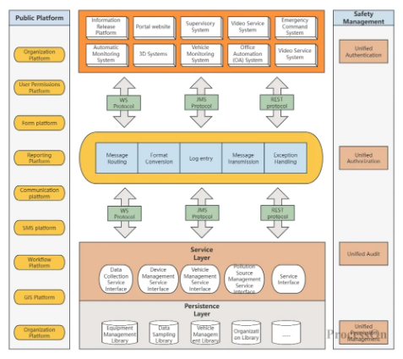
Intelligent System Architecture
Modular Functional Design
•
Role-Based Access: Specific optimized interfaces for Students, Teachers, and Administrators.
•
Adaptive Engine: ML models mapping learning paths based on performance patterns.
•
Automated Assistance: Integrated NLP chatbots for query resolution.
•
Learning Analytics: Real-time processing of activity data.
03

Slide 4


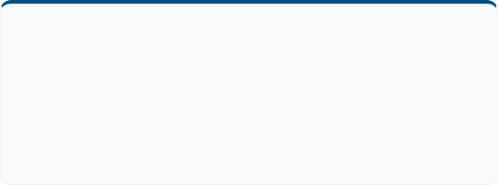
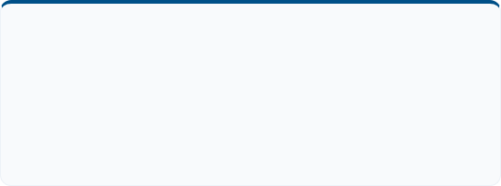
Core Modules & Capabilities
Course Management
Smart Assessment
Allows instructors to seamlessly upload multimedia resources and define prerequisite structures for automated, sequential learning.
Features auto-grading for quizzes and automated plagiarism detection, reducing manual evaluation time for educators.
Interactive AI Chatbot
Analytics Dashboard
An integrated NLP assistant available 24/7 to clarify course material and guide users through platform functionalities.
Provides faculty with visualized data on progress, engagement rates, and predictive risk factors for early intervention.
04

Slide 5







The TeachMate Learning Experience
Harnessing AI to create a seamless, high-performance pedagogical environment.
Cognitive Pacing
NLP Support
Visual Insights
Role Security
AI adjusts material difficulty and delivery based on real-time comprehension levels.
Natural language interactions for instant academic guidance and platform support.
Interactive progress maps for tracking complex technical skill acquisition over time.
Encrypted, context-aware environments tailored for specific academic roles.
Empowering learners and educators through adaptive, data-driven intelligence.
05

Slide 6

Conclusion & Future Scope
Project Summary
Future Directions
TeachMate bridges the gap in digital education by combining Adaptive Intelligence with Role-Based Access Control.
•
Integration of Deep Learning for behavioral prediction.
•
Implementation of Multilingual NLP for global accessibility.
•
Enhances student engagement through personalized content delivery.
•
Exploring VR/AR & Blockchain for immersive learning.
•
Reduces instructor workload via automated grading and prediction.
•
Expanding API integrations with academic libraries.
•
Ensures secure and intelligent decision-making for administrators.
06

Slide 7

Thank You!
Questions and feedback are welcome.
CONTACT INFORMATION
vk6918100@gmail.com | tomerprince188@gmail.com
07

