Slide 1

School of Computer Science And Engineering Department of Computer Science And Engineering
Minor Project Presentation-I
on
Title: Anomalous Human Activity Detection
Presented By:
Student Name : Sumit Kumar & Vaibhav Kr Goel
Enrollment: 219301597 & 219301152
Section:- I
Group No: 1
Supervised By:
Supervisor Name : Dr. Sandeep Chaurasia
Designation: Director, School of Computer Science & Engineering

Slide 2
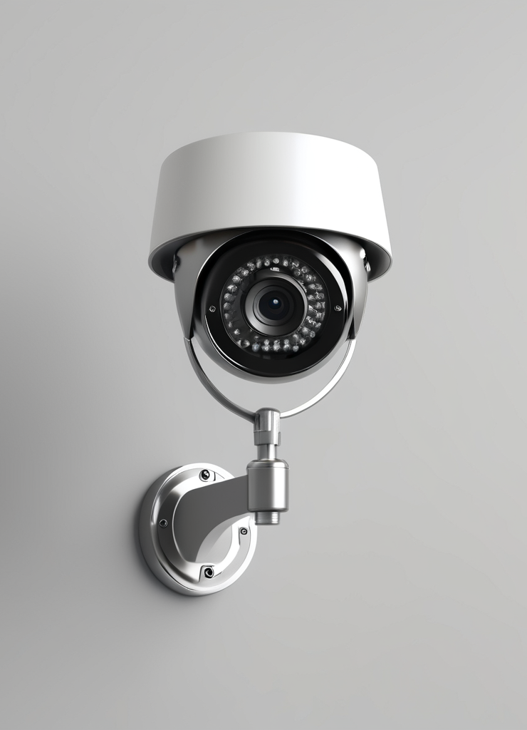
Anomalous Human Activity Detection

Slide 3
Agenda/ contents
Introduction
Problem Statements
Requirements Engineering
Design/ Development
Result
Implementation, Testing, Limitations, and Future Enhancements
Testing
Requirements
Deployment and Monitoring
Outcome
Conclusion
References

Slide 4
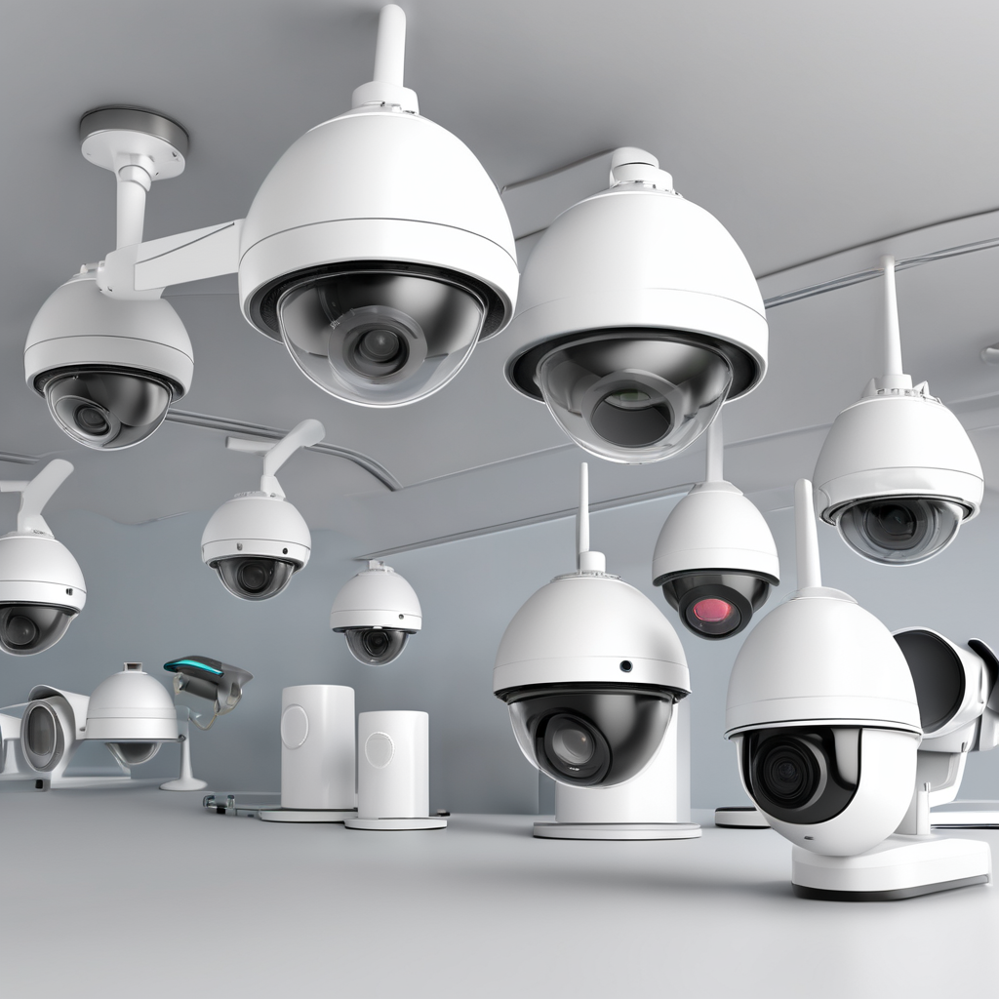
Introduction
The Anomalous Human Activity Detection(AHAD) project aims to tackle anti-social activities using artificial intelligence and computer vision algorithms.
With the escalating concern over anti-social activities, there is a growing need for Anomalous Human Activity Detection(AHAD).
By leveraging artificial intelligence and computer vision algorithms, we can enhance the effectiveness and efficiency of security monitoring.
Notes:
Introduction: The Anomalous Human Activity Detection (AHAD) project addresses rising concerns about anti-social activities using AI and computer vision. Leveraging these technologies improves security monitoring's effectiveness and efficiency

Slide 5

Problem Statement
The increasing prevalence of anti-social activities has become a major concern in today's society. Manual surveillance methods have several limitations, including the inability to detect abnormal events in real-time and the reliance on human operators to monitor large areas.
To address these challenges, there is a need for an intelligent surveillance system that can provide timely detection of abnormal events and enhance security measures.

Slide 6

Requirements Engineering
Hardware and Software Requirements
Functional and Non-Functional Requirements
Importance of Usability, Performance, and Reliability
The Anomalous Human Activity Detection (AHAD) project requires Intel Core i3 processor or equivalent, NVIDIA GeForce GTX 1050 GPU, 500GB HDD/SSD storage, 8GB RAM, Python 3.11+, PyTorch 1.7+, and OpenCV.
In addition to hardware and software requirements, the project also requires to detect abnormal activities in surveillance footage and provide timely alerts to operators for intervention.
The system should ensure ease of use, rapid processing, and high reliability, achieving high accuracy in abnormality detection within a fixed processing rate.

Slide 7
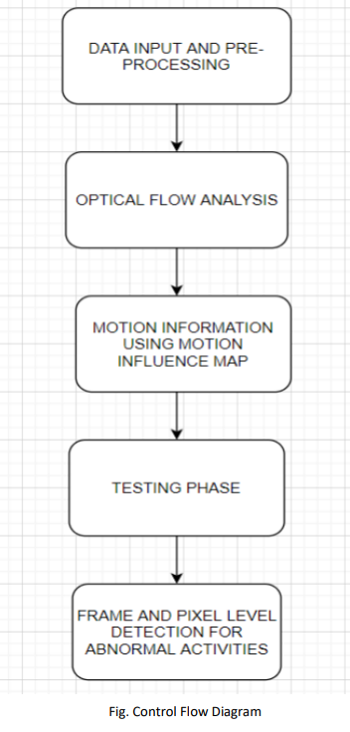
Design/ Development
Future Enhancements and Limitations
The Anomalous Human Activity Detection(AHAD) project has the potential for future enhancements and limitations. Integration with other systems, such as alarm systems. This would allow for a more comprehensive security solution and improve overall efficiency.
However, In extreme weather conditions or low-light environments, the system may not perform as well as expected.

Slide 8
Implementation and Working
Data Input and Pre processing
Optical Flow Analysis:
Motion Information Using Motion Influence Map:
Feature Extraction and CLUSTERING:
Convert video frames from RGB to grayscale. Simplify processing by focusing on intensity instead of color. Prepare frames for further analysis.
Determine pixel movement between frames. Calculate motion direction and magnitude. Divide frames into blocks for analysis.
Consider factors affecting pedestrian movement. Determine blocks influenced by movement direction and speed. Extract features from consecutive frames.
Create non-overlapping mega blocks. Sum motion influence values within each block. Extract feature vectors from mega blocks. Cluster mega blocks based on spatio-temporal features. Set cluster centers as code words to model patterns of normal activities for analysis.

Slide 9
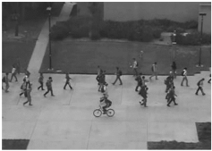
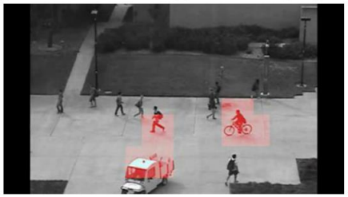
Result:
The system detects an abnormal activity where a vehicle is present in a pedestrian walking area, posing a potential safety risk. Such events trigger alerts for timely intervention, ensuring public safety and security by preventing accidents or unauthorized vehicle access in pedestrian zones.

Slide 10
Implementation, Testing, Limitations, and Future Enhancements
Regular maintenance and updates are essential.
Conduct testing to identify vulnerabilities.
The system may have limitations in extreme weather conditions and low-light environments.
False positives and false negatives may occur.
Possibility of integrating the system with IoT devices.
Investigate the algorithms to improve accuracy and reduce false positives.
May include facial recognition technology for enhanced identification capabilities.

Slide 11
Testing
Completeness: | Conciseness: | Portability: | Testability: | Usability: | Reliability:
Verifying that the system processes entire video for abnormalities detection, marking each abnormal frame. | Checking for any redundant processing that may impact efficiency. | Testing the system’s ability to detect abnormalities in videos captured by different CCTV cameras with varying resolution | Developing test cases to evaluate system’s performance in detecting abnormalities under various scenarios. | Assessing the user interface for ease of understanding and navigation during abnormality detection. | Conductive extensive testing with diverse datasets to validate the system’s reliability in accurately detecting abnormalities

Slide 12
Testing
Efficiency: | Security:
Measuring the system’s efficiency in processing video frames and detecting abnormalities within a reasonable timeframe, Optimizing resource allocation | Ensuring that the marking of abnormal frames doesn’t compromise security and integrity of the surveillance system.

Slide 13
Requirements
Hardware Requirements:
Ensuring that the hardware meets the specified requirements for processing video data and generating alerts.
Software Requirements:
Installing the necessary software components for abnormality detection, including Puthon, PyTorch, OpenCV, and visualization libraries.

Slide 14
Deployment and monitoring
Deploying the system in production environments and integrating it with existing surveillance infrastructure.
Monitoring the system’s performance and alert generation process to ensure timely intervention in case of abnormalities.

Slide 15
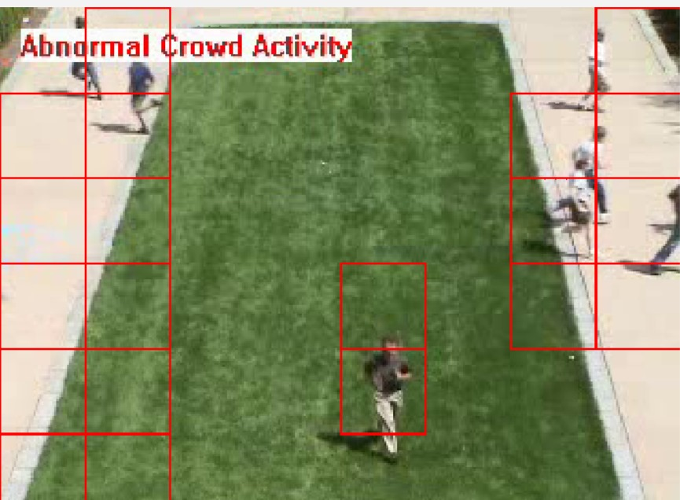
Outcome
The final outcome of our project is the successful detection of anomalous human activity.
It functions effectively, particularly in crowded environments.
When it detects any anomalous human activity, it will generate a alert on the screen.

Slide 16

Conclusion
. Utilizes motion influence maps for abnormal event detection.
Enhances surveillance systems through automation.
Enables quick identification and intervention for anomalies.
Significantly improves public safety and security.
Promises greater effectiveness and applicability in diverse scenarios through continued advancements

Slide 17
references
Attard, L., & Farrugia, R. A. (2011, April). Vision based surveillance system. In 2011 IEEE EUROCON-International Conference on Computer as a Tool (pp. 1-4). IEEE.
Khan, K., Albattah, W., Khan, R. U., Qamar, A. M., & Nayab, D. (2020). Advances and trends in real time visual crowd analysis. Sensors, 20(18), 5073.
Gnouma, M., Ejbali, R., & Zaied, M. (2018). Abnormal events’ detection in crowded scenes. Multimedia Tools and Applications, 77(19), 24843-24864.
Rodriguez, M. D., & Shah, M. (2007, September). Detecting and segmenting humans in crowded scenes. In Proceedings of the 15th ACM international conference on Multimedia (pp. 353-356).
Sultani, W., Chen, C., & Shah, M. (2018). Real-world anomaly detection in surveillance videos. In Proceedings of the IEEE Conference on Computer Vision and Pattern Recognition (pp. 6479-6488).
Lee, D. G., Suk, H. I., Park, S. K., & Lee, S. W. (2015). Motion influence map for unusual human activity detection and localization in crowded scenes. IEEE Transactions on Circuits and Systems for

Slide 18
Thank You

