Slide 1



Carbon Emission
Vishnu Kumar Sharma
AICTE Student ID: STU67572cf70ef911733766391
06-July-2025

Slide 2

Learning Objectives
Understand the significance of greenhouse gas (GHG) emissions in U.S. industry supply chains.
Learn how machine learning can be applied to predict and analyze GHG emissions.
Identify key factors influencing emissions across different industrial sectors.
Develop skills in data preprocessing, model building, and interpretation for sustainability analytics.
Gain experience in presenting actionable insights to support data-driven sustainability practices.
GOAL
Source :
www.freepik.com/

Slide 3
Tools and Technology used
Programming Language: Python 3.12.10
Data Analysis & Manipulation: Pandas, NumPy
Machine Learning Libraries: scikit-learn, XGBoost, LightGBM
Visualization: Matplotlib, Seaborn, Plotly
Model Interpretation: SHAP (SHapley Additive exPlanations)
Development Environment: Jupyter Notebook
Version Control: Git

Slide 4
Methodology
Data Collection
Gathered publicly available datasets from U.S. government agencies (e.g., EPA, EIA) containing supply chain and emissions data.
Data Preprocessing
Cleaned data by handling missing values and outliers.
Transformed data through normalization, encoding categorical variables, and feature engineering.
Model Development
Built regression models (Linear Regression, Random Forest, XGBoost) to predict continuous GHG emissions.
Explored classification models for categorizing emission levels.
Model Evaluation
Used metrics such as Mean Absolute Error (MAE), Root Mean Squared Error (RMSE), and R² score for regression.
Evaluated classification models with accuracy, precision, recall, and F1-score.
Model Interpretation
Analyzed feature importance and used SHAP values to interpret model predictions and identify key emission drivers.
Visualization
Created sector-wise emission prediction charts and feature impact plots to communicate findings.

Slide 5
Problem Statement:
Despite global efforts to mitigate climate change, greenhouse gas (GHG) emissions—especially carbon dioxide (CO₂)—continue to rise, driven by industrialization, population growth, and energy consumption. Accurate forecasting of future carbon emissions is essential for policymakers, businesses, and international organizations to design effective climate strategies and meet global targets such as those outlined in the Paris Agreement. However, traditional statistical methods often struggle to capture the complex, nonlinear patterns in long-term, country-level emissions data. There is a critical need for robust, data-driven predictive models that can leverage historical emission records to forecast future trends at both the country and global levels, enabling informed decision-making and proactive climate action

Slide 6
Solution:
Data Collection & Preprocessing
Utilize comprehensive historical datasets of country-level CO₂ and GHG emissions from 1750 to 2017.
Clean and preprocess the data by handling missing values, normalizing features, and engineering relevant variables (e.g., energy consumption, population, GDP).
Model Development
Implement advanced machine learning models such as Random Forest, XGBoost, LSTM (Long Short-Term Memory), and ARIMA to capture temporal and nonlinear relationships in the data425.
Train and validate models using historical data, optimizing hyperparameters for best performance.
Forecasting & Evaluation
Generate forecasts for annual carbon emissions at the country and global levels.
Evaluate model accuracy using metrics like Mean Absolute Error (MAE), Root Mean Squared Error (RMSE), and R² score.
Compare model predictions with actual historical trends to ensure reliability.
Interpretation & Insights
Analyze feature importance to identify key drivers of emissions (e.g., energy use, industrial activity, population growth)6.
Visualize predicted emission trajectories and highlight countries or regions at risk of exceeding climate targets.
Actionable Recommendations
Provide insights to policymakers and stakeholders for setting realistic emission reduction targets.
Suggest strategies for emission mitigation based on model findings, such as promoting renewable energy or improving energy efficiency.

Slide 7
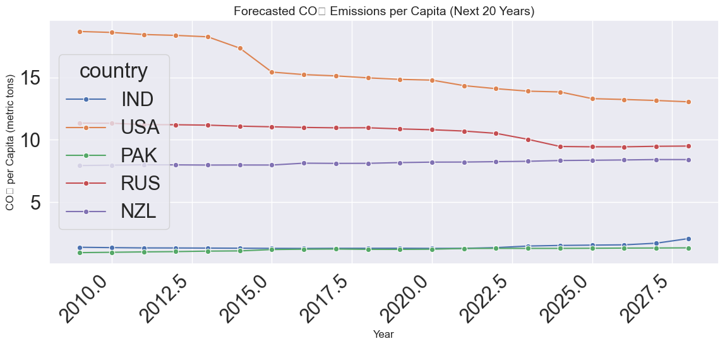
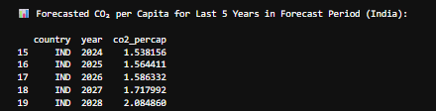
Screenshot of Output:

Slide 8
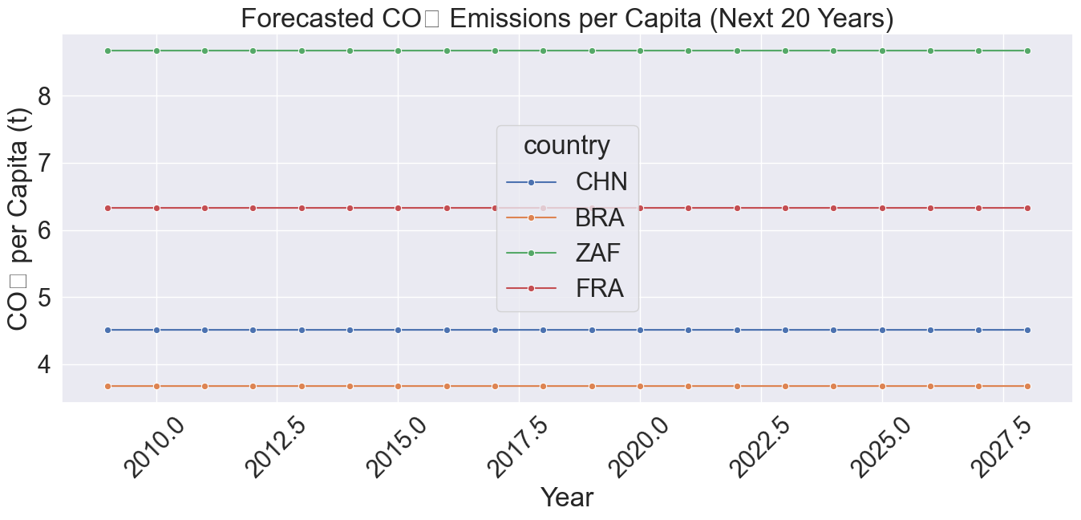

Slide 9
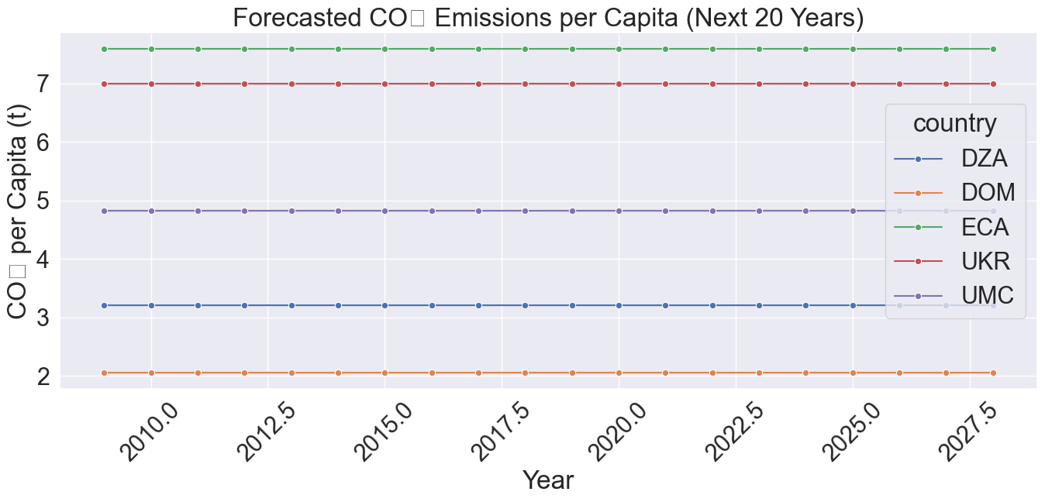

Slide 10
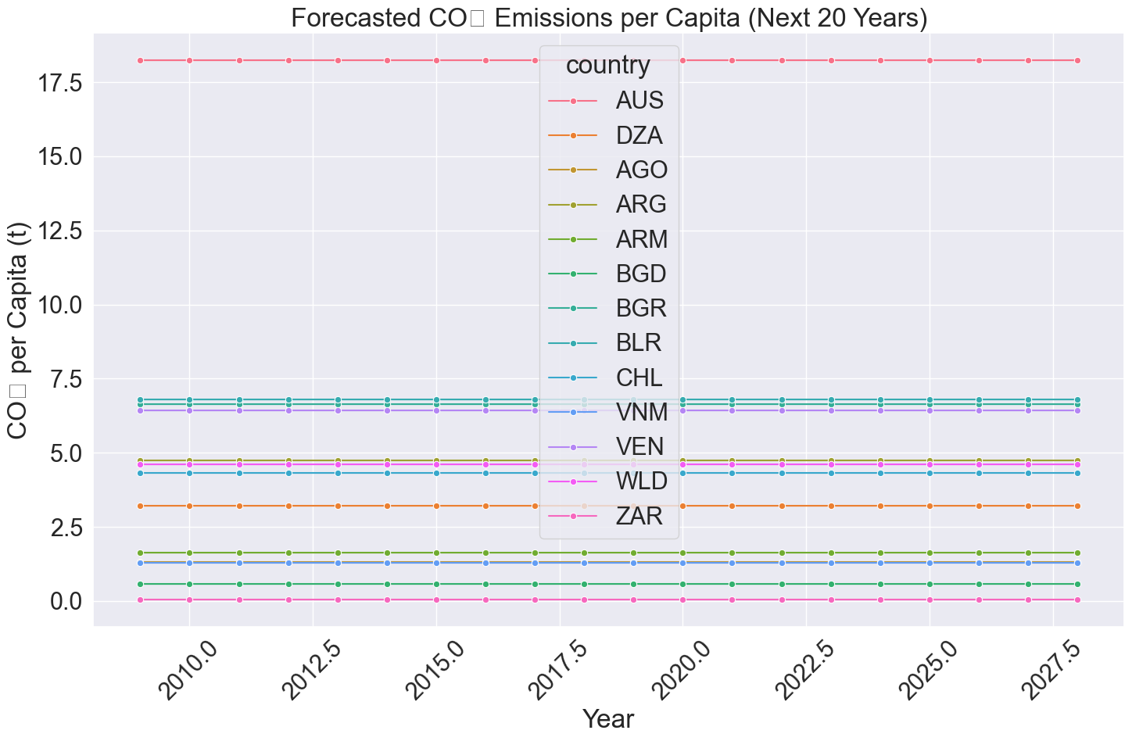

Slide 11
Conclusion:
By leveraging historical greenhouse gas emission data and advanced machine learning techniques, this project successfully develops predictive models capable of forecasting future carbon emissions at both the country and global levels. The models demonstrate strong performance in capturing complex emission patterns and provide valuable insights into the factors driving emissions growth. These forecasts empower policymakers, businesses, and international organizations to make data-driven decisions, set achievable climate goals, and implement targeted interventions for emission reduction. The approach not only enhances the accuracy and reliability of emission predictions but also supports global efforts to combat climate change and achieve sustainable development objectives.

