Slide 1
SOLID
five design principles intended to make software designs more understandable, flexible and maintainable

Slide 2
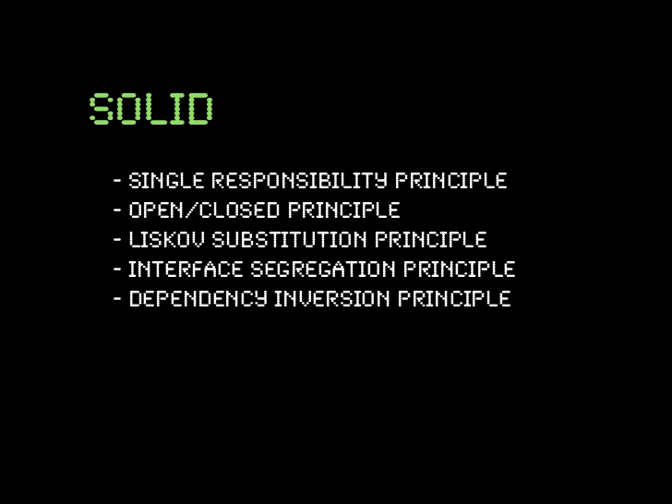

Slide 3
Single-responsibility Principle
A class should have one and only one reason to change, meaning that a class should have only one job.
Function S.R.P – do only one thing, but do it perfectly.
Classes S.R.P. – Every module or class should have responsibility over a single part of the functionality provided by the software, and that responsibility should be entirely encapsulated by the class.
S.R.P makes tests easy to write
Too much responsibility leads to coupling.

Slide 4
Open / closed
Software entities (classes, modules, functions, etc.) should be open for extension, but closed for modification.”
Add new functionality without changing existing code
A class is closed, since it may be compiled, stored in a library, baselined, and used by client classes. But it is also open, since any new class may use it as parent, adding new features. When a descendant class is defined, there is no need to change the original or to disturb its clients.
Polymorphic Open/Closed Principle uses interfaces instead of superclasses to allow different implementations which you can easily substitute without changing the code that uses them
Prefer inheritance over composition

Slide 5
Liskov Substitution
objects of a superclass shall be replaceable with objects of its subclasses without breaking the application
It means that overridden method of a subclass should have the same semantic (arguments and return value)
The compiler only checks the structural rules, to check that behavior of subclass is similar and this does not break the application we need to make code review and write tests for all subclasses.
In the whole, Liskov Substitution principle extends the Open/Closed principle and enables you to replace objects of a parent class with objects of a subclass without breaking the application.

Slide 6
Interface Segregation
Clients should not be forced to depend upon interfaces that they do not use.
interface pollution leads to bloated interfaces that contain methods implementing several responsibilities.
Solution is to split the software into multiple, independent parts
Many small interfaces are better than one big.

Slide 7
Dependency Inversion
High-level modules should not depend on low-level modules. Both should depend on abstractions.
high-level and low-level modules depend on the abstraction
If you consequently apply the Open/Closed Principle and the Liskov Substitution Principle to your code, it will also follow the Dependency Inversion Principle.

