Slide 1
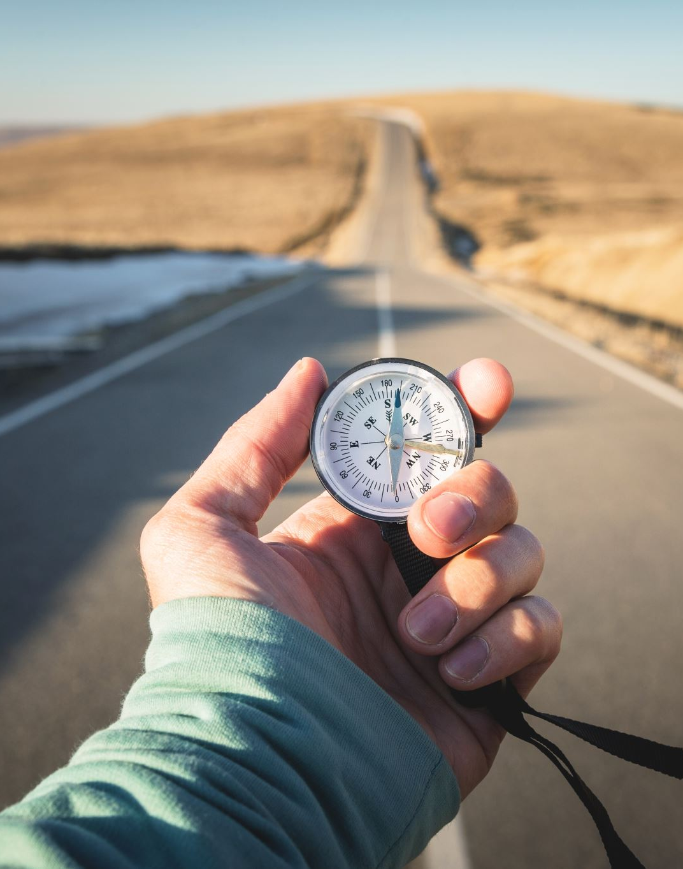
Sustainability in Navigation
How our daily travels can be optimised for Carbon emissions

Slide 2

Navigation in the modern world
Modern systems that rely on navigational software but not limited to:
Shipping (and delivery) Industry
Example: Weather routing
Traffic management
Day to day travel
Emergency services

Slide 3
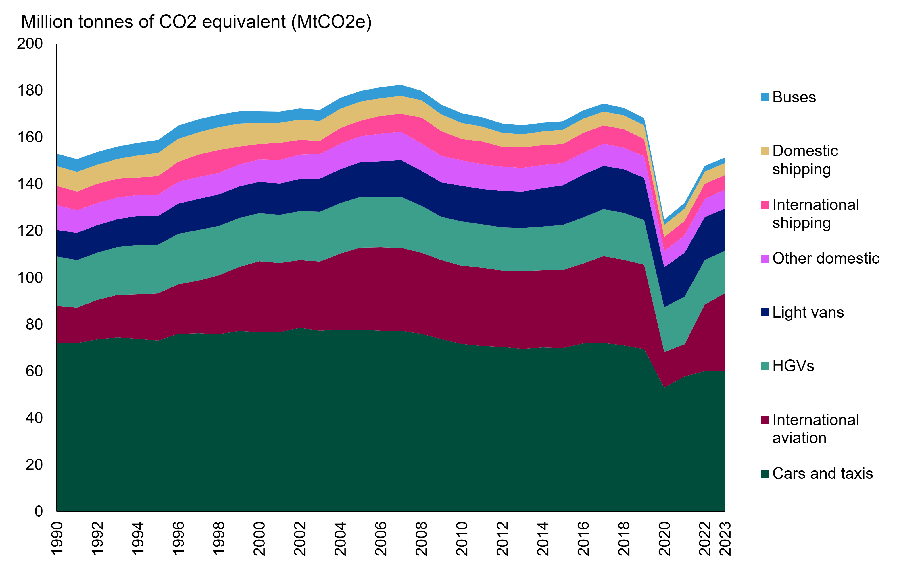
Travel and CO2
Travel contributes to about 22% of global energy related CO2 emissions.
Roughly 75% of these is from road related transportation, 89% in the UK [Gov.UK reference].
Transport related CO2 output can be significantly reduced if road-based travel is optimised.

Slide 4
Saving by simply being better
A start to this would be an improvement to our driving routes.
Google maps already saves an estimate of 10% - 30% energy on a trip.
DO consider the computational cost of such calculations, although it is extremely efficient.

Slide 5
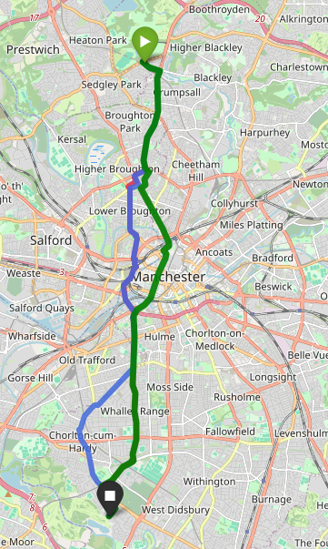
Personal Model example
The main example is a drive from North to South of Manchester.
Specifically, from Heaton part to Chorlton water park

Slide 6
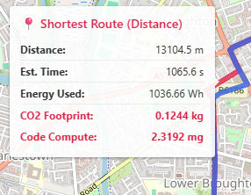
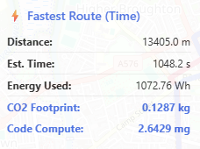
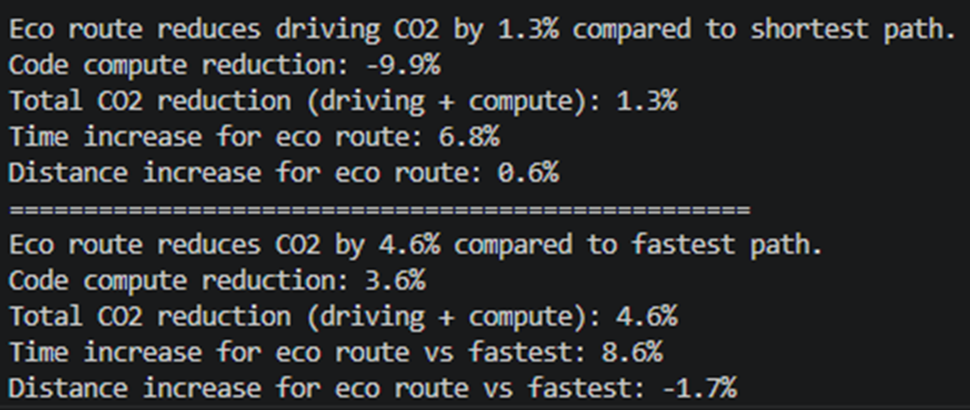
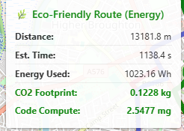
Model profiling and evaluation

Slide 7
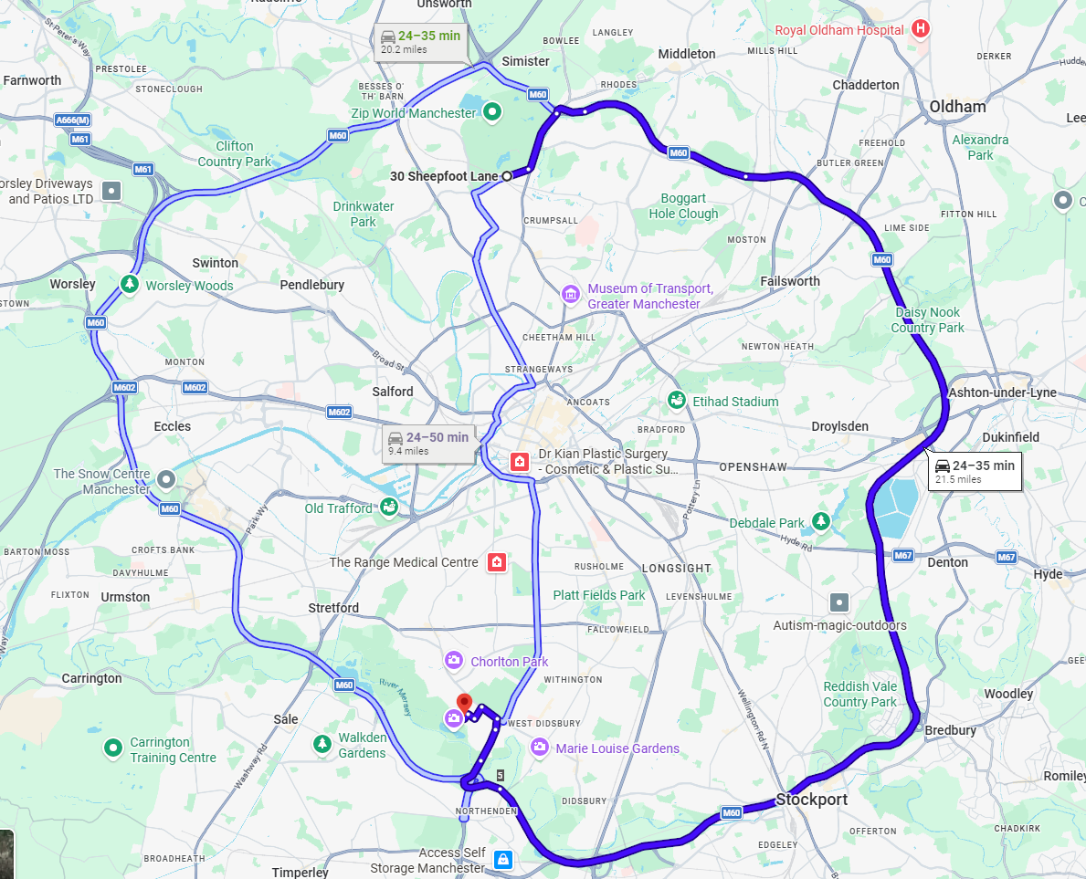
Other prominent examples
Google maps proposes taking the ring road to reach the destination faster.
The city route is still available although with a slower max estimated time.

Slide 8
Conclusion
If everyone were to use the model you could significantly reduce the CO2 emissions of travel as even a 5% reduction in energy usage will scale to millions of CO2 saved per year
However, this model would require to be developed further to include traffic, specific car stats

Slide 9
Thanks for listening

