Slide 1
Performance of SiPM
Contents
・Introduction
・Test results
・Summary
・To do
Ryuhei Nakamura (Kobe Univ.)
GLC calorimeter group
(KEK, Kobe, Konan, Niigata, Shinshu, Tsukuba)

Slide 2
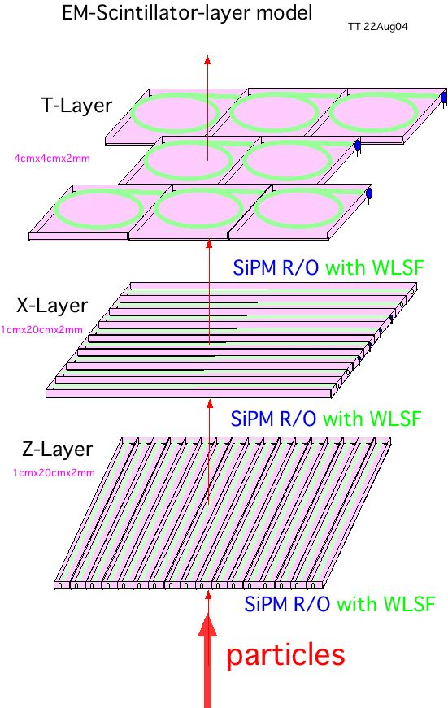
Introduction
・Particle Flow Algorithm
→Fine segmentation
→Large number of channels
・Less expensive example is
Scintillator (+WLS)
&
SiPM readout
→ Direct attachment to
Scinti. or WLS
Particle
Notes:
SiPMがくっついてますよ。という図
細かいとチャンネルが増えるー>安い
Expected to be cheep
One of the candidates

Slide 3
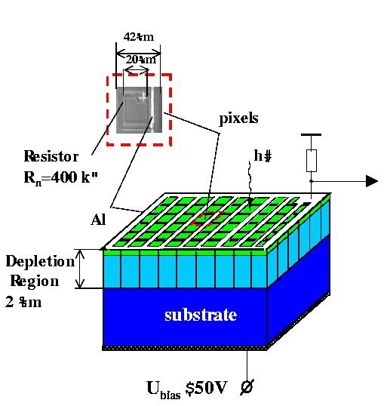
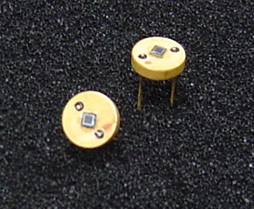
SiPM (provided by JINR group)
・Micro-APD cells operated in Geiger-mode
・~1000 pixels (~1mm × 1mm)
・High Gain (~10⁶)
・Operational at low voltage (~65V)
2mm
8mm
Notes:
-1mm by 1mm
-10 to the 6th

Slide 4
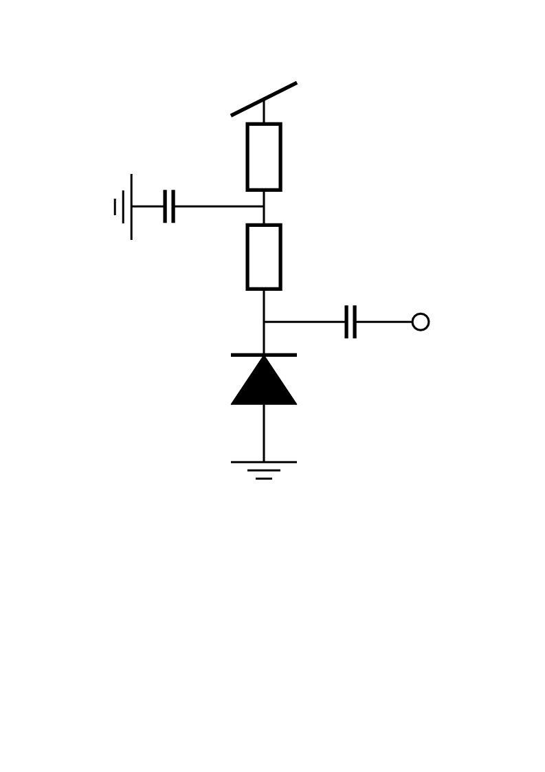
Set up (for Gain mesurement)
Readout Circuit
Thermostatic Chamber
LED Pulse
width : 10nsec
height : 5.5V
Bias
64.0V~67.5V
Gate width
: 35nsec
LED
P.G.
G.G.
50Ω
100ｎF
SiPM
Bias
100kΩ
100ｎF
Output
CAMAC
ADC
FastAmp
SiPM
Fast Amp : ORTEC FTA820
(Gain 200)
ADC : Phillips 7166
Notes:
Bias V Apply

Slide 5
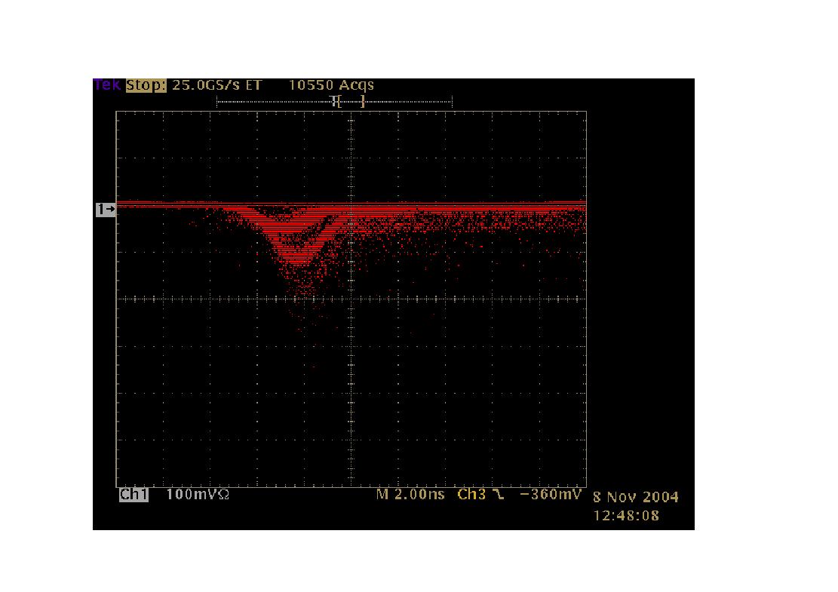
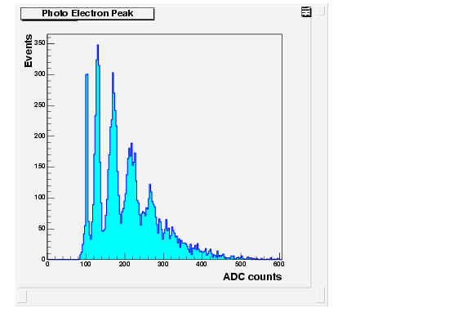
Photon Counting
at Room Temperature
Ped
1p.e.
1p.e.
2p.e.
Ped
2p.e.
2.00ns/div
100mV/div
3p.e.
4p.e.
Notes:
The left Fig. is a view showing a frame format of readout circuit.
Reverse bias.

Slide 6
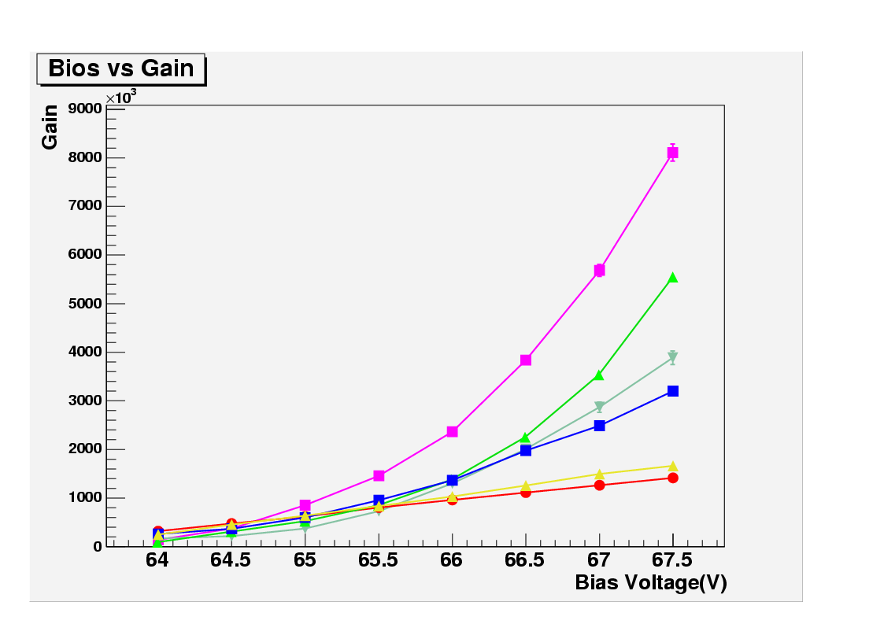
Gain
・Gain vs Bias voltage
( 6 SiPMs checked )
This #Serial ④ SiPM is used for the
mesurement of Temp. dependence.
(→Next page)
as
#Serial Number
① ―――
② ―――
③ ―――
④ ―――
⑤ ―――
⑥ ―――
Notes:
It is different about 10 times to the smallest gain SiPM.
Bios
Gain is obtained by single photoelectron peak (up to –Gain…)

Slide 7
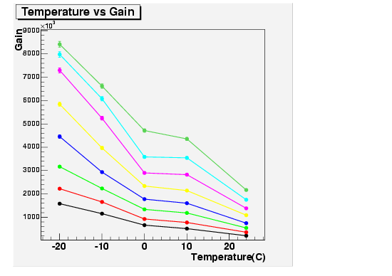
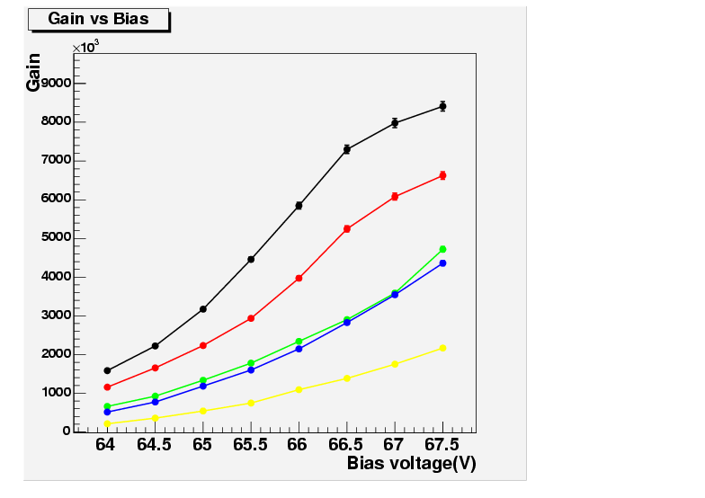
Temperature dependence
( for 1 SiPM )
67.5V ―――
67.0V ―――
‐20℃ ―――
66.5V ―――
‐10℃ ―――
66.0V ―――
0℃ ―――
65.5V ―――
65.0V ―――
10℃ ―――
64.5V ―――
20℃ ―――
64.0V ―――
Notes:
Reference Russian data.

Slide 8
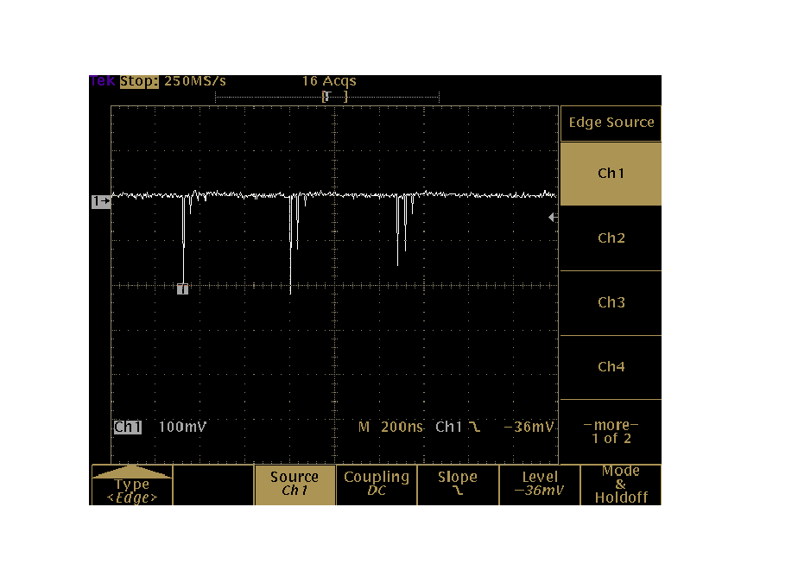
Thermal Noise
・SiPM has a MHz order thermal noise.
---Some pixels discharge at random.
-Set up
1pixel
Bias
SiPM
Thermostatic Chamber
FastAmp
Discriminater
Scalar
200ns/div
100mV/div

Slide 9
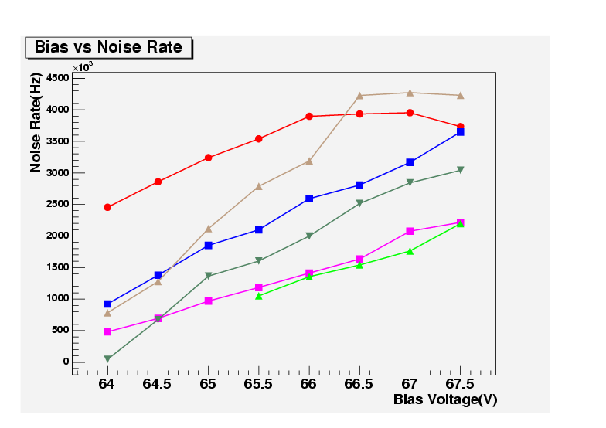
Thermal Noise vs Bias Voltage
( 6 SiPM checked )
→ This #Serial ④ SiPM is used for the measurement
of Temp. dependence. (→Next page)
(Same one was used in Gain vs Temp. mesurement)
#Serial Number
① ―――
② ―――
③ ―――
④ ―――
⑤ ―――
⑥ ―――
Notes:
Discriminator(25nsec Gate) or Scalar (80MHz)saturation

Slide 10
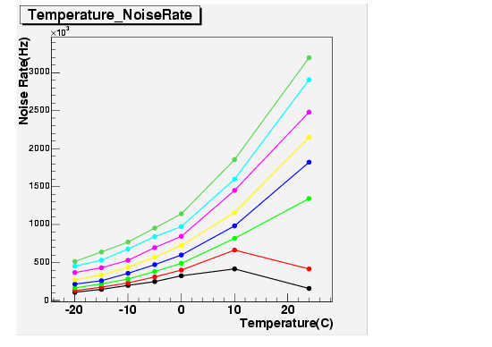
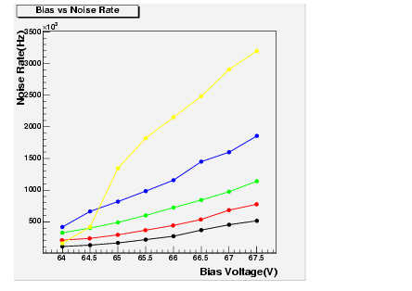
Temperature dependence
( for 1 SiPM )
It was measured one day after (at room temperature)
67.5V ―――
２４℃ ―――
67.0V ―――
10℃ ―――
66.5V ―――
0℃ ―――
66.0V ―――
‐10℃ ―――
65.5V ―――
‐20℃ ―――
65.0V ―――
64.5V ―――
64.0V ―――

Slide 11
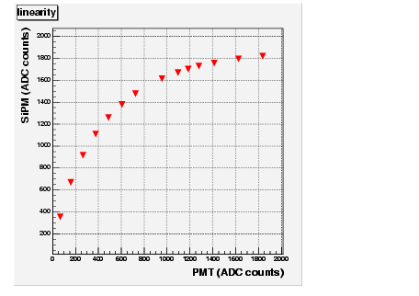
Linearity
・SiPM signal is saturated when two or more photons
go into one pixel.
N_{HIT} = N_{pixels}(1－e^{－<Np.e.>/ Npixels})
LED Pulse
width : 15nsec
height : 4.0V to 8.0V
GATE
width : 100nsec
LED
P.G.
G.G.
WLS fiber
SiPM
Bias
CAMAC
ADC
PMT
Notes:
Photon number について聞かれたら、まだ測定中だ。
Hit function

Slide 12
Summary
・We made a first measurements of Russian SiPMs
(The result is very very preliminary)
・Photo electron peak is observed
・The gain of SiPM is ~10⁶
・We measured
-- Gain vs Bias V
-- Gain vs Temp.
-- Thermal Noise vs Bias V
-- Thermal Noise vs Temp.
-- Linearity ・・・ Saturation is observed
Notes:
One tenth
First result very very preliminaly

Slide 13
To do
・Check reproducibility of the measurements
・Check long term stability
・Comparison with other photon sensors
(MRS, AMPD, HPK’s…)
Notes:
One tenth

