Slide 1
Online monitor for ReD experiment
Oleynikov Vladislav
Italy, Napoli, 16 October 2017

Slide 2
What do we want?
1) Fast system
2) Display waveforms from 6 channels.
3) Integral waveforms in gate
4) Display histograms from 6 channels.
5) Display combined histograms (for top and bottom detectors)
6) Comfortable GUI

Slide 3
Realization
Root Cern GUI, because it is free. Qt will be better, but can be some problems with license in future).
Root Cern Threads. Later I can rewrite code using c++11 standard, if Root Cern Threads will not have desirable functionality.
Root Cern 5.34/36 version libraries. So, my program is cross-platform.

Slide 4
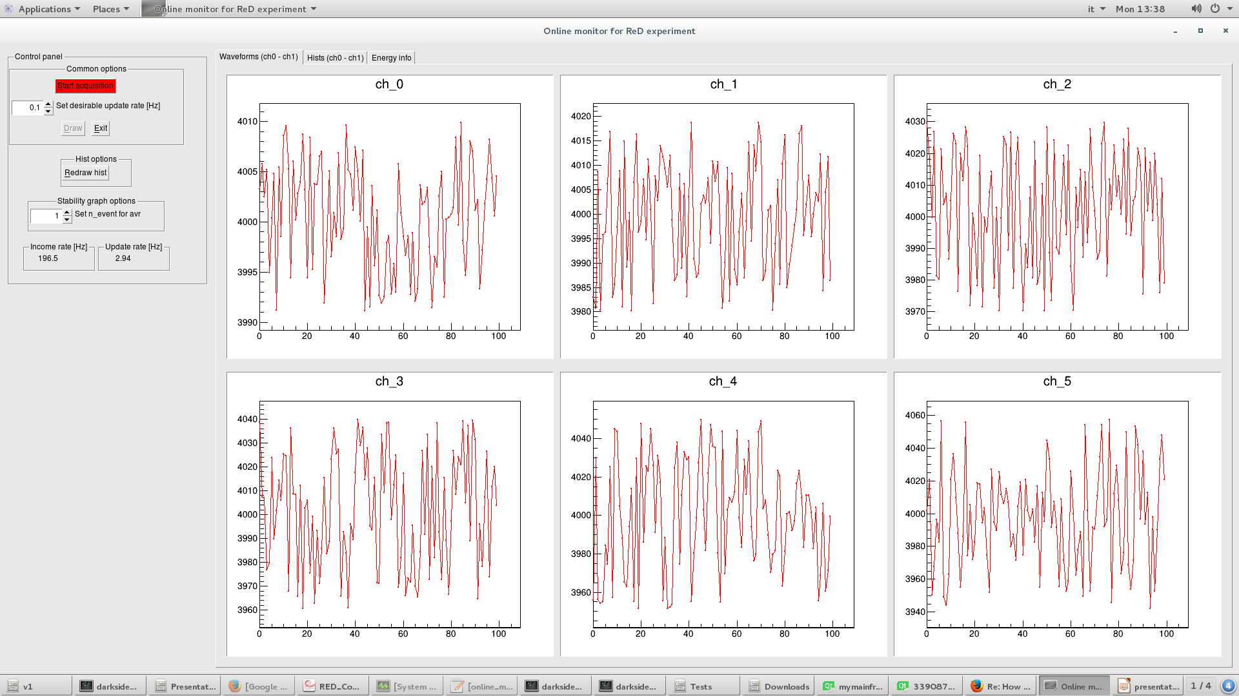
Interface
Preliminary!

Slide 5
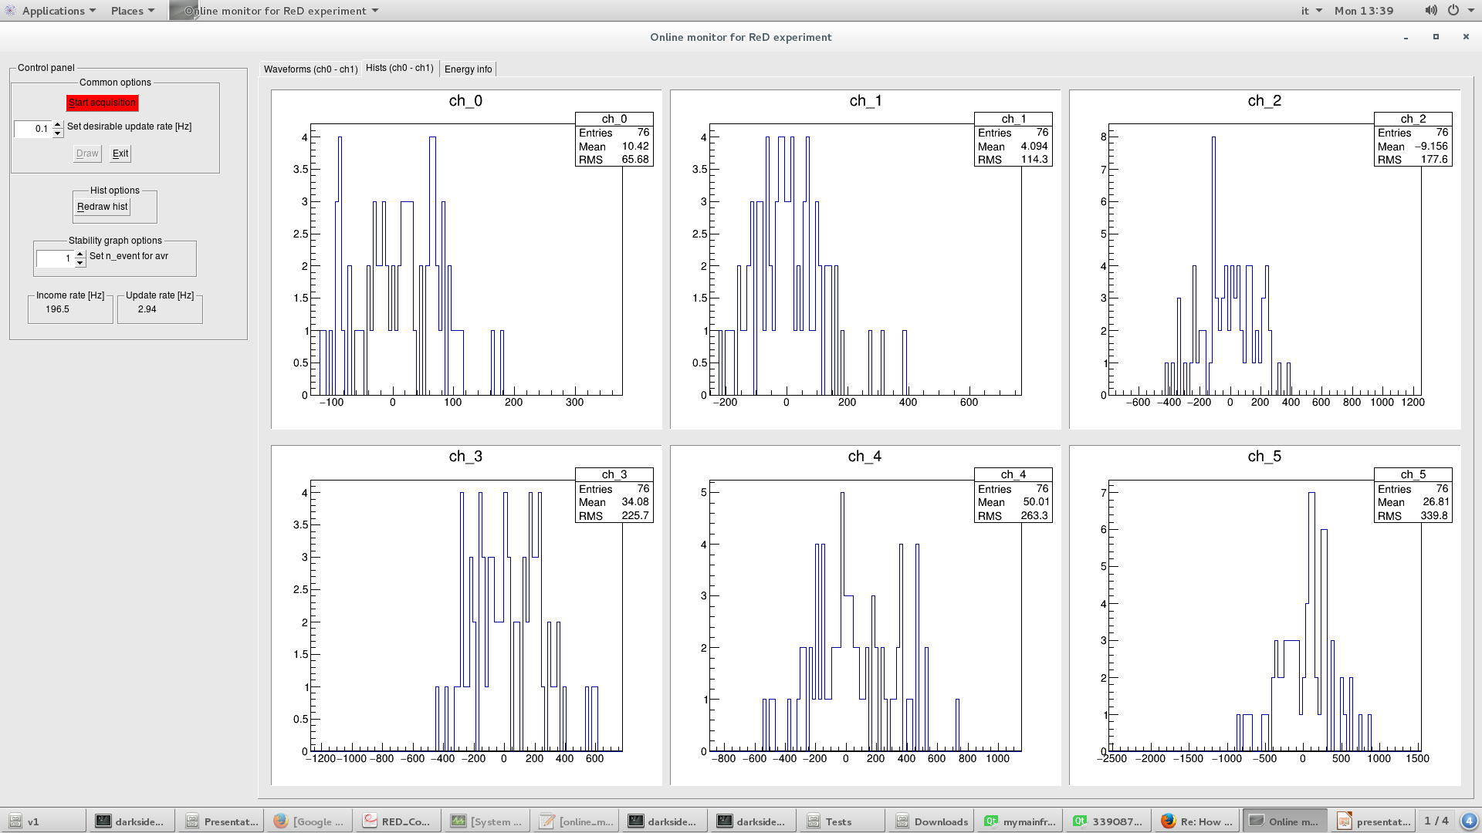
Interface
Preliminary!

Slide 6
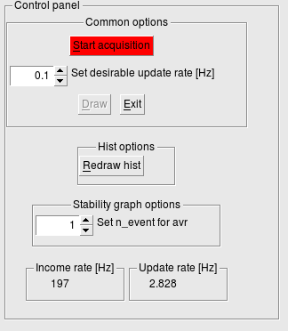
Interface
Preliminary!

Slide 7
Plans
Time gates for integral
Panel to choose histograms to combine
Pulse shape discrimination for S1
Send data from DAQ to OnlineMonitor
My code is here: https://github.com/Vlad-ole/RedOnlineMonitor

