Slide 1


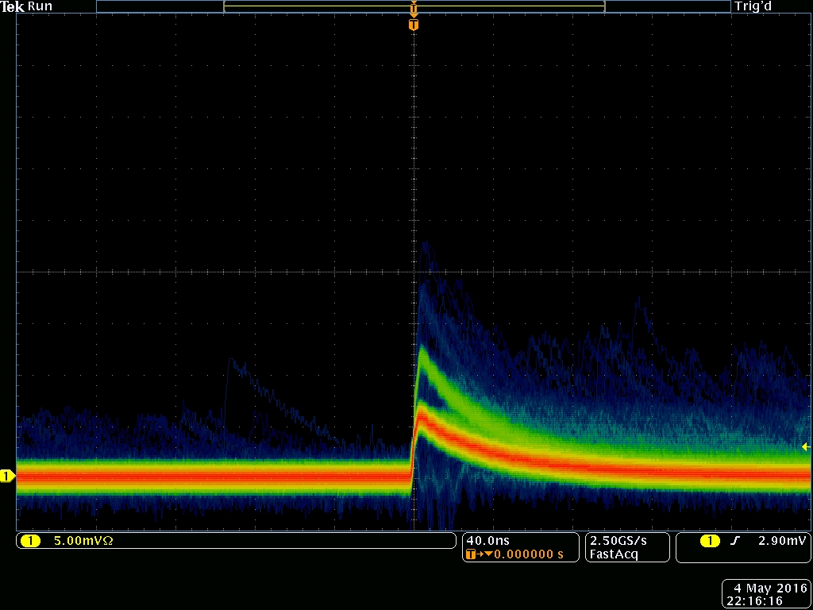
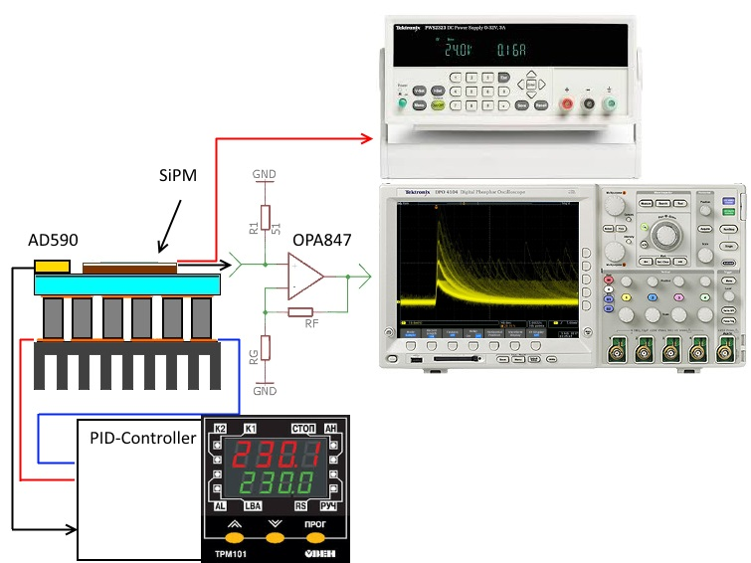
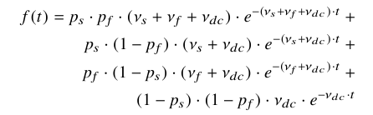
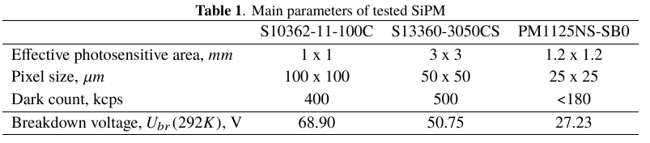


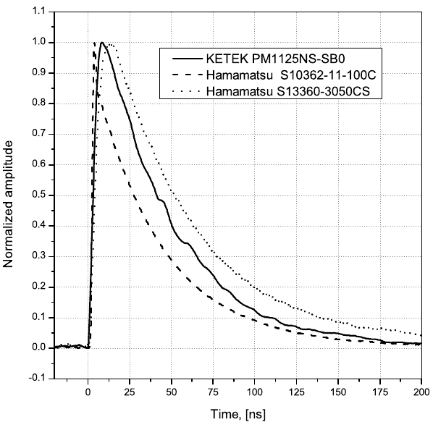
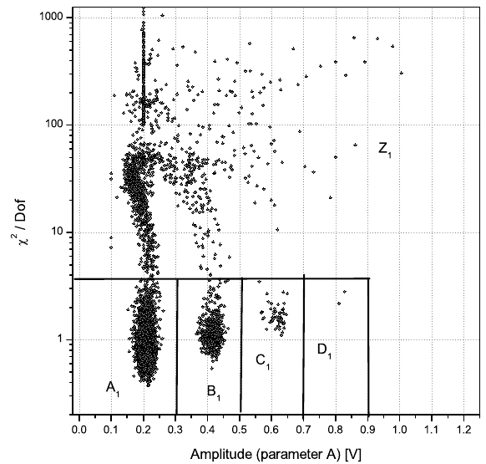
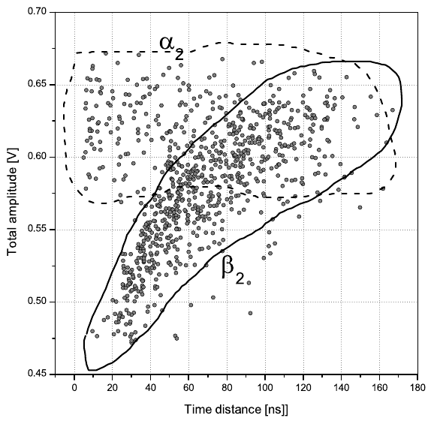
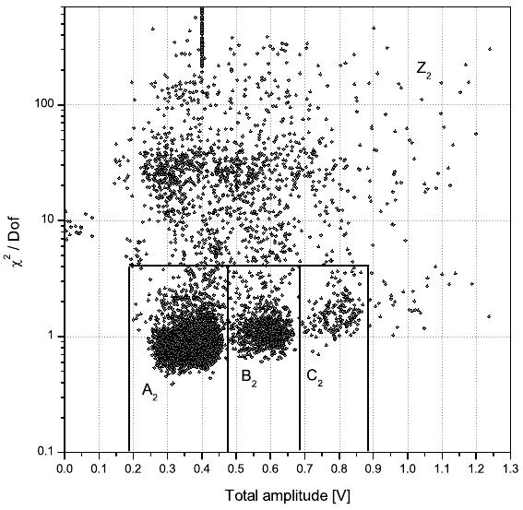
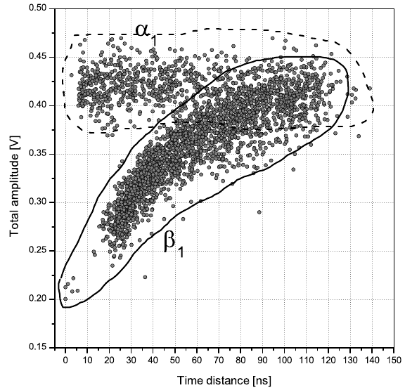
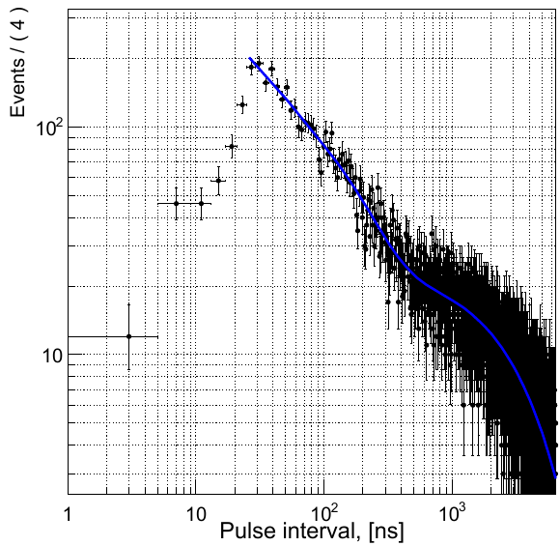
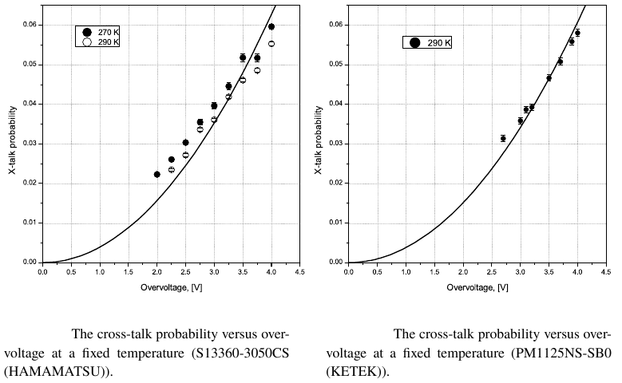
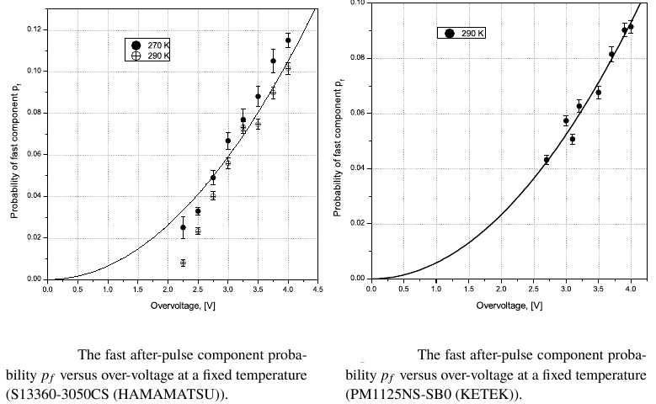
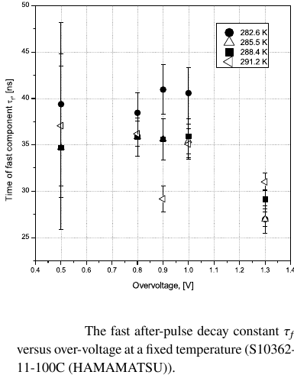
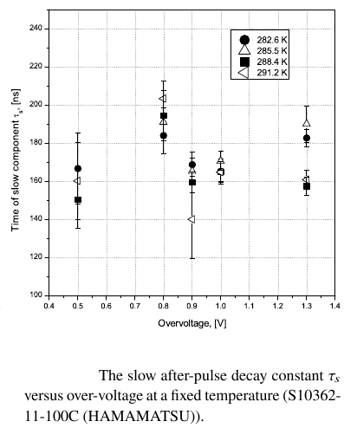
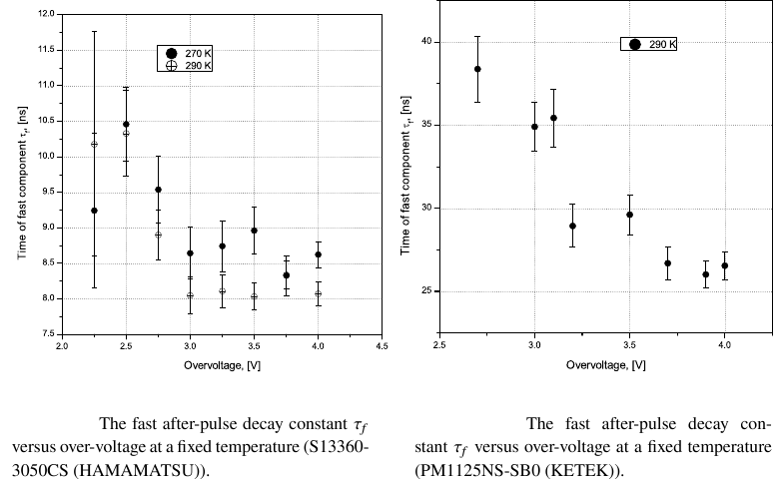
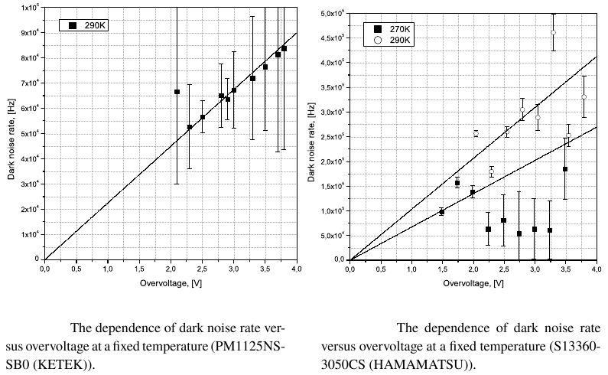
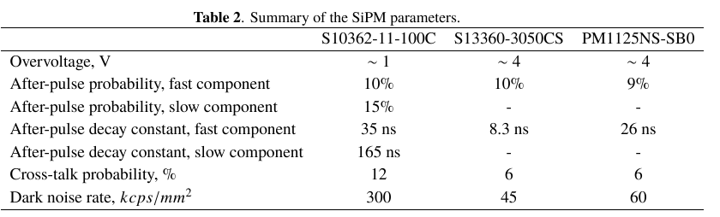
After-pulsing and cross-talk comparison for PM1125NS-SB0 (KETEK), S10362-11-100C (HAMAMATSU) and S13360-3050CS (HAMAMATSU).
Oleynikov V.P.*, Porosev V.V.
Budker Institute of Nuclear Physics, SB RAS Novosibirsk
Novosibirsk State University
Introduction
For many years BINP has been developing the detectors for X-ray imaging. These detectors are used in various fields: security inspection systems at airports, medical imaging, synchrotron radiation research etc. One of the successfully used detectors is Multistrip Ionization Chamber filled with pure Xe. However, it has a disadvantage: it works in the signal integrating mode - when a detector measures a net charge created in a x-ray sensitive media and it loss information about a number of the detected particles. As a result, at a low input flux, an electronic noise seriously degrades quality of images. Another drawback is a conspicuous degradation of a detector quantum efficiency for high-energy photons. In this regard, it was decided to design a new scintillation detector based on a SiPM which will have a higher detection efficiency and will operate in a photon counting mode. To correctly distinguish low energy photons from the SiPM noise, the detector have to provide a rather good energy resolution. The last strongly depends on an excess noise factor of the SiPM that is defined by after-pulses and cross-talk. The purpose of this work was to find a way to correctly measure these SiPM parameters.
Cross-talk and after-pulses probabilities finding algorithm
There are several methods to find cross-talk probabilities. One of them is to measure a dark noise rate at different thresholds. A cross-talk probability can be defined as the ratio of the rates with 1.5 photoelectrons and 0.5 photoelectrons threshold. However, this method has the significant disadvantage: after-pulses are indistinguishable from cross-talk if the former above a threshold. Furthermore, this algorithm does not use information about a signal shape. It makes a finding of the thresholds more complicated. A more advanced algorithm should use an information about a waveform. There are two approaches for a signal processing in this way: a deconvolution and an approximation with known waveform. In our work we decided to use the method of signal approximation. In the process of approximation we should to obtain amplitudes and time stamps of the events.
The first process is after-pulsing. It is re-triggering of a cell originating from a capture of electrons into traps during an avalanche and their subsequent release in a time interval from a few nanoseconds to several microseconds. After initial triggering a voltage in a cell decreases to a breakdown one and then will recover to its original value exponentially. The after-pulses could be characterized at least two different mean release time: fast and slow component. Another process is a cell triggering induced by thermally generated electrons. Each of the processes has exponential distribution in time. If we can measure a distribution of time intervals between successive pulses, we can characterize the time constants and the probabilities of processes leading to the triggering.
Experimental setup
A schematic overview of the experimental setup that was used for a recording of the SiPM signals is shown in Fig.1 The offset voltage for SiPM was provided with PWS2721 (TEKTRONIX). A temperature sensor AD590 (Analog Devices) was situated at the same base as a tested SiPM and provided a reference signal for a PID-controller based on TRM101 regulator (OWEN LLC, Russia) to stabilize SiPM temperature with Peltier element. At each temperature, the SiPM breakdown voltage was extrapolated from experimental data as a voltage when the SiPM gain goes to zero. The amplified signal with a home made OPA847 (Texas Instruments) based amplifier was recorded with oscilloscope DPO4104B (TEKTRONIX) with sample rate 5GHz. A record length was 5M-samples. For each voltage and temperature combination 1000 files totally were recorded (net record length is one second). We did comparison of three different SiPM: S10362-11-100C (HAMAMATSU), S13360-3050CS (HAMAMATSU), and PM1125NS-SB0 (KETEK). The main SiPM parameters are summarized in Table 1. The first one is rather "old" device with a large noise, and large probabilities of cross-talk and after-pulses. The last ones are examples of the "modern" generation with improved characteristics.
Figure 1. Experimental setup
Data analysis
The analyzed signal can be presented as a superposition of single-electron pulses with amplitude A_{i} and start time t_{i}: To build an "ideal" response, single-electron pulses not effected by after-pulses were specially selected and averaged. After that it was approximated by an analytical function. Generally, we can approximate a continuous waveform from a oscilloscope with a length of 5M samples as superposition of 30∼300 events. But this task has too many unknown parameters. In practice, the continuous waveform could be divided into practically independent fragments with N = 1 or N = 2 in each fragment. Further, an each independent fragment it was approximated N = 1. In Fig.3 the correlation between the amplitude and is presented. One can notice few outlying clusters: A1, B1, C1 etc. The cluster A1 corresponds to single-electron signals. Clusters B1, C1 etc. corresponds to events when simultaneously triggered two, three or more cells (cross-talk), and these signals clearly separated. Other events with the > 4 value (we denote them as Z1 cluster) correspond to the overlapped pulses (N > 1), located at a relatively short distance each other. In the next step the events from the Z1 cluster were approximated at N = 2. In this case, each event is characterized by four parameters: , , amp₁, amp₂ - amplitudes of the first and the second signals, and Δt - a distance between the signals. In Fig.4 a correlation between the total amplitude amp₁ + amp₂ and is presented.
Figure 2. The waveform of the single-electron
pulse from different SiPMs.
Figure 3. The χ² / Dof dependence of the amplitude when all pulses are approximated by one-component function
Figure 4. The χ² / _{Dof} dependence of the total amplitude when the pulses from Z1 cluster are approximated by two-component function
Figure 5. The dependence of the total amplitude from the pulse interval when approximating the A2 cluster by two-component function.
Figure 6. The dependence of the total amplitude from the pulse interval when approximating the B2 cluster by two-component function.
Figure 7. The pulse interval spectrum for
S10362-11-100C (HAMAMATSU) at 1V
overvoltage and 295K
The A2 cluster consists of events that are conventionally divided into two sets: α1 and β1 (Figure 5). The set α1 corresponds to the signals when the total amplitude equal to double amplitude of the single-electron pulse. This means that these signals were caused by triggering of separate cells and they could be treated as coincidence of dark noise events or delayed cross-talk. At the same time signals from the set β1 have an amplitude that depends on the distance between pulses. This means that the first signal was a single-electron pulse and the subsequent signal was an after-pulse. The similar correlation can be constructed for the B2 set (Figure 6). To built a distribution of intervals, we have to take into account only the pulses without cross-talk. Assuming that a probability of other processes like delayed crass-talk is small, we measured the time intervals between the pulses that belong to the A1 or A2 clusters. The sample of an analyzed distribution is shown on Figure.7 and measured SiPM parameters are presented below.
Conclusion:
The summary of the main SiPM parameters is presented in Table 2. As it is expected the "modern" SiPMs S13360-3050CS (HAMAMATSU) and PM1125NS-SB0 (KETEK) demonstrated significantly better parameters than "old" one. To measure these parameters we analyzed a distribution of time between occurrences of successive events. To get accurate timing information we fit the signals with a known waveform. The presented method allowed us to estimate SiPM parameters. However, it has significant drawback because it requires a large computation power and it requires a manual adjustment of initial parameters of fits. Additionally, the modern SiPMs have a small after-pulse decay constant. As a result, a detection of low amplitude after-pulses among an electronics noise becomes very difficult task. Therefore it is the main origin of systematic errors in current research.

