Slide 1
Gersh Budker
Oleynikov Vladislav Petrovich
Budker Institute of Nuclear Physics, 8 May 2015

Slide 2
Content
5 minutes
Biography
Concluding comments

Slide 3
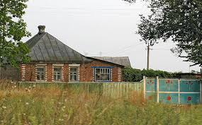
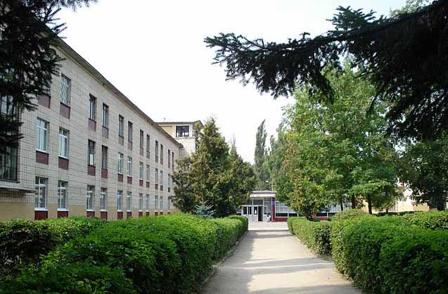
1918 - 1936
Murafa village
Vinnitsa Middle School

Slide 4
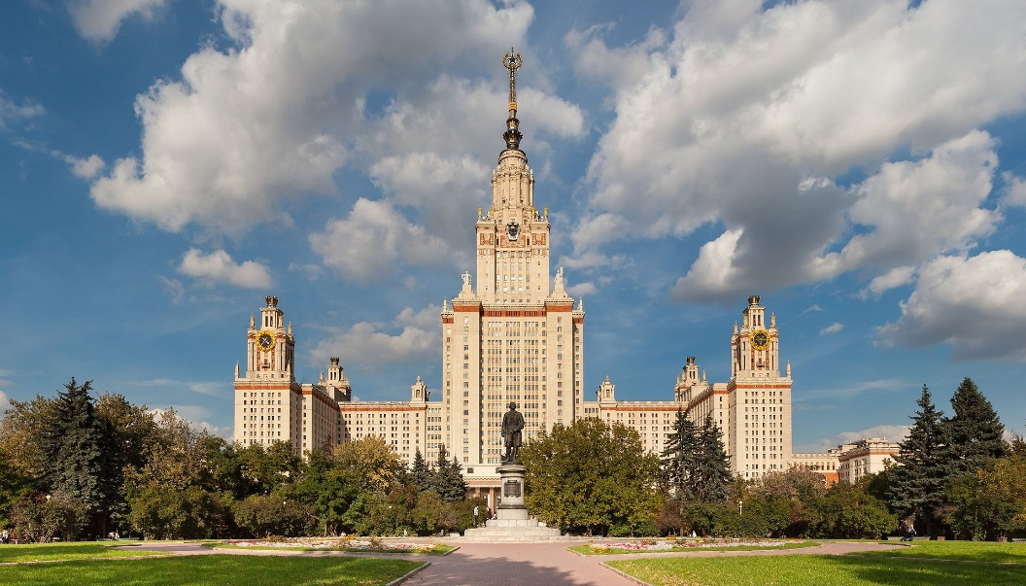
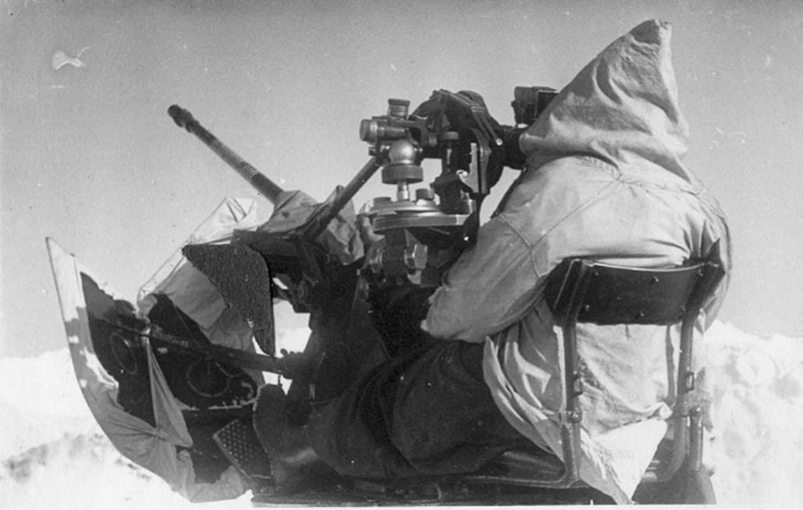
1936 - 1945
He graduated from Moscow University in 1941
Until the end of the war, he served as anti-aircraft gunner in the Far East

Slide 5
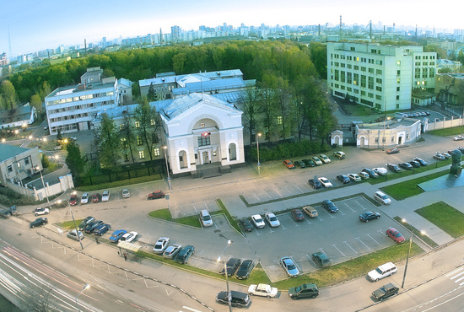
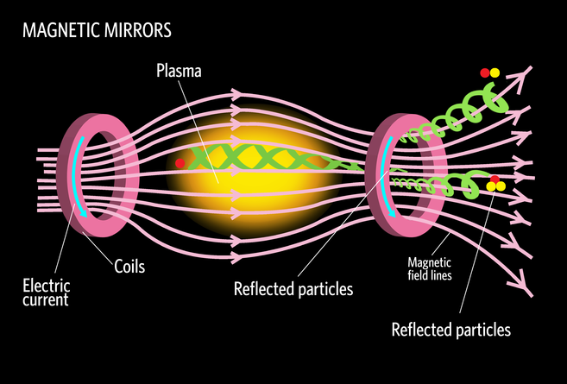
1945 - 1952
In 1945 he came to work at the Institute of Atomic Energy of the USSR Academy
In 1952 Budker offers the magnetic mirrors for plasma confinement

Slide 6
1952 - 1964
was created a laboratory of new acceleration methods in 1954
Budker defended his doctoral thesis in 1956
he was elected a corresponding member in 1958
he was elected full member of the Academy of Sciences of the USSR in 1964

Slide 7
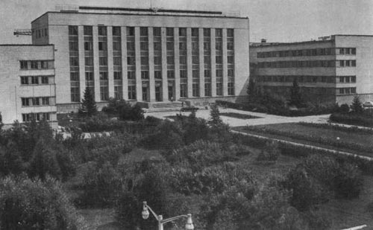
1957
With the support of Kurchatov, Budker started the creation of the Institute of Nuclear Physics, Siberian Branch of the USSR Academy of Sciences, in 1957 and his laboratory was transformed into a separate institution in 1958.

Slide 8
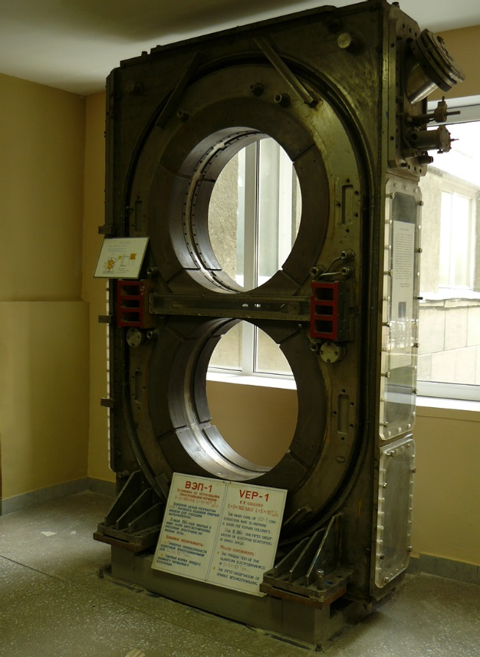
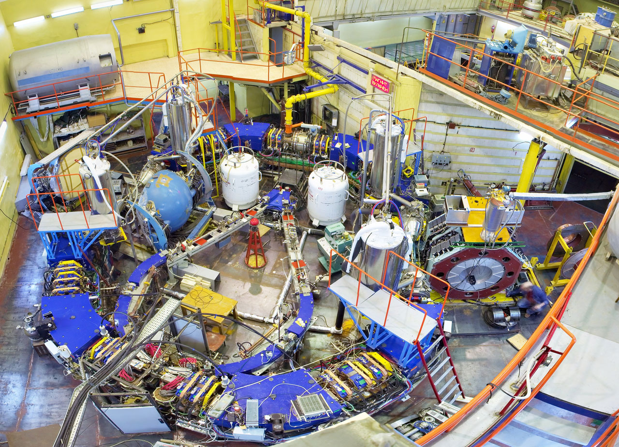
1960 - nowadays
He implemented the VEP-1 accelerator in 1964
In the future, for experiments in elementary particle physics was build VEhPP-2 VEhPP-2M and VEhPP-4 accelerators.

Slide 9
Concluding Comments
Gersh Itskovich Budker was a great scientist
Because of his ideas and enthusiasm our world made a significant leap ahead.

Slide 10
Thank you for your attention!

