Slide 1
An application of the foresight method in my work
Oleynikov Vladislav Petrovich
Budker Institute of Nuclear Physics, 9 April 2015

Slide 2
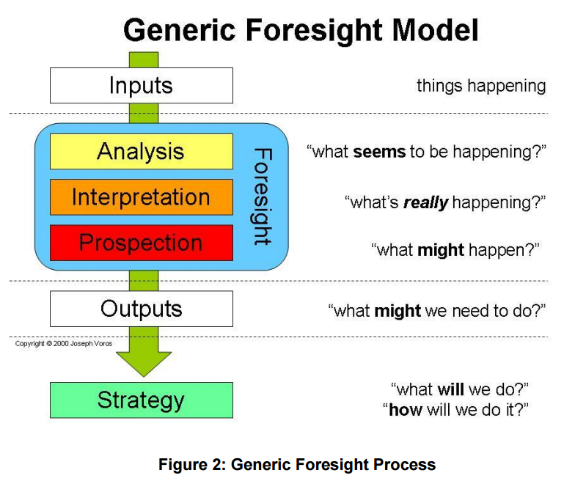
Foresight Methodologies

Slide 3
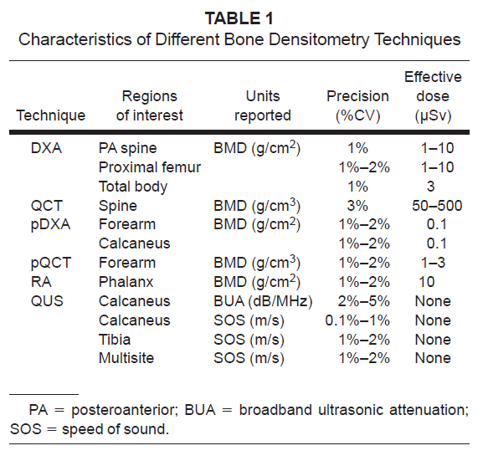
Input Methods: what’s going on?

Slide 4
Input Methods: what’s going on?
We want to develop the device with the same characteristics (or better)

Slide 5
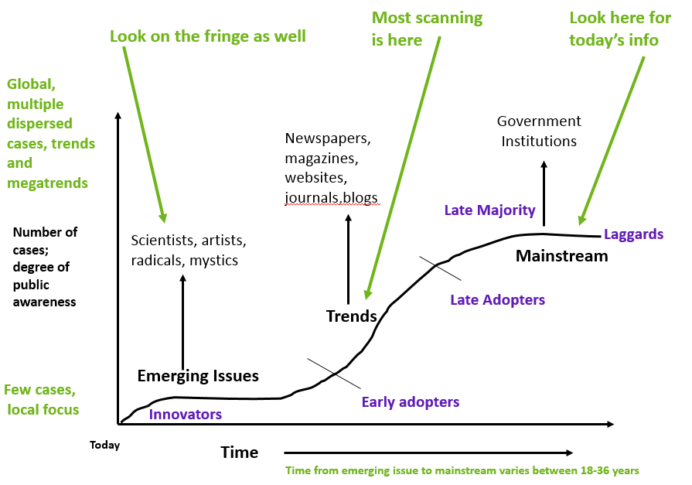
Analytical Methods: what seems to be happening?

Slide 6
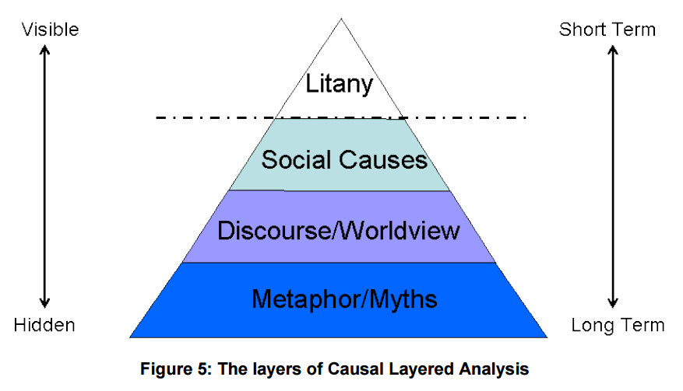
Interpretive Methods: what’s really happening?

Slide 7
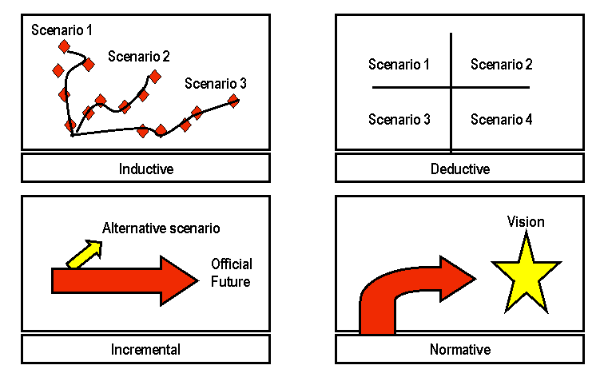
Prospective Methods: what might happen?

Slide 8
Prospective Methods: what might happen?
Scenario 1
We will use the CdTe detector with the good energy resolution and low emission time
Scenario 2
We will use the SiPM-scintillator detector with the worse energy resolution but shorter emission time
Scenario 3
We will use the combination of these detectors

Slide 9

Concluding Comments

Slide 10
Thank you for your attention!

