Slide 1
Is Warp Drive Real?
Oleynikov Vladislav Petrovich
Budker Institute of Nuclear Physics, 8 May 2015

Slide 2
Content
5 minutes
Definition
Warp core
Concluding comments

Slide 3
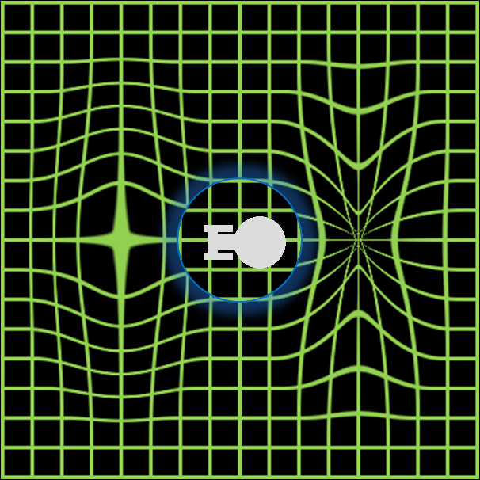
Defenition
Warp drive is a hypothetical faster-than-light (FTL) propulsion system
A spacecraft equipped with a warp drive may travel at apparent speeds greater than that of light by many orders of magnitude

Slide 4
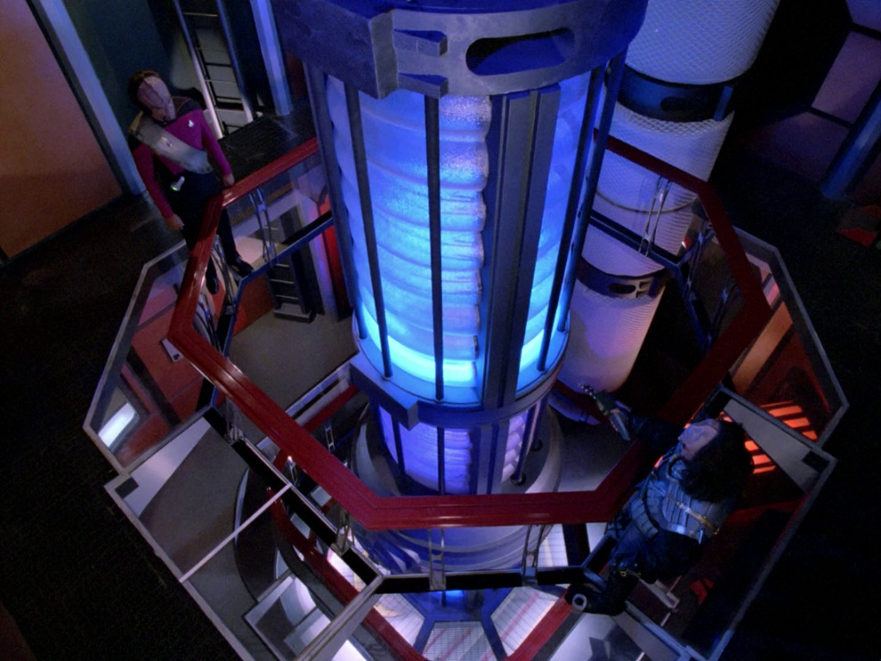
Warp core
It is a fictional reactor that taps the energy released in a matter-antimatter annihilation to provide the energy

Slide 5
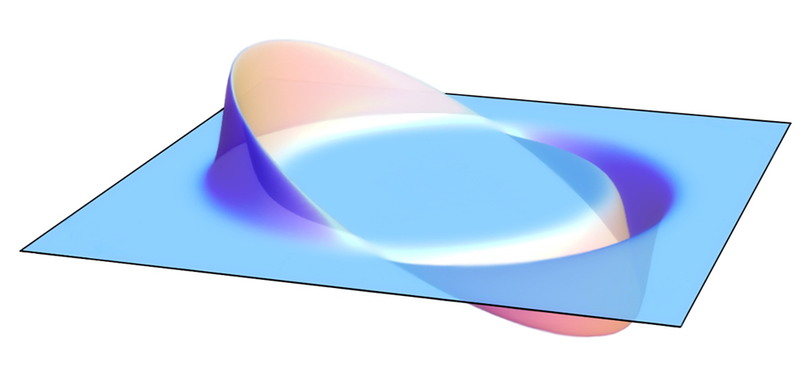
Real-world theories and science
A theoretical solution for faster-than-light travel which models the warp drive concept, called the Alcubierre drive, was formulated by physicist Miguel Alcubierre in 1994.
the energy required is still many orders of magnitude greater than anything currently possible by modern technology

Slide 6
Thank you for your attention!

