Slide 1
Nanomaterials
Oleynikov Vladislav Petrovich
Budker Institute of Nuclear Physics, 8 May 2015

Slide 2
Content
5 minutes
Definition and history
Carbon nanotubes
Graphene
Concluding comments

Slide 3
Definition and history
Nanomaterials is a material with single unit is sized (in at least one dimension)
between 1 and 1000 nanometers (10⁻⁹ meter) but is usually 1—100 nm
Richard Feynman was the first who offered to move mechanically single atoms with the help of a manipulator of the appropriate size at the conference in 1959

Slide 4
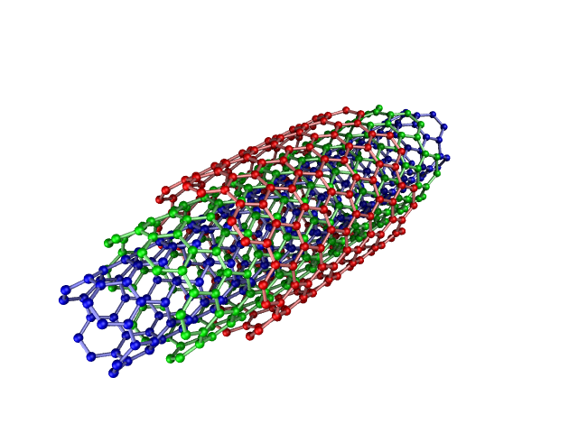

Carbon nanotubes
ultra-strong threads for space lift

Slide 5
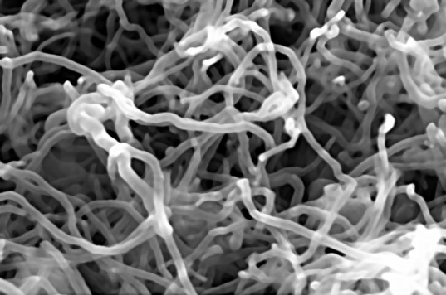

Carbon nanotubes
artificial muscles
power generator

Slide 6
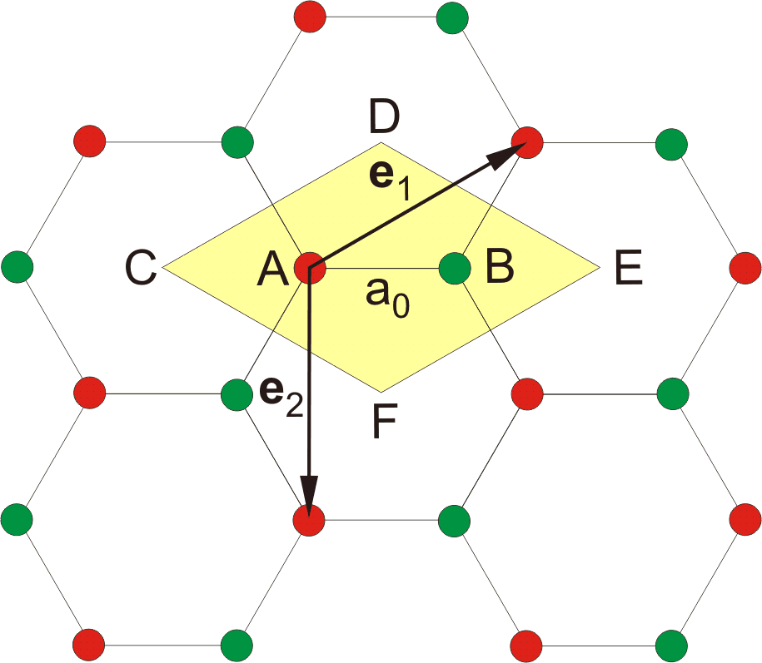
Graphene
flexible displays
transistors
solar cells
Image of a hexagonal lattice of graphene

Slide 7
Concluding Comments
Nanomaterials was discovered only ten years ago, but we have the variety of available applications now.

Slide 8
Thank you for your attention!

