Slide 1
Laboratory 3 sector 13
Oleynikov Vladislav Petrovich
Budker Institute of Nuclear Physics, 20 April 2015

Slide 2
Content
5 minutes
Introduction
Our laboratory staff
Low dose Digital Radiographic Installation (Siberia)
X-ray inspection system (Sibscan)
Concluding comments

Slide 3
Our laboratory staff
Dmitry Grigoriev [Head of laboratory]
(candidate of physico-mathematical sciences)
Shechtman Lev
(doctor of physico-mathematical sciences)
Simeon Bary
(doctor of technical sciences)
Porosev Vyacheslav (candidate of physico-mathematical sciences)
Savinov Gennady (designer of electronics)
Babicevs Eugene (engineer)
Shabarov Alexey
(engineer)
Oleynikov Vladislav (postgraduate)
Talyshev Alexey (designer of electronics)
Toropova Lyubov (engineer)
Bragin Andrei (engineer)
Fedoruk Valeria (engineer)
Akhmetshin Ravil
Kazanin Vasily

Slide 4
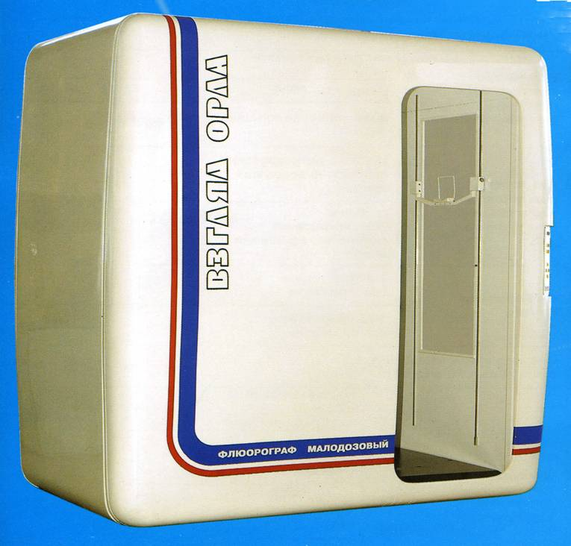

Low dose Digital Radiographic Installation (Siberia)
spatial resolution
contrast sensitivity
increased speed
dynamic range

Slide 5
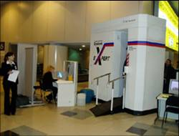
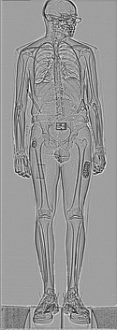
X-ray inspection system (Sibscan)
detect hidden on the body and clothing the dangerous items, weapon and explosive
ultra-Low dose of X-ray irradiation comparable to the background

Slide 6
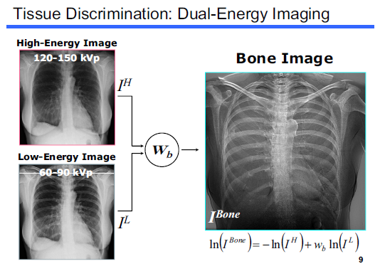
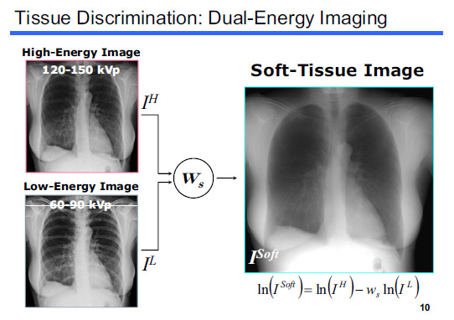
But progress does not stand still…

Slide 7

Concluding Comments

Slide 8
Thank you for your attention!

