Slide 1
Laboratory 3 sector 13
Oleynikov Vladislav Petrovich
Budker Institute of Nuclear Physics, 20 April 2015

Slide 2
Content
6 minutes
Introduction
Input method
Analysis method
Prospection method
Concluding comments

Slide 3
Our laboratory staff
Dmitry Grigoriev [Head of laboratory]
(candidate of physico-mathematical sciences)
Lev Shechtman
(doctor of physico-mathematical sciences)
Simeon Bary
(doctor of technical sciences)
Porosev Vyacheslav (candidate of physico-mathematical sciences)
Gennady Savinov (designer of electronics)
Babicevs Eugene (engineer)
Shabarov Alexey
(engineer)
Oleynikov Vladislav (postgraduate)
Talyshev Alexey (designer of electronics)
Toropova Lyubov (engineer)
Andrei Bragin (engineer)
Fedoruk Valeria (engineer)
Akhmetshin Ravil
Kazanin Vasily

Slide 4
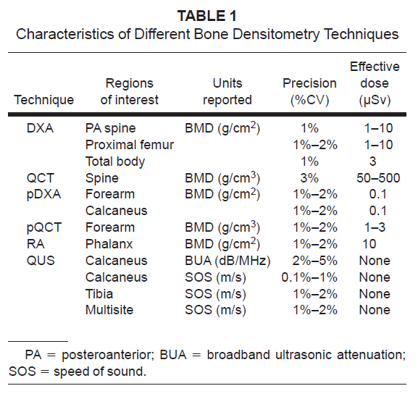
Input Methods: what’s going on?

Slide 5
Input Methods: what’s going on?
We want to develop the device with the same characteristics (or better)

Slide 6
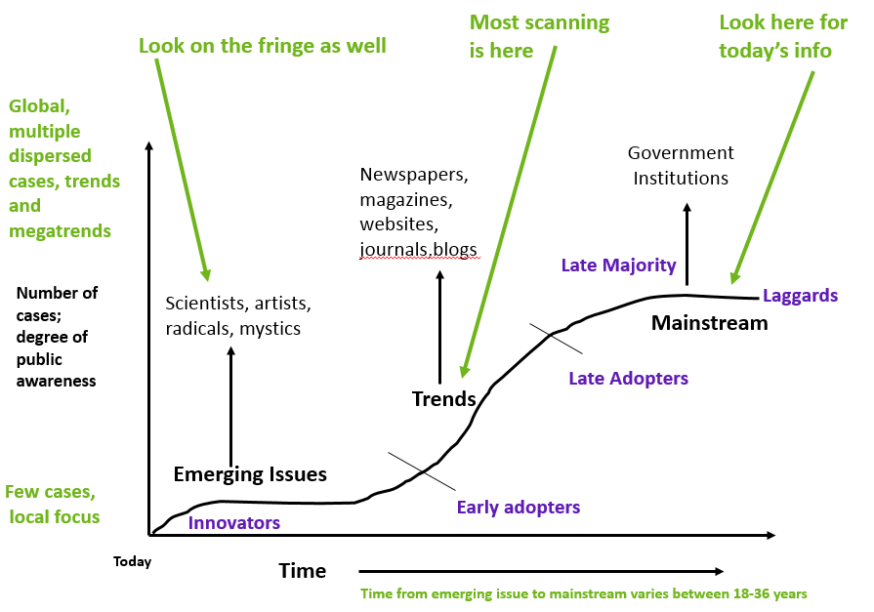
Analytical Methods: what seems to be happening?

Slide 7
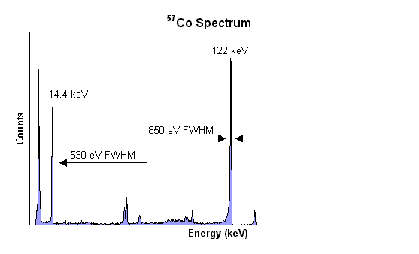
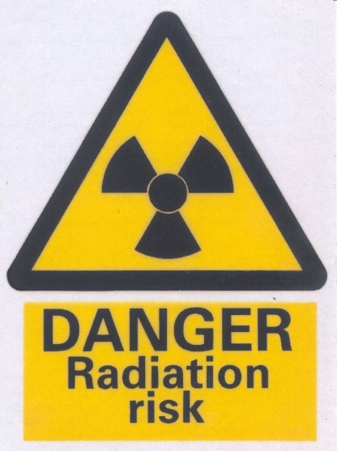
DXA is the “gold standard”, but …
the better the energy resolution,
the lower dose a person receives

Slide 8
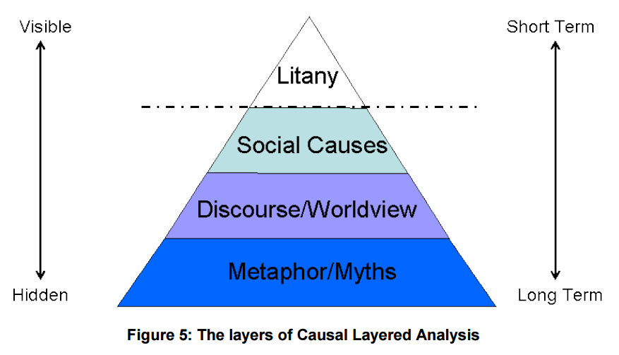
Interpretive Methods: what’s really happening?

Slide 9
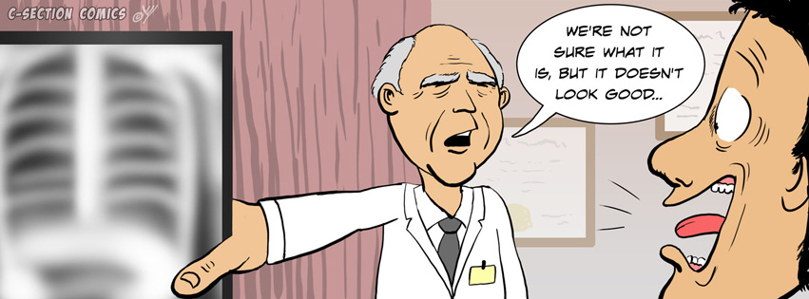

Social causes
to Improve x-ray medicine
to take care
of elderly people

Slide 10
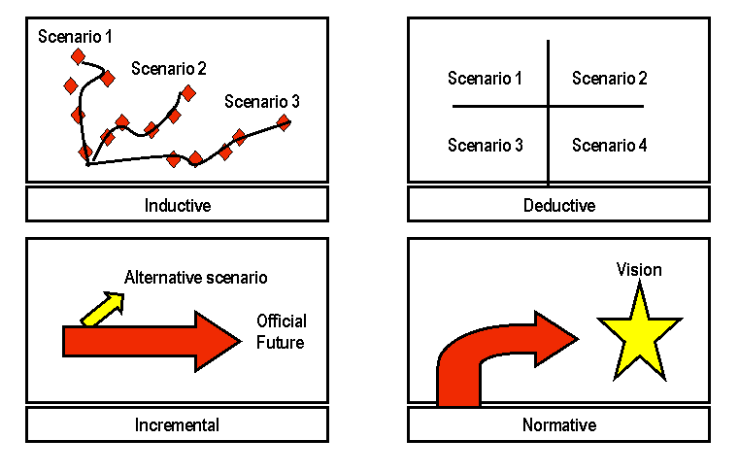
Prospective Methods: what might happen?

Slide 11
Three ways of development the DXA
Scenario 1
We will use the CdTe detector with the good energy resolution and low emission time
Scenario 2
We will use the SiPM-scintillator detector with the worse energy resolution but shorter emission time
Scenario 3
We will use the combination of these detectors

Slide 12

Concluding Comments
I have examined the application of foresight methods
This work really was useful for me

Slide 13
Thank you for your attention!

