Slide 1
An application of the foresight method in my work
Oleynikov Vladislav Petrovich
Budker Institute of Nuclear Physics, 9 April 2015

Slide 2
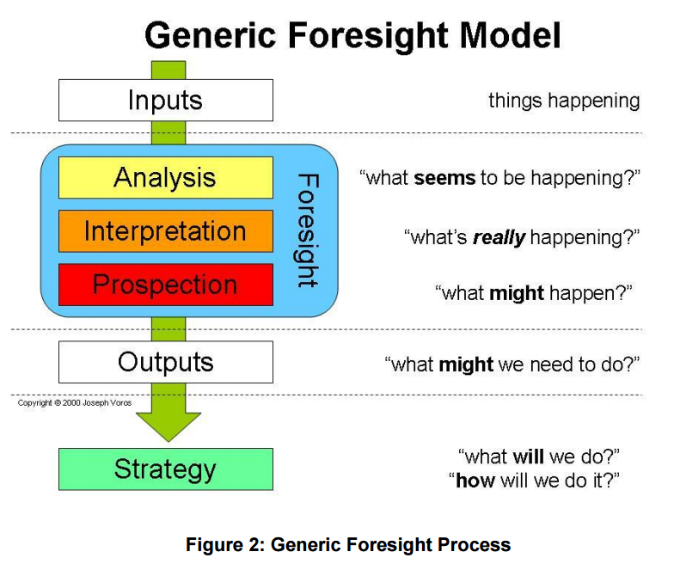
Foresight Methodologies

Slide 3
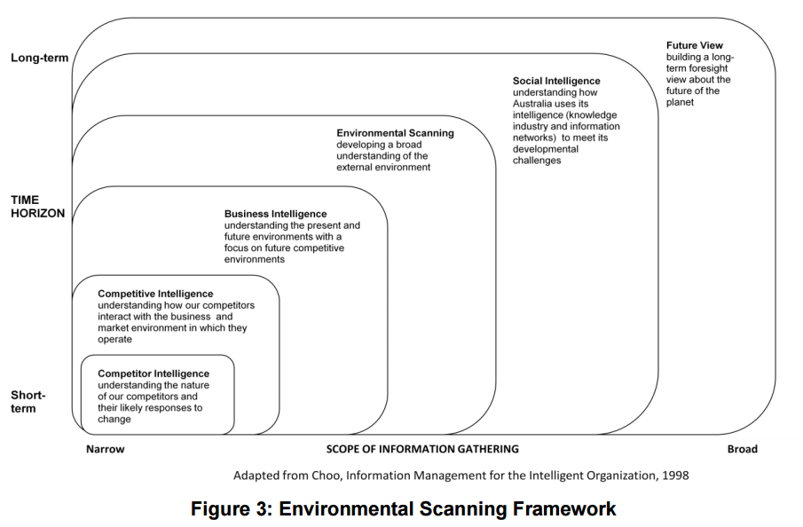
Input Methods: what’s going on?

Slide 4
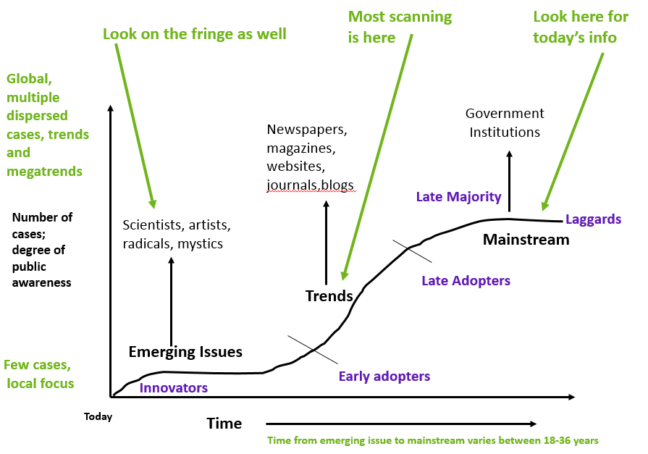
Analytical Methods: what seems to be happening?

Slide 5
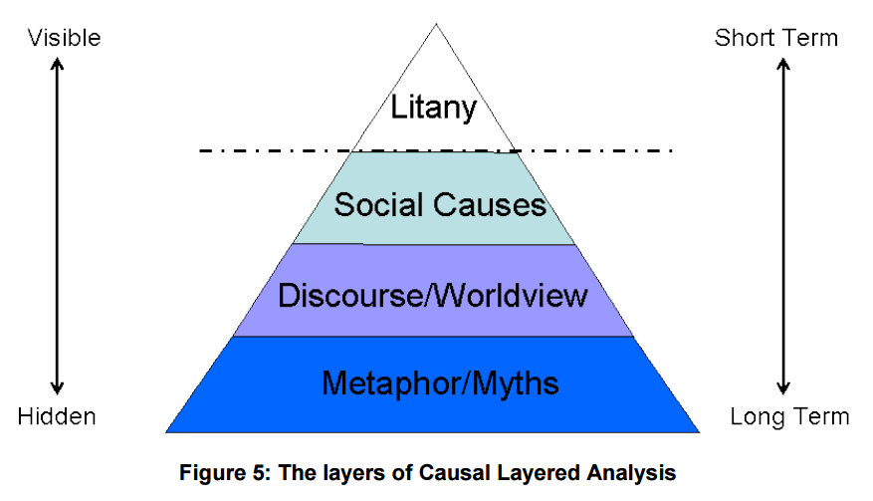
Interpretive Methods: what’s really happening?

Slide 6
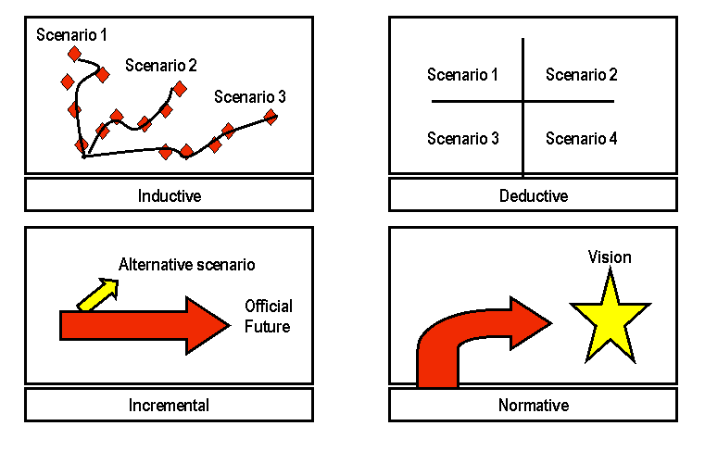
Prospective Methods: what might happen?

Slide 7

Concluding Comments

Slide 8
Thank you for your attention!

