Slide 1
Article abstracting Optimal Energy Thresholds and Weights for Separating Materials Using Photon Counting X-Ray Detectors with Energy Discriminating Capabilities
Adam S. Wang and Norbert J. Pelc
Departement of Electrical Engineering, Stanford University, Stanford, CA
Oleynikov Vladislav Petrovich
Budker Institute of Nuclear Physics, 20 April 2015

Slide 2
Content
5 minutes
Introduction
Model
Maximum-Likelihood Estimator for binned data
Estimator Performance
Numerical Example
Conclusion

Slide 3
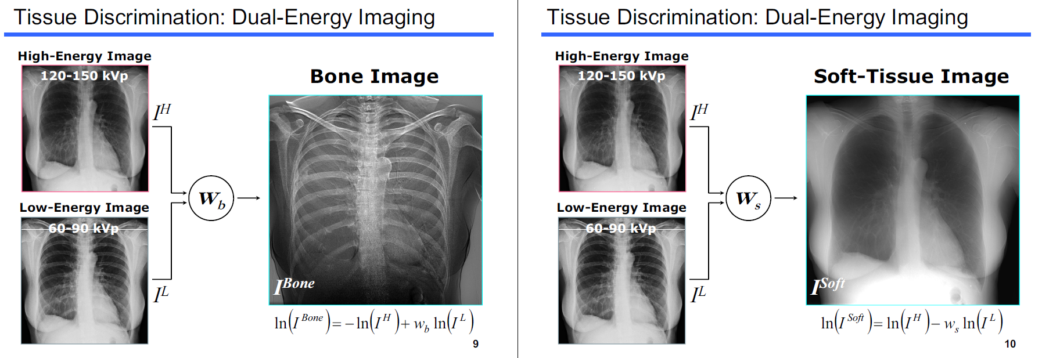
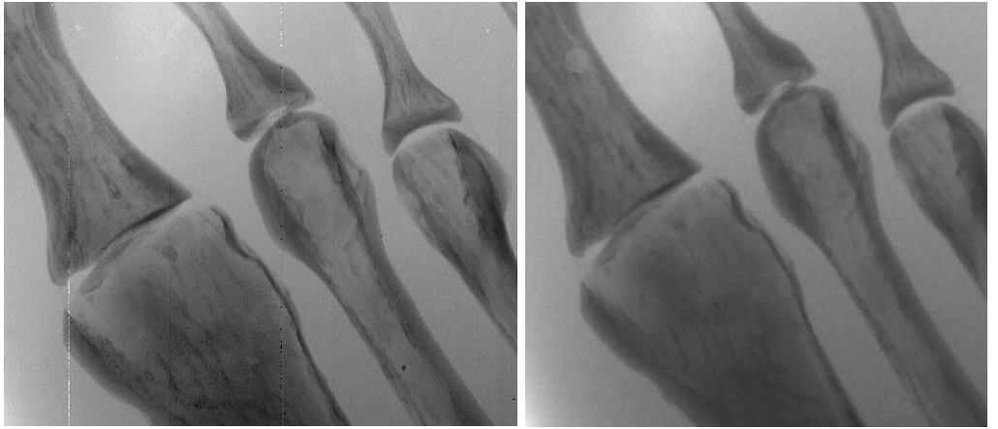
Introduction (identify a method that yields the optimal energy thresholds )
material subtraction
contrast enhancement

Slide 4
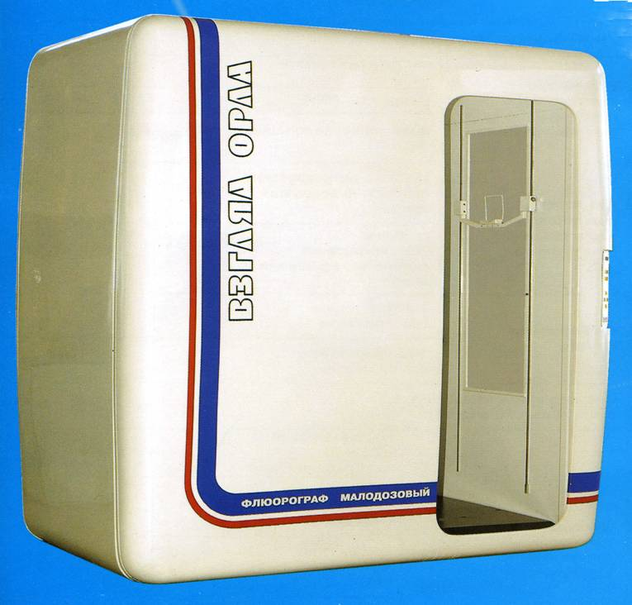

Low dose Digital Radiographic Installation (Siberia)
spatial resolution
contrast sensitivity
increased speed
dynamic range

Slide 5
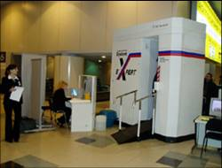
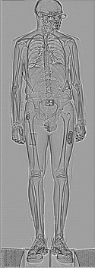
X-ray inspection system (Sibscan)
detect hidden on the body and clothing the dangerous items, weapon and explosive
ultra-Low dose of X-ray irradiation comparable to the background

Slide 6
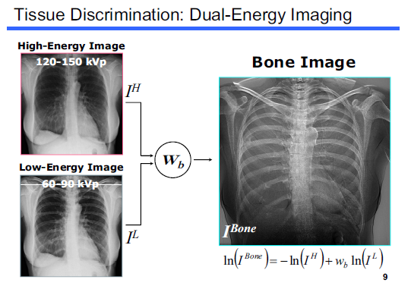
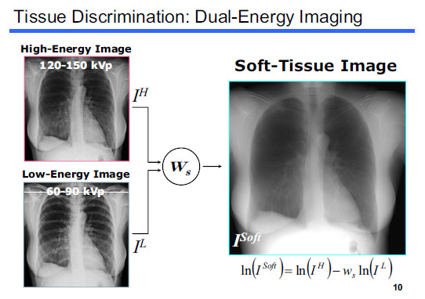
But progress does not stand still…

Slide 7

Concluding Comments

Slide 8
Thank you for your attention!

