Slide 1
Why do we sleep?
Oleynikov Vladislav Petrovich
Budker Institute of Nuclear Physics, 18 May 2015
From http://www.bbc.com/news

Slide 2
Content
5 minutes
Introduction
Warp core
Real-world theories and science
Concluding comments

Slide 3

Introduction
Sleep made our ancestors vulnerable to attack from wild animals
Some sort of evolutionary advantage

Slide 4
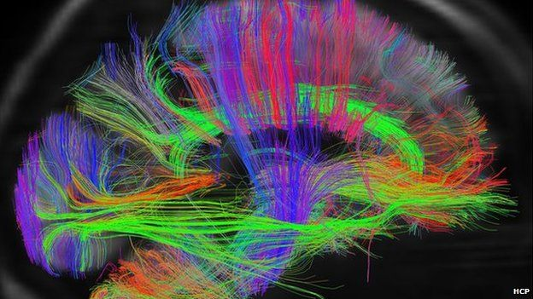
Why do I sleep?
You can think of it like having a house party. You can either entertain the guests or clean up the house, but you can't really do both at the same time

Slide 5
What happens when I don't get enough sleep?
A theoretical solution for faster-than-light travel which models the warp drive concept, called the Alcubierre drive, was formulated by physicist Miguel Alcubierre in 1994.
the energy required is still many orders of magnitude greater than anything currently possible by modern technology

Slide 6

What is the role of dreaming?

Slide 7

Concluding comments
The investigators hope to find out soon whether the old adage "early to bed and early to rise" really does make us, if not "wealthy and wise", at least "healthy and wise".

Slide 8
Thank you for your attention!

