Slide 1
Is Warp Drive Real?
Oleynikov Vladislav Petrovich
Budker Institute of Nuclear Physics, 8 May 2015

Slide 2
Content
5 minutes
Definition
Warp core
Real-world theories and science
Concluding comments

Slide 3
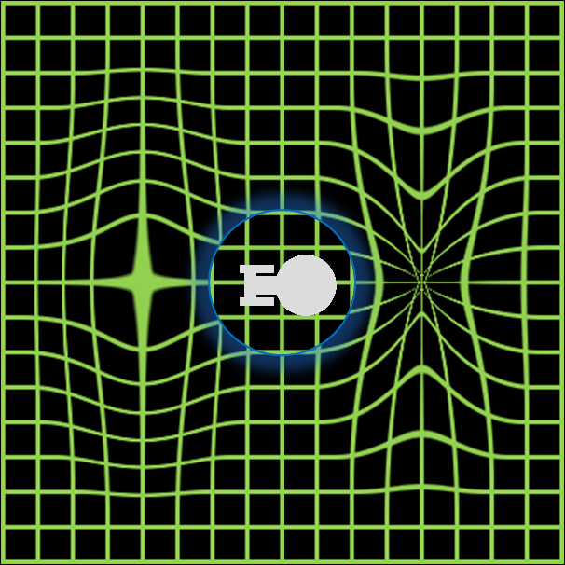
Defenition
Warp drive is a hypothetical faster-than-light (FTL) propulsion system
A spacecraft equipped with a warp drive may travel at apparent speeds greater than that of light by many orders of magnitude

Slide 4
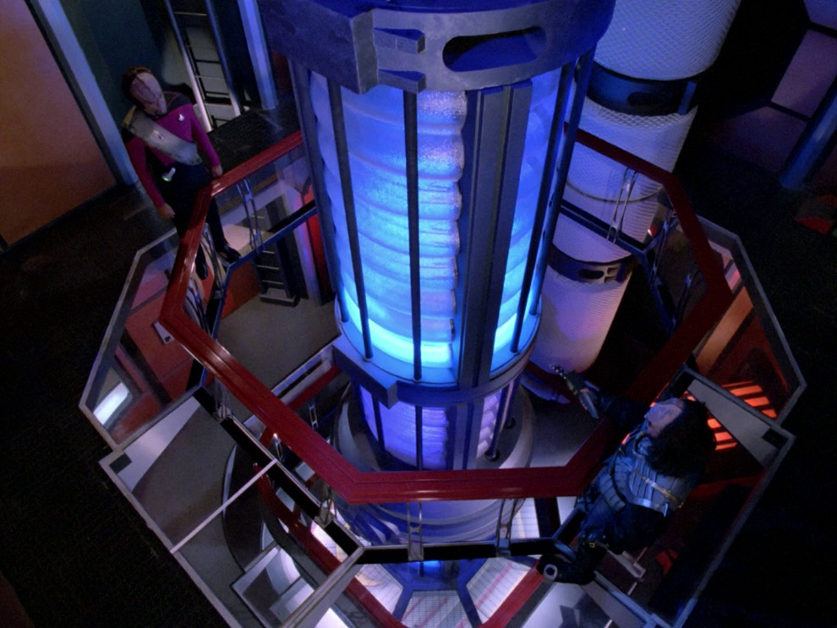
Warp core
It is a fictional reactor that taps the energy released in a matter-antimatter annihilation to provide the energy

Slide 5
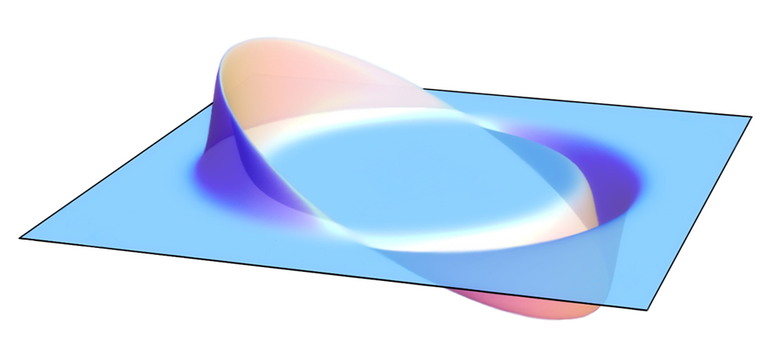
Real-world theories and science
A theoretical solution for faster-than-light travel which models the warp drive concept, called the Alcubierre drive, was formulated by physicist Miguel Alcubierre in 1994.
the energy required is still many orders of magnitude greater than anything currently possible by modern technology

Slide 6
Concluding comments
Ever since the sound barrier was broken, people have turned their attention to how we can break the light speed barrier
But “Warp Drive” or any other term for faster-than-light travel still remains at the level of speculation and for the near future, warp drive remains a dream

Slide 7
Thank you for your attention!

