Slide 1

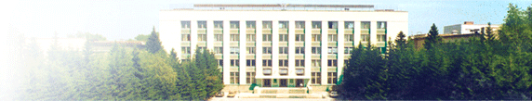
The development of digital X-ray detector for osteodensitometry
Budker Institute of Nuclear Physics
Oleynikov Vladislav Petrovich
Scientific adviser – Porosev Vyacheslav Viktorovich
Ph.D. in Physics and Mathematics, Senior Scientist

Slide 2
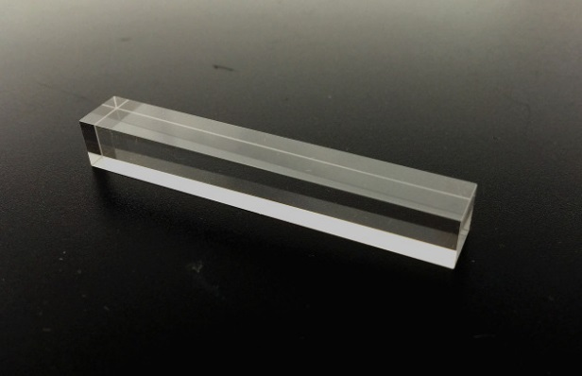
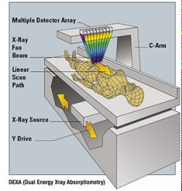
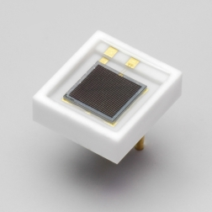
The main aim
detector
osteodensitometr

Slide 3
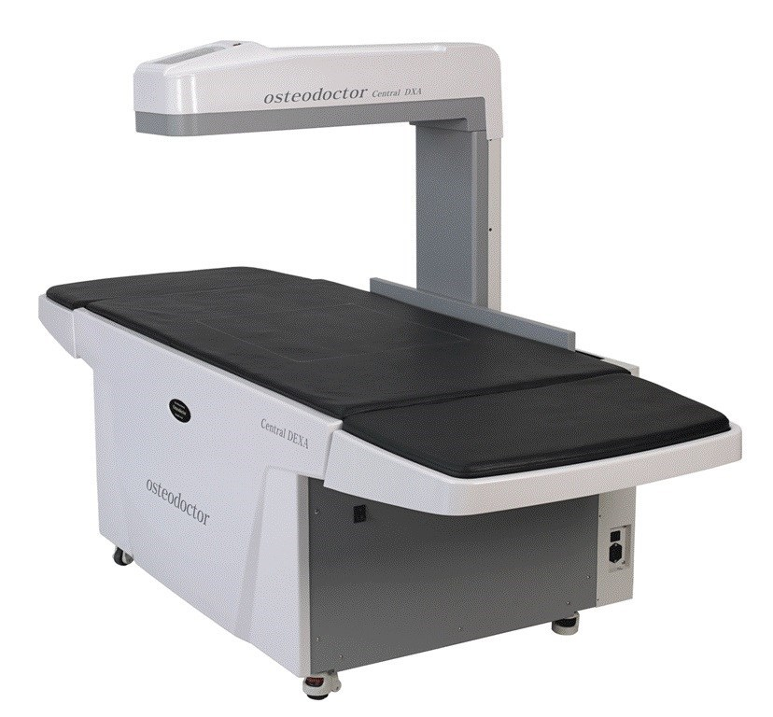
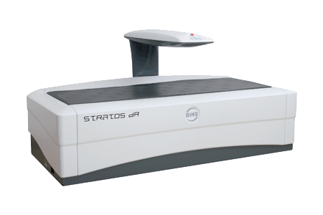
At present, densitometers are not produced in Russia
Place of Origin: South Korea
Place of Origin: France

Slide 4
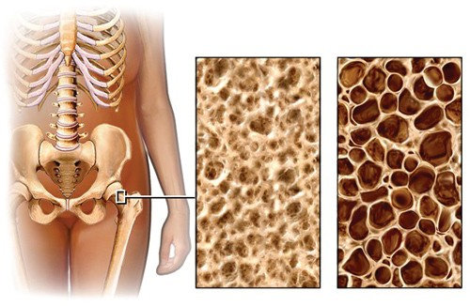
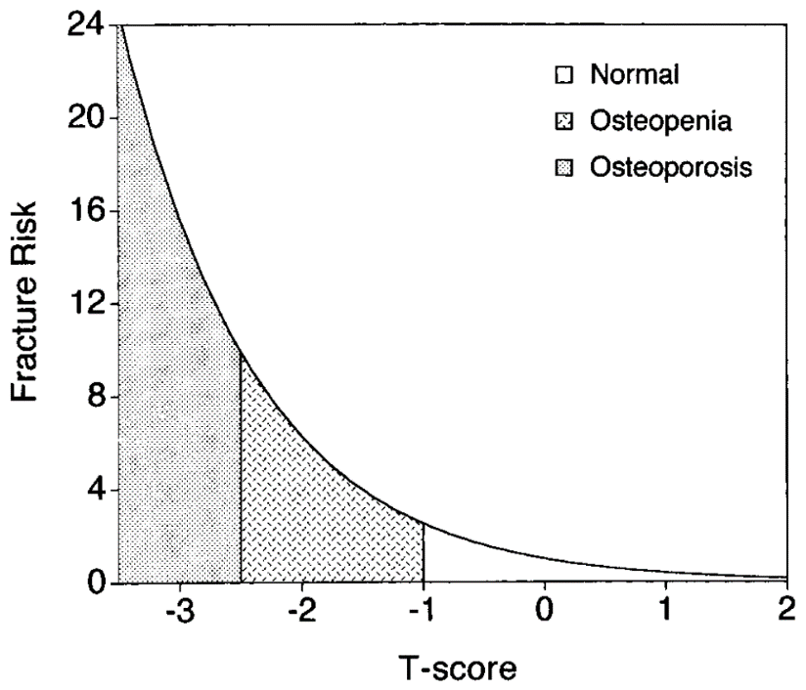
Densitometer is a device that allows to determine bone mineral density

Slide 5

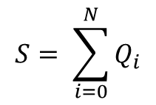



There are three main ways of collecting information from the detector
1) integrating mode (signal is proportional to the number of detected photons)
$$S= \sum_{i=0}^{N}{Q_{i}}$$
$$Var\left[S\right]=Var\left[N\right]∗{E\left[Q\right]}^{2}+Var\left[Q\right]∗{E\left[N\right]}^{2}$$
2) counting mode (allows to distinguish each individual X-ray photon)
$$S=Q_{i}$$
$$Var\left[S\right]=Var\left[Q\right]$$
3) spectrometric mode (we not only separates each individual photon, but also register its energy)
$$S=Q_{i}$$
$$Var\left[S\right]=Var\left[Q\right]$$

Slide 6
The detector
SiPM
Scintillator
non-hygroscopic
bright
fast
high density and atomic number
high energy resolution

Slide 7
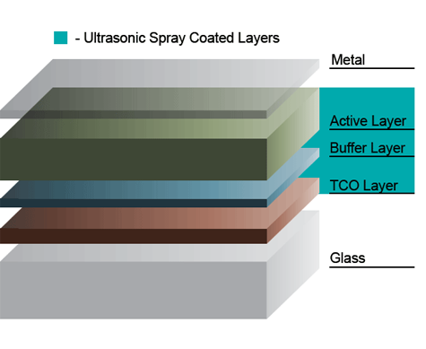
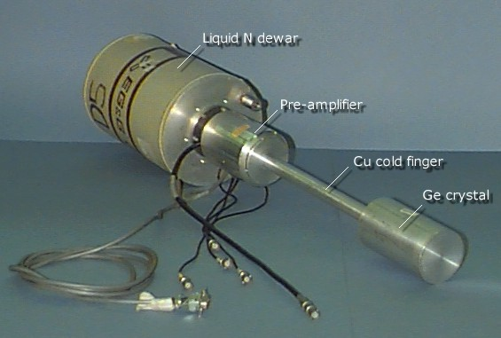
Two scintillators
YAP:Ce or LuYAG:Pr
CdTe is not technologically and requires special electronics
HPGe is too expensive for everyday use, because it requires cooling

Slide 8
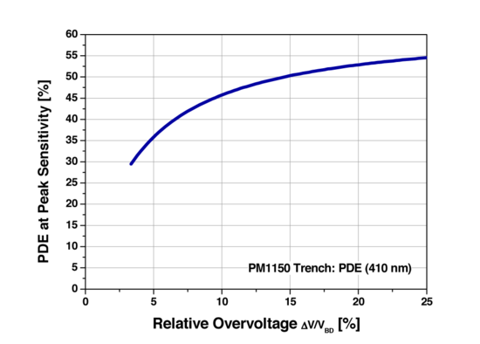
Selection of SiPM
The main characteristic significantly affecting the energy resolution is quantum efficiency
KETEC

Slide 9
What is necessary energy resolution of the detector?
17% energy resolution at the energy of 59.5 keV
SiPM KETEC
YAP:Ce
20% (FWHM at an energy of 40 keV (estimation)

Slide 10
Self-consistent model
the response of the detector
the incident X-ray spectrum
the number of particles in it
the error of determining bone density

Slide 11
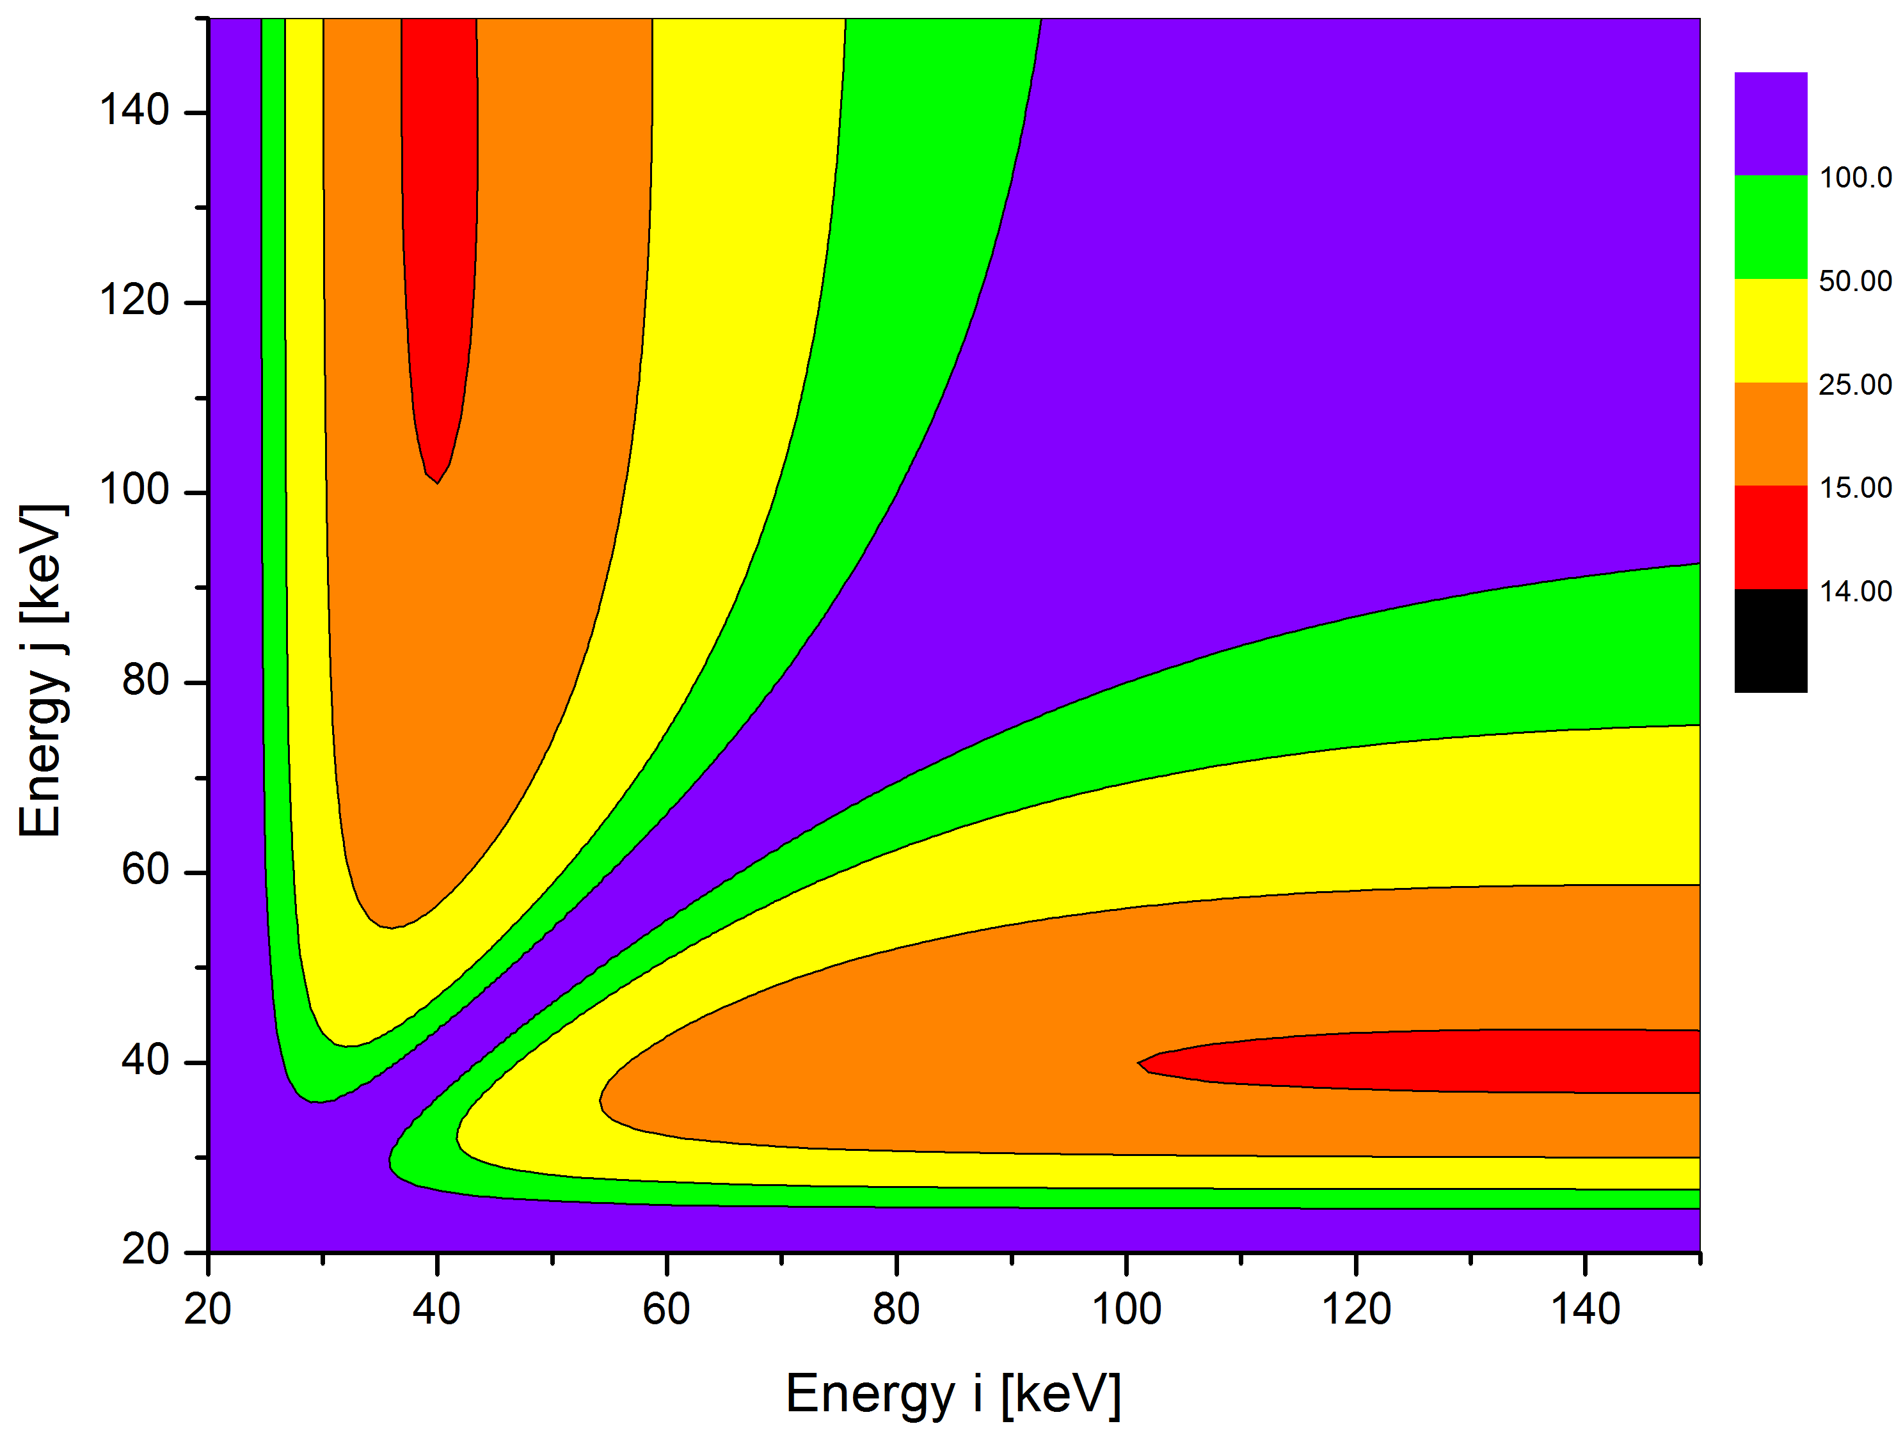
The case of two monoenergetic sources

Slide 12
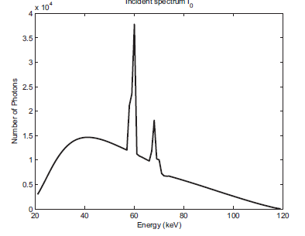
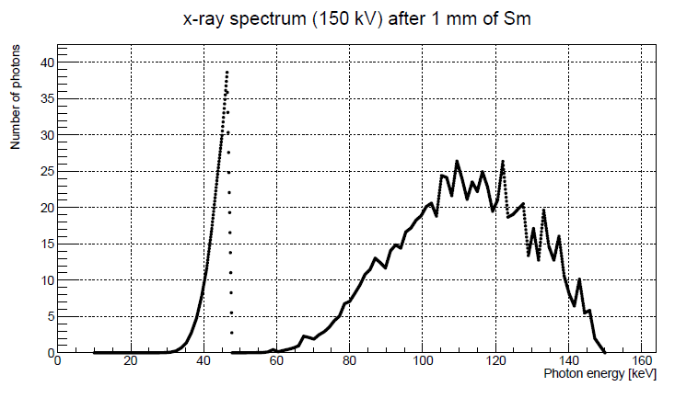
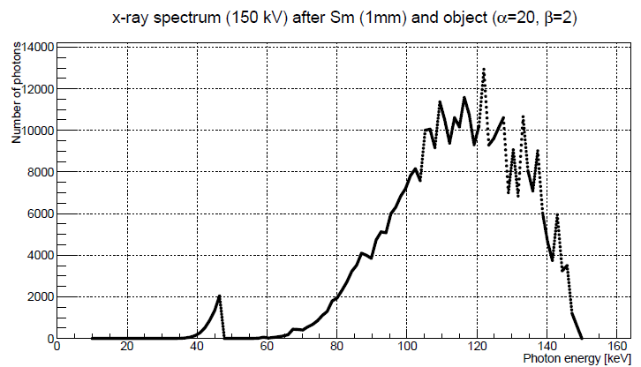


At present
a more precise and complex model

Slide 13
Conslusions
one produced detector based on the combination of SiPM - scintillator allowing to achieve 17% energy resolution at the energy of 59.5 keV with high counting rate
The model of the two monoenergetic sources allowing in the first approximation to estimate the error of determining bone density was considered

Slide 14
Thank you for your attention!

