Slide 1
An Overview of Foresight Methodologies
Oleynikov Vladislav Petrovich
Budker Institute of Nuclear Physics, 9 April 2015

Slide 2
Introduction
Foresight is “a university human capacity which allows people to think ahead and consider, model, create and respond to future eventualities” (Foresight International, 2006).

Slide 3
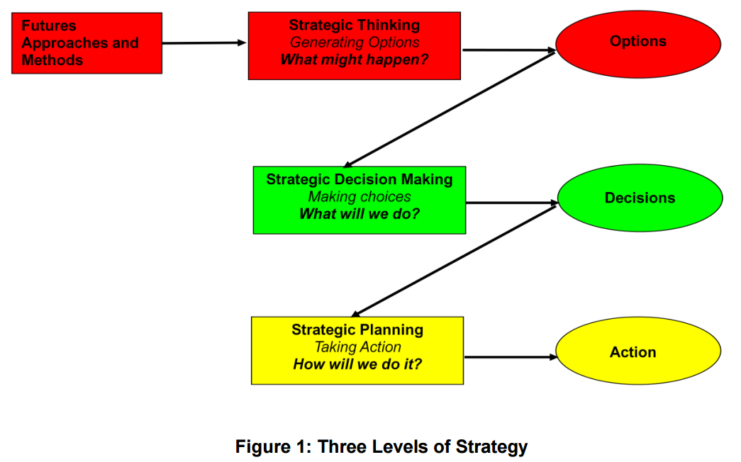
Organisational Strategy Processes

Slide 4
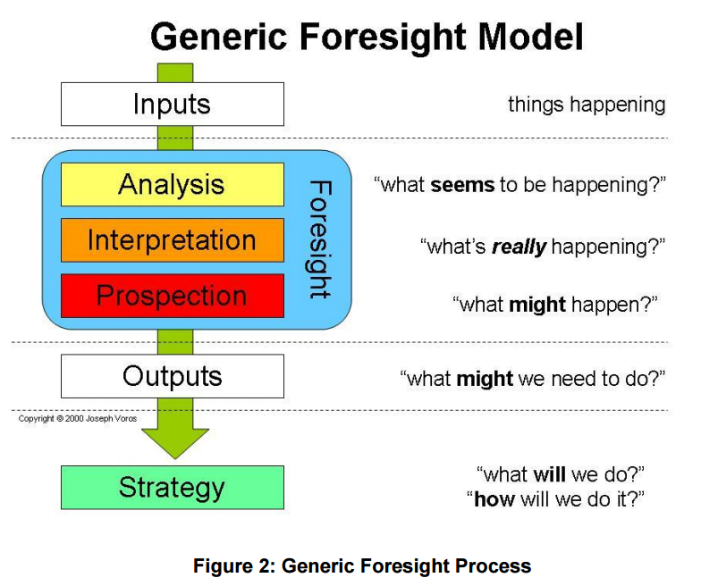
Foresight Methodologies

Slide 5
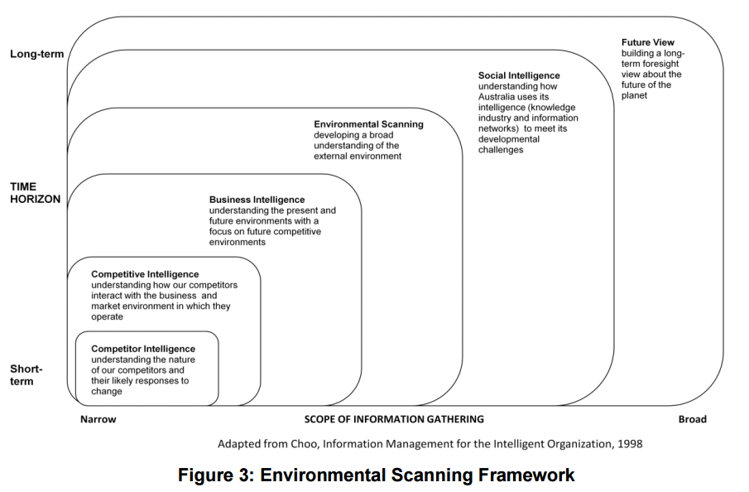
Input Methods: what’s going on?

Slide 6
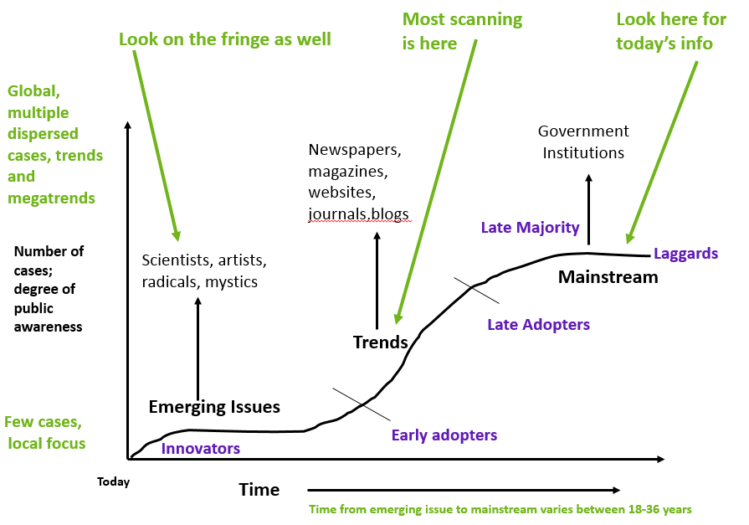
Analytical Methods: what seems to be happening?

Slide 7
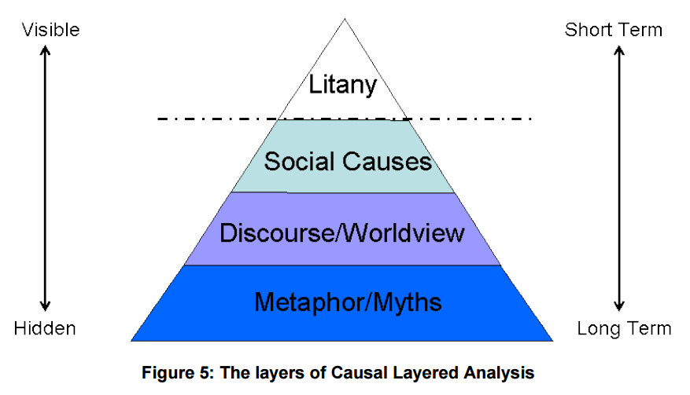
Interpretive Methods: what’s really happening?

Slide 8
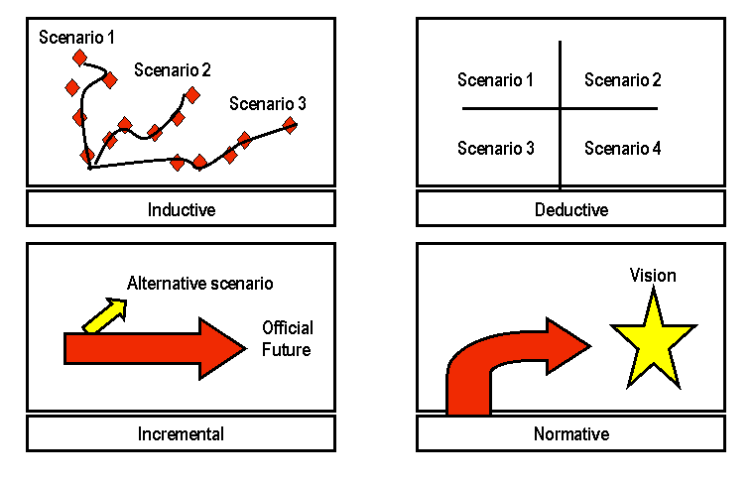
Prospective Methods: what might happen?

Slide 9

Concluding Comments

Slide 10
Thank you for your attention!

