Slide 1
An application of the foresight method in my work
Oleynikov Vladislav Petrovich
Budker Institute of Nuclear Physics, 9 April 2015

Slide 2
Content
Introduction (generic foresight model)
Input method
Analysis method
Prospection method
Concluding comments

Slide 3
Content
5 minutes
Introduction (generic foresight model)
Input method
Analysis method
Prospection method
Concluding comments

Slide 4
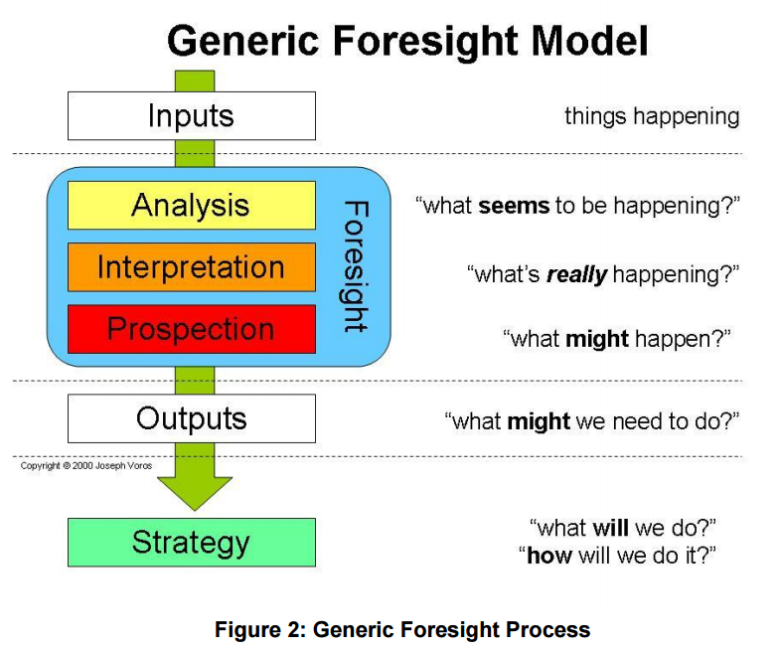
A generic foresight model

Slide 5
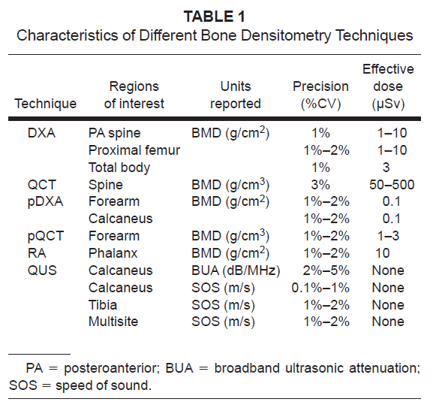
Input Methods: what’s going on?

Slide 6
Input Methods: what’s going on?
We want to develop the device with the same characteristics (or better)

Slide 7
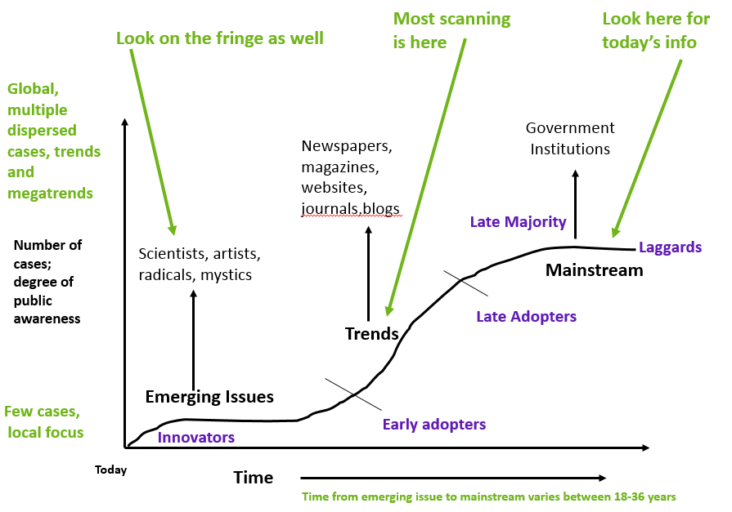
Analytical Methods: what seems to be happening?

Slide 8
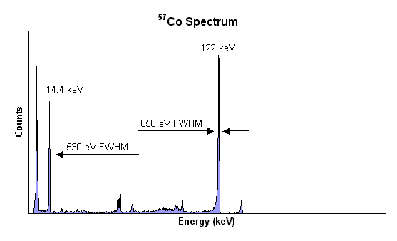
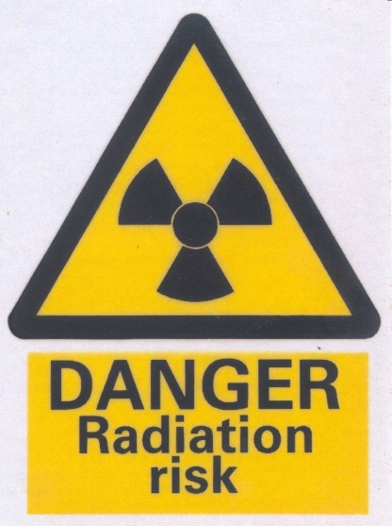
DXA is the “gold standard”, but …
the better the energy resolution,
the lower dose a person receives

Slide 9
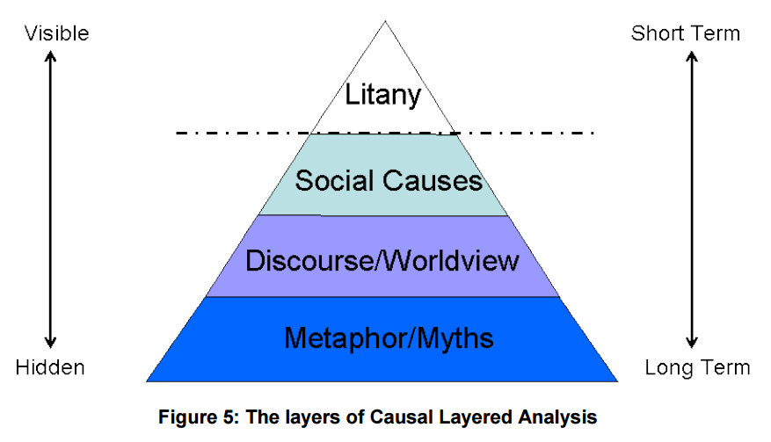
Interpretive Methods: what’s really happening?

Slide 10
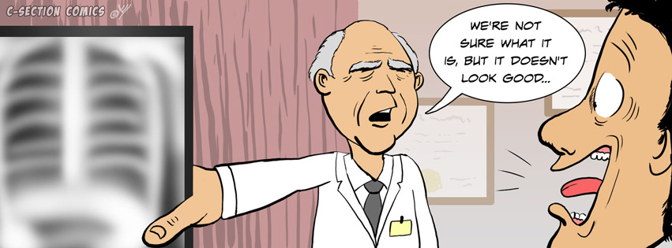

Social causes
to Improve x-ray medicine
to take care
of elderly people

Slide 11
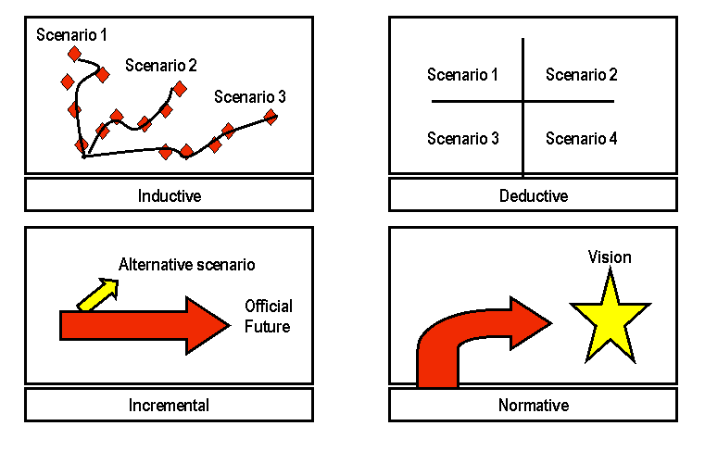
Prospective Methods: what might happen?

Slide 12
Three ways of development the DXA
Scenario 1
We will use the CdTe detector with the good energy resolution and low emission time
Scenario 2
We will use the SiPM-scintillator detector with the worse energy resolution but shorter emission time
Scenario 3
We will use the combination of these detectors

Slide 13

Concluding Comments
I have examined the application of foresight methods
This work really was useful for me

Slide 14
Thank you for your attention!

