Slide 1
Article abstracting Optimal Energy Thresholds and Weights for Separating Materials Using Photon Counting X-Ray Detectors with Energy Discriminating Capabilities
Adam S. Wang and Norbert J. Pelc (authors)
Departement of Electrical Engineering, Stanford University, Stanford, CA
Oleynikov Vladislav Petrovich
Budker Institute of Nuclear Physics, 20 April 2015

Slide 2
Content
5 minutes
Introduction
Model
Maximum-Likelihood Estimator for binned data
Conclusion

Slide 3
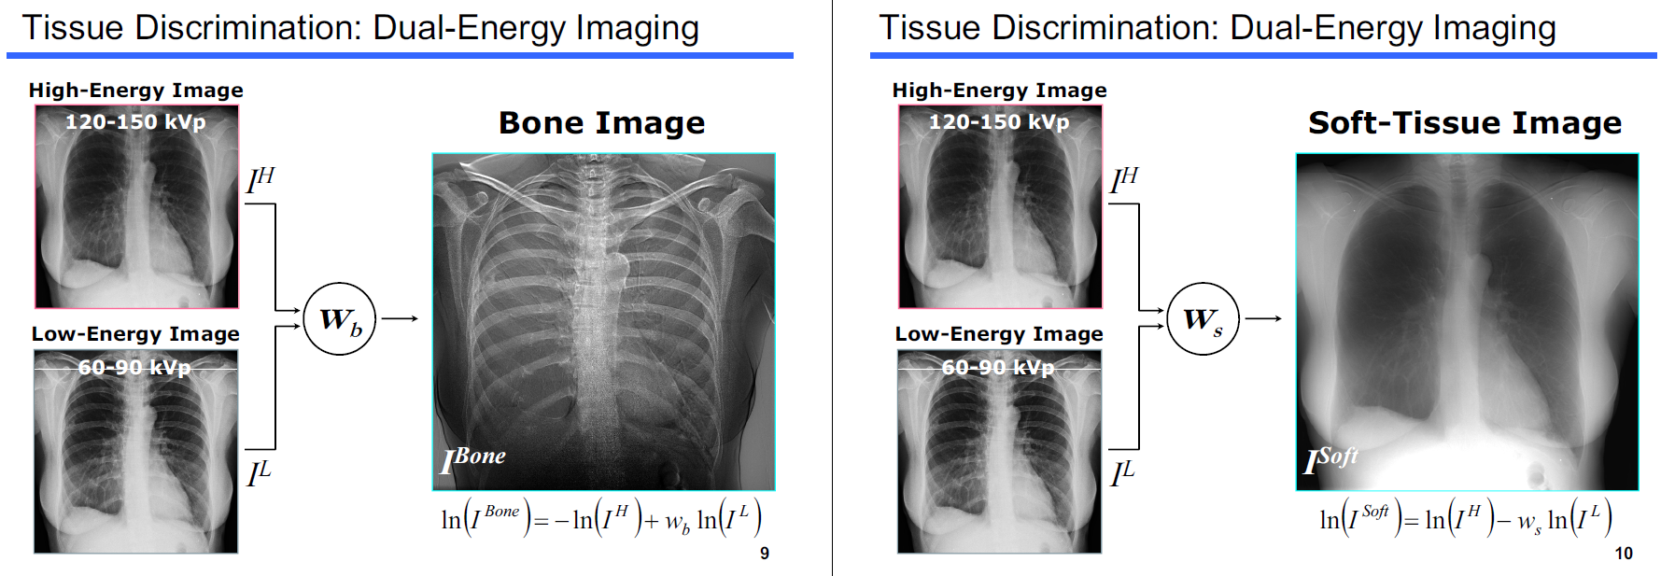
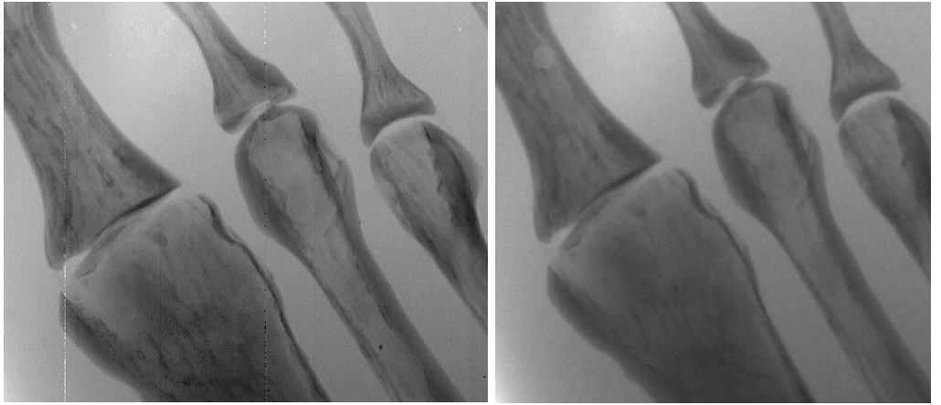
Introduction (identify a method that yields the optimal energy thresholds )
material subtraction
contrast enhancement

Slide 4

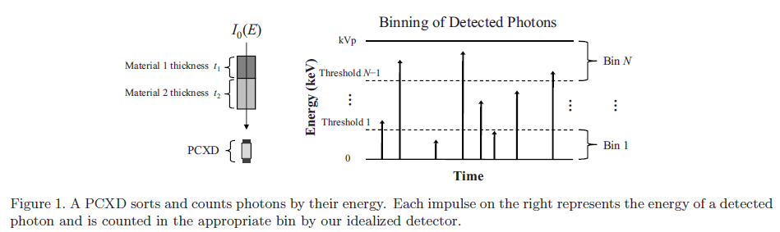
Model
the thicknesses of material 1 and 2, respectively
the expected number of photons of energy j
the number of photons of
energy j that fall on the detector

Slide 5
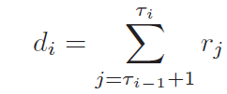
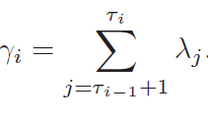
Model
The number of detected counts in bin i
Because di is a sum of Poisson random variables,
di is itself a Poisson random variable with mean
for i = 1, . . . , N, and where {τi} are the cutoff threshold energies, with τ0 = 0 and τN = M.

Slide 6
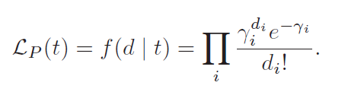

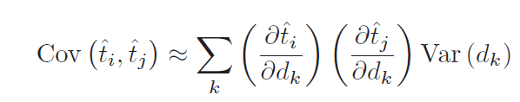
Maximum-Likelihood Estimator for binned data (Estimator Performance)

Slide 7
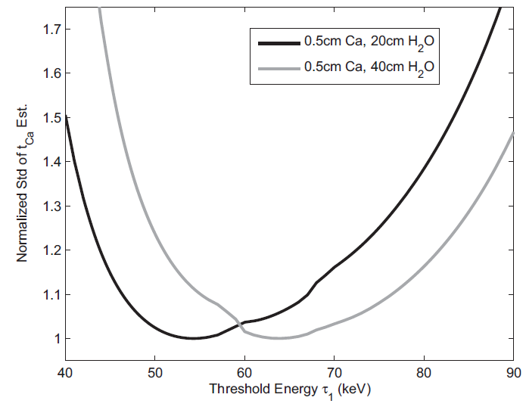
Maximum-Likelihood Estimator for binned data (Numerical Example)
For two energy bins, the normalized standard deviation of ˆtCa is shown as a function of threshold energy τ1.

Slide 8
Conclusion
PCXDs offer a wealth of new information about the object being measured that traditional energy integrating detectors cannot assess
Their work offers new insight into increasing the precision of material or basis function decomposition.

Slide 9
Thank you for your attention!

