Slide 1


Scintillator Non-Proportionality: Why a Constant Isn’t a Constant…
William W. Moses
Lawrence Berkeley National Laboratory
October 21, 2011
This work supported by the National Nuclear Security Administration, Office of Defense Nuclear Nonproliferation, Office of Nonproliferation Research and Development (NA-22) of the U.S. Department of Energy under Contract No. DE-AC02-05CH11231.

Slide 2
Light Yield
BGO 8,200 photons/MeV
NaI:Tl 38,000 photons/MeV
CsI:Tl 60,000 photons/MeV
LSO 28,000 photons/MeV
LaCl₃:Ce 50,000 photons/MeV
LaBr₃:Ce 63,000 photons/MeV
Fundamental Scintillator Constant

Slide 3
Non-Proportionality
Light Yield Not Constant
Depends on Particle Energy & Type

Slide 4
1950’s: Non-Proportionality First Studied
Alkali Halides (NaI & CsI)
Different Particle Types (γ, β, p, α, Light & Heavy Nuclei, Fission Fragments, …)
~4 Orders of Magnitude Energy Range
Question Studied: Why Does Light Yield Depend on Particle Type & Energy?

Slide 5
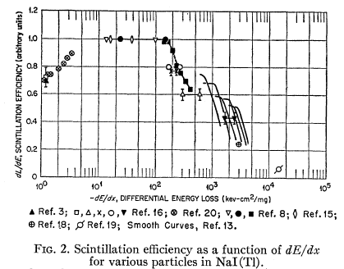
Light Yield Correlated with Ionization Density • Mechanism: Saturation of Luminescent Centers
Scintillation Efficiency
(dL/dE)
Ionization Density (dE/dx)
Work Stopped in Late 1960’s
Figure from R. B. Murray & A. Meyer, Phys. Rev. 122, pp. 815–826, 1961

Slide 6
1991: LSO Discovered
BGO
LSO
662 keV
9.9% fwhm
662 keV
9.4% fwhm
~4x More Light Than BGO, But Same Energy Resolution
Why Isn’t Resolution Dominated by Counting Statistics?

Slide 7
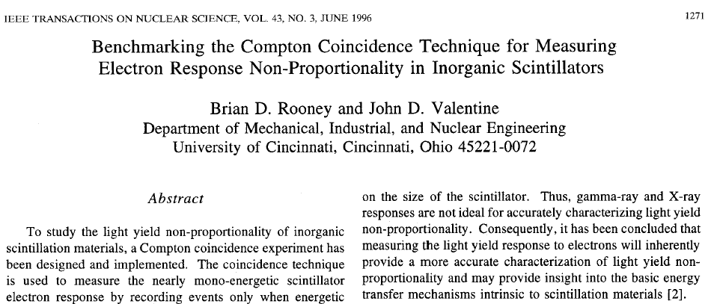
1995: Non-Proportionality Resurrected to Explain Poor Energy Resolution
Interest Growing Steadily (for γ spectroscopy / excitation…)

Slide 8
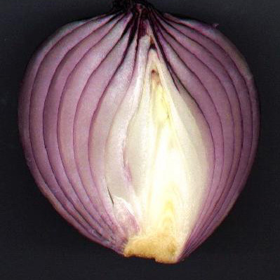
How Does Non-Proportionality Affect Energy Resolution?
The Onion Model…

Slide 9
Layer 1: Photon Response

Slide 10
Initial Interaction: Compton vs. Photoelectric
Scintillator
Photoelectric
Incident Gamma
Compton
Photoelectric
Non-Proportionality + Multiple Energy Deposit
⇒ Degraded Energy Resolution

Slide 11
Energy Resolution for Small LSO Crystal
LSO – 2 mm Cube
LSO – 1 cm Cube
662 keV
10.7% fwhm
662 keV
9.4% fwhm
• Large Difference in Photoelectric Fraction
• No Difference in Energy Resolution
⇒ There Must Be Something More…

Slide 12
Photoelectric Interactions
W
K
L
M
Valence
γ
photoelectron
• Usually Occur with Inner Shell Electrons
⇒ Inner Shell Hole Filled via Cascade

Slide 13
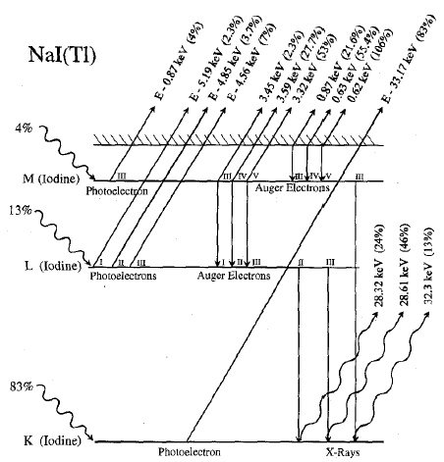
Simplified Cascade Diagram for NaI
1–4 keV
Auger Electrons
Different
Photoelectron
Energies
~30 keV
Fluorescent
X-Rays
83% K-Shell
Interactions
Many Energetic (>1 keV) Particles Created
Fluorescent X-Rays & Auger Electrons
Figure from B.D. Rooney & J.D. Valentine, IEEE Trans. Nucl. Sci. 44, pp. 509–516, 1997

Slide 14
Cascade After Photoelectric Interaction
Photoelectron
Initial Gamma
Fluorescent X-Ray
Auger Electrons
Non-Proportionality + Multiple Energy Deposit
⇒ Degraded Energy Resolution

Slide 15
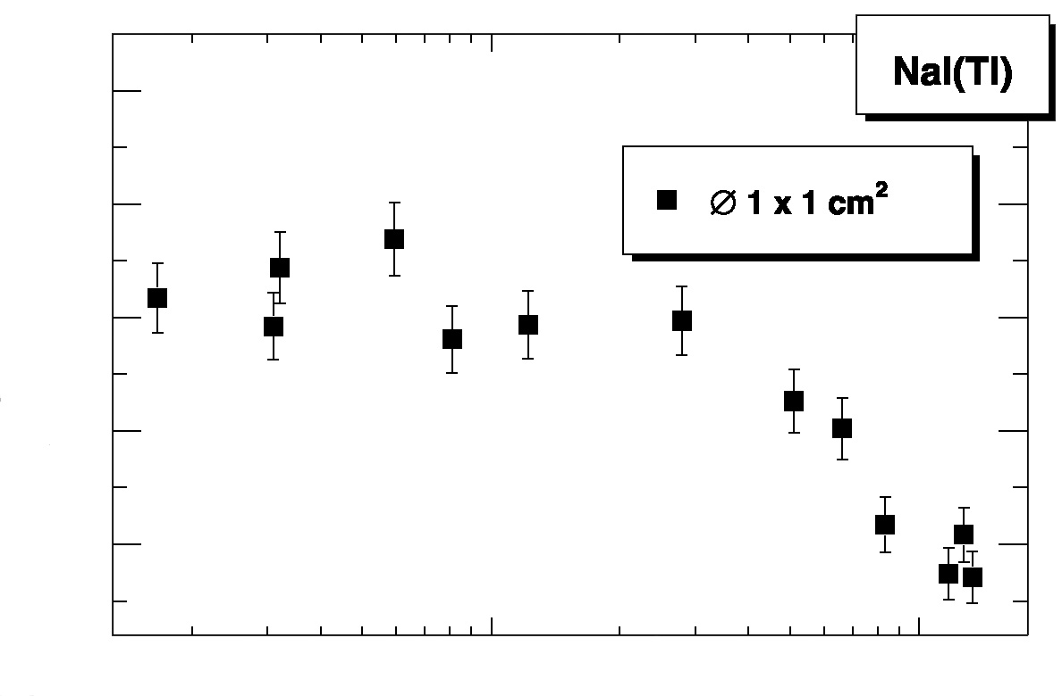

Photon Response
Scintillator
1.50
Monochromatic Gamma
1.38
1.25
Relative Light Yield
1.13
1.00
Photodetector
10
10²
10³
Energy (keV)
Structure in Photon Response Curve
Includes Many Confounding Effects
Figure from M. Moszyński, et al., Nucl. Instr. Meth. A-484, pp. 259–269, 2002

Slide 16
Layer 2: Electron Response

Slide 17
Electron Response
Scintillator
Monochromatic Electron
Photodetector
Surface Effects
Sample Charging

Slide 18
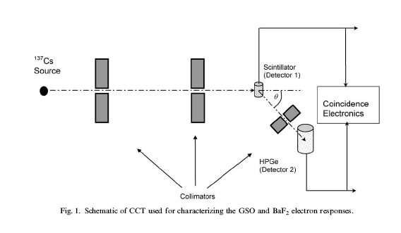
How Is Electron Response Measured?
Compton Coincidence Technique
662 keV Gamma Compton Scatters in Scintillator
Energy of Scattered Gamma Measured in HPGe
Plot Light Output vs. Electron Energy (E_{γ}–E_{HPGe})
Figure from J.D. Valentine, et al., Nucl. Instr. Meth. A-486, pp. 452, 2002

Slide 19
Compton Interactions
W
K
L
M
Valence
γ
Compton electron
• Usually Occur with Outer Shell Electrons
⇒ All Energy Transferred to e– (No Cascade)

Slide 20
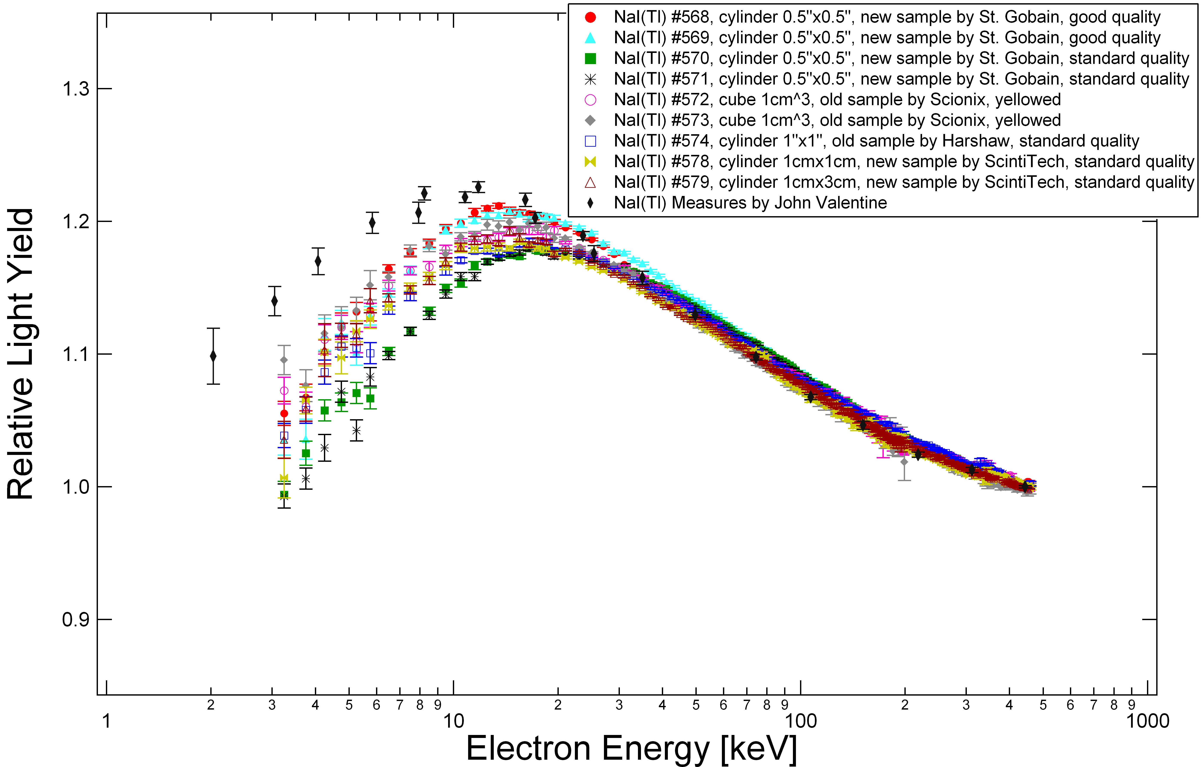
Electron Response vs. Photon Response
Photon Response
Electron Response
1.50
1.3
1.38
1.2
Relative Light Yield
1.25
Relative Light Yield
1.1
1.13
1.0
1.00
0.9
10
10²
10³
1
10
10²
10³
Photon Energy (keV)
Electron Energy (keV)
Electron Response Has Less Structure
Photon Response Can Be Qualitatively Predicted from Electron Response & Cascade
Figure on left from M. Moszyński, et al., Nucl. Instr. Meth. A-484, pp. 259–269, 2002
Data on right from G. Hull, et al., IEEE Trans. Nucl. Sci. 56, pp. 331–336, 2009

Slide 21
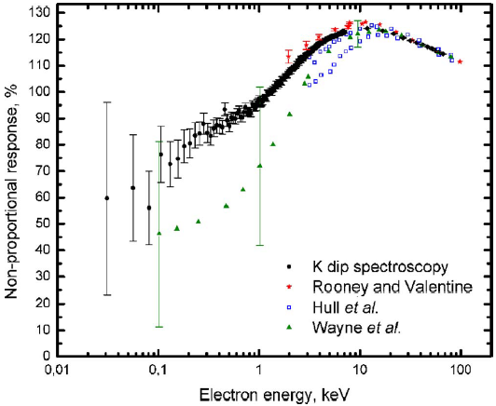
How Is Electron Response Measured?
K-Dip Spectroscopy
NaI:Tl
W
K L M Valence
W
K L M Valence
γ
E= E_{K}
γ
E= E_{K}+1
Photo-electron
(E= 0 keV)
Photo-electron
(E= 1 keV)
Total Light =
Light (K-shell hole) +
Light (0 keV electron)
Total Light =
Light (K-shell hole) +
Light (1 keV electron)
Synchrotron X-Ray Ejects K-Shell Electron
Measure Light, Subtract “Offset” from K-Shell Filling
Measures Electron Response From Tenths of keV to Tens of keV
Figure from I.V. Khodyuk, et al., J. Appl. Phys. 107, pp. 113513, 2010

Slide 22
Do Primary Compton & Core Holes / Cascade Completely Explain Resolution Degradation?
NaI:Tl
Electron
Excited
Gamma
Excited
Counting Stats
No!!! There Must Be Something More…
Figure from W.W. Moses, et al., IEEE Trans. Nucl. Sci. NS-55, pp. 1049, 2008

Slide 23
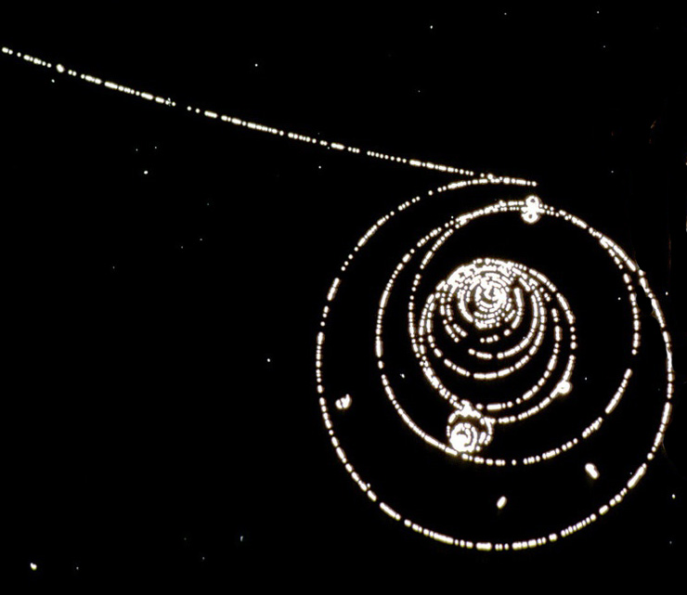
Electron Energy Deposit Still Non-Uniform!
Landau Fluctuations
Delta Ray
γ→e⁺e– in Bubble Chamber

Slide 24
Layer 3: Ionization Density

Slide 25
Yield Depends on Electron Ionization Density
Non-Proportionality + Non-Uniform Energy Deposit
⇒ Degraded Energy Resolution

Slide 26
Model Fluctuations in Light Output Along the Electron Track
Bethe-Block Equation
⇒ Gives ionization density (dE/dx) as function of E
Landau Equation
⇒ Gives variation in ionization density (dE/dx)
Measured Electron Response
⇒ Gives scintillation efficiency as function of E
Compute Variance in Light Produced at Each Point
Integrate Variance Along Track To Get Total Variance

Slide 27
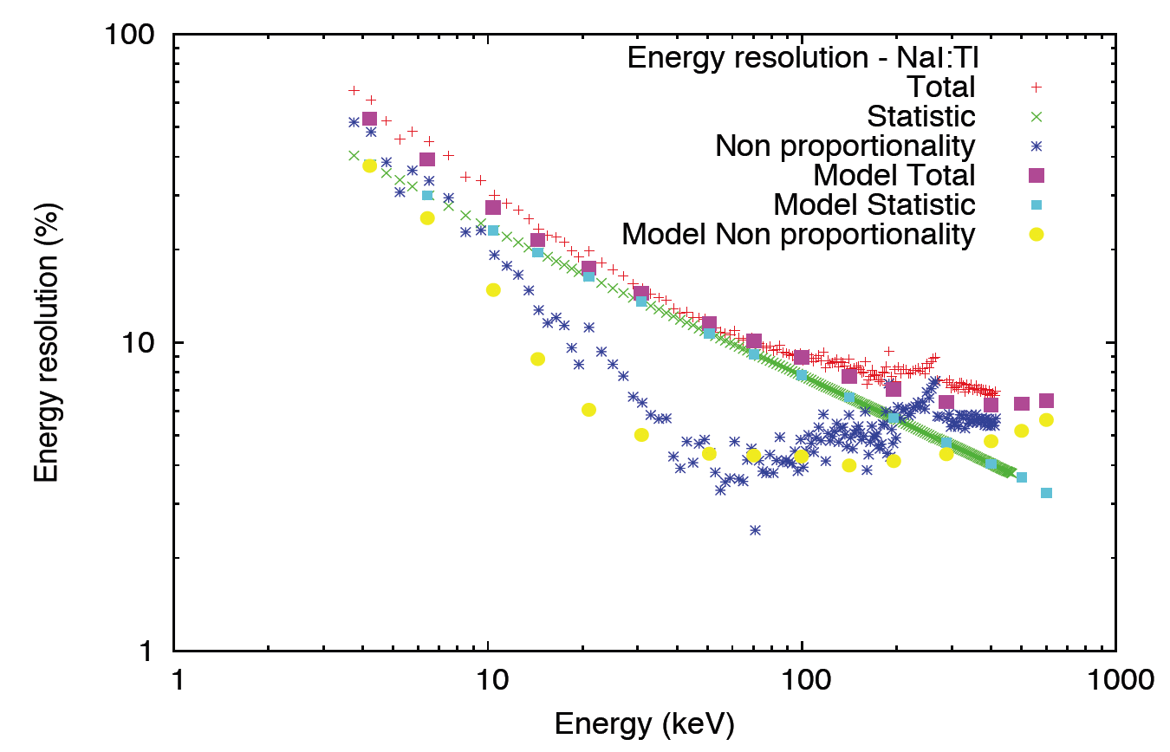
Success!!!
Given the Electron Response for a Material, Can Quantitatively Predict the Energy Resolution
Figure from G. Bizarri, et al., Presentation I8-2 at SCINT09, Jeju Island, Korea

Slide 28
Can We Understand the Shape of the Electron Response Curve?

Slide 29
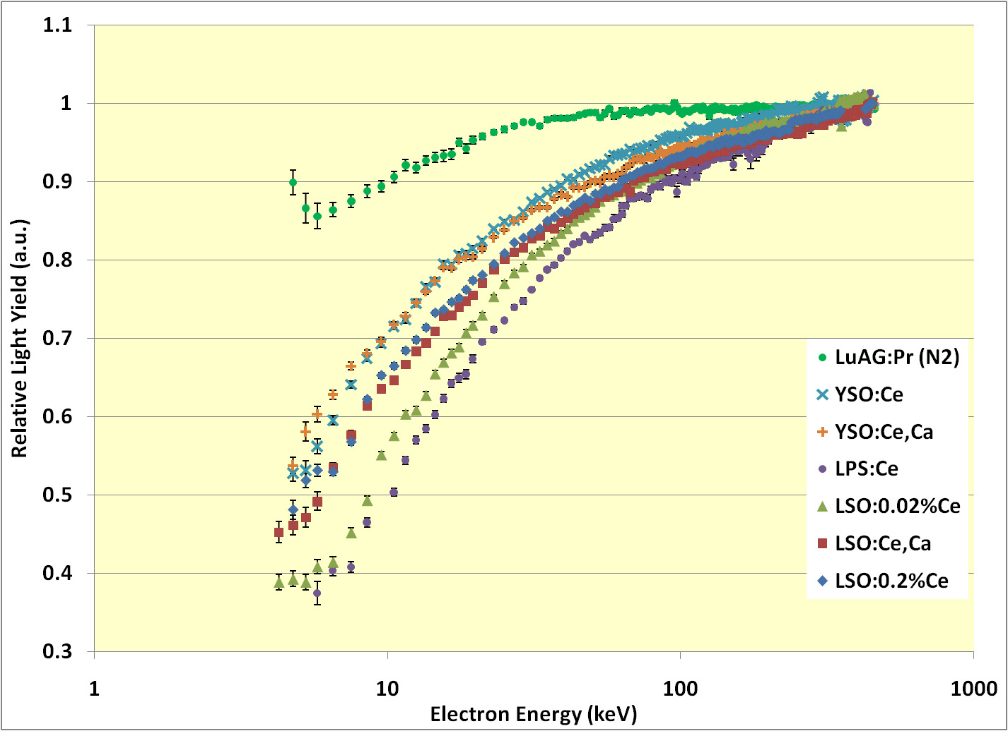
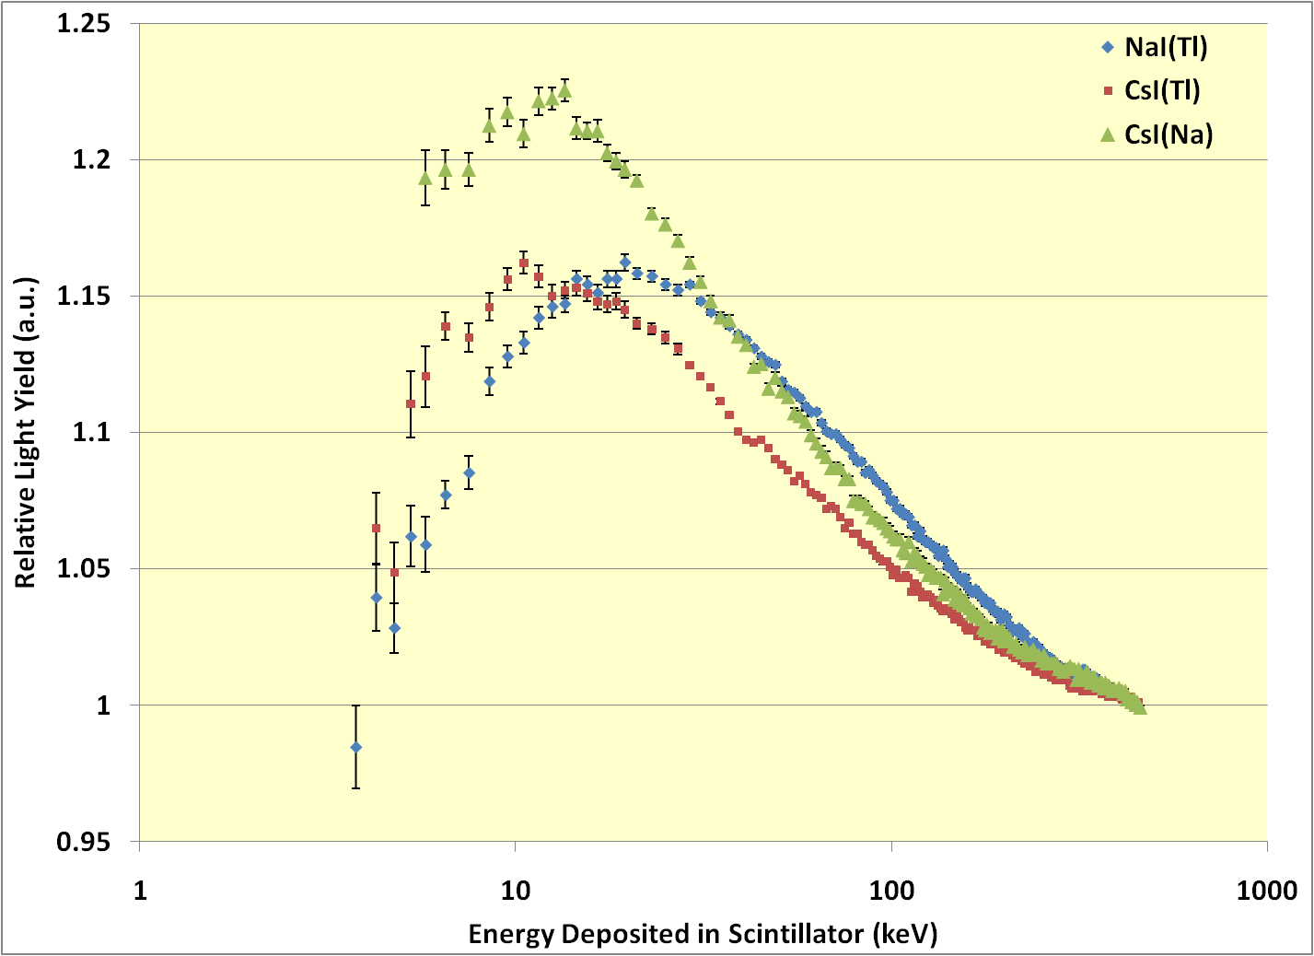
What Creates the Shape of the Electron Response Curve?
Oxides
Alkali Halides
Decrease at High Ionization Density
(All Materials)
Decrease at Low Ionization Density
(~Only Alkali Halides)
Key Empirical Observation:
Light Output Depends on Ionization Density

Slide 30
Competing Processes for e/h Recombination
One Voxel
Electron Ionization Track
h
e
h
e
e
e
h
Non-Radiative Trapping
Exciton Formation
Electron / Hole / Exciton Interactions
Luminescence
e
e
h
h
h
e
h
h
e
h
h
e
h
e
e
e
e
h
e
e
h
e
h
e
h
h
h
h
h
e
h
e
e
e
h
e
h
h
h
e
h
Many Ways for e/h Pairs in a Voxel to Recombine
Not All Recombinations Produce Light
Processes Depend on Ionization Density

Slide 31
Pause for Definitions
Exciton: A bound state of a hole and an excited electron
Moves as a single particle through the lattice
Frequently de-excites radiatively (by emitting a photon)
Auger Process: Two particles in excited states turn into one particle in an excited state
Initial State: Two excited state particles (e, hole, or exciton)
They Collide!
Energy from Particle 1 transferred to Particle 2
Particle 1 is now in the ground state (without radiating)
Particle 2 now has extra energy, which it tends to lose by thermalization (i.e., without radiating photons)

Slide 32
Approach 1: Minimalist Model (Steve Payne)
Only Excitons Luminesce
Free electrons or holes get trapped / quenched
Excitation Density Assumed To Be Independent of Time
Initial ionization density used
At High Excitation Density, Auger-Like Quenching Occurs
Colliding excitons de-excite
“Birks” mechanism
At Low Excitation Density, Exciton Formation Hindered
Separated electrons & holes can’t “find each other”
Some “geminate” excitons (formed at time zero)
Two Free Parameters:
“Strength” of Auger Quenching (Birks Parameter)
Fraction of Geminate Excitons

Slide 33
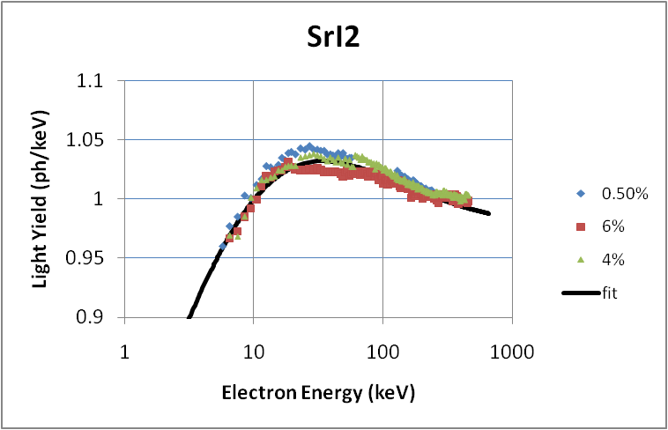
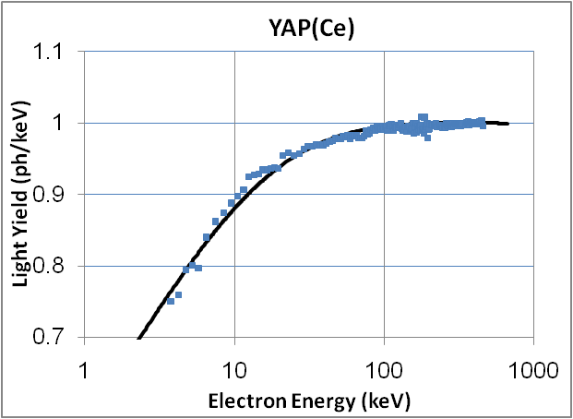
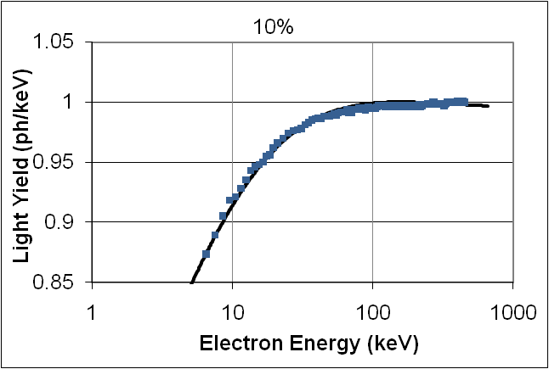
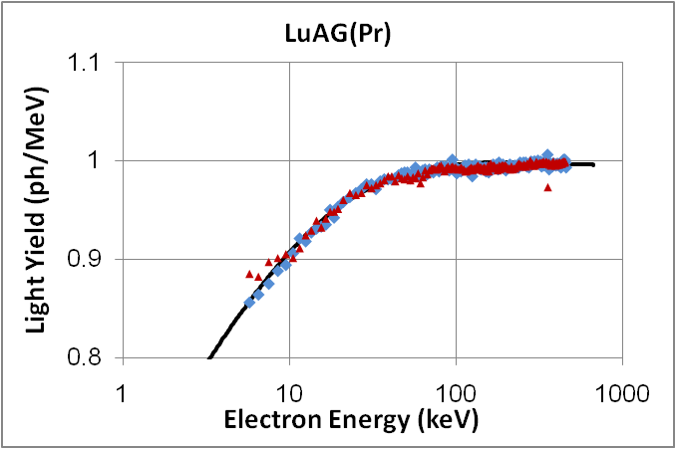
Excellent at Fitting Electron Response, But Can’t Predict It
Scintillator | η_{e/h} | (dE/dx)_{BIRKS}
Alkali Halides
CsI(Tl) | 36 % | 556 MeV/cm
CsI(Na) | 39.5 | 667
NaI(Tl) | 53.4 | 166
Simple Oxides
YAG(Ce) | 10 | 526
GYGAG(Ce) | 22 | 599
YAP(Ce) | 12 | 606
LuAG(Ce) | 8.8 | 752
LuAG(Pr) | 11 | 806
Silicate Oxides
LSO(Ce) | 13 | 185
GSO(Ce) | 7 | 556
YSO(Ce) | 13 | 167
LPS(Ce) | 5 | 125
Fluorides
CaF₂(Eu) | 0 | 333
CeF₃(Ce) | 0 | 313
Organics
Std Plastic | 0 | 91
Ir:Plastic | 0 | 200
Liquid | 0 | 111
Stilbene | 0 | 80
PVK | 0 | 91
Multivalent Halides
SrI₂(Eu) | 24 | 454
Undoped SrI₂ | 44.5 | 159
LaBr₃(Ce) | 15.5 | 444
LaCl₃(Ce) | 22 | 345
Tungstate
Cd(WO₄) | 20 | 454
SrI₂(Eu)
LaBr₃(Ce)
Data from S. Payne, et al., Presentation 7805-18 at 2011 SPIE Meeting

Slide 34
Approach 2: Kinetic Model (G. Bizarri, S. Kerisit, J. Singh, A. Vasil’ev, R. Williams…)
Excitation Density Assumed To Depend on Time
Rate equations determine propagation with time
Several Carrier Species are Present
Free electrons, free holes, and excitons
Some “geminate” excitons formed
Several Emission Mechanisms Occur
Excitonic emission
Sequential free electron & free hole capture
Several Quenching Mechanisms Occur
Colliding excitons de-excite (“Birks” mechanism)
Trapping on impurities / defects
The Processes are Described by Kinetic Rates
Many More Processes Can Participate
Different Dependences on the Ionization Density

Slide 35
General Rate Equation for One Species
Radiative Recombination Terms:
First and second order (with ionization density)
Non-Radiative Recombination Terms:
First, second, and third order (with ionization density)
Multiple Species (excitons, free electrons, free holes):
Separate equation needed for each species
Conversion / coupling terms also needed
General Concept Seems Correct, But…
Too Many Rate Constants Needed to Describe System
Must Simplify Somehow!!!

Slide 36
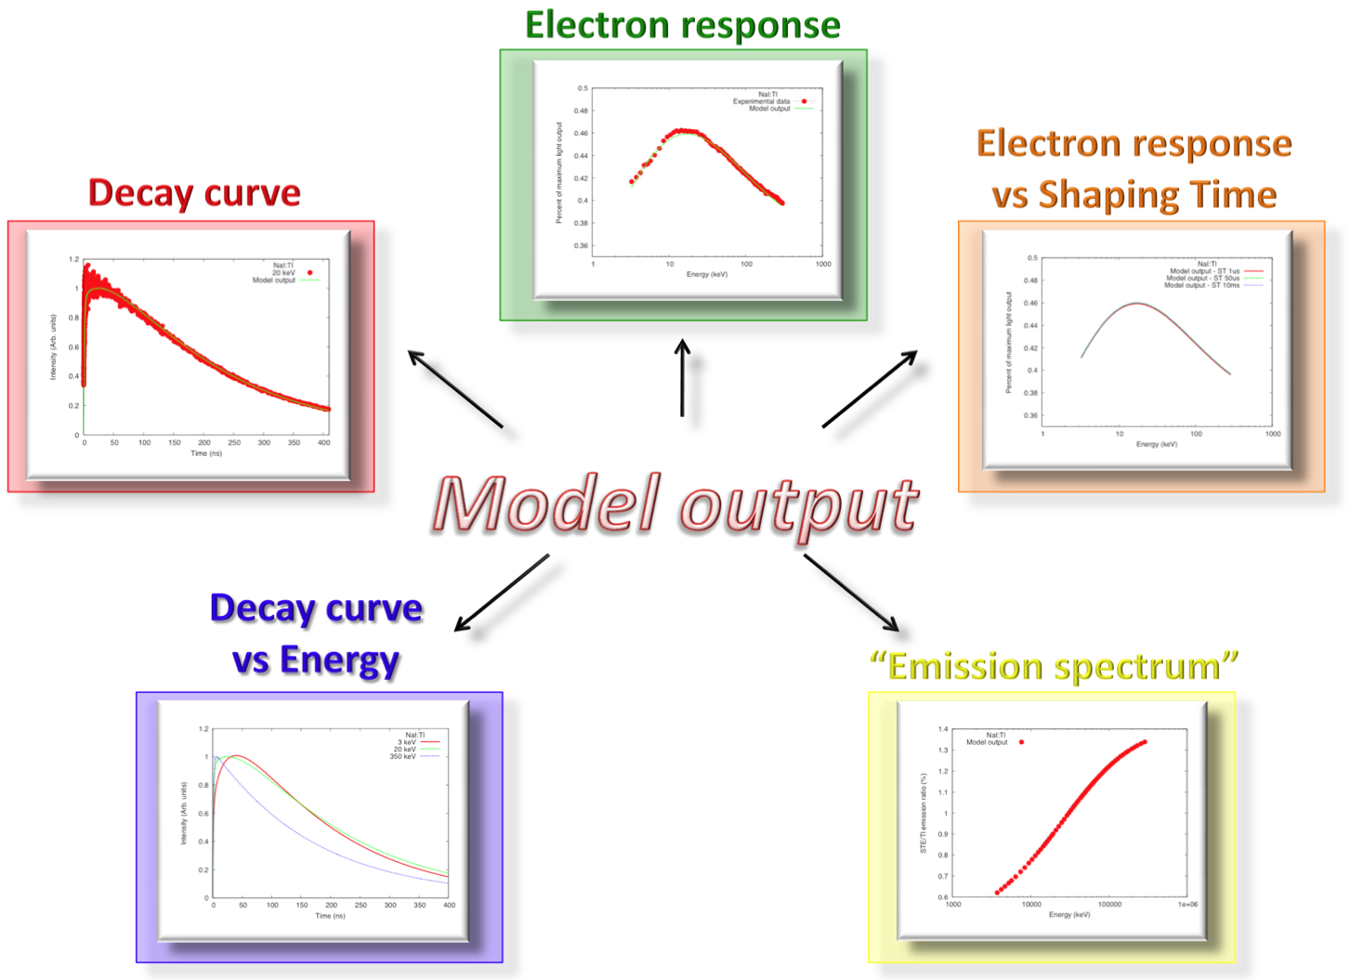
Model Reproduces Multiple Features
Figure from G. Bizarri, et al., Presentation at 2008 NSS/MIC, Dresden, Germany

Slide 37
Approach 3: Diffusion Model (Richard Williams)
Non-Proportionality Depends on Volumetric Ionization Density
Bethe-Bloch Equation Gives Linear Ionization Density
Need Track Radius to Compute Volumetric Ionization Density
Electron
Path
Electron Distribution
Hole Distribution
Electrons & Holes Diffuse After Creation
Diffusion Diameter Greatly Affects Ionization Density

Slide 38
Ratio of Electron & Hole Mobilities Important
μ_{hole} << μ_{electron}
μ_{hole} ≈ μ_{electron}
Electron
Path
Hole Distribution
Electron Distribution
Ratio of Diameters ∝ Ratio of Mobilities
Similar Diameters ➔ High Recombination Probability
μ_{hole} ≈ μ_{electron} ➔ Proportional Scintillator

Slide 39
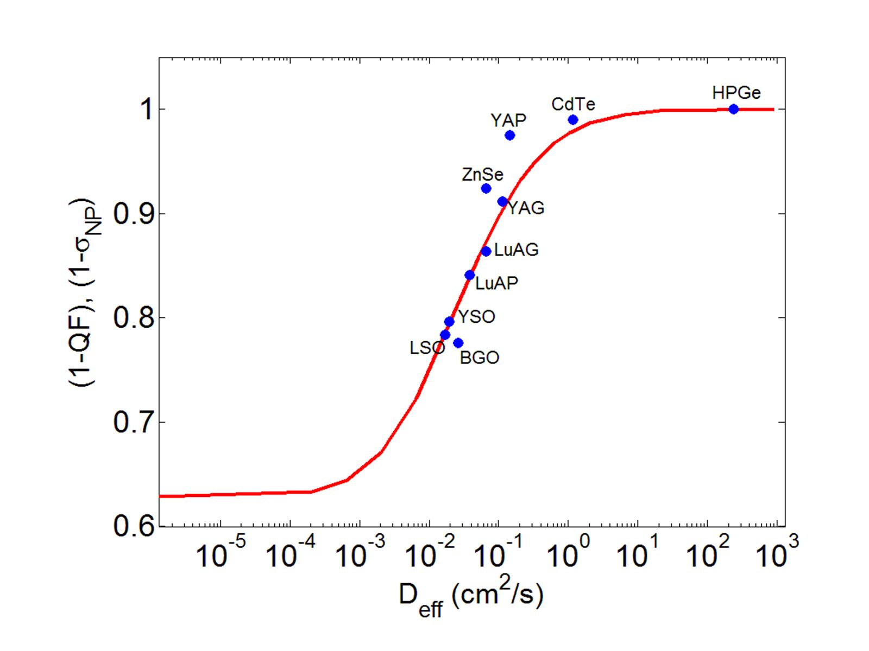
Value of (Hole) Mobility Important
Sets time scale to reach equilibrium
High mobility implies that electrons & holes separate rapidly ➔ Ionization density becomes Very low in a Very short time ➔ Auger (non-radiative) processes are Greatly suppressed!
Measured Light Yield at Low Electron E
This is Why Solid-State Detectors are Proportional!!!
Modeled Survival Probability at 10 ps
(Related to Light Yield at Low Electron E)
Figure from R. Williams, et al., SCINT11, Giessen, Germany
High Hole Mobility ➔ Proportional Scintillator

Slide 40
Engineering Electron Response

Slide 41
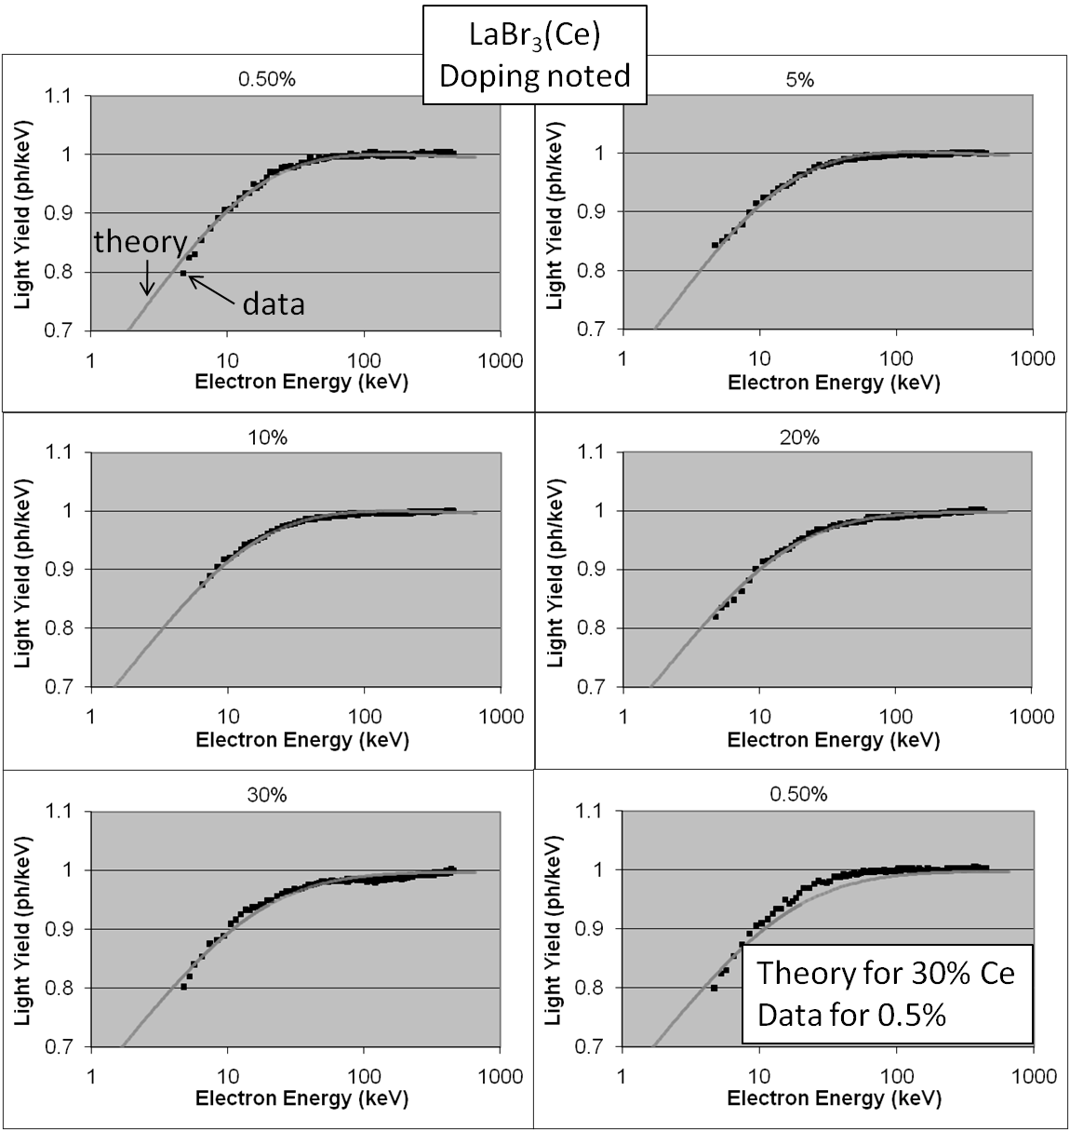
What Affects Electron Response? Dopant Concentration?
LaBr₃:Ce
LSO:Ce
Dependence on Dopant Concentration is Small
Data from S. Payne, et al., Presentation 7805-18 at 2011 SPIE Meeting

Slide 42
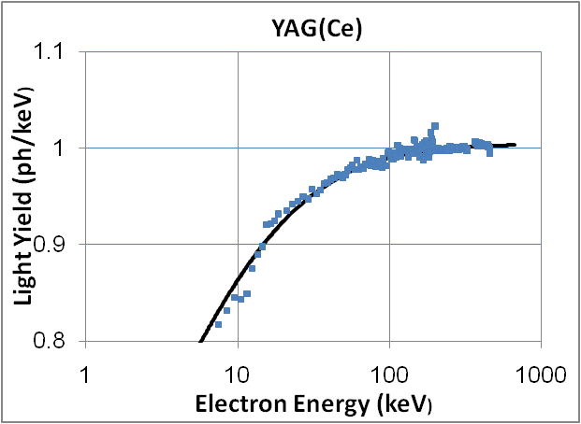
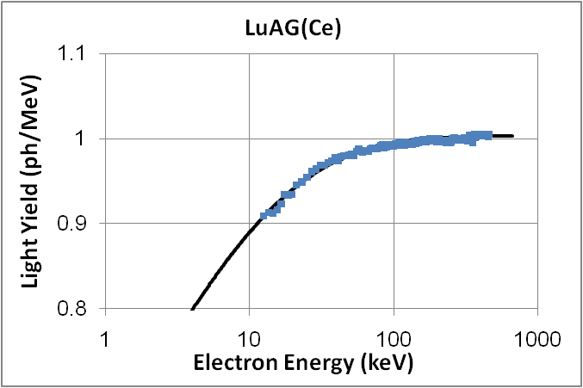
What Affects Electron Response? Crystal Structure?
Major Differences in LuAG / LSO / LPS System
Data from S. Payne, et al., Presentation 7805-18 at 2011 SPIE Meeting

Slide 43
Sample to Sample Variation in NaI:Tl
Modeling Results: Quenching Due To Auger & Traps
Data from G. Hull, et al., IEEE Trans. Nucl. Sci. NS-56, pp. 331–336, 2009

Slide 44
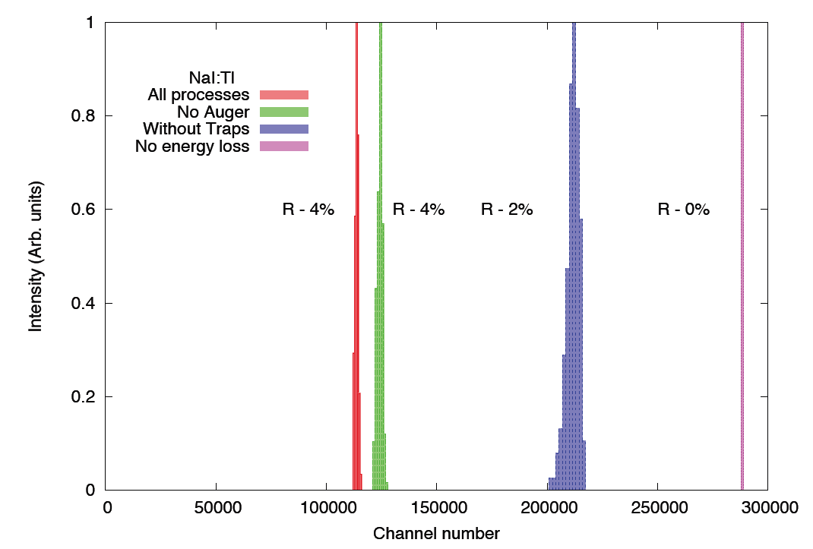
Use Model to Predict Energy Resolution if Quenching Removed in NaI:Tl
Potential to Reach 4–5% Energy Resolution @ 662 keV?
Figure from G. Bizarri, et al., Presentation I8-2 at SCINT09, Jeju Island, Korea

Slide 45
Conclusion:
A Few Layers Peeled, but
Plenty of Onion Left!

Slide 46


Thanks To:
John Valentine, SAIC
Gregory Bizarri, LBNL
Steve Payne, LLNL
Giulia Hull, IPN Orsay
Richard Williams, Wake Forest University
Andrey Vasil’ev, Moscow State University
And Many, Many More, Including…
IEEE NPSS Distinguished Lecturer Program
http://www.ieee-npss.org

