Slide 1
(run 744)
Сampaign V
Oleynikov Vladislav
06 Dec 2018

Slide 2
Code:
1) run_744.root file from Simone

Slide 3
Cut list:
bool cls0_is_S1 = clusters.at(0)->f90 > 0.2;
bool cls0_is_full = clusters.at(0)->rep == 1;
bool cls0 = nc_i == 0;//cluster 0
bool cls1 = nc_i == 1;//cluster 1
bool is_S1 = nc == 2 && cls0 && cls0_is_full && cls0_is_S1;
bool is_S2 = nc == 2 && cls1 && cls0_is_full && cls0_is_S1;
bool is_S1_only = nc == 1 && cls0_is_full && cls0_is_S1;
bool is_S2_v2 = is_S2 && clusters.at(1)->f90 < 0.2;
bool region_of_S2_uniformity =
(clusters.at(1)->pos_x > 2.2) && (clusters.at(1)->pos_x < 2.8) &&
(clusters.at(1)->pos_y > 2) && (clusters.at(1)->pos_y < 3);
bool is_good_r537_v1 = is_S1_S2 && region_of_S2_uniformity && clusters.at(0)->charge > 300 && clusters.at(0)->charge < 700;

Slide 4
Ph1, Am241, run 744
V_top = 34V (7 OV)
V_bot = 68V (7 OV)

Slide 5
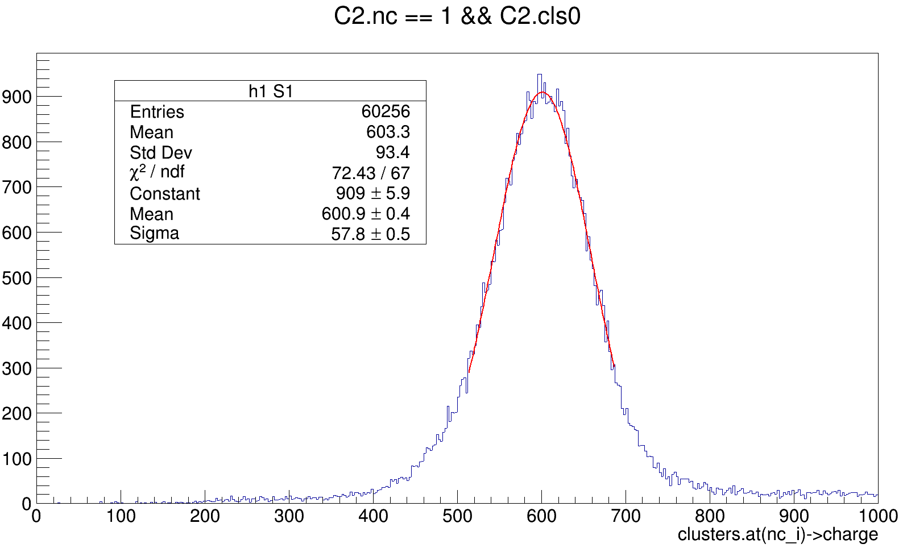
Ph1, Am241, run 744

Slide 6
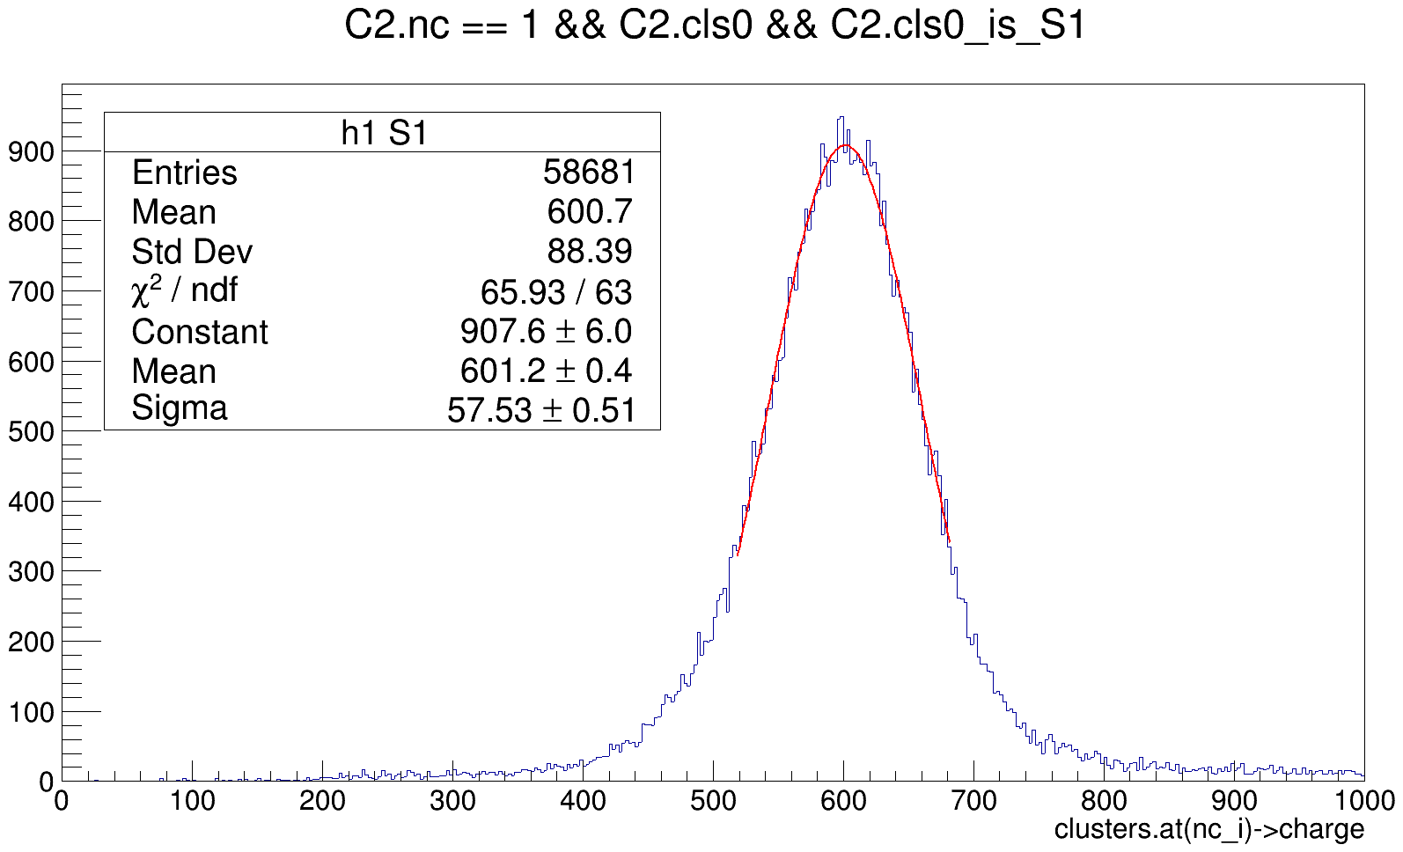
Ph1, Am241, run 744

Slide 7
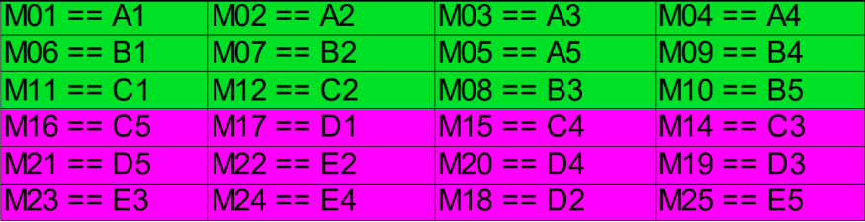
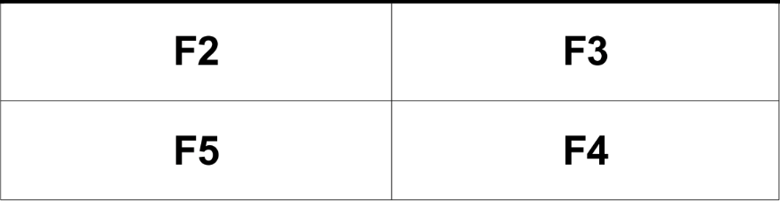
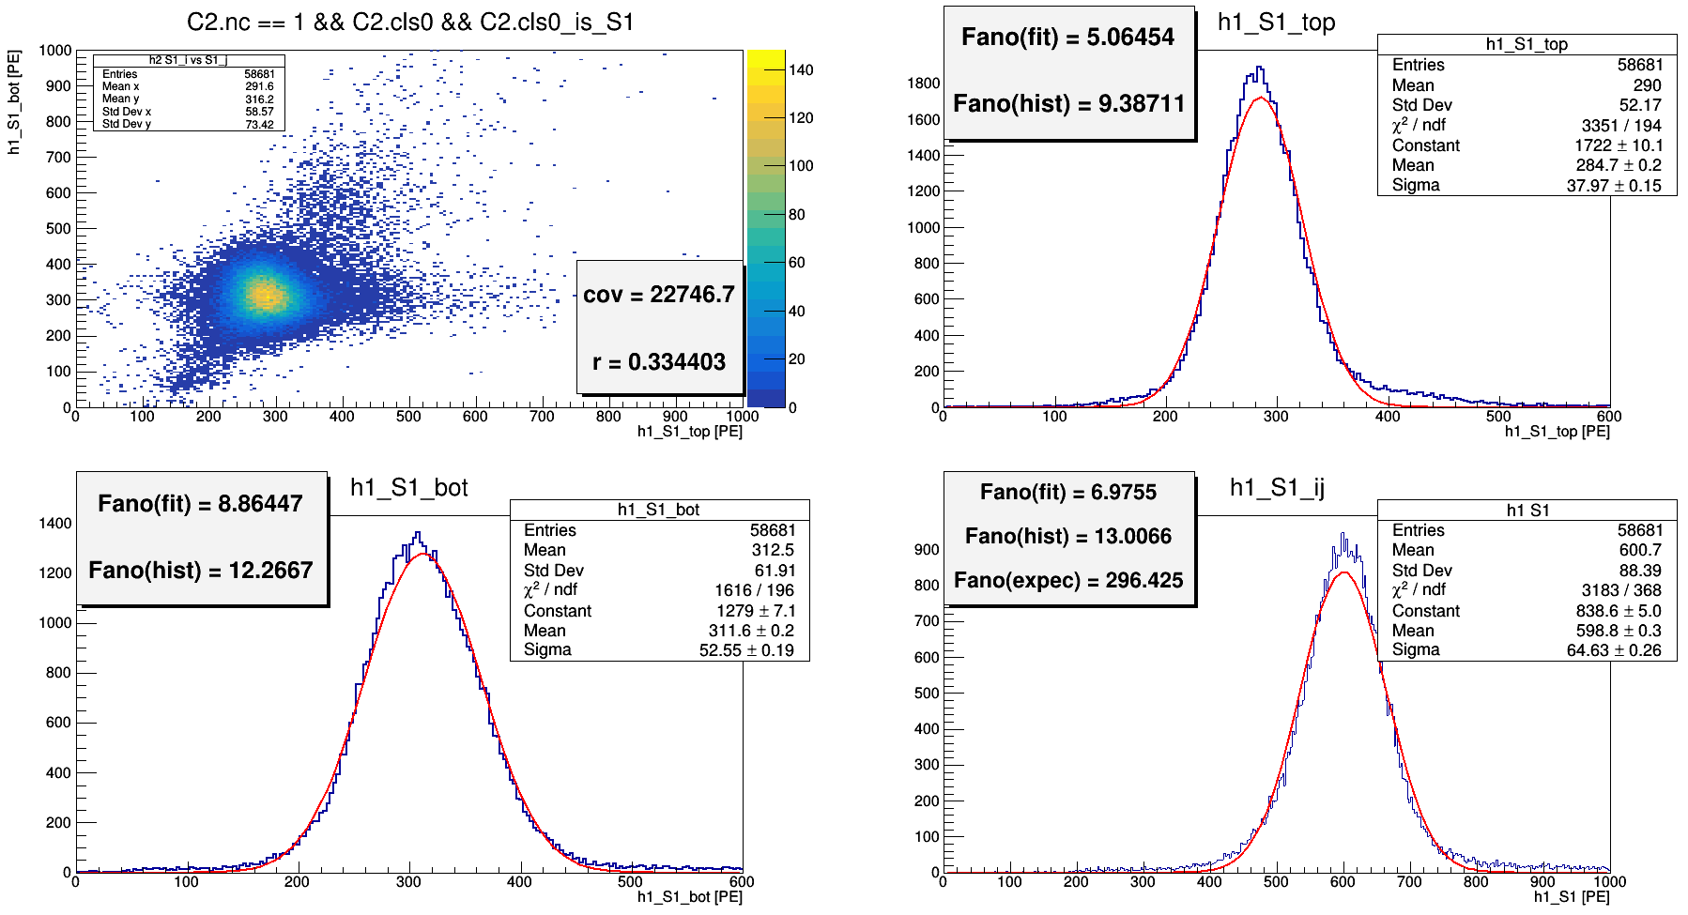
Ph1, Am241, run 744

Slide 8
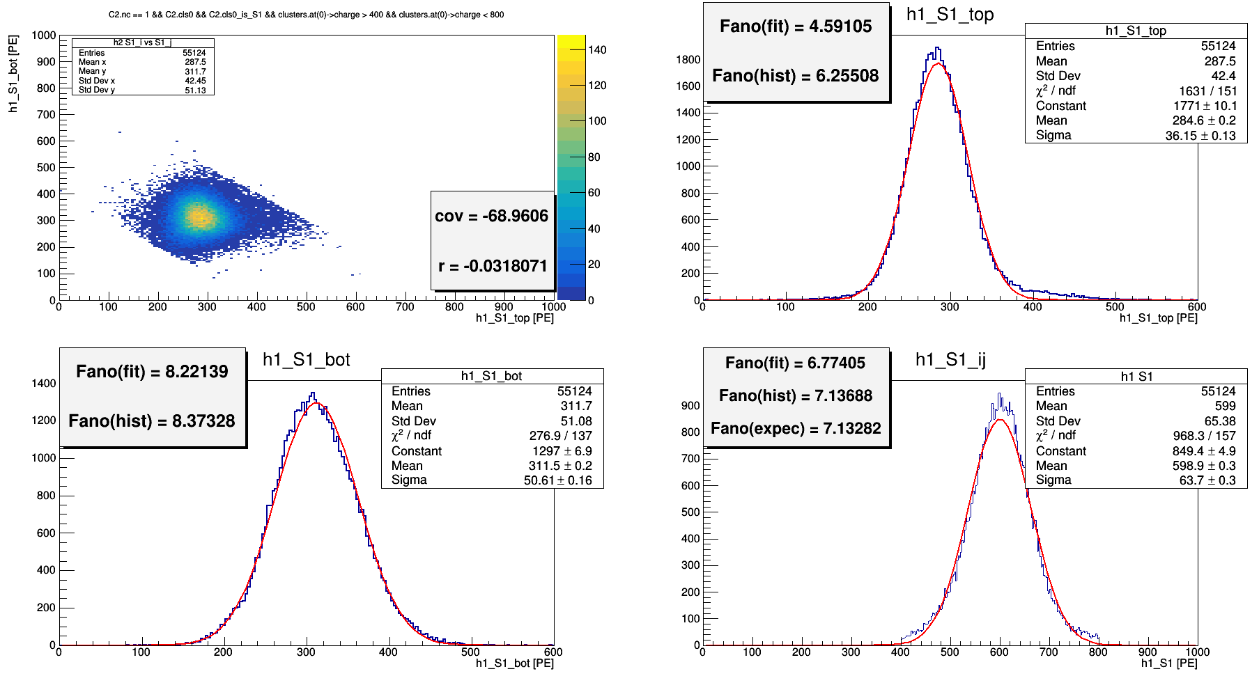
Ph1, Am241, run 744
400 < S1 < 800 [PE]

Slide 9
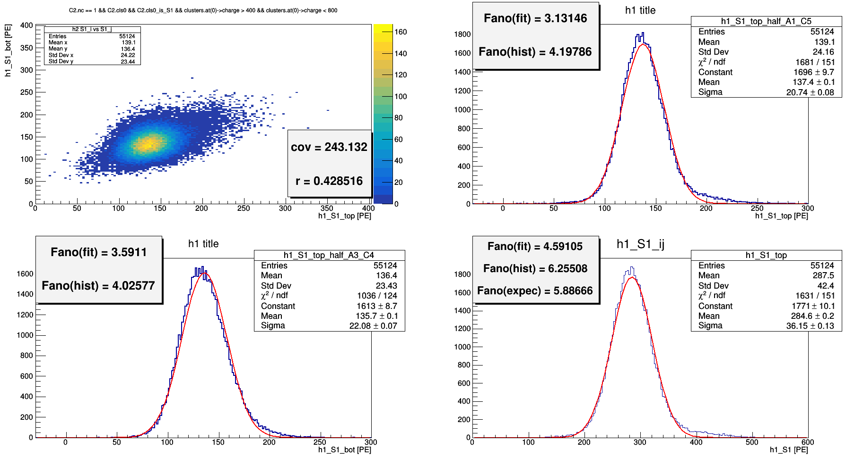
Ph1, Am241, run 744

