Slide 1
Problem of S2 right tail
Сampaign V
Oleynikov Vladislav
26 Nov 2018

Slide 2
Algorithm:
11713f949ea5bffcc2f0ceb22d1267b5f314a5af
Merge branch 'barycenter' into 'master'

Slide 3
Cut list:
bool cls0_is_S1 = clusters.at(0)->f90 > 0.2;
bool cls0_is_full = clusters.at(0)->rep == 1;
bool cls0 = nc_i == 0;//cluster 0
bool cls1 = nc_i == 1;//cluster 1
bool is_S1 = nc == 2 && cls0 && cls0_is_full && cls0_is_S1;
bool is_S2 = nc == 2 && cls1 && cls0_is_full && cls0_is_S1;
bool is_S2_v2 = is_S2 && clusters.at(0)->f90 < 0.2;
bool is_S1_only = nc == 1 && cls0_is_full && cls0_is_S1;
bool is_S1_S2 = nc == 2 && cls0_is_full && cls0_is_S1;
bool is_S2_v2 = is_S2 && clusters.at(1)->f90 < 0.2;
bool region_of_S2_uniformity =
(clusters.at(1)->pos_x > 2.2) && (clusters.at(1)->pos_x < 2.8) &&
(clusters.at(1)->pos_y > 2) && (clusters.at(1)->pos_y < 3);

Slide 4
Ph2, Am241, run 537

Slide 5
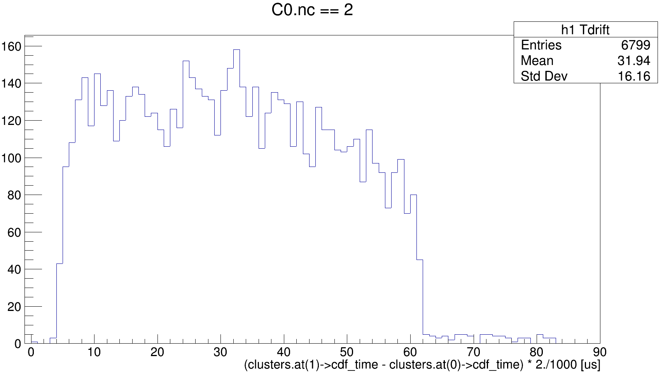
Ph2, Am241, run 537

Slide 6
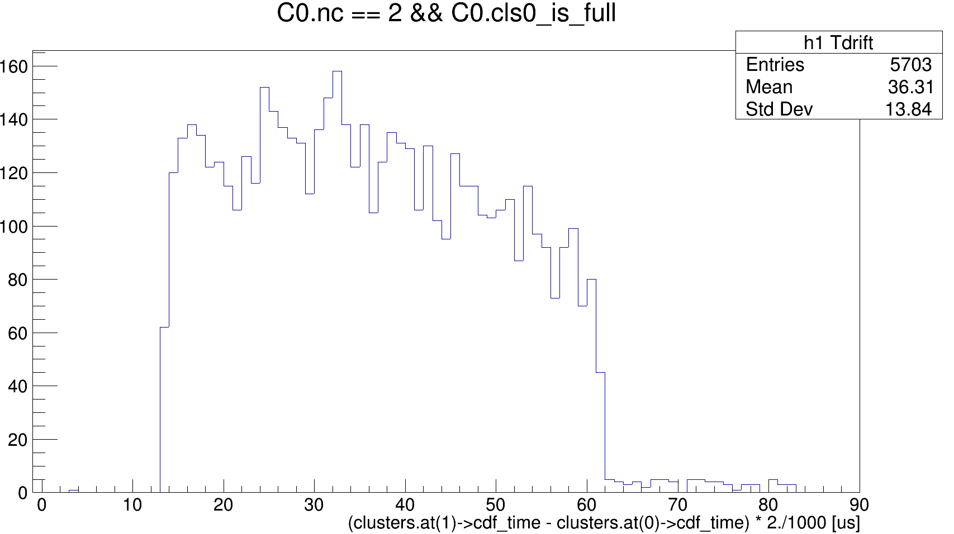
Ph2, Am241, run 537

Slide 7
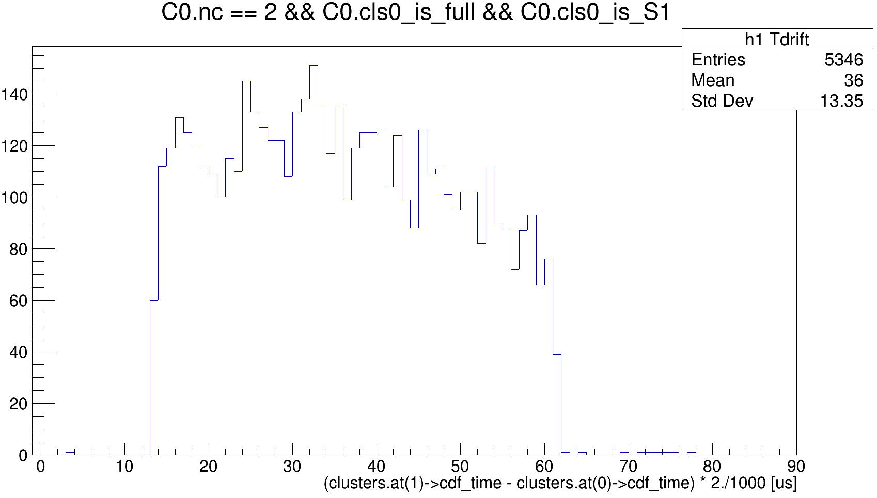
Ph2, Am241, run 537

Slide 8
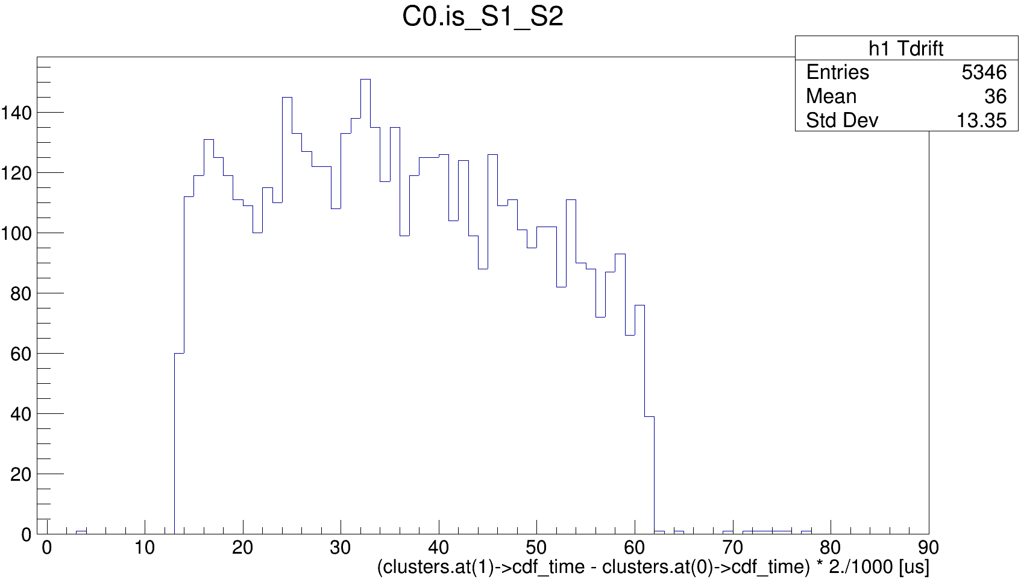
Ph2, Am241, run 537

Slide 9
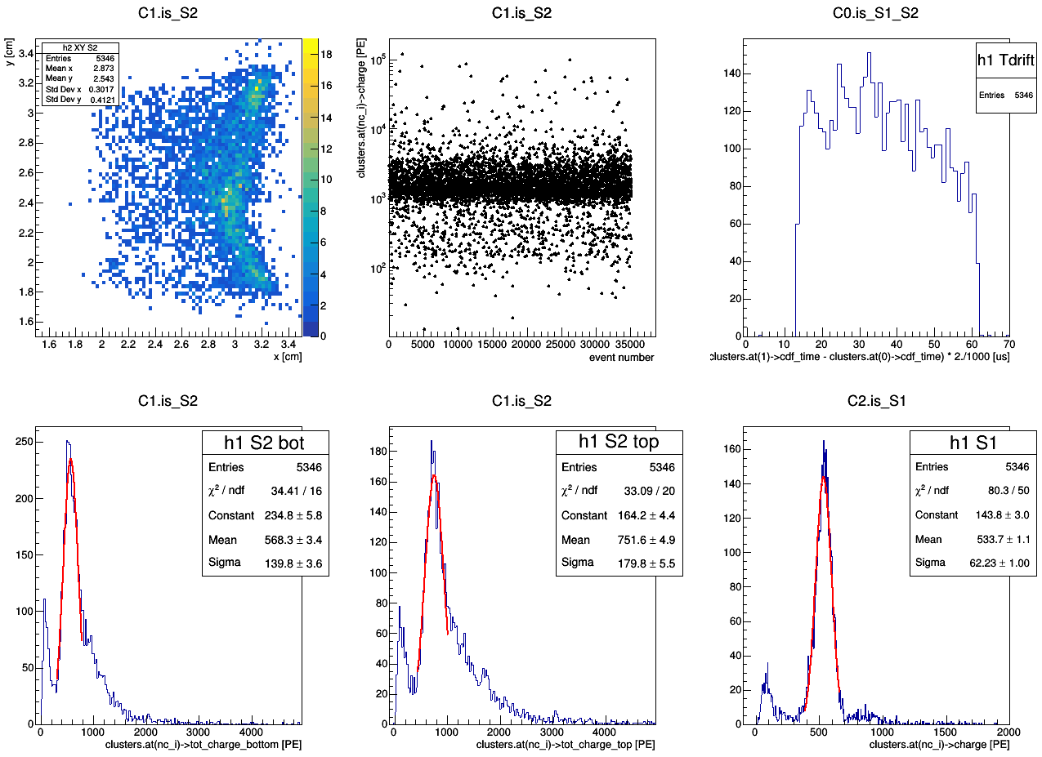
master cut
Ph2, Am241, run 537

Slide 10
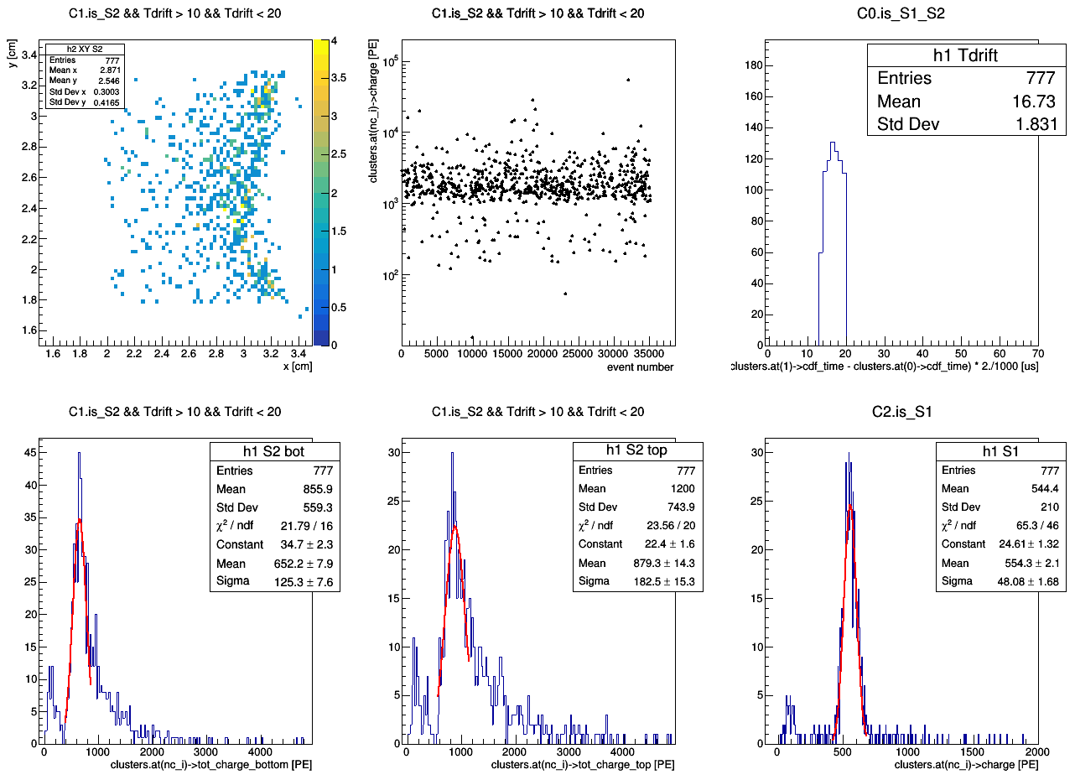
master cut
Ph2, Am241, run 537

Slide 11
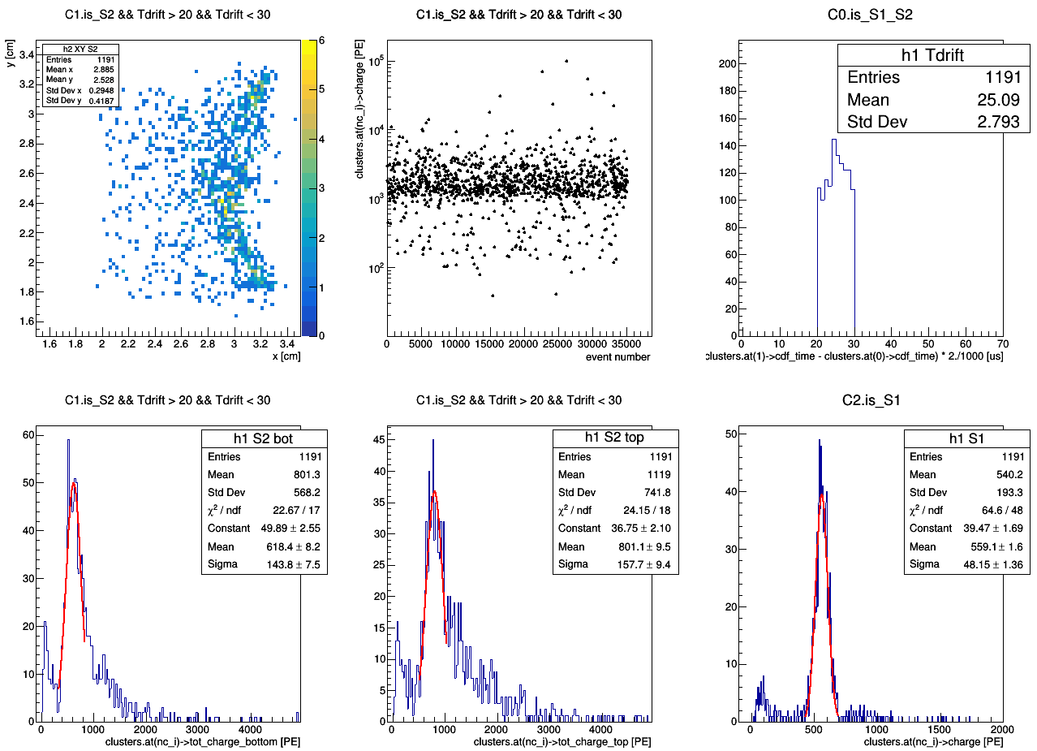
master cut
Ph2, Am241, run 537

Slide 12
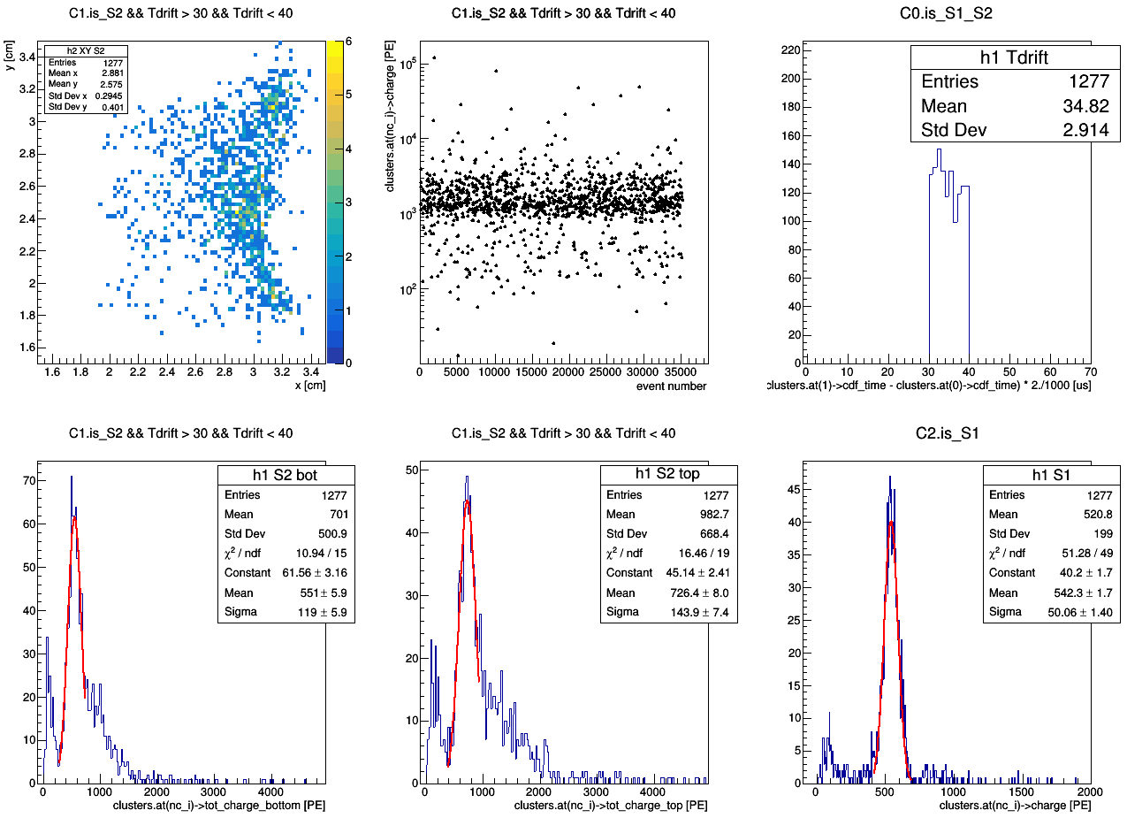
master cut
Ph2, Am241, run 537

Slide 13
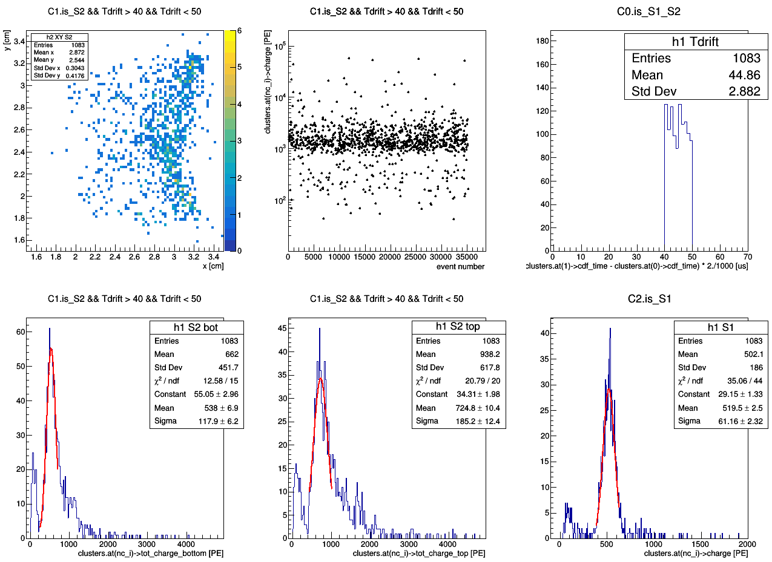
master cut
Ph2, Am241, run 537

Slide 14
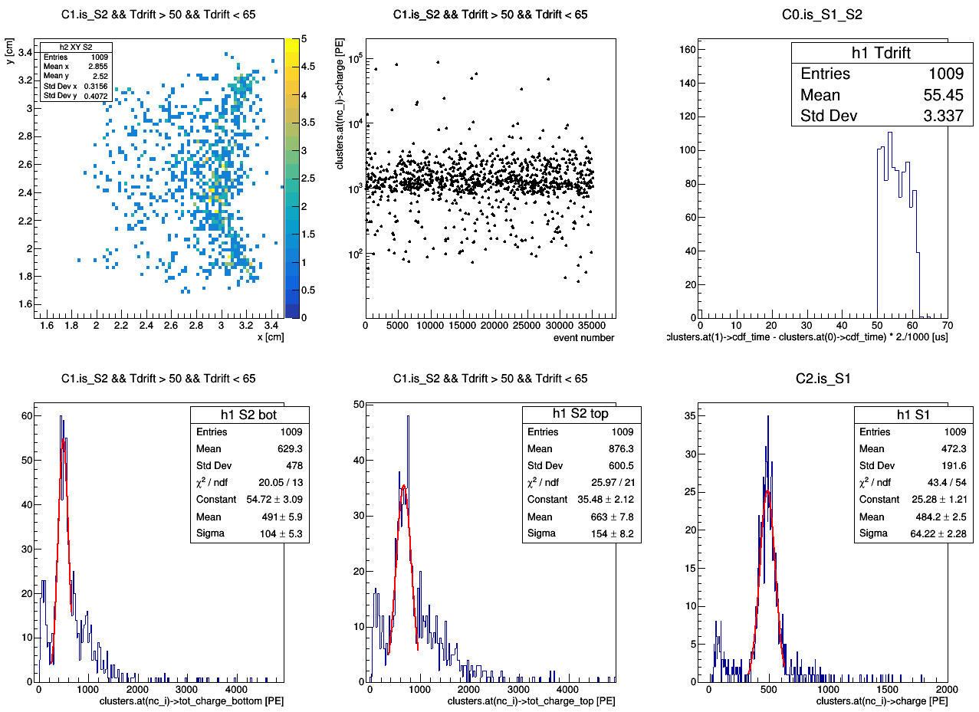
master cut
Ph2, Am241, run 537

Slide 16
master cut
Ph2, Am241, run 537

Slide 17
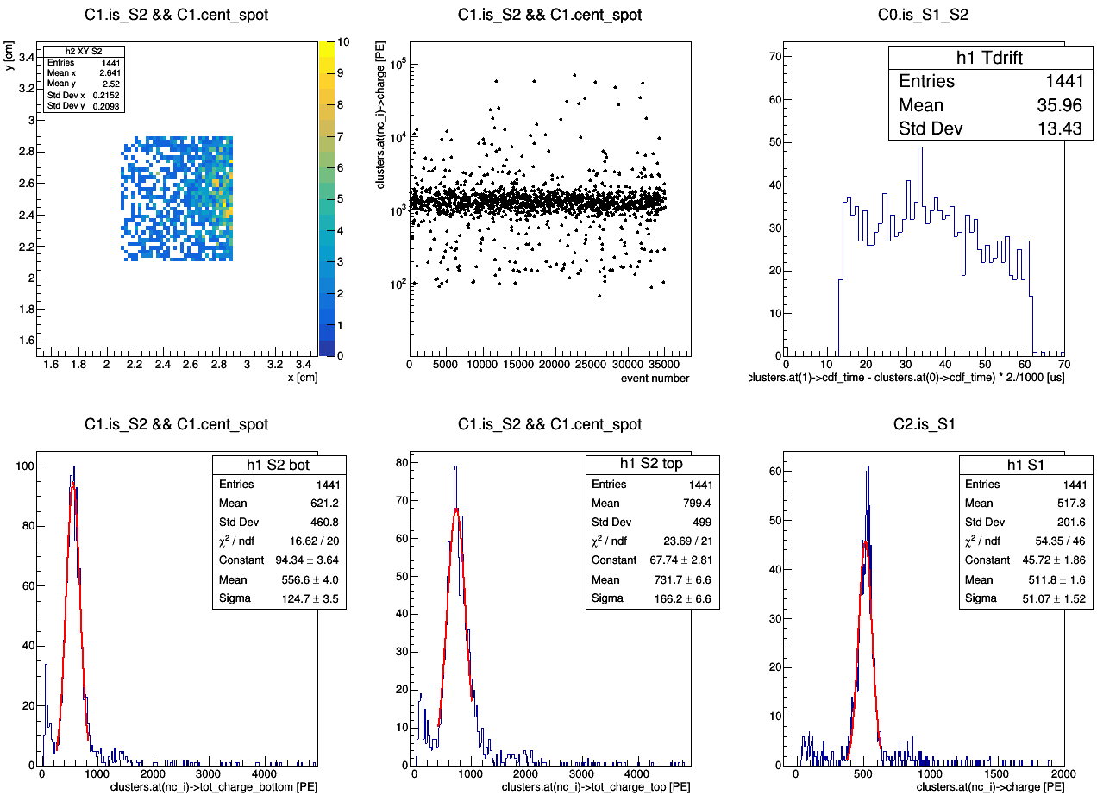
master cut
Ph2, Am241, run 537

Slide 18
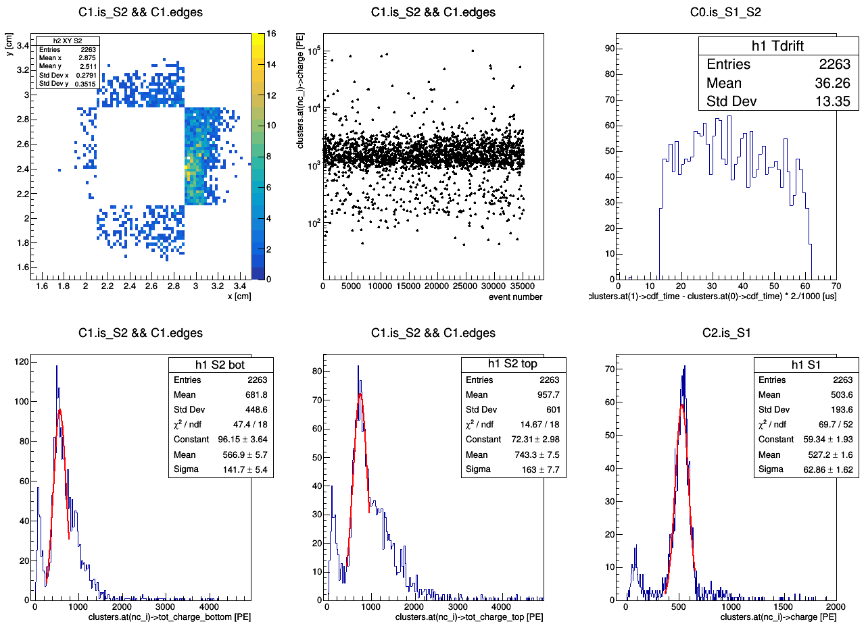
master cut
Ph2, Am241, run 537

Slide 19
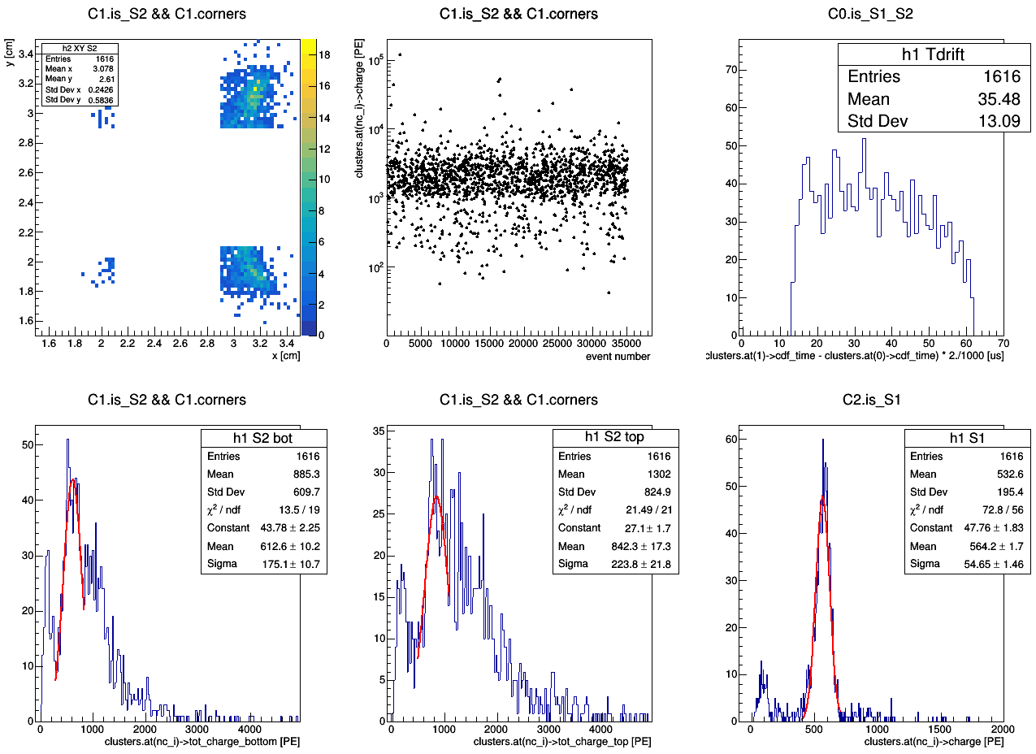
master cut
Ph2, Am241, run 537

Slide 21
Ph2, Am241, run 537
master cut

Slide 22
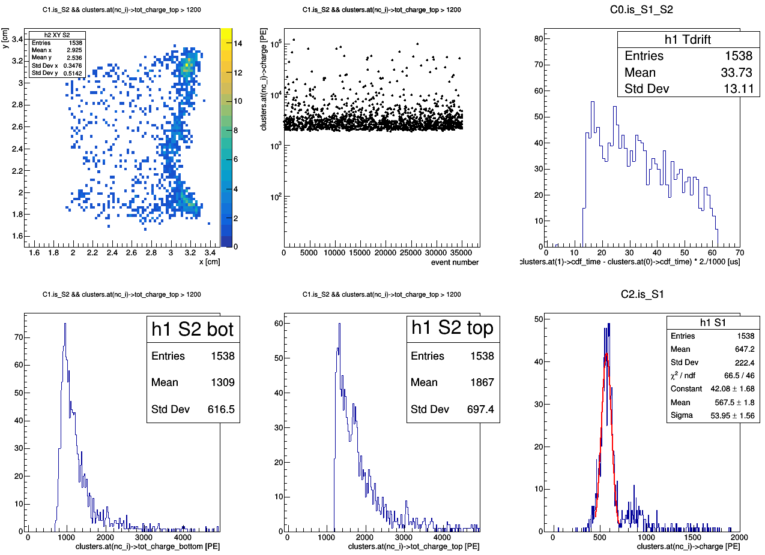
aka map of bad events
Ph2, Am241, run 537
master cut
tot_charge_top > 1200 [PE]

Slide 23
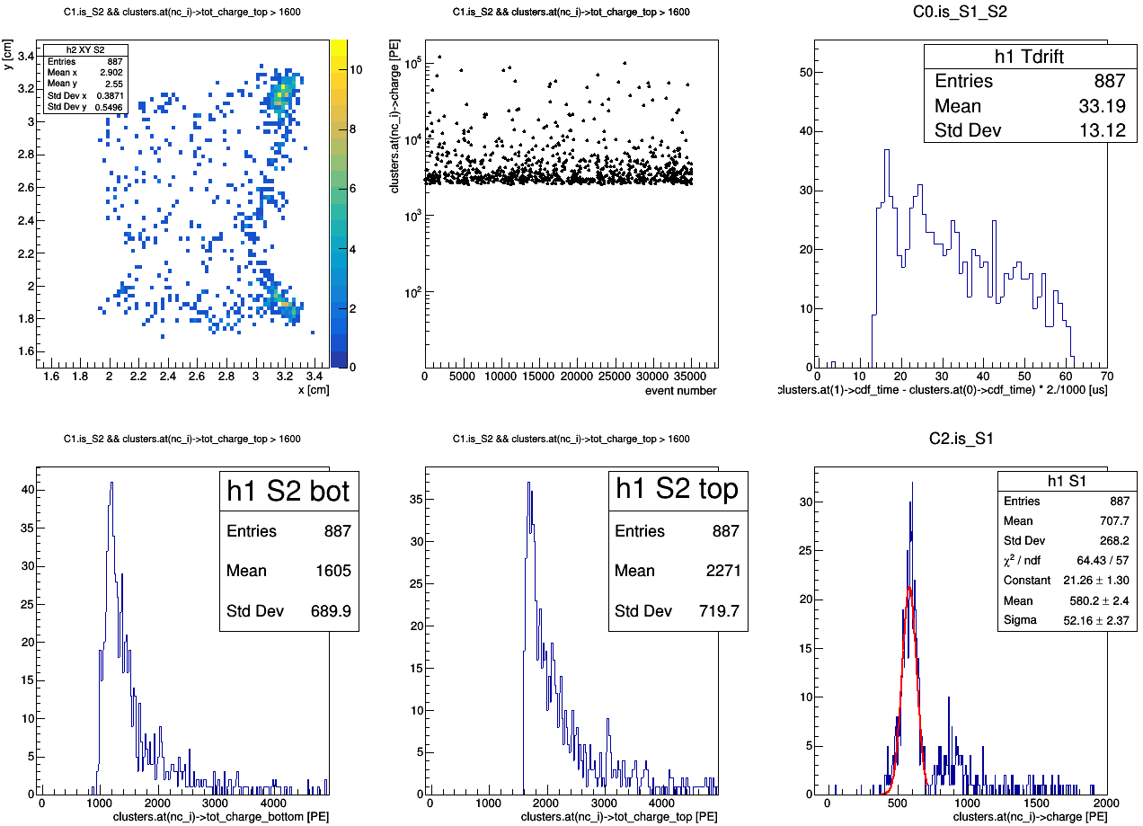
aka map of bad events
Ph2, Am241, run 537
master cut
tot_charge_top > 1600 [PE]

Slide 24
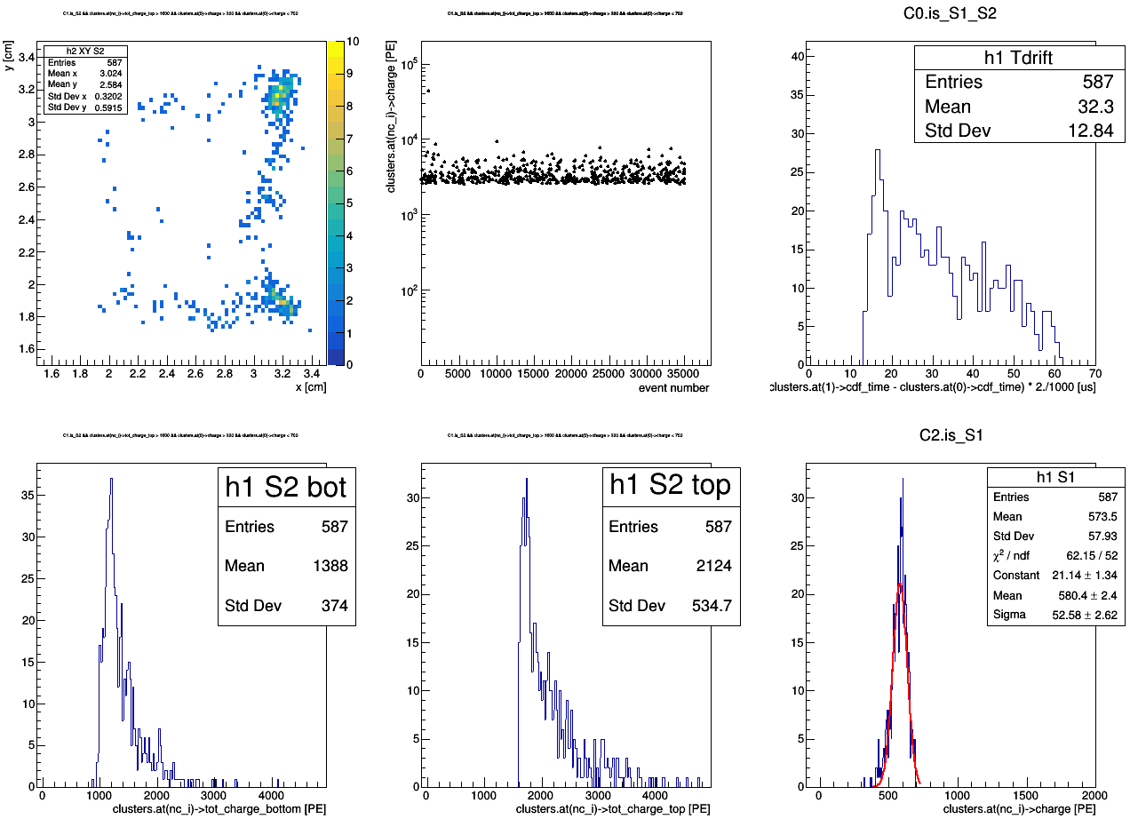
aka map of bad events
Ph2, Am241, run 537
tot_charge_top > 1600 [PE]
300 < S1 charge < 700 [PE]
master cut1
master cut2

Slide 25
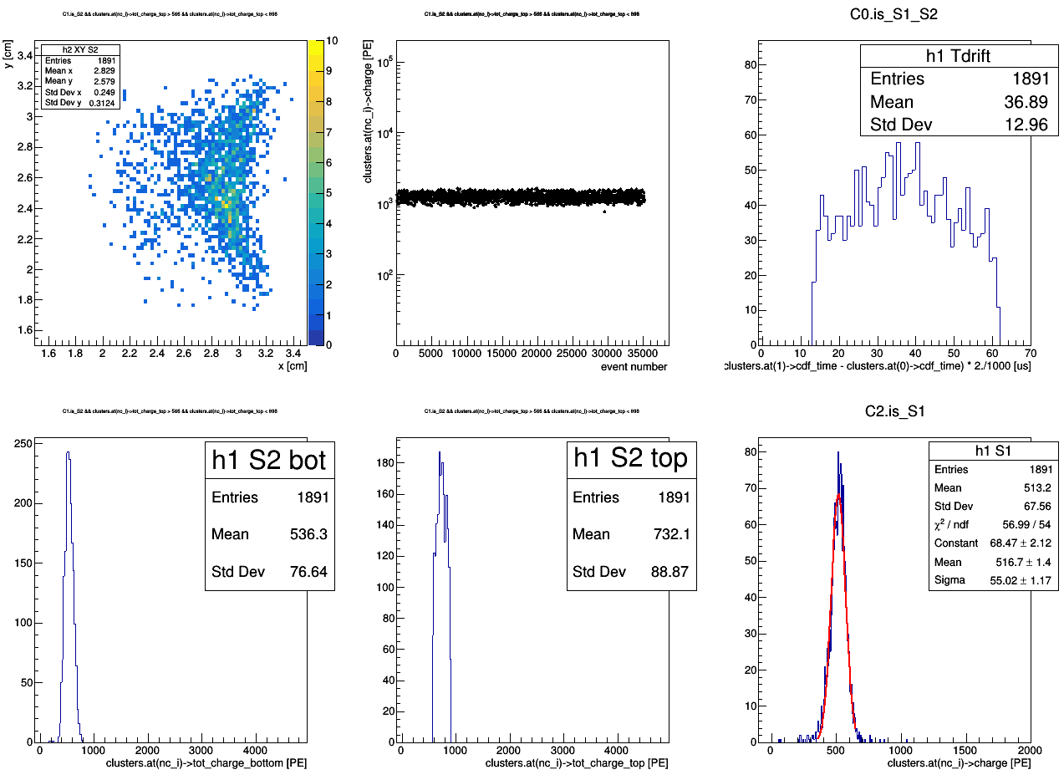
aka map of good events
Ph2, Am241, run 537
master cut
566 < tot_charge_top > 898 [PE]

Slide 27
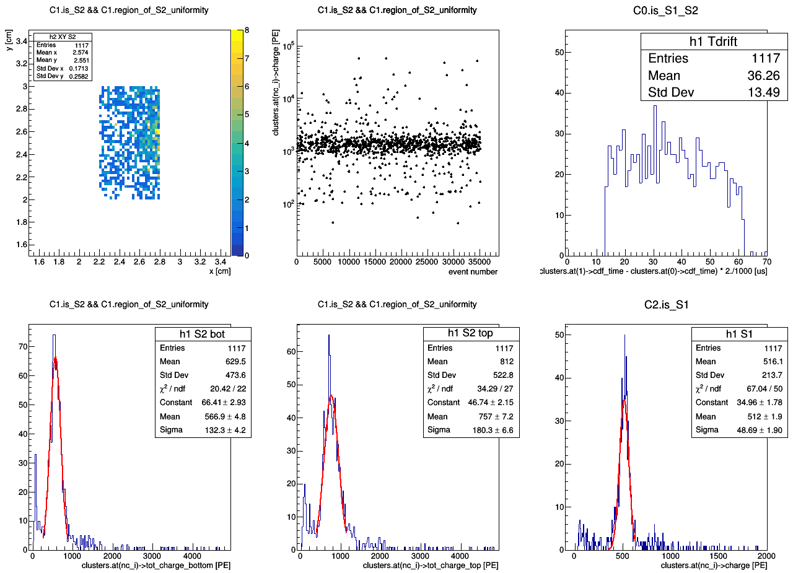
So, I created new cut: region_of_S2_uniformity (2.2 < x < 2.8; 2 < y < 3)
Ph2, Am241, run 537

Slide 28
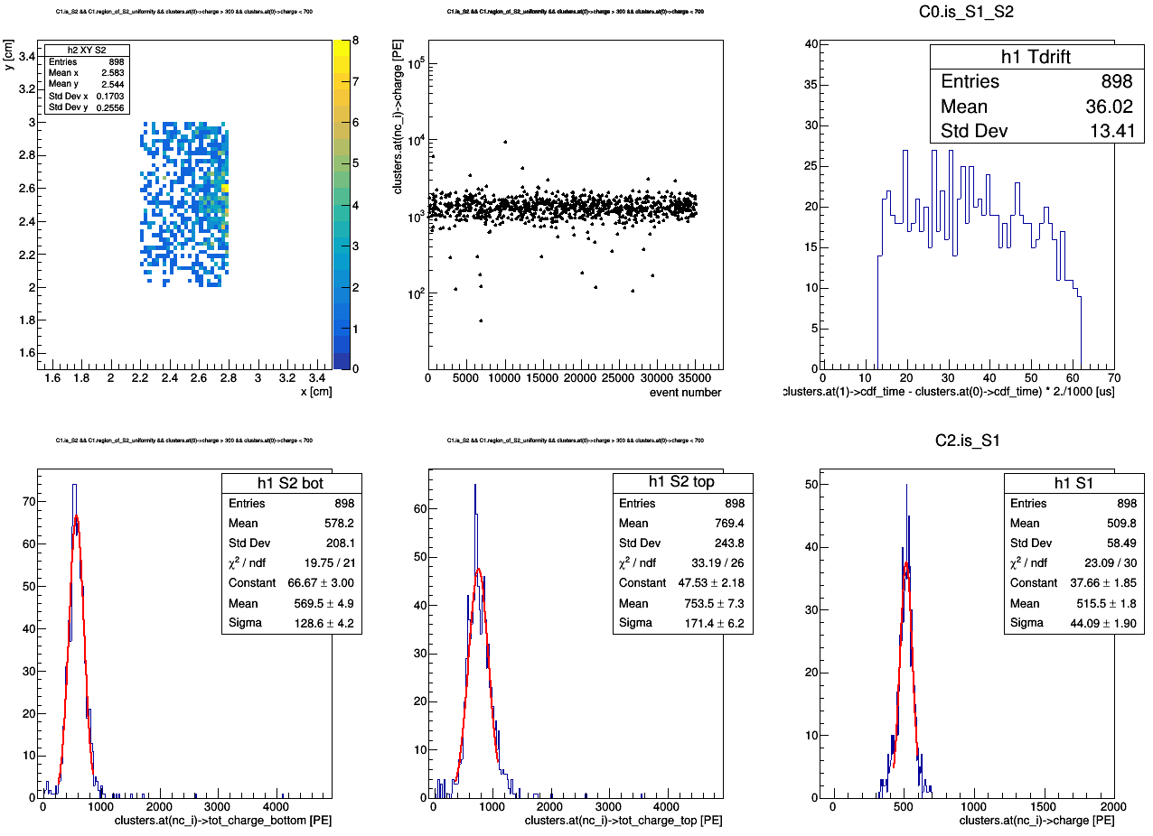
Ph2, Am241, run 537
&& region_of_S2_uniformity && 300 < S1_charge < 700

Slide 30
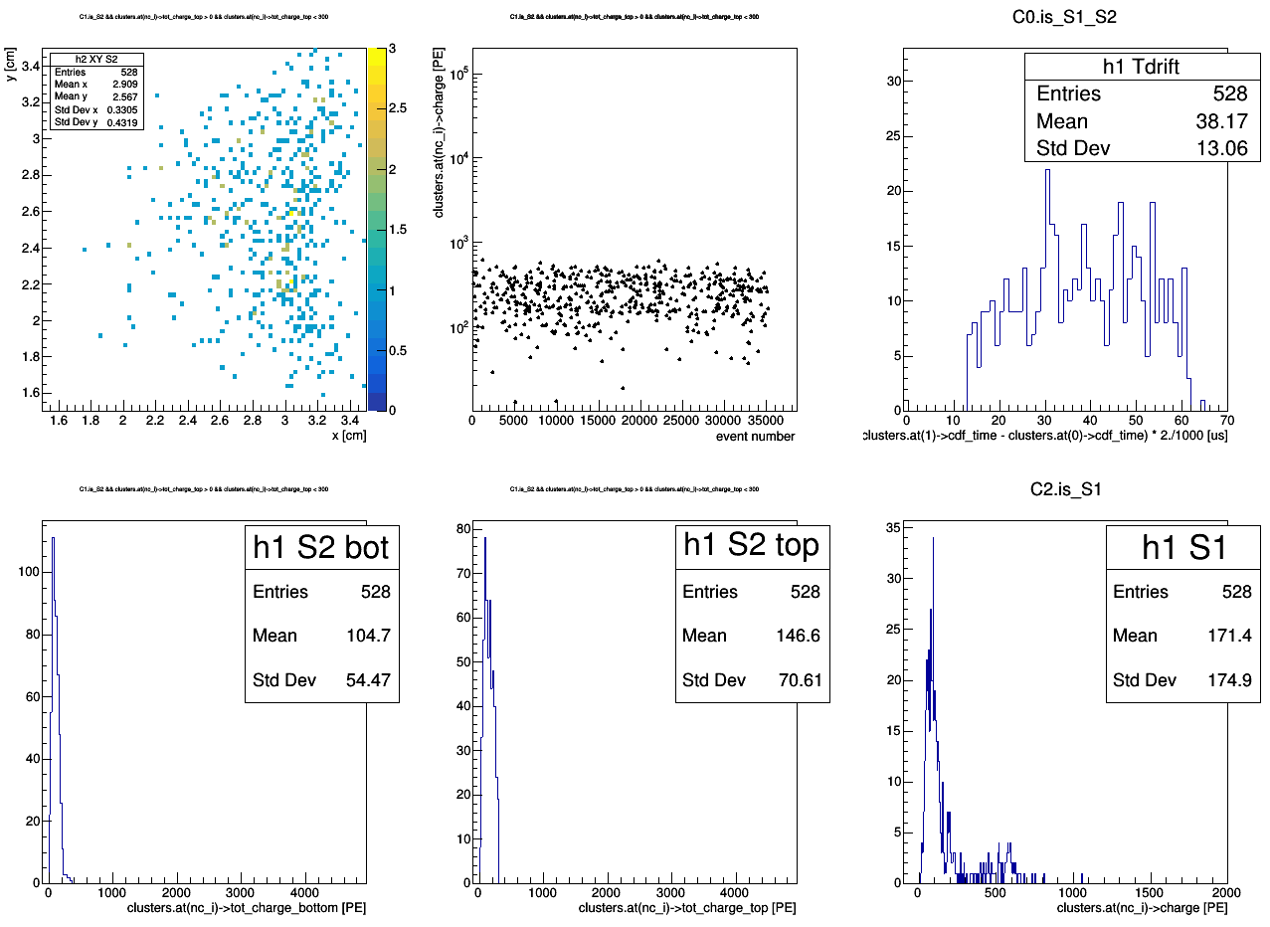
Ph2, Am241, run 537
master cut
0 < tot_charge_top < 300 [PE]

Slide 31
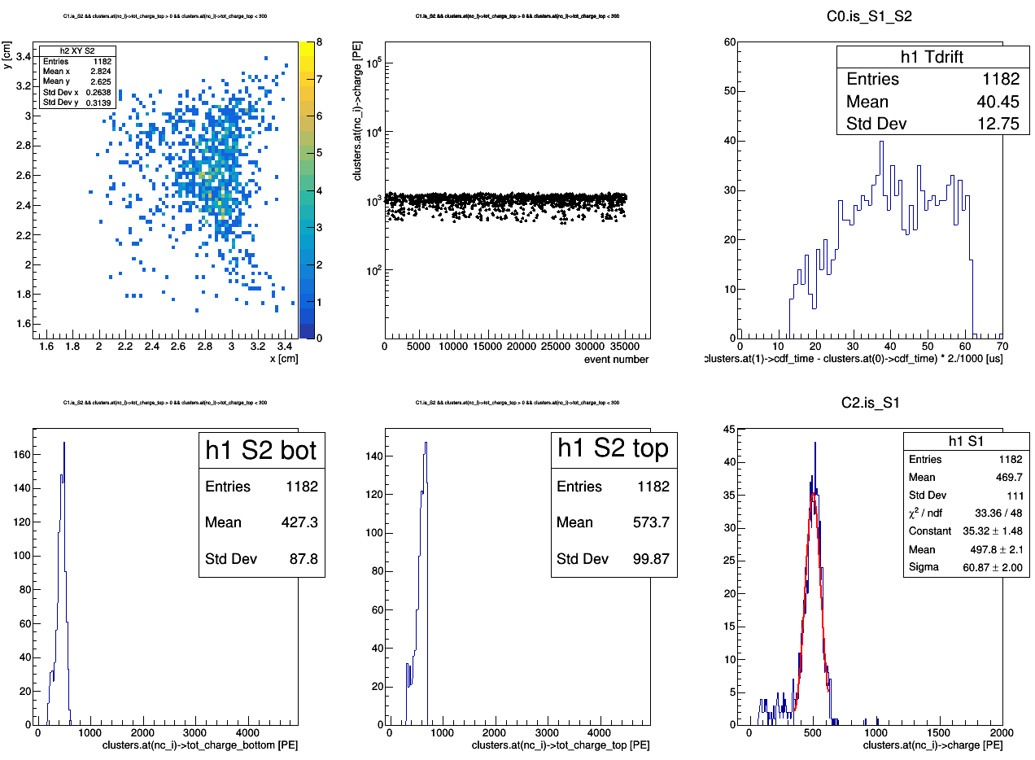
Ph2, Am241, run 537
master cut
300 < tot_charge_top < 700 [PE]

Slide 32
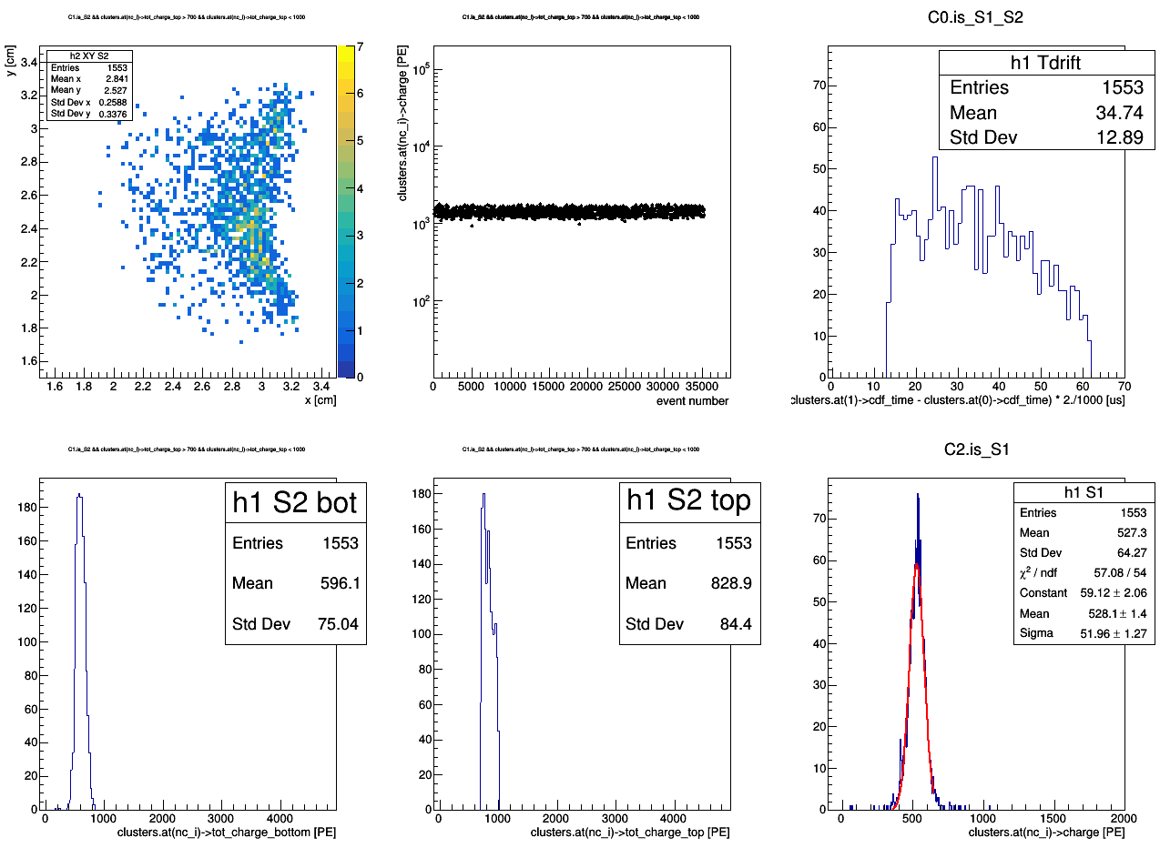
Ph2, Am241, run 537
master cut
700 < tot_charge_top < 1000 [PE]

Slide 33
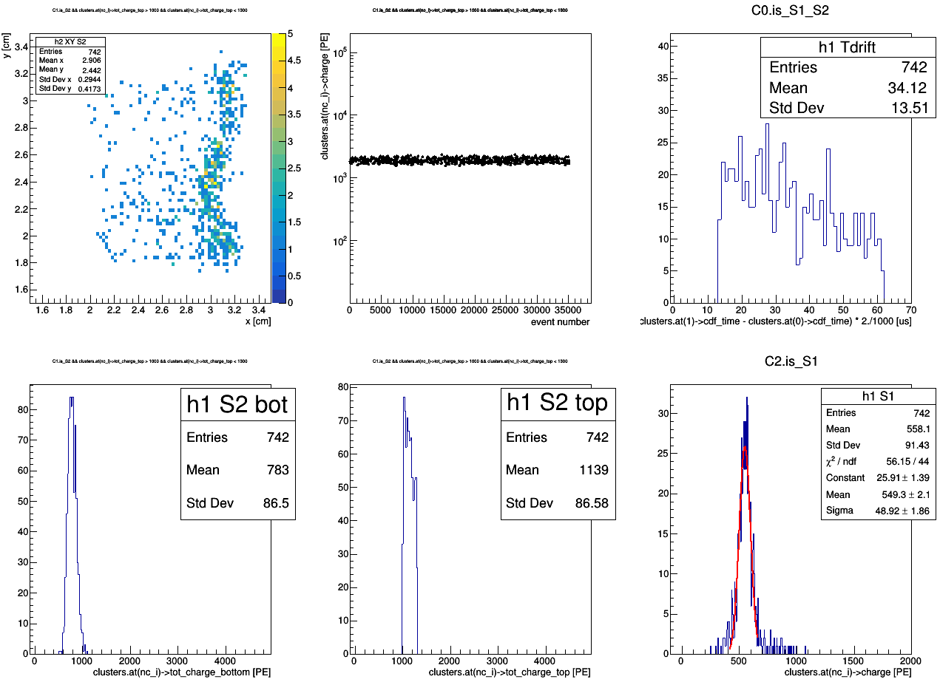
Ph2, Am241, run 537
master cut
1000 < tot_charge_top < 1300 [PE]

Slide 34
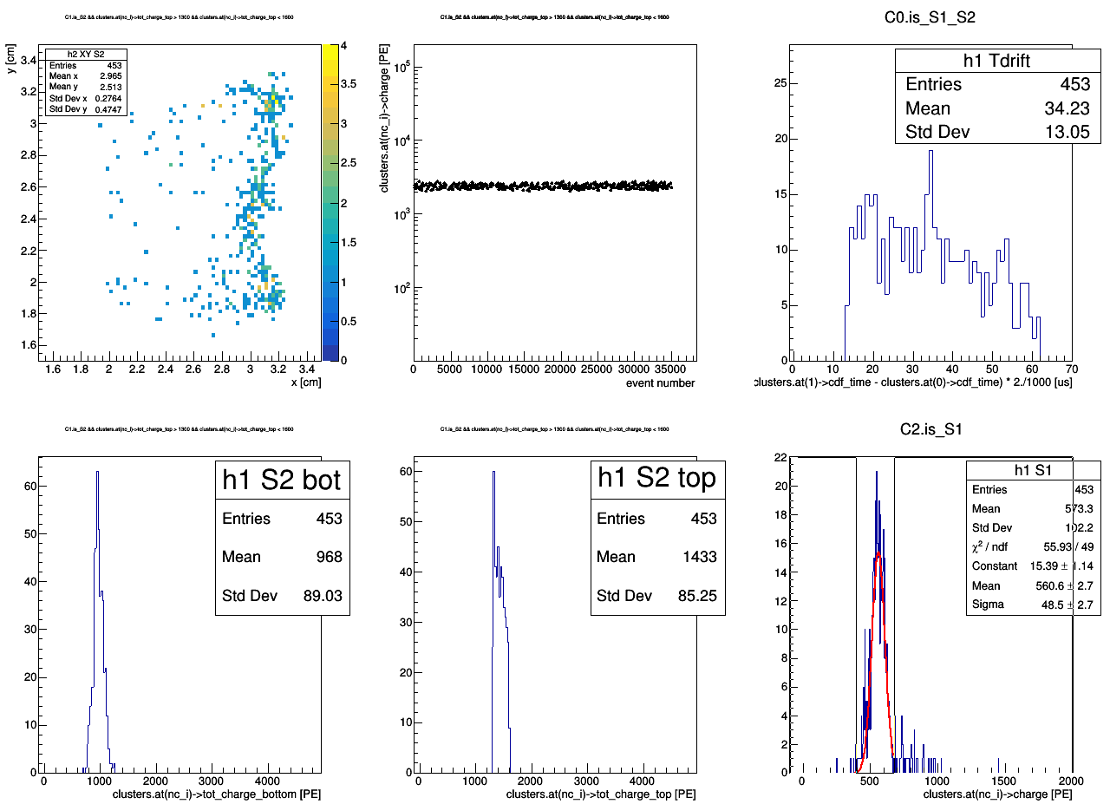
Ph2, Am241, run 537
master cut
1300 < tot_charge_top < 1600 [PE]

Slide 35
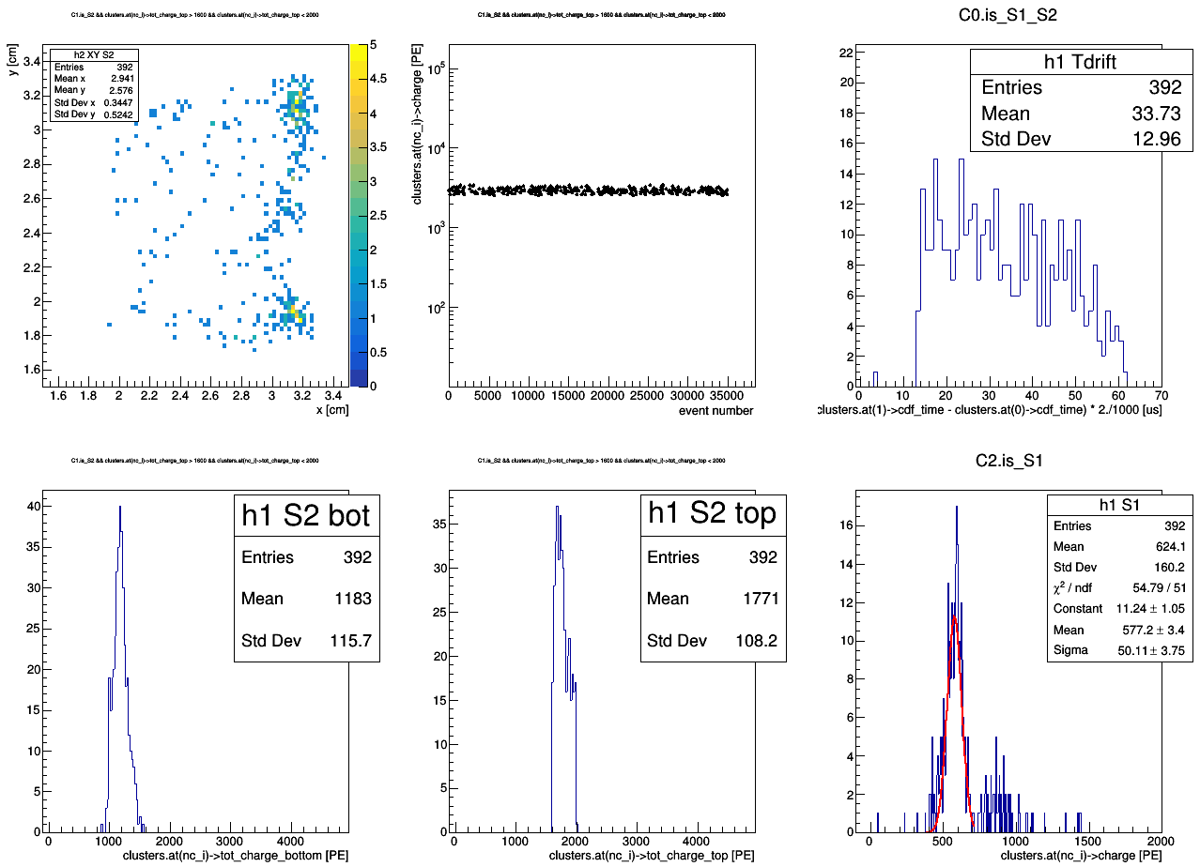
Ph2, Am241, run 537
master cut
1600 < tot_charge_top < 2000 [PE]

Slide 36
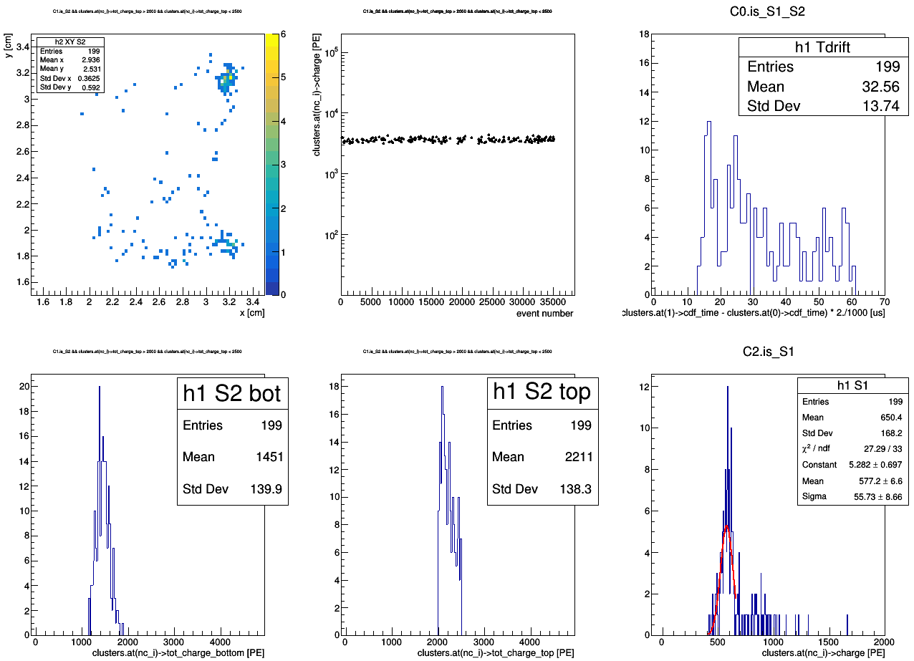
Ph2, Am241, run 537
master cut
2000 < tot_charge_top < 2500 [PE]

Slide 37
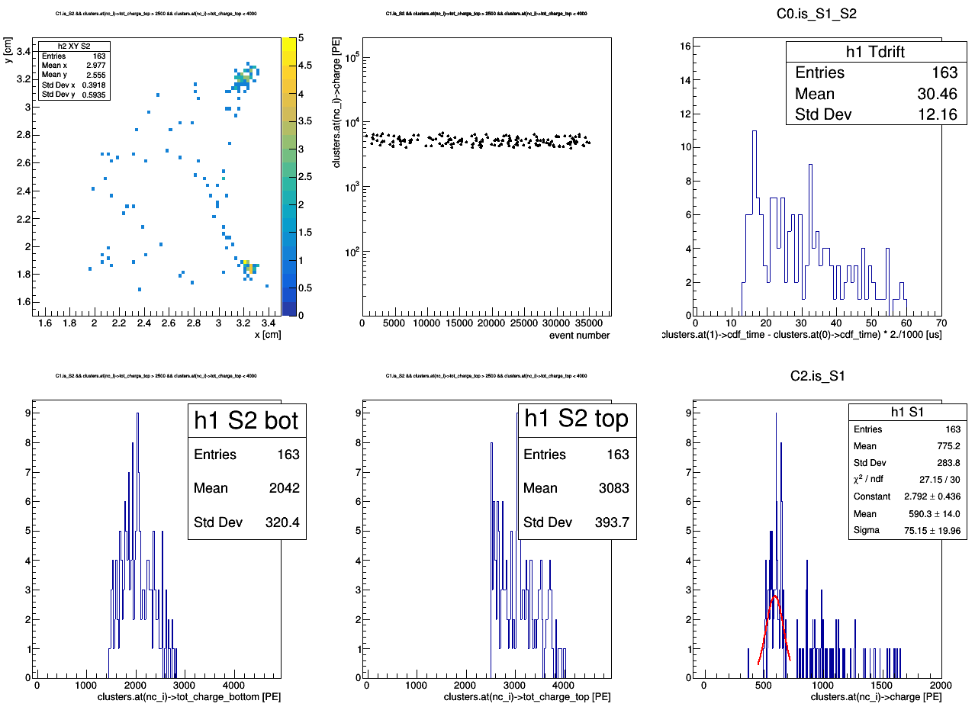
Ph2, Am241, run 537
master cut
2500 < tot_charge_top < 4000 [PE]

Slide 39
Ph2, Am241, run 542

Slide 40
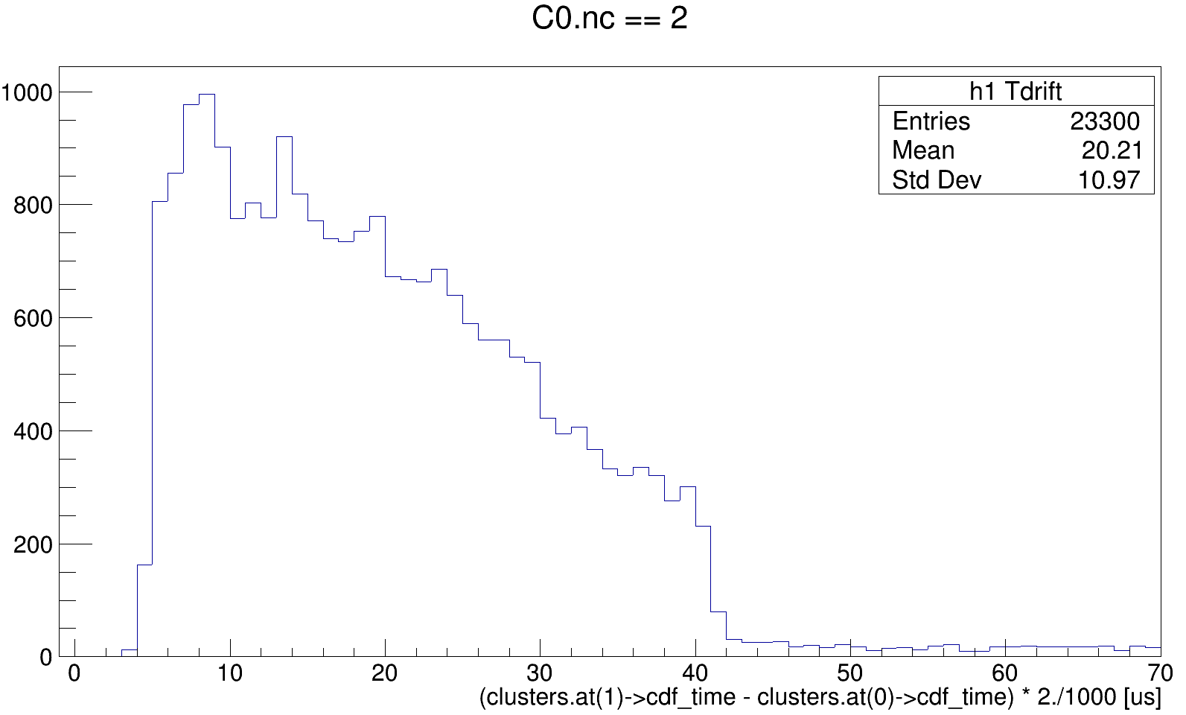
Ph2, Am241, run 542

Slide 41
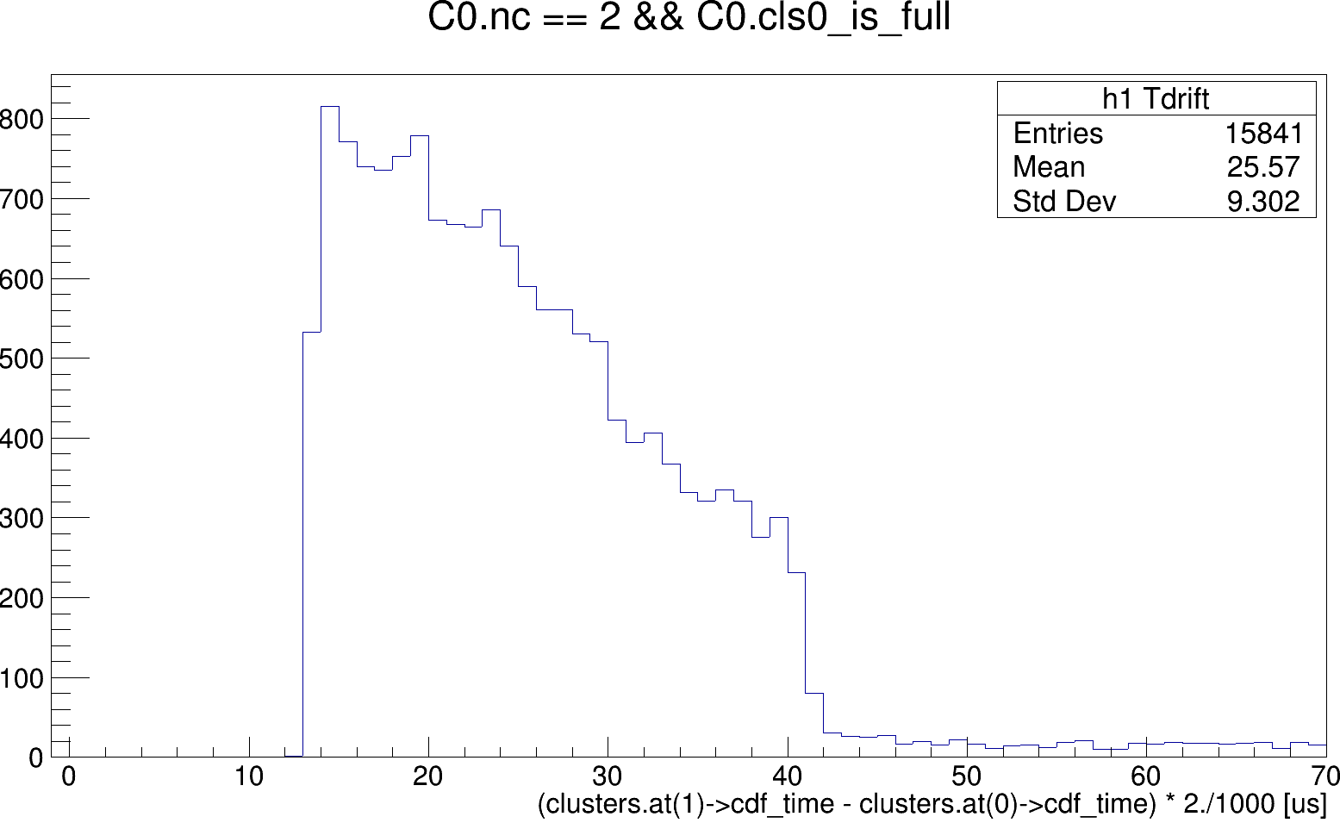
Ph2, Am241, run 542

Slide 42
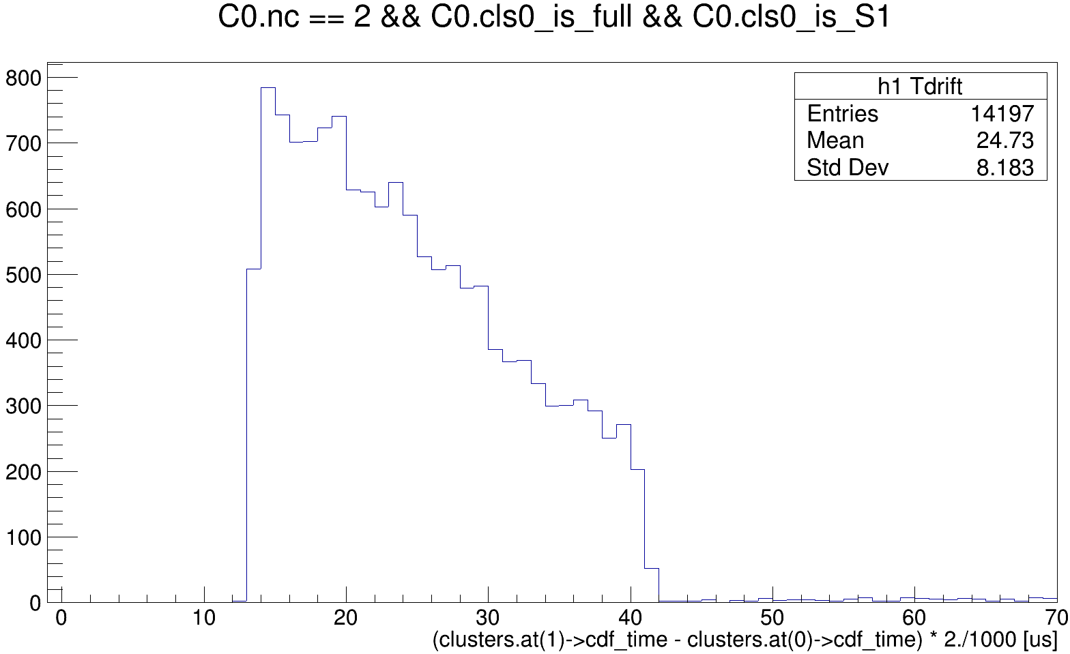
Ph2, Am241, run 542
Ph2, Am241, run 542

Slide 43
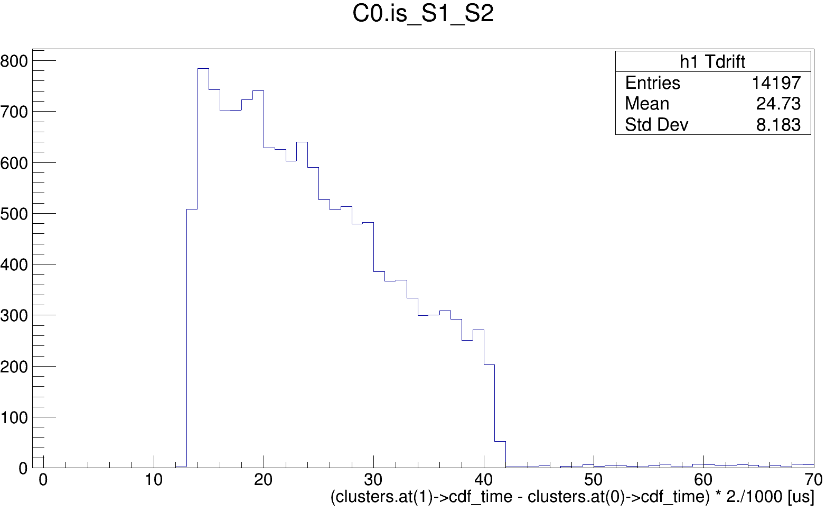
Ph2, Am241, run 542

Slide 44
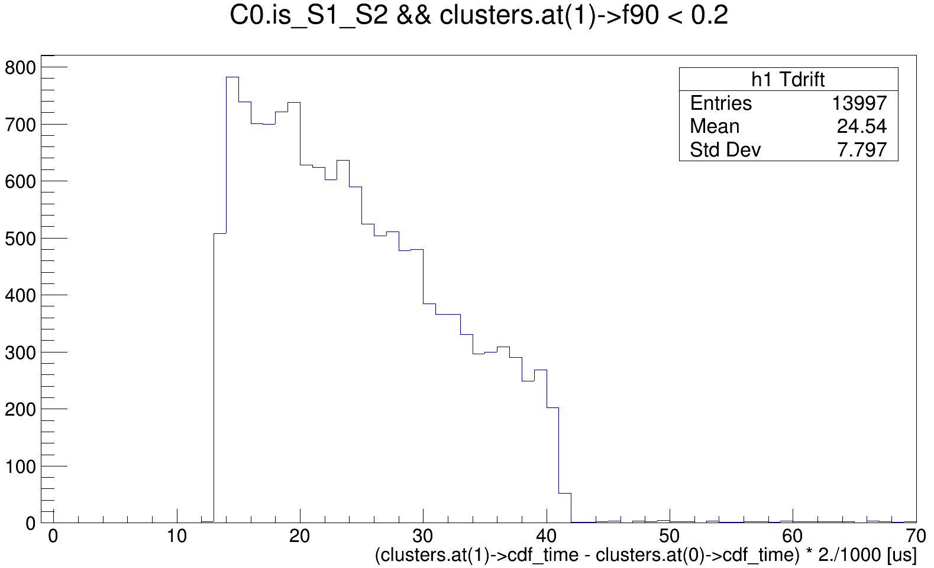
Ph2, Am241, run 542

Slide 45
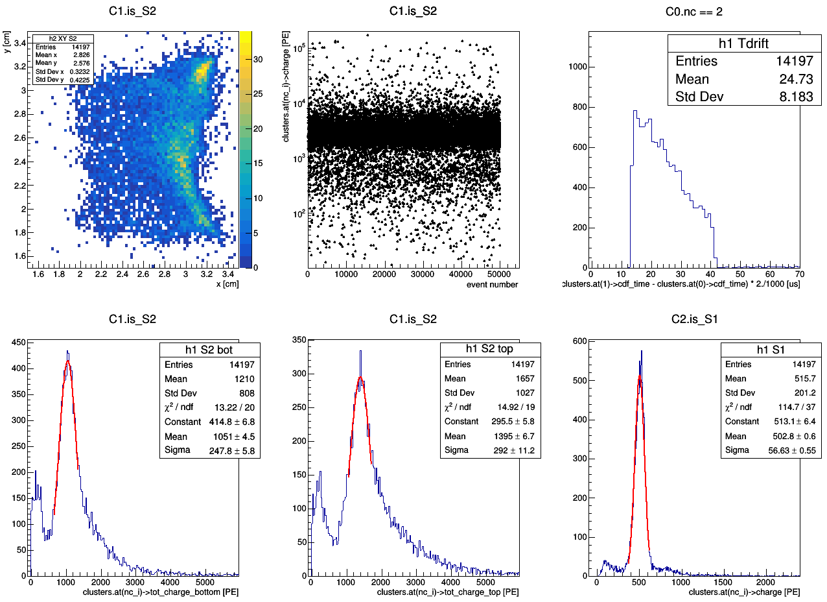
master cut
Ph2, Am241, run 542

Slide 46
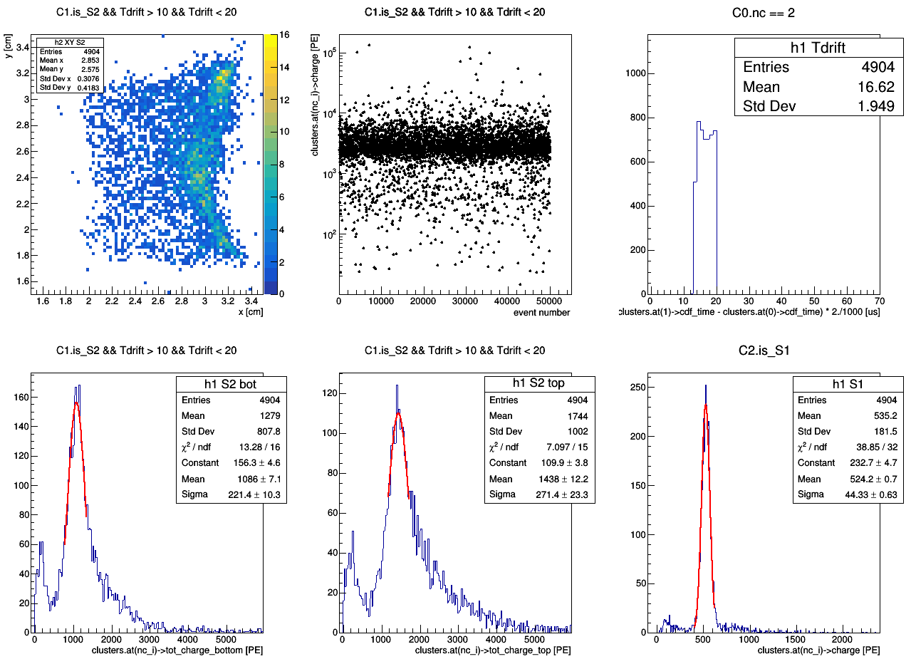
master cut
Ph2, Am241, run 542

Slide 47
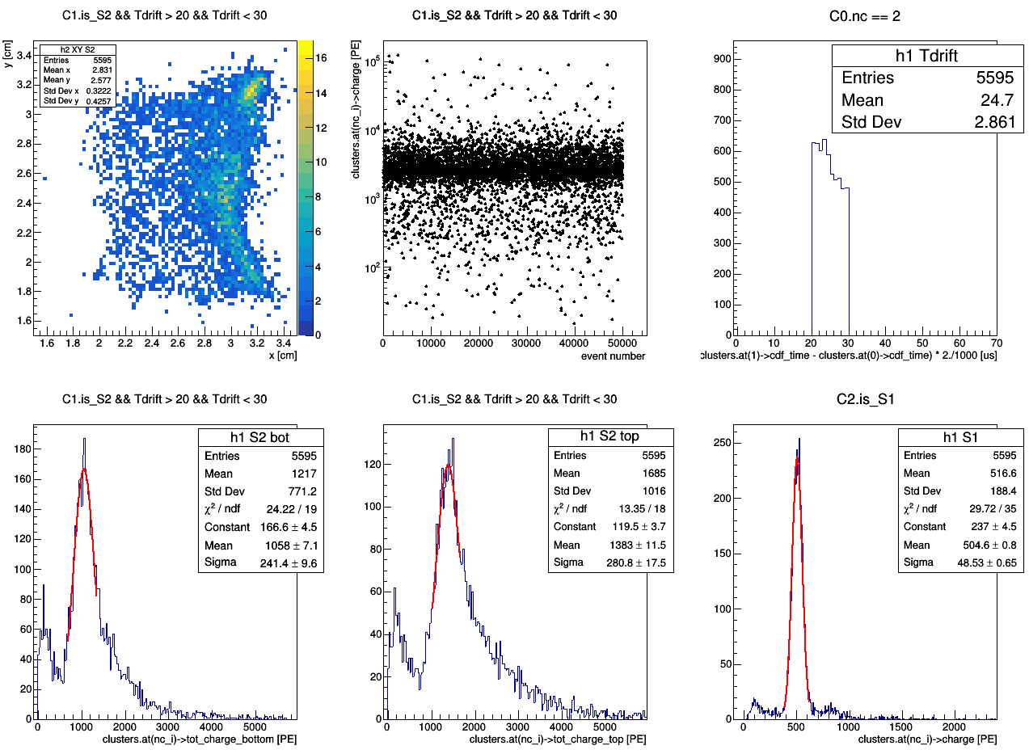
master cut
Ph2, Am241, run 542

Slide 48
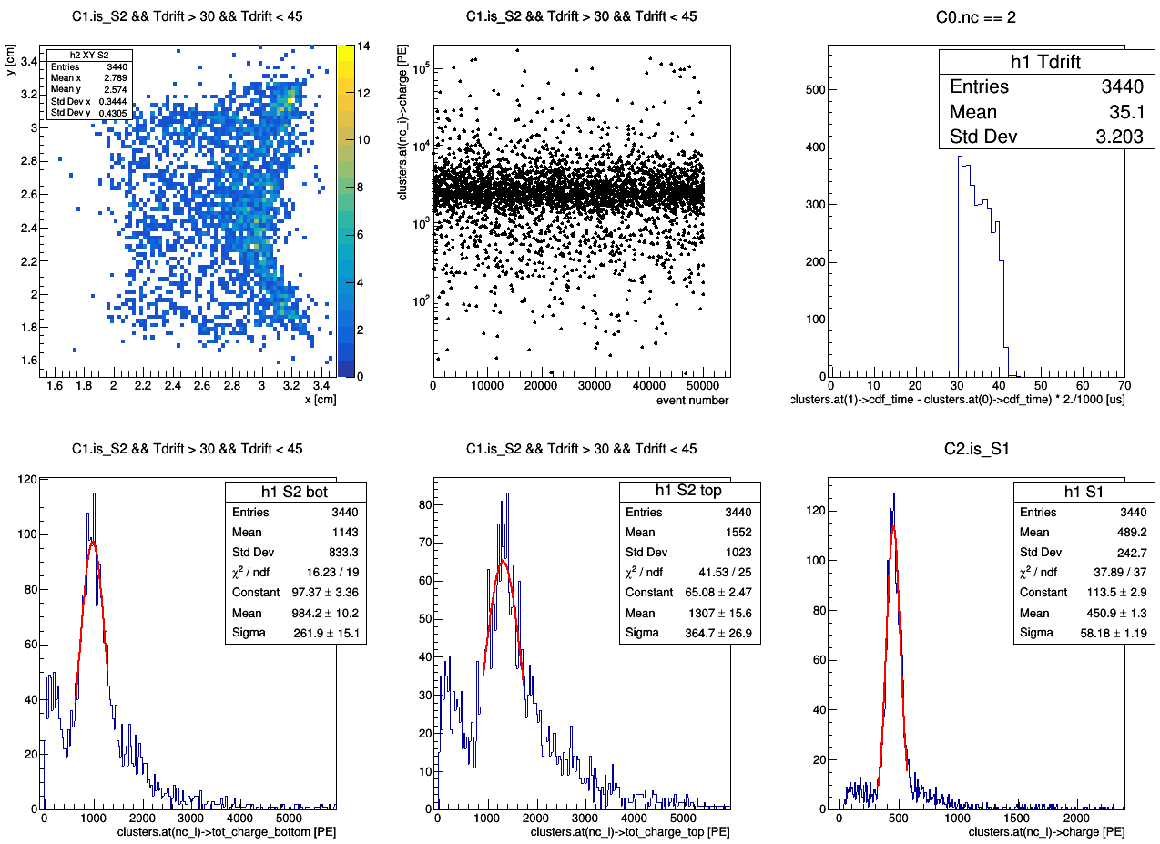
master cut
Ph2, Am241, run 542

Slide 50
Ph2, Am241, run 542
master cut

Slide 51
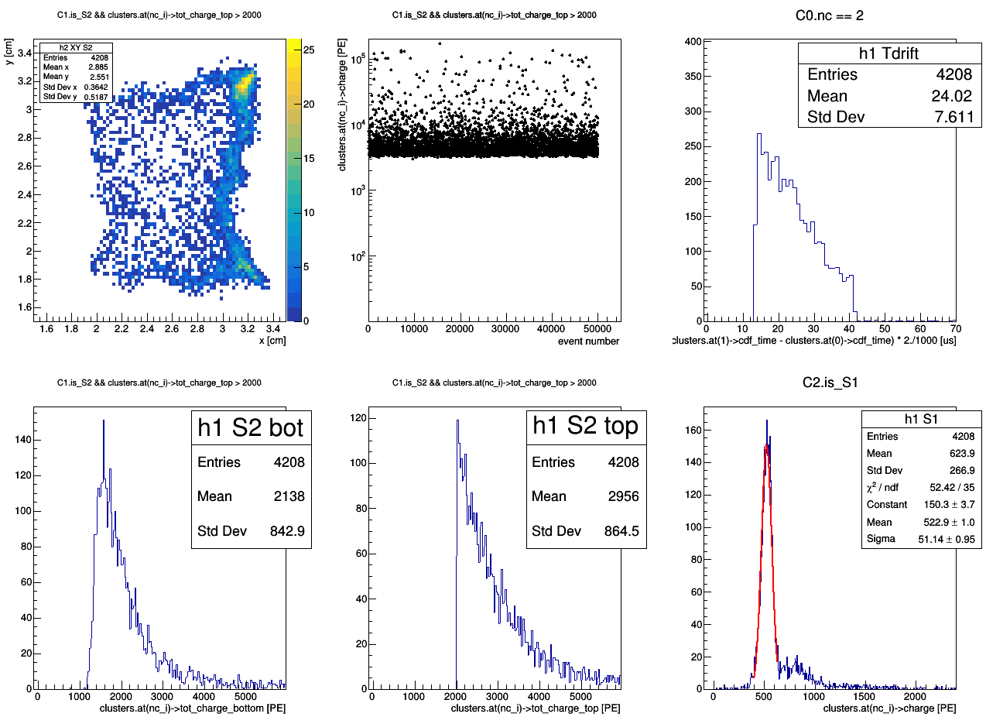
Ph2, Am241, run 542
tot_charge_top > 2000 [PE]
master cut

Slide 52
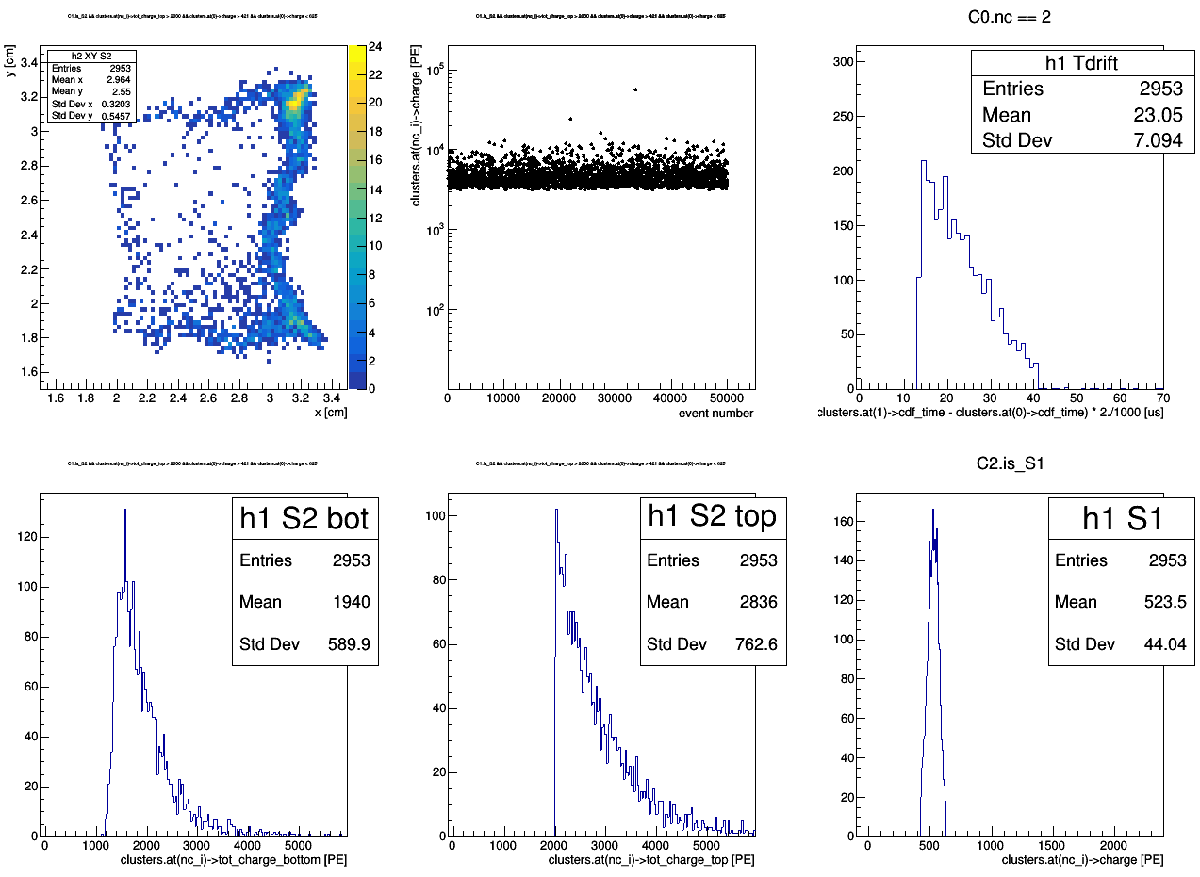
region_of_S2_uniformity (2.2 < x < 2.8; 2 < y < 3)
tot_charge_top > 2000 [PE]
421 < charge < 625 [PE]
Ph2, Am241, run 542
master cut1
master cut2

Slide 53
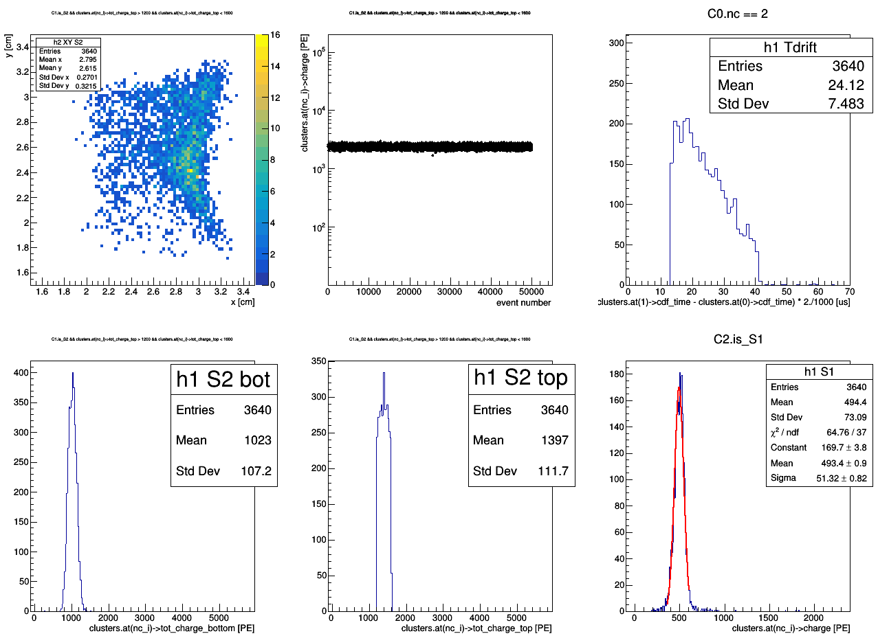
Ph2, Am241, run 542
1200 < tot_charge_top < 1600 [PE]
master cut

Slide 55
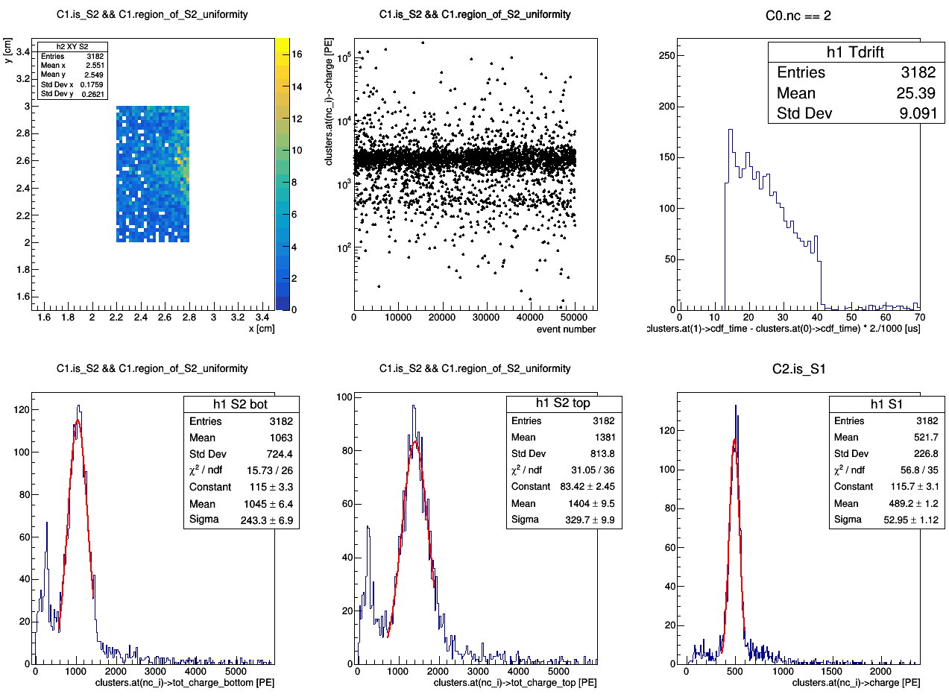
master cut
Ph2, Am241, run 542

Slide 56
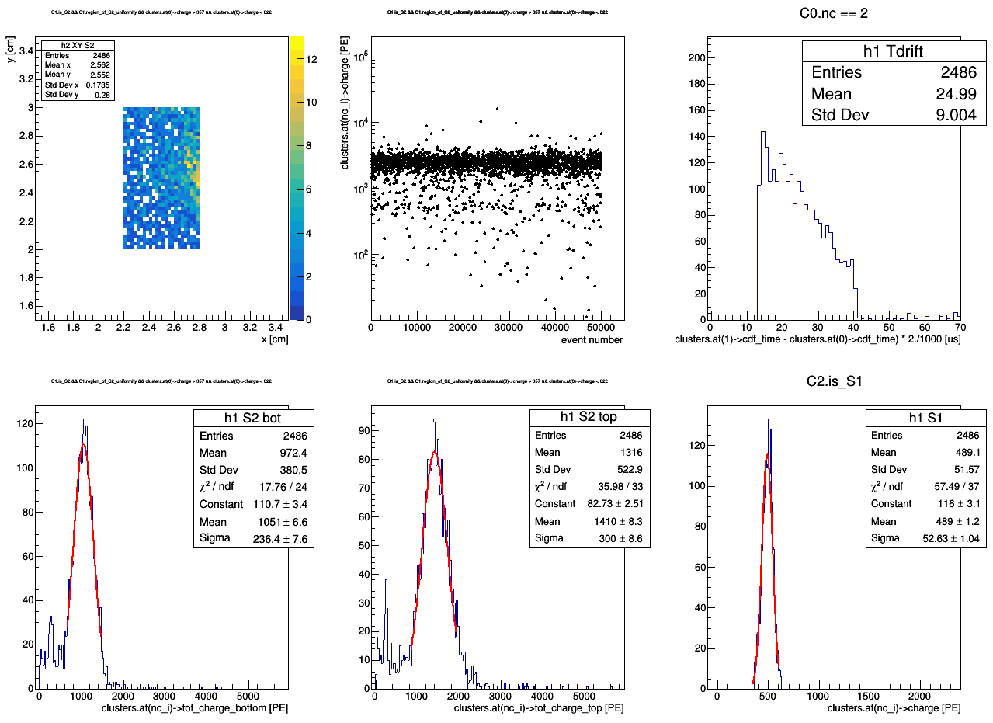
master cut1
Ph2, Am241, run 542
357 < charge < 622 [PE]
master cut2

Slide 58
master cut
Ph2, Am241, run 542

Slide 59
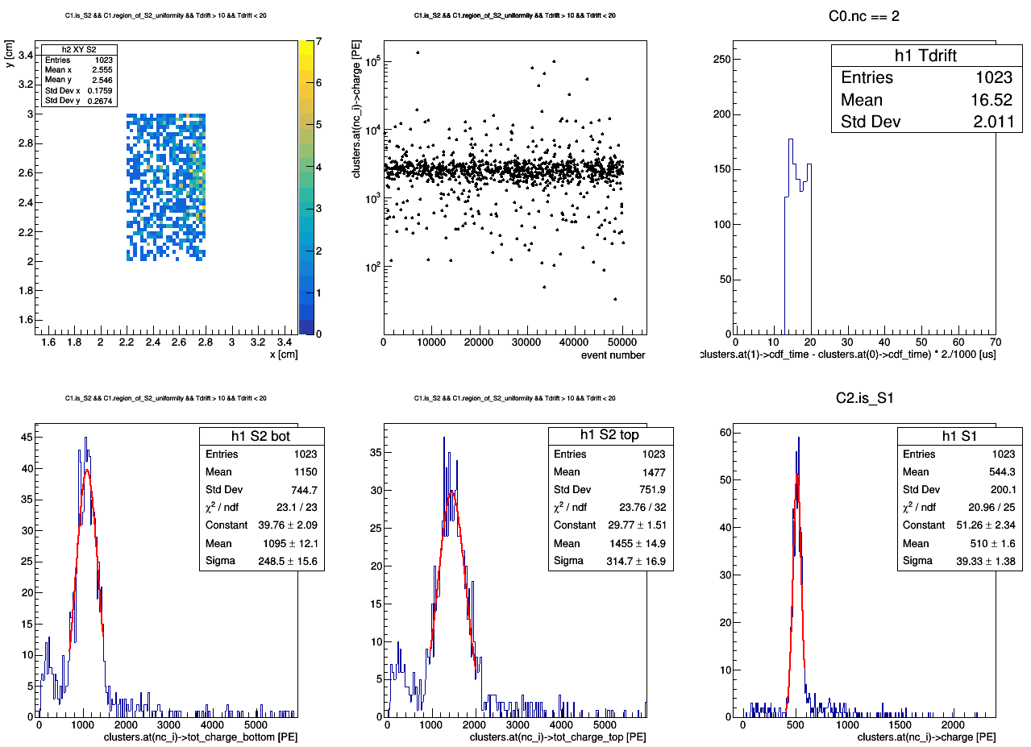
master cut
Ph2, Am241, run 542

Slide 60
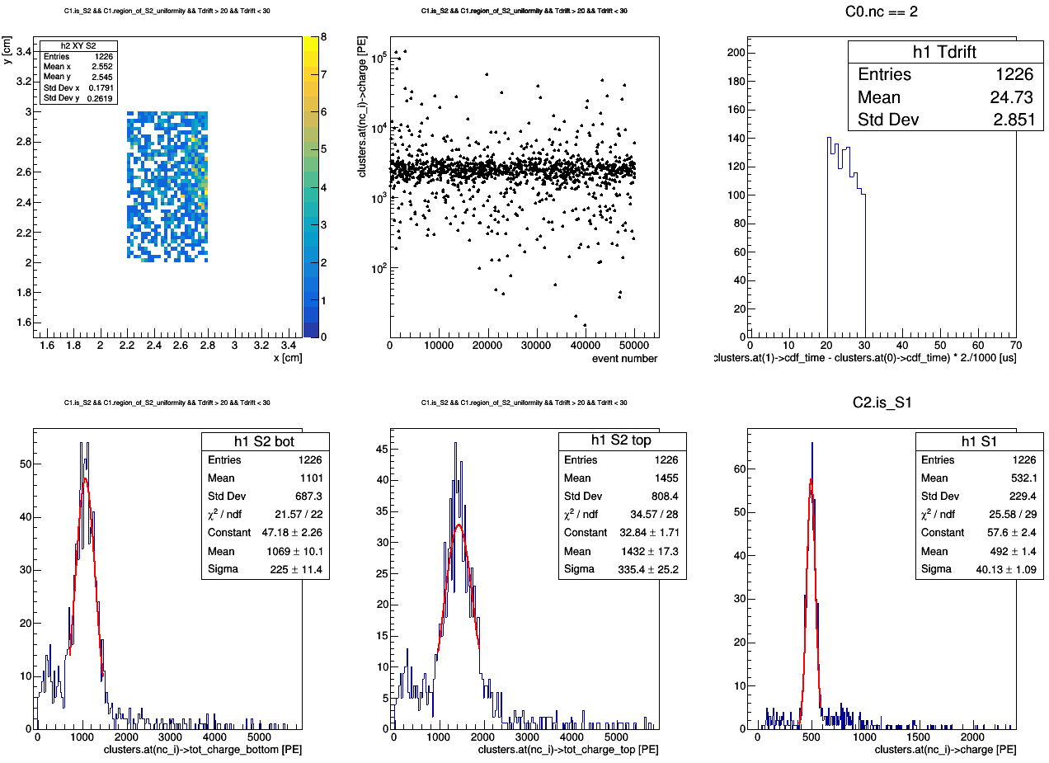
master cut
Ph2, Am241, run 542

Slide 61
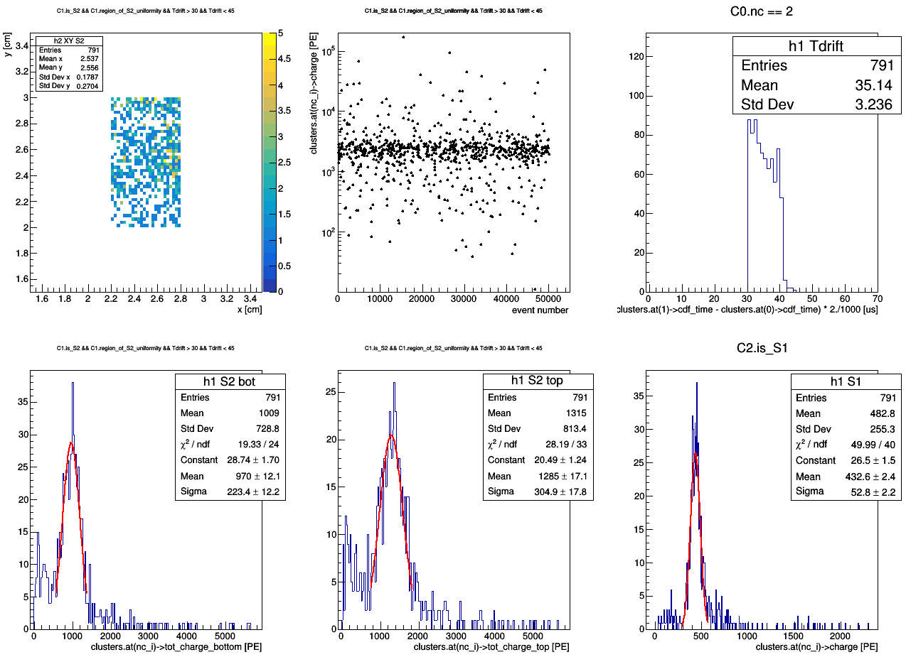
master cut
Ph2, Am241, run 542

Slide 63
master cut
Ph2, Am241, run 542

Slide 64
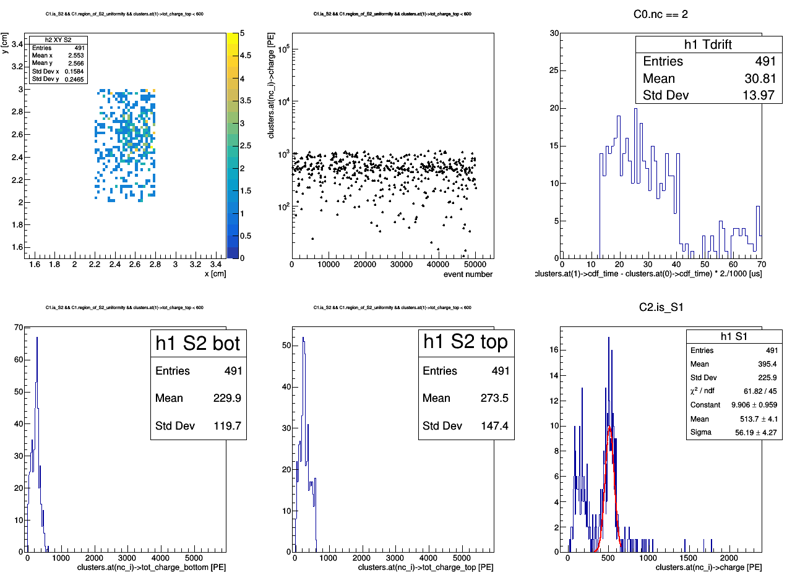
tot_charge_top < 600 [PE]
Ph2, Am241, run 542
master cut

Slide 65
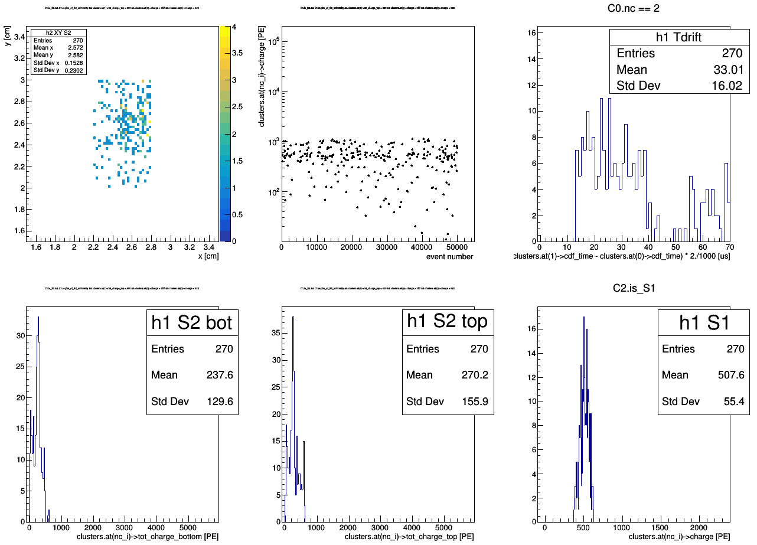
tot_charge_top < 600 [PE]
357 < charge < 622 [PE]
Ph2, Am241, run 542
master cut1
master cut2

Slide 66
tot_charge_top < 600 [PE]
357 < charge < 622 [PE]
Ph2, Am241, run 542
master cut1
master cut2

Slide 67
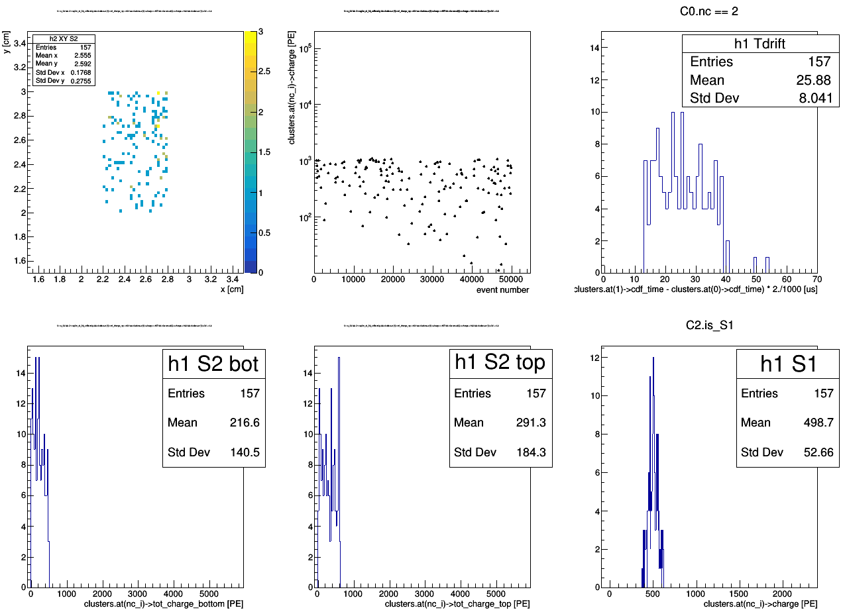
tot_charge_top < 600 [PE]
357 < charge < 622 [PE]
clusters.at(1)->f90 < 0.2
Ph2, Am241, run 542
master cut1
master cut2

Slide 69
Ph2, Am241, run 544

Slide 70
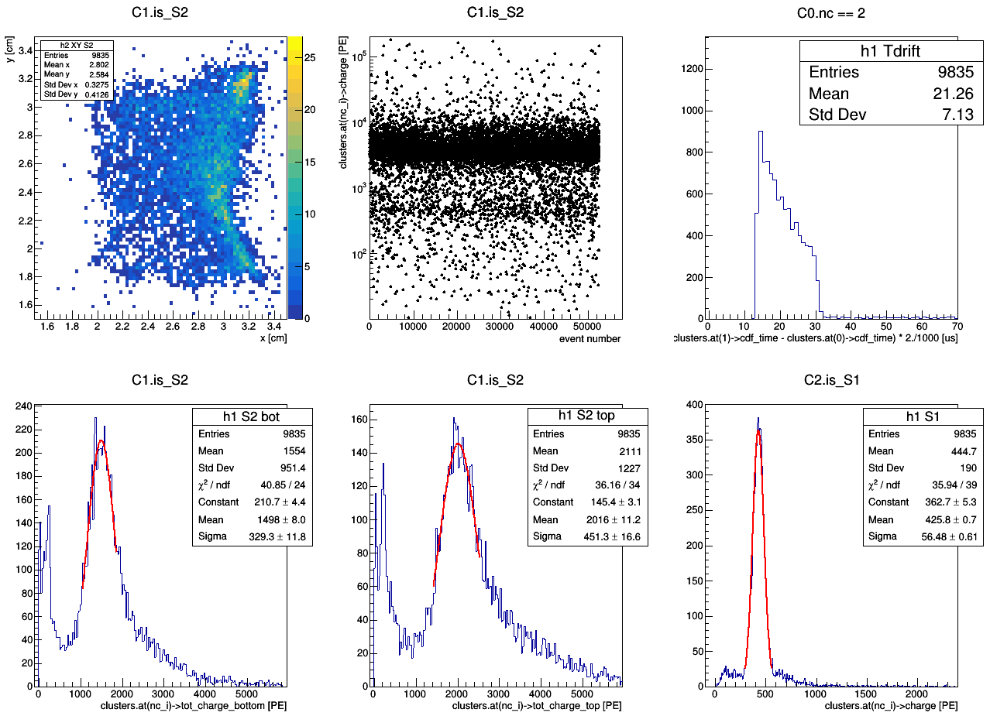
Ph2, Am241, run 544

Slide 71
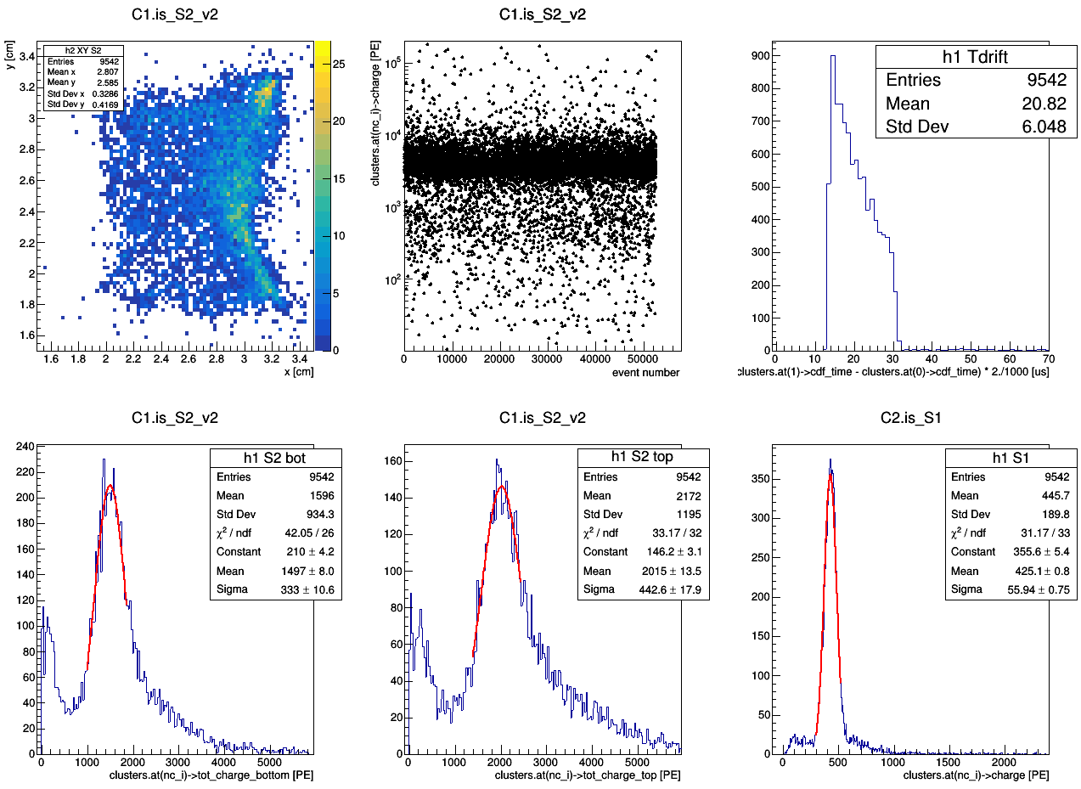
Ph2, Am241, run 544

Slide 72
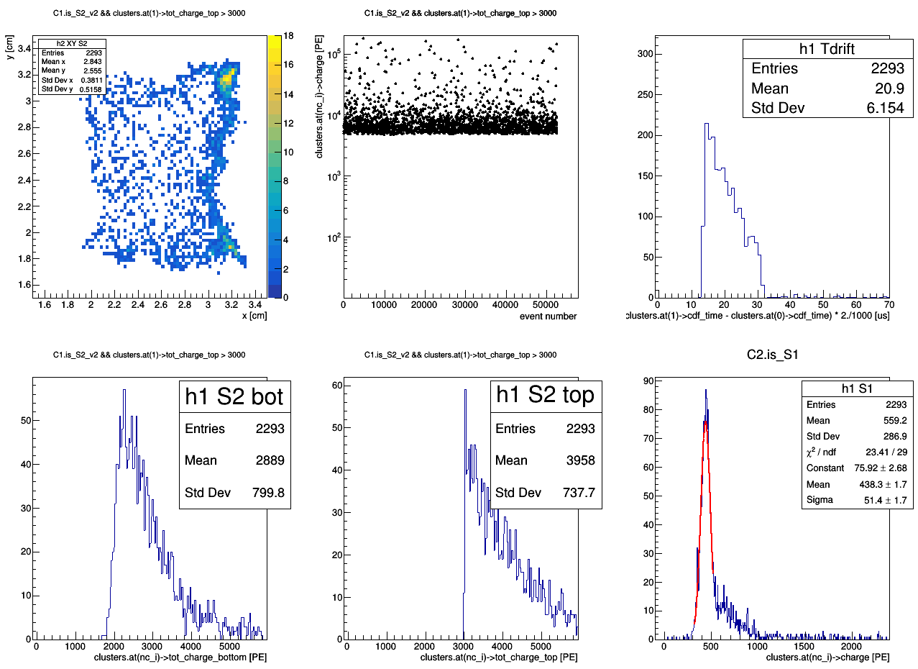
tot_charge_top > 3000 [PE]
Ph2, Am241, run 544
master cut

Slide 73

tot_charge_top > 3000 [PE]
350 < charge < 510 [PE]
Ph2, Am241, run 544
master cut1
master cut2

Slide 74

1573 < tot_charge_top < 2457 [PE]
Ph2, Am241, run 544
master cut

Slide 76

master cut
Ph2, Am241, run 544

Slide 77

master cut1
Ph2, Am241, run 544
300 < charge < 510 [PE]
master cut2

Slide 81
Ph2, bkg, run 534

Slide 82

Ph2, bkg, run 534

Slide 83

Ph2, bkg, run 534

Slide 84

Ph2, bkg, run 534

Slide 85

Ph2, bkg, run 534

Slide 86

Ph2, bkg, run 534

Slide 87

Ph2, bkg, run 534

Slide 88

Ph2, bkg, run 534
master cut

Slide 89

Ph2, bkg, run 534
master cut

Slide 90

Ph2, bkg, run 534
master cut
0 < tot_charge_top < 1000 [PE]

Slide 91

Ph2, bkg, run 534
master cut
1000 < tot_charge_top < 2000 [PE]

Slide 92

Ph2, bkg, run 534
master cut
2000 < tot_charge_top < 4000 [PE]

Slide 93

Ph2, bkg, run 534
master cut
4000 < tot_charge_top < 8000 [PE]

Slide 94

Ph2, bkg, run 534
master cut
8000 < tot_charge_top < 14000 [PE]

Slide 95

Ph2, bkg, run 534
master cut
14000 < tot_charge_top < 25000 [PE]

Slide 96

Ph2, bkg, run 534
master cut
25000 < tot_charge_top < 40000 [PE]

