Slide 1
Spectra for individual channels
Сampaign V
Oleynikov Vladislav
20 Nov 2018

Slide 2
Algorithm:
11713f949ea5bffcc2f0ceb22d1267b5f314a5af
Merge branch 'barycenter' into 'master'

Slide 3
Cut list:
bool cls0_is_S1 = clusters.at(0)->f90 > 0.2;
bool cls0_is_full = clusters.at(0)->rep == 1;
bool S1_Am_peak = (clusters.at(0)->charge > 440) &&
(clusters.at(0)->charge < 630); // mean +- 1.5sigma using run 537
//bool S1_Am_peak = (clusters.at(0)->charge > 419) &&
(clusters.at(0)->charge < 587); // mean +- 1.5sigma using run 542
//bool S1_Am_peak = (clusters.at(0)->charge > 342) &&
(clusters.at(0)->charge < 482); // mean +- 1.5sigma using run 544
bool cls0 = nc_i == 0;//cluster 0
bool cls1 = nc_i == 1;//cluster 1
bool is_S1 = nc == 2 && cls0 && cls0_is_full && cls0_is_S1;
bool is_S2 = nc == 2 && cls1 && cls0_is_full && cls0_is_S1;
bool is_S1_only = nc == 1 && cls0_is_full && cls0_is_S1;

Slide 4
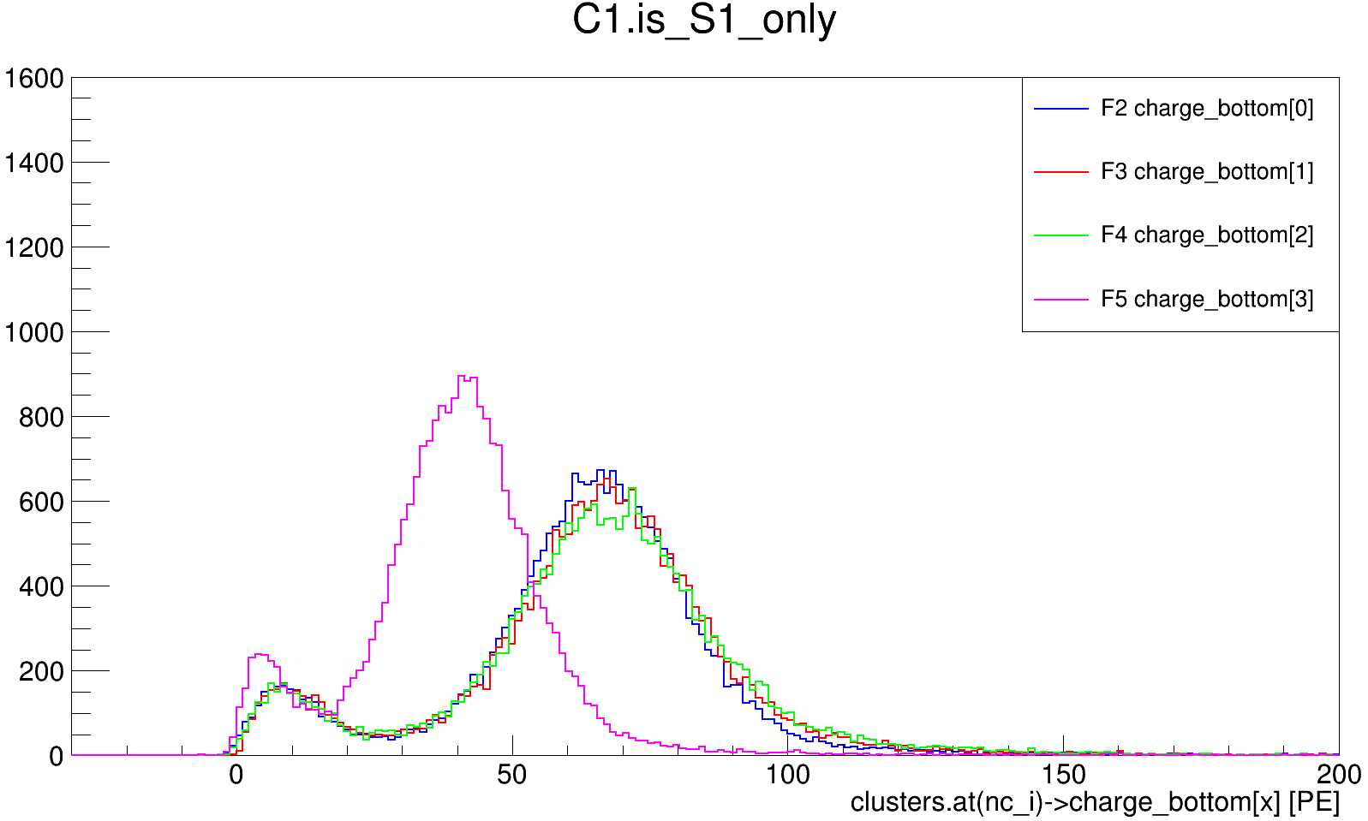
Ph1, Am241, run 399

Slide 5
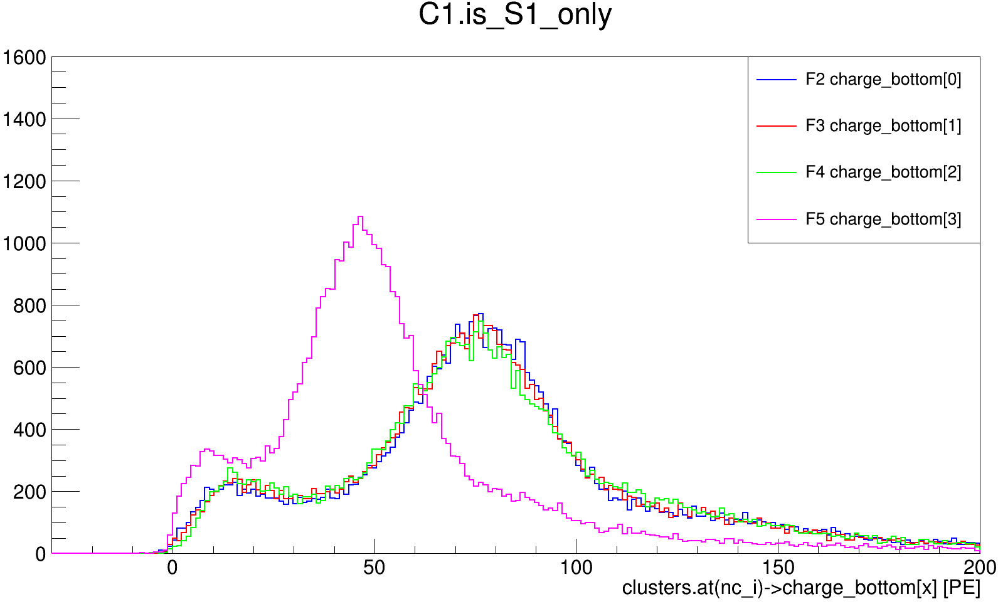
Ph1, Am241, run 418

Slide 6
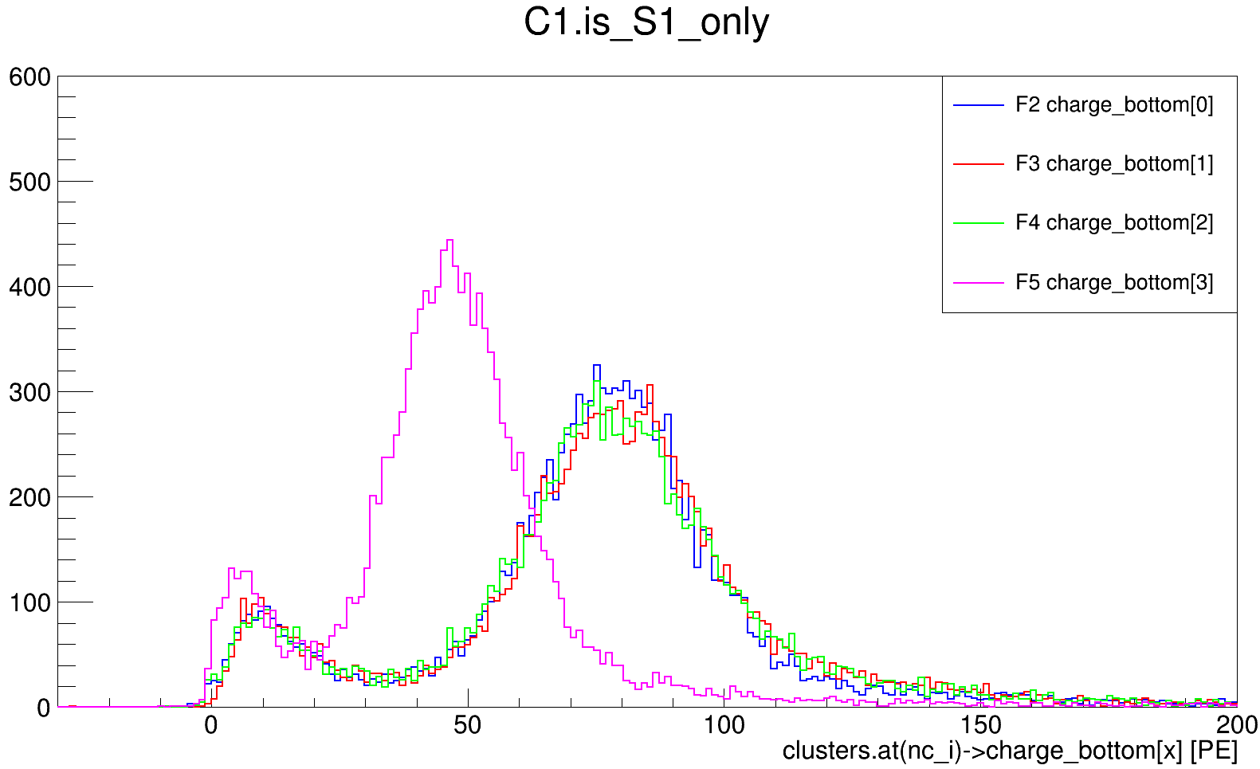
Ph1, Am241, run 511

Slide 7
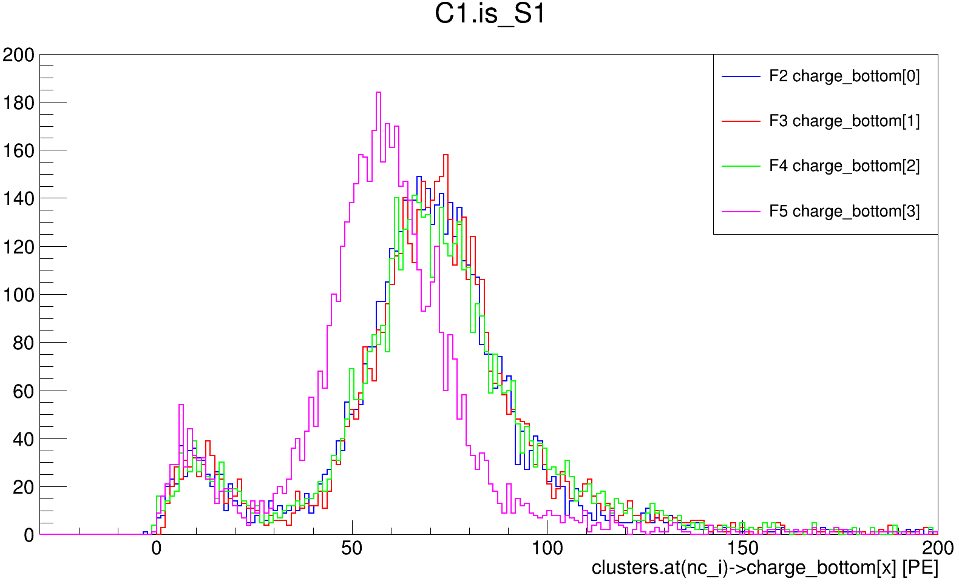
Ph2, Am241, run 537

Slide 8
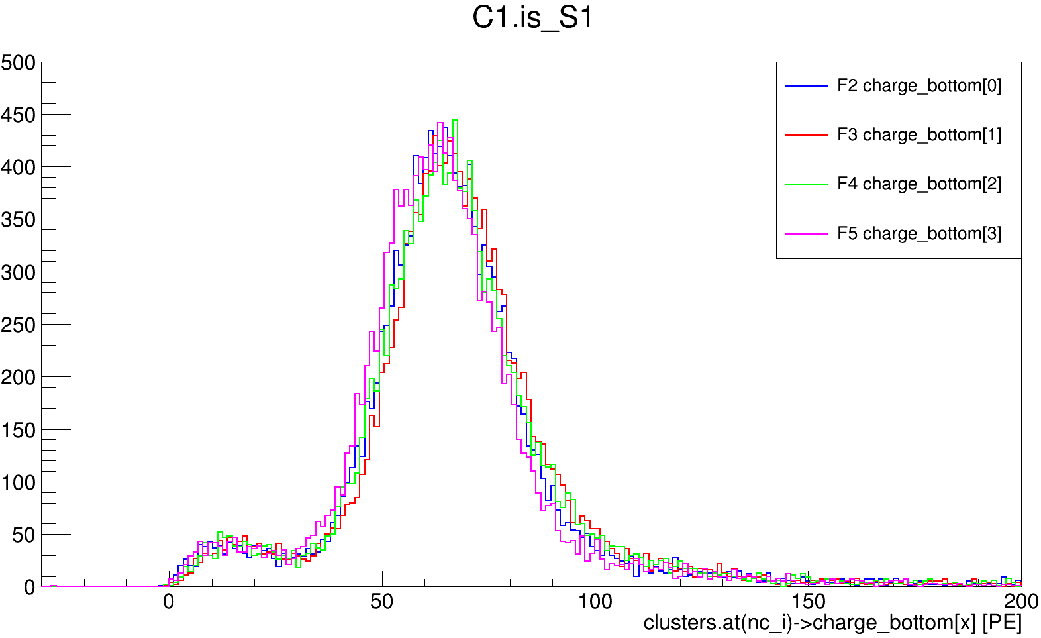
Ph2, Am241, run 542

Slide 9
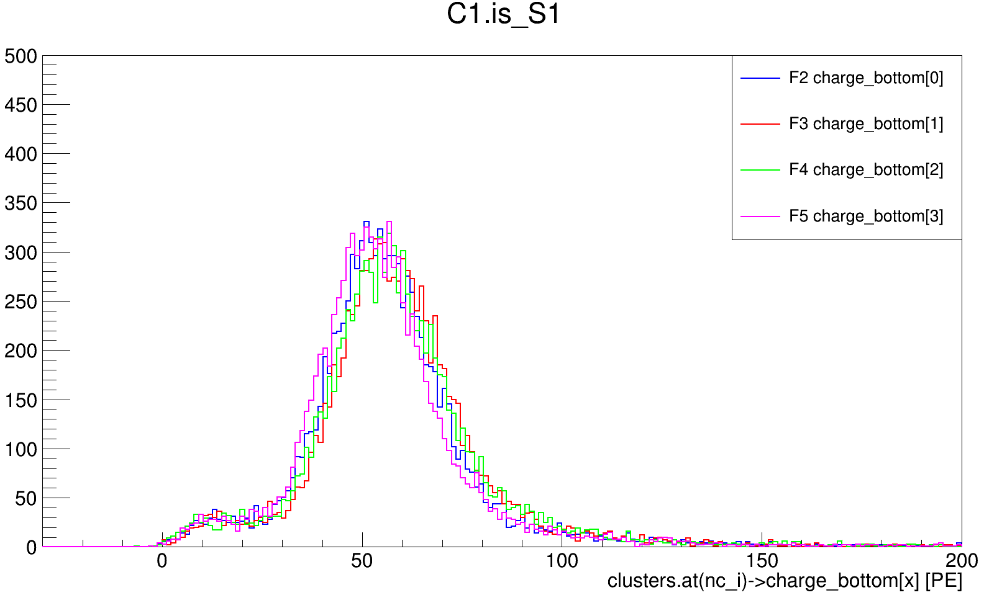
Ph2, Am241, run 544

Slide 10
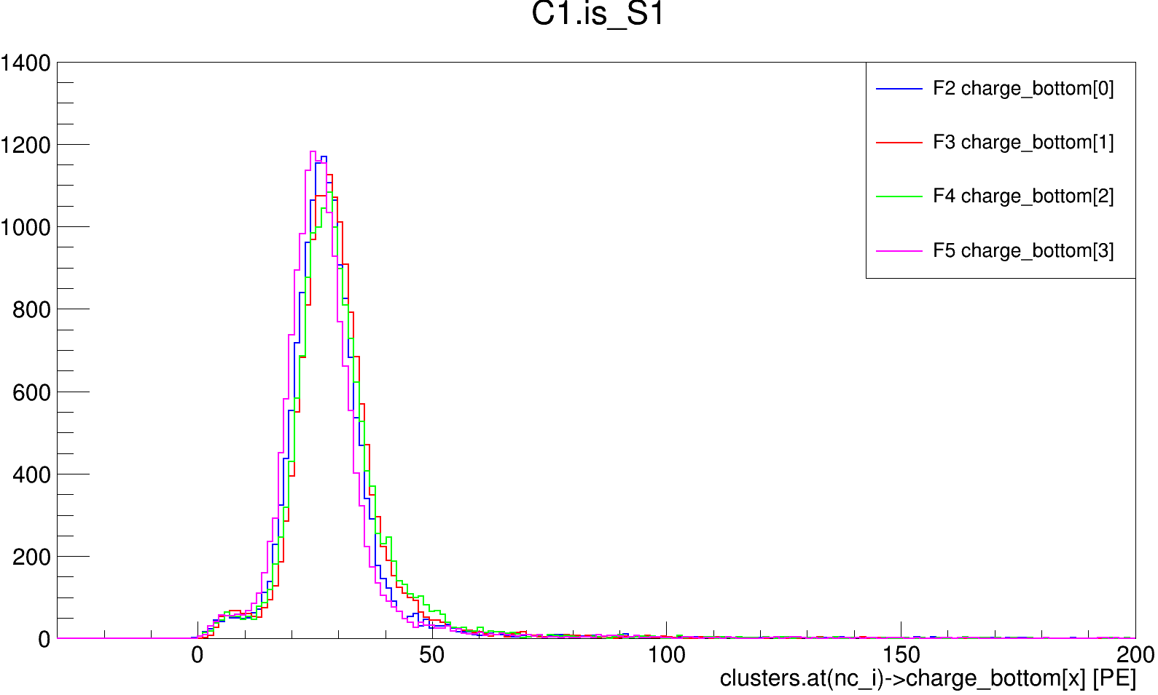
Ph2, Am241, run 550

Slide 11
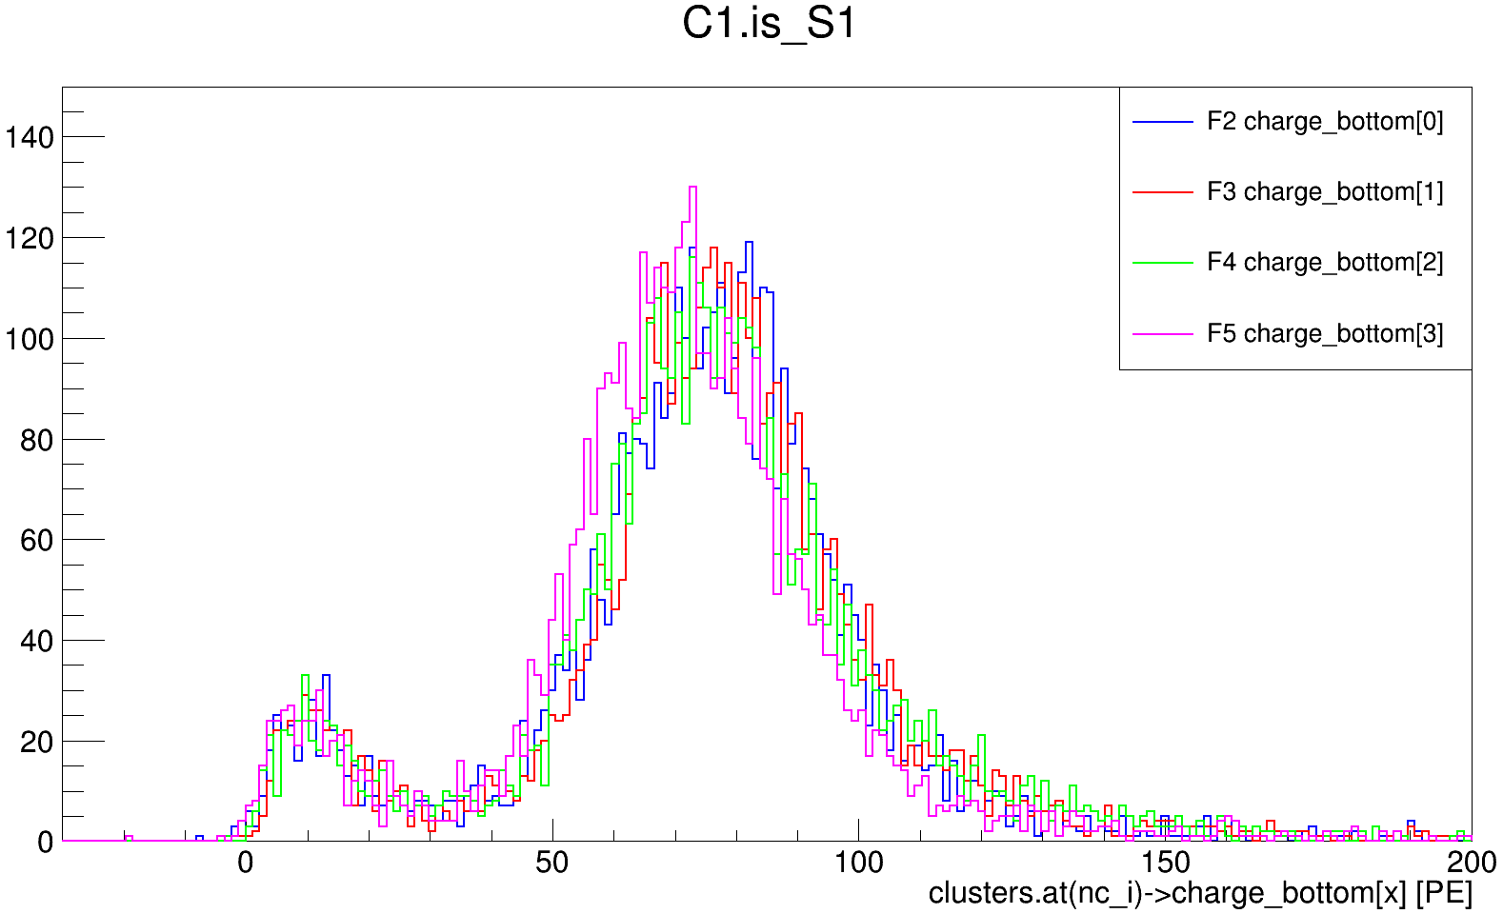
Ph2, Am241, run 554

Slide 13
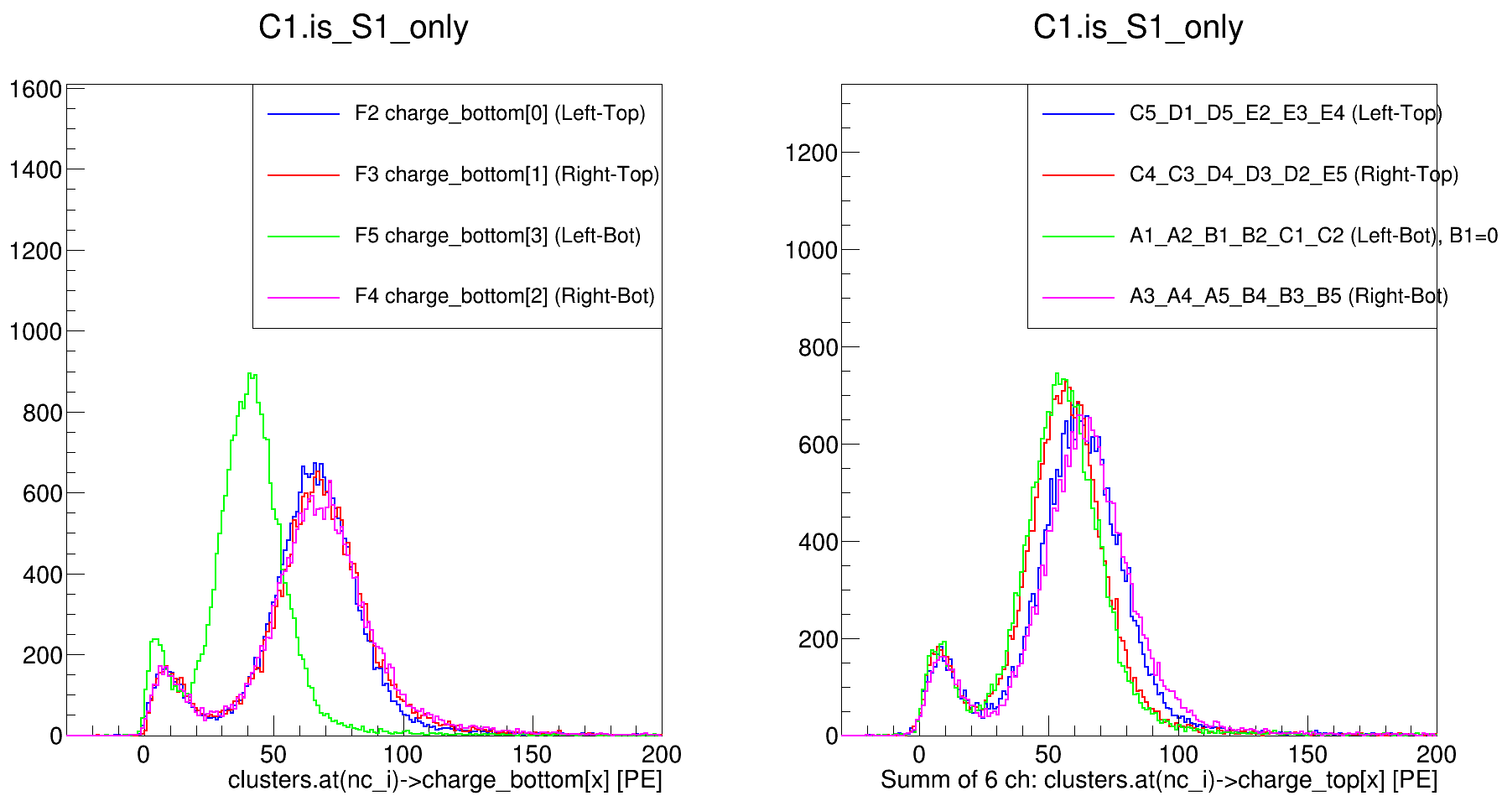
Ph1, Am241, run 399

Slide 14
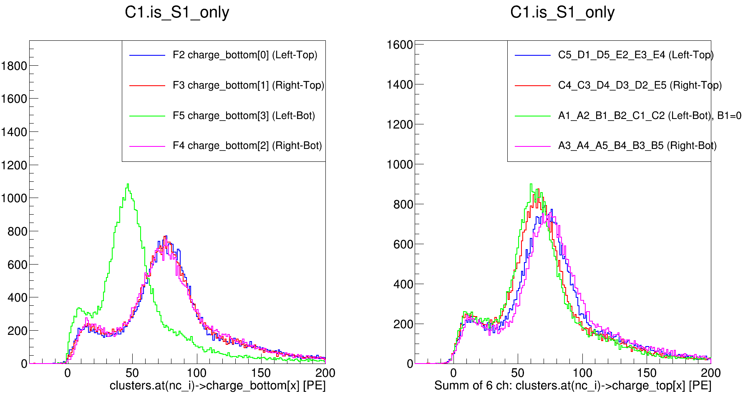
Ph1, Am241, run 418

Slide 15
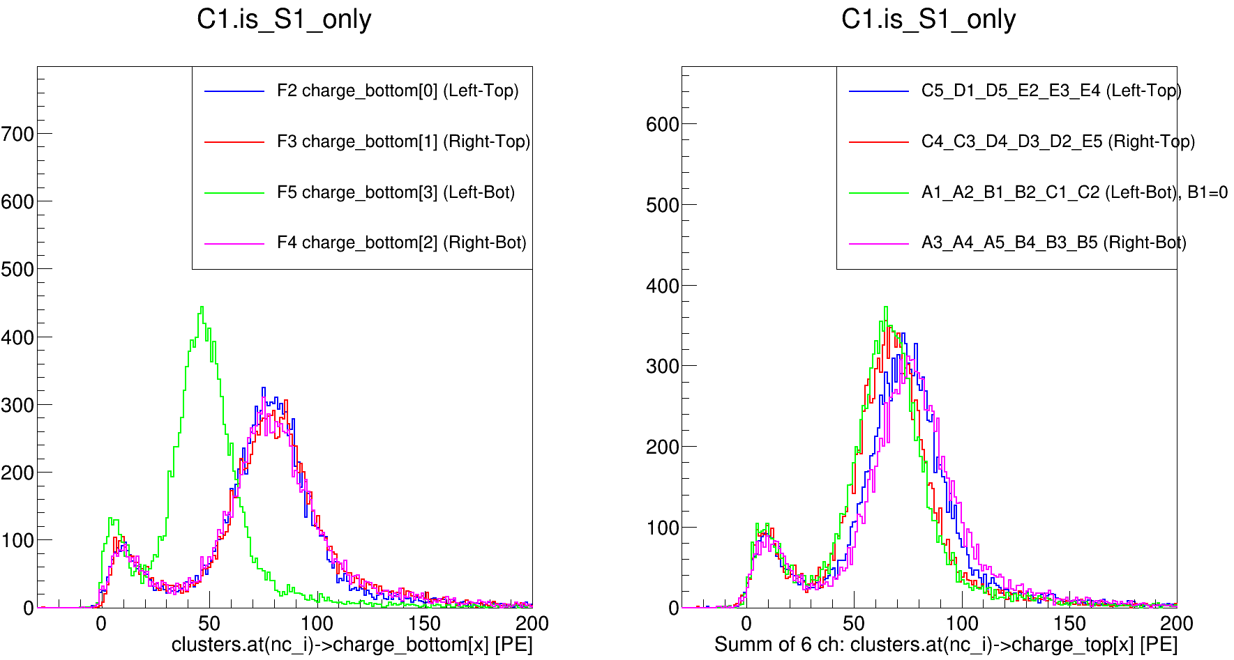
Ph1, Am241, run 511

Slide 16
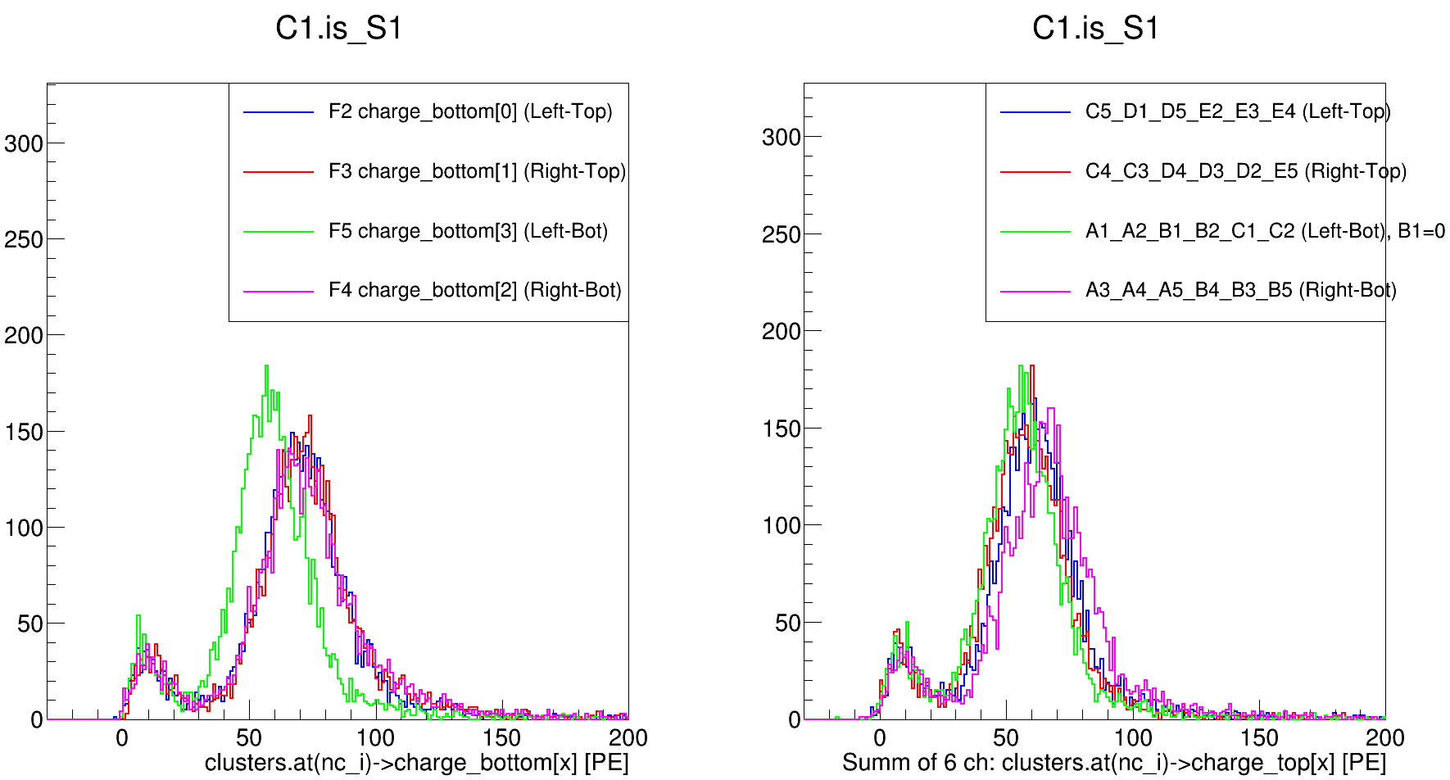
Ph2, Am241, run 537

Slide 17
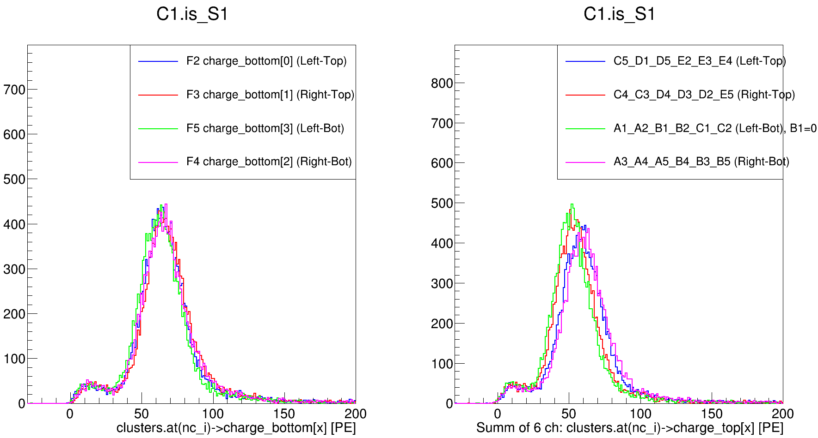
Ph2, Am241, run 542

Slide 18
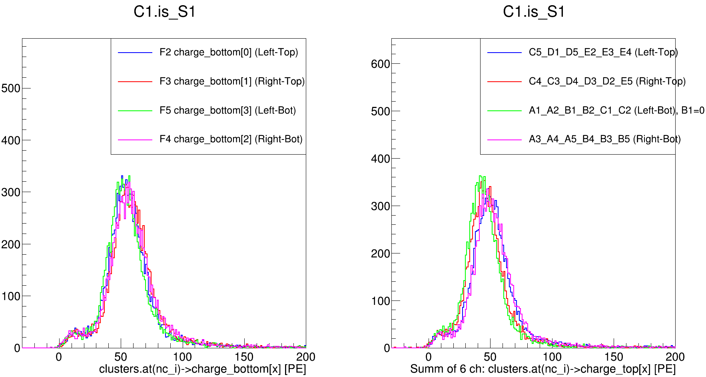
Ph2, Am241, run 544

Slide 19
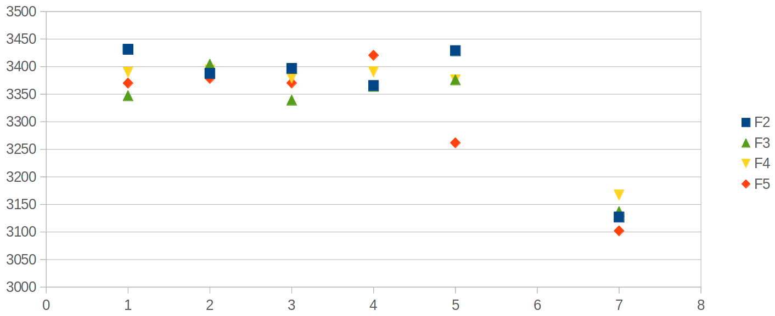
393
416
499
533
541
555

