Slide 1
Why events localized in the center?

Slide 2
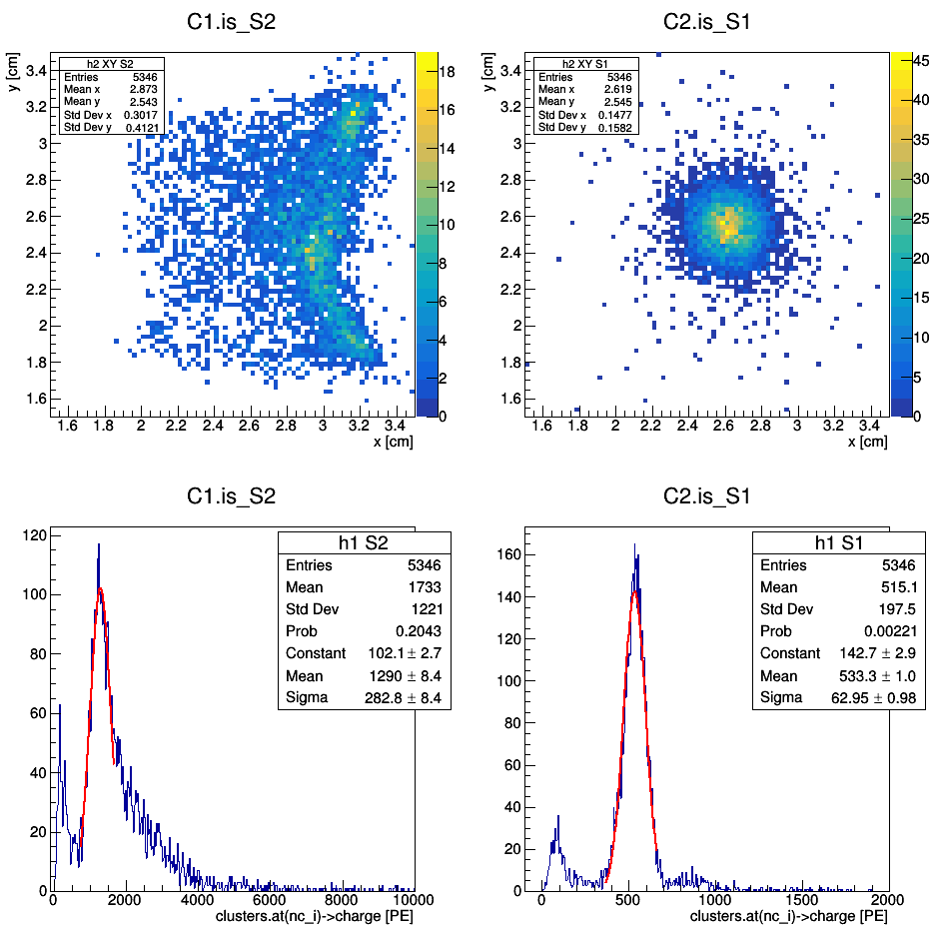
Ph2, Am241, run 537

Slide 3
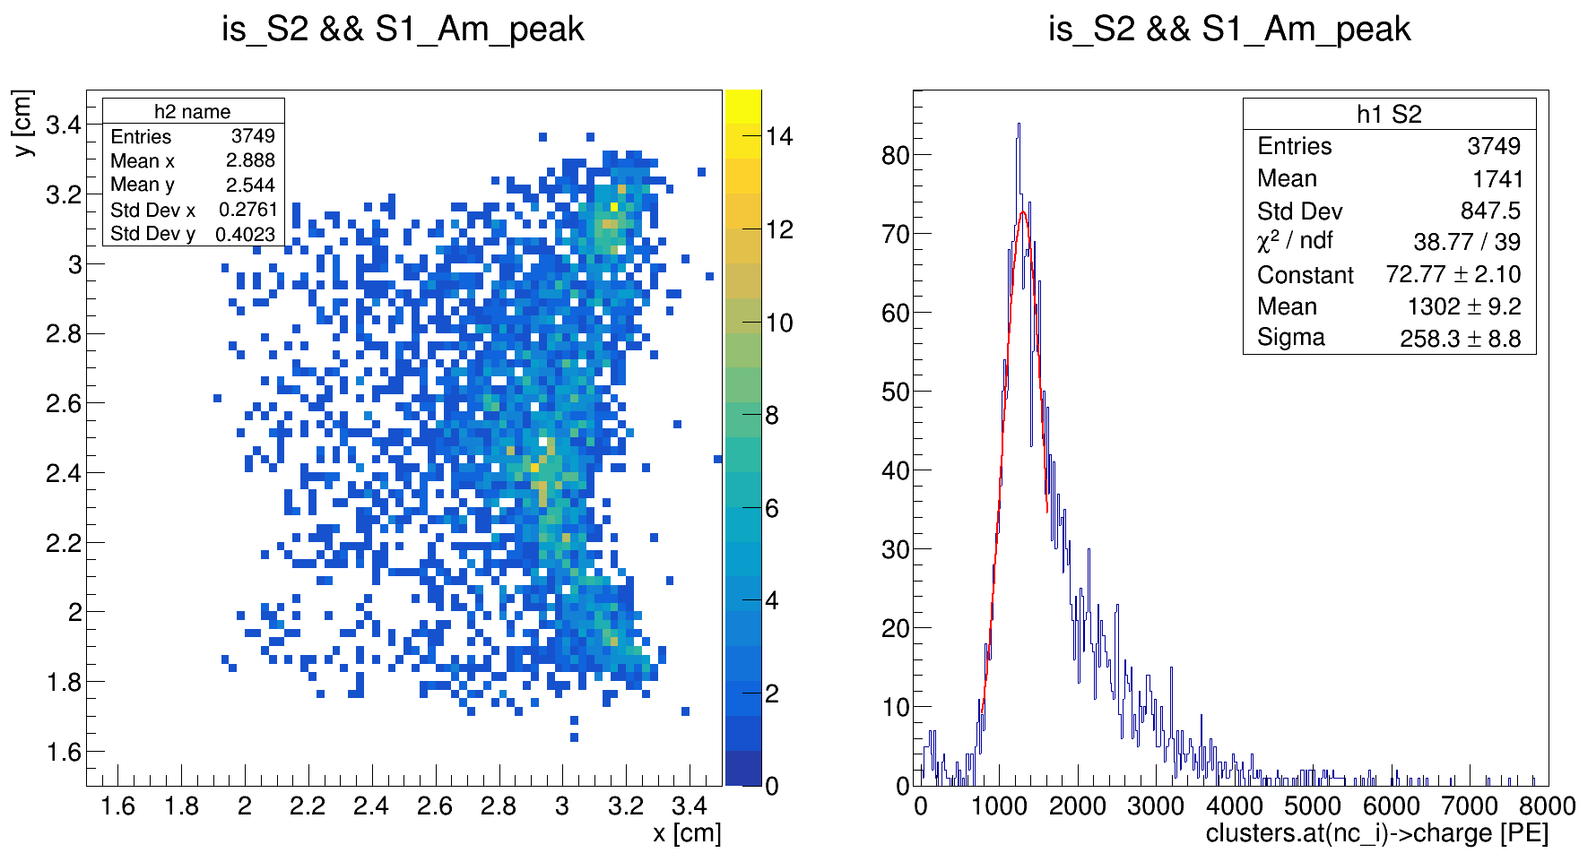
Ph2, Am241, run 537

Slide 4
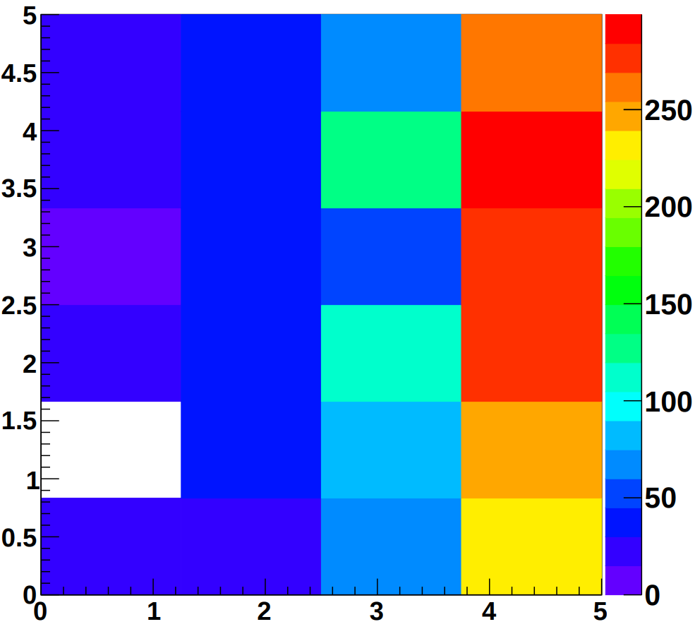
By Maximo
XY on s2_max_chan for Am241

Slide 5
S2 spectrum: right tail
S2 for different XY cuts:
central, edges, corners

Slide 6
Ph2, Am241, run 537

Slide 7
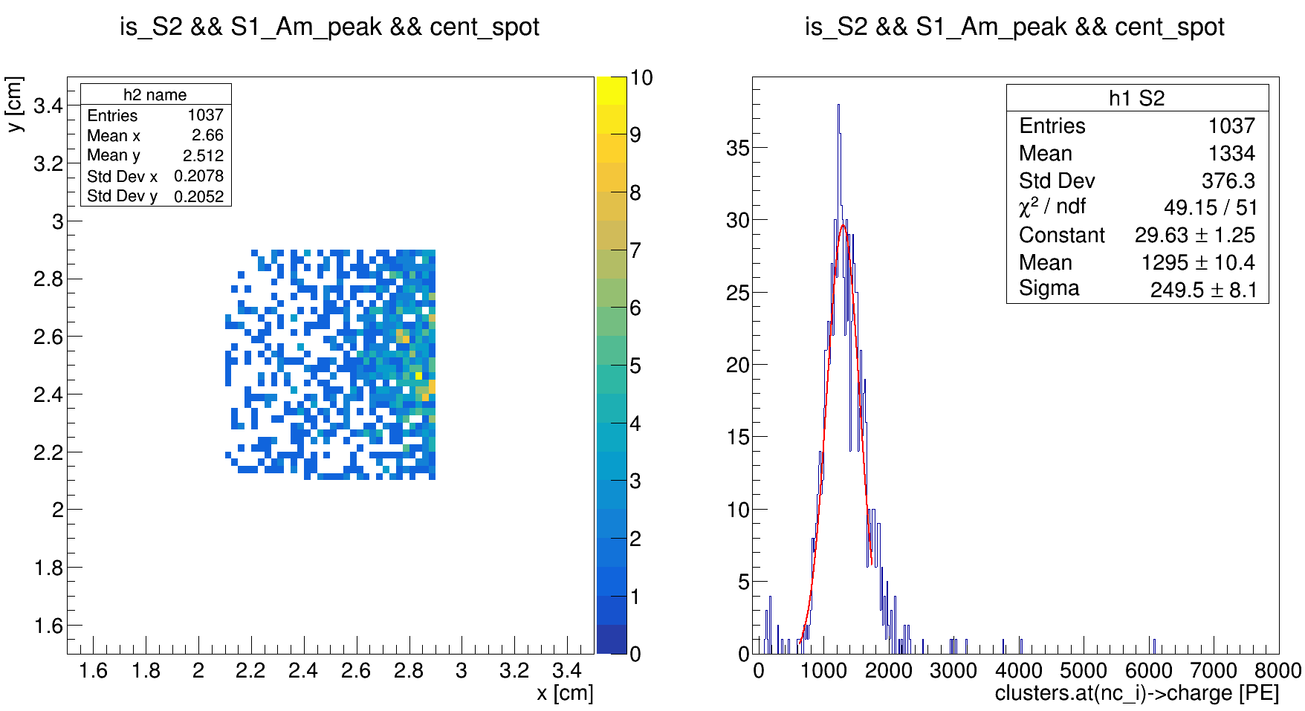
Ph2, Am241, run 537

Slide 8
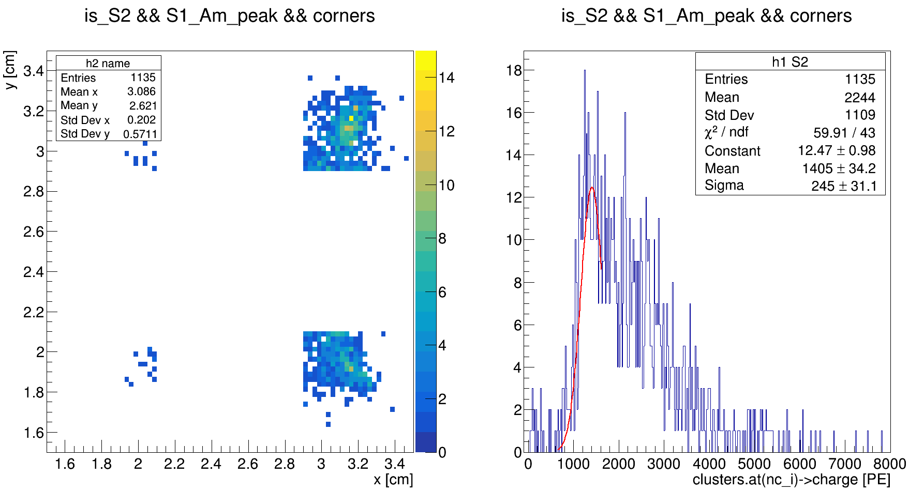
Ph2, Am241, run 537

Slide 9
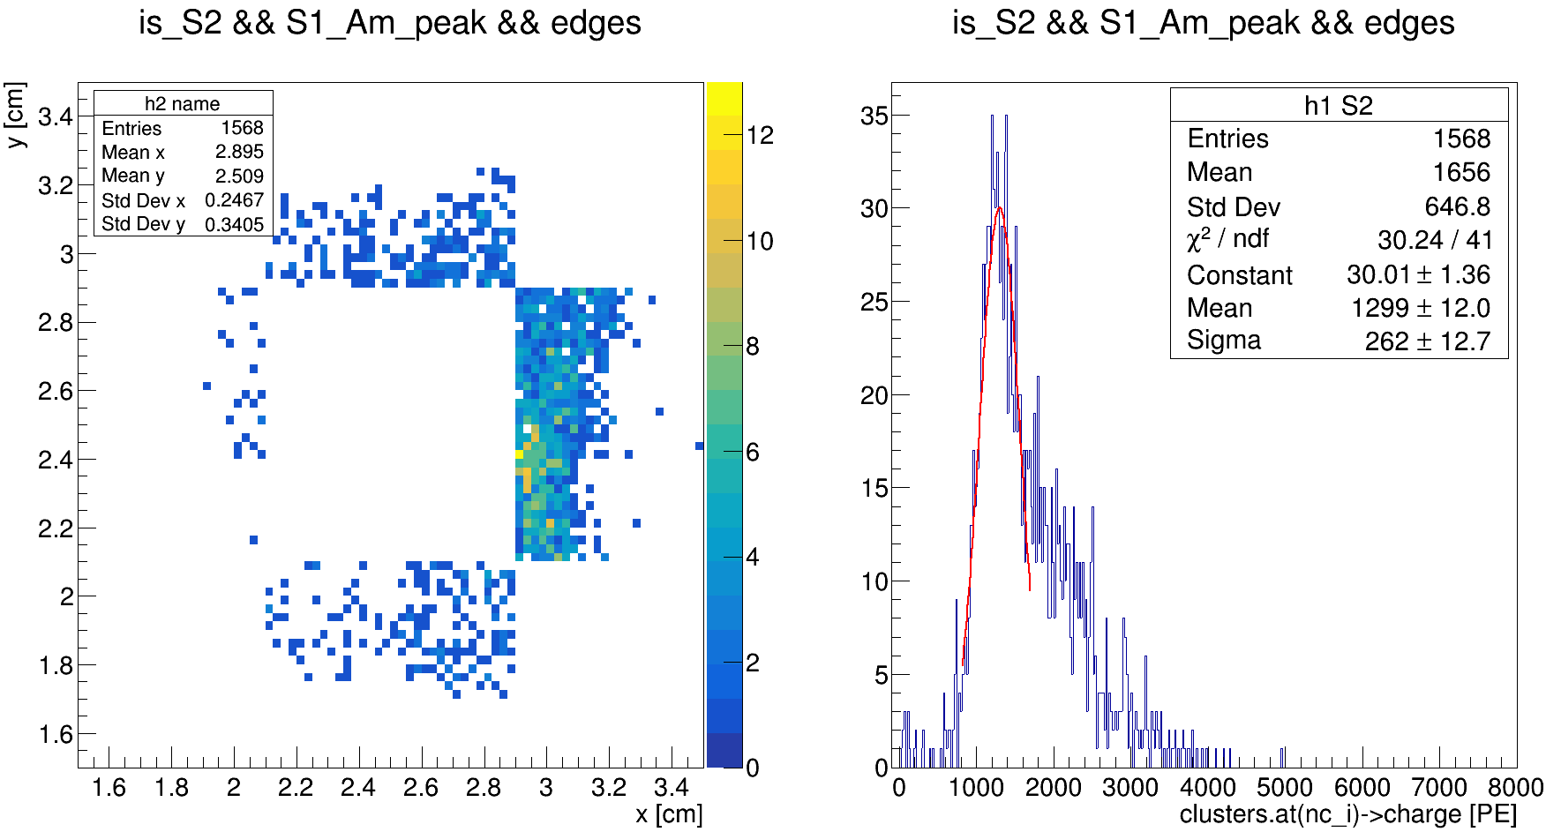
Ph2, Am241, run 537

Slide 10
S1, S2, S2/S1 for different XY cuts:
central, edges, corners

Slide 11
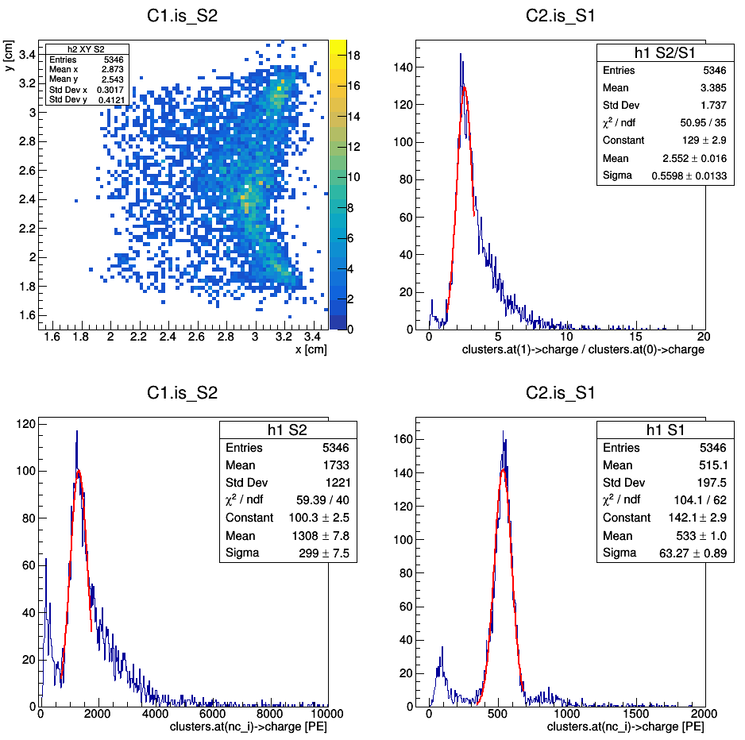
Ph2, Am241, run 537

Slide 12
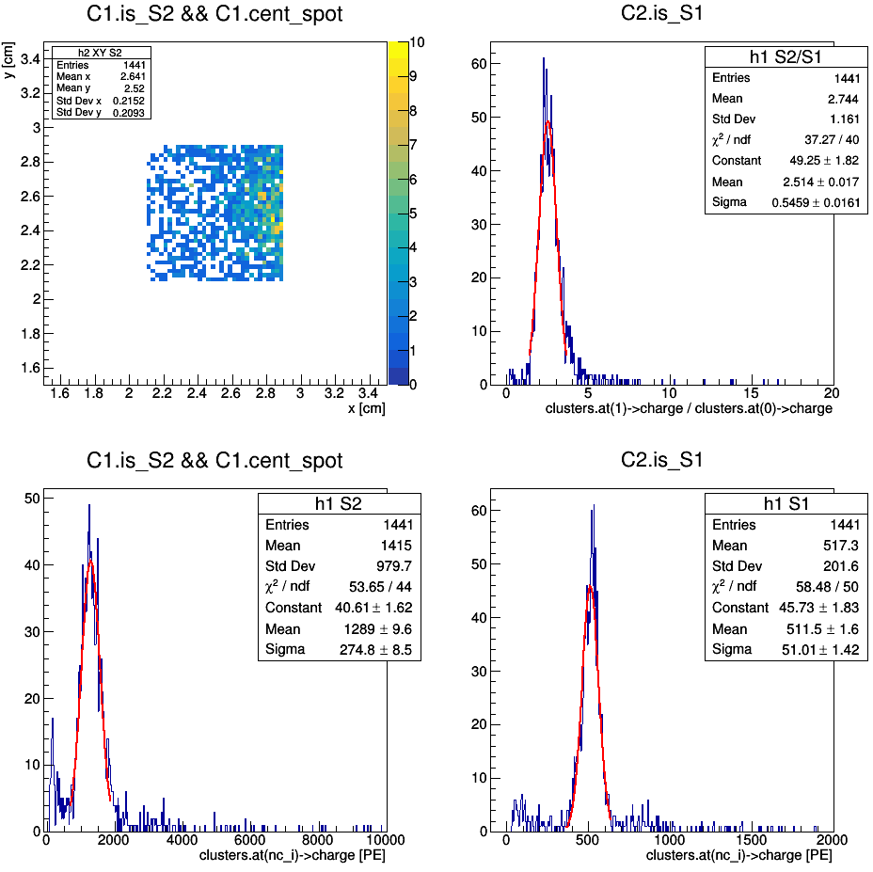
Ph2, Am241, run 537

Slide 13
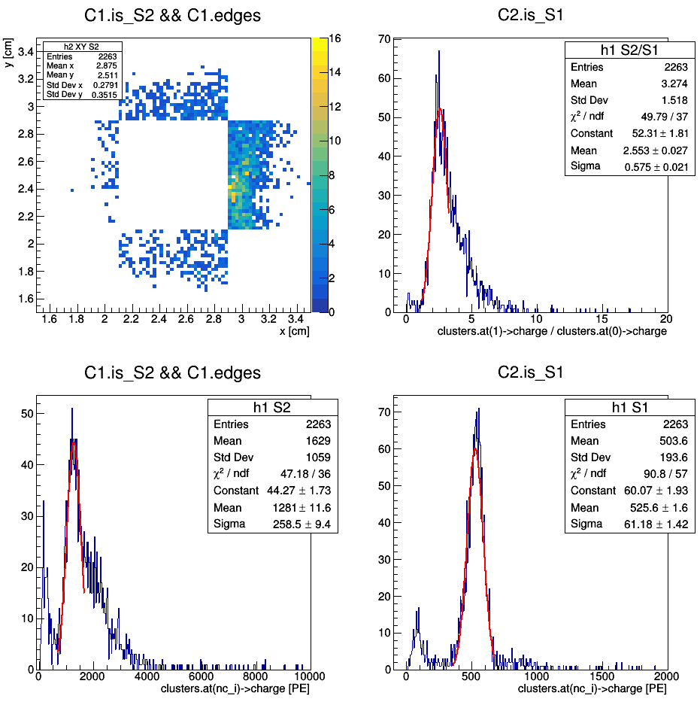
Ph2, Am241, run 537

Slide 14
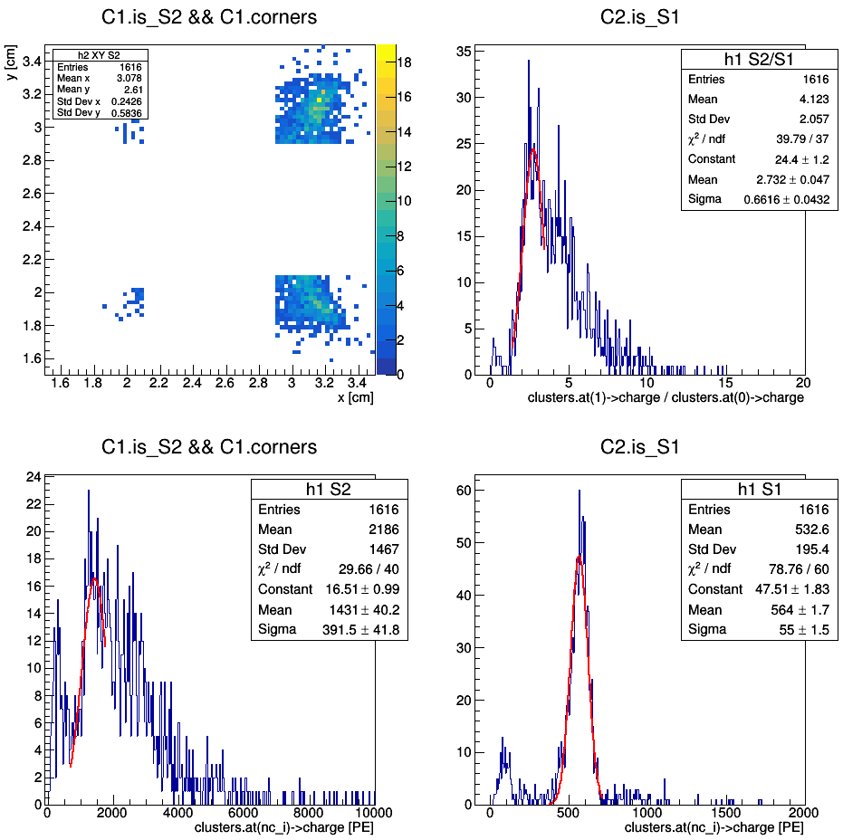
Ph2, Am241, run 537

Slide 15
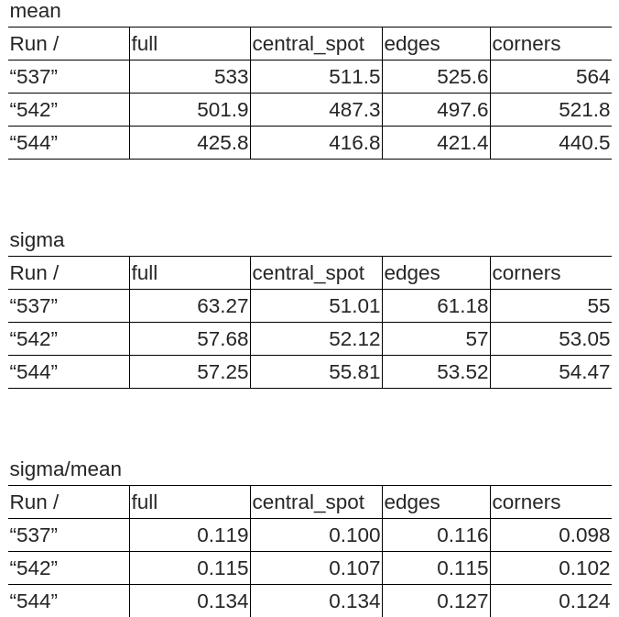
Mean, sigma and sigma/mean for S1 spectra for different XY cuts and runs:

Slide 16
S2/S1 for different corners

Slide 17
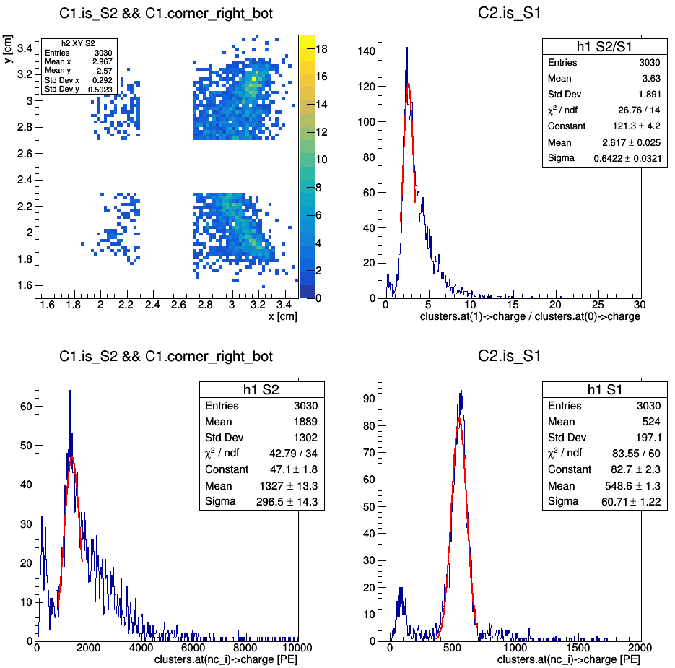
(redefinition of corners)
Ph2, Am241, run 537

Slide 18
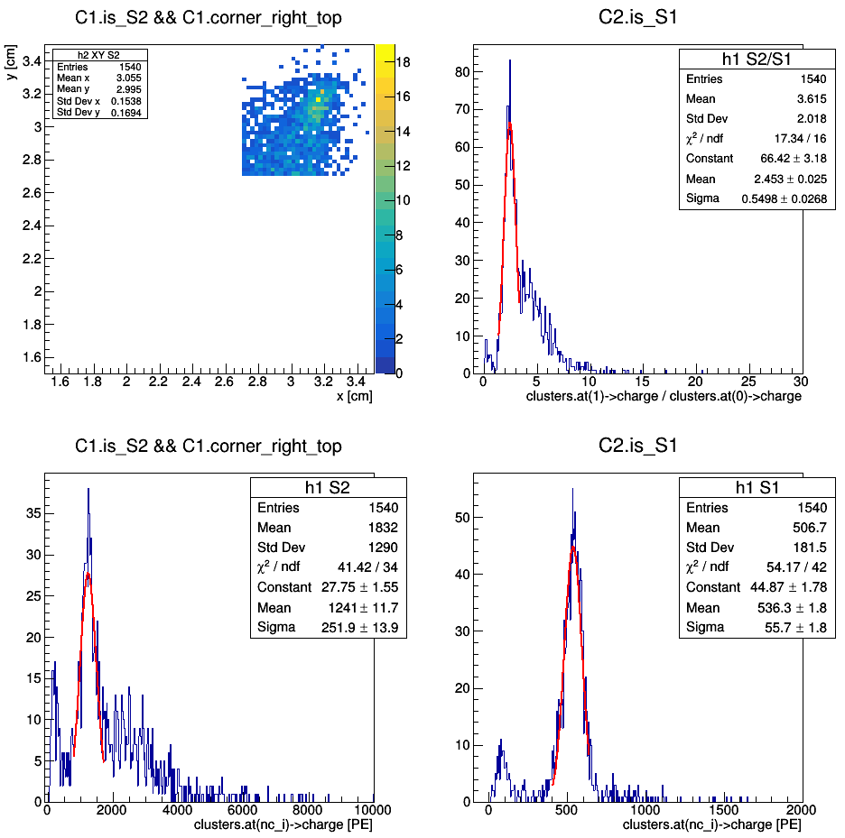
(redefinition of corners)
Ph2, Am241, run 537

Slide 19
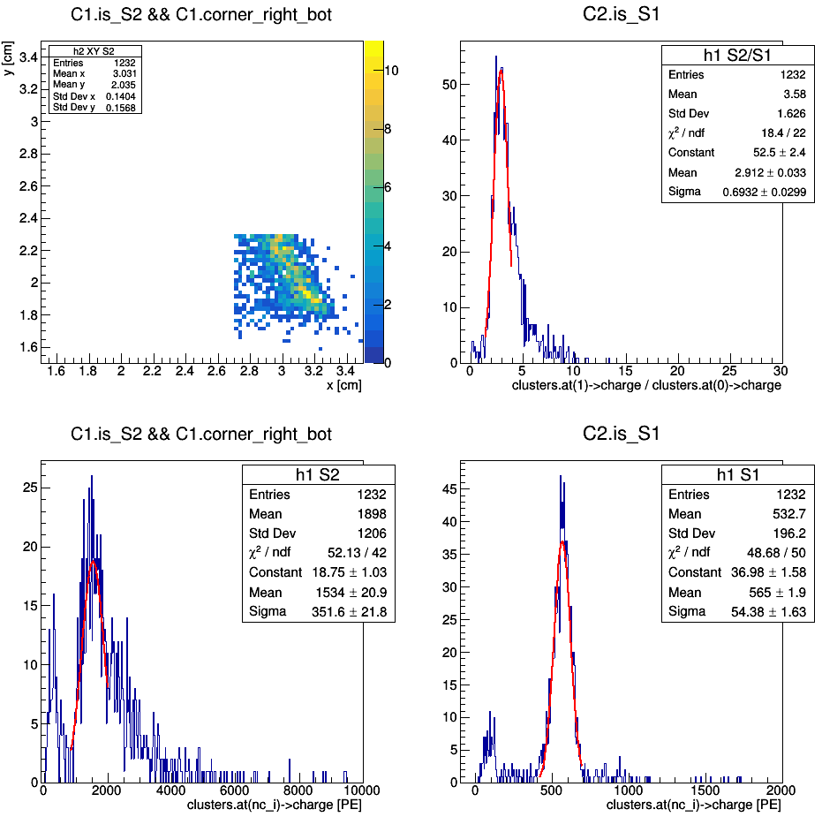
(redefinition of corners)
Ph2, Am241, run 537

Slide 20
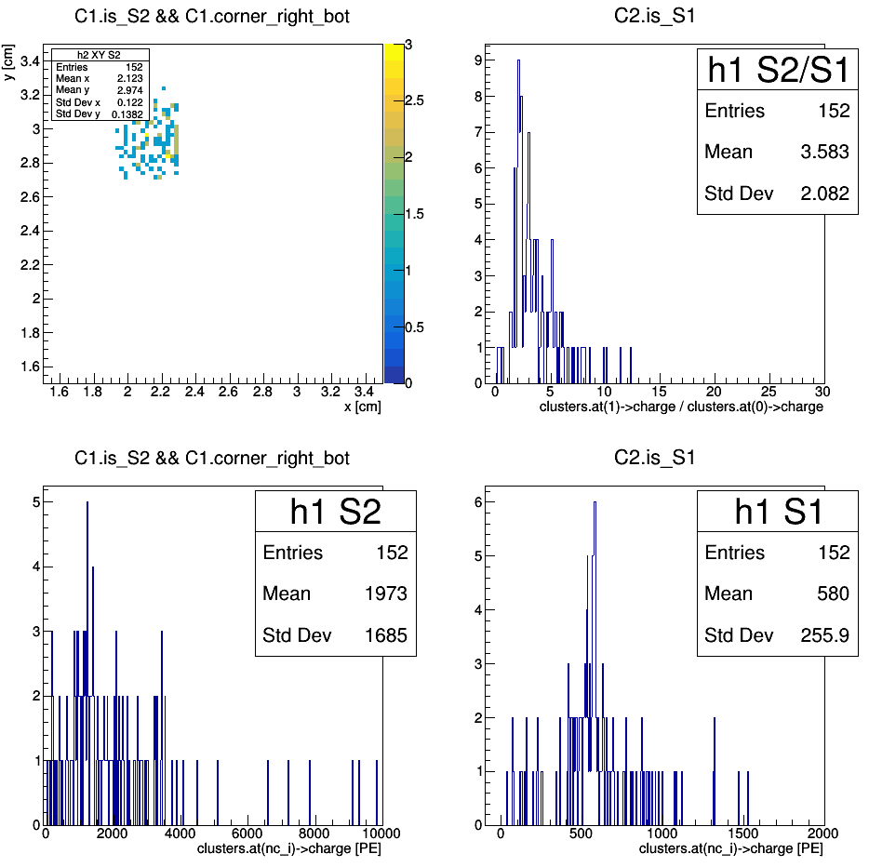
(redefinition of corners)
Ph2, Am241, run 537

Slide 21
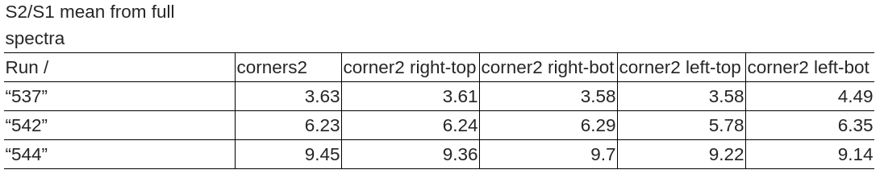
Luciano: did I get wrong, or there is a corner having a S2/S1 very different from the other three?

Slide 22
Am241 spectrum from F4 (bottom)

Slide 23
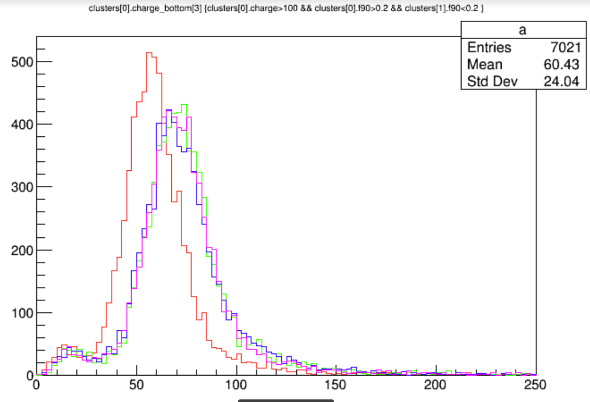
Marco: Here in Madrid, prompted by Davide, I made this one plot which also cast some doubts.

Slide 24
Hypotheses:
1) Luciano: Firstly, we should check to rule out "stupid" bugs in the
Reconstruction.
2) Nicola: From the corresponding laser run it seems that this channel doesn't have a different gain. So it looks like it is a like collection problem.
3) Luciano: could it be that one (or more) SiPM in the bottom tile is dead? This wouldn't affect the SER, but only the total charge spectrum
4) Nicola: George has just told me that if one SiPM dies, it can either produce a short circuit or an interruption. In both cases, he says, we must see some strong change in the gain due to the new partition of the over-voltage.

Slide 25
Hypotheses:
5) Marco: Vlad in the attachment shows that the distinct response of the "rogue" bottom tile channel is dependent on the electric field in the channel, is worse by far with no Field (run 511), and become similar to the other with increasing field (537 ~ 200 V/cm, 542 ~ 400 V/cm, 544 ~800 V/cm). Similar trend (on another scale) might be guessed for the top tile.
6) Nicola: Anyway the presence of some problematic SiPM proposed by Luciano may be a plausible explanation. When increasing the HHV, maybe some instability in the SiPM was removed.
7) Marco: it seems to me that the strange channel has a particularly long time constant, that might in principle affect indeed the integral in the fixed roi.

Slide 26
Luciano:
If the bottom effect is confirmed, I wonder: if we "bottomize" the top
tile, i.e. sum up the SiPM in groups of six, will we see a similar
effect also in the top tile? If it comes from a xy non-uniformity, I
expect to see the same trend.

Slide 27
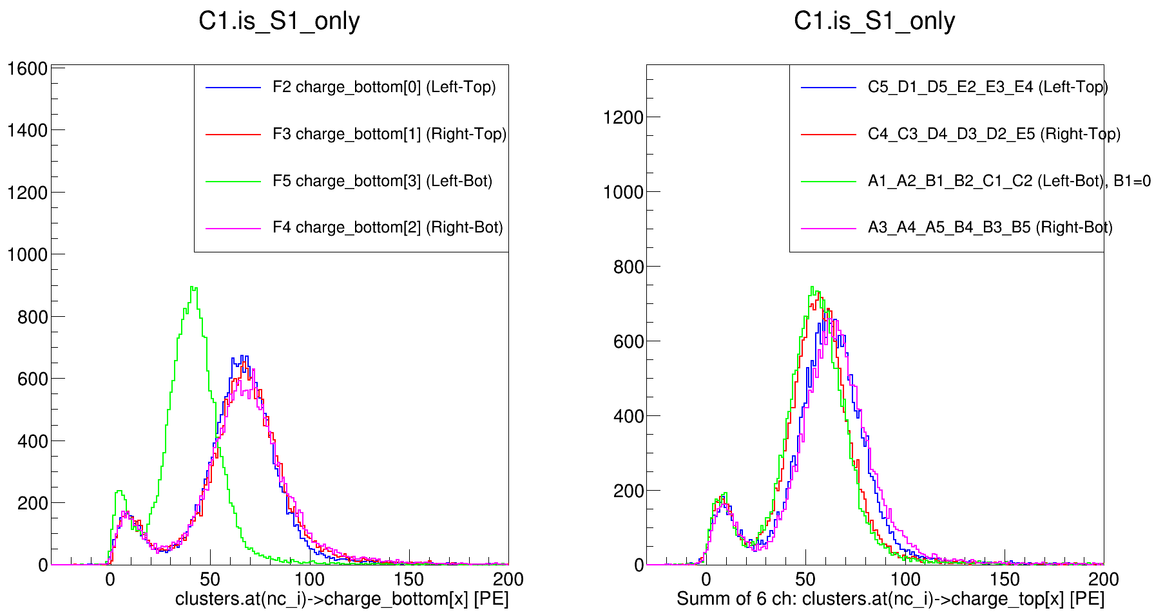
Ph1, Am241, run 399

Slide 28
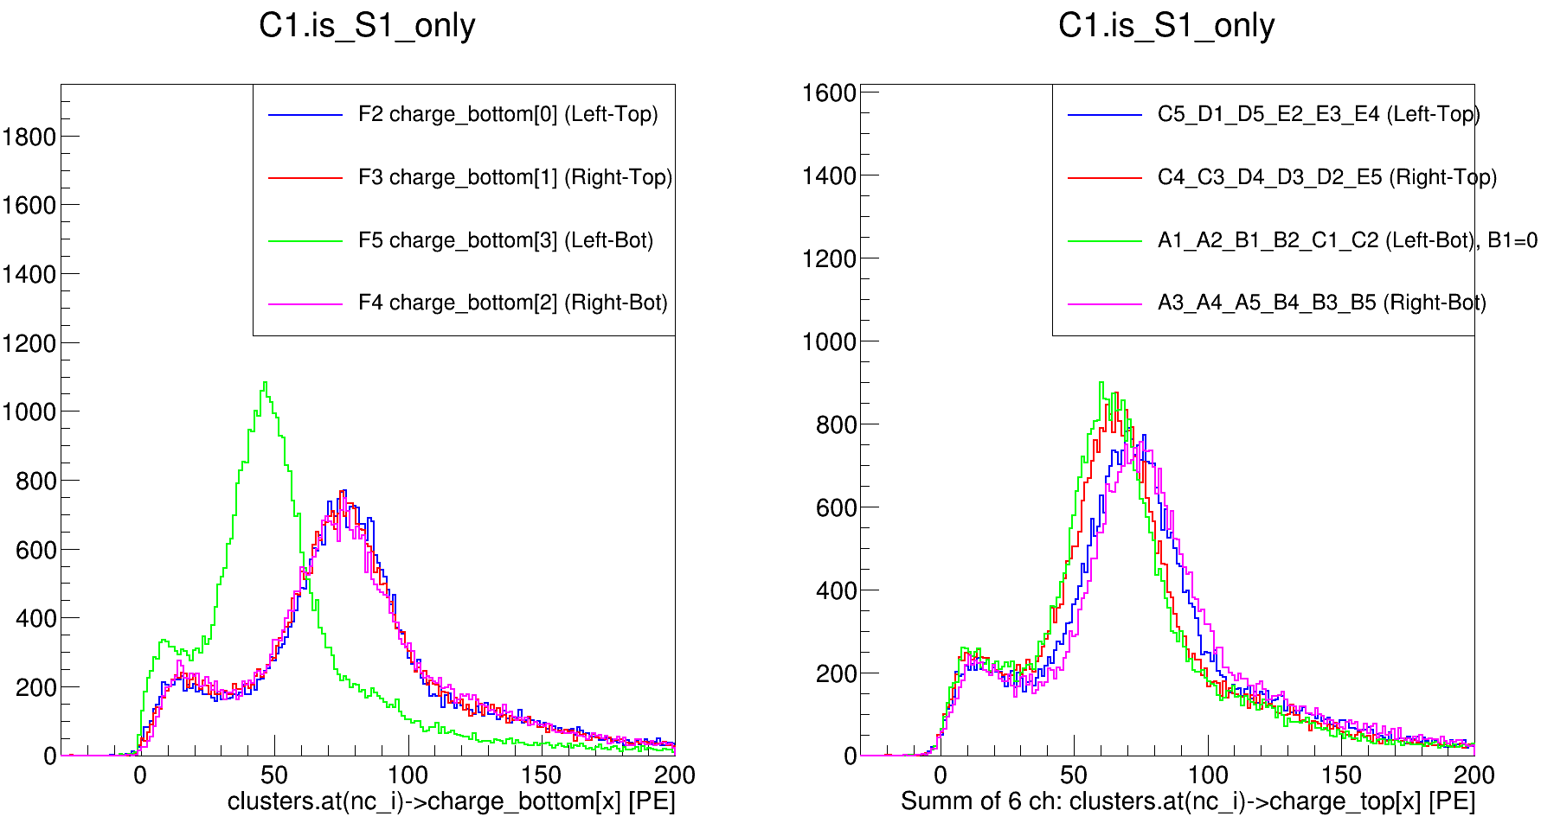
Ph1, Am241, run 418

Slide 29
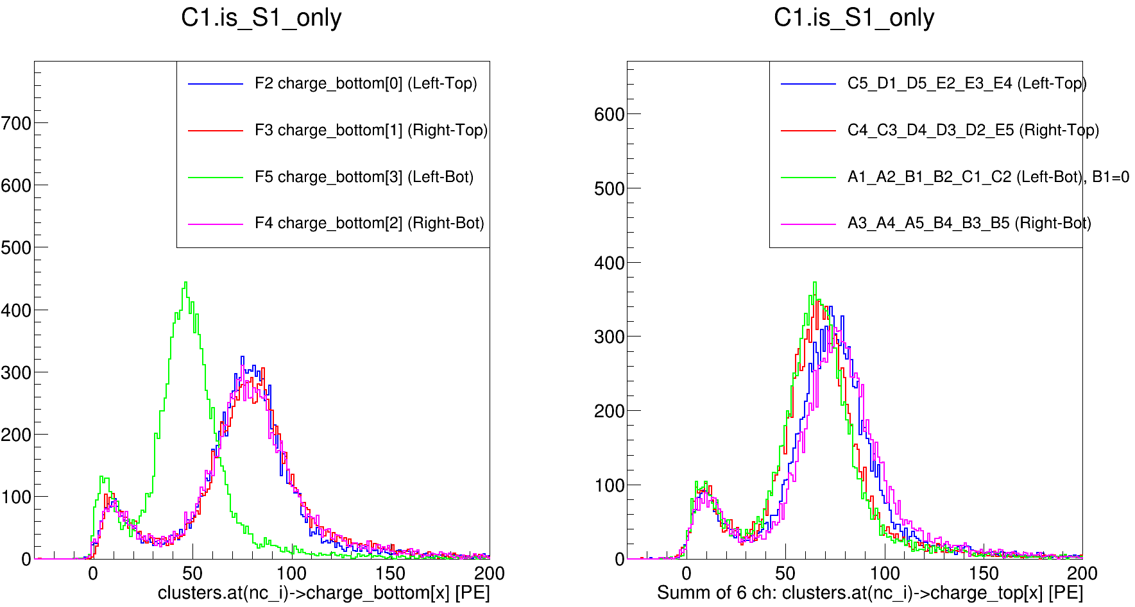
Ph1, Am241, run 511

Slide 30
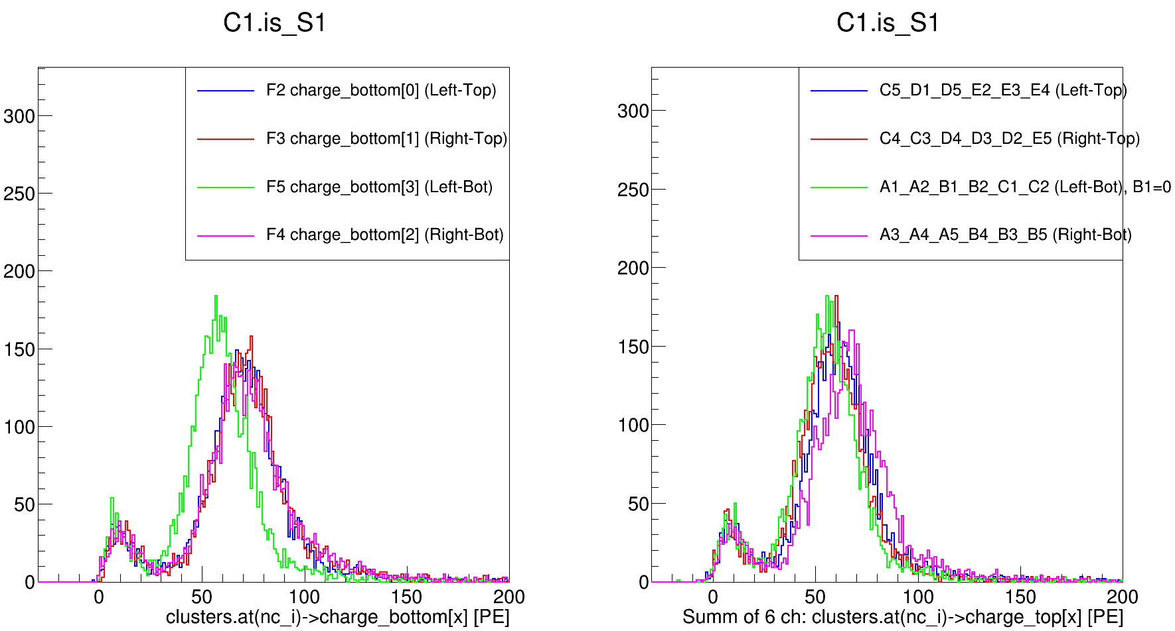
Ph2, Am241, run 537

Slide 31
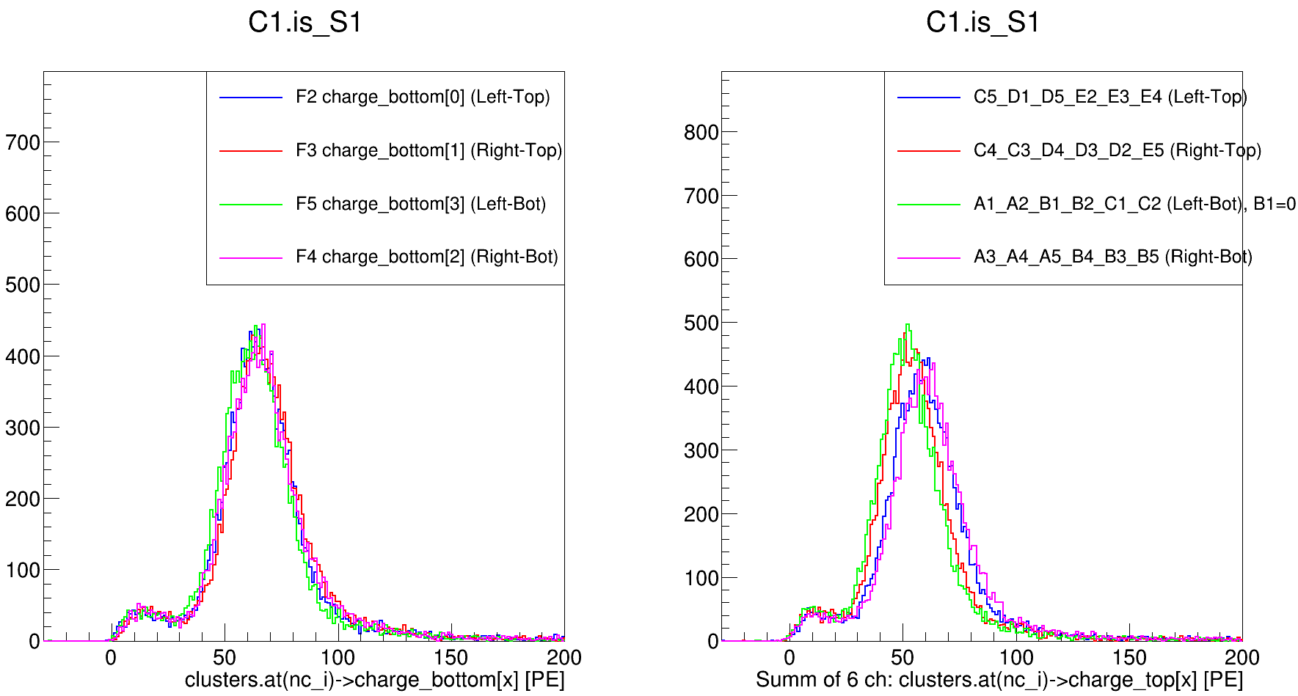
Ph2, Am241, run 542

Slide 32
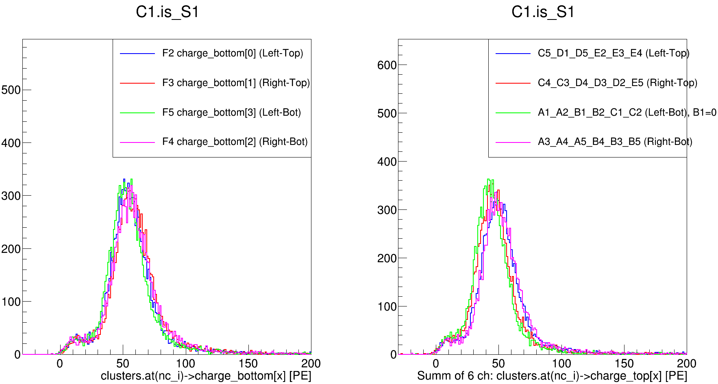
Ph2, Am241, run 544

Slide 33
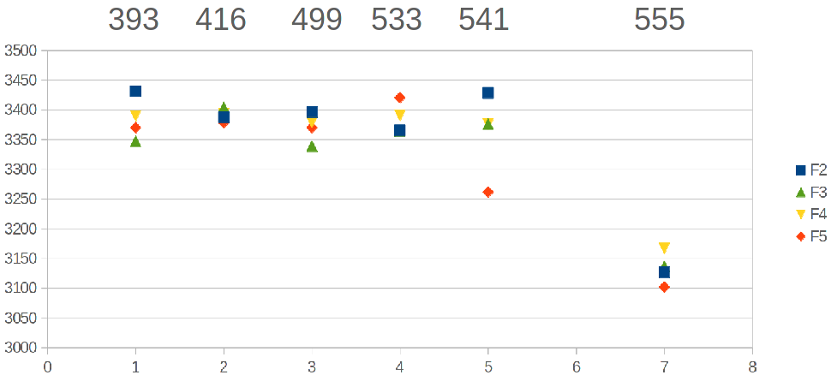
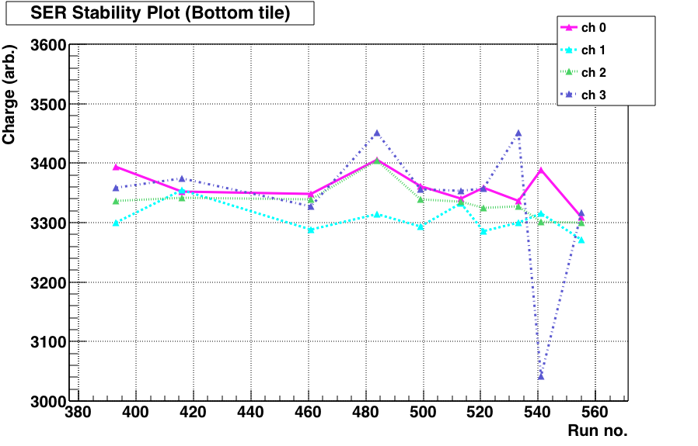
By Vlad
By Simone

Slide 34
Tasks:
1) Tdrift spectrum, XY slices for Tdrift, Tdrift spectrum for XY cuts
2) XY for S2 spectrum cuts
3) Repeat all tasks using S2_max_channel algorithm

