Slide 1
Problem of S2 right tail
Сampaign V
Oleynikov Vladislav
23 Nov 2018

Slide 2
Algorithm:
11713f949ea5bffcc2f0ceb22d1267b5f314a5af
Merge branch 'barycenter' into 'master'

Slide 3
Cut list:
bool cls0_is_S1 = clusters.at(0)->f90 > 0.2;
bool cls0_is_full = clusters.at(0)->rep == 1;
bool S1_Am_peak = (clusters.at(0)->charge > 440) &&
(clusters.at(0)->charge < 630); // mean +- 1.5sigma using run 537
//bool S1_Am_peak = (clusters.at(0)->charge > 419) &&
(clusters.at(0)->charge < 587); // mean +- 1.5sigma using run 542
//bool S1_Am_peak = (clusters.at(0)->charge > 342) &&
(clusters.at(0)->charge < 482); // mean +- 1.5sigma using run 544
bool cls0 = nc_i == 0;//cluster 0
bool cls1 = nc_i == 1;//cluster 1
bool is_S1 = nc == 2 && cls0 && cls0_is_full && cls0_is_S1;
bool is_S2 = nc == 2 && cls1 && cls0_is_full && cls0_is_S1;
bool is_S2_v2 = is_S2 && clusters.at(0)->f90 < 0.2;
bool is_S1_only = nc == 1 && cls0_is_full && cls0_is_S1;
bool is_S1_S2 = nc == 2 && cls0_is_full && cls0_is_S1;

Slide 4
Ph2, Am241, run 537

Slide 5
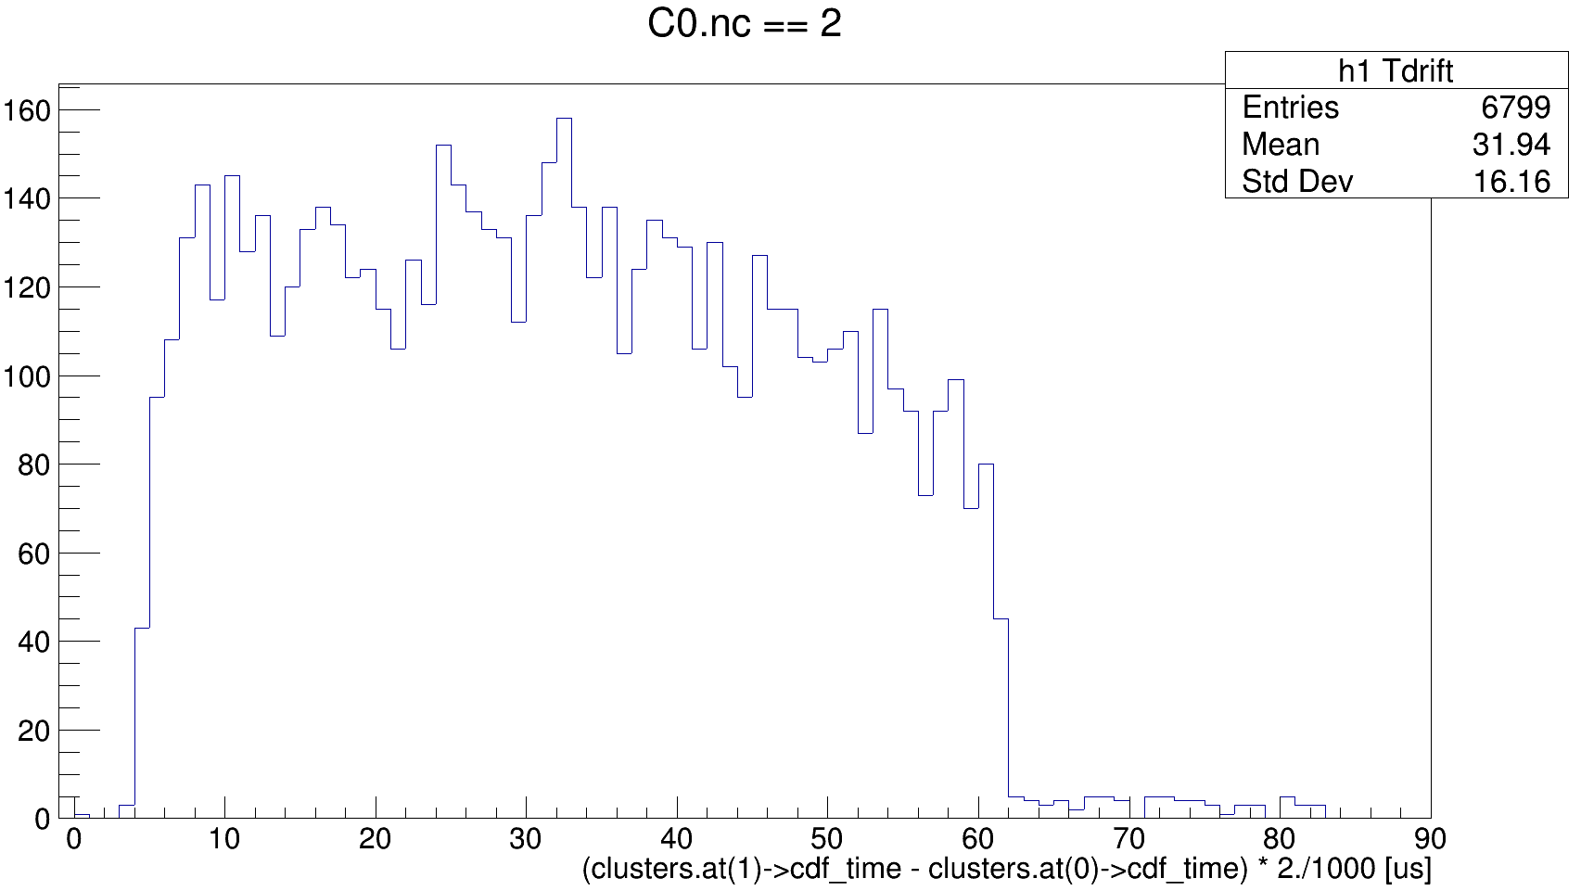
Ph2, Am241, run 537

Slide 6
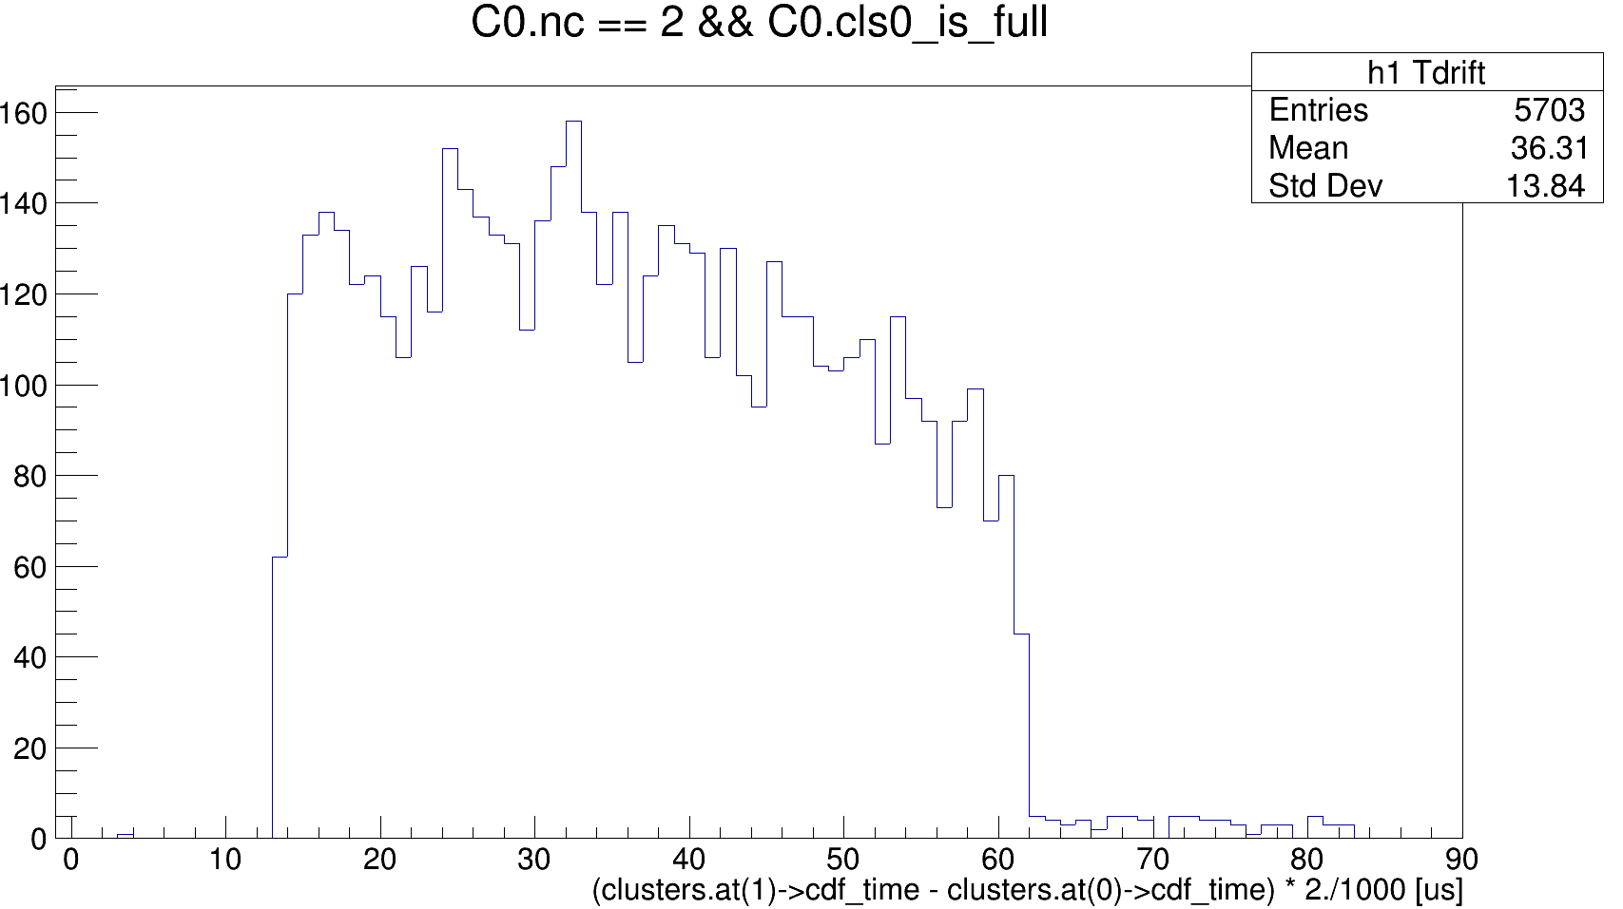
Ph2, Am241, run 537

Slide 7
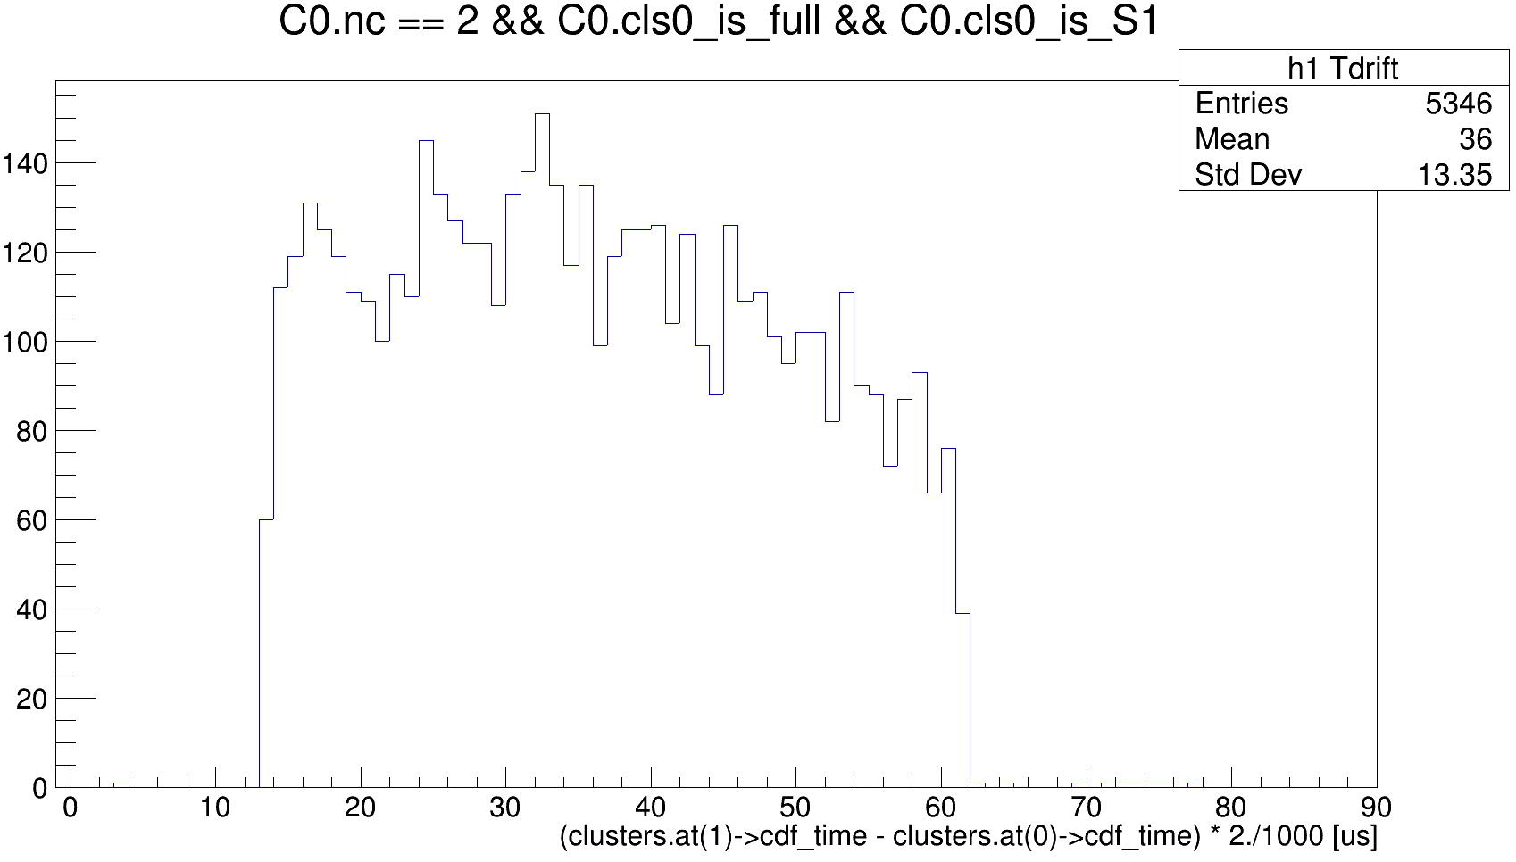
Ph2, Am241, run 537

Slide 8
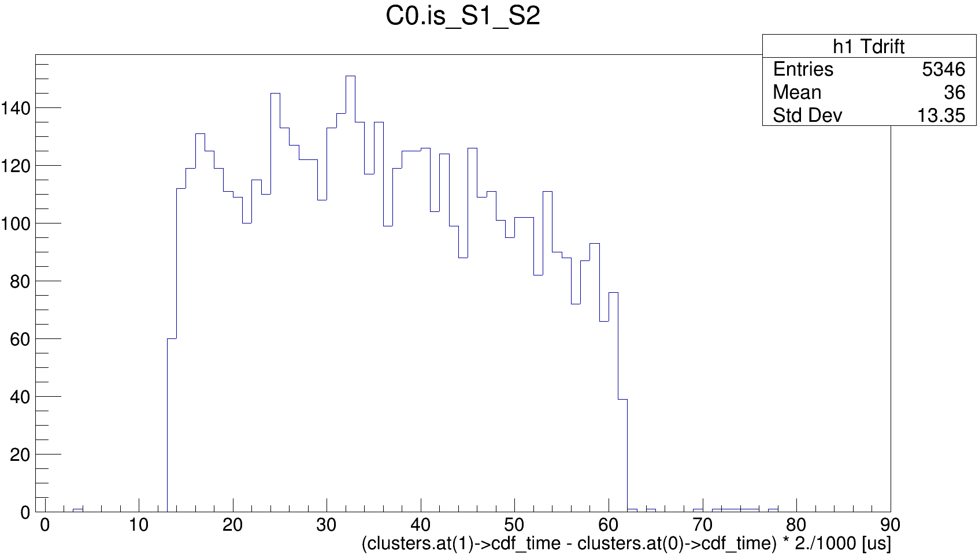
Ph2, Am241, run 537

Slide 9
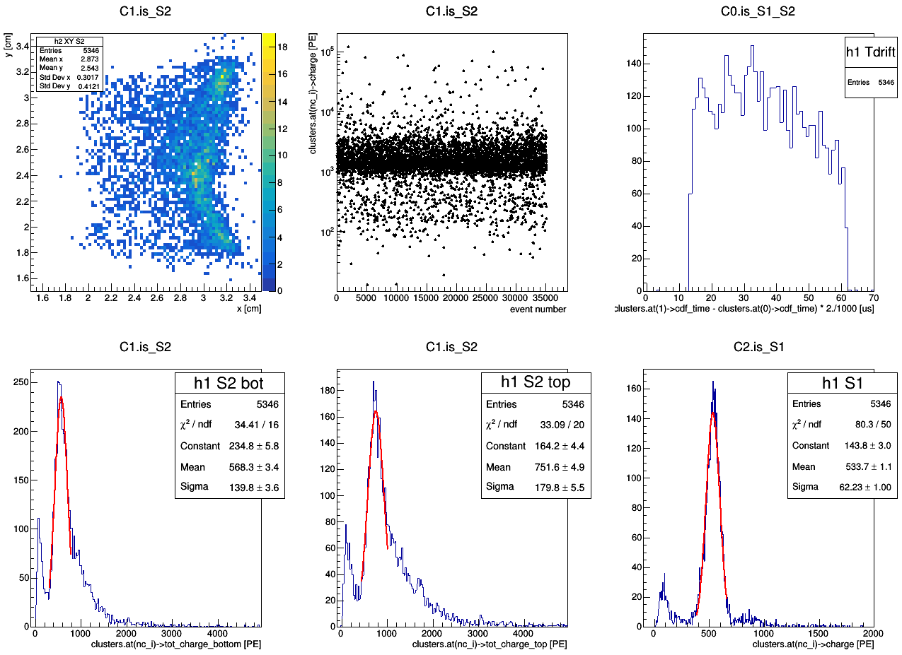
master cut
Ph2, Am241, run 537

Slide 10
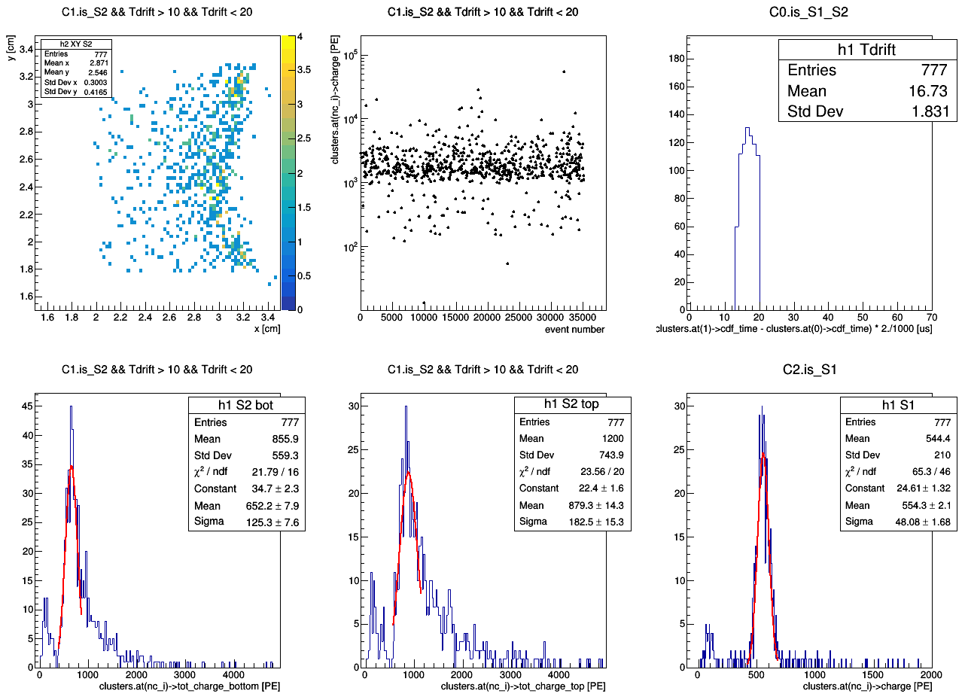
master cut
Ph2, Am241, run 537

Slide 11
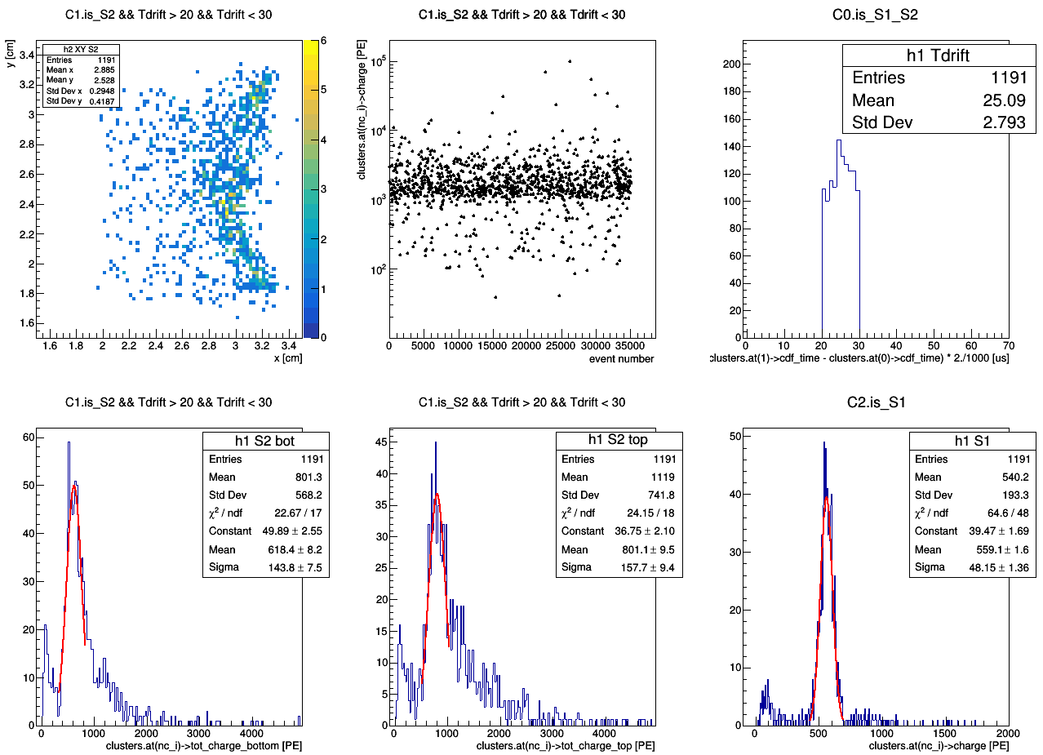
master cut
Ph2, Am241, run 537

Slide 12
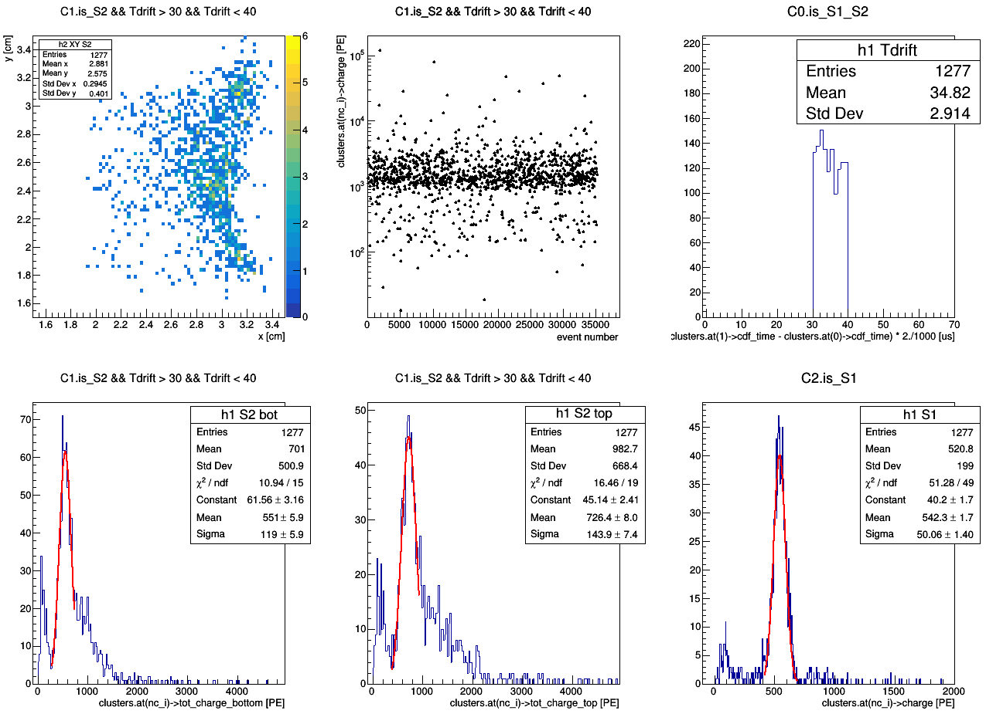
master cut
Ph2, Am241, run 537

Slide 13
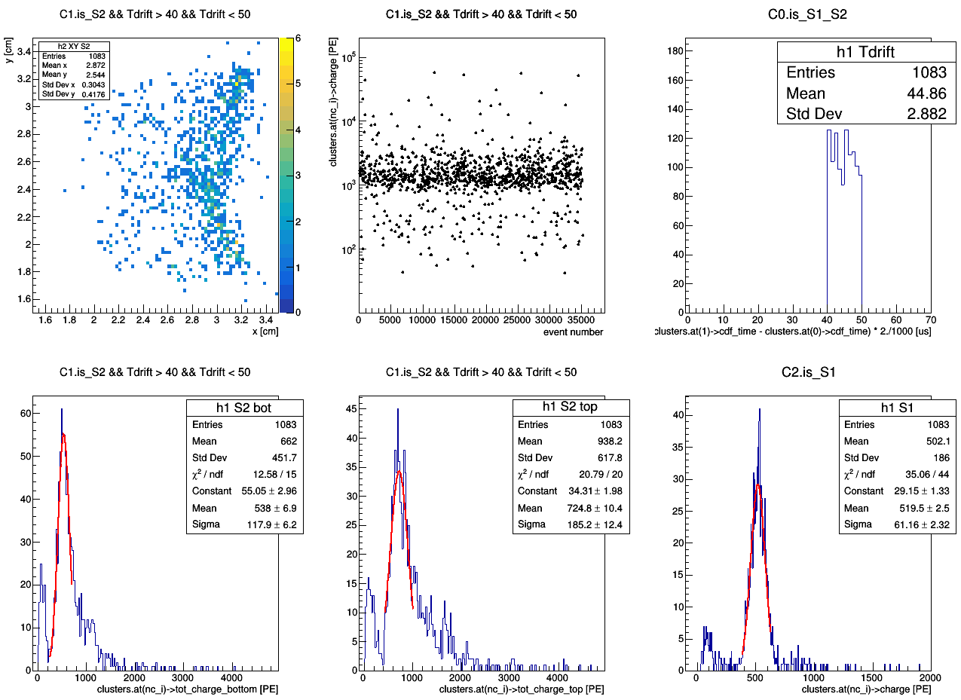
master cut
Ph2, Am241, run 537

Slide 14
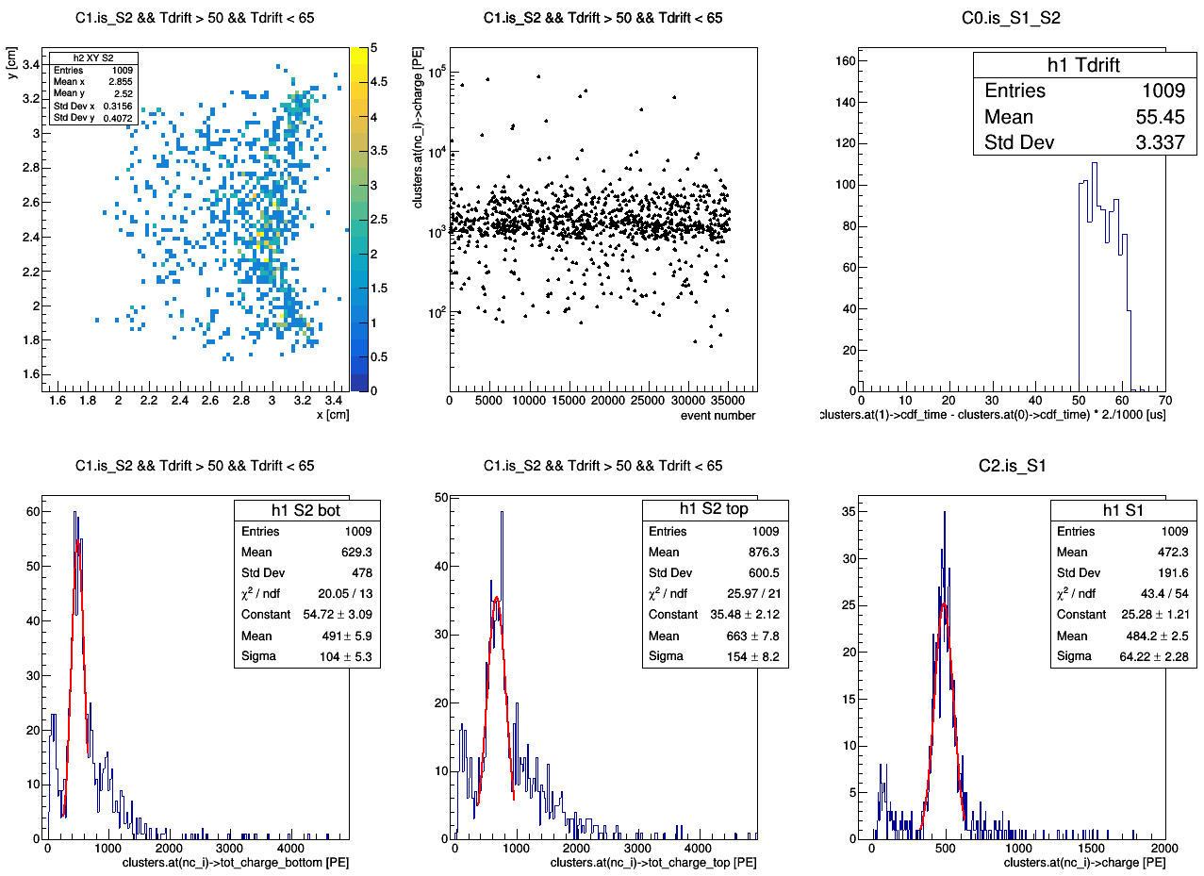
master cut
Ph2, Am241, run 537

Slide 16
master cut
Ph2, Am241, run 537

Slide 17
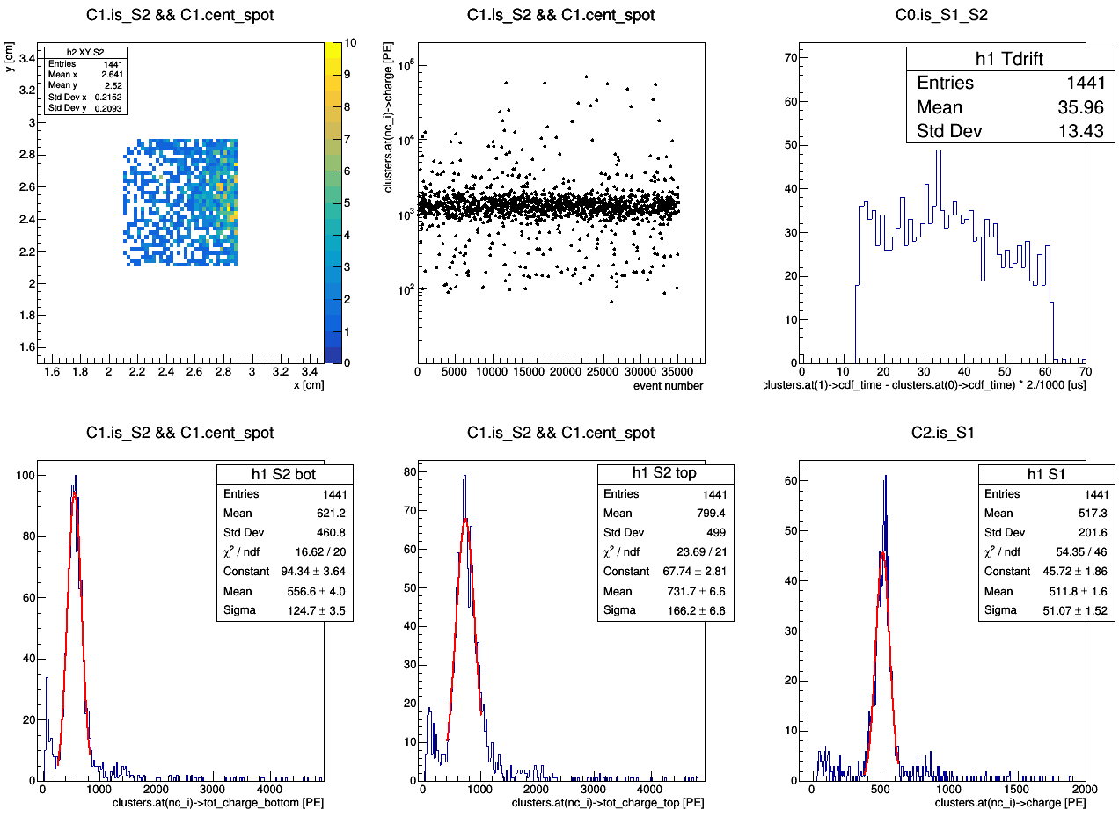
master cut
Ph2, Am241, run 537

Slide 18
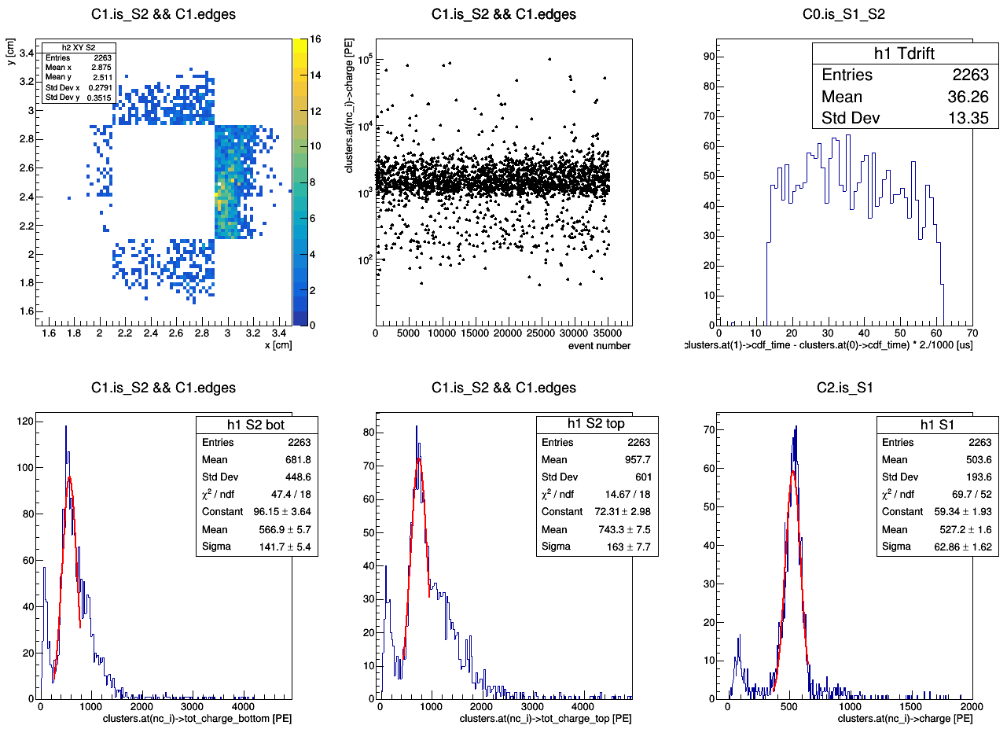
master cut
Ph2, Am241, run 537

Slide 19
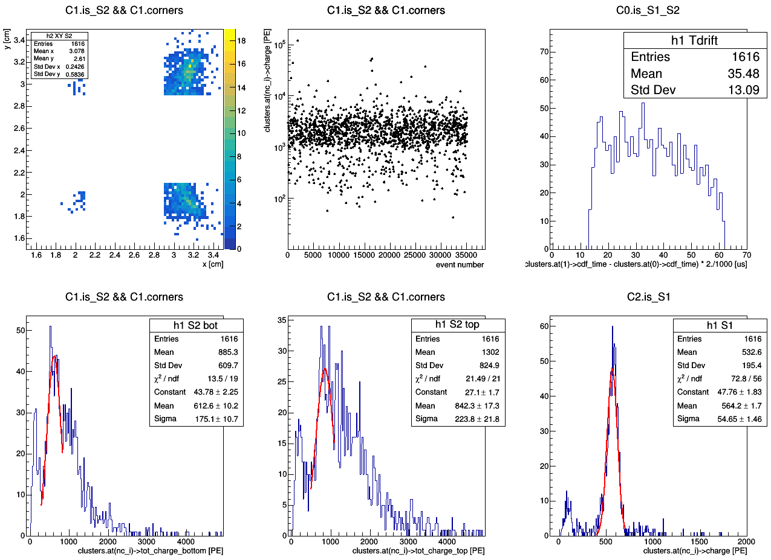
master cut
Ph2, Am241, run 537

Slide 21
Ph2, Am241, run 537
master cut

Slide 22
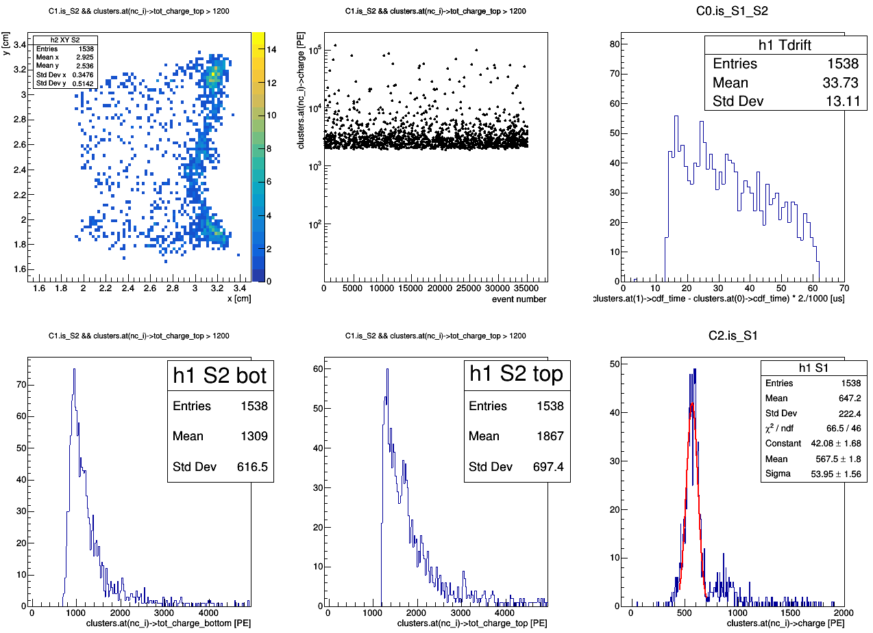
aka map of bad events
Ph2, Am241, run 537
master cut
tot_charge_top > 1200 [PE]

Slide 23
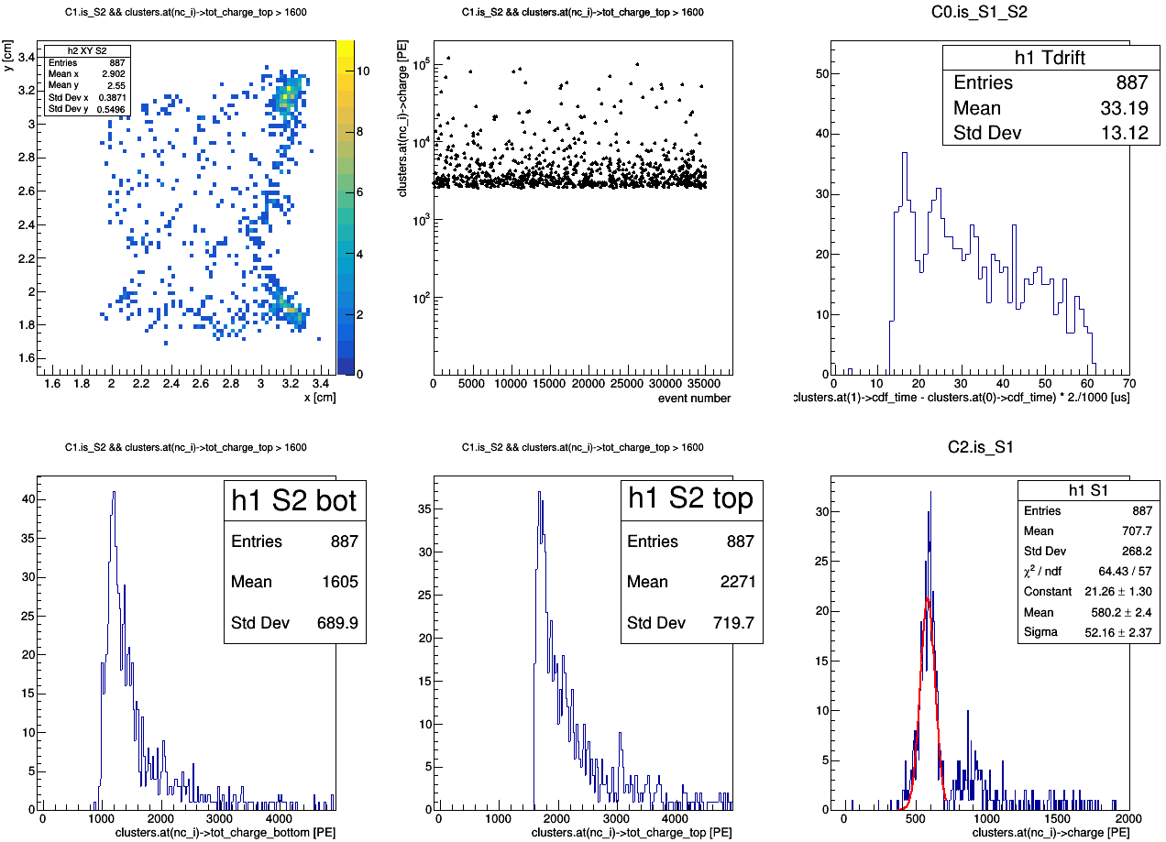
aka map of bad events
Ph2, Am241, run 537
master cut
tot_charge_top > 1600 [PE]

Slide 24
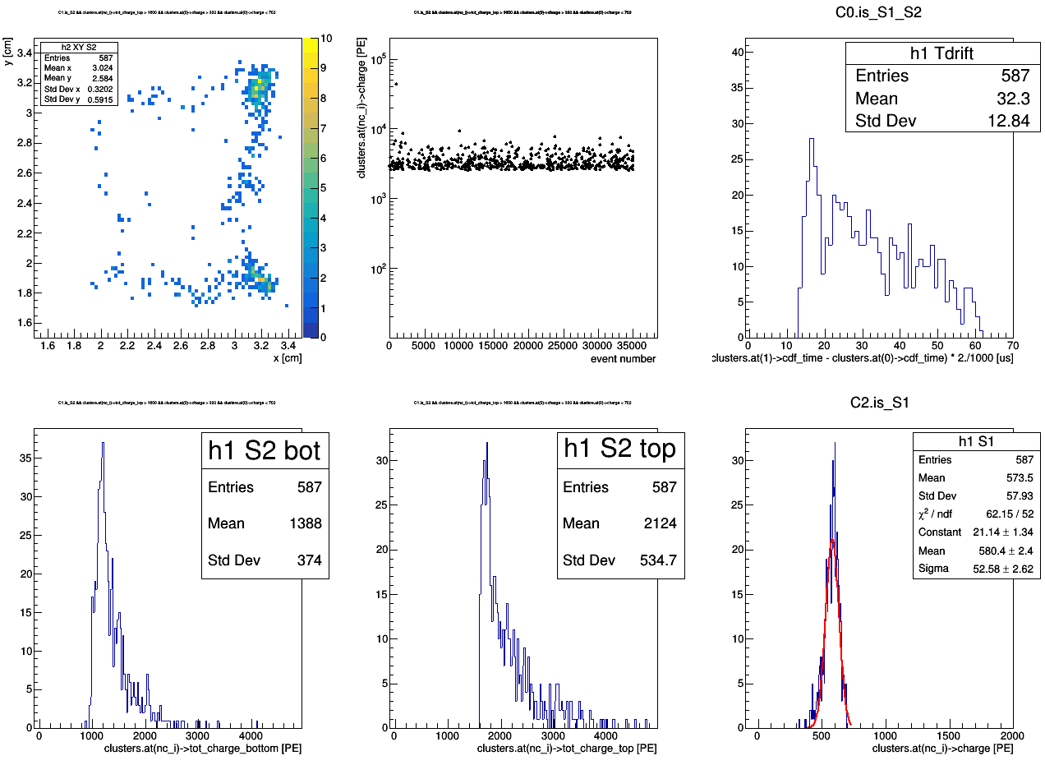
aka map of bad events
Ph2, Am241, run 537
tot_charge_top > 1600 [PE]
300 < S1 charge < 700 [PE]
master cut1
master cut2

Slide 25
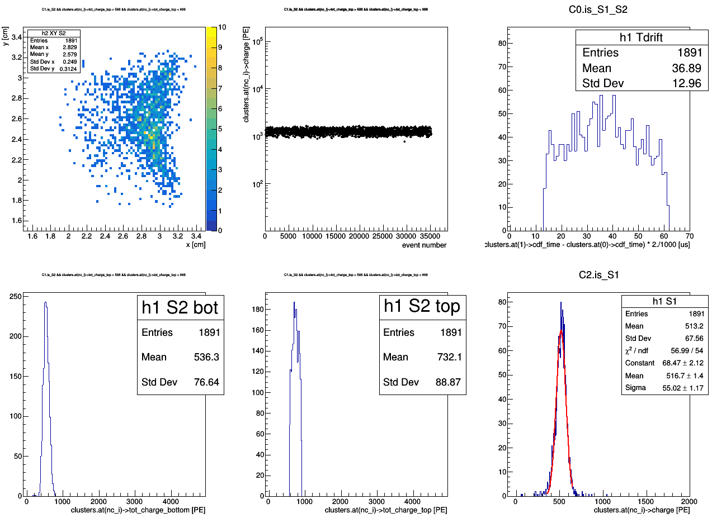
aka map of good events
Ph2, Am241, run 537
master cut
566 < tot_charge_top > 898 [PE]

Slide 26
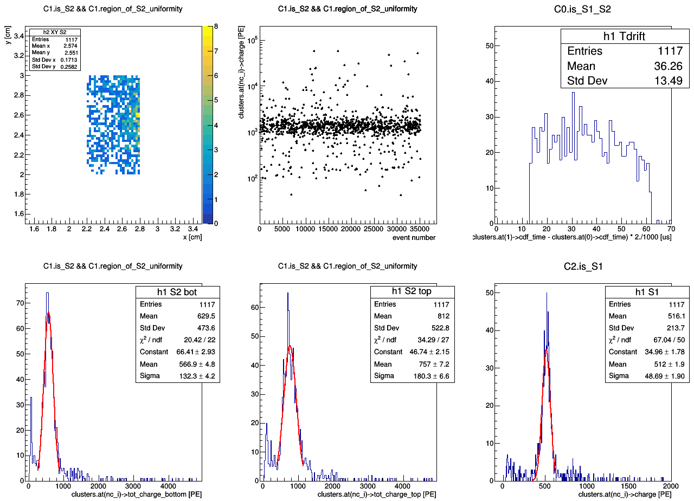
So, I created new cut: region_of_S2_uniformity (2.2 < x < 2.8; 2 < y < 3)
Ph2, Am241, run 537

Slide 27
So, I created new cut: region_of_S2_uniformity (2.2 < x < 2.8; 2 < y < 3)
Ph2, Am241, run 537

Slide 28
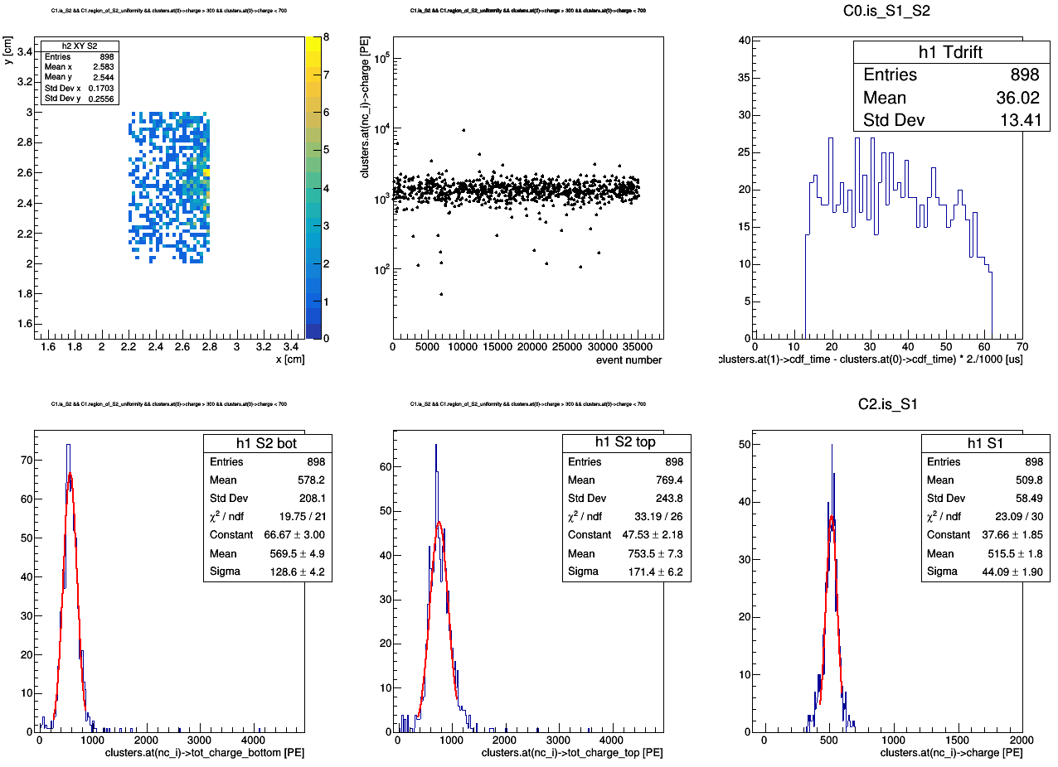
Ph2, Am241, run 537
&& region_of_S2_uniformity && 300 < S1_charge < 700

Slide 29
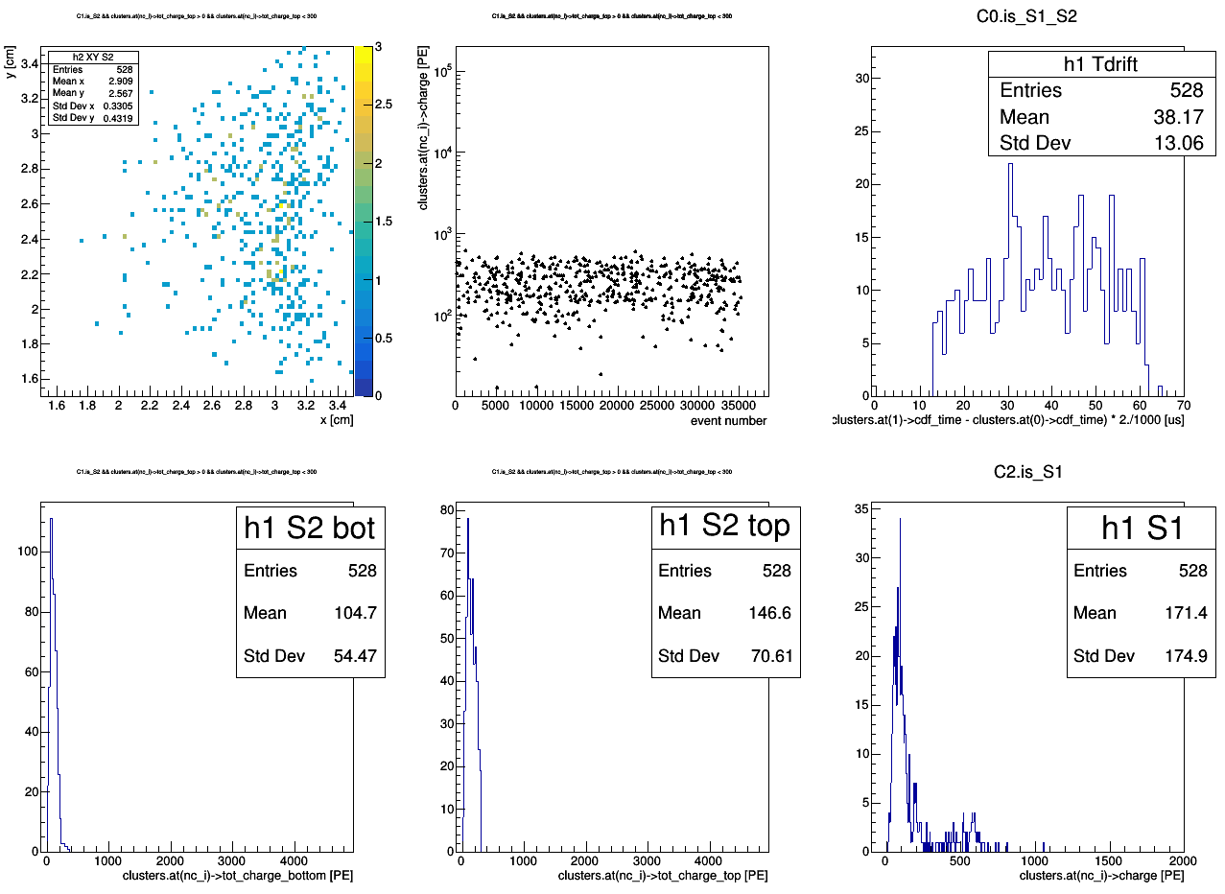
Ph2, Am241, run 537
master cut
0 < tot_charge_top < 300 [PE]

Slide 30
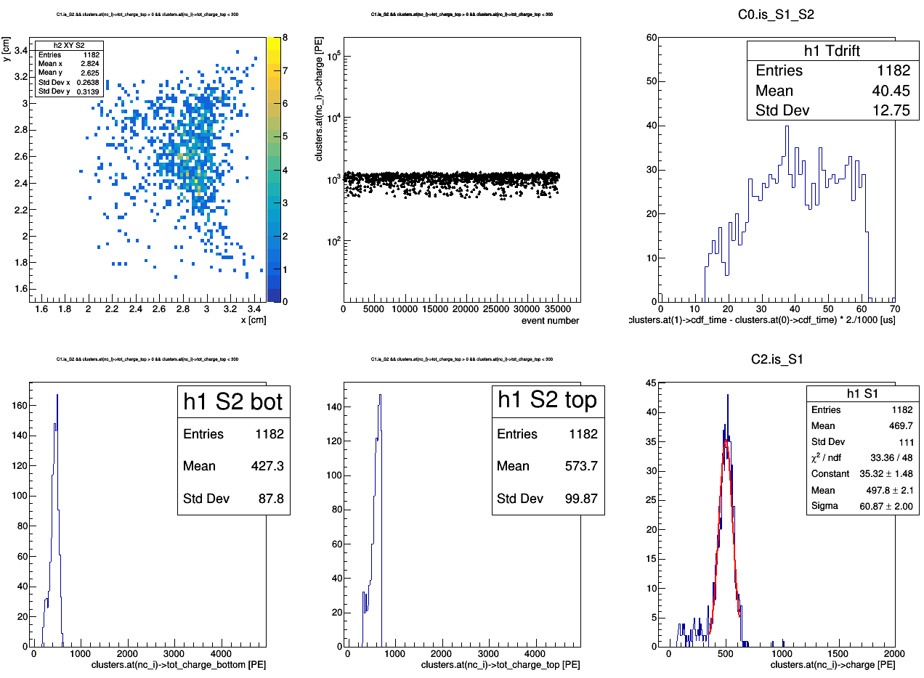
Ph2, Am241, run 537
master cut
300 < tot_charge_top < 700 [PE]

Slide 31
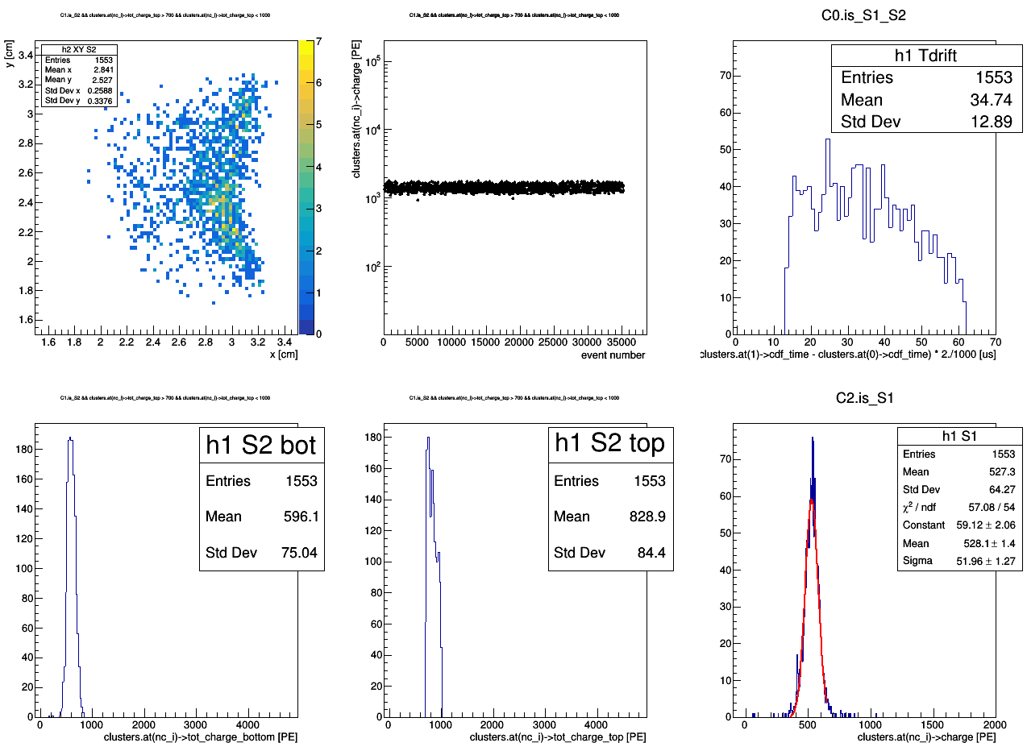
Ph2, Am241, run 537
master cut
700 < tot_charge_top < 1000 [PE]

Slide 32
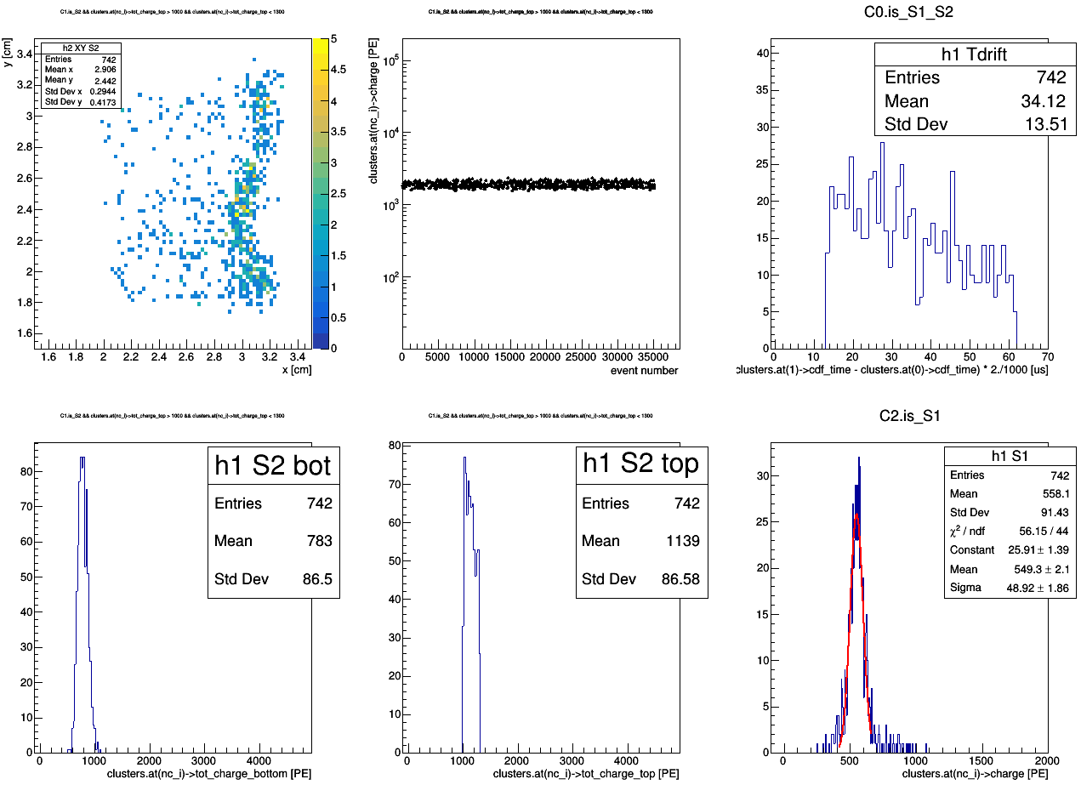
Ph2, Am241, run 537
master cut
1000 < tot_charge_top < 1300 [PE]

Slide 33
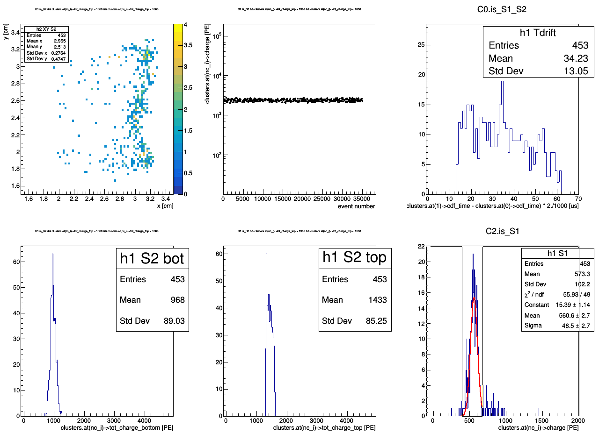
Ph2, Am241, run 537
master cut
1300 < tot_charge_top < 1600 [PE]

Slide 34
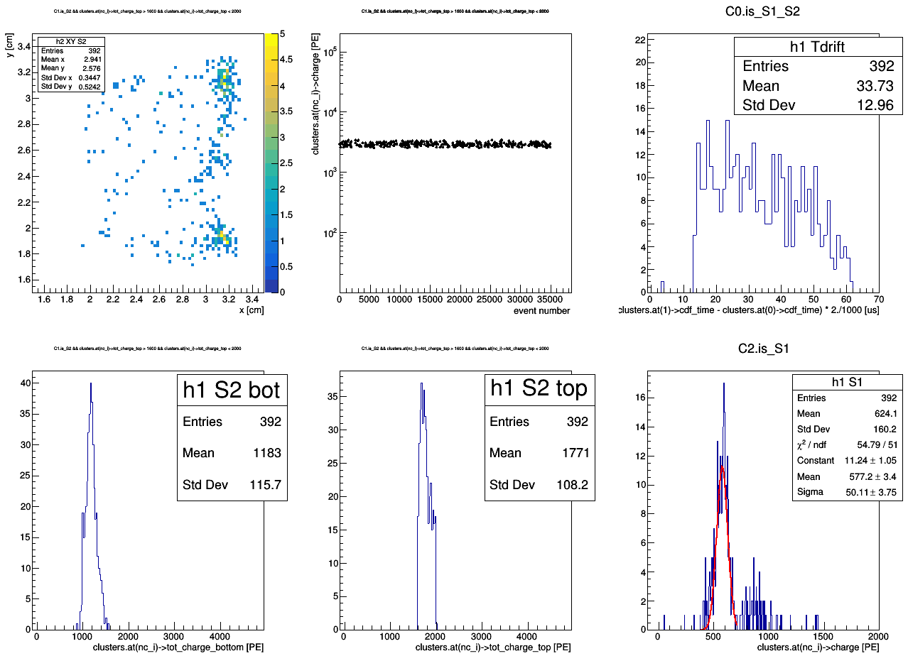
Ph2, Am241, run 537
master cut
1600 < tot_charge_top < 2000 [PE]

Slide 35
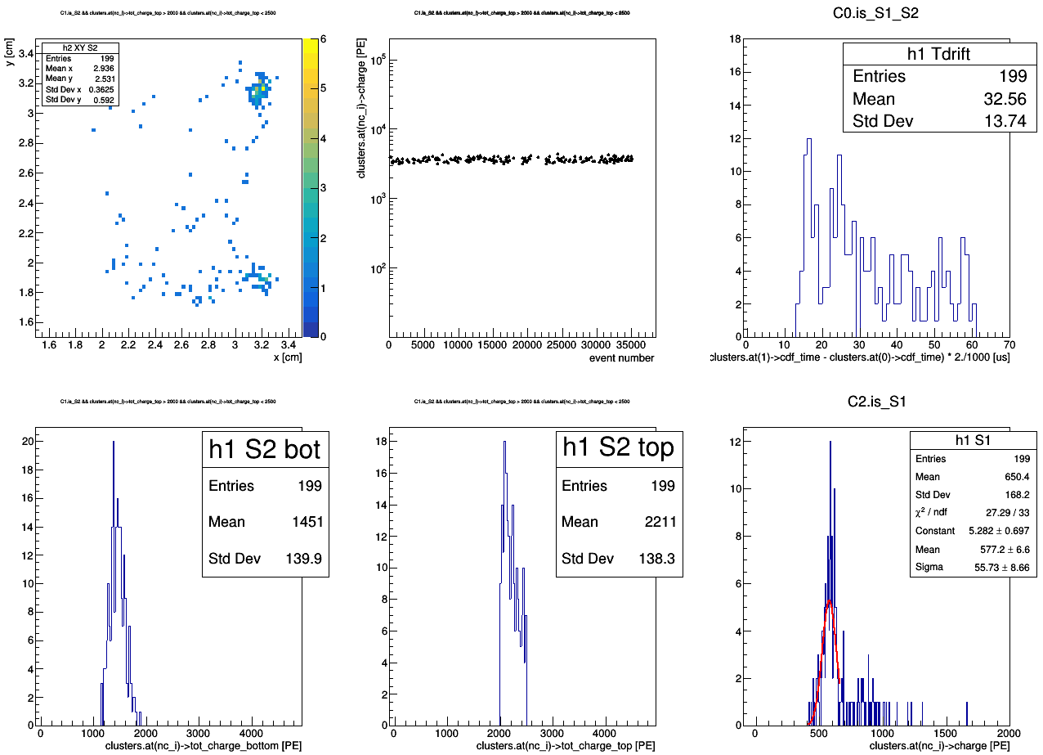
Ph2, Am241, run 537
master cut
2000 < tot_charge_top < 2500 [PE]

Slide 36
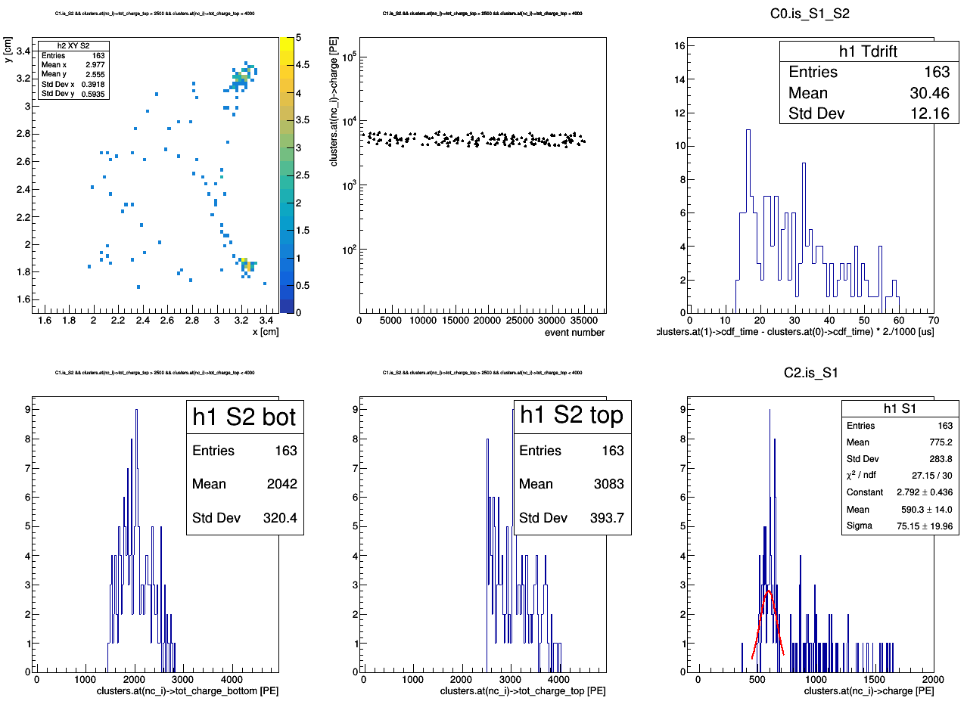
Ph2, Am241, run 537
master cut
2500 < tot_charge_top < 4000 [PE]

Slide 38
Ph2, Am241, run 542

Slide 39
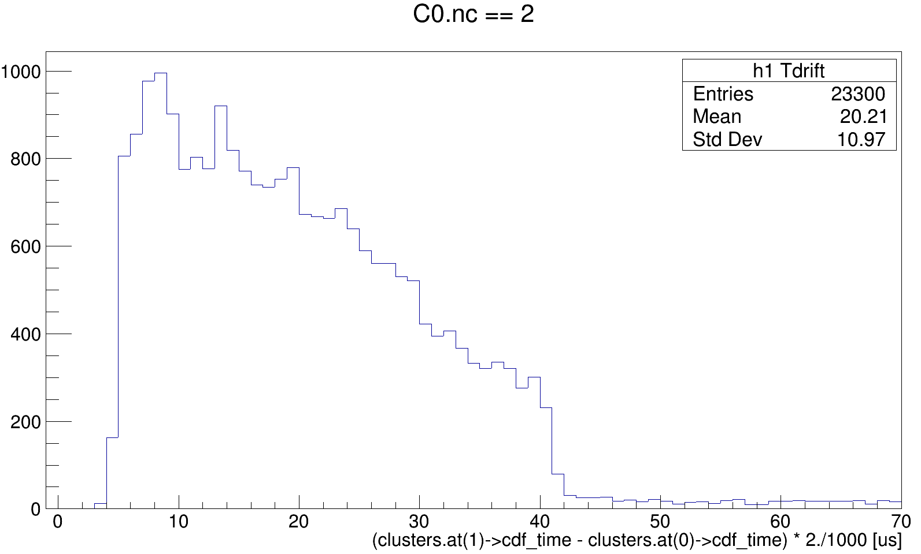
Ph2, Am241, run 542

Slide 40
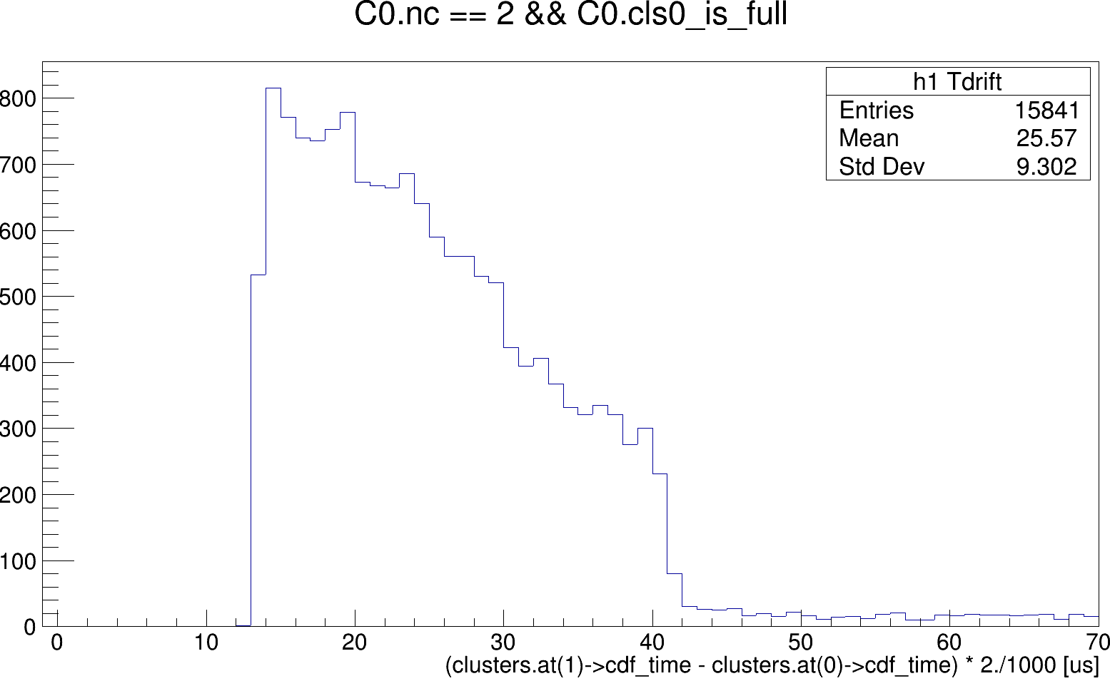
Ph2, Am241, run 542

Slide 41
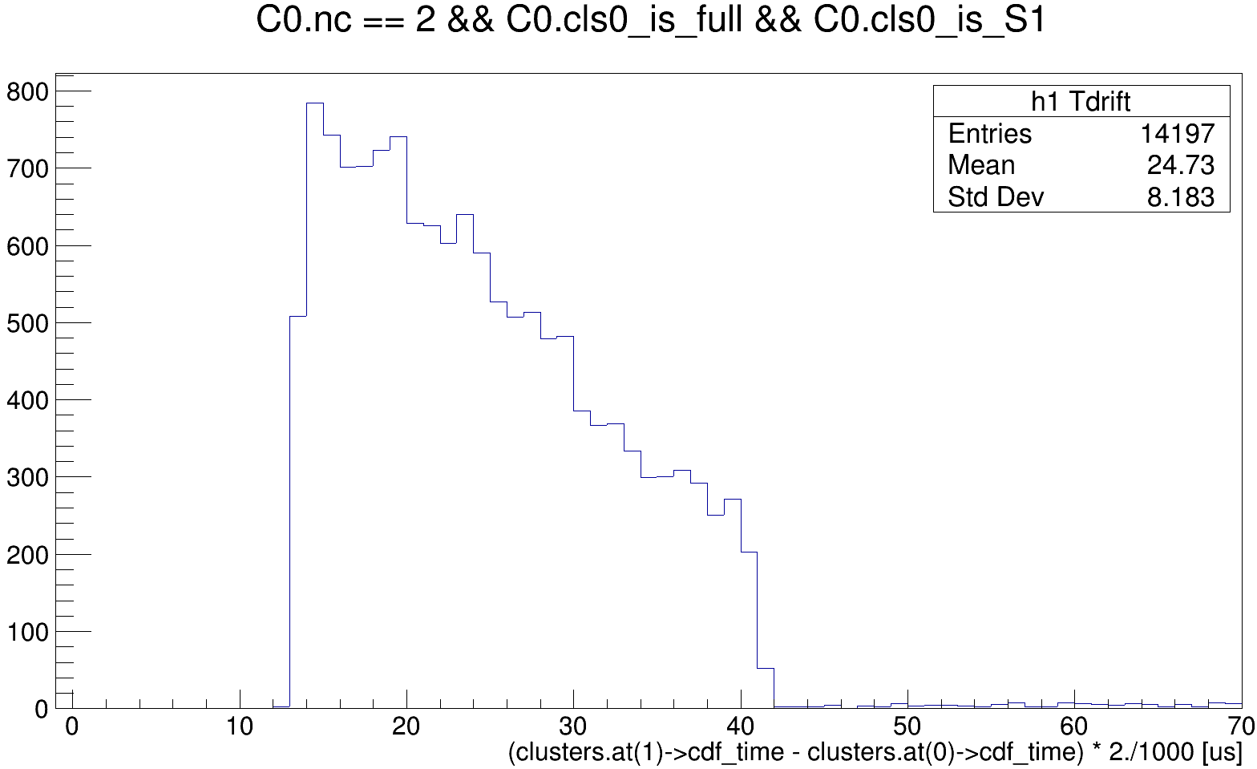
Ph2, Am241, run 542
Ph2, Am241, run 542

Slide 42
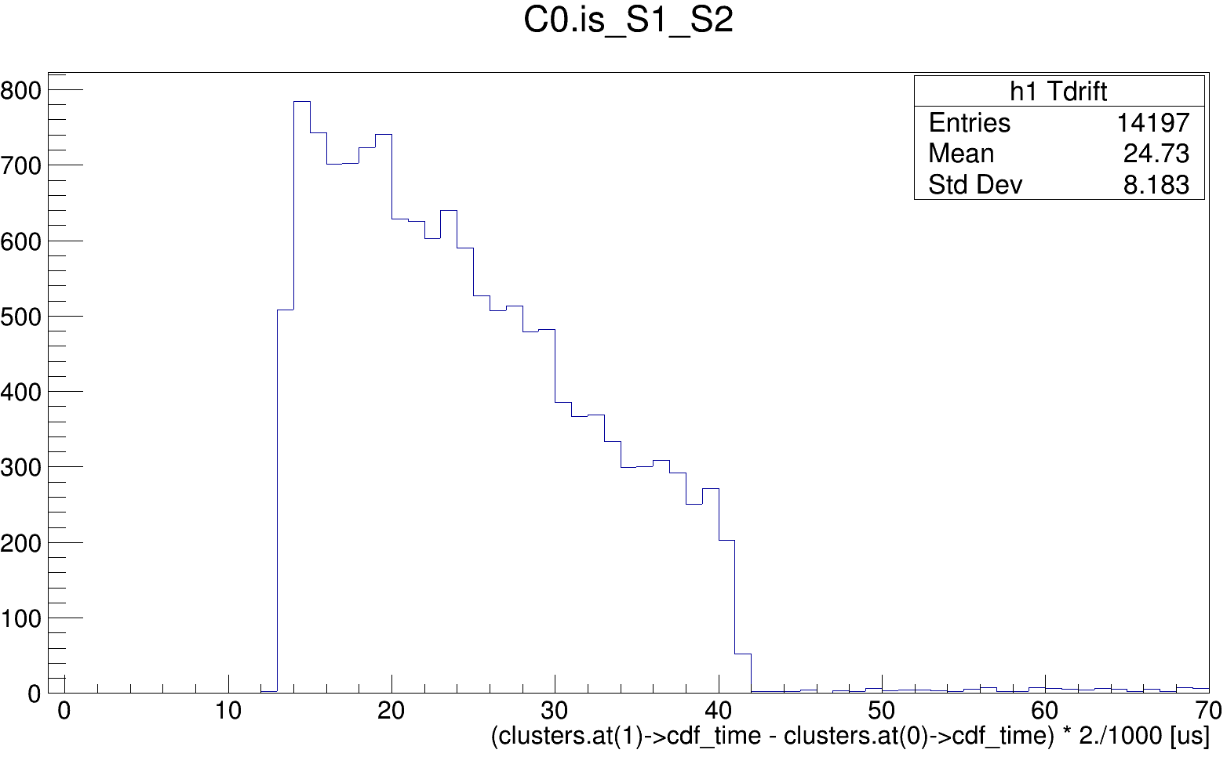
Ph2, Am241, run 542

Slide 43
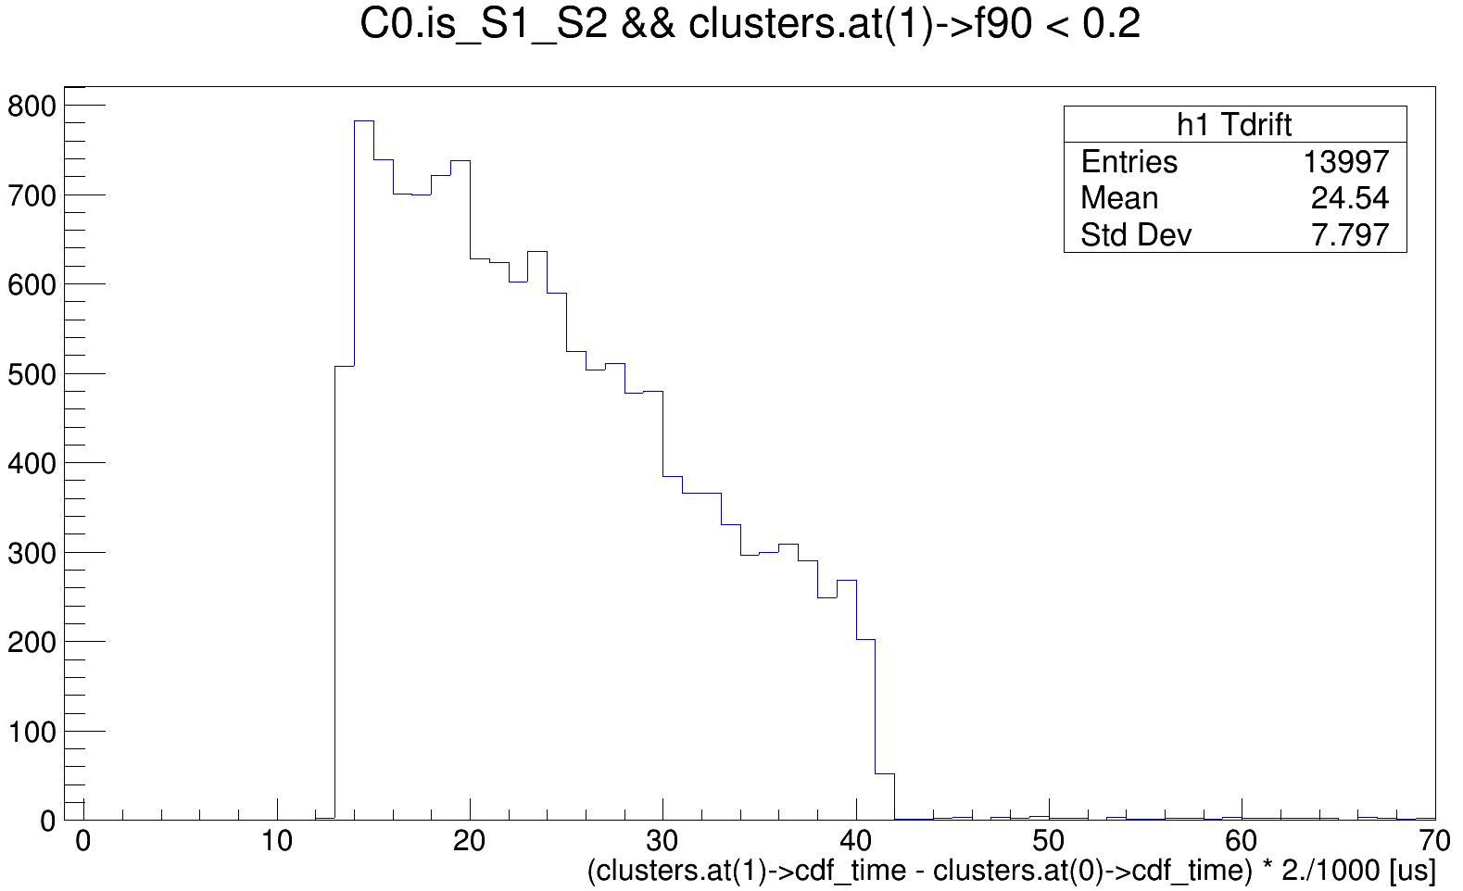
Ph2, Am241, run 542

Slide 44
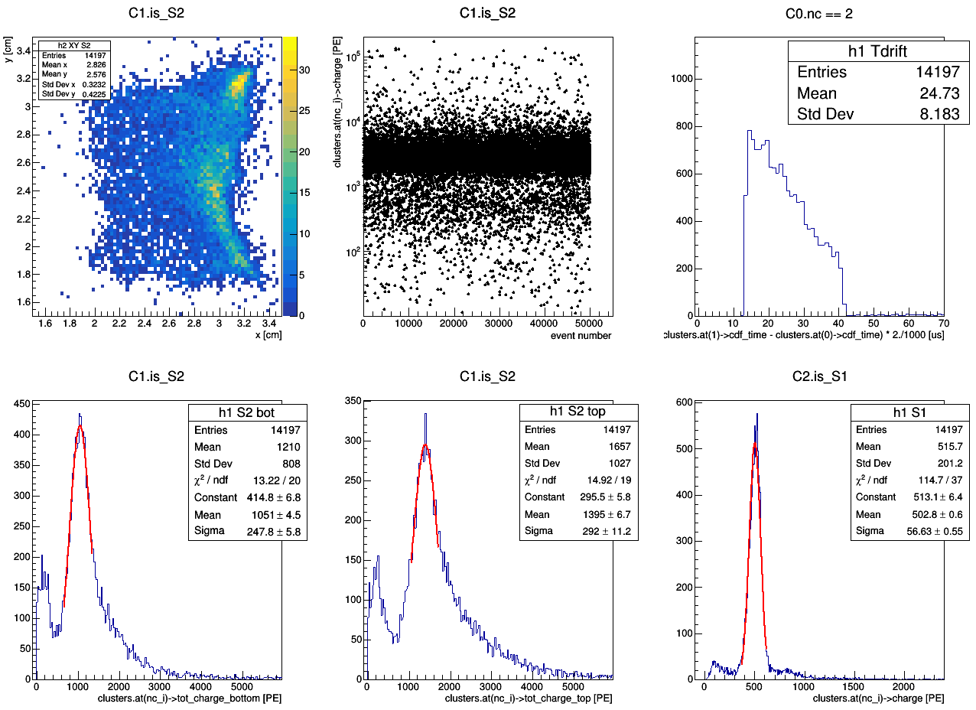
master cut
Ph2, Am241, run 542

Slide 45
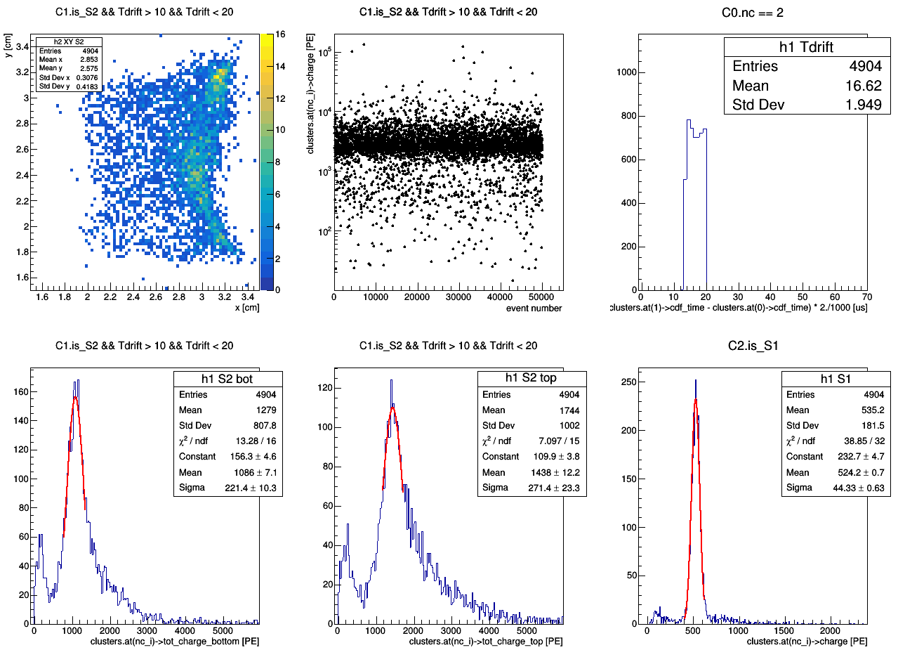
master cut
Ph2, Am241, run 542

Slide 46
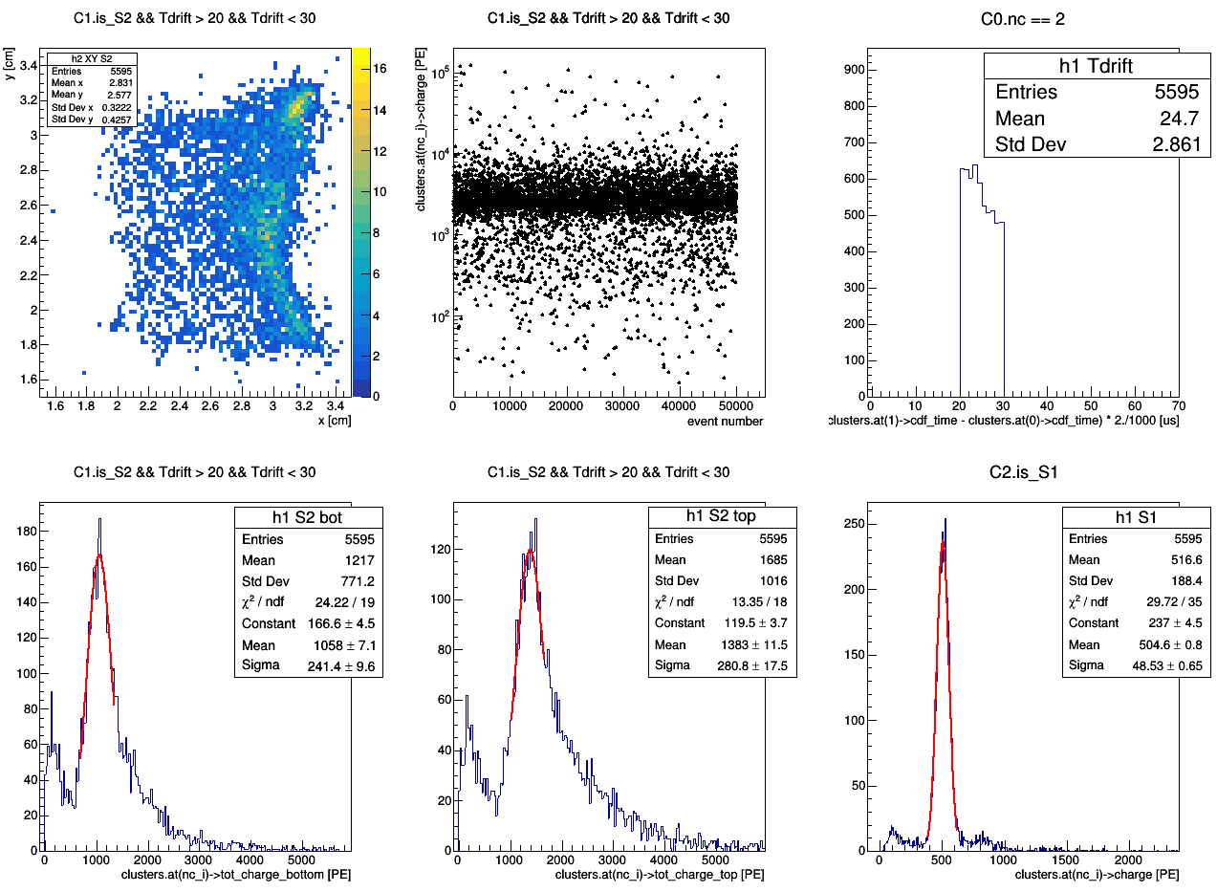
master cut
Ph2, Am241, run 542

Slide 47
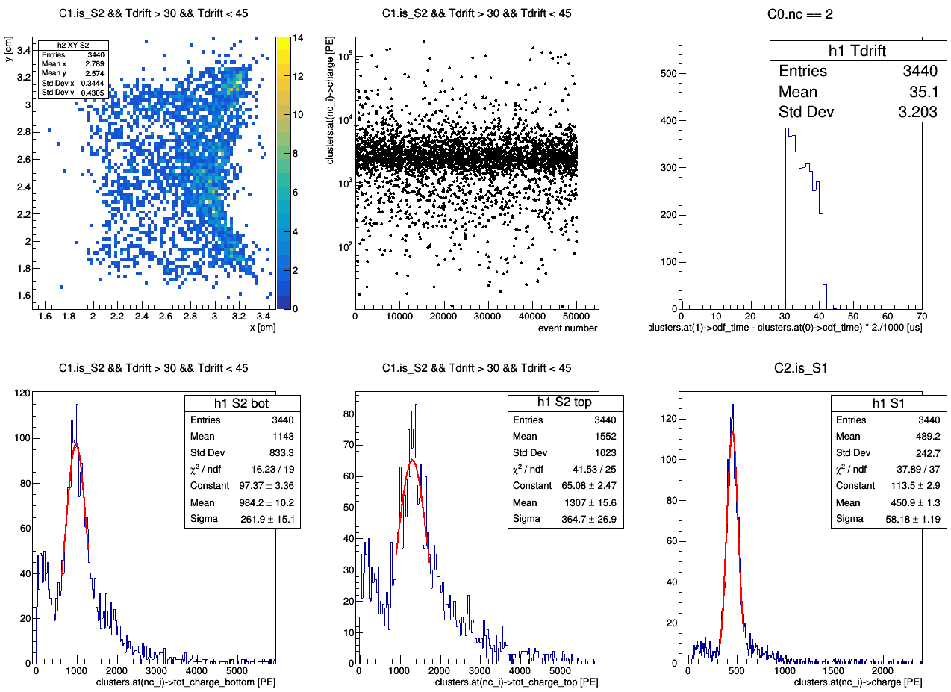
master cut
Ph2, Am241, run 542

Slide 49
Ph2, Am241, run 542
master cut

Slide 50
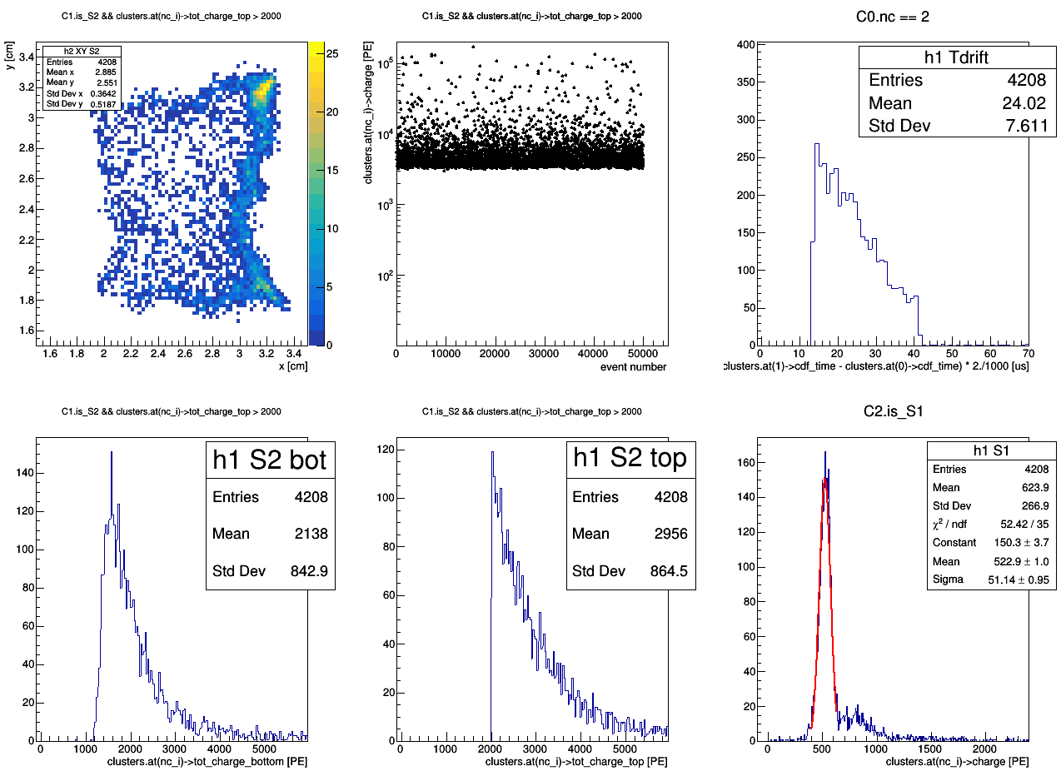
Ph2, Am241, run 542
tot_charge_top > 2000 [PE]
master cut

Slide 51
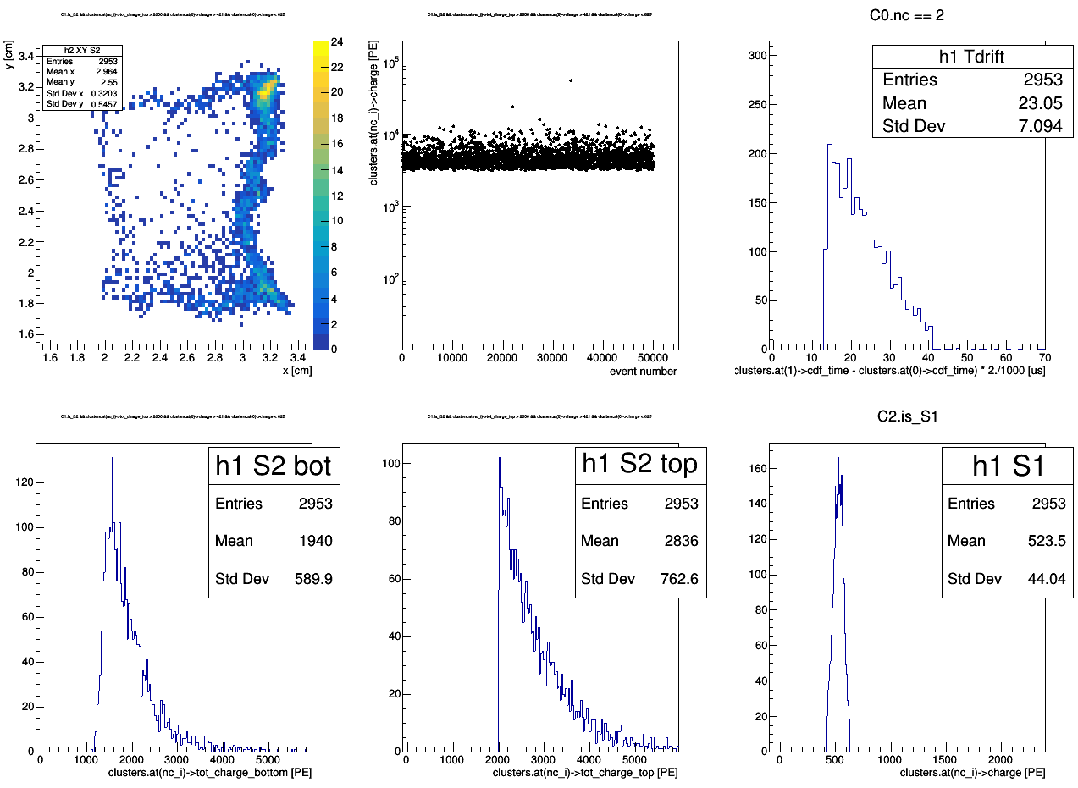
region_of_S2_uniformity (2.2 < x < 2.8; 2 < y < 3)
tot_charge_top > 2000 [PE]
421 < charge < 625 [PE]
Ph2, Am241, run 542
master cut1
master cut2

Slide 52
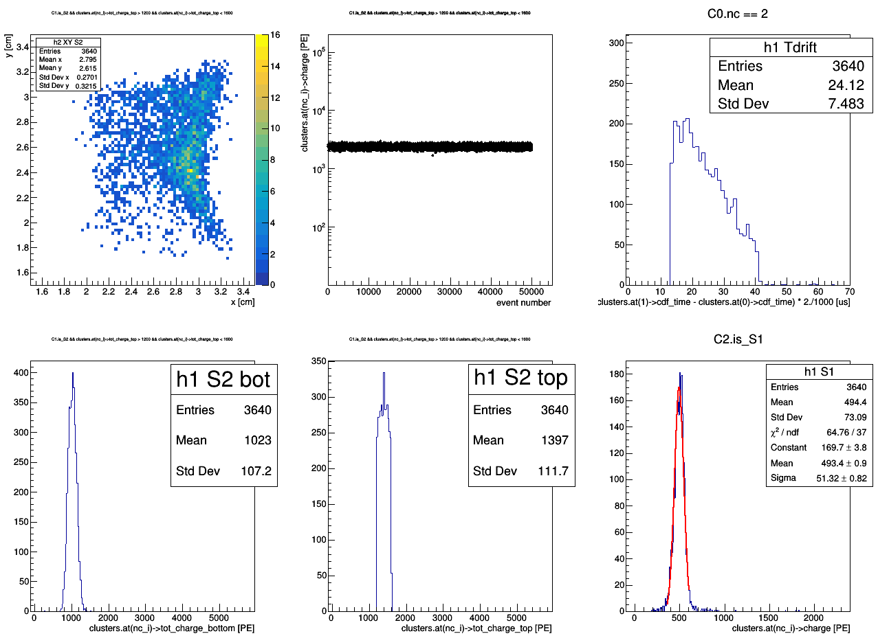
Ph2, Am241, run 542
1200 < tot_charge_top < 1600 [PE]
master cut

Slide 53
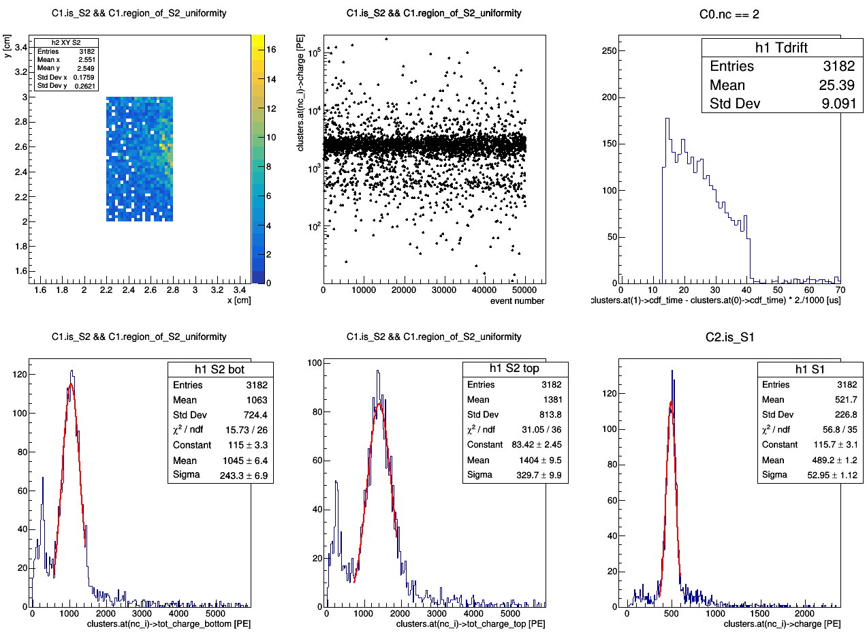
master cut
Ph2, Am241, run 542

Slide 54
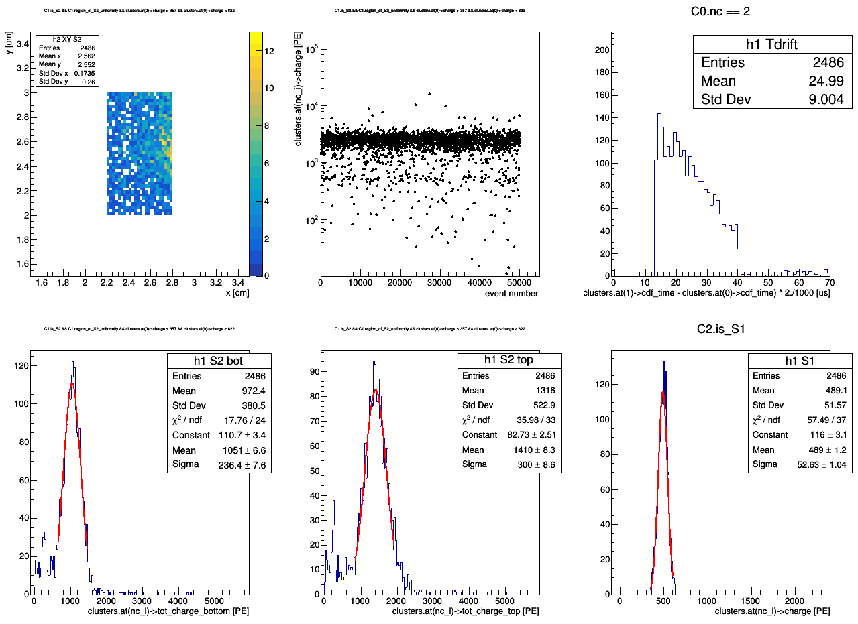
master cut1
Ph2, Am241, run 542
357 < charge < 622 [PE]
master cut2

Slide 56
master cut
Ph2, Am241, run 542

Slide 57
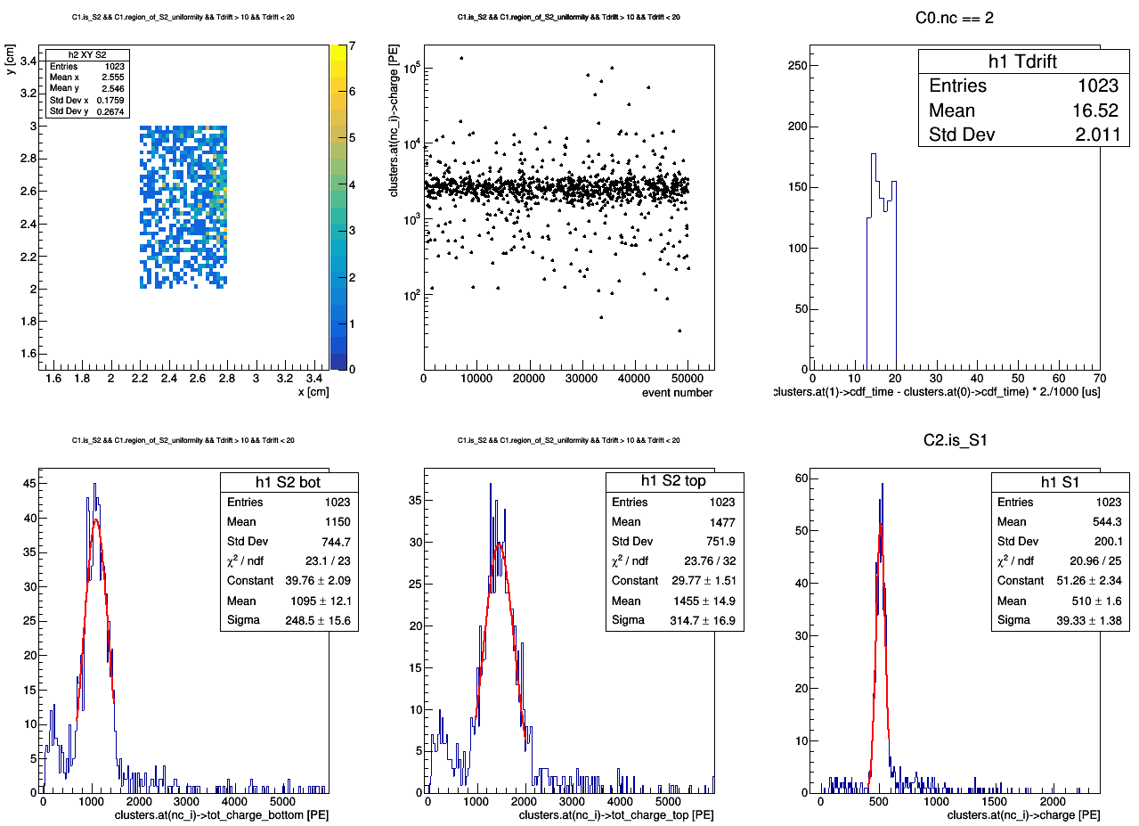
master cut
Ph2, Am241, run 542

Slide 58
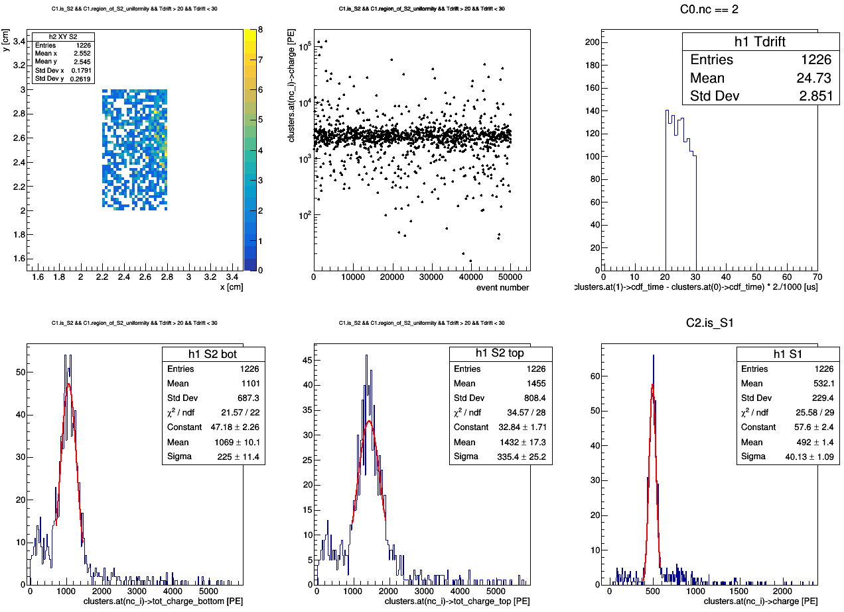
master cut
Ph2, Am241, run 542

Slide 59
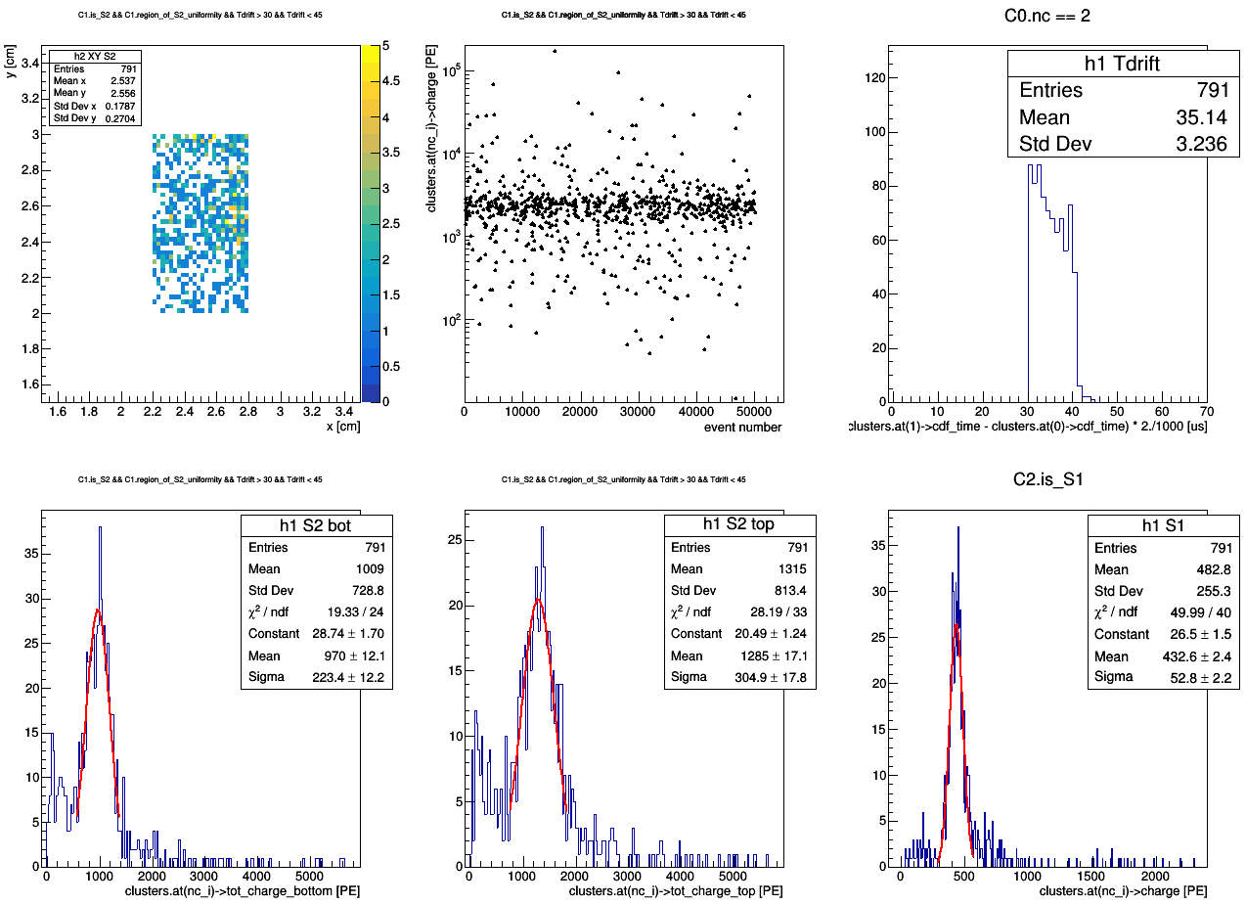
master cut
Ph2, Am241, run 542

Slide 61
master cut
Ph2, Am241, run 542

Slide 62
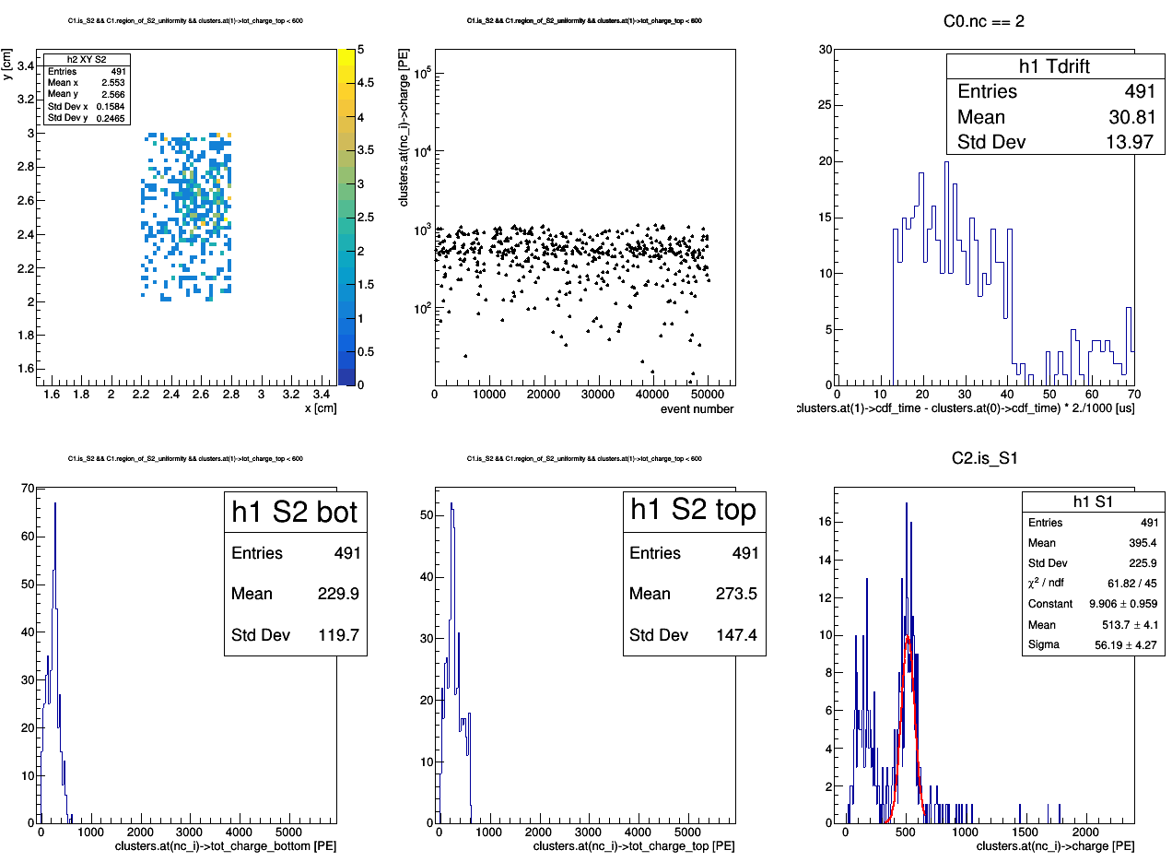
tot_charge_top < 600 [PE]
Ph2, Am241, run 542
master cut

Slide 63
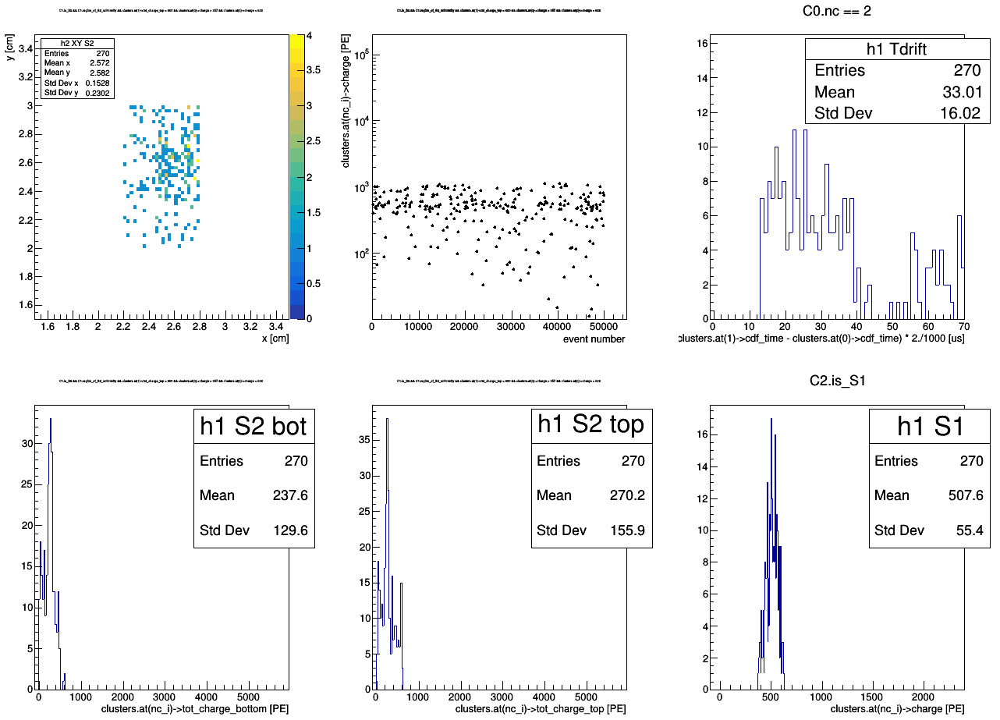
tot_charge_top < 600 [PE]
357 < charge < 622 [PE]
Ph2, Am241, run 542
master cut1
master cut2

Slide 64
tot_charge_top < 600 [PE]
357 < charge < 622 [PE]
Ph2, Am241, run 542
master cut1
master cut2

Slide 65
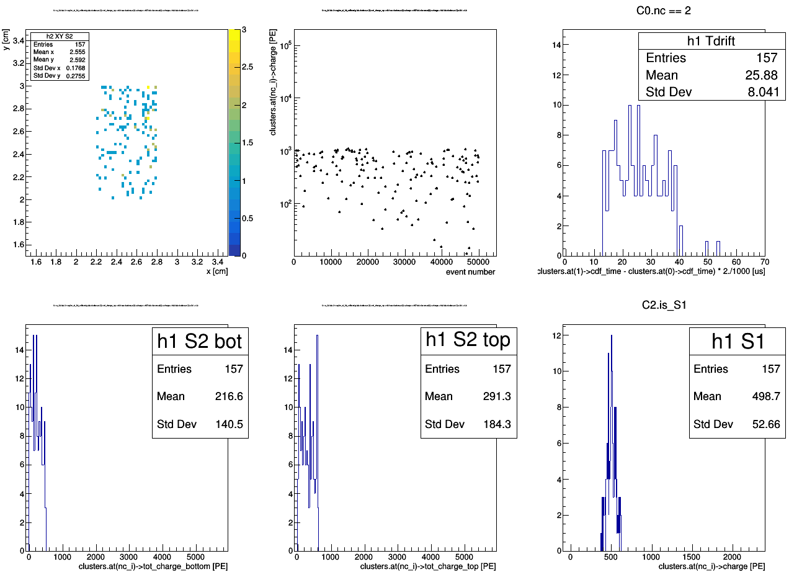
tot_charge_top < 600 [PE]
357 < charge < 622 [PE]
clusters.at(1)->f90 < 0.2
Ph2, Am241, run 542
master cut1
master cut2

Slide 67
Ph2, Am241, run 544

Slide 68
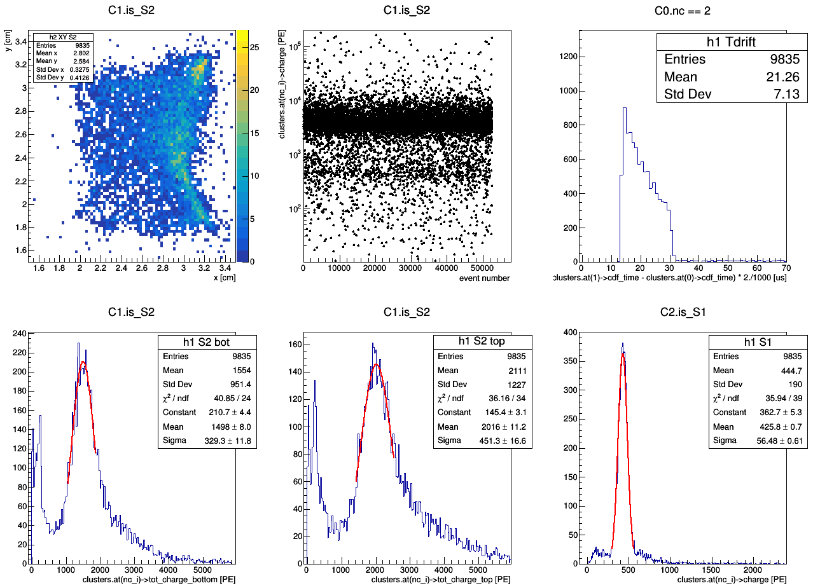
Ph2, Am241, run 544

Slide 69
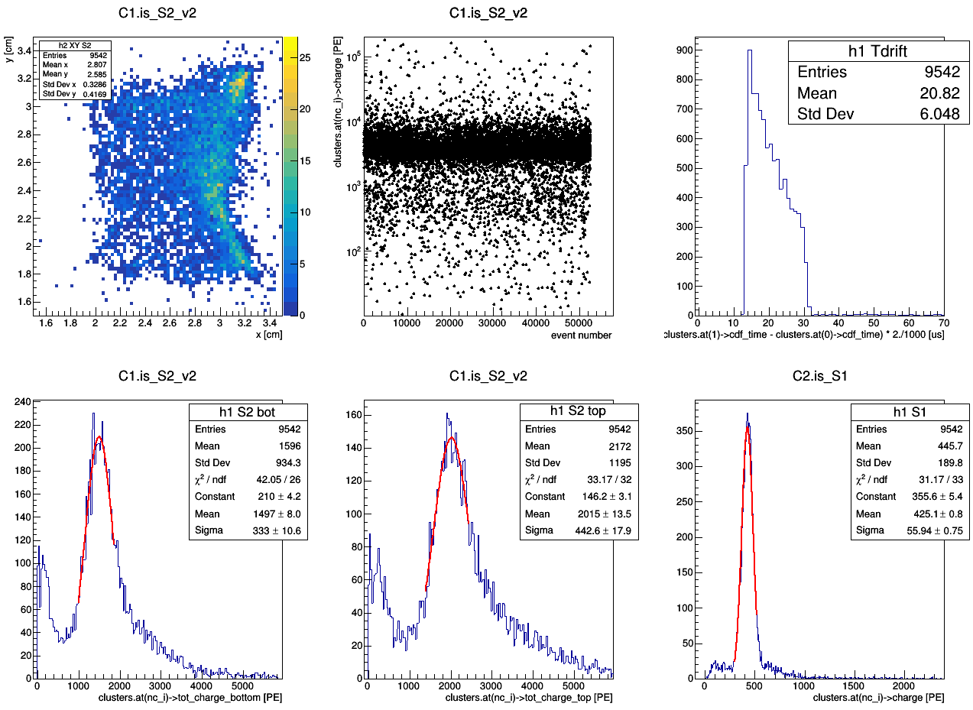
Ph2, Am241, run 544

Slide 70
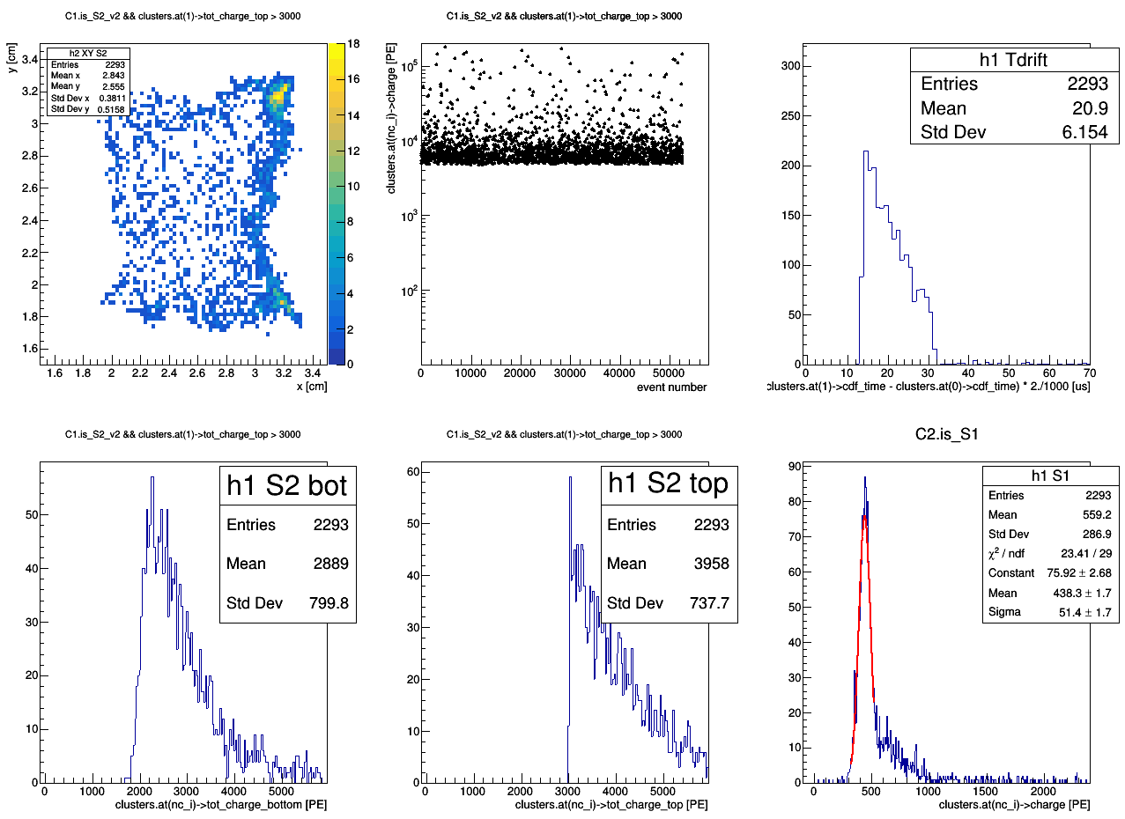
tot_charge_top > 3000 [PE]
Ph2, Am241, run 544
master cut

Slide 71

tot_charge_top > 3000 [PE]
350 < charge < 510 [PE]
Ph2, Am241, run 544
master cut1
master cut2

Slide 72

master cut
Ph2, Am241, run 544

Slide 77
Ph2, bkg, run 534

Slide 78

Ph2, bkg, run 534

Slide 79

Ph2, bkg, run 534

Slide 80

Ph2, bkg, run 534

Slide 81

Ph2, bkg, run 534

Slide 82

Ph2, bkg, run 534

Slide 83

Ph2, bkg, run 534

Slide 84

Ph2, bkg, run 534
master cut

Slide 85

Ph2, bkg, run 534
master cut

Slide 86

Ph2, bkg, run 534
master cut
0 < tot_charge_top < 1000 [PE]

Slide 87

Ph2, bkg, run 534
master cut
1000 < tot_charge_top < 2000 [PE]

Slide 88

Ph2, bkg, run 534
master cut
2000 < tot_charge_top < 4000 [PE]

Slide 89

Ph2, bkg, run 534
master cut
4000 < tot_charge_top < 8000 [PE]

Slide 90

Ph2, bkg, run 534
master cut
8000 < tot_charge_top < 14000 [PE]

Slide 91

Ph2, bkg, run 534
master cut
14000 < tot_charge_top < 25000 [PE]

Slide 92

Ph2, bkg, run 534
master cut
25000 < tot_charge_top < 40000 [PE]

