Slide 1
XY-reconstruction
Сampaign V
Oleynikov Vladislav
13 Nov 2018

Slide 2
Algorithm:
11713f949ea5bffcc2f0ceb22d1267b5f314a5af
Merge branch 'barycenter' into 'master'

Slide 3
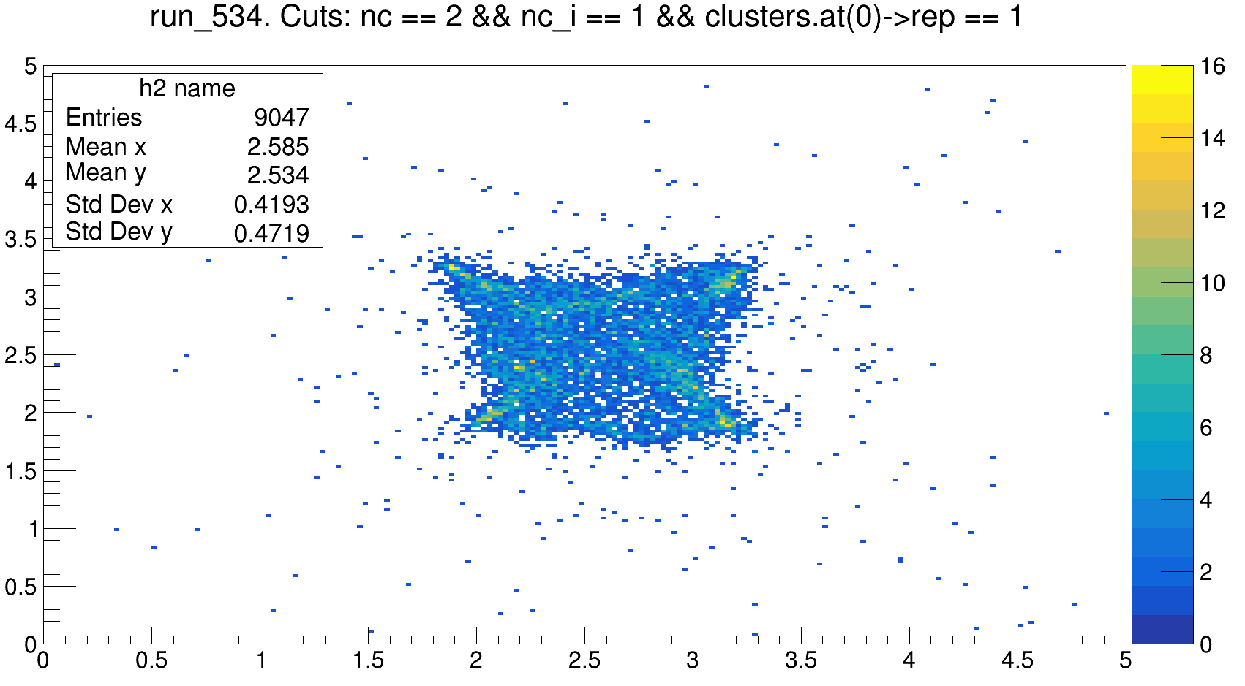
Ph2, backgroud

Slide 4
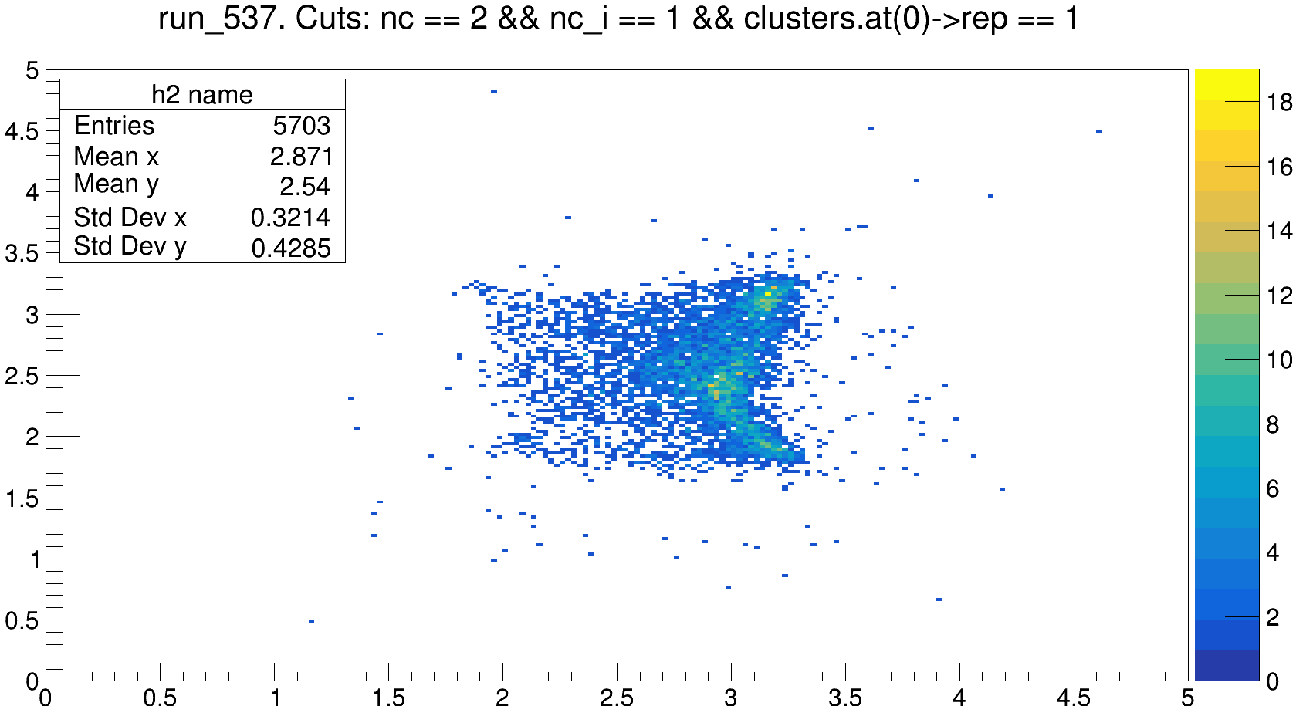
Ph2, Am241

Slide 5
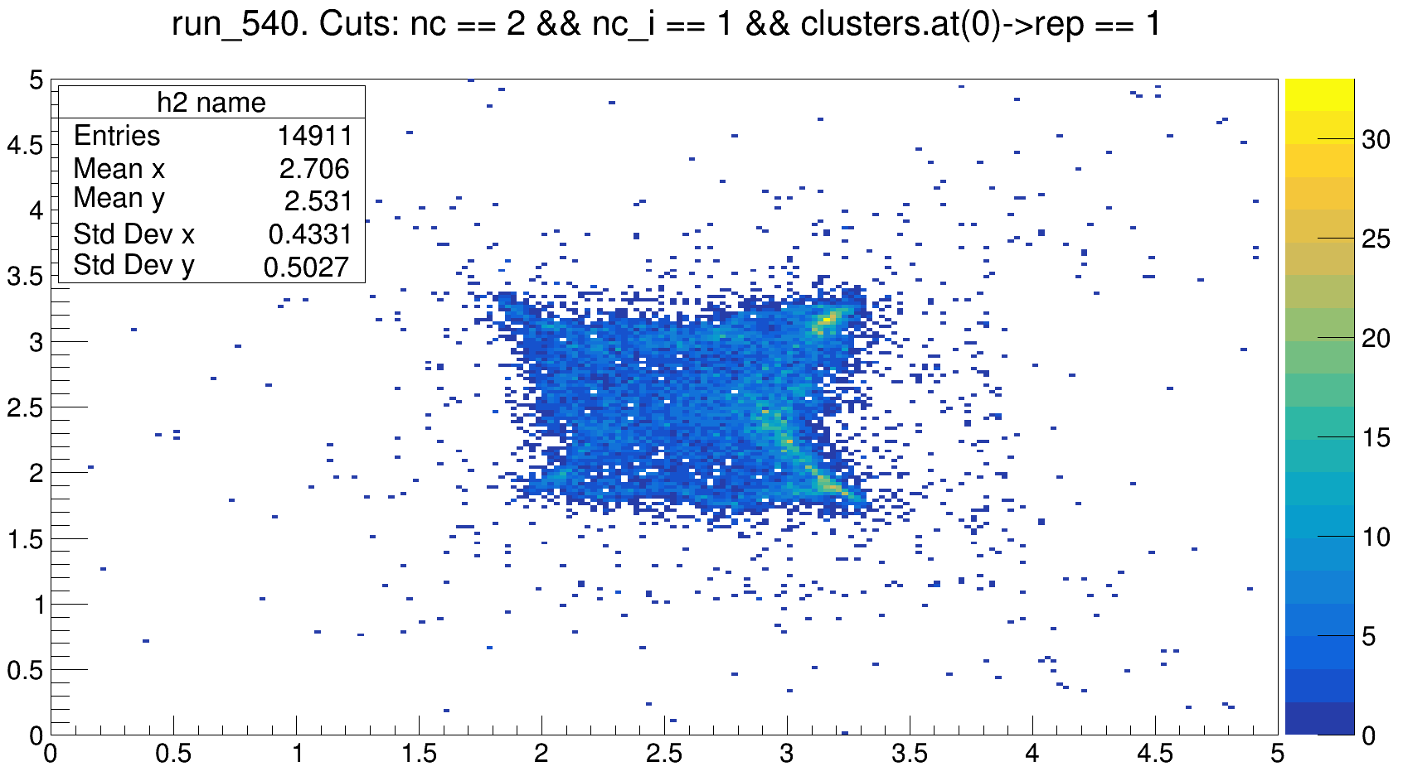
Ph2, Cf252

Slide 6
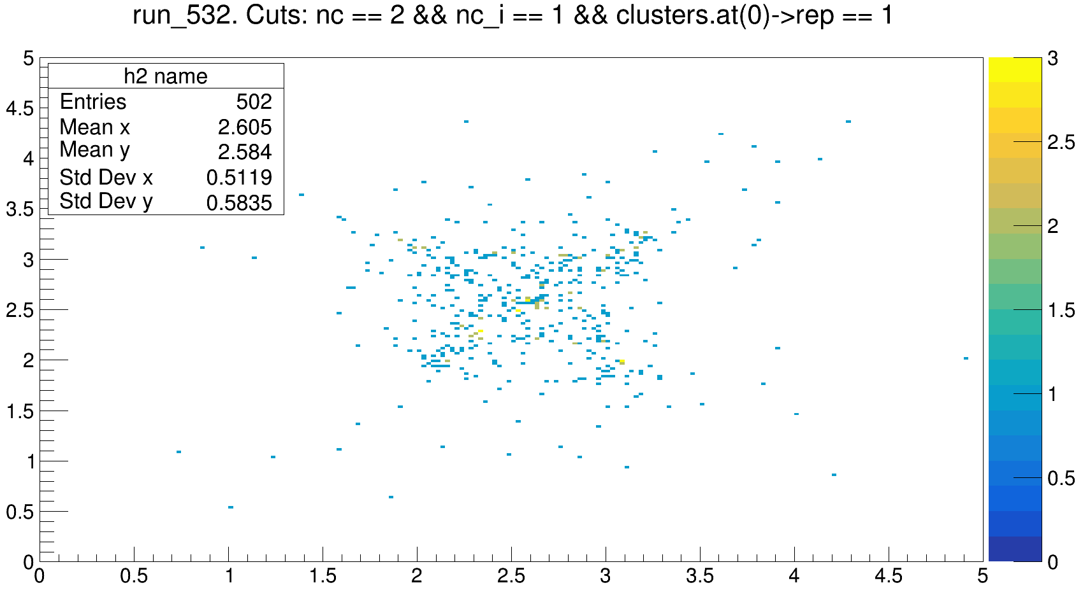
Ph2, BEAM ON (E = 28 MeV, i = 12 nA)

Slide 8
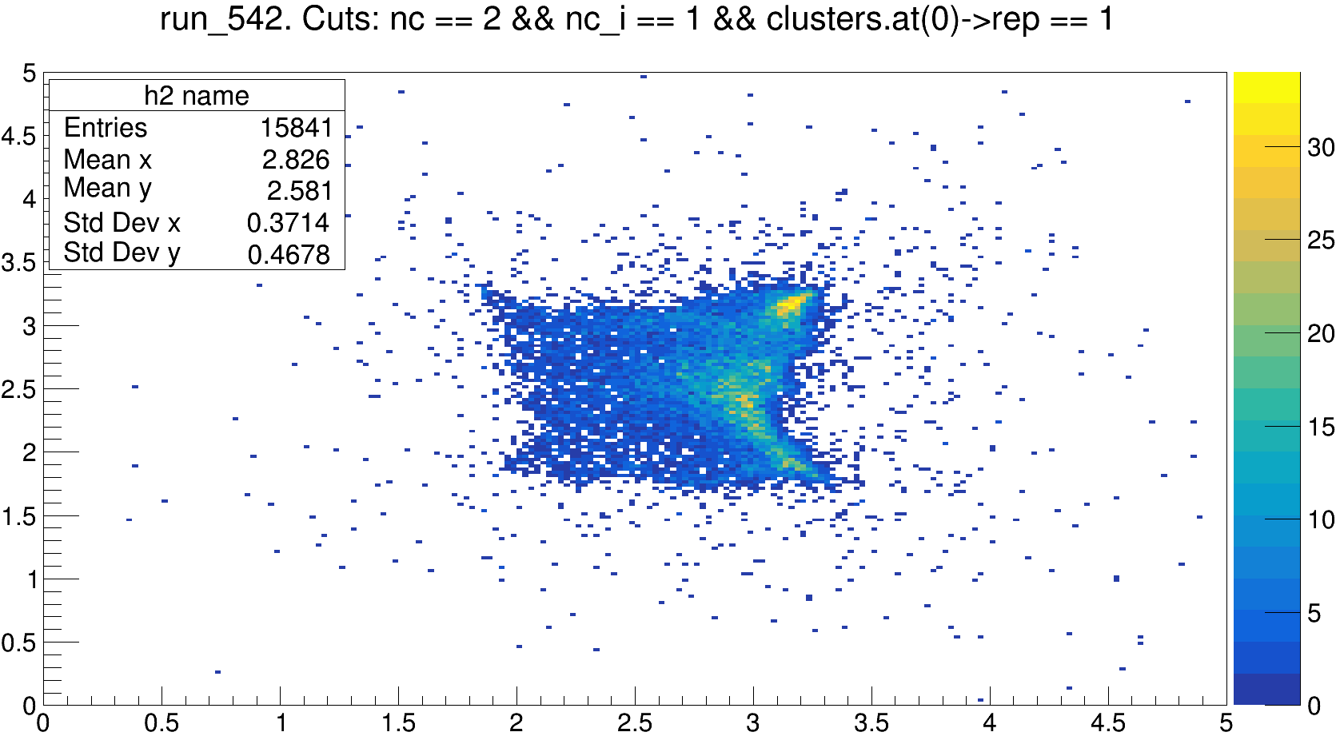
Ph2, Am241

Slide 9
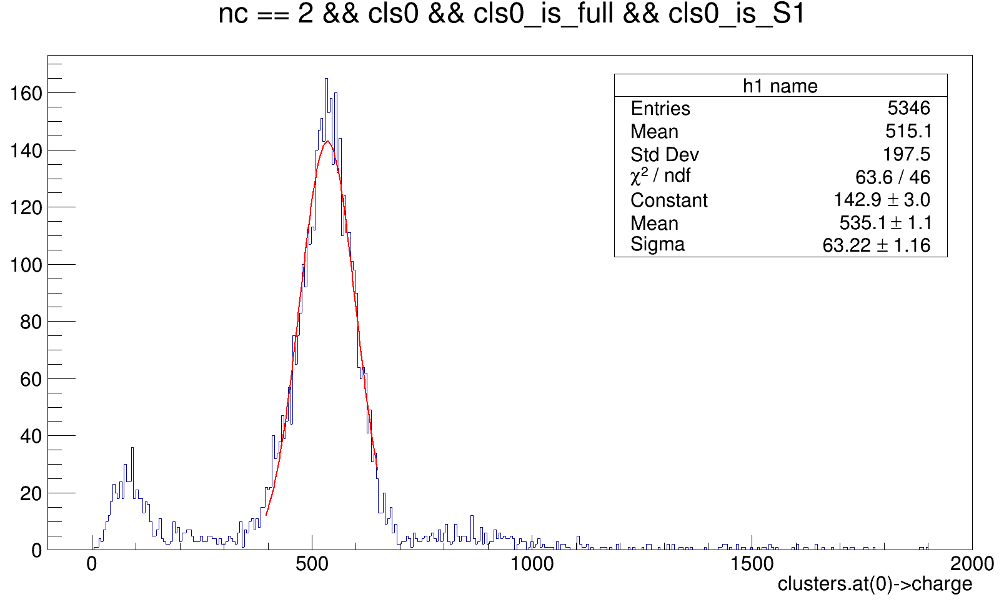
Ph2, Am241, run 537

Slide 10
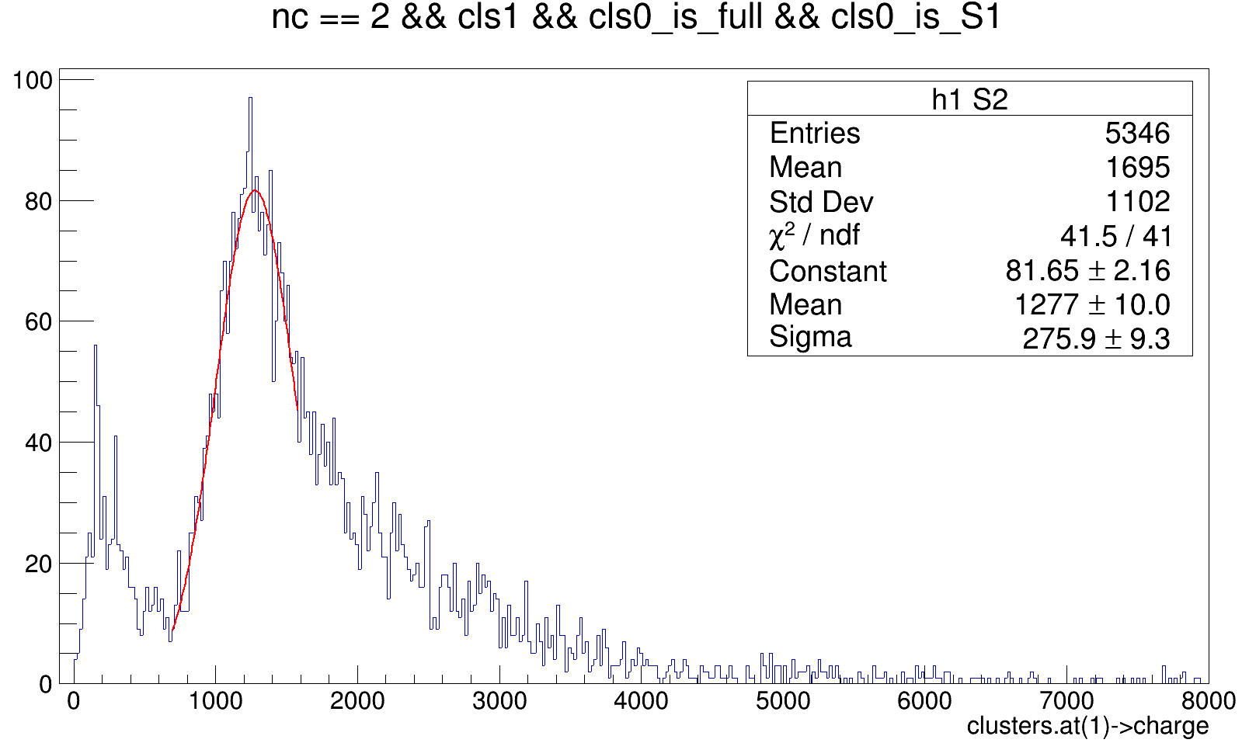
Ph2, Am241, run 537

Slide 11
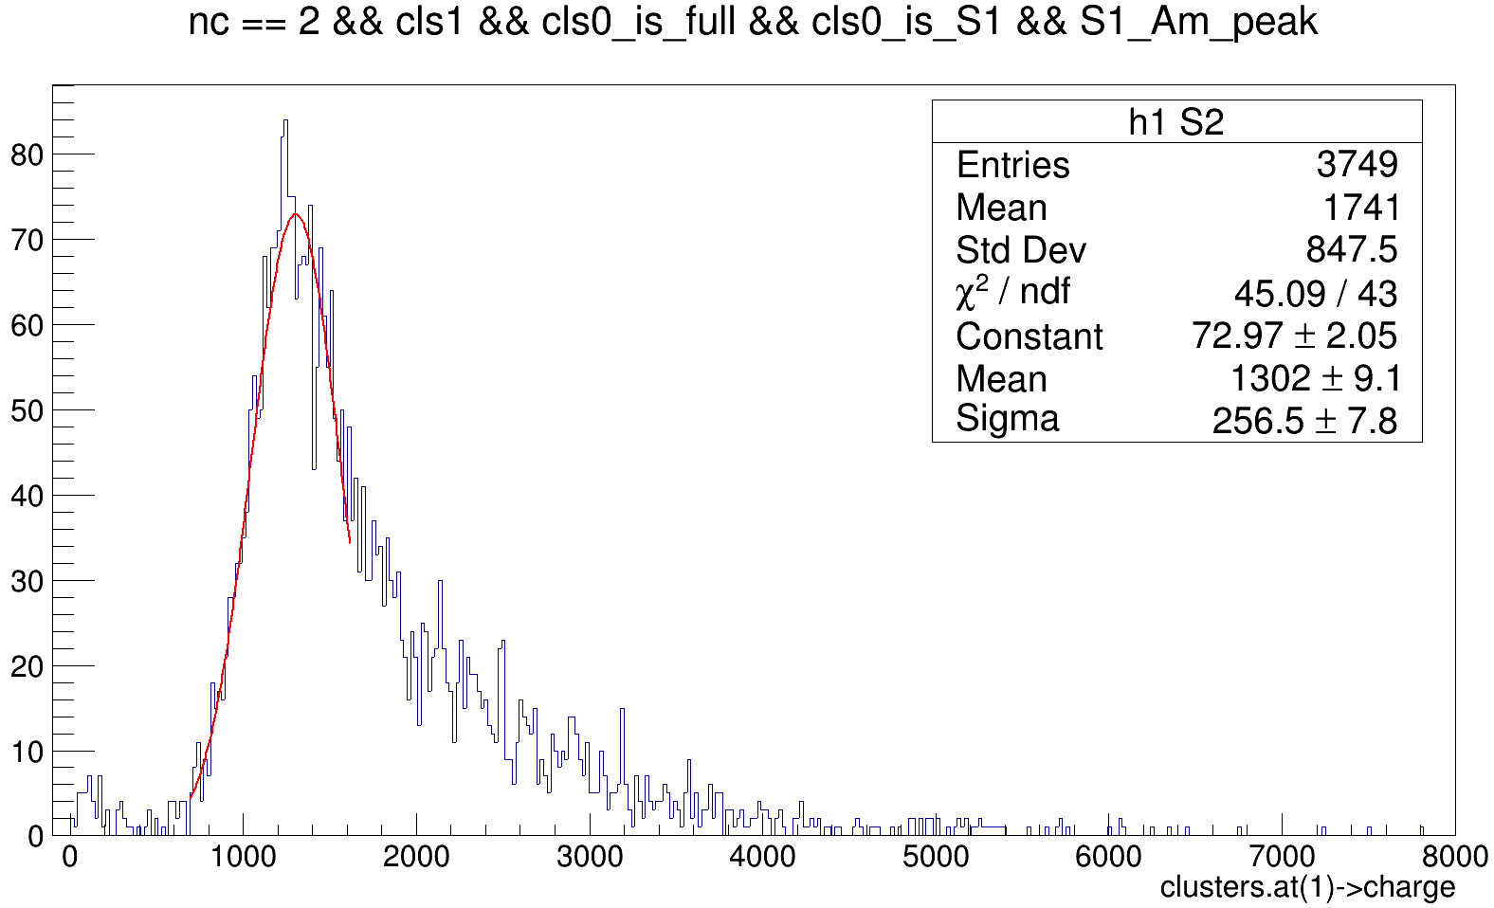
Ph2, Am241, run 537

Slide 12
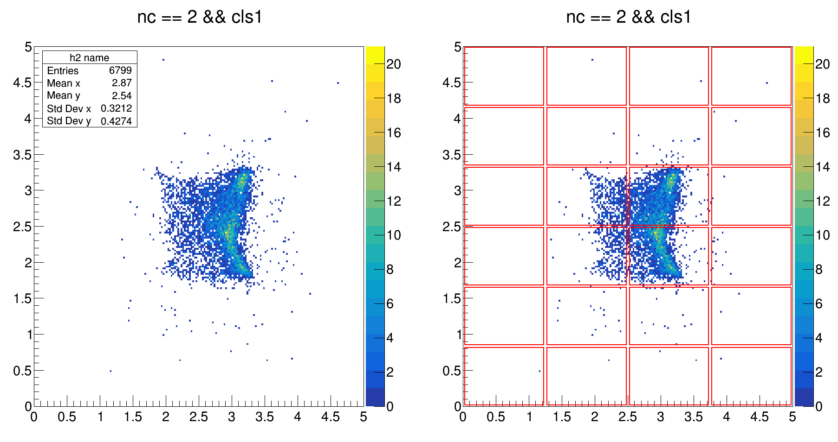
Ph2, Am241, run 537

Slide 13
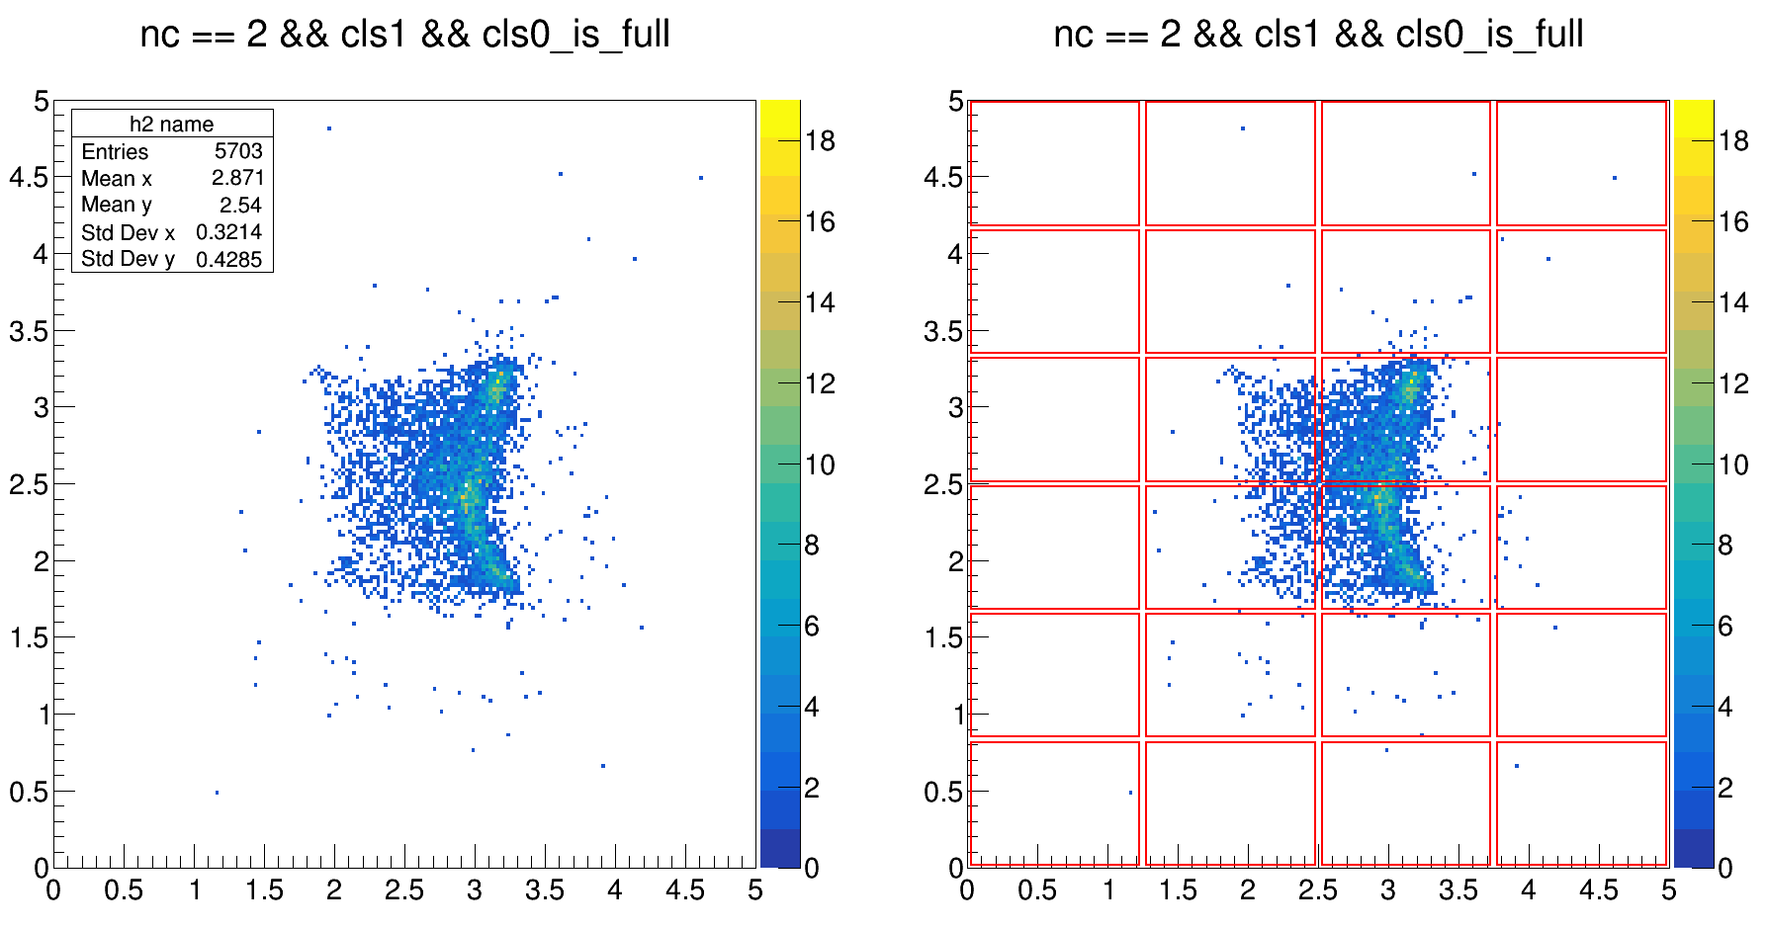
Ph2, Am241, run 537

Slide 14
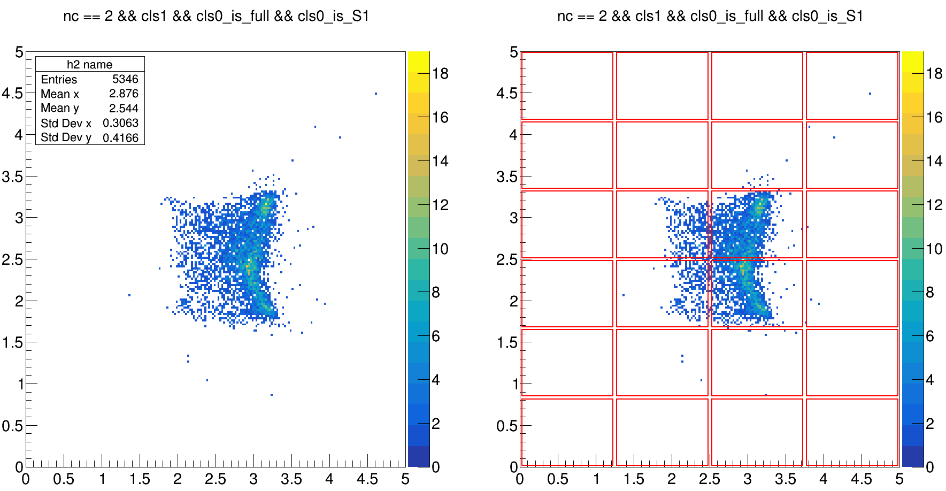
Ph2, Am241, run 537

Slide 15
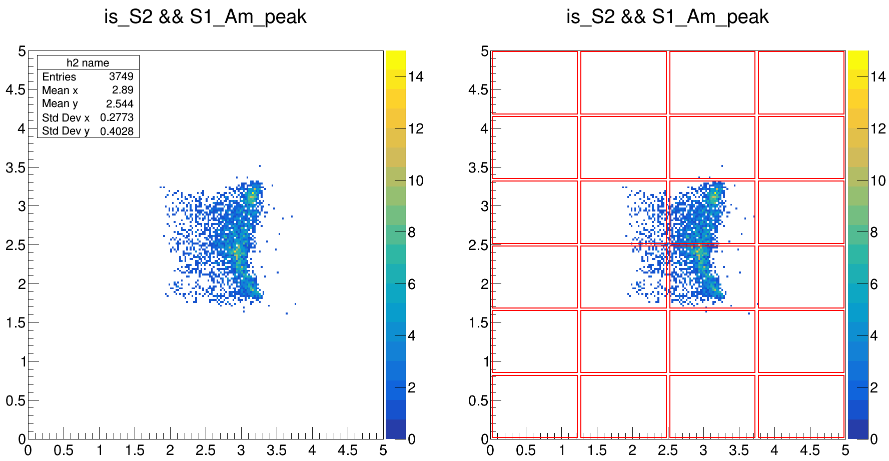
Ph2, Am241, run 537

Slide 16
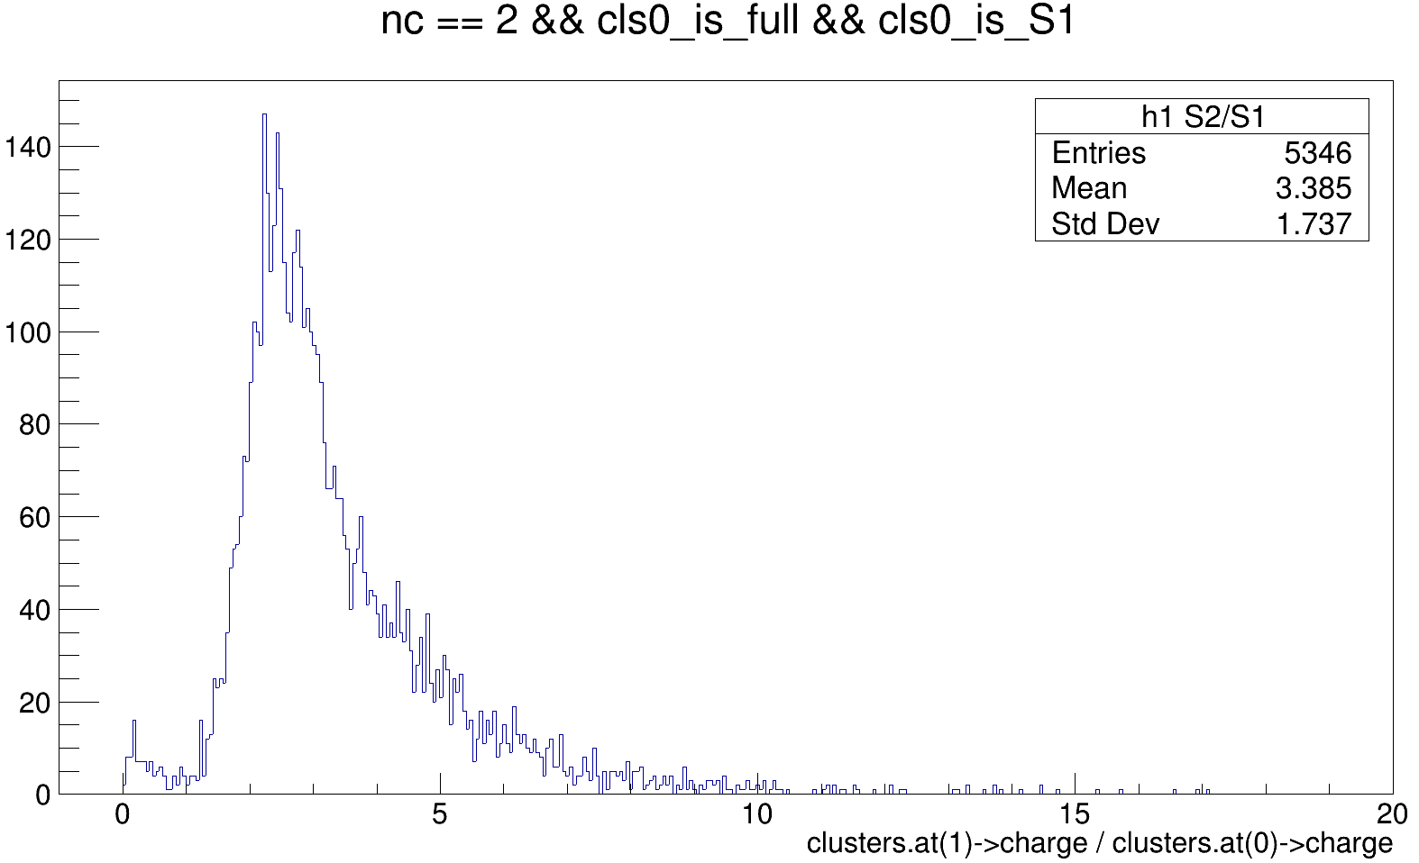
Ph2, Am241, run 537

Slide 17
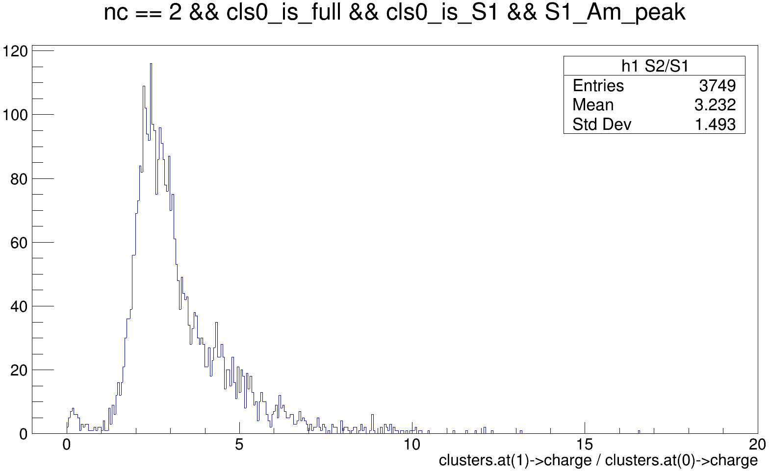
Ph2, Am241, run 537

Slide 18
Cut list

