Slide 1
XY-reconstruction
Сampaign V
Oleynikov Vladislav
14 Nov 2018

Slide 2
Algorithm:
11713f949ea5bffcc2f0ceb22d1267b5f314a5af
Merge branch 'barycenter' into 'master'

Slide 3
Cut list:
bool cls0_is_S1 = clusters.at(0)->f90 > 0.2;
bool cls0_is_full = clusters.at(0)->rep == 1;
bool S1_Am_peak = (clusters.at(0)->charge > 440) &&
(clusters.at(0)->charge < 630); // mean +- 1.5sigma using run 537
//bool S1_Am_peak = (clusters.at(0)->charge > 419) &&
(clusters.at(0)->charge < 587); // mean +- 1.5sigma using run 542
//bool S1_Am_peak = (clusters.at(0)->charge > 342) &&
(clusters.at(0)->charge < 482); // mean +- 1.5sigma using run 544
bool cls0 = nc_i == 0;//cluster 0
bool cls1 = nc_i == 1;//cluster 1
bool is_S1 = nc == 2 && cls0 && cls0_is_full && cls0_is_S1;
bool is_S2 = nc == 2 && cls1 && cls0_is_full && cls0_is_S1;

Slide 4
Ph2, Am241, run 537

Slide 5
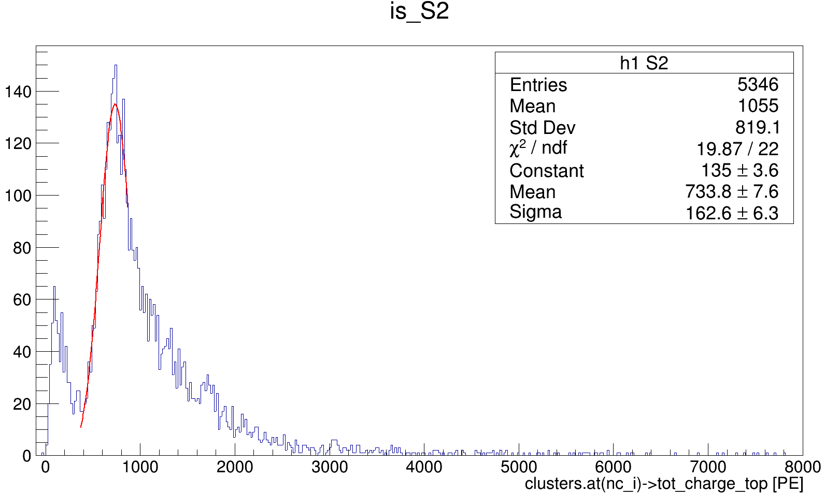
Ph2, Am241, run 537

Slide 6
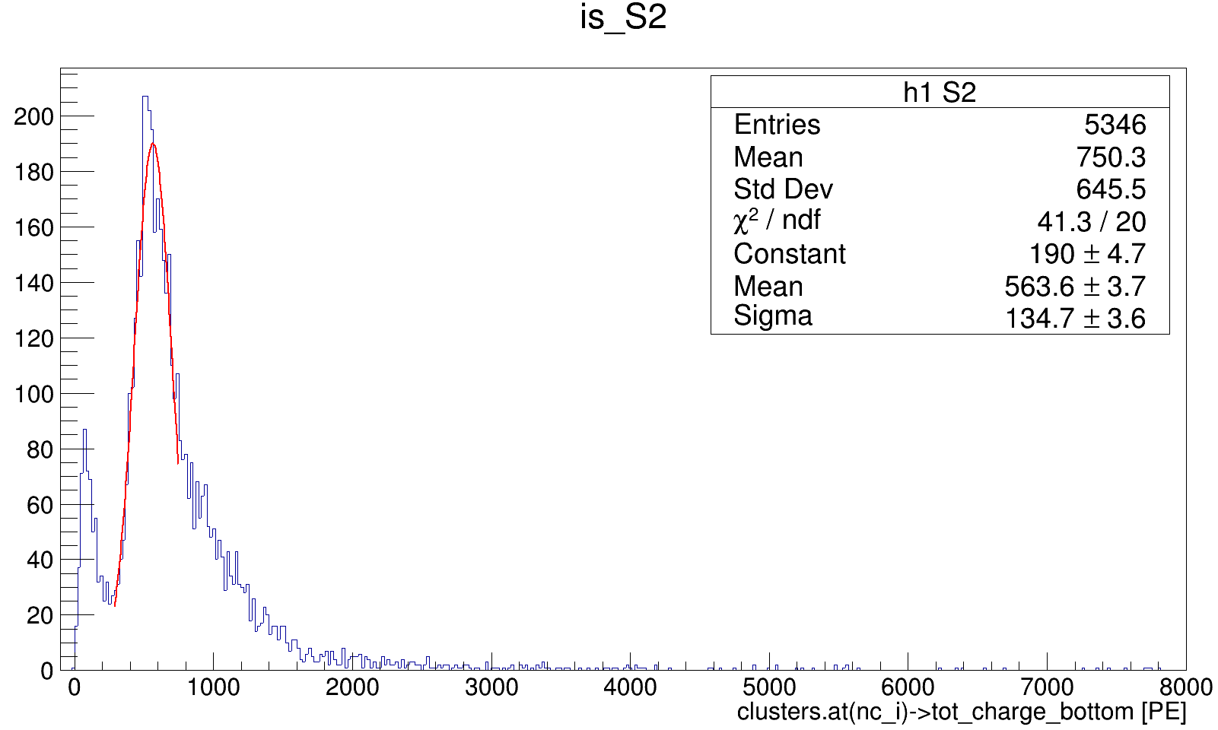
Ph2, Am241, run 537

Slide 7
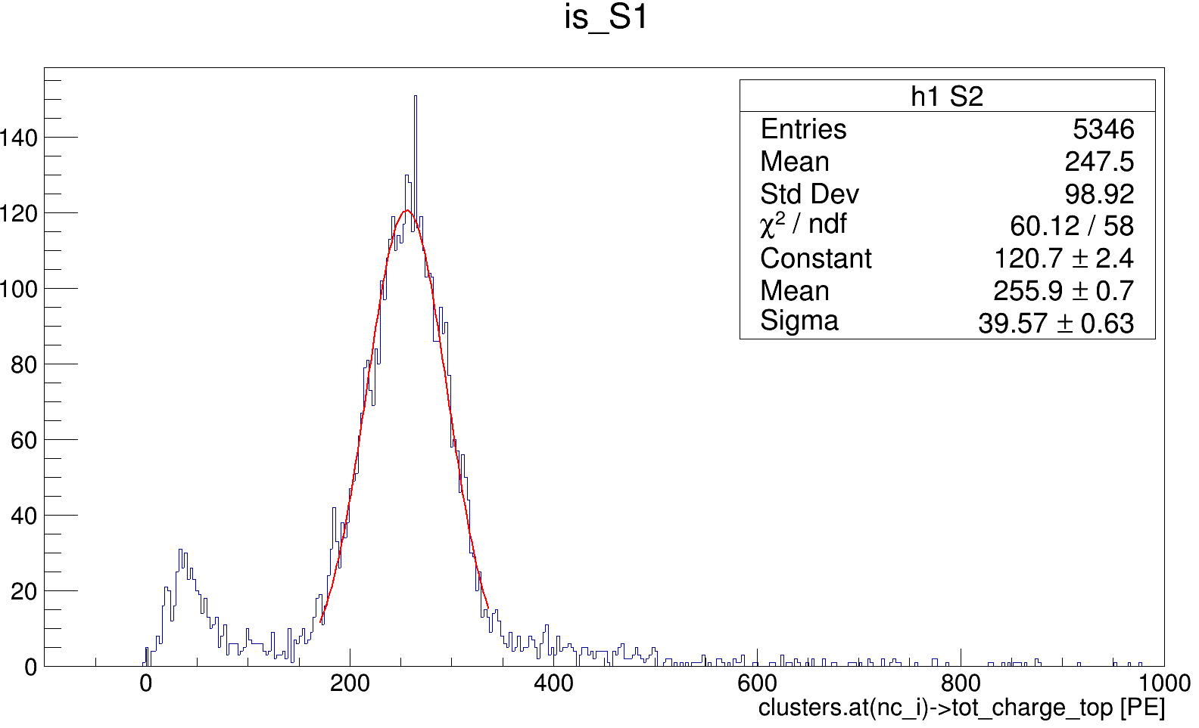
Ph2, Am241, run 537

Slide 8
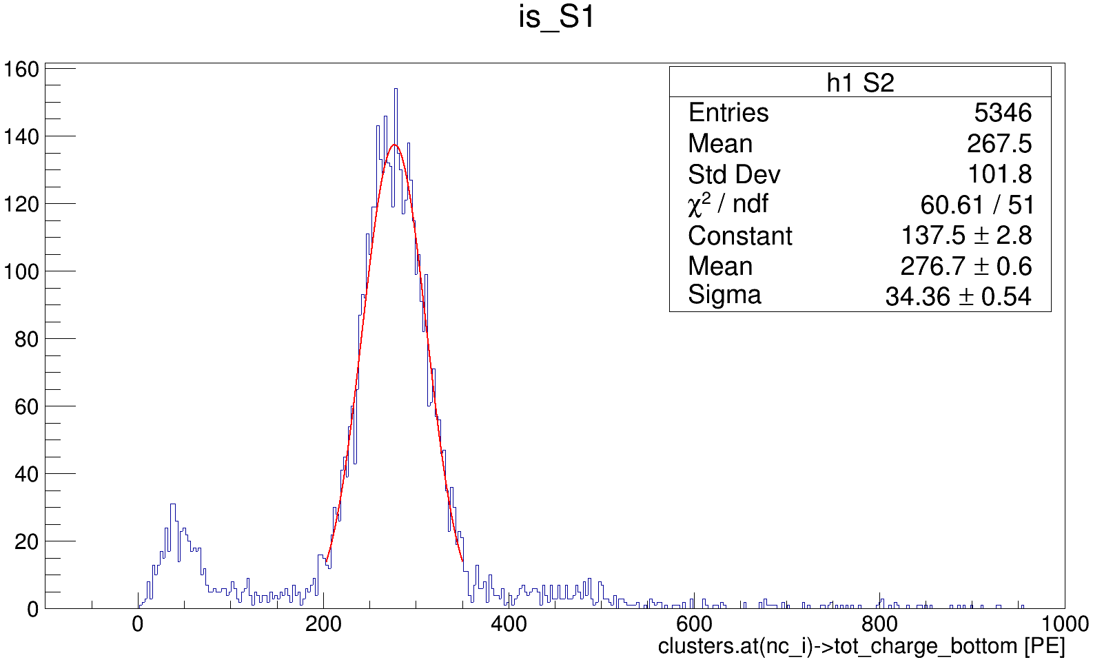
Ph2, Am241, run 537

Slide 9
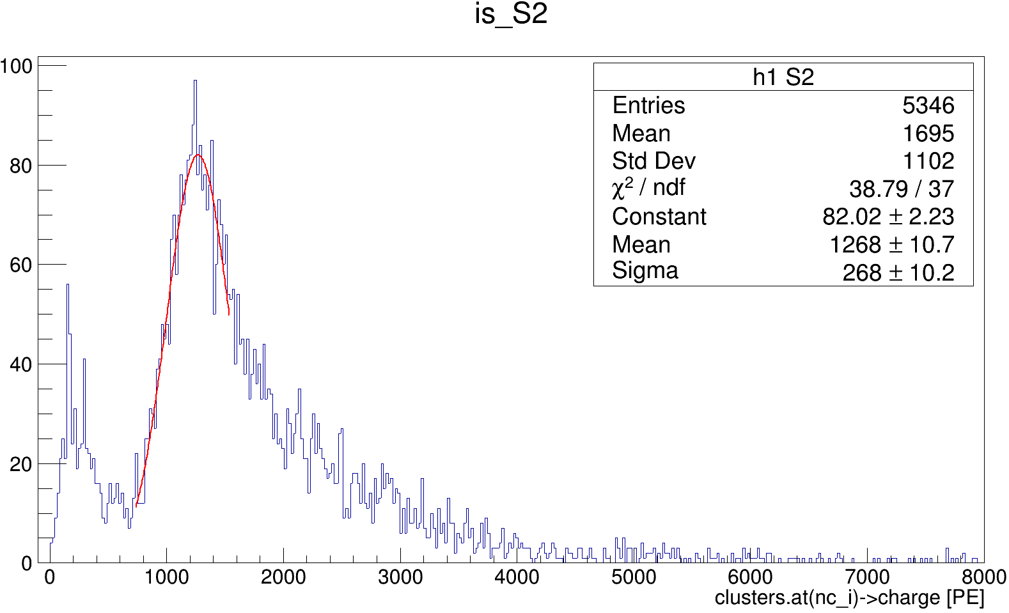
Ph2, Am241, run 537

Slide 10
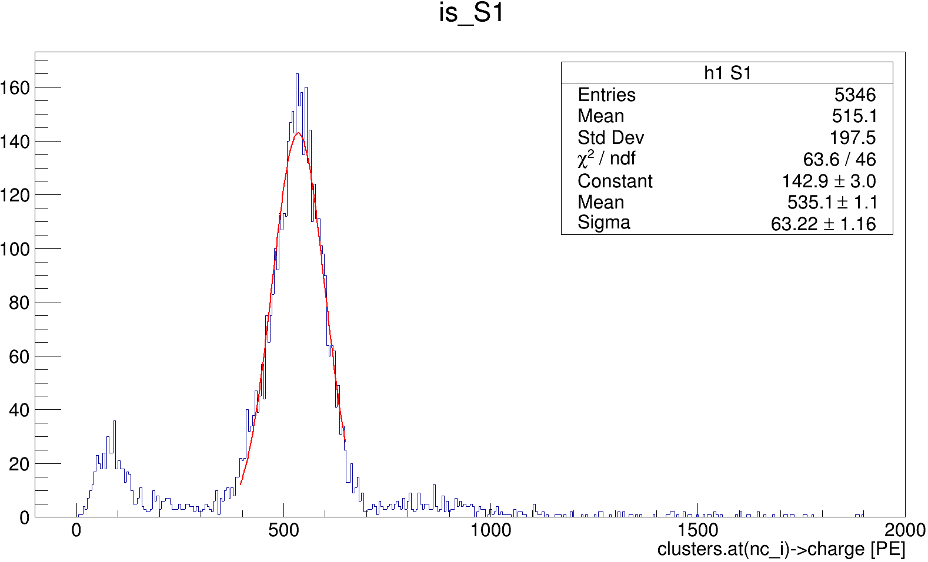
Ph2, Am241, run 537

Slide 11
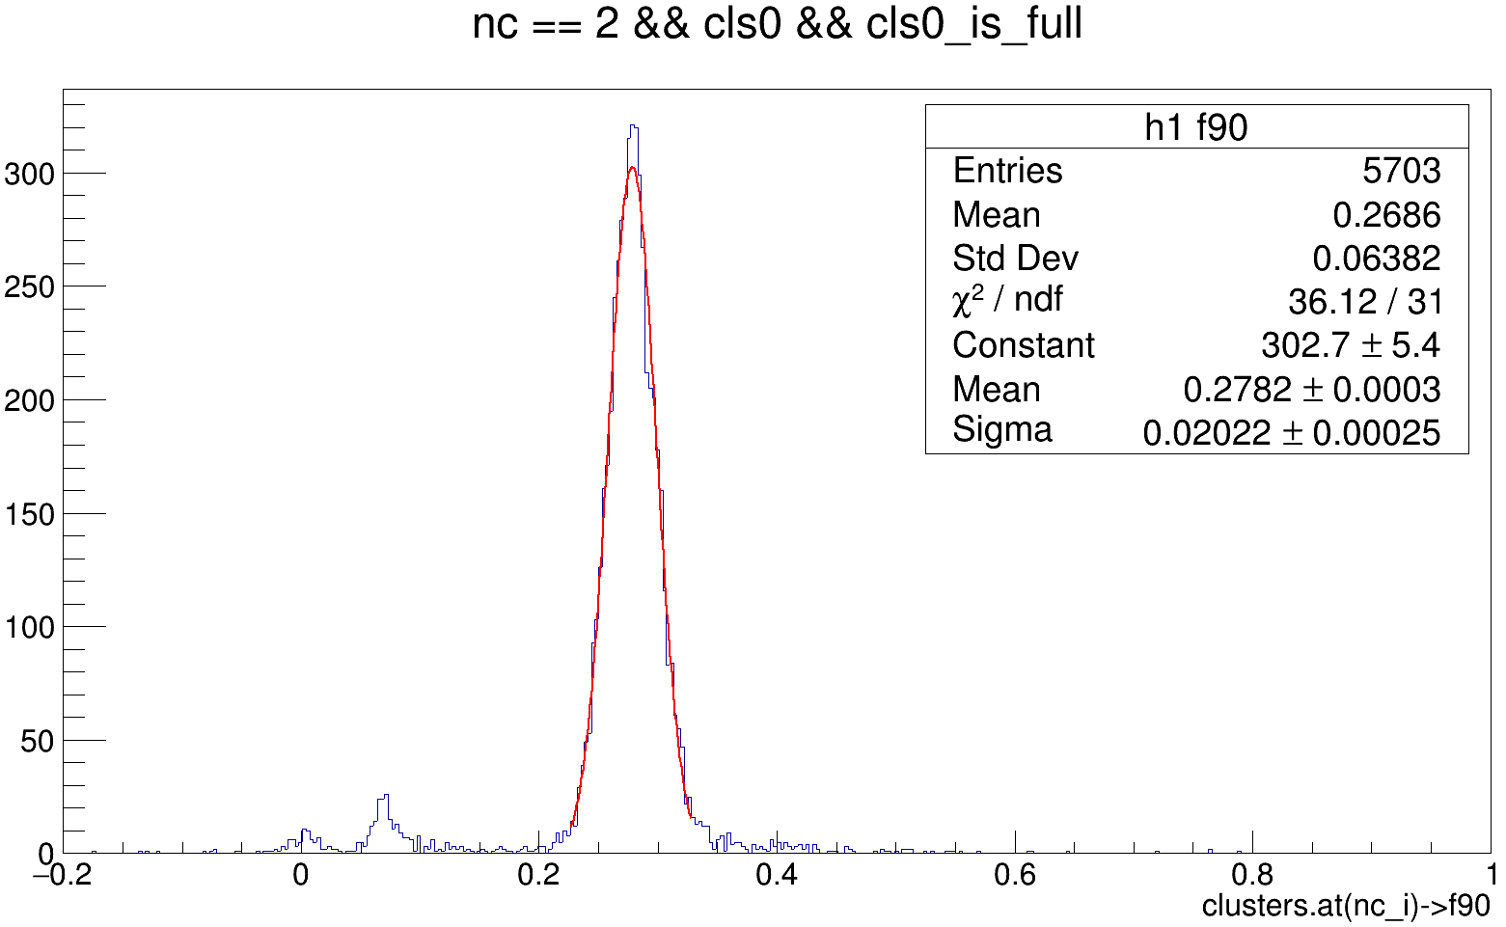
Ph2, Am241, run 537

Slide 12
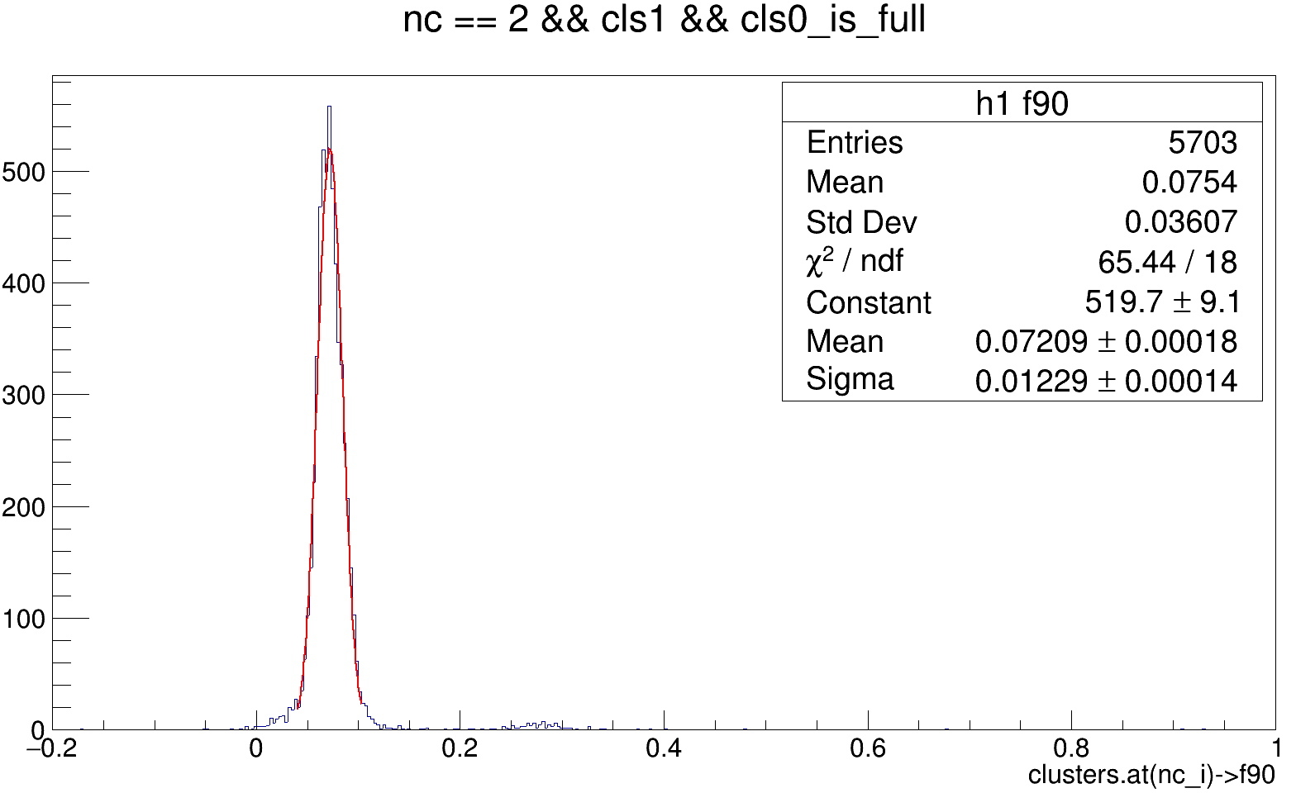
Ph2, Am241, run 537

Slide 13
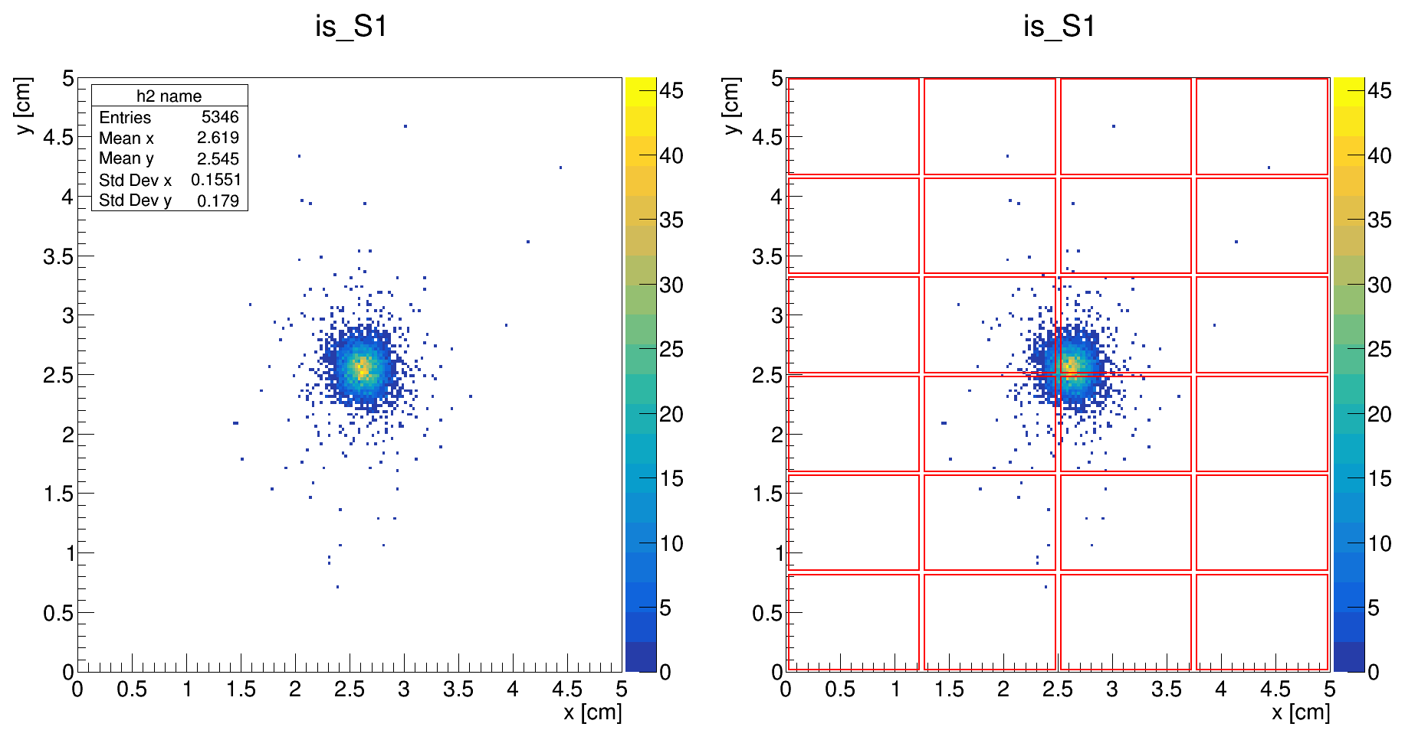
Ph2, Am241, run 537

Slide 14
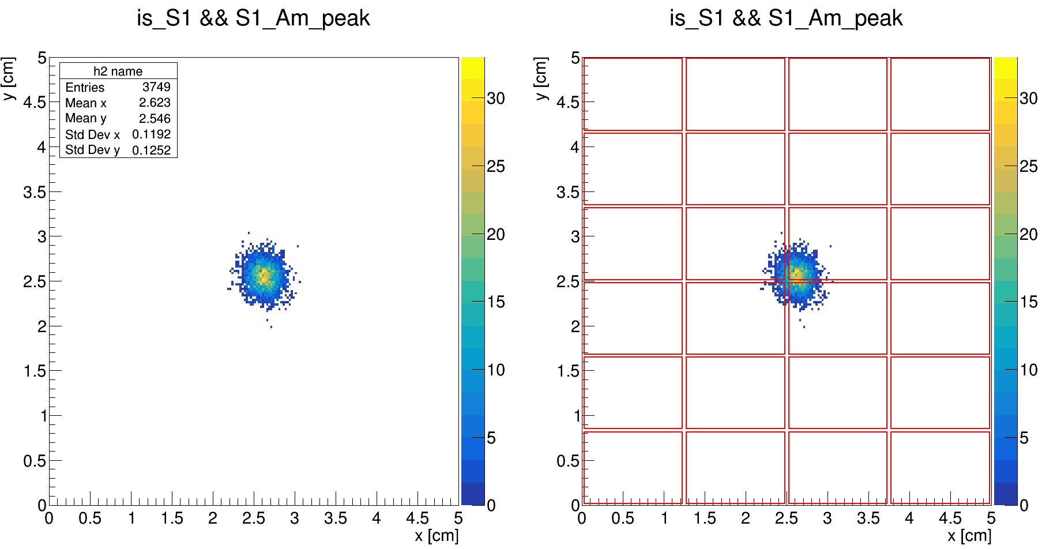
Ph2, Am241, run 537

Slide 15
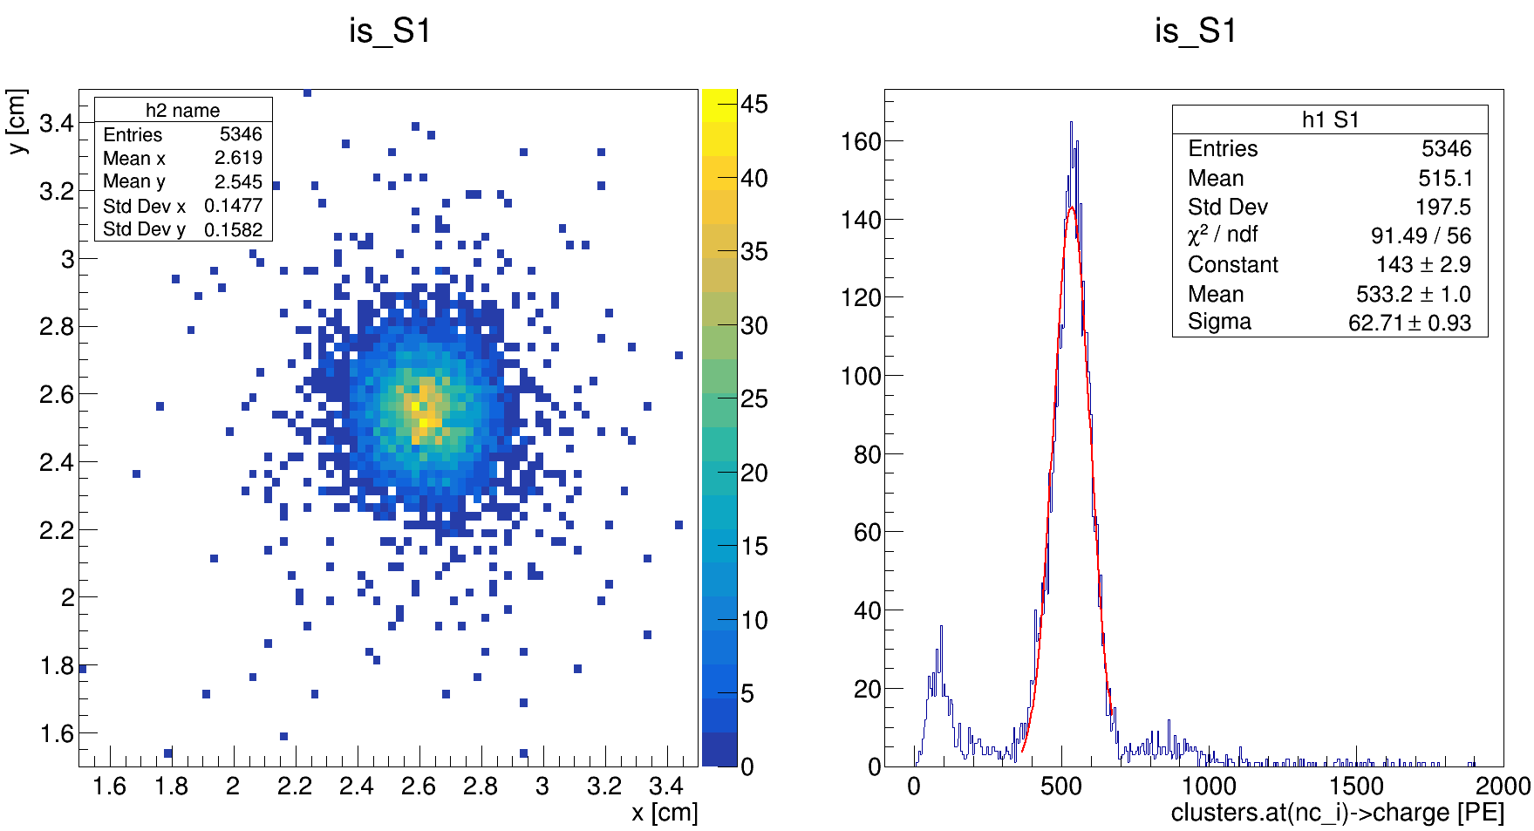
Ph2, Am241, run 537

Slide 16
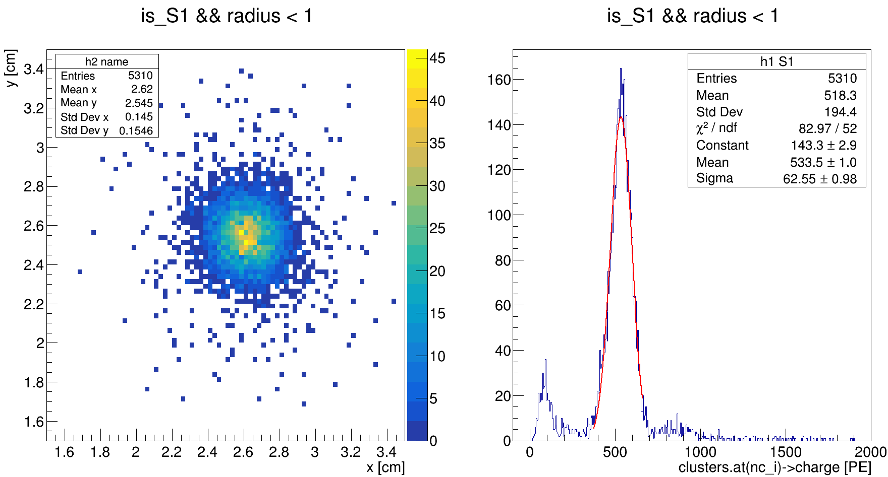
Ph2, Am241, run 537

Slide 17
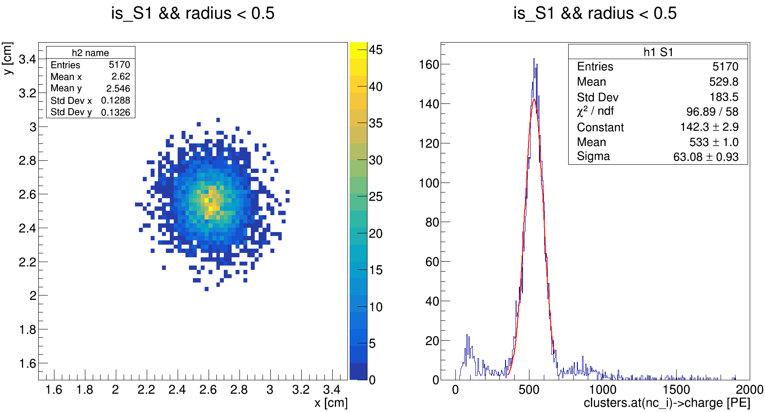
Ph2, Am241, run 537

Slide 18
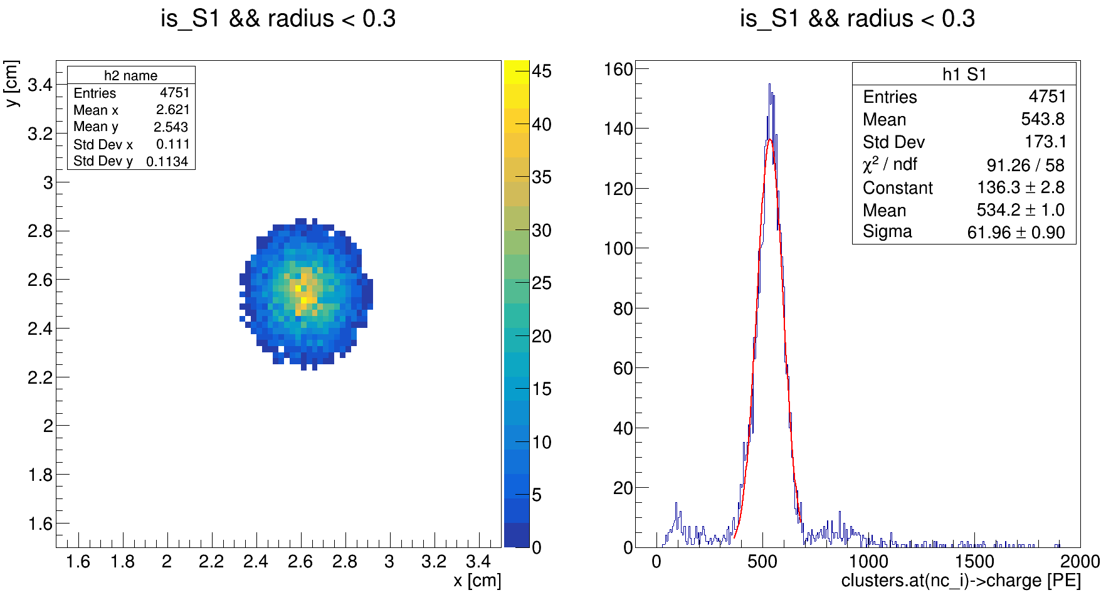
Ph2, Am241, run 537

Slide 19
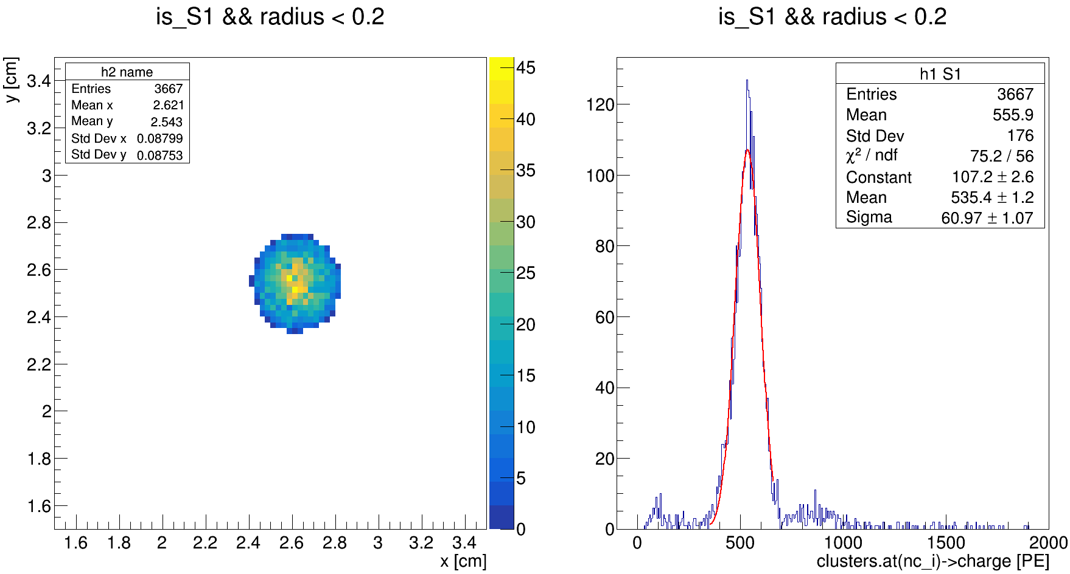
Ph2, Am241, run 537

Slide 20
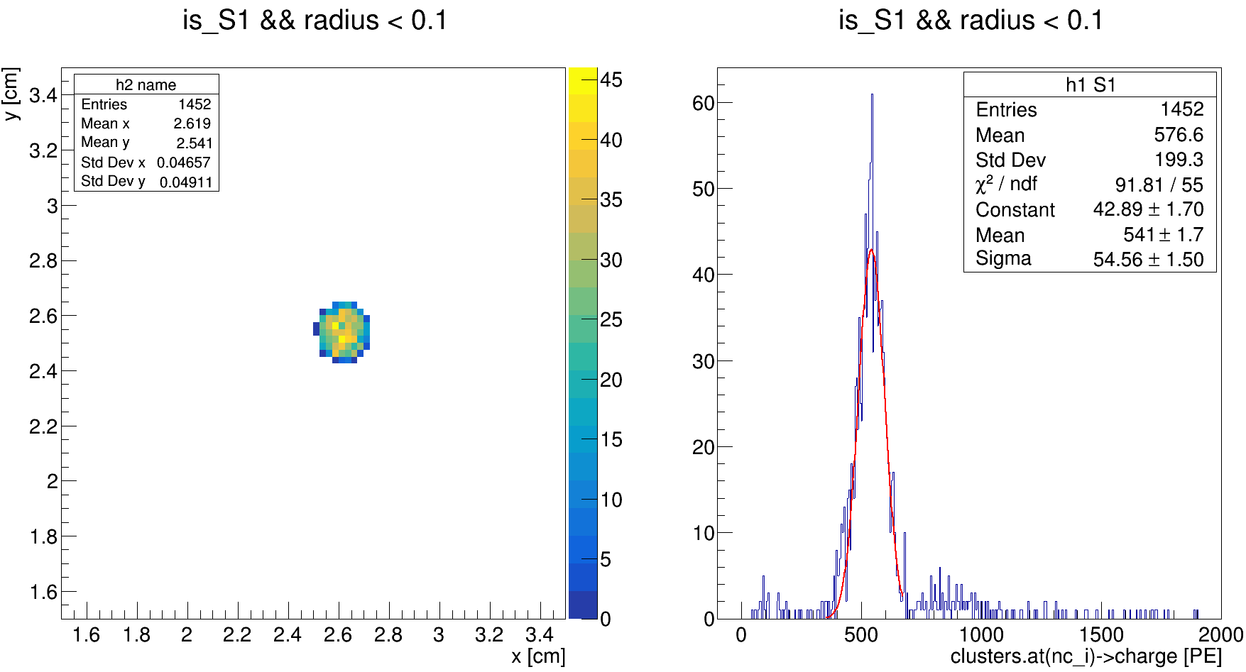
Ph2, Am241, run 537

Slide 21
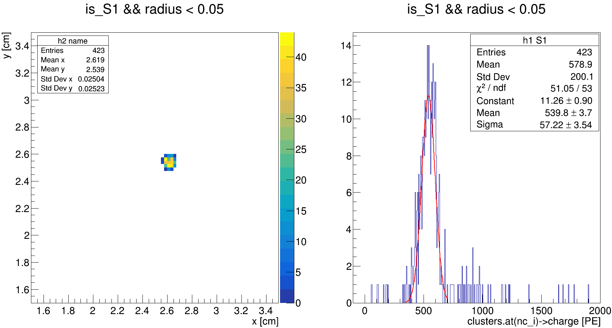
Ph2, Am241, run 537

Slide 22
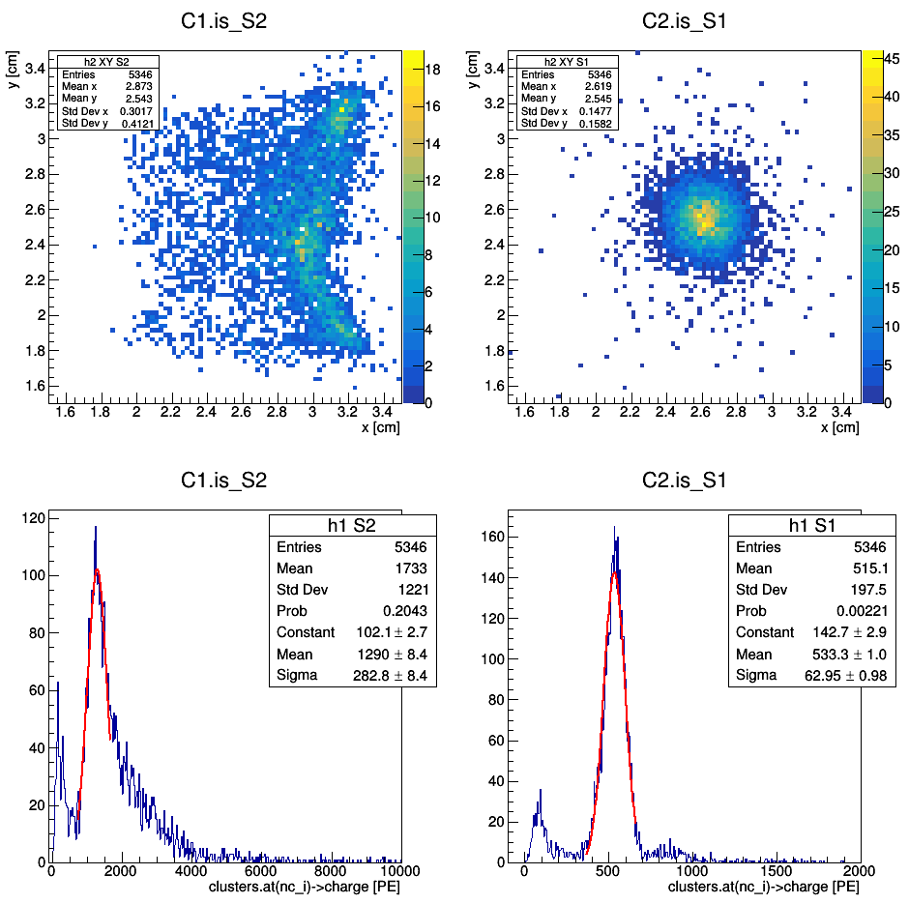
Ph2, Am241, run 537

Slide 23
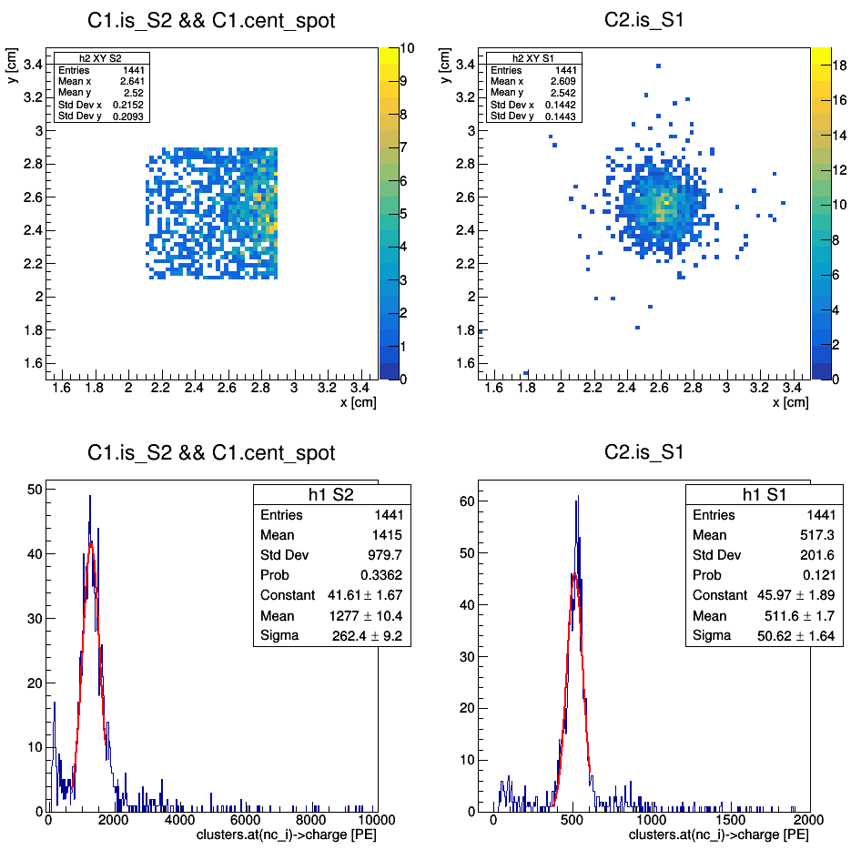
Ph2, Am241, run 537

Slide 24
Ph2, Am241, run 537

Slide 25
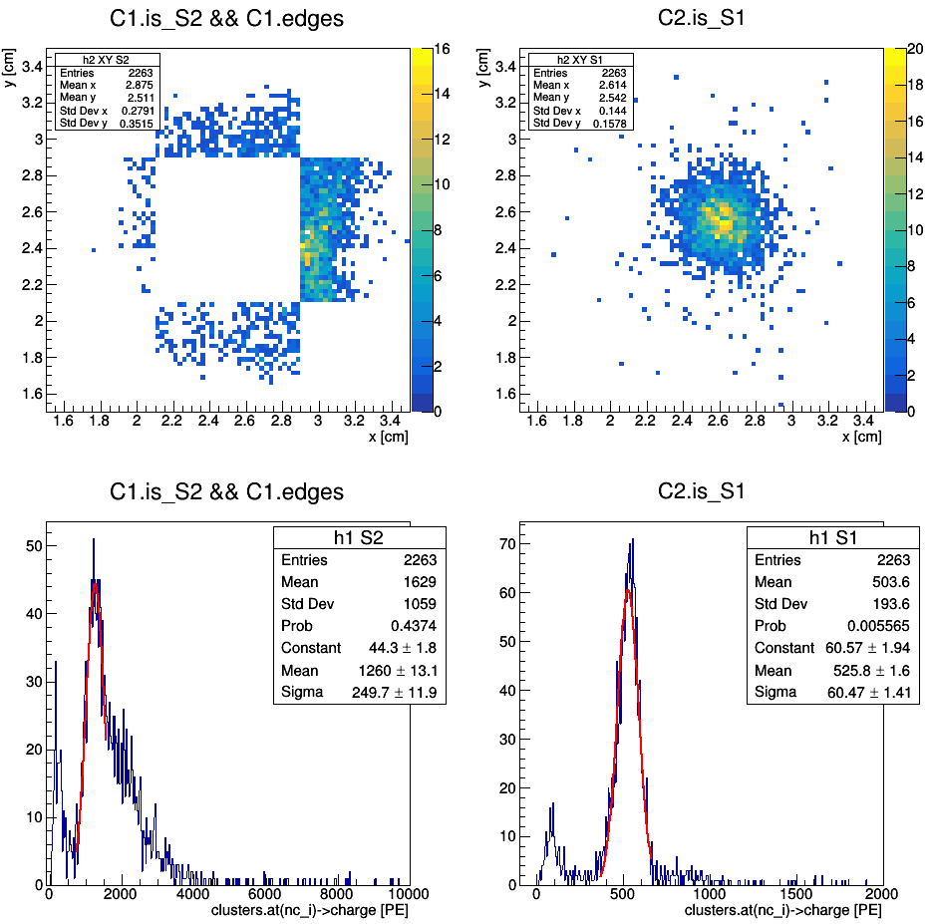
Ph2, Am241, run 537

Slide 26
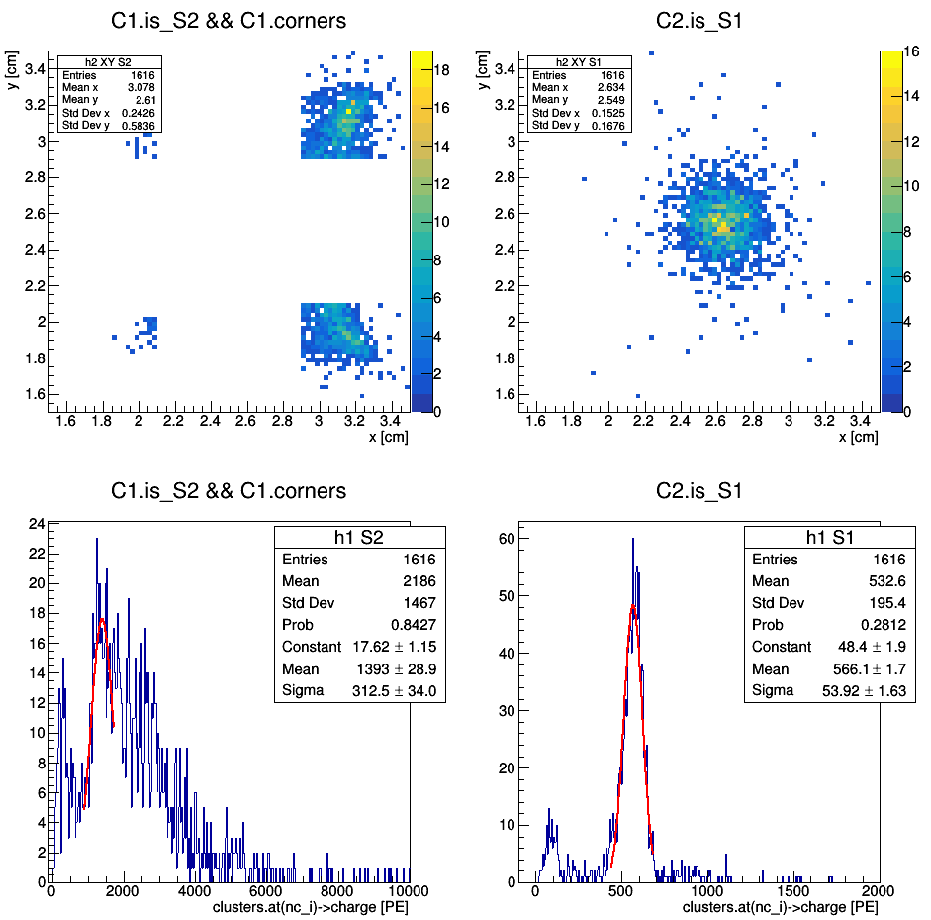
Ph2, Am241, run 537

Slide 27
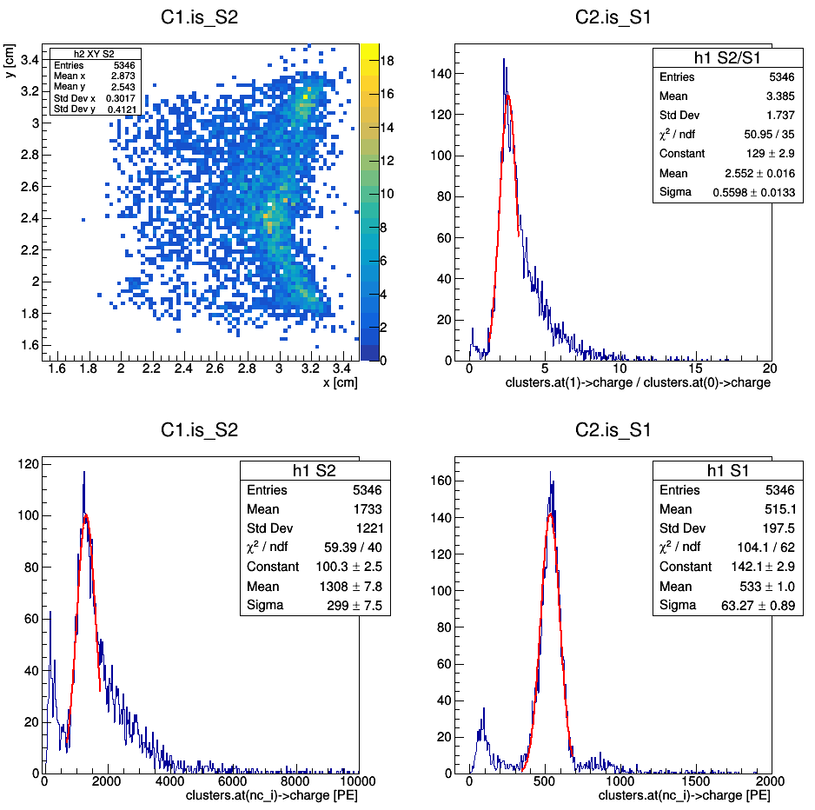
Ph2, Am241, run 537

Slide 28
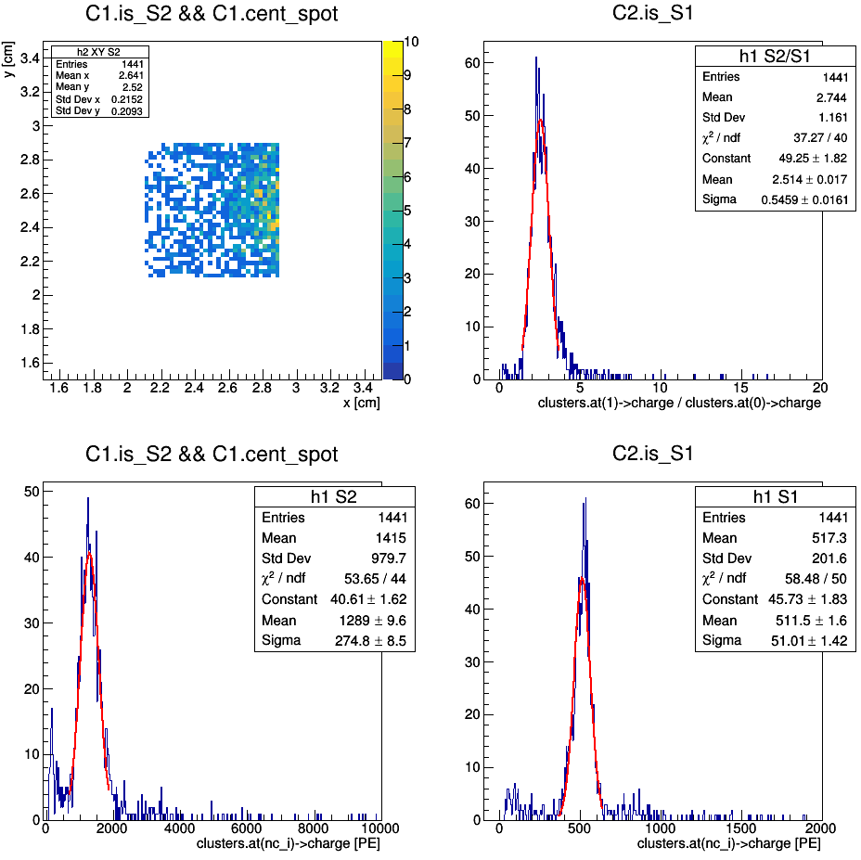
Ph2, Am241, run 537

Slide 29
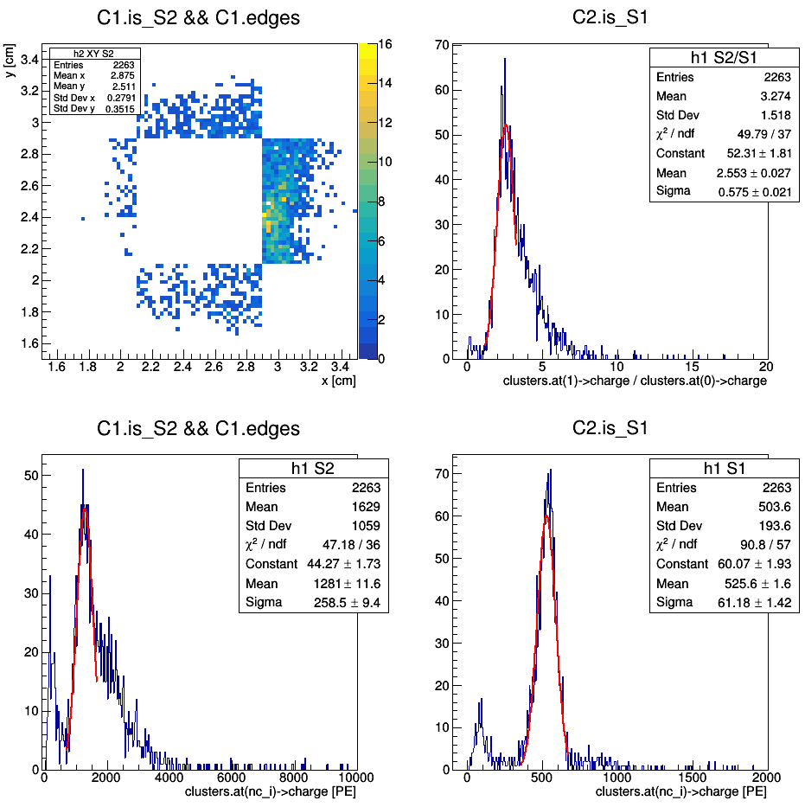
Ph2, Am241, run 537

Slide 30
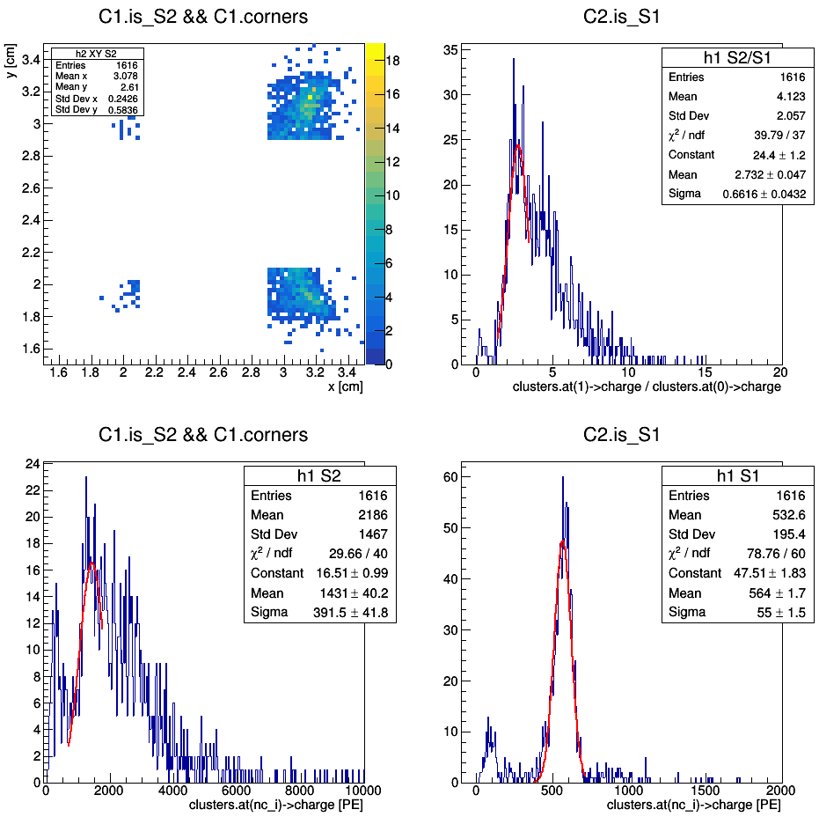
Ph2, Am241, run 537

Slide 31
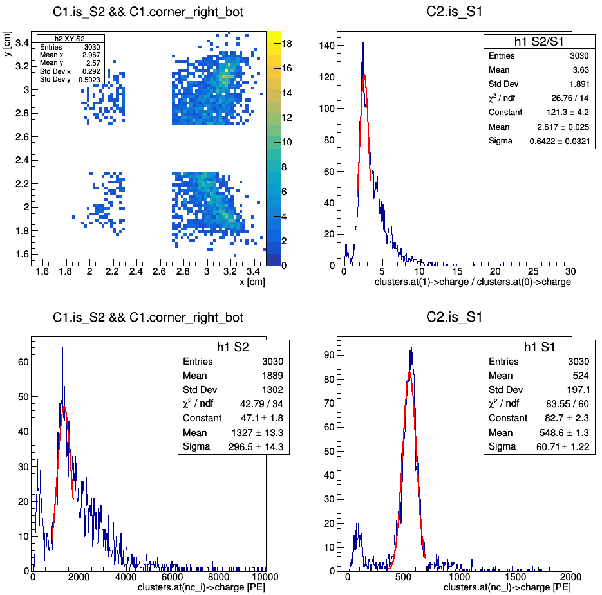
(redefinition of corners)
Ph2, Am241, run 537

Slide 32
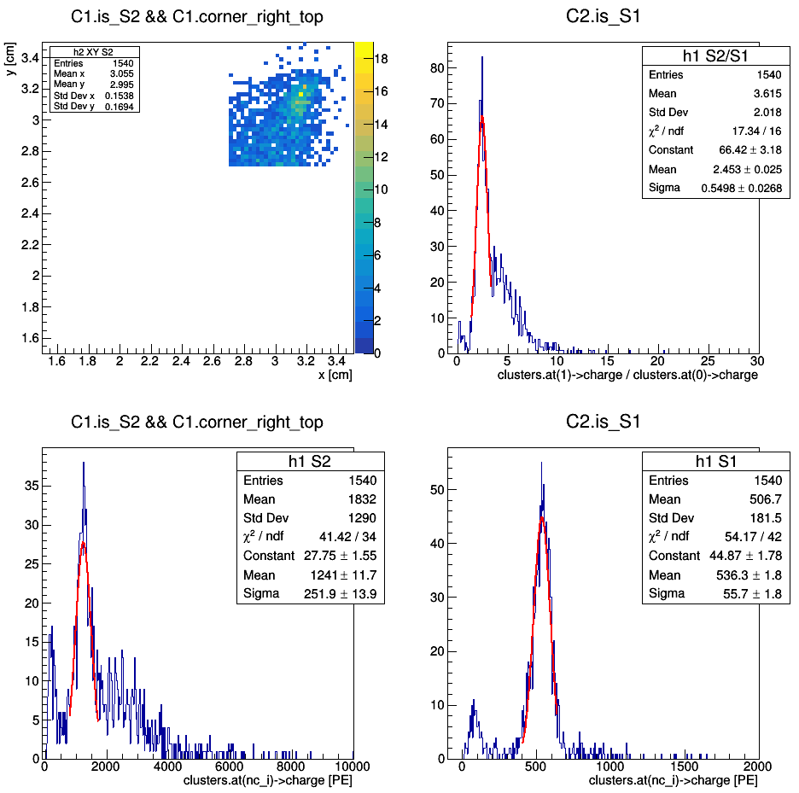
(redefinition of corners)
Ph2, Am241, run 537

Slide 33
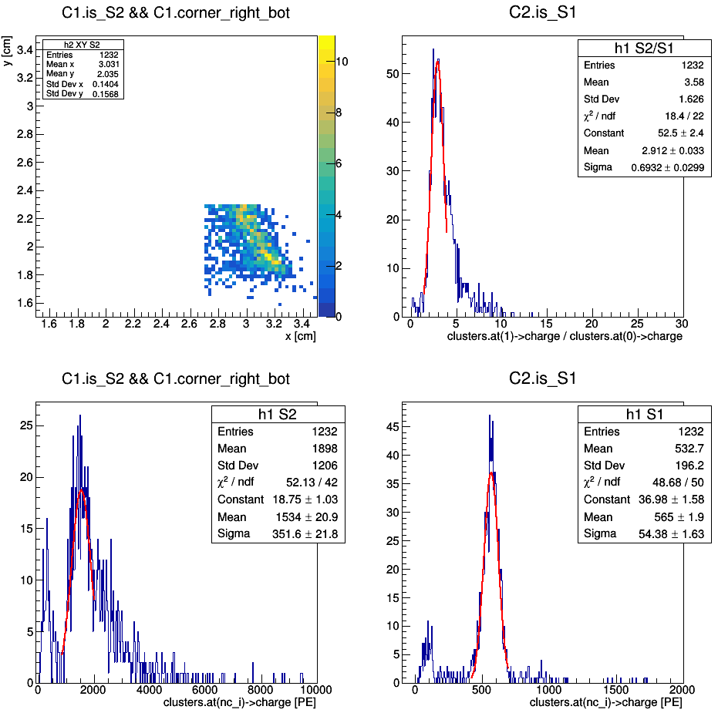
(redefinition of corners)
Ph2, Am241, run 537

Slide 34
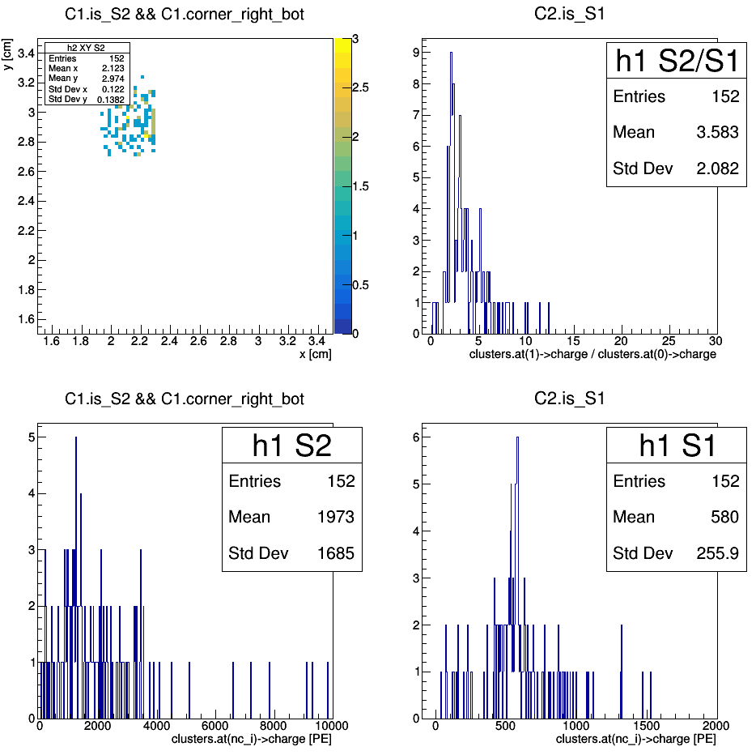
(redefinition of corners)
Ph2, Am241, run 537

Slide 35
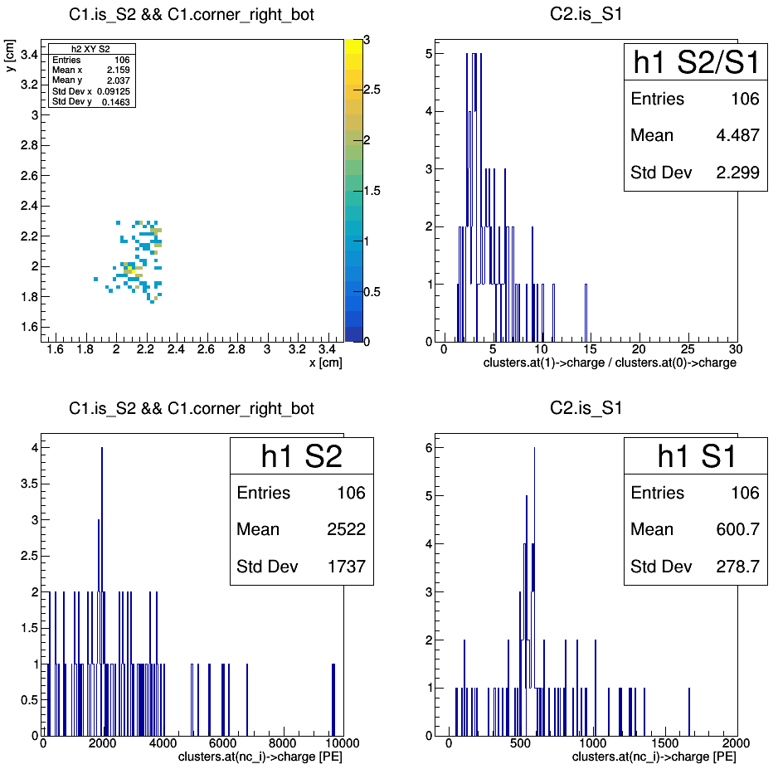
(redefinition of corners)

Slide 36

Ph2, Am241, run 537

Slide 37
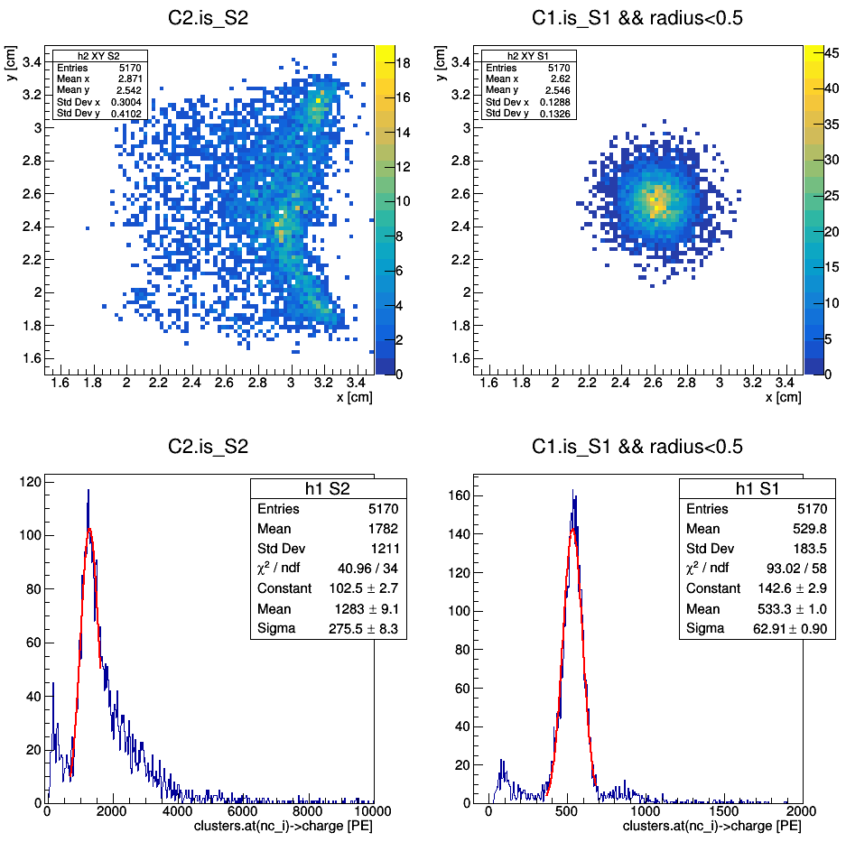
Ph2, Am241, run 537

Slide 38
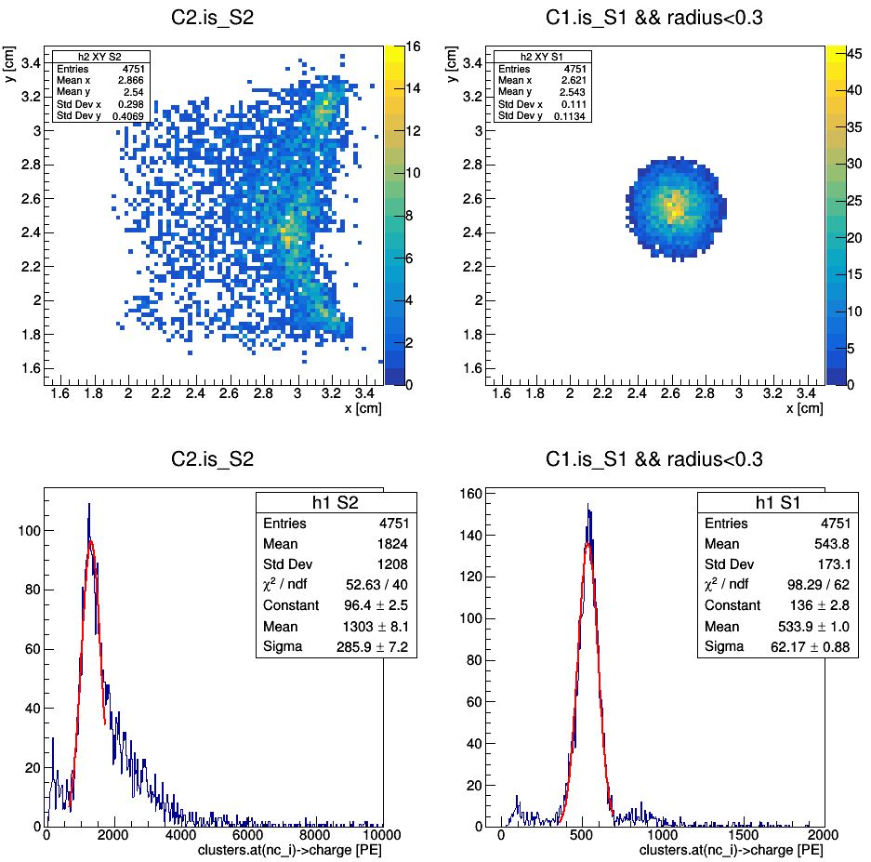
Ph2, Am241, run 537

Slide 39
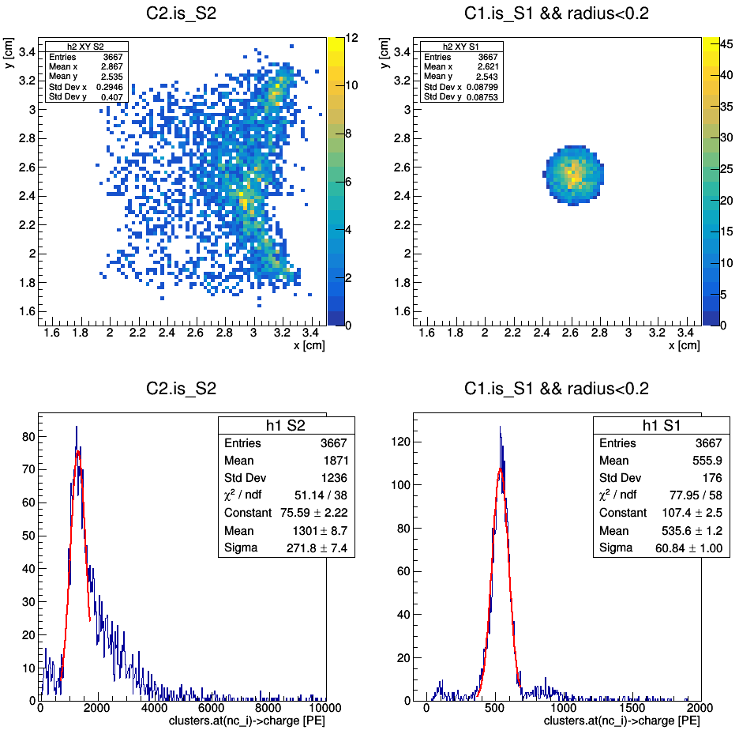
Ph2, Am241, run 537

Slide 40
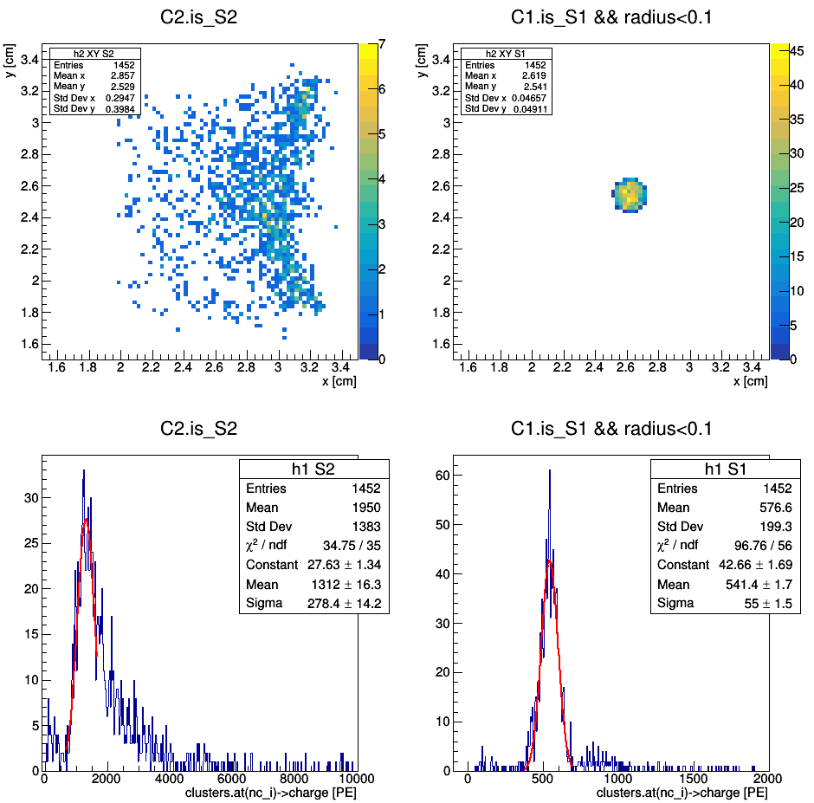
Ph2, Am241, run 537

Slide 44
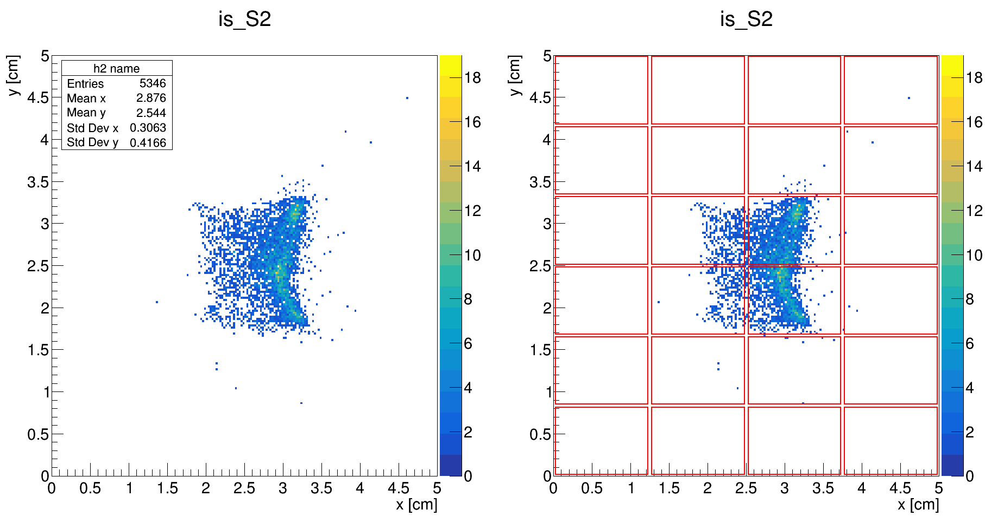
Ph2, Am241, run 537

Slide 45
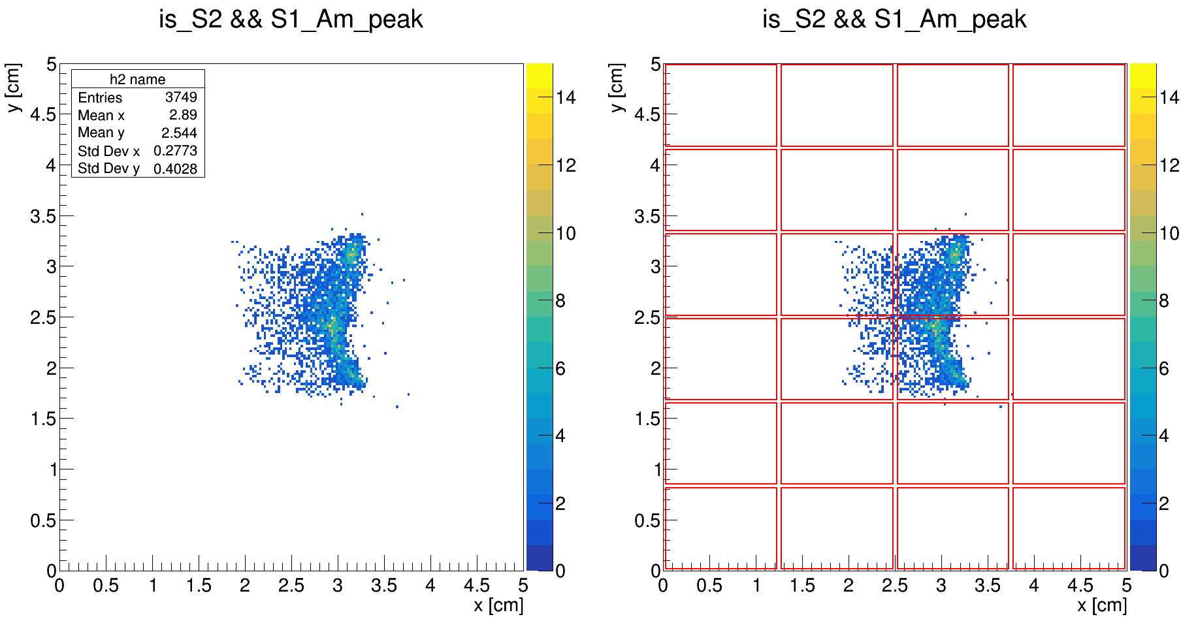
Ph2, Am241, run 537

Slide 46
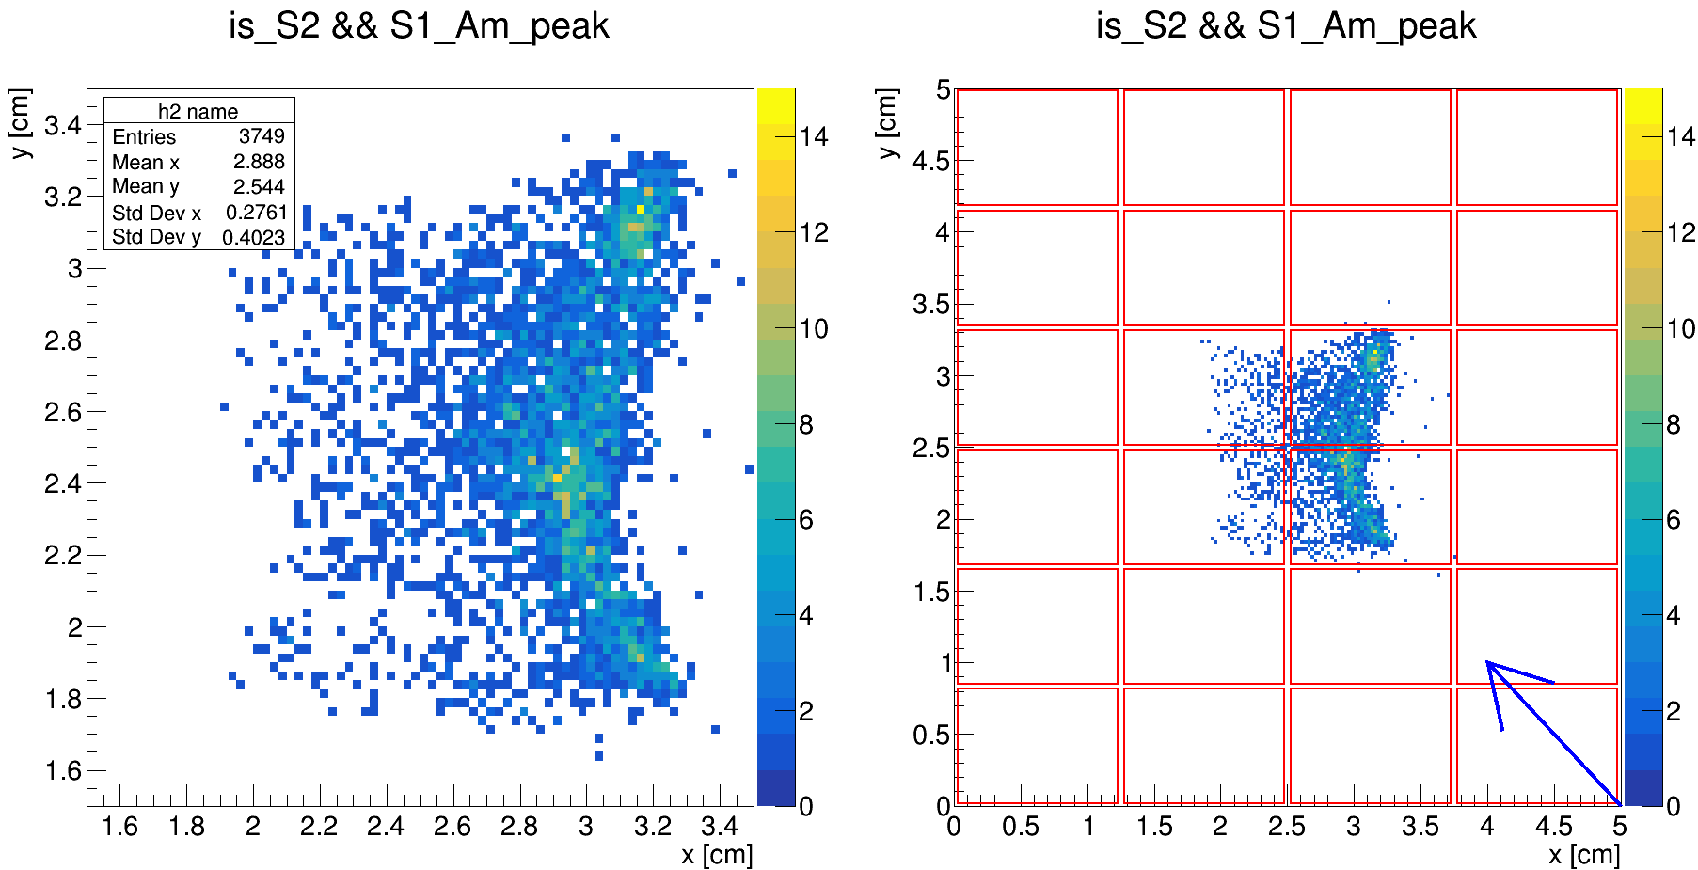
Ph2, Am241, run 537

Slide 47
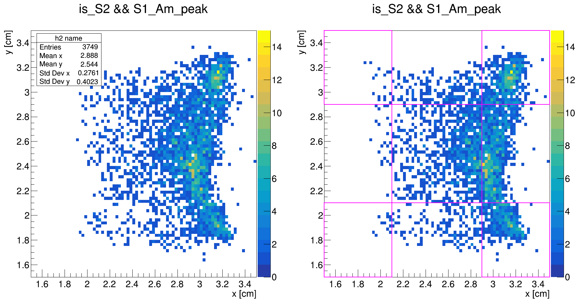
Ph2, Am241, run 537

Slide 48
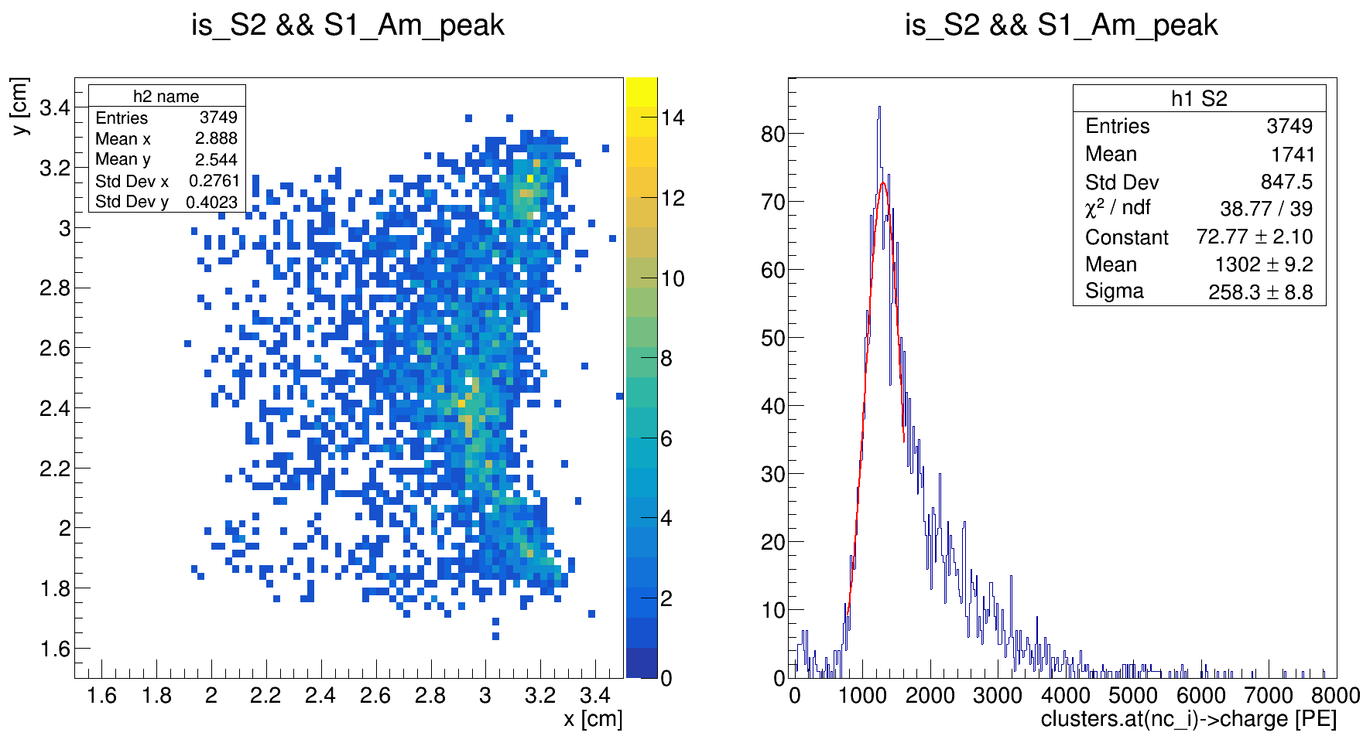
Ph2, Am241, run 537

Slide 49
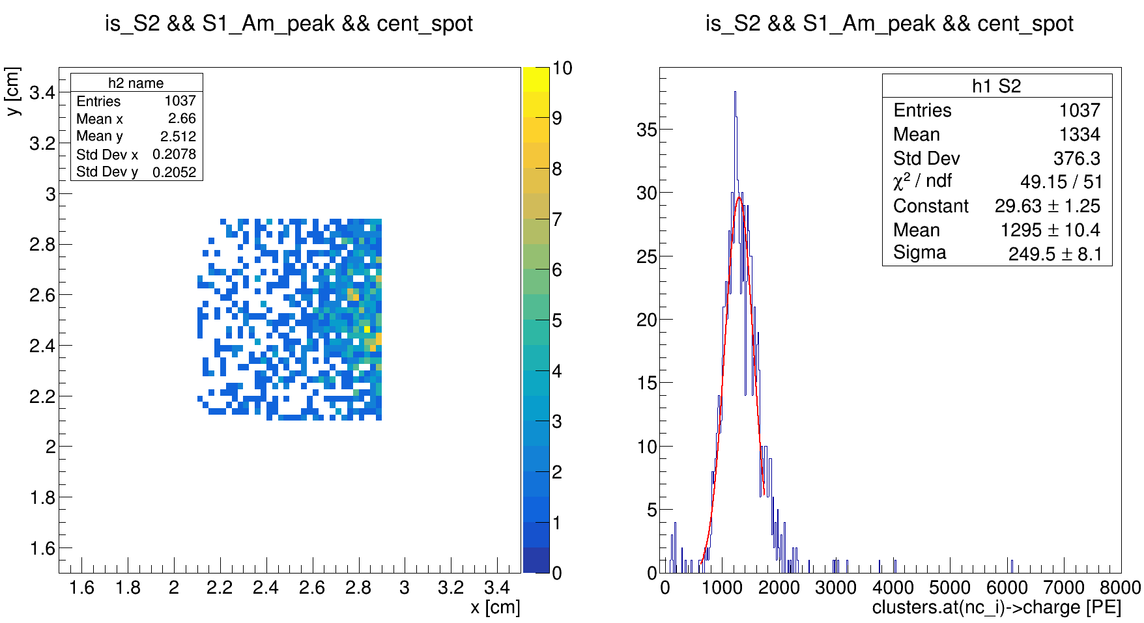
Ph2, Am241, run 537

Slide 50
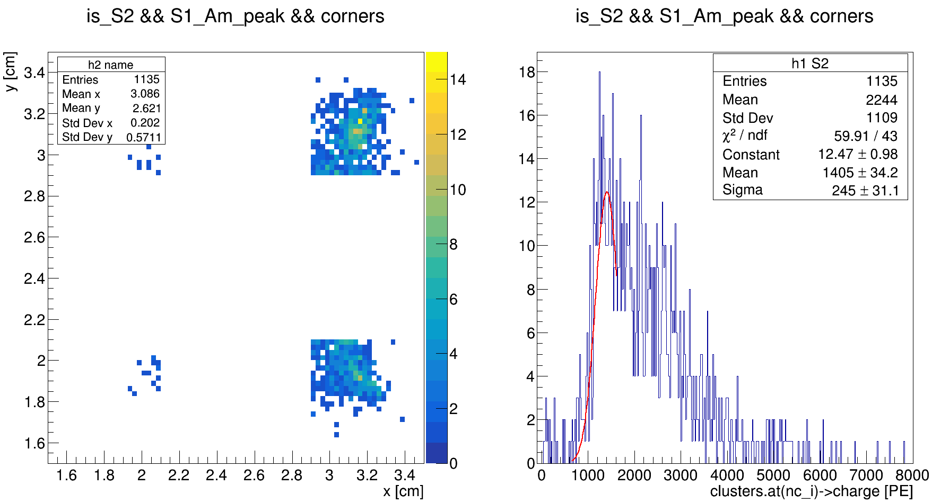
Ph2, Am241, run 537

Slide 51
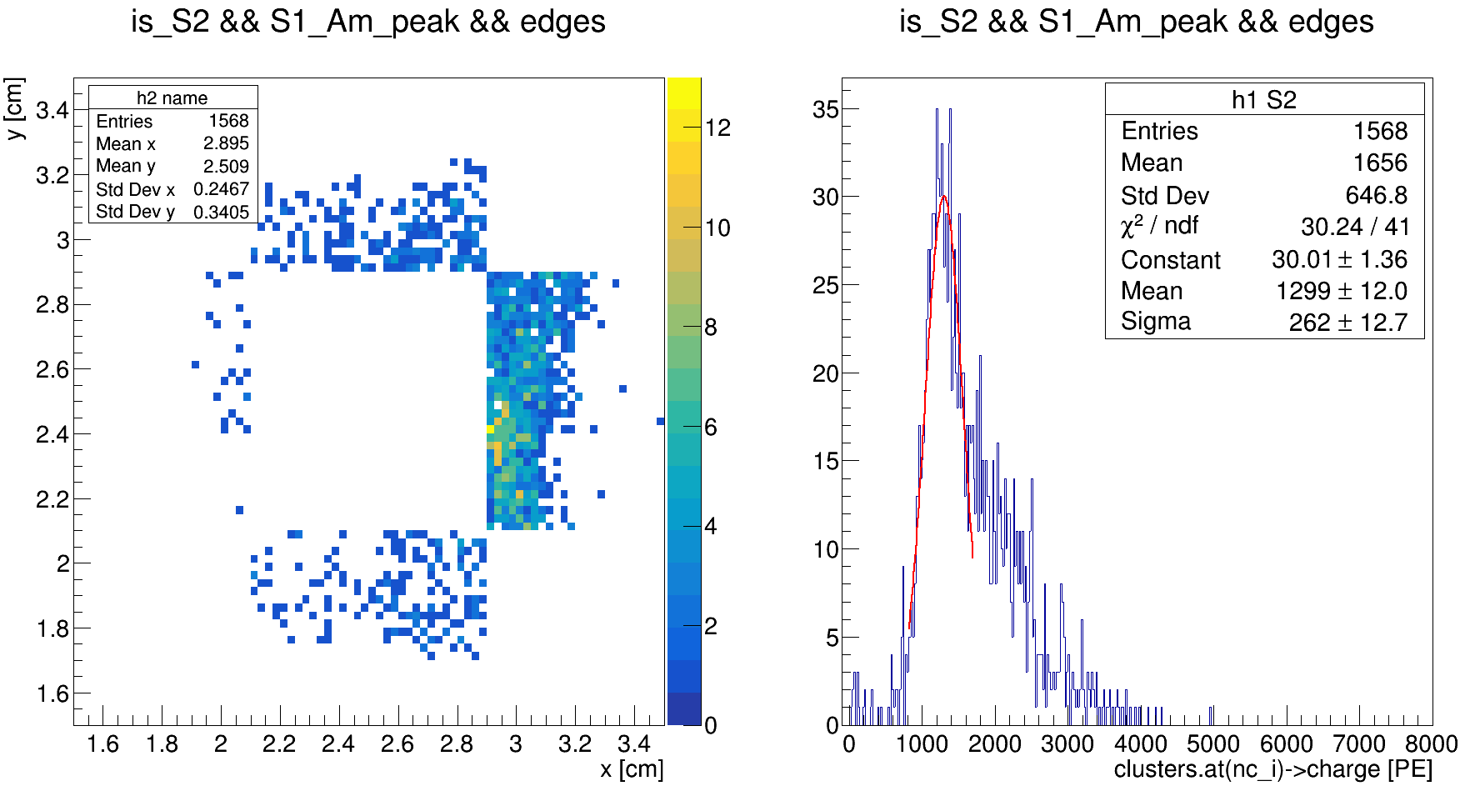
Ph2, Am241, run 537

Slide 52
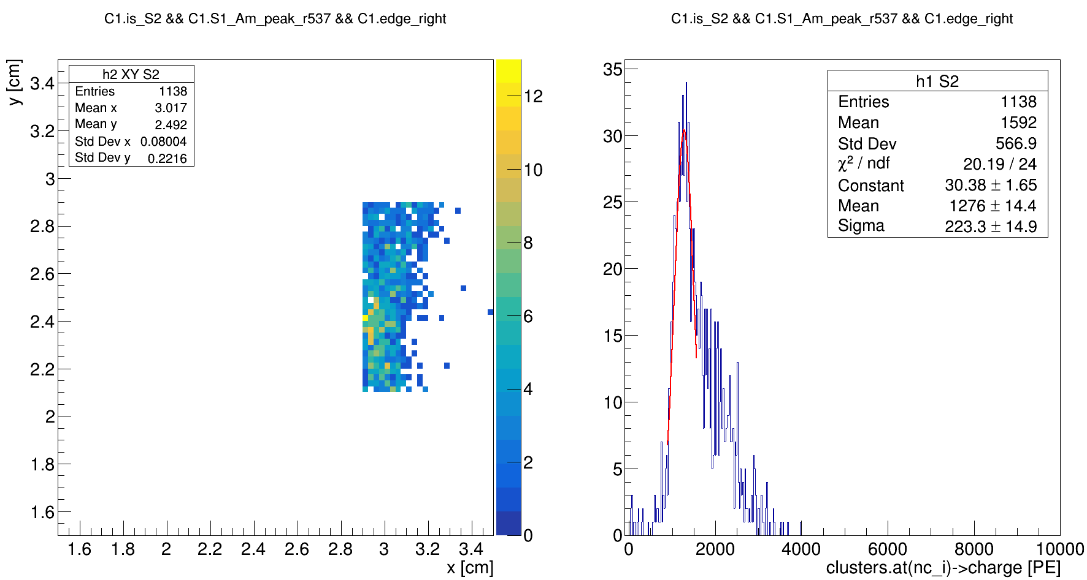
Ph2, Am241, run 537

Slide 53
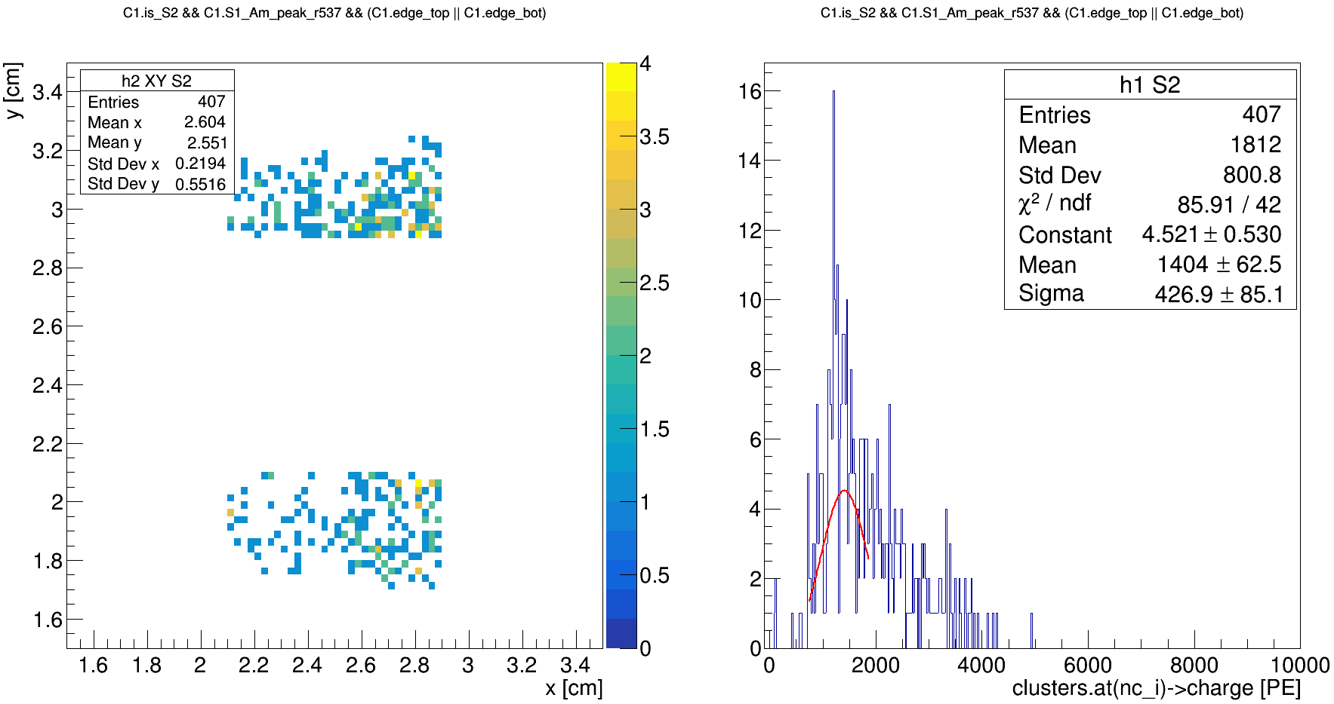
Ph2, Am241, run 537

Slide 54
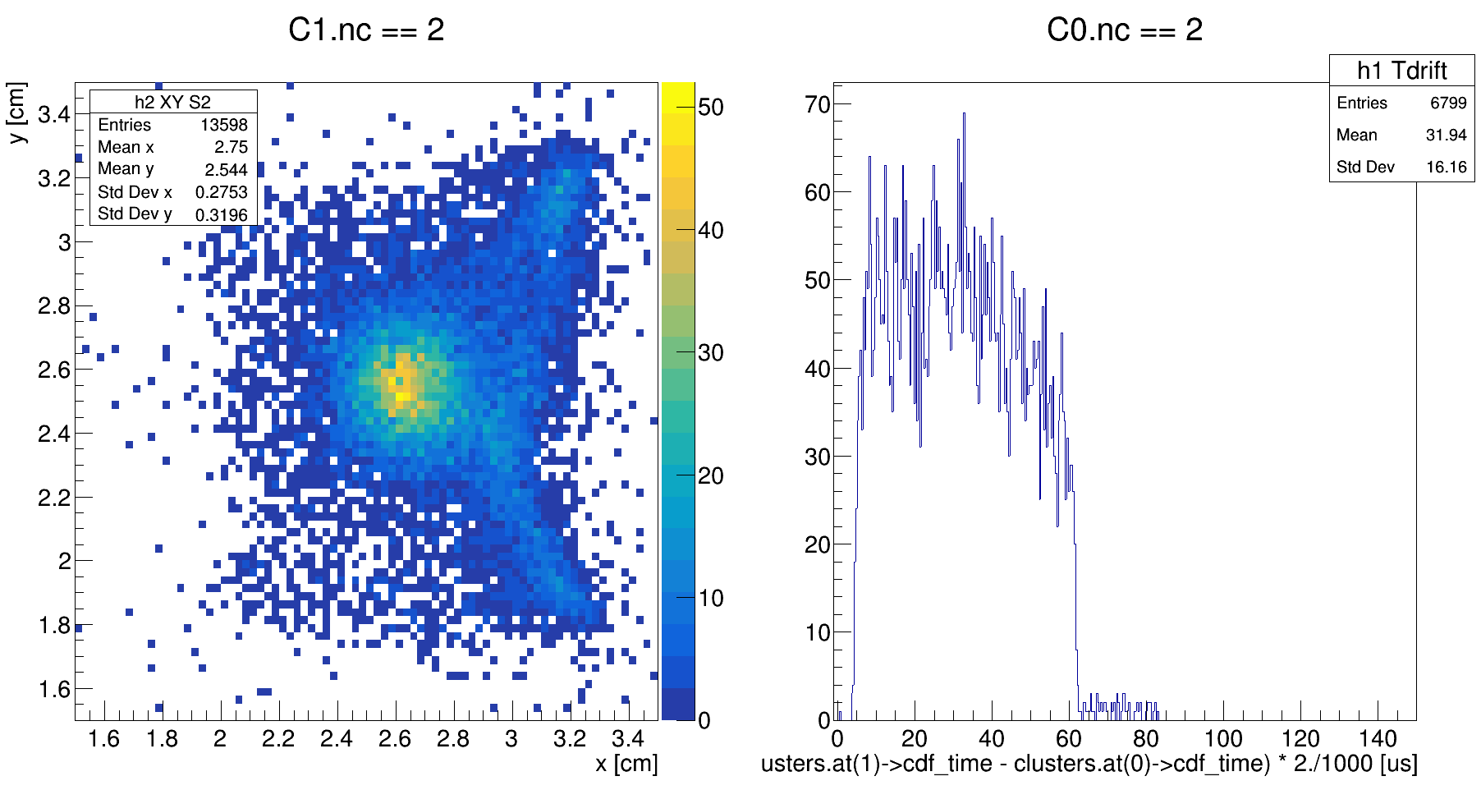
Ph2, Am241, run 537

Slide 55
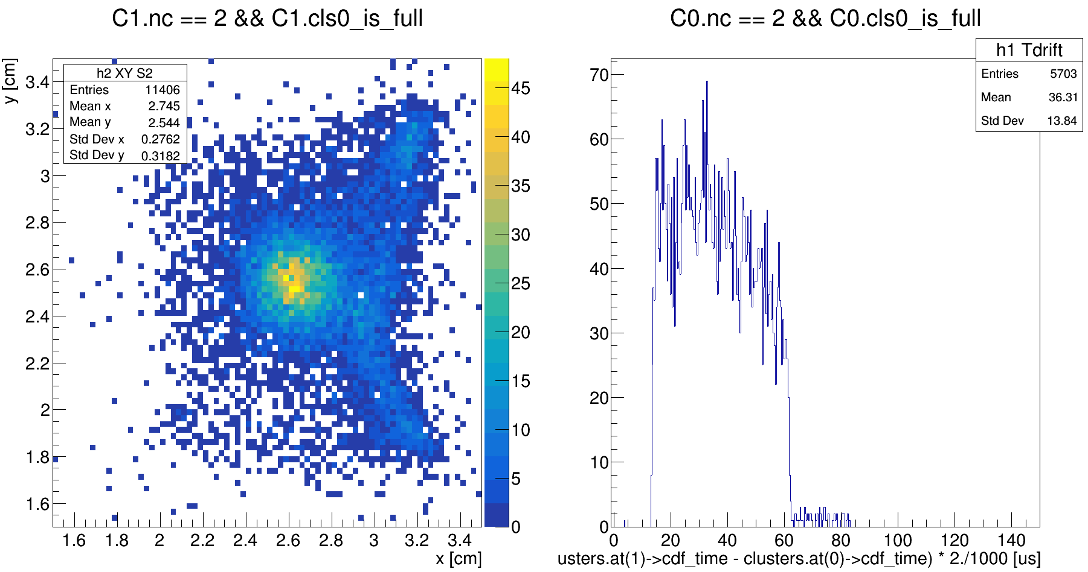
Ph2, Am241, run 537

Slide 56
Ph2, Am241, run 537

Slide 57
Ph2, Am241, run 537

Slide 58
Ph2, Am241, run 537

Slide 60
Ph2, Am241, run 542

Slide 61
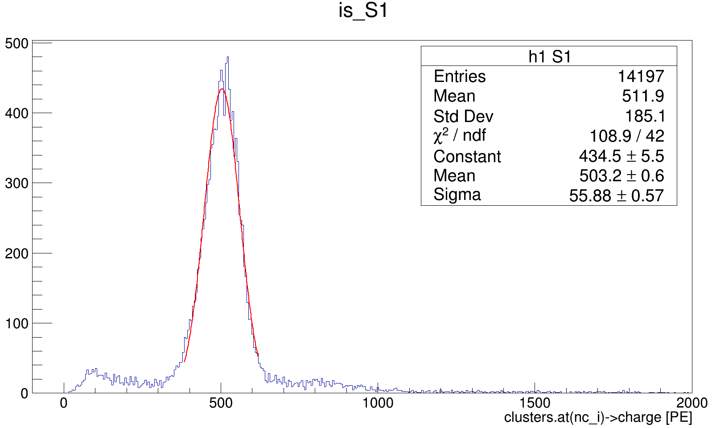
Ph2, Am241, run 542

Slide 62
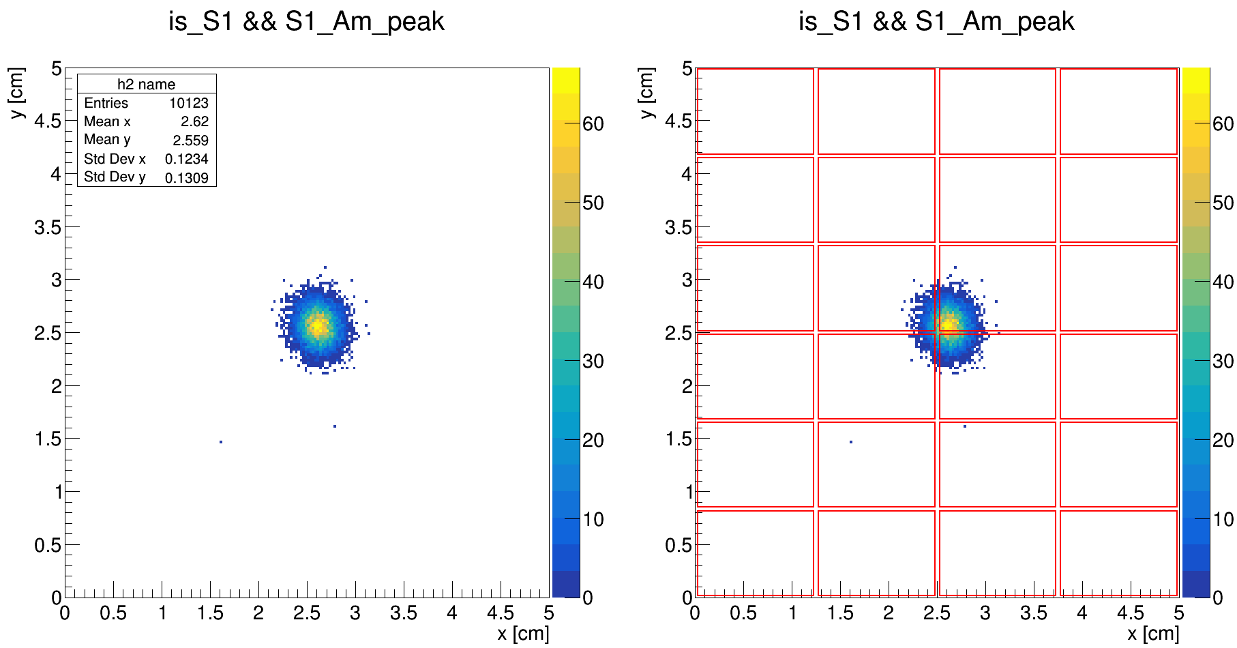
Ph2, Am241, run 542

Slide 63
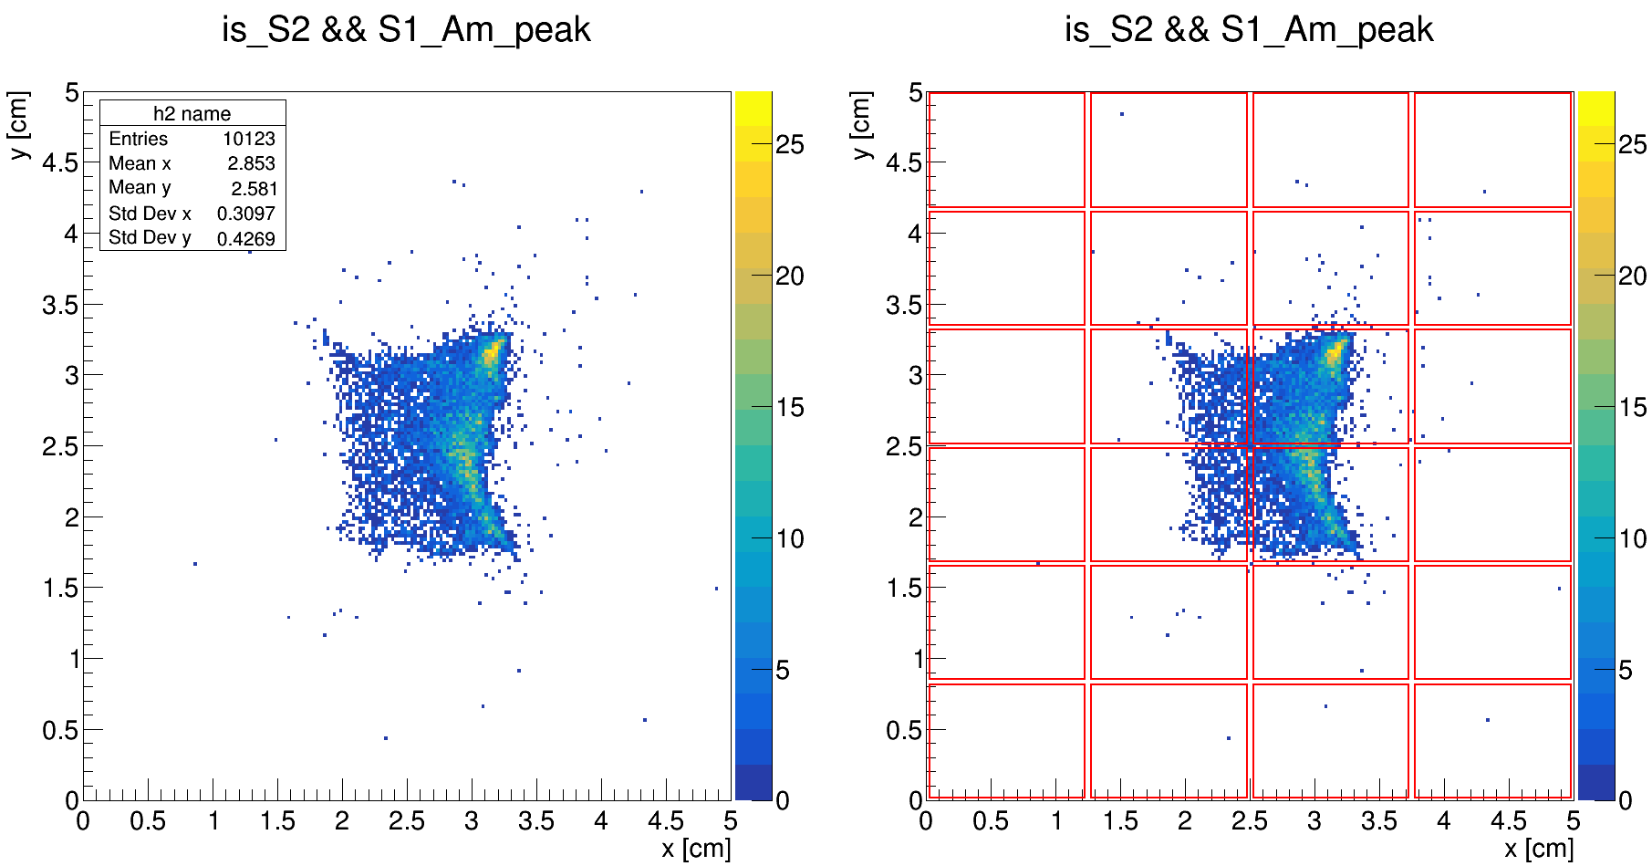
Ph2, Am241, run 542

Slide 64
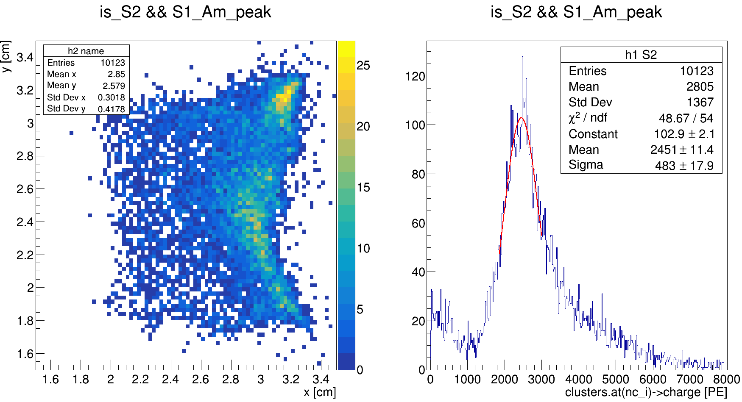
Ph2, Am241, run 542

Slide 65

Ph2, Am241, run 542

Slide 66

Ph2, Am241, run 542

Slide 67

Ph2, Am241, run 542

Slide 68

Ph2, Am241, run 542

Slide 69

Ph2, Am241, run 542

Slide 70

Ph2, Am241, run 542

Slide 71

Ph2, Am241, run 542

Slide 72

(redefinition of corners)
Ph2, Am241, run 542

Slide 73

(redefinition of corners)
Ph2, Am241, run 542

Slide 74

(redefinition of corners)
Ph2, Am241, run 542

Slide 75

(redefinition of corners)
Ph2, Am241, run 542

Slide 76

(redefinition of corners)
Ph2, Am241, run 542

Slide 79
Ph2, Am241, run 544

Slide 80

Ph2, Am241, run 544

Slide 81

Ph2, Am241, run 544

Slide 82

Ph2, Am241, run 544

Slide 83

Ph2, Am241, run 544

Slide 84

Ph2, Am241, run 544

Slide 85

Ph2, Am241, run 544

Slide 86

Ph2, Am241, run 544

Slide 87

Ph2, Am241, run 544

Slide 88

Ph2, Am241, run 544

Slide 89

Ph2, Am241, run 544

Slide 90

Ph2, Am241, run 544

Slide 91

Ph2, Am241, run 544
(redefinition of corners)

Slide 92

Ph2, Am241, run 544
(redefinition of corners)

Slide 93

Ph2, Am241, run 544
(redefinition of corners)

Slide 94

Ph2, Am241, run 544
(redefinition of corners)

Slide 95

Ph2, Am241, run 544
(redefinition of corners)

Slide 98

Ph2, Am241, run 554

Slide 99

Ph2, Am241, run 554

Slide 100


