Slide 1
XY-reconstruction
Сampaign V
Oleynikov Vladislav
19 Nov 2018

Slide 2
Algorithm:
11713f949ea5bffcc2f0ceb22d1267b5f314a5af
Merge branch 'barycenter' into 'master'

Slide 3
Cut list:
bool cls0_is_S1 = clusters.at(0)->f90 > 0.2;
bool cls0_is_full = clusters.at(0)->rep == 1;
bool S1_Am_peak = (clusters.at(0)->charge > 440) &&
(clusters.at(0)->charge < 630); // mean +- 1.5sigma using run 537
//bool S1_Am_peak = (clusters.at(0)->charge > 419) &&
(clusters.at(0)->charge < 587); // mean +- 1.5sigma using run 542
//bool S1_Am_peak = (clusters.at(0)->charge > 342) &&
(clusters.at(0)->charge < 482); // mean +- 1.5sigma using run 544
bool cls0 = nc_i == 0;//cluster 0
bool cls1 = nc_i == 1;//cluster 1
bool is_S1 = nc == 2 && cls0 && cls0_is_full && cls0_is_S1;
bool is_S2 = nc == 2 && cls1 && cls0_is_full && cls0_is_S1;

Slide 4
Ph2, Am241, run 537

Slide 5
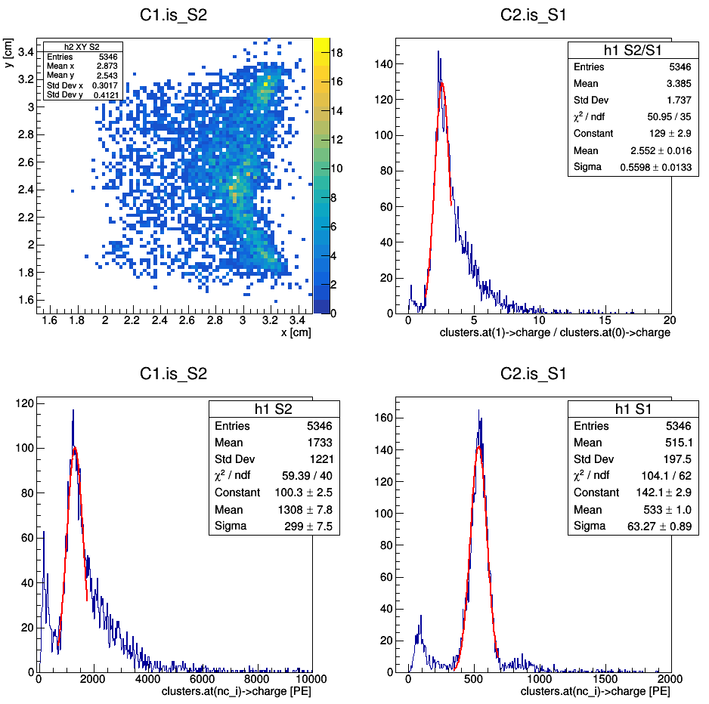
Ph2, Am241, run 537

Slide 6
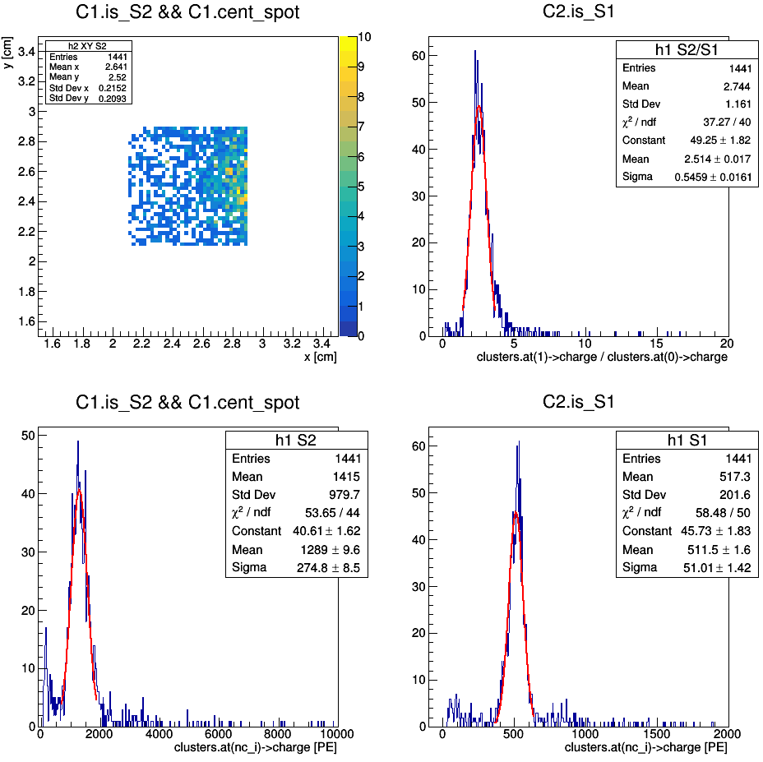
Ph2, Am241, run 537

Slide 7
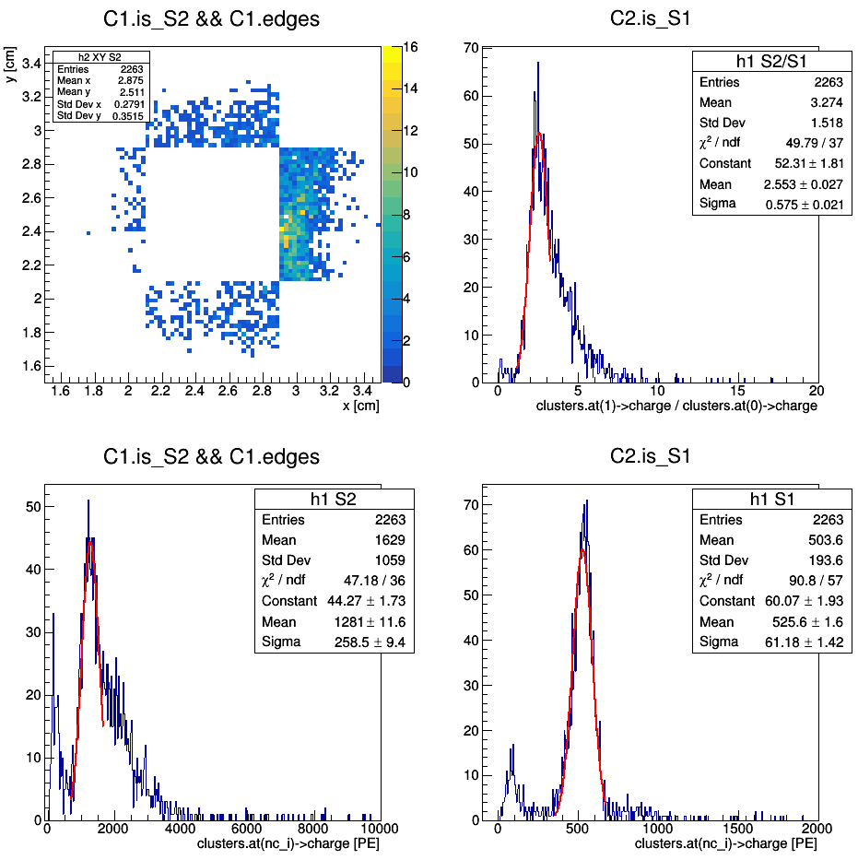
Ph2, Am241, run 537

Slide 8
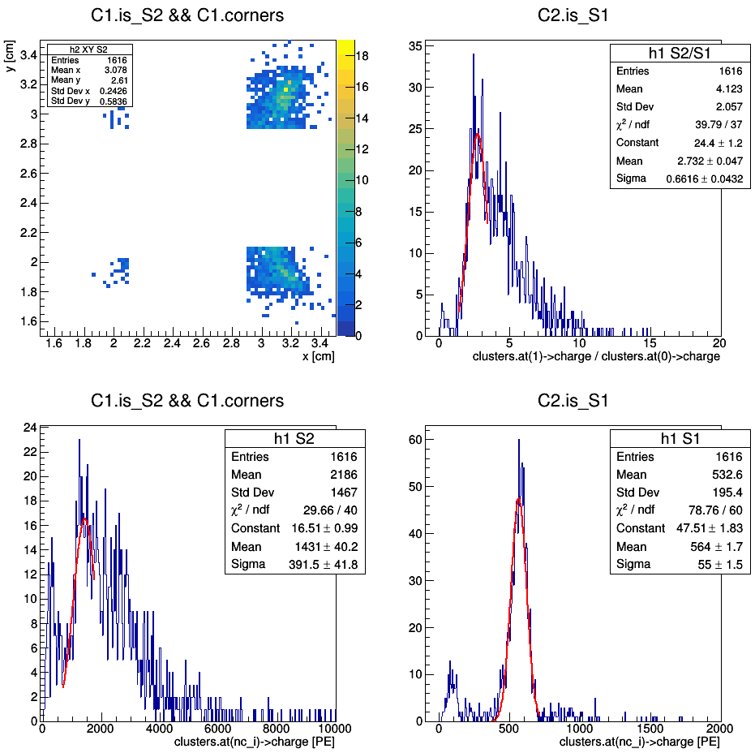
Ph2, Am241, run 537

Slide 9
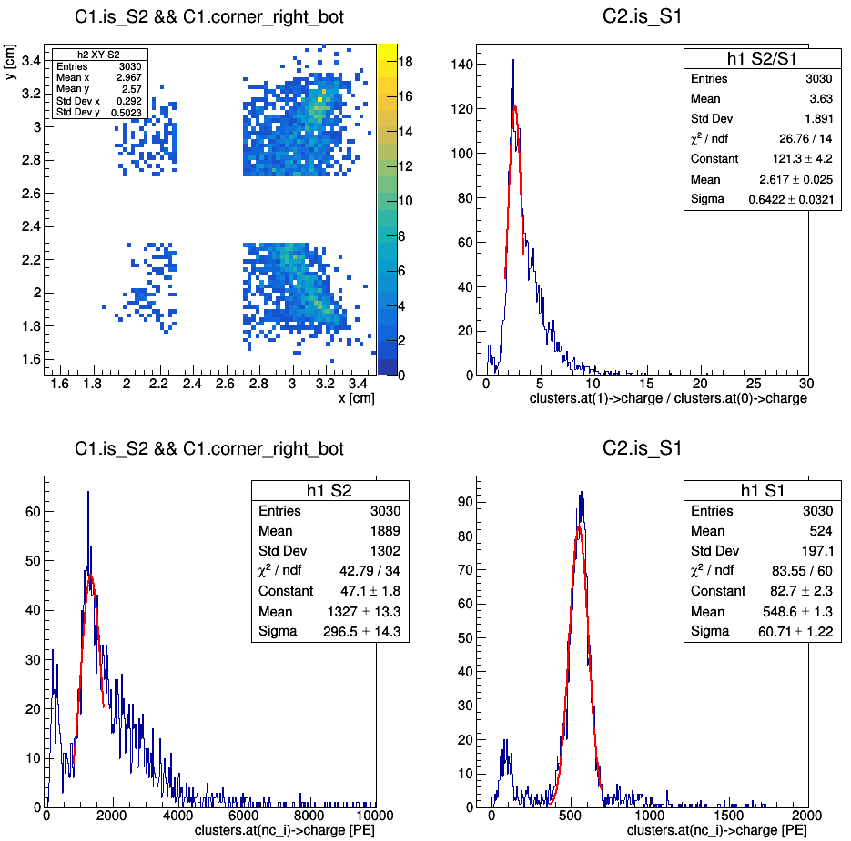
(redefinition of corners)
Ph2, Am241, run 537

Slide 10
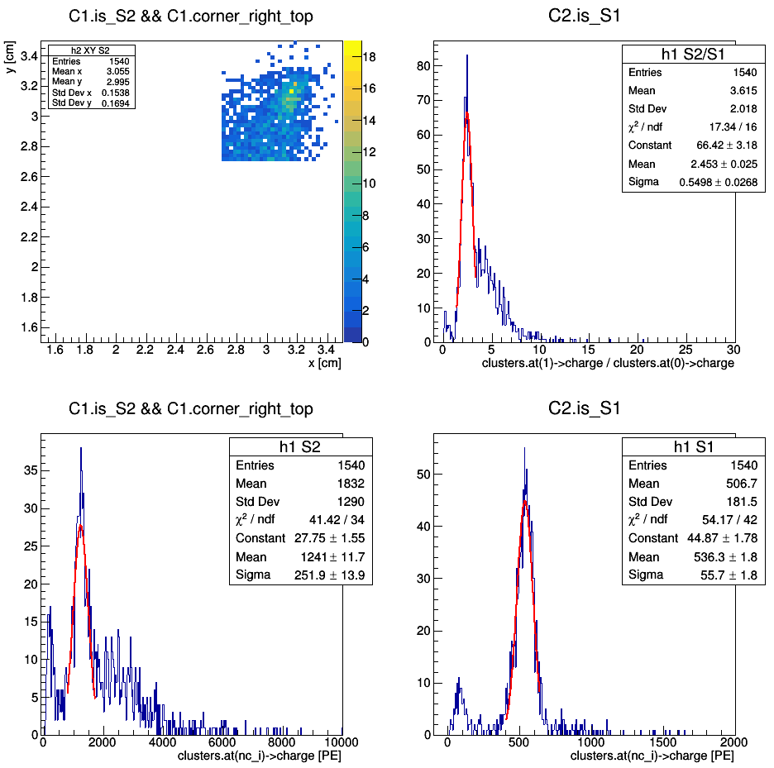
(redefinition of corners)
Ph2, Am241, run 537

Slide 11
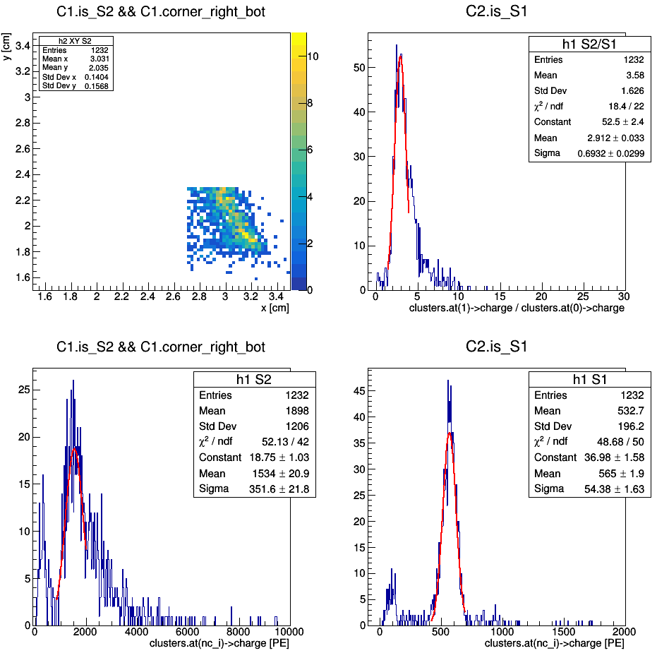
(redefinition of corners)
Ph2, Am241, run 537

Slide 12
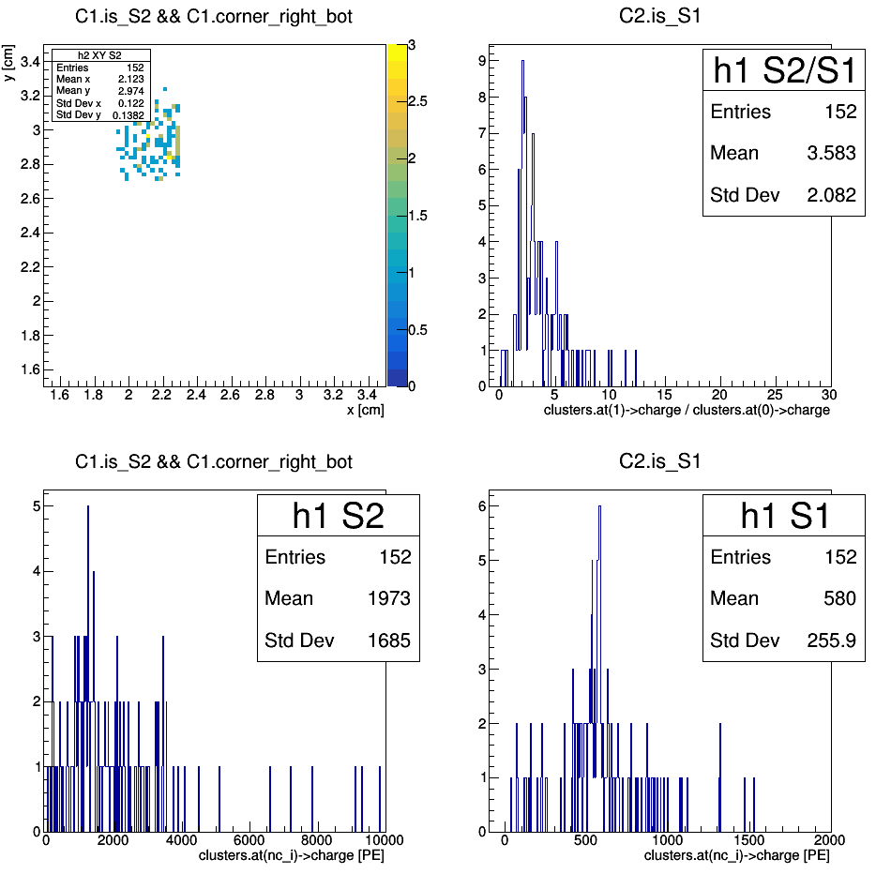
(redefinition of corners)
Ph2, Am241, run 537

Slide 13
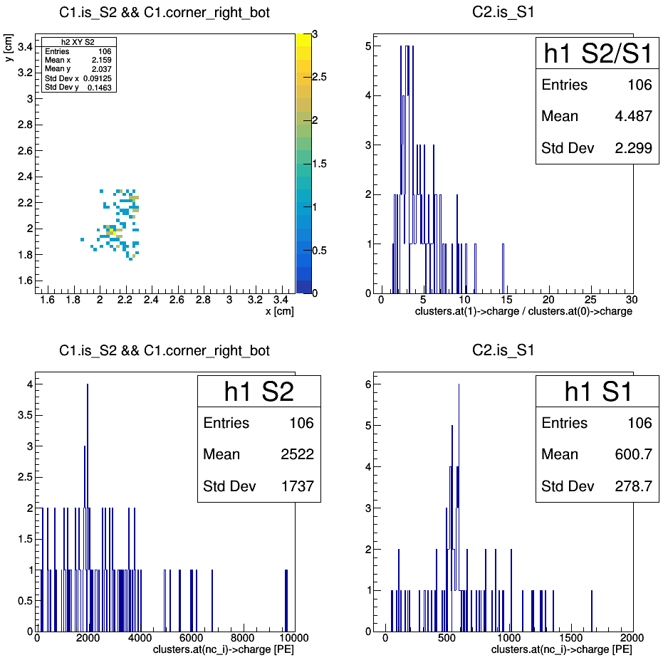
(redefinition of corners)
Ph2, Am241, run 537

Slide 14
Ph2, Am241, run 542

Slide 15
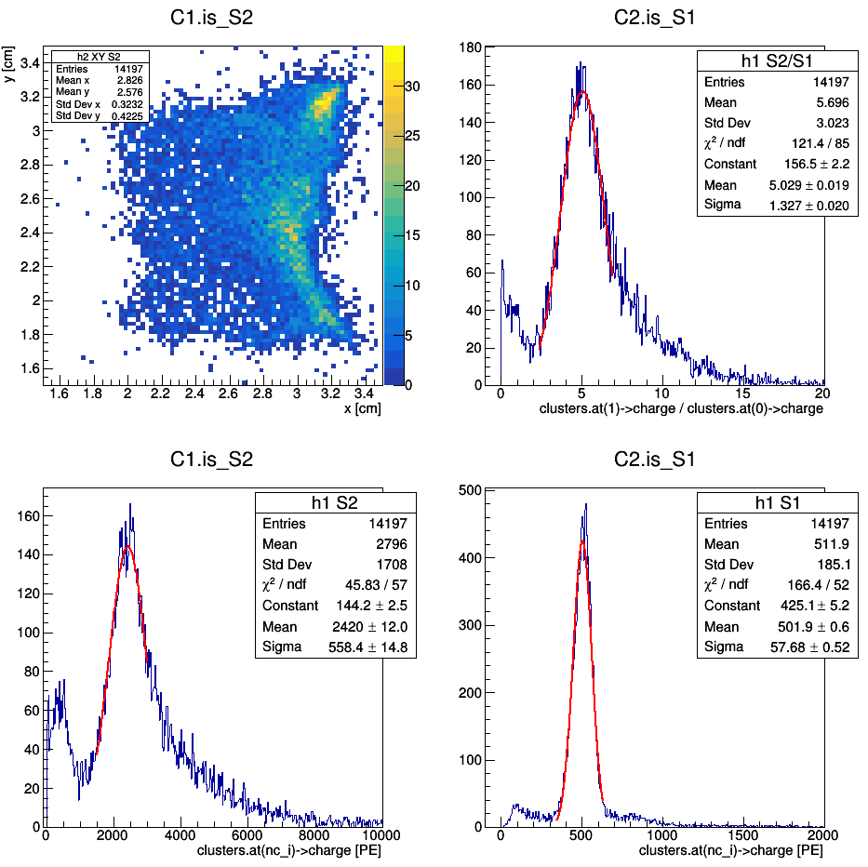
Ph2, Am241, run 542

Slide 16
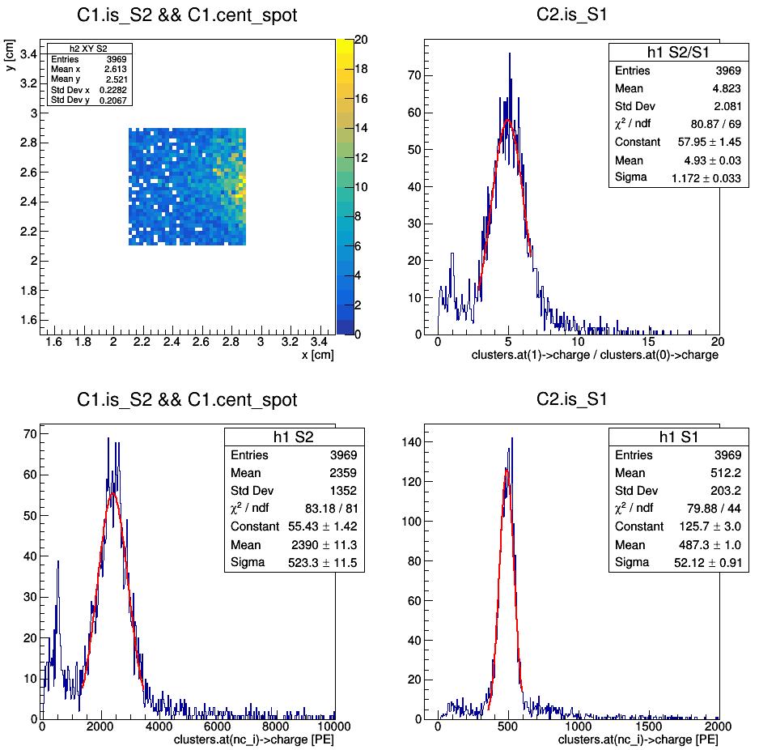
Ph2, Am241, run 542

Slide 17
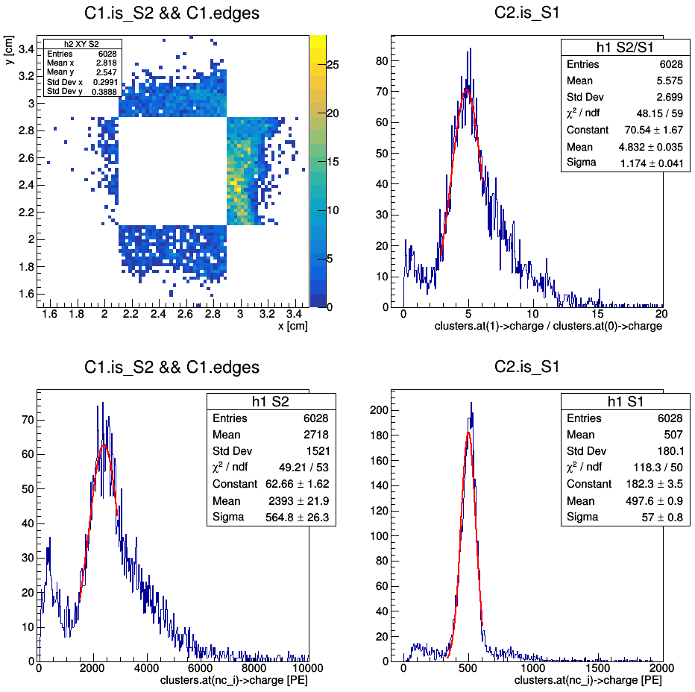
Ph2, Am241, run 542

Slide 18
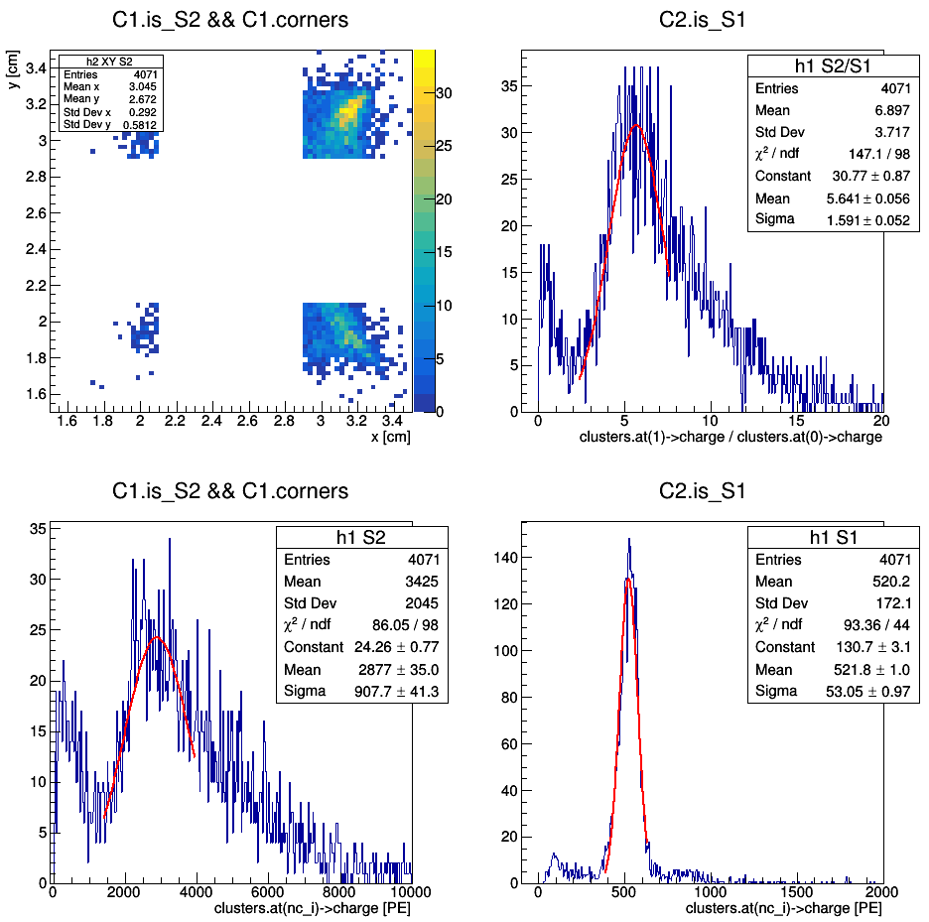
Ph2, Am241, run 542

Slide 19
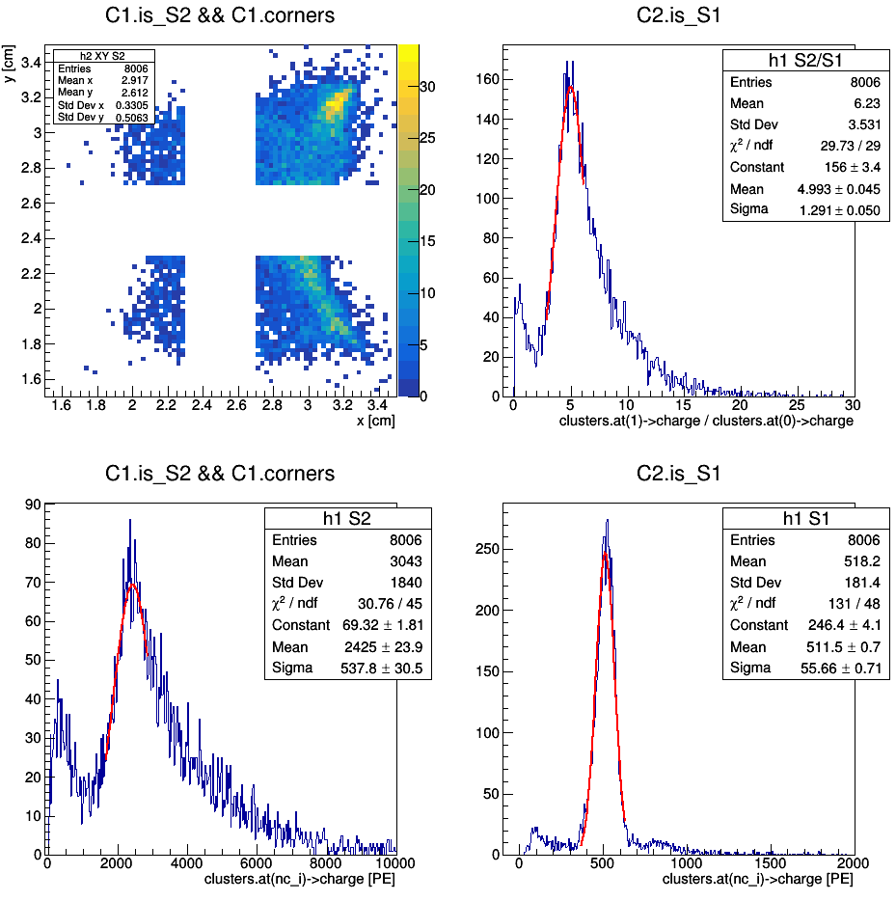
(redefinition of corners)
Ph2, Am241, run 542

Slide 20
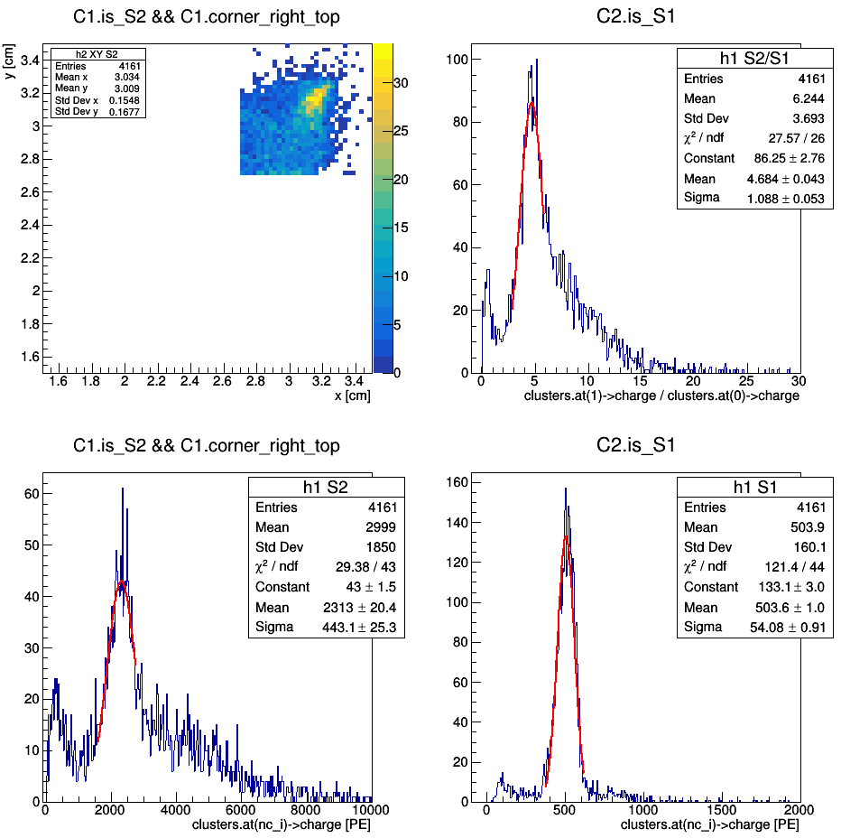
(redefinition of corners)
Ph2, Am241, run 542

Slide 21
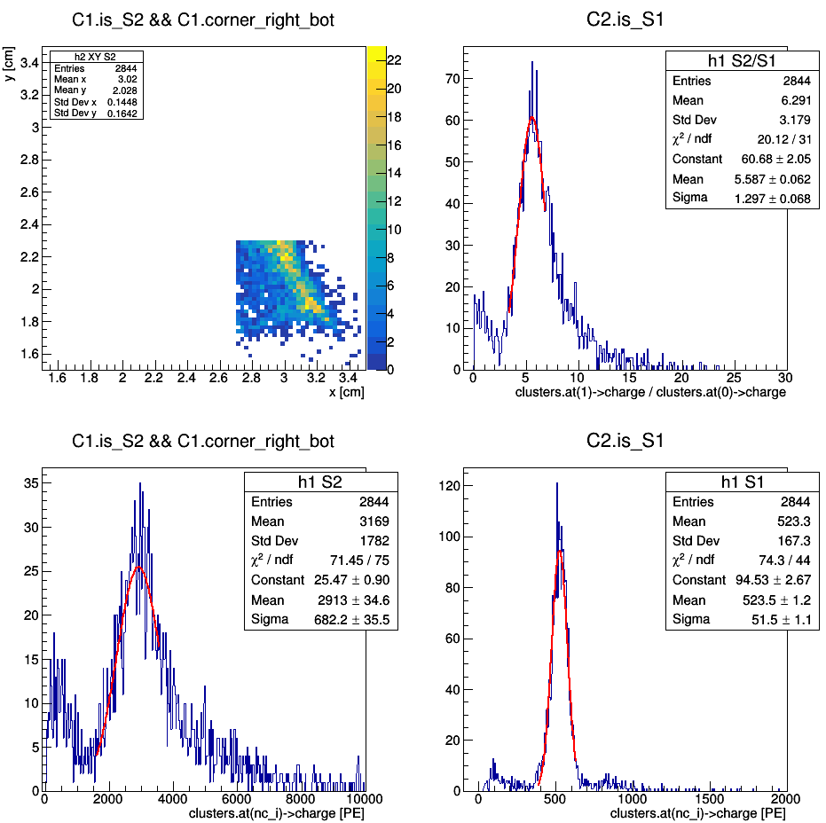
(redefinition of corners)
Ph2, Am241, run 542

Slide 22
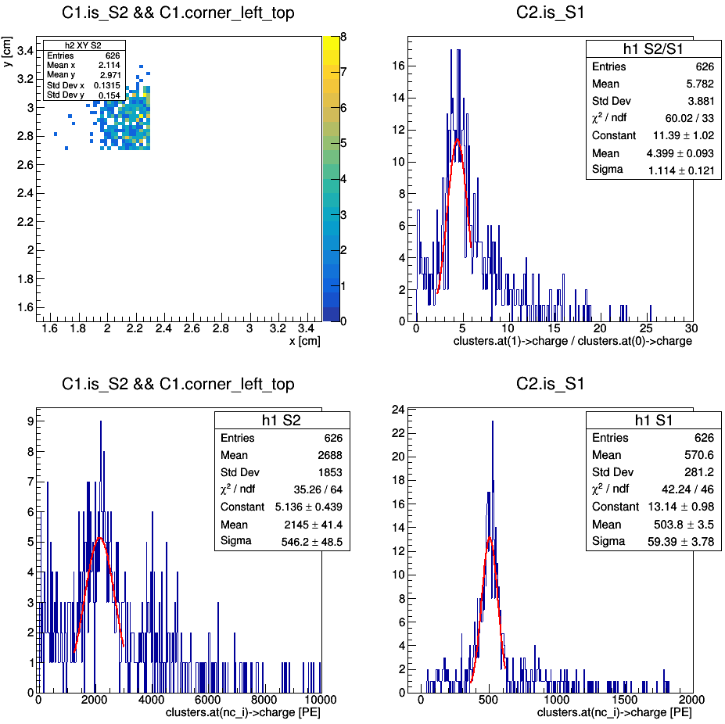
(redefinition of corners)
Ph2, Am241, run 542

Slide 23
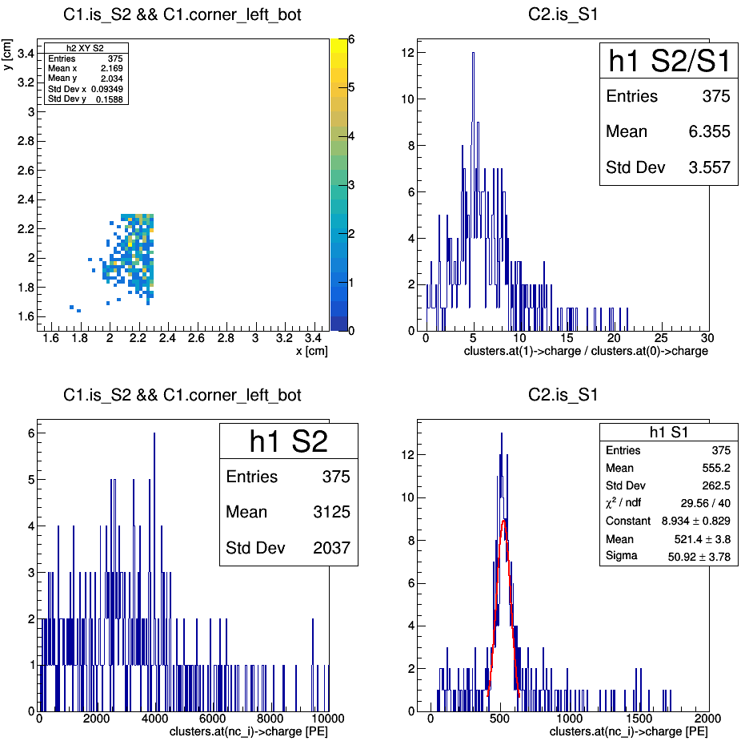
(redefinition of corners)
Ph2, Am241, run 542

Slide 24
Ph2, Am241, run 544

Slide 25
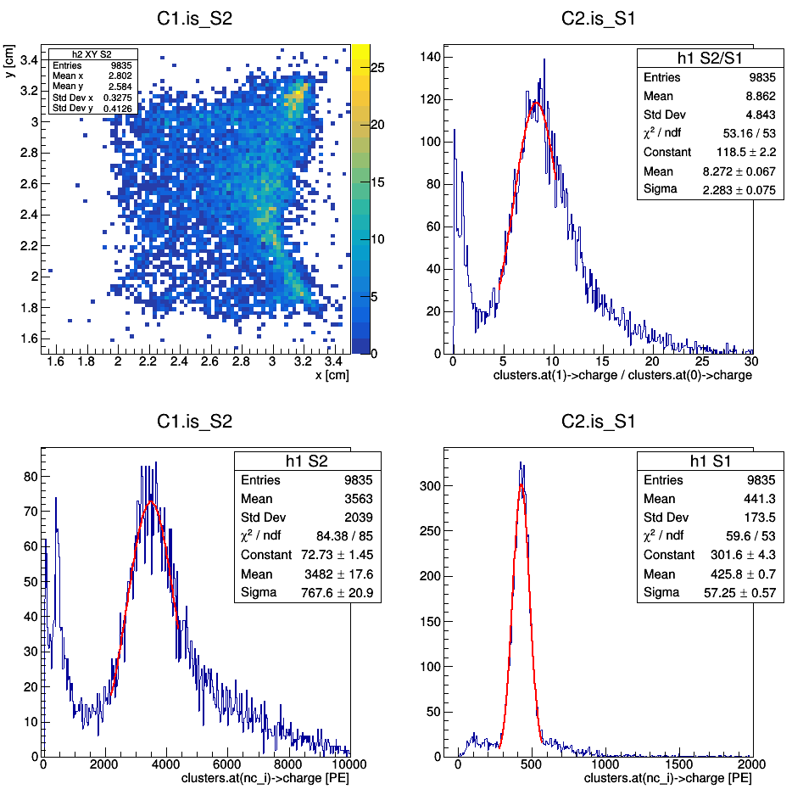
Ph2, Am241, run 544

Slide 26
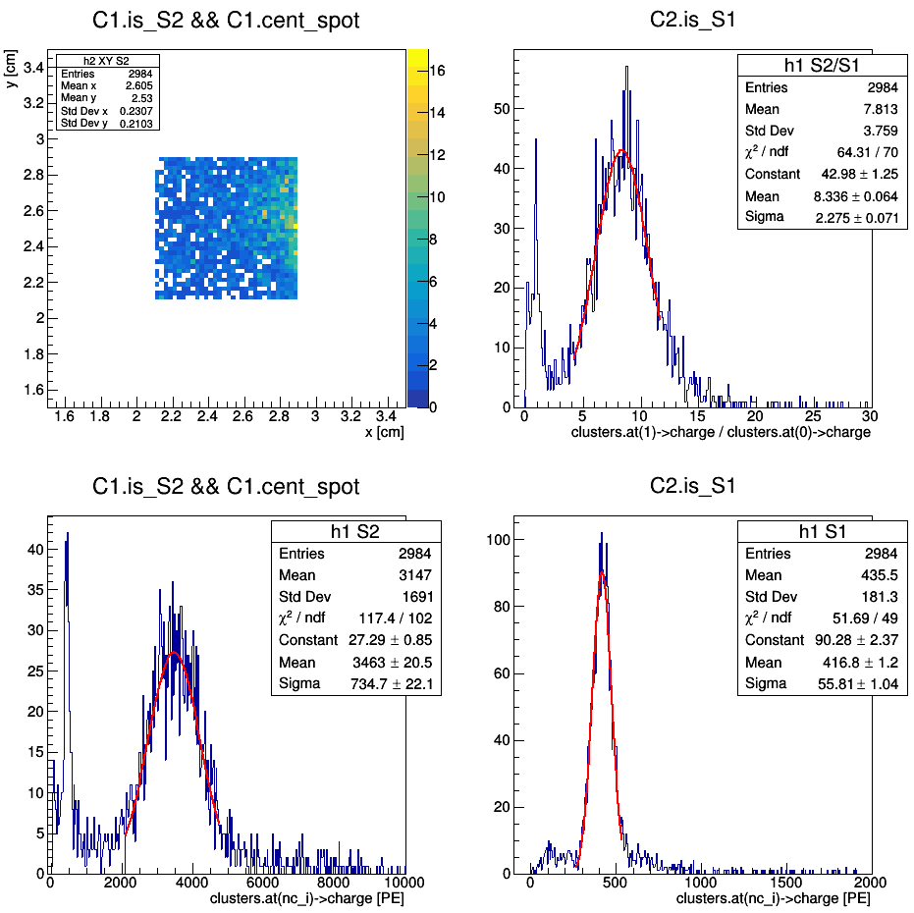
Ph2, Am241, run 544

Slide 27
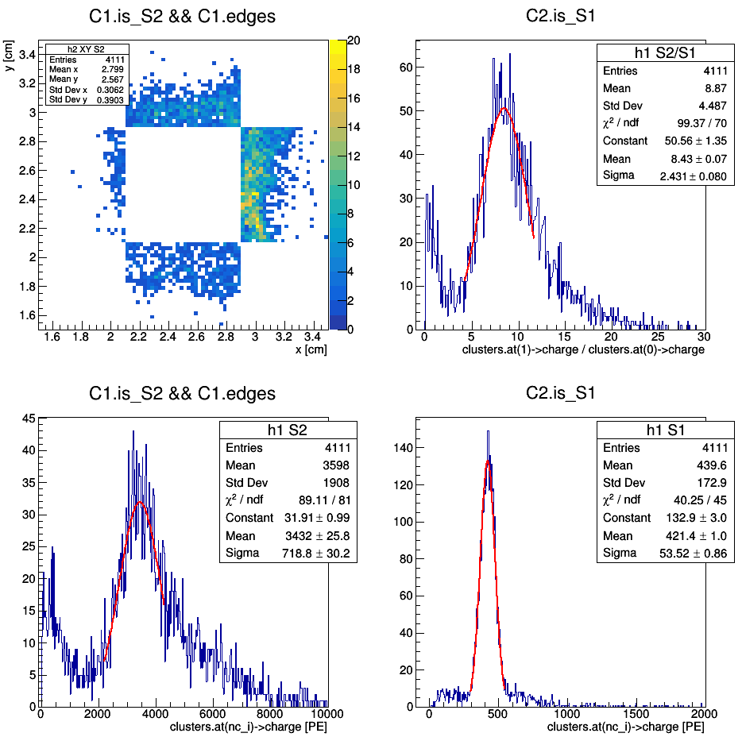
Ph2, Am241, run 544

Slide 28
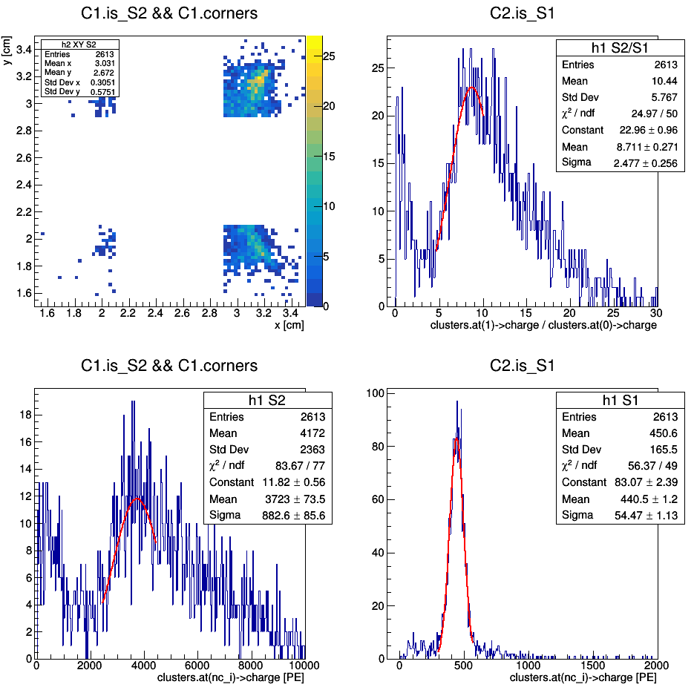
Ph2, Am241, run 544

Slide 29
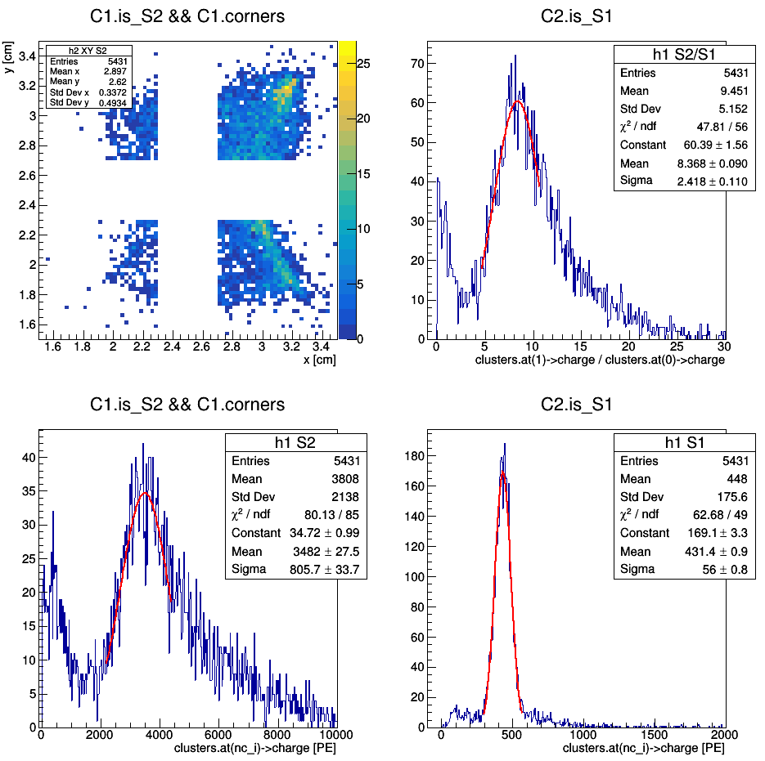
Ph2, Am241, run 544
(redefinition of corners)

Slide 30
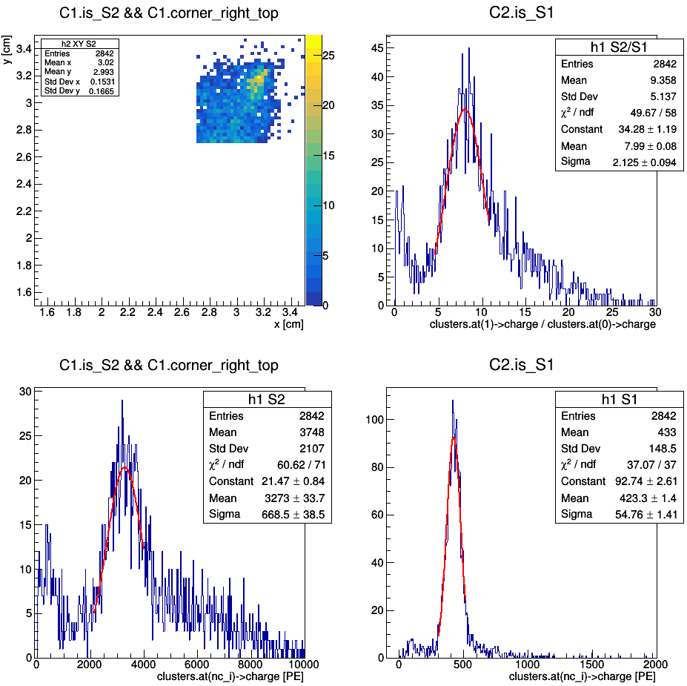
Ph2, Am241, run 544
(redefinition of corners)

Slide 31
Ph2, Am241, run 544
(redefinition of corners)

Slide 32
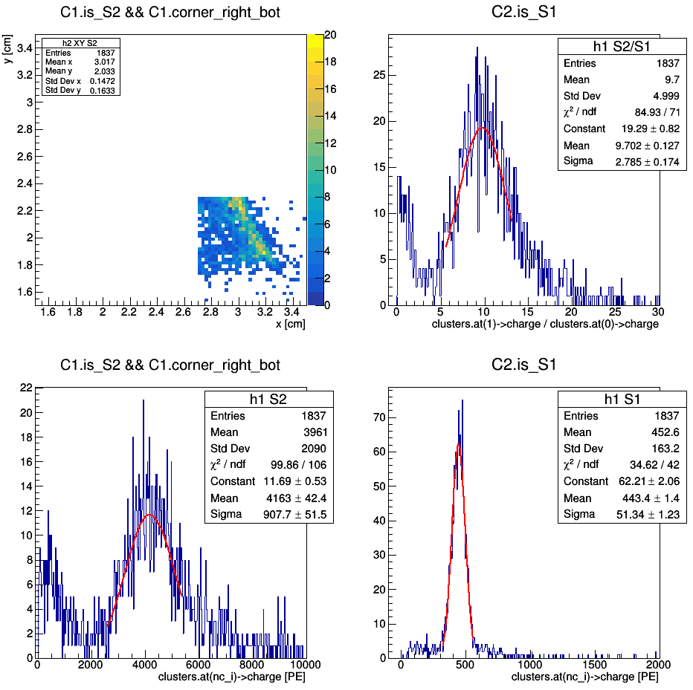
Ph2, Am241, run 544
(redefinition of corners)

Slide 33
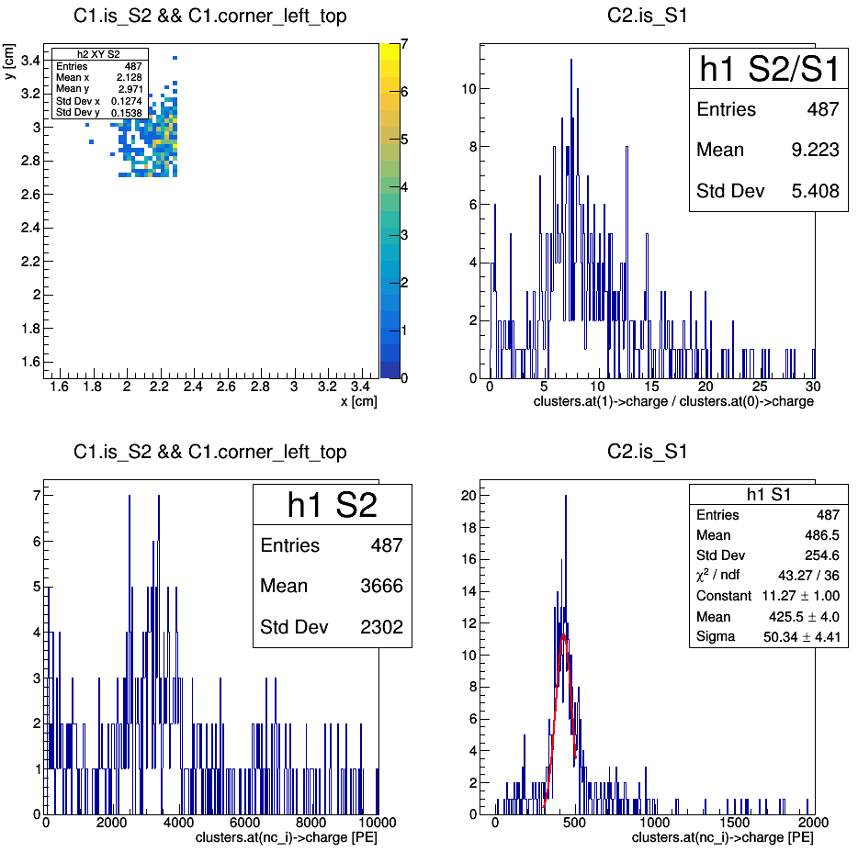
Ph2, Am241, run 544
(redefinition of corners)

Slide 34
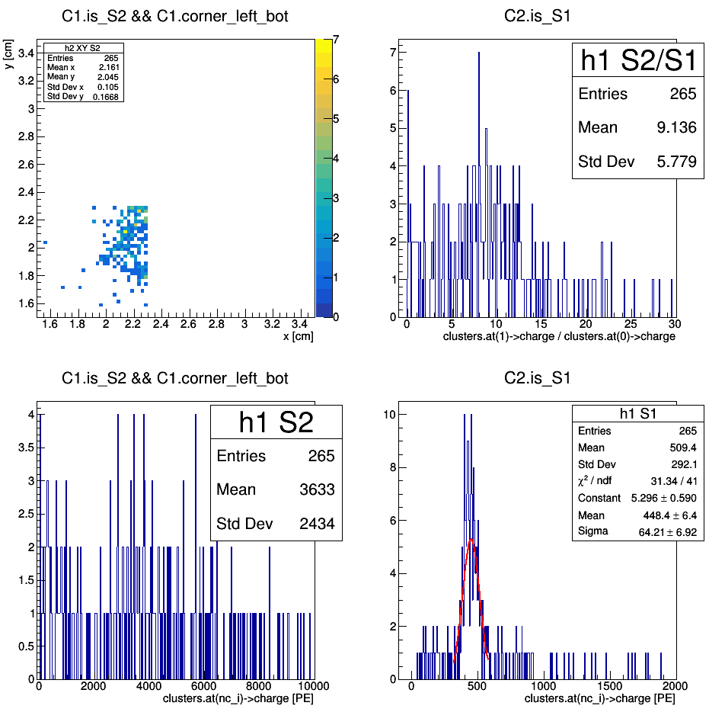
Ph2, Am241, run 544
(redefinition of corners)

Slide 35
Ph2, Am241,
comparison
(just copies of previous slides)

Slide 36
Ph2, Am241, run 537

Slide 37
Ph2, Am241, run 542

Slide 38
Ph2, Am241, run 544

