Slide 1
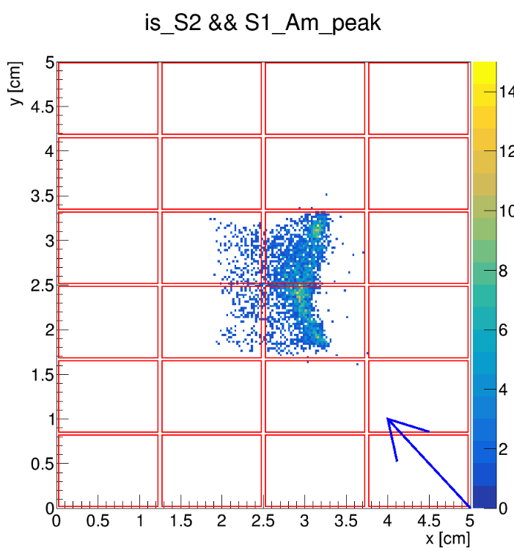
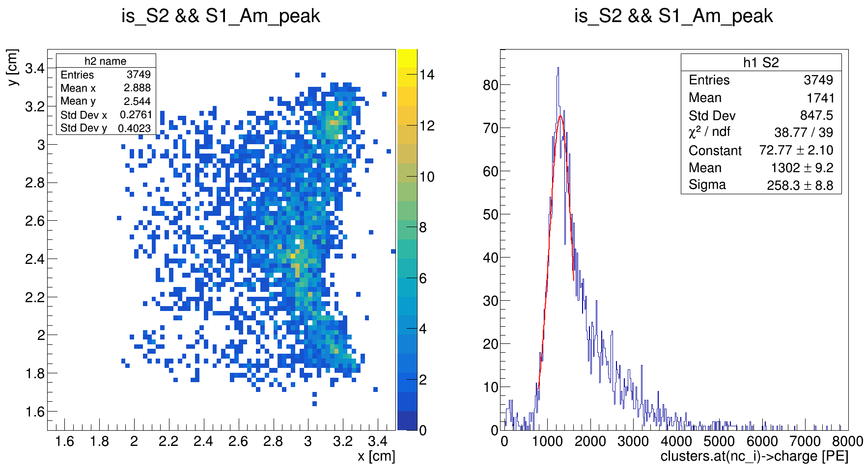
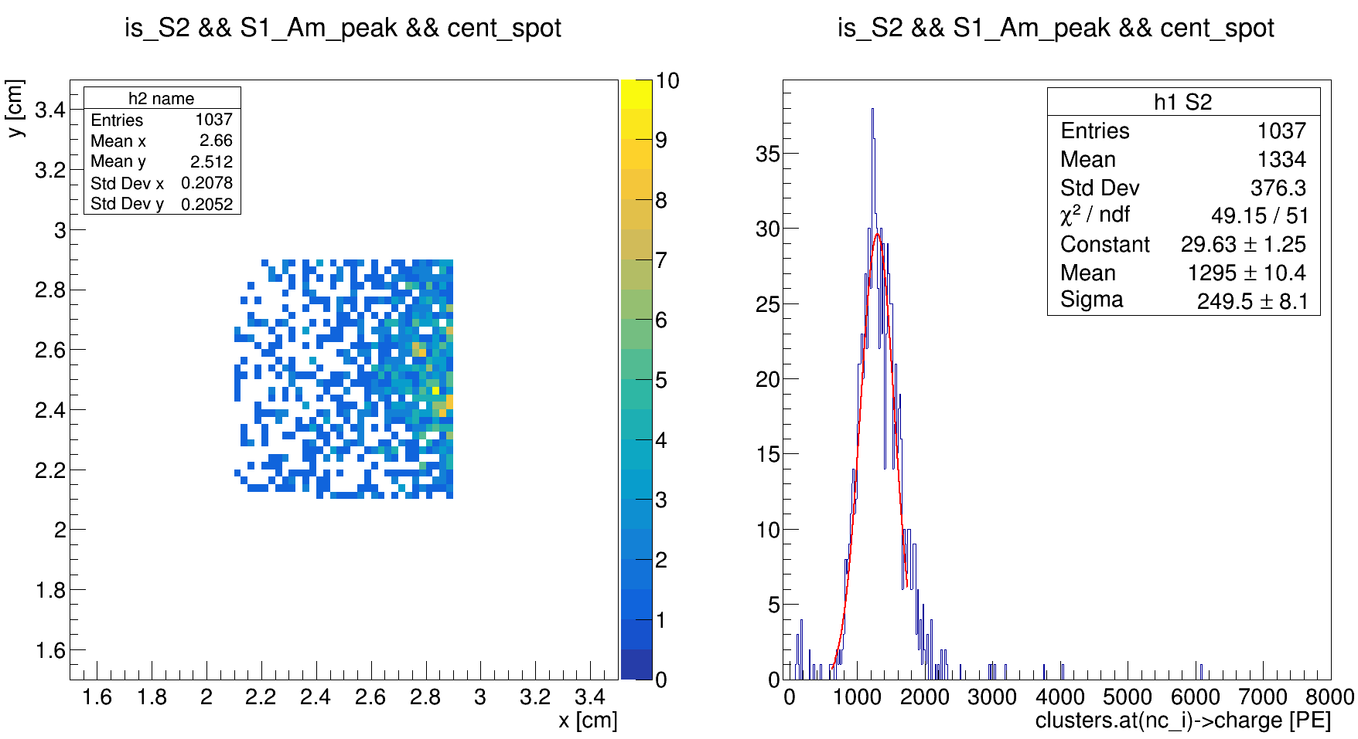
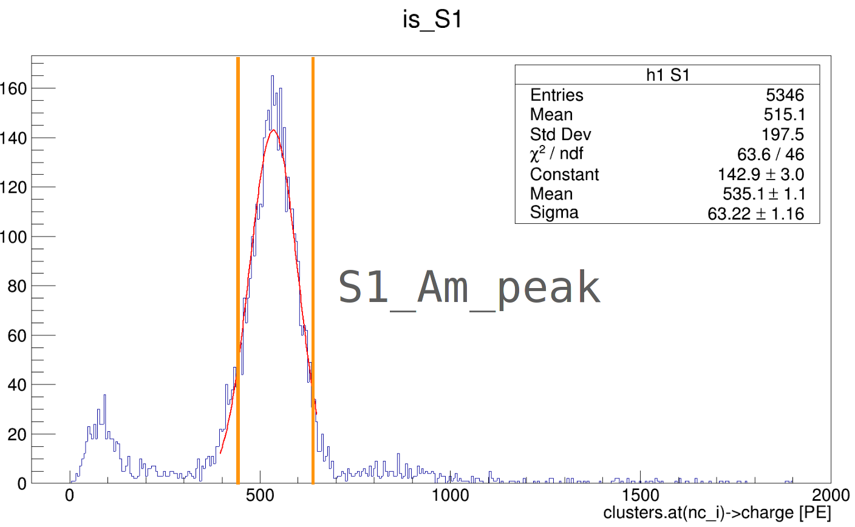
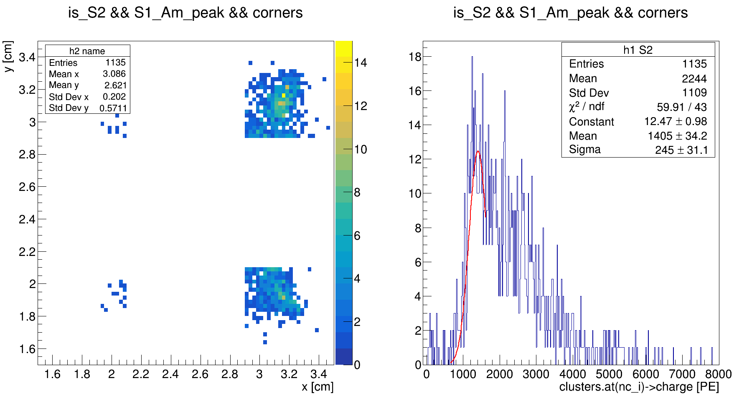
We observe S2 fluctuations vs XY
SiPM
Am241

Slide 2
Text
Barycenter (center of gravity) algorithm
Red boxes are SiPM's
Blue arrow is direction from Am source to SiPM-matrix
Data for run_537 (double phase, TPC trigger, Am241 source)
Events located in the region form 1.5 to 3.5 cm due to biased algorithm

Slide 3
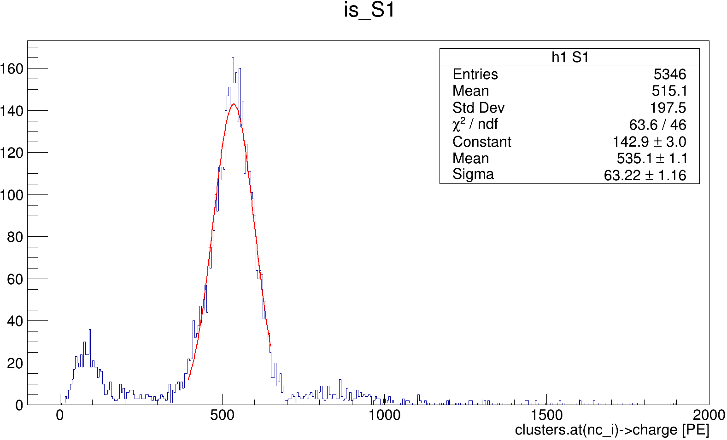
S1_Am_peak

