Slide 1
Neutron / gamma separation using scintillation signal in LAr
Oleynikov Vladislav
Italy, Napoli, December 2016

Slide 2
Content
Separation in theory
Detector description
Laser run 6061
  Typical signals
  averaged signals
  integration spectra
  Fourier transform
Am run 6064
  Typical signals
  averaged signals
  Fourier transform
  Inverse Fourier transform
Optimum in theory
Signal reconstruction
  Find derivative and identify peaks
  Approximation by sum of individual responses
  Deconvolution
Deconvolution algorithms
  Root CERN Tspectrum::Deconvolution
Ratio vs N_pe
Sigmas comparison
What are reasons of broadening?
Further steps

Slide 3
Separation in theory

Slide 4
Detector description

Slide 5
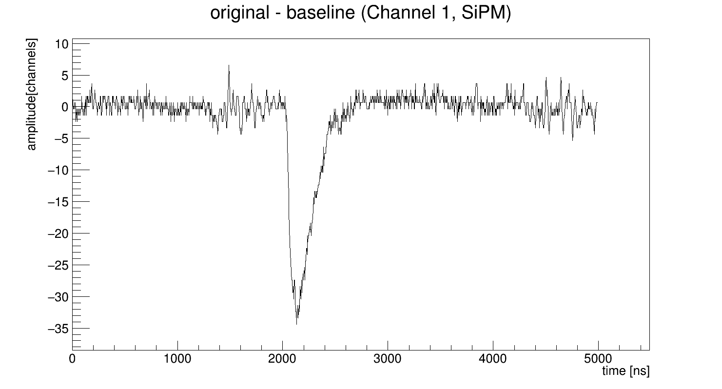
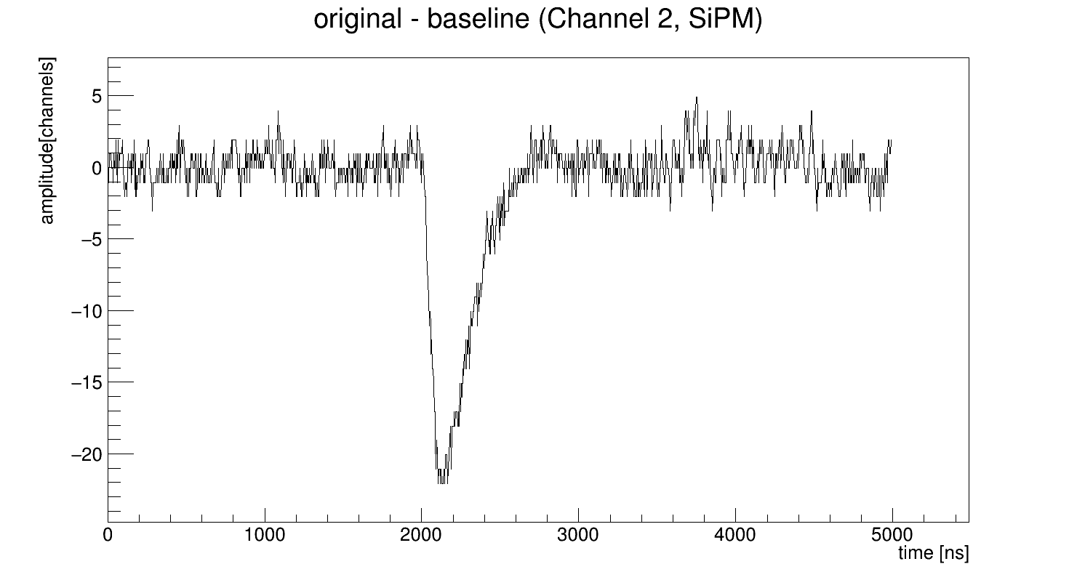
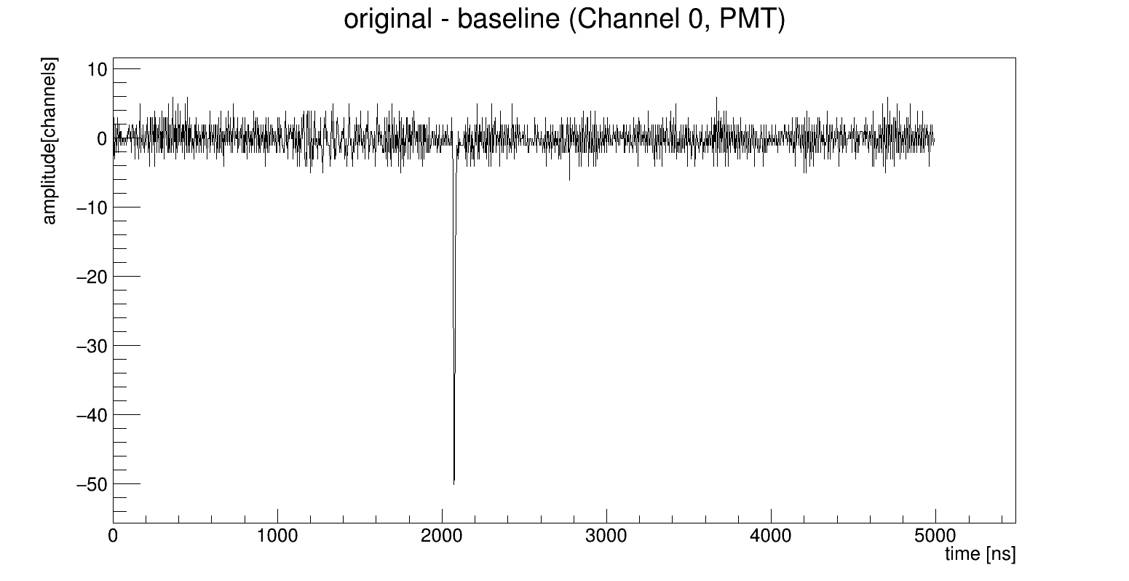
Laser run 6061. Typical signals

Slide 6
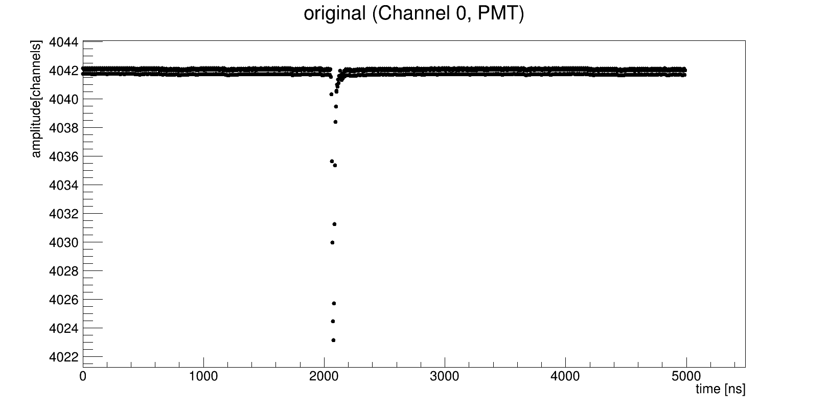
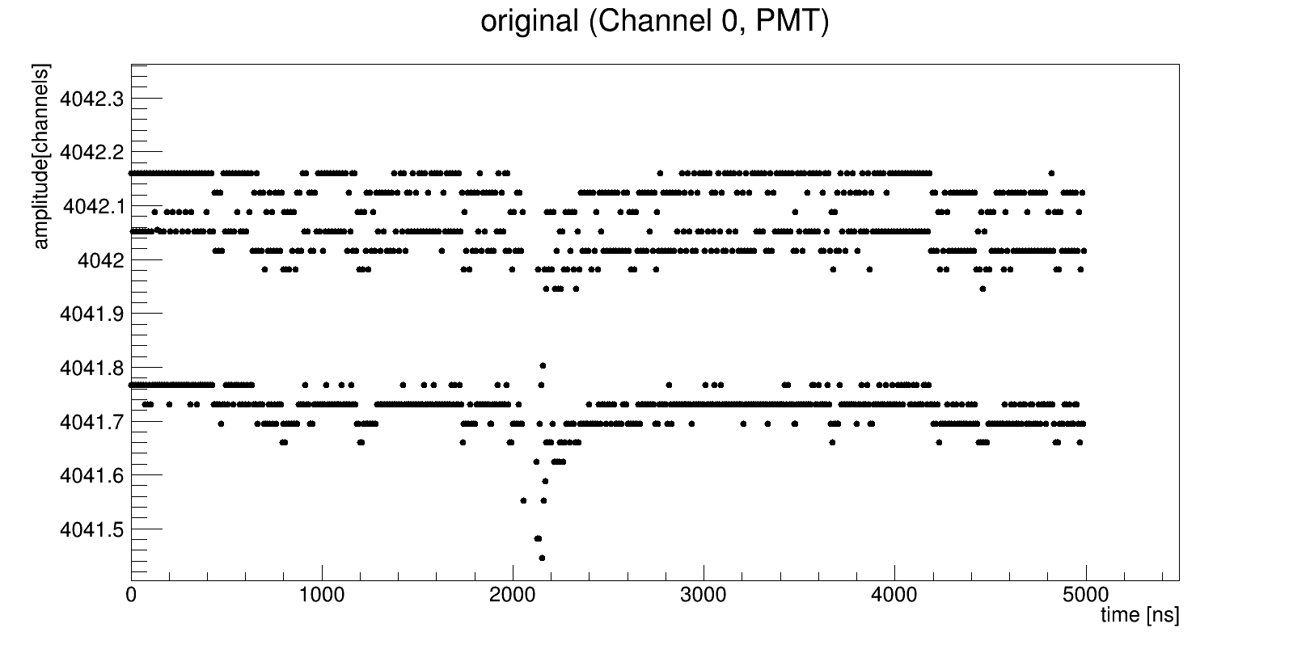
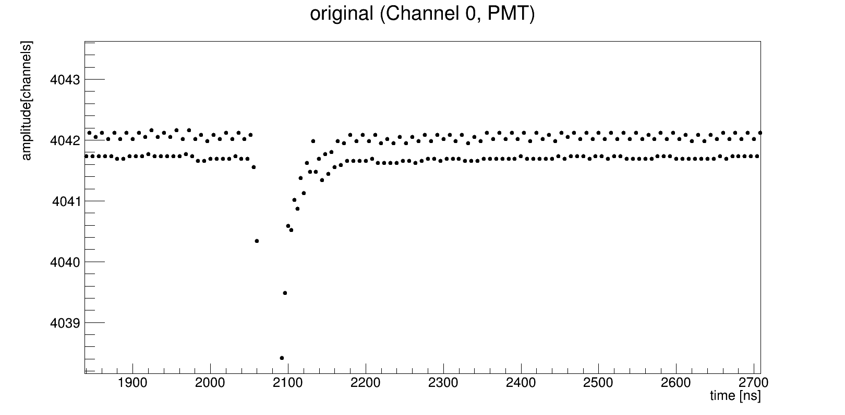
Laser run 6061. Averaged signals
Avr_signal[i] += signal[i] / n_events

Slide 7
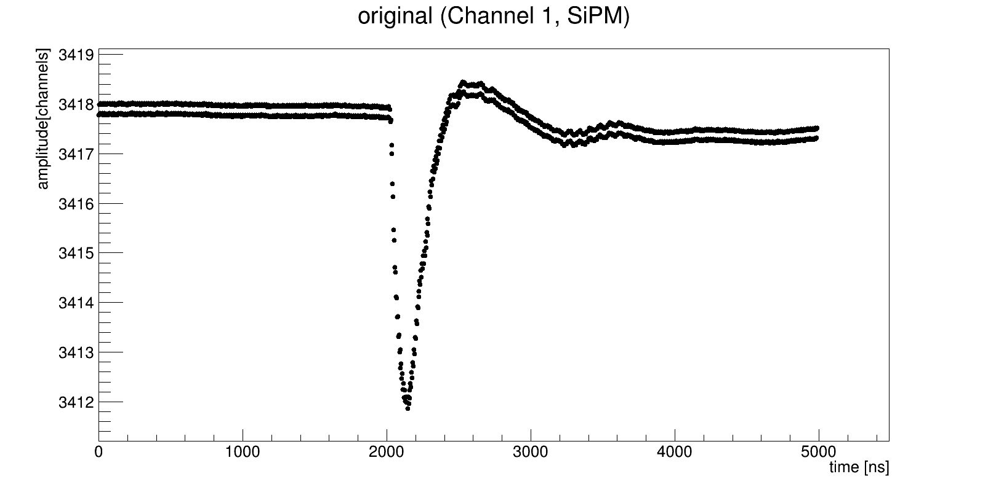
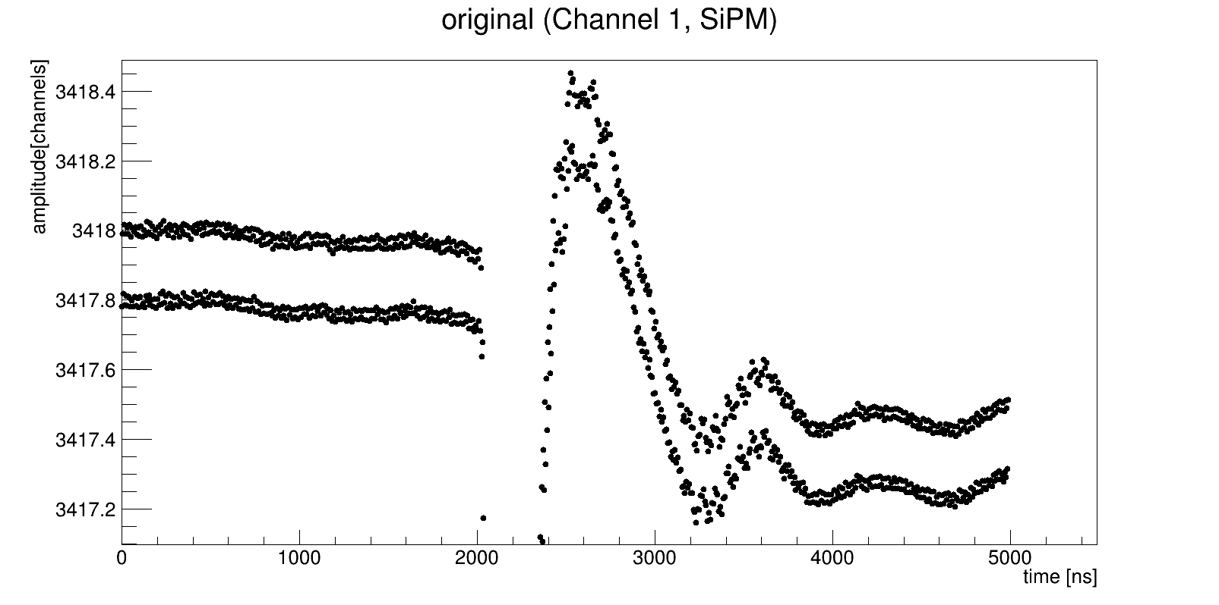
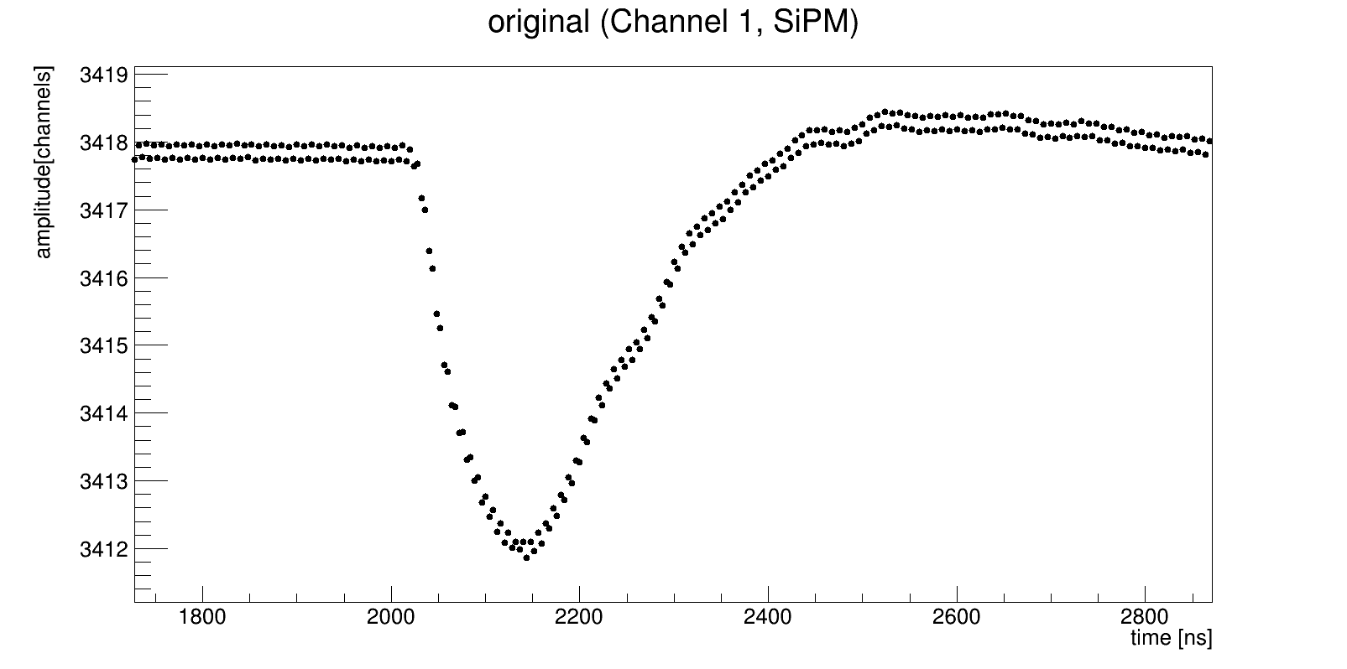
Laser run 6061. Averaged signals
Avr_signal[i] += signal[i] / n_events

Slide 8
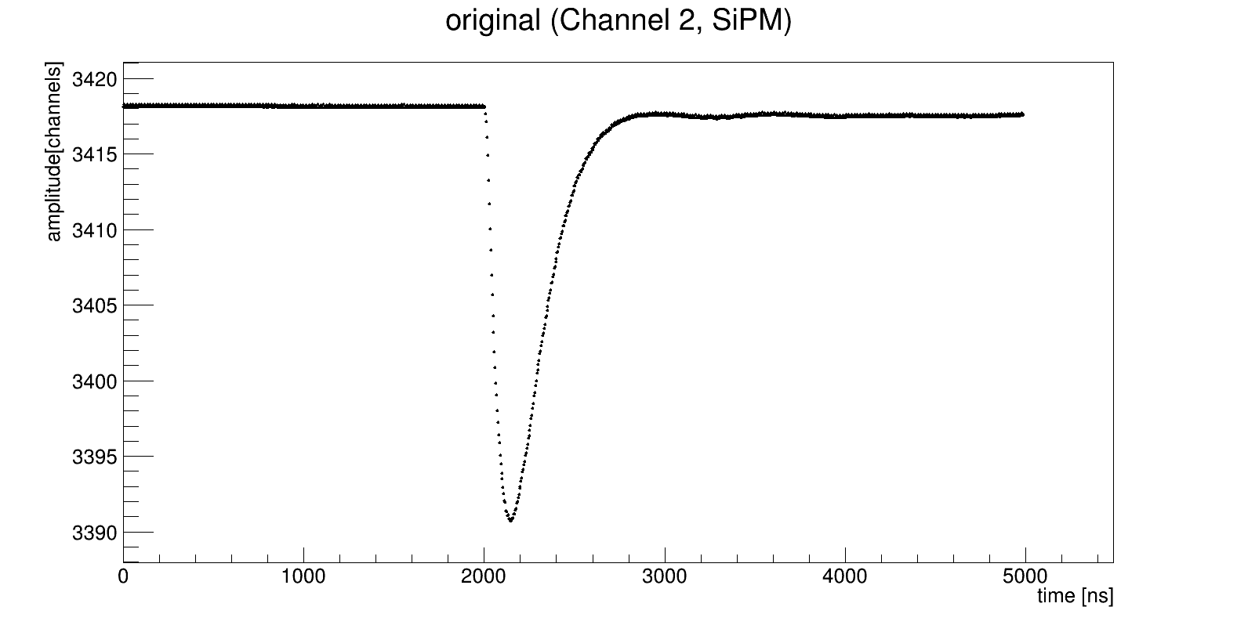
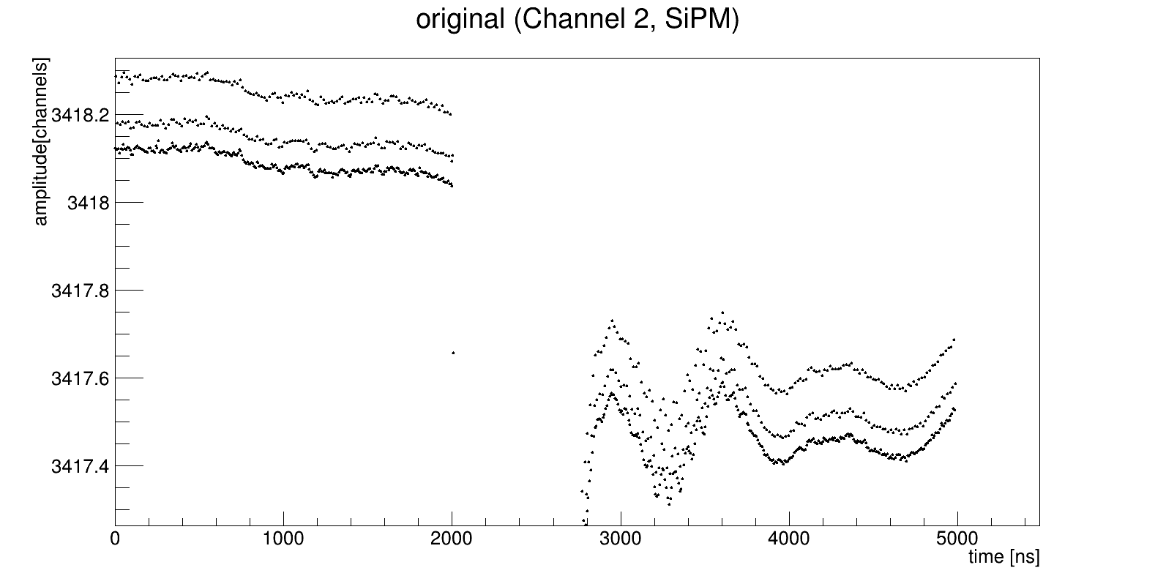
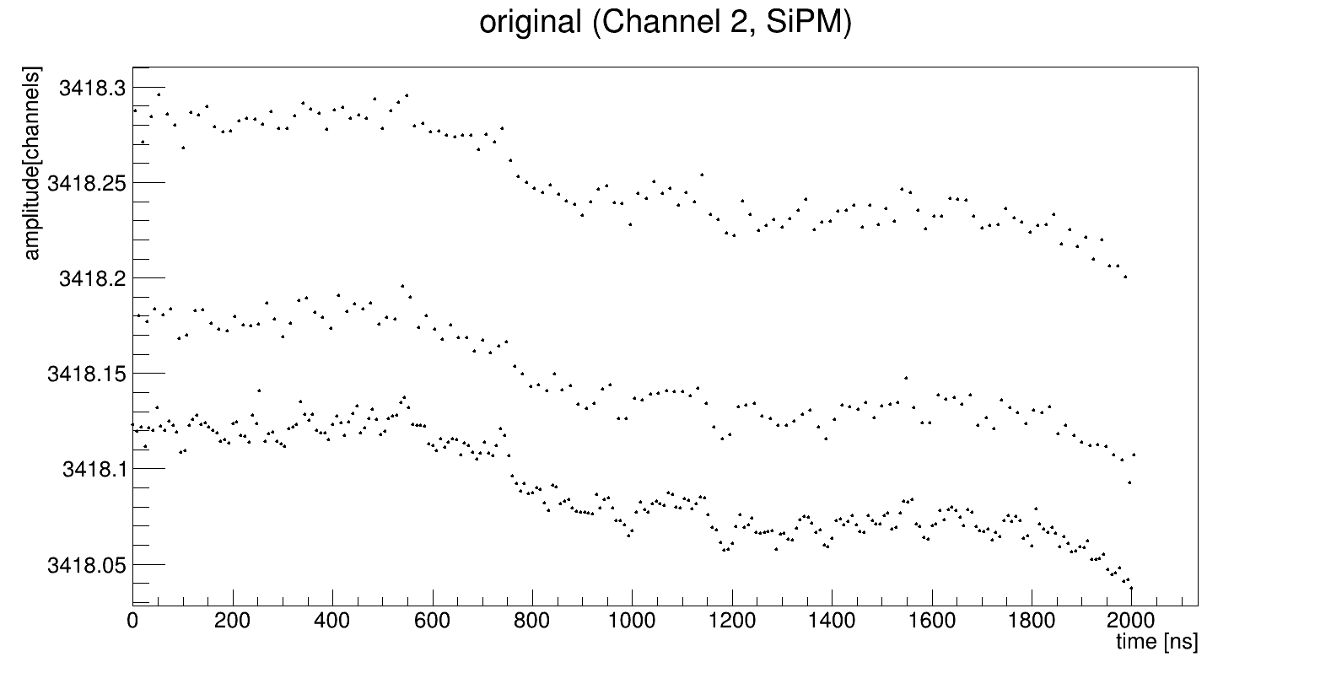
Laser run 6061. Averaged signals
Avr_signal[i] += signal[i] / n_events

Slide 9
What is reason of such signal?
I expected smooth signal. Even if baseline has fluctuation +-n_channels this signal have to be smooth.

Slide 10
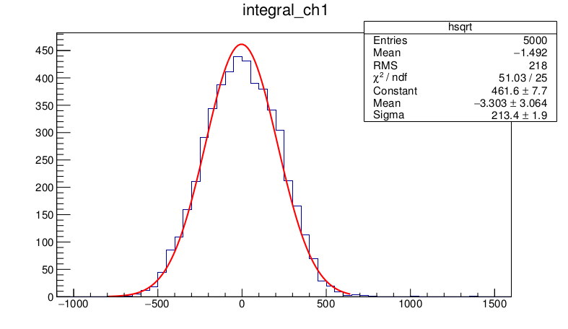
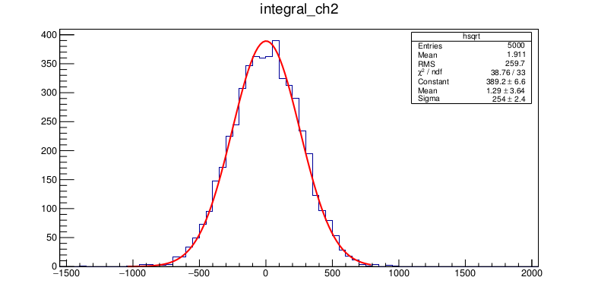
Laser run 6061. Integration spectra
Integral = sum(y[i] – baseline[i]) * sampling_rate
baseline = avr(y) from 0 to 1600 ns
Let's calculate integral from 0 to 1600 ns just to check

Slide 11
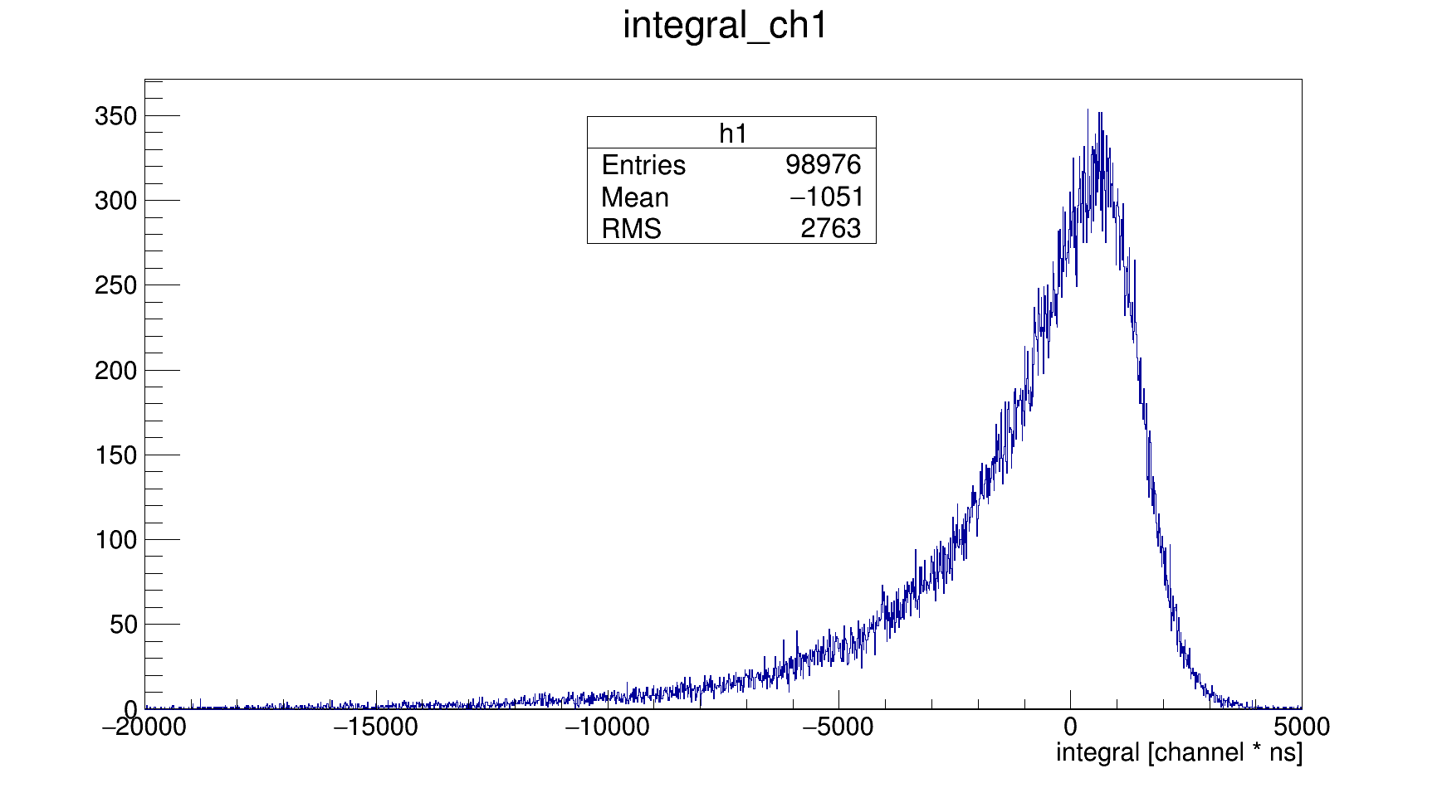
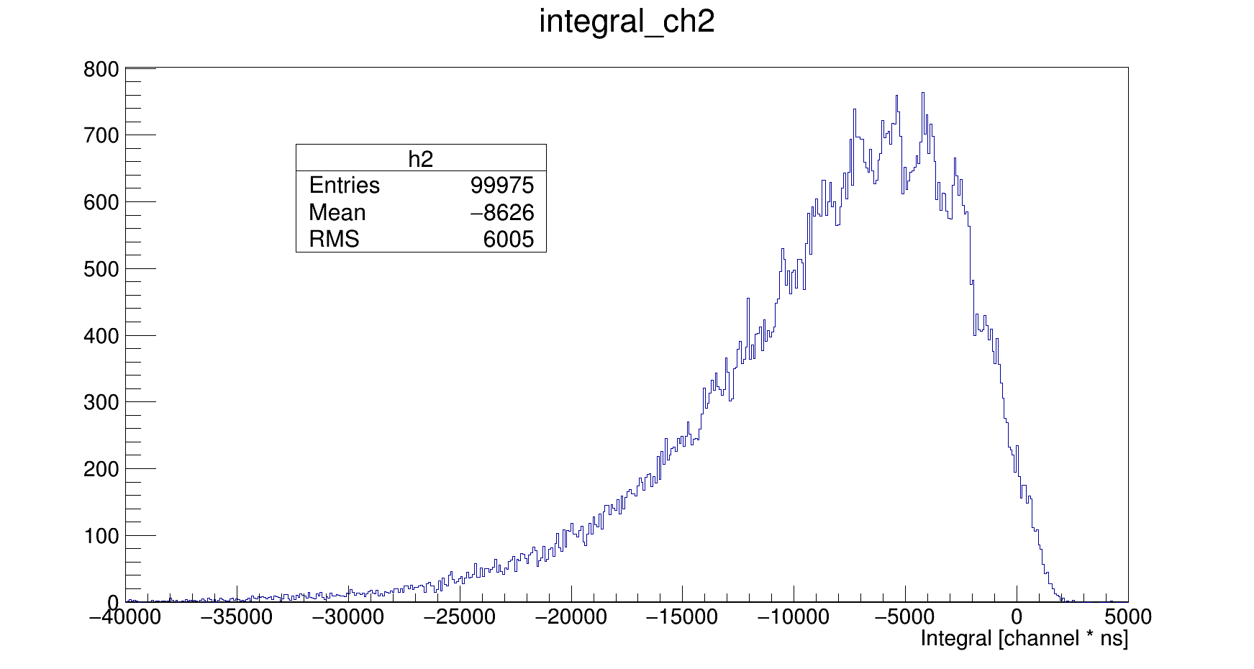
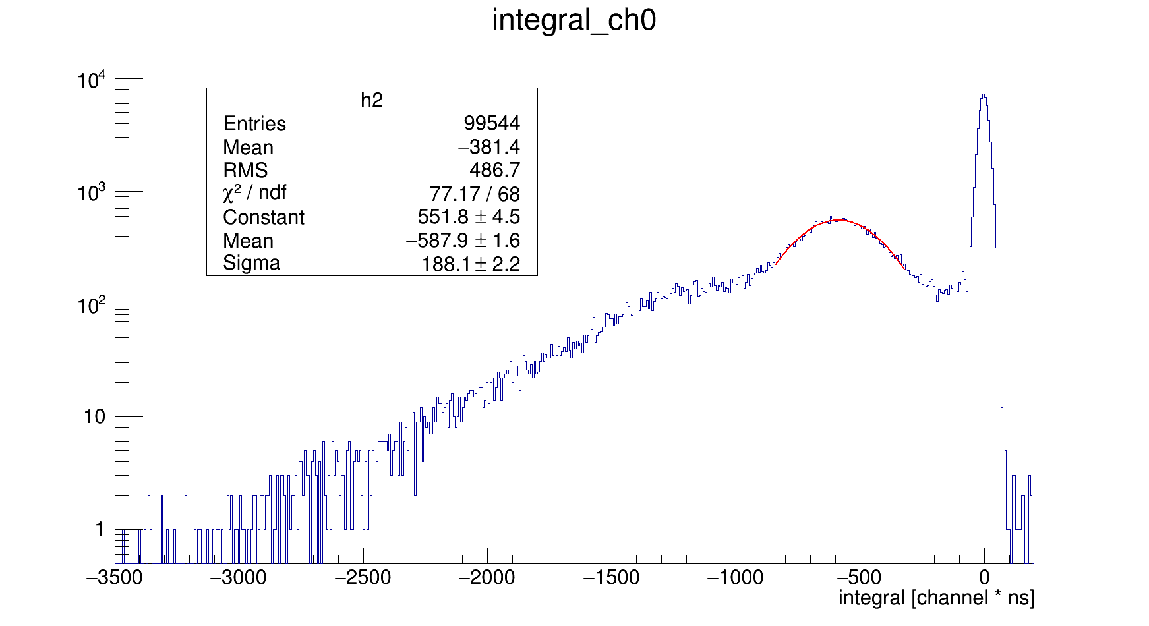
Laser run 6061. Integration spectra
For ch0:
Integral from 2050 to 2100 ns
For ch1 and ch2:
Integral from 1950 to 2650 ns
I have not found any peaks for ch1 (for any binning)
Avr spe integral for ch2 is -1484 [channel * ns]

Slide 12
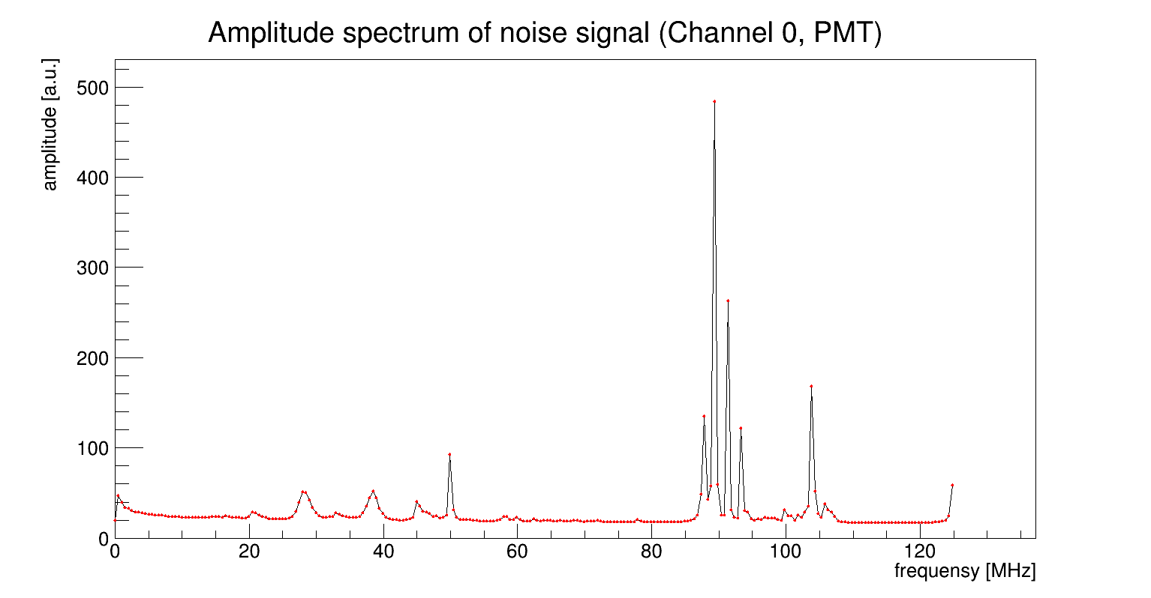
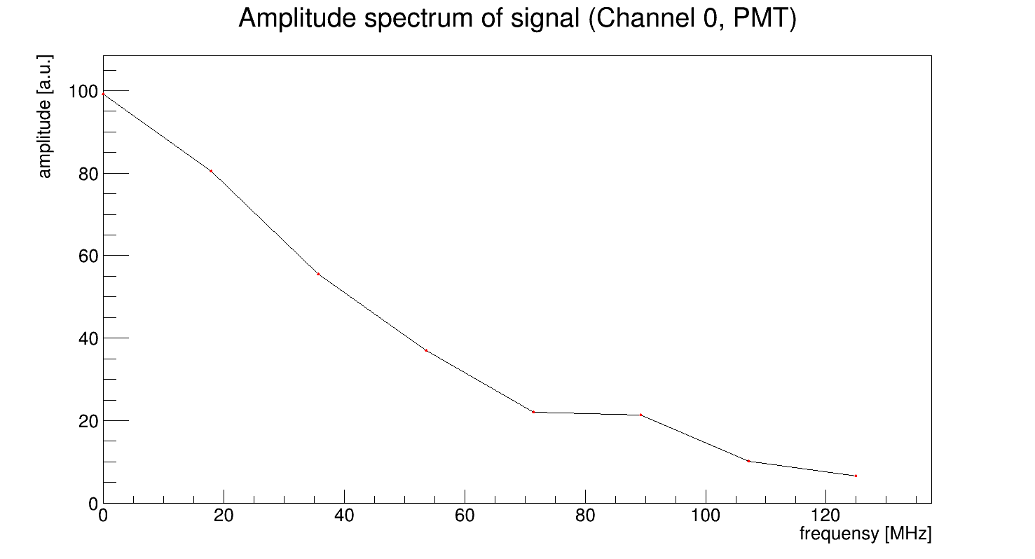
Laser run 6061. Fourier transform
Fourier transform for individual signal is noisy, so let's get avr spectra
Baseline was subtracted before ft.
PMT signal is short → amplitude spectrum of signal is wide (ft of delta-func is constant)
PMT signal is short and sampling rate is low →bad frequency resolution
Range for noise from 0 to 2000 ns
Range for signal from 2050 to 2100 ns

Slide 13
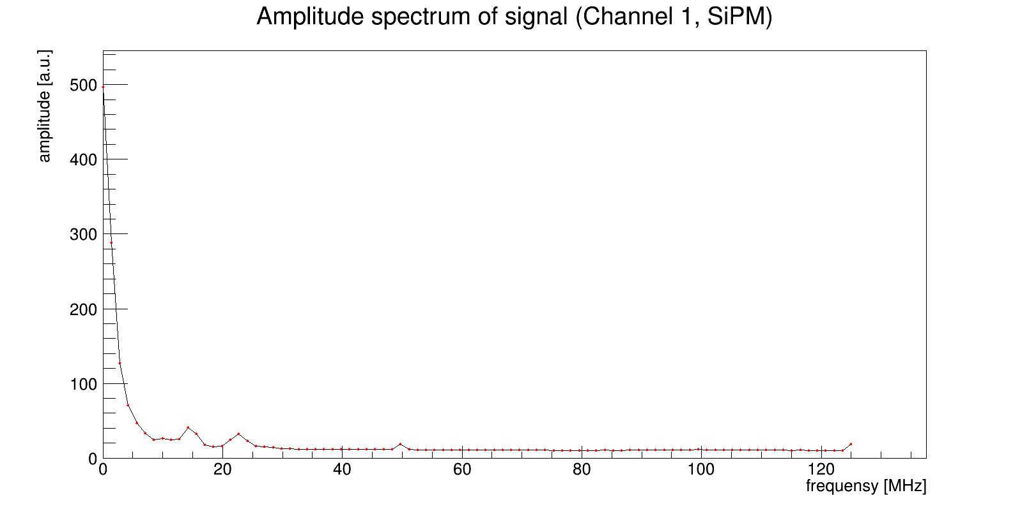
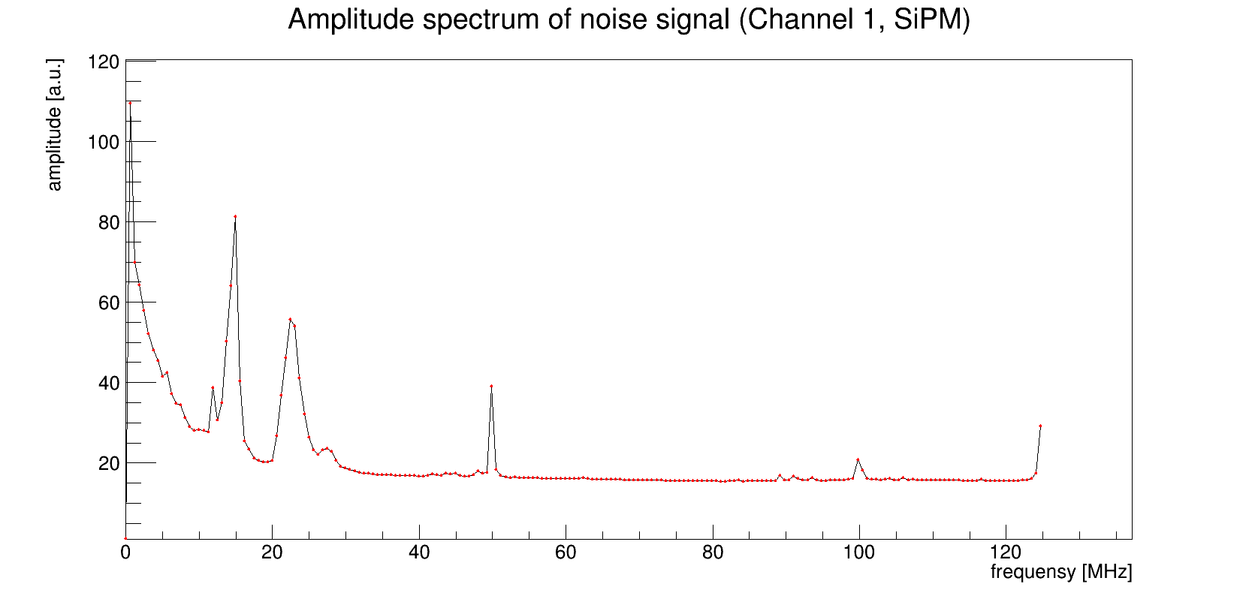
Laser run 6061. Fourier transform
Range for noise from 0 to 1600 ns
Range for signal from 1950 to 2650 ns

Slide 14
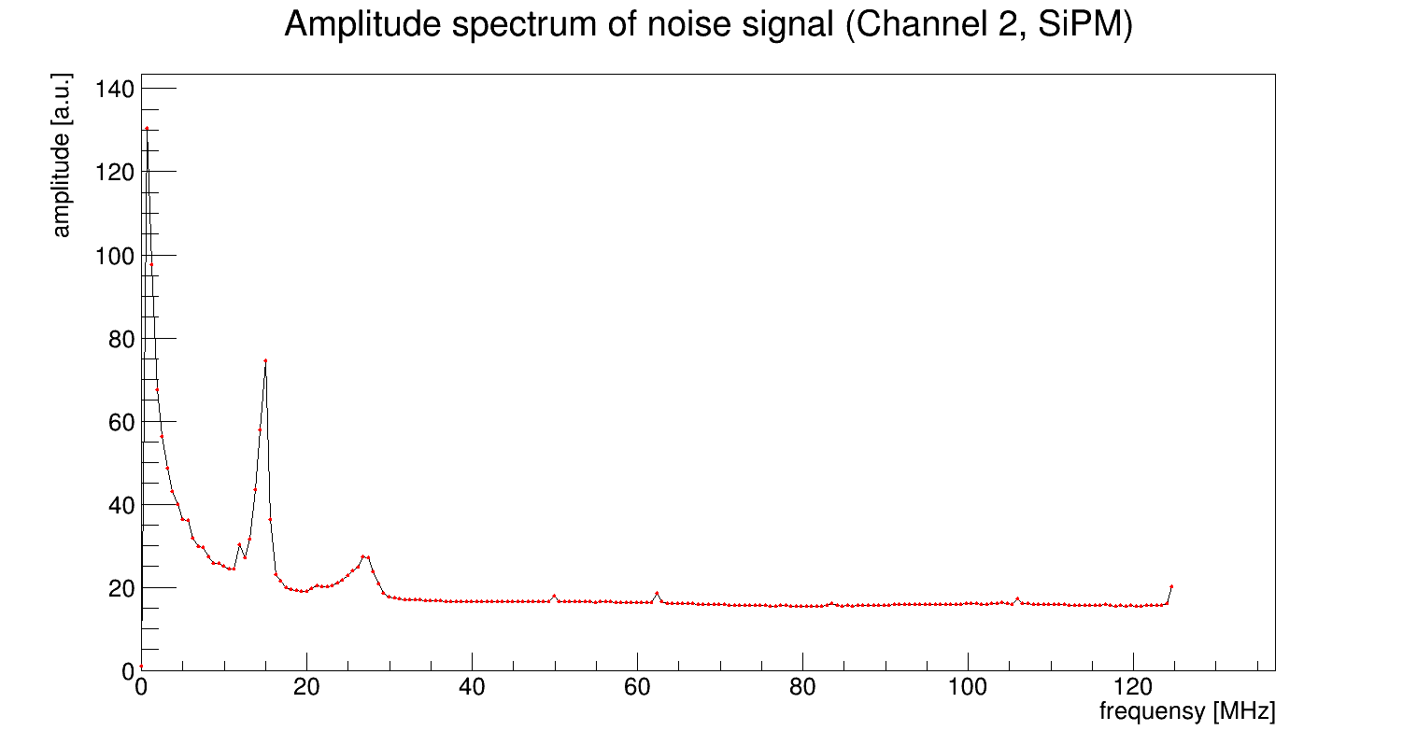
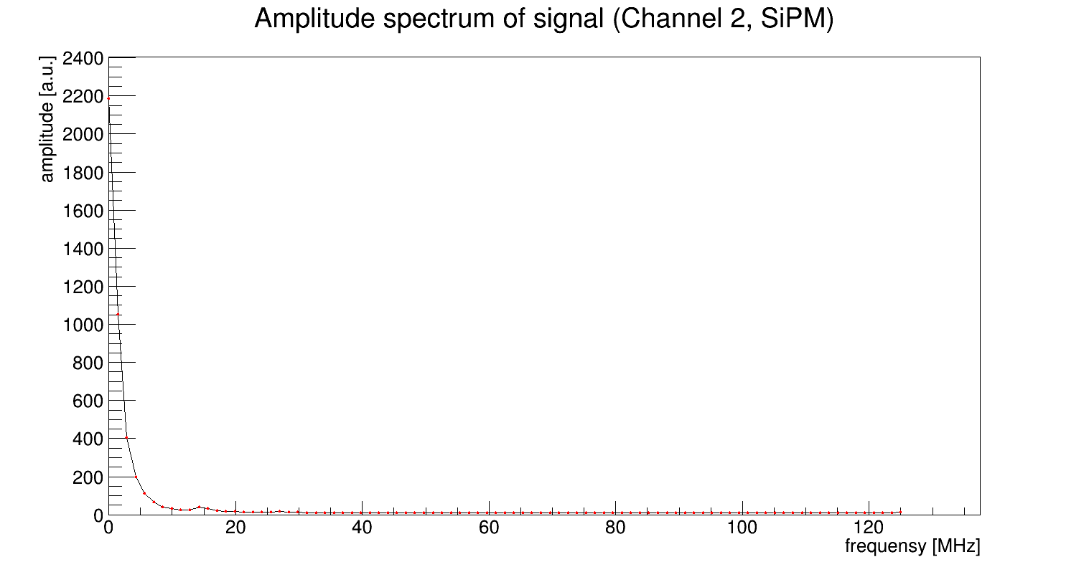
Laser run 6061. Fourier transform
Range for noise from 0 to 1600 ns
Range for signal from 1950 to 2650 ns

Slide 15
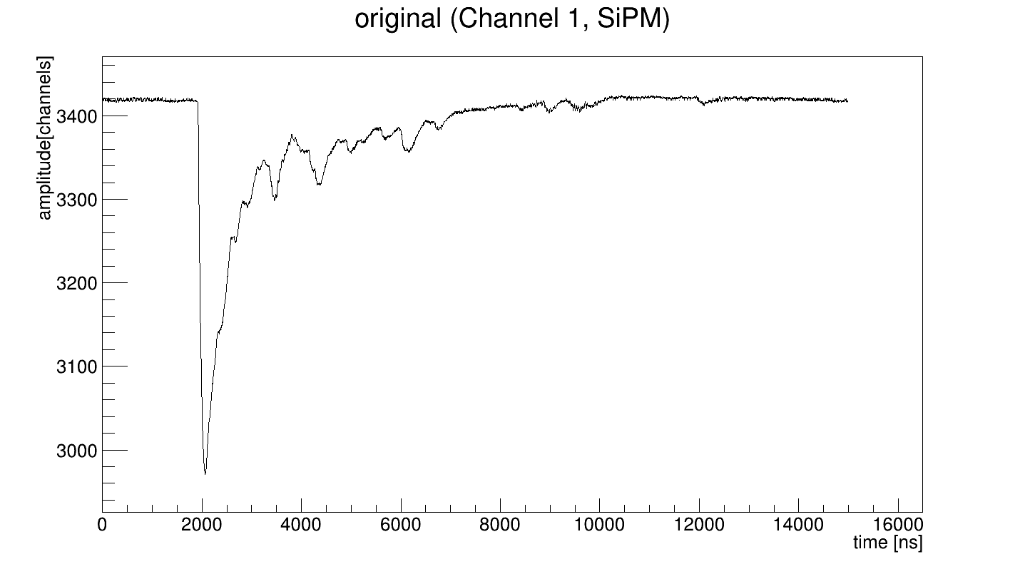
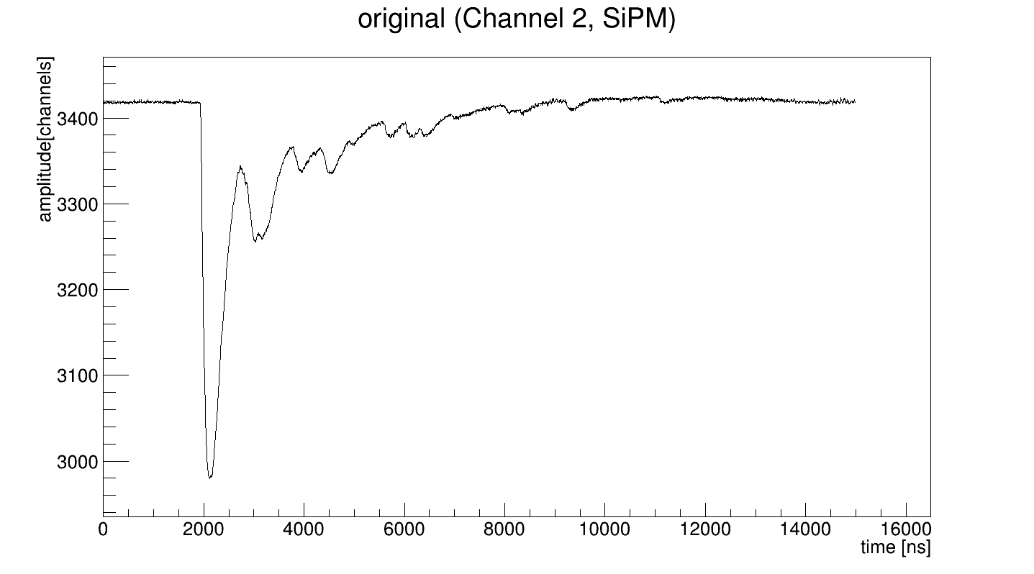
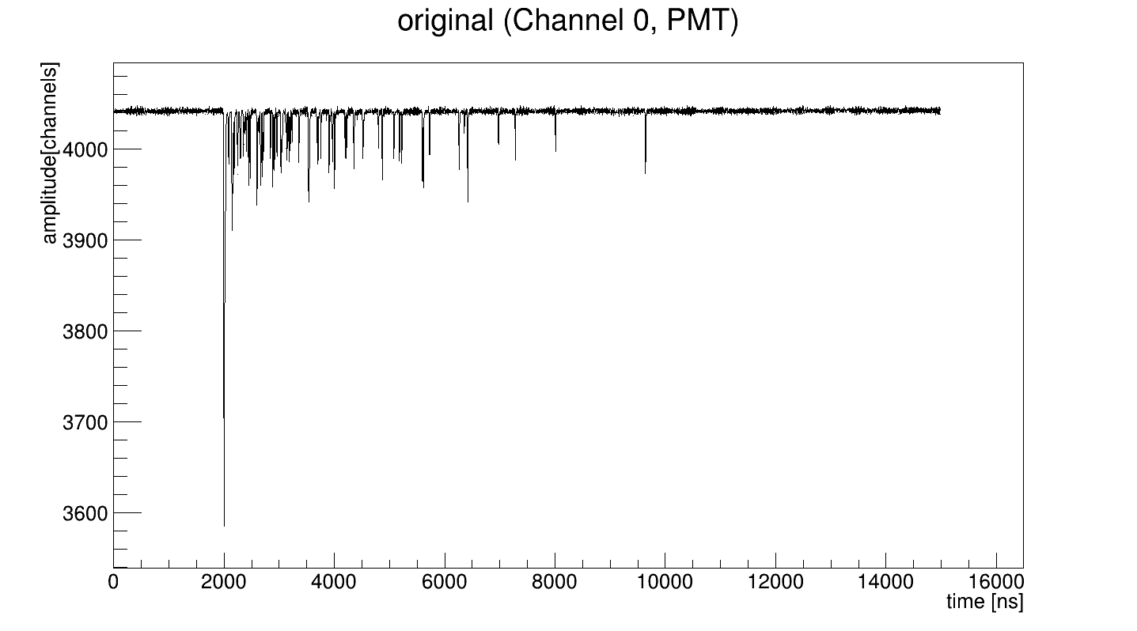
Am run 6064. Typical signals

Slide 16
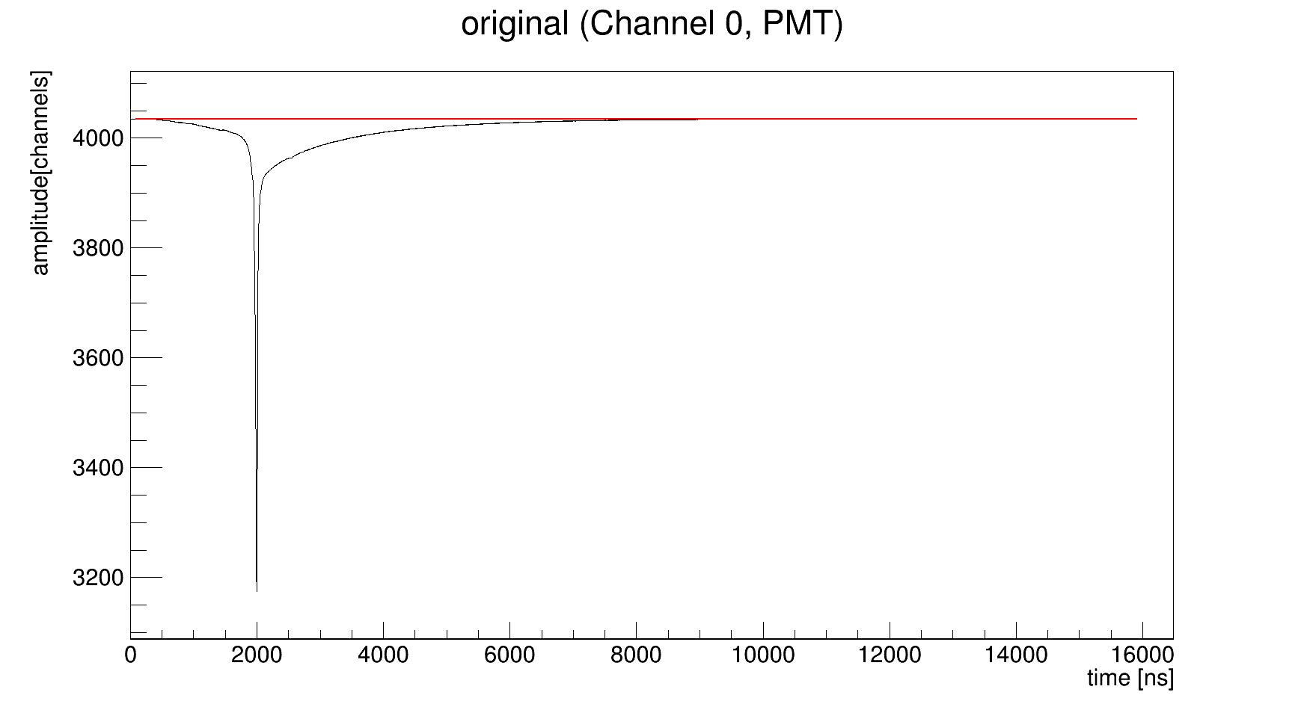
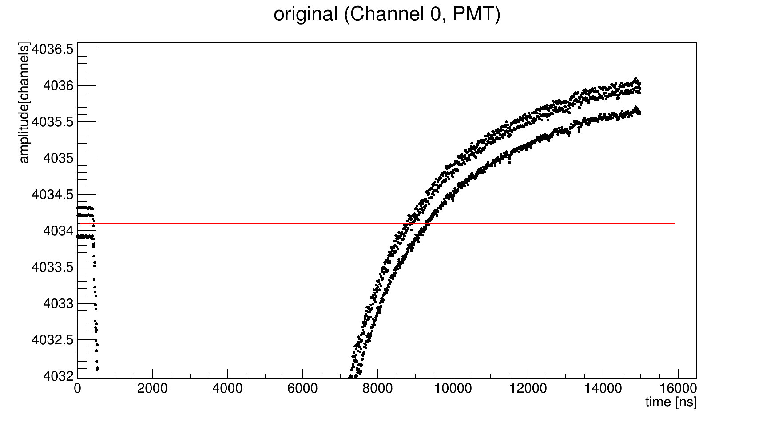
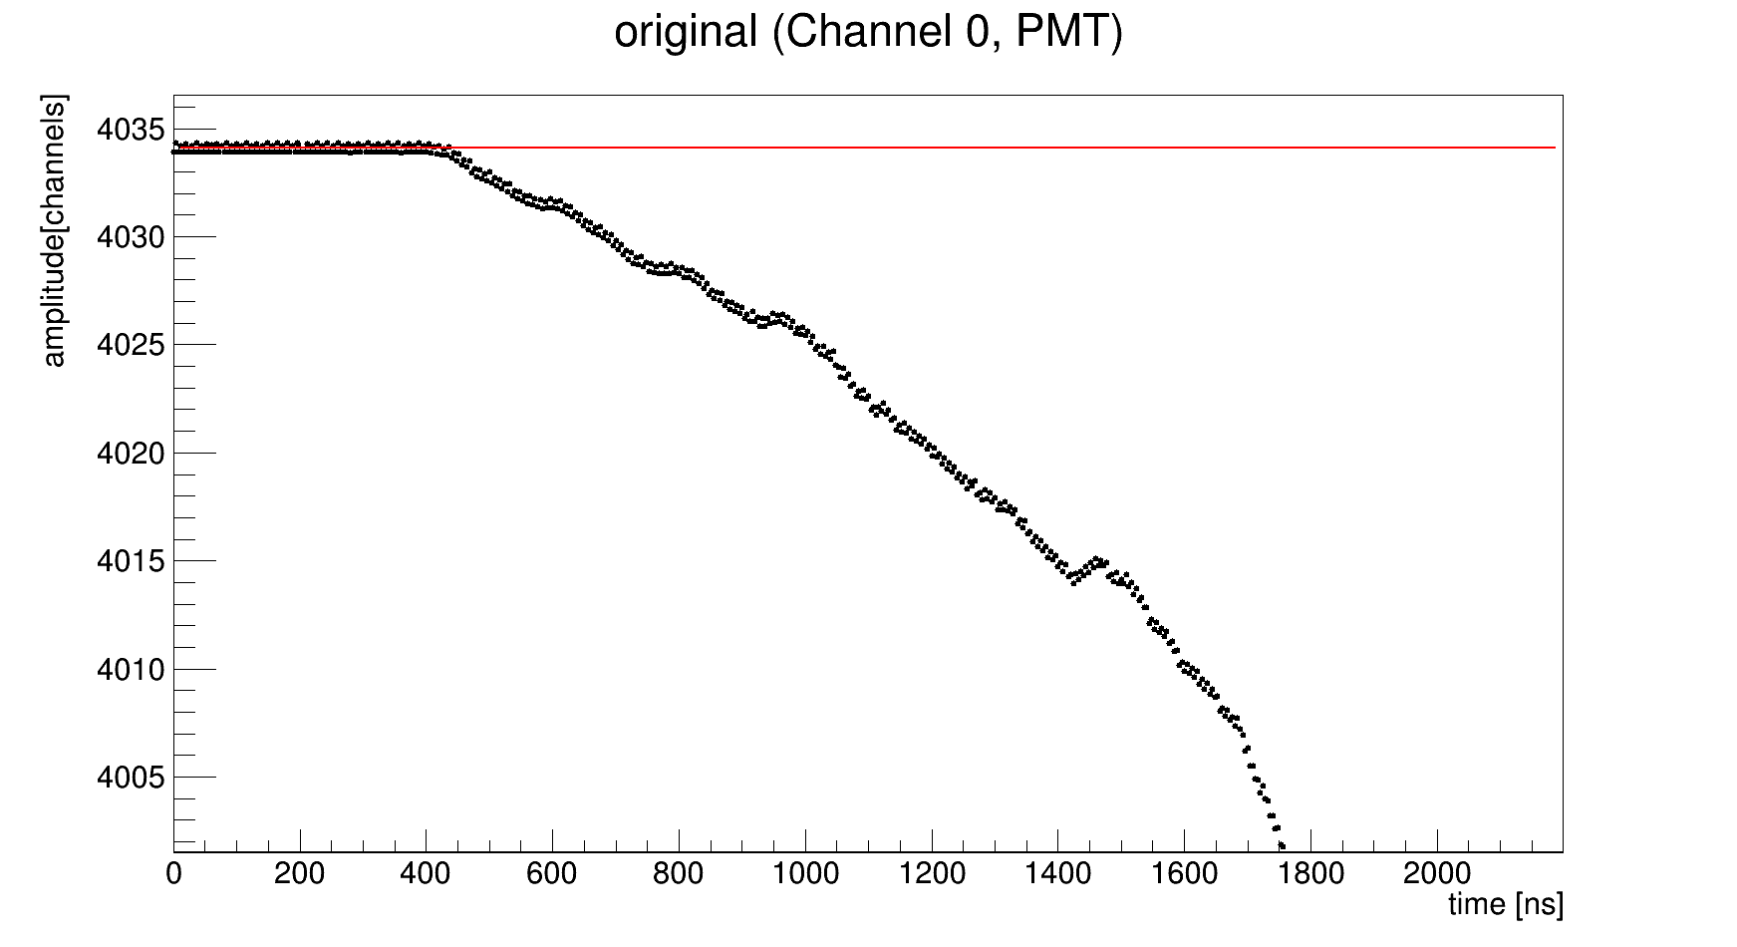
Am run 6064. Averaged signals

Slide 17
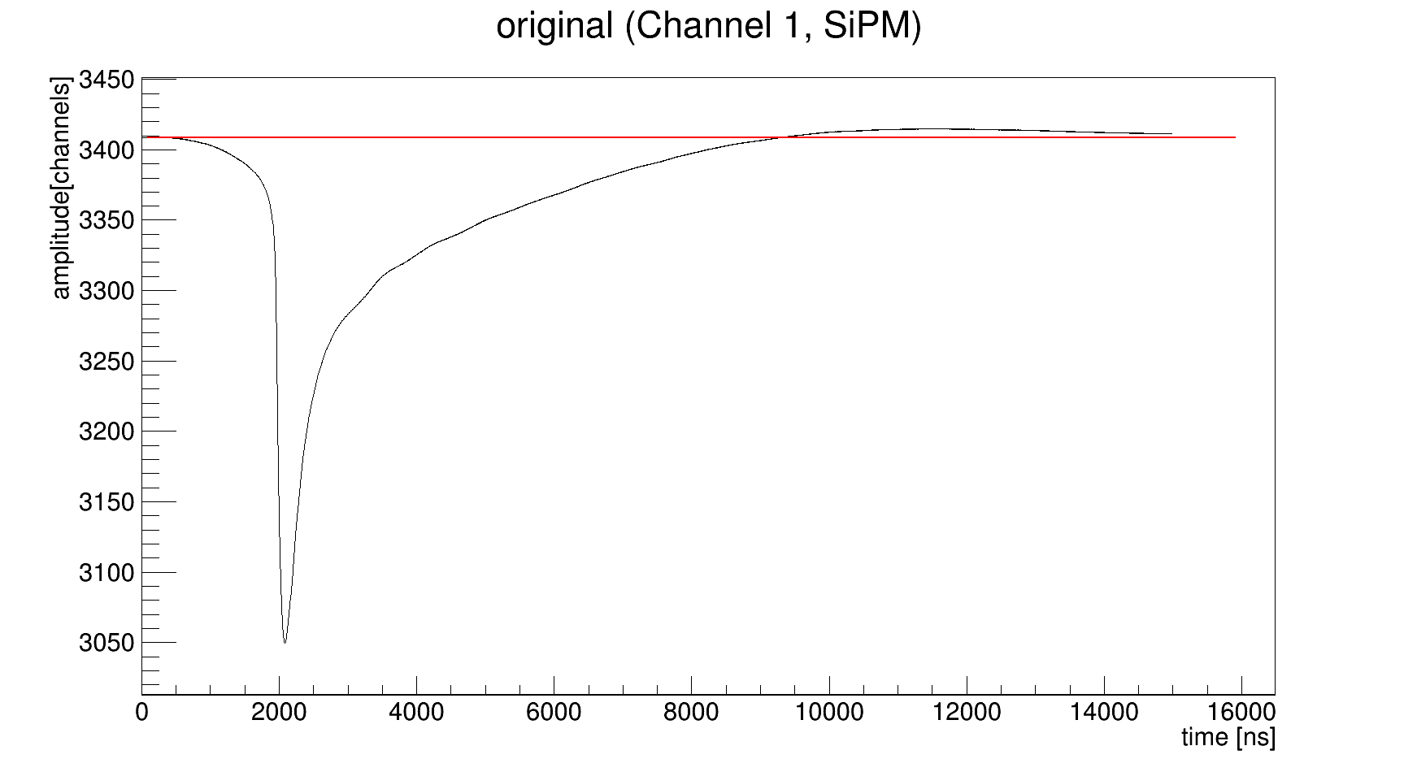
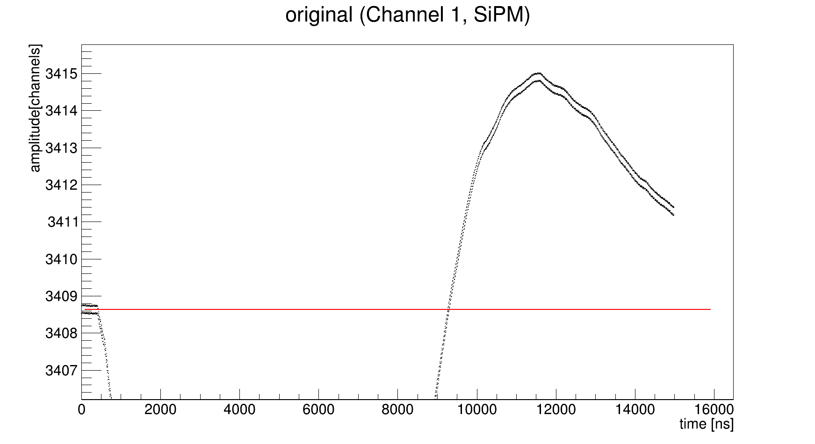
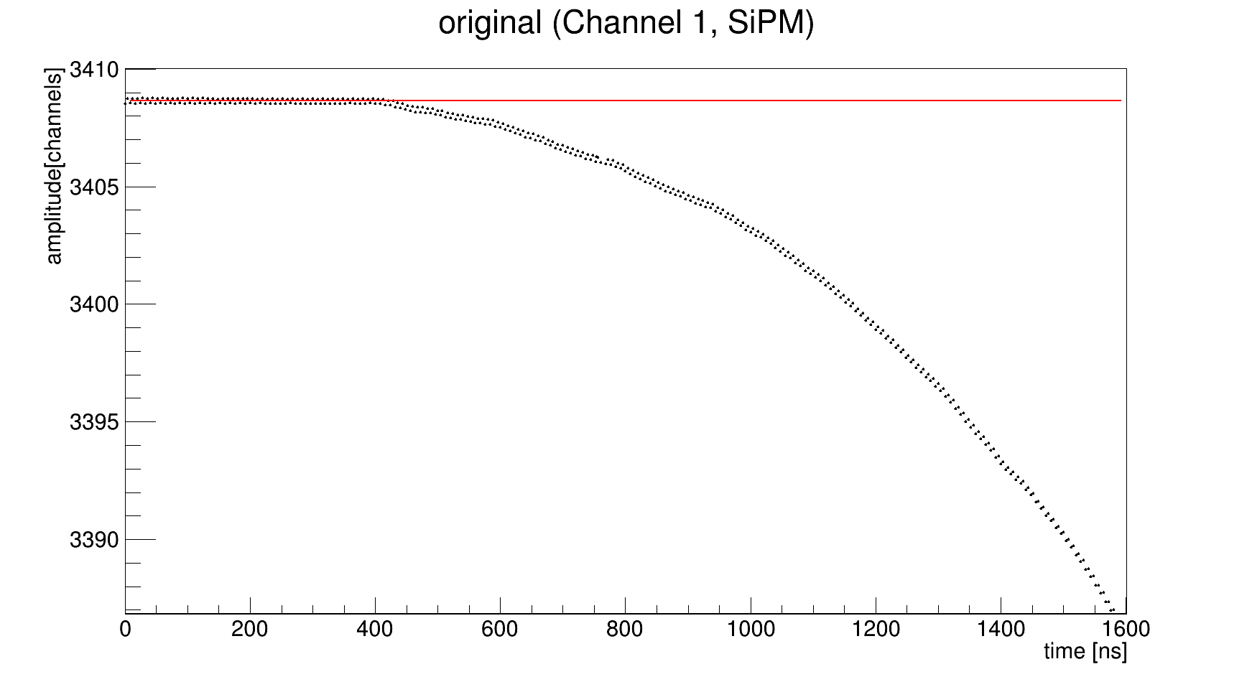
Am run 6064. Averaged signals

Slide 18
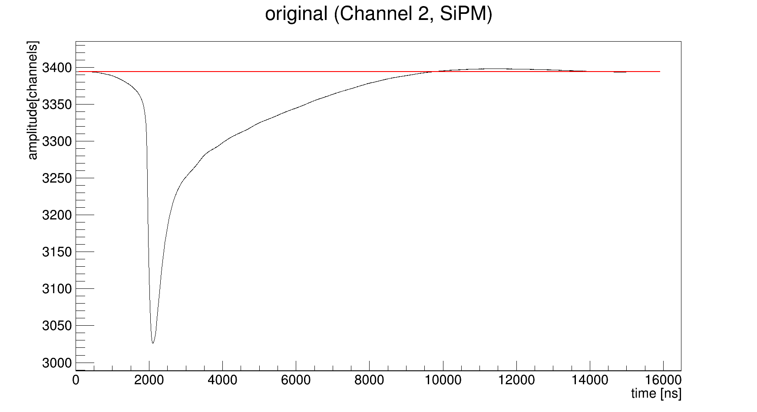
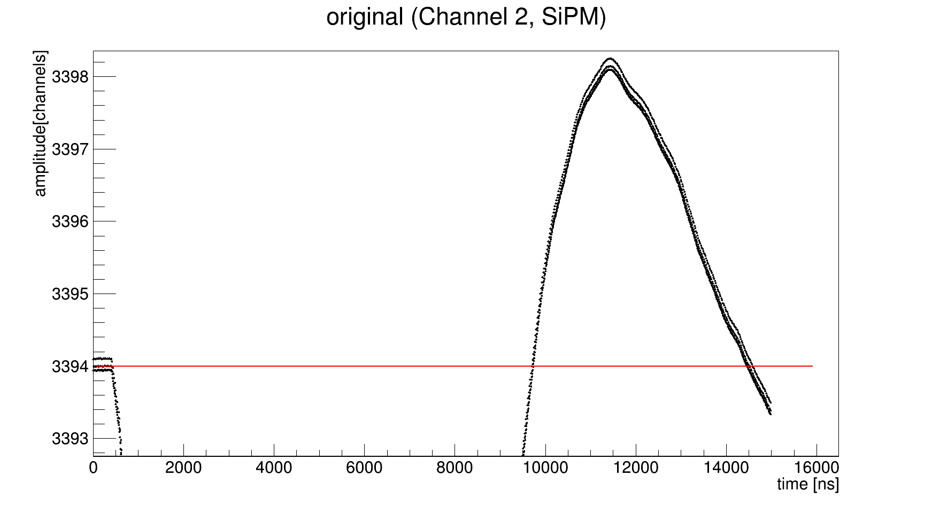
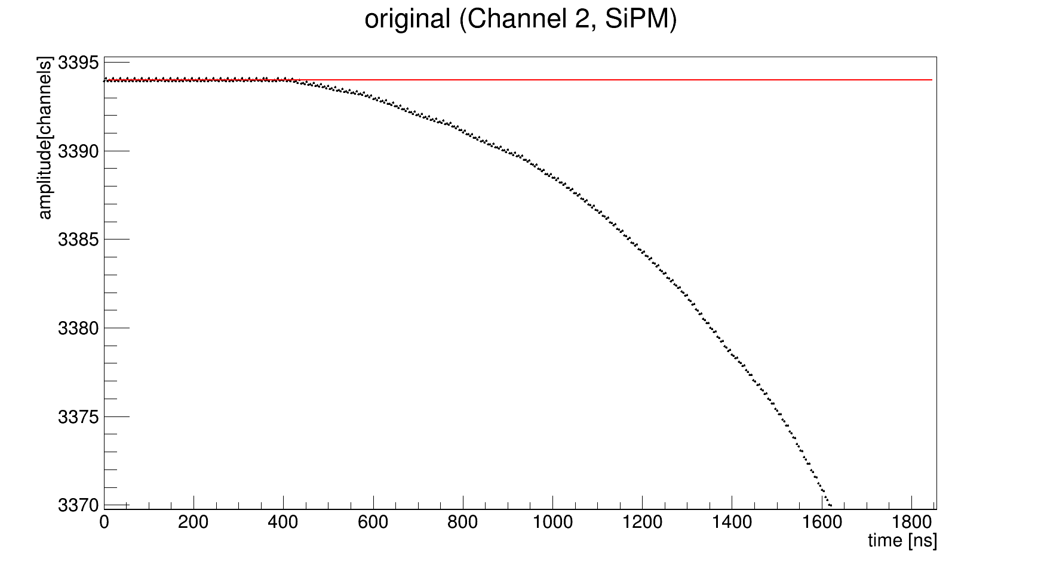
Am run 6064. Averaged signals

Slide 19
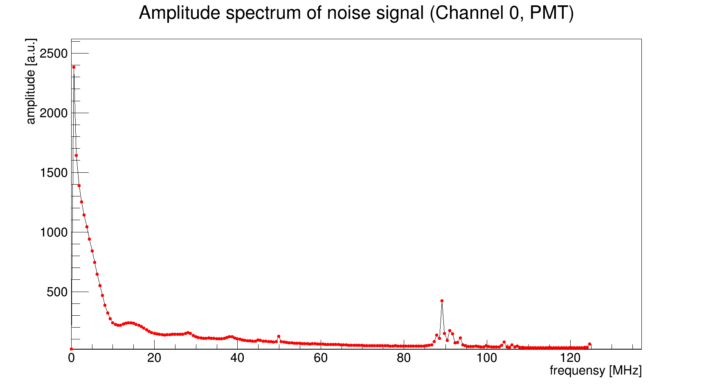
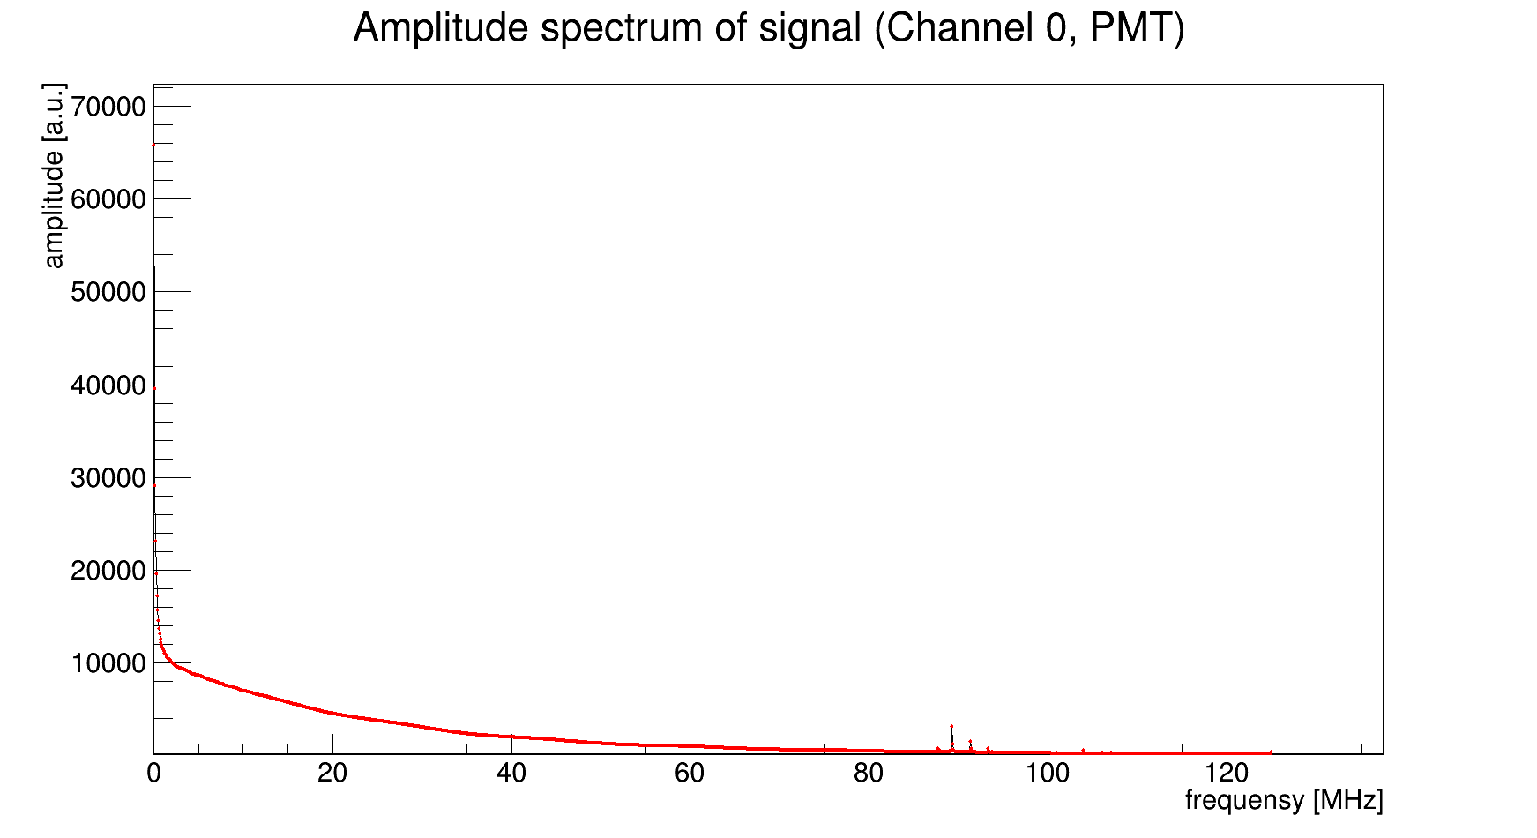
Am run 6064. Fourier transform
Range for noise from 0 to 1600 ns
Range for signal from 1900 to 14900 ns

Slide 20
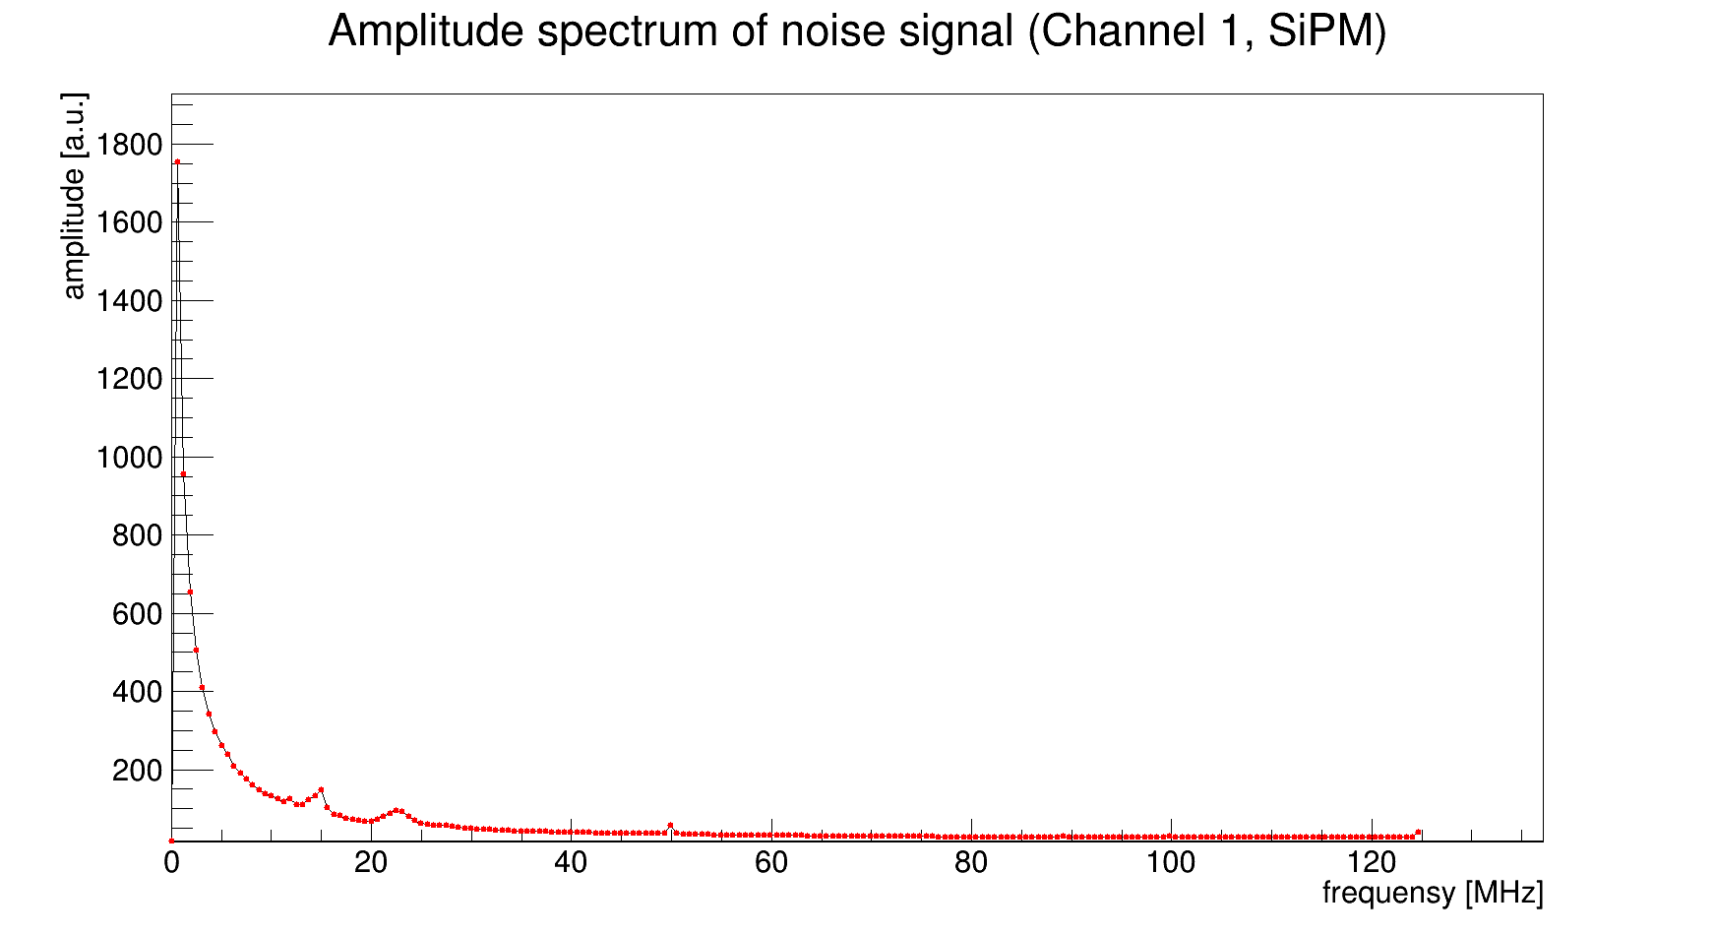
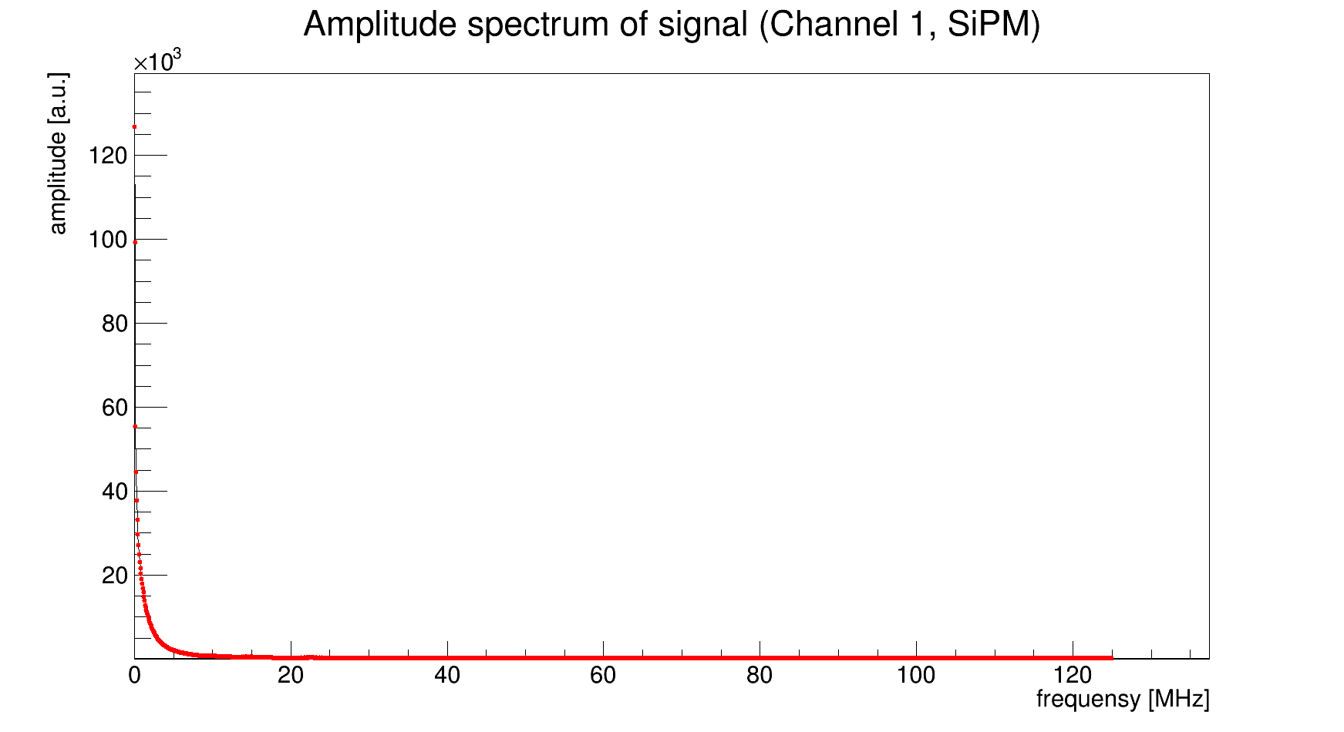
Am run 6064. Fourier transform
Range for noise from 0 to 1600 ns
Range for signal from 1900 to 14900 ns

Slide 21

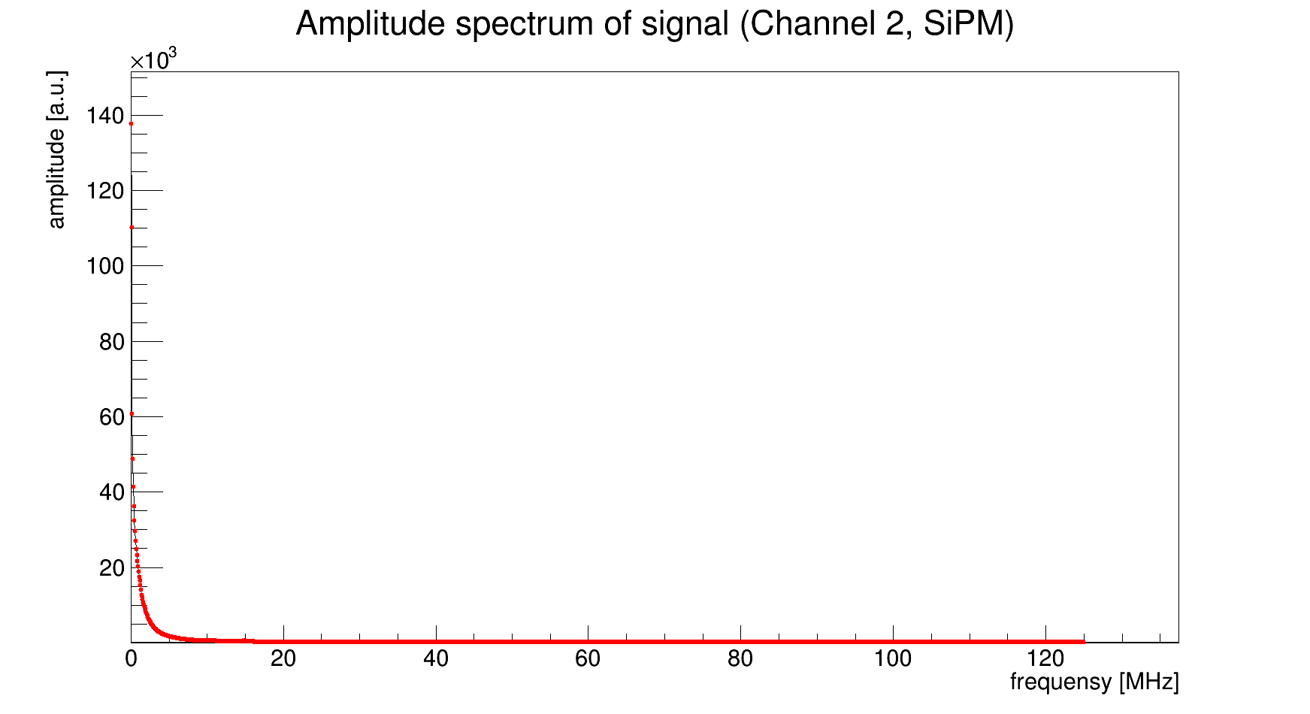
Am run 6064. Fourier transform
Range for noise from 0 to 1600 ns
Range for signal from 1900 to 14900 ns

Slide 22
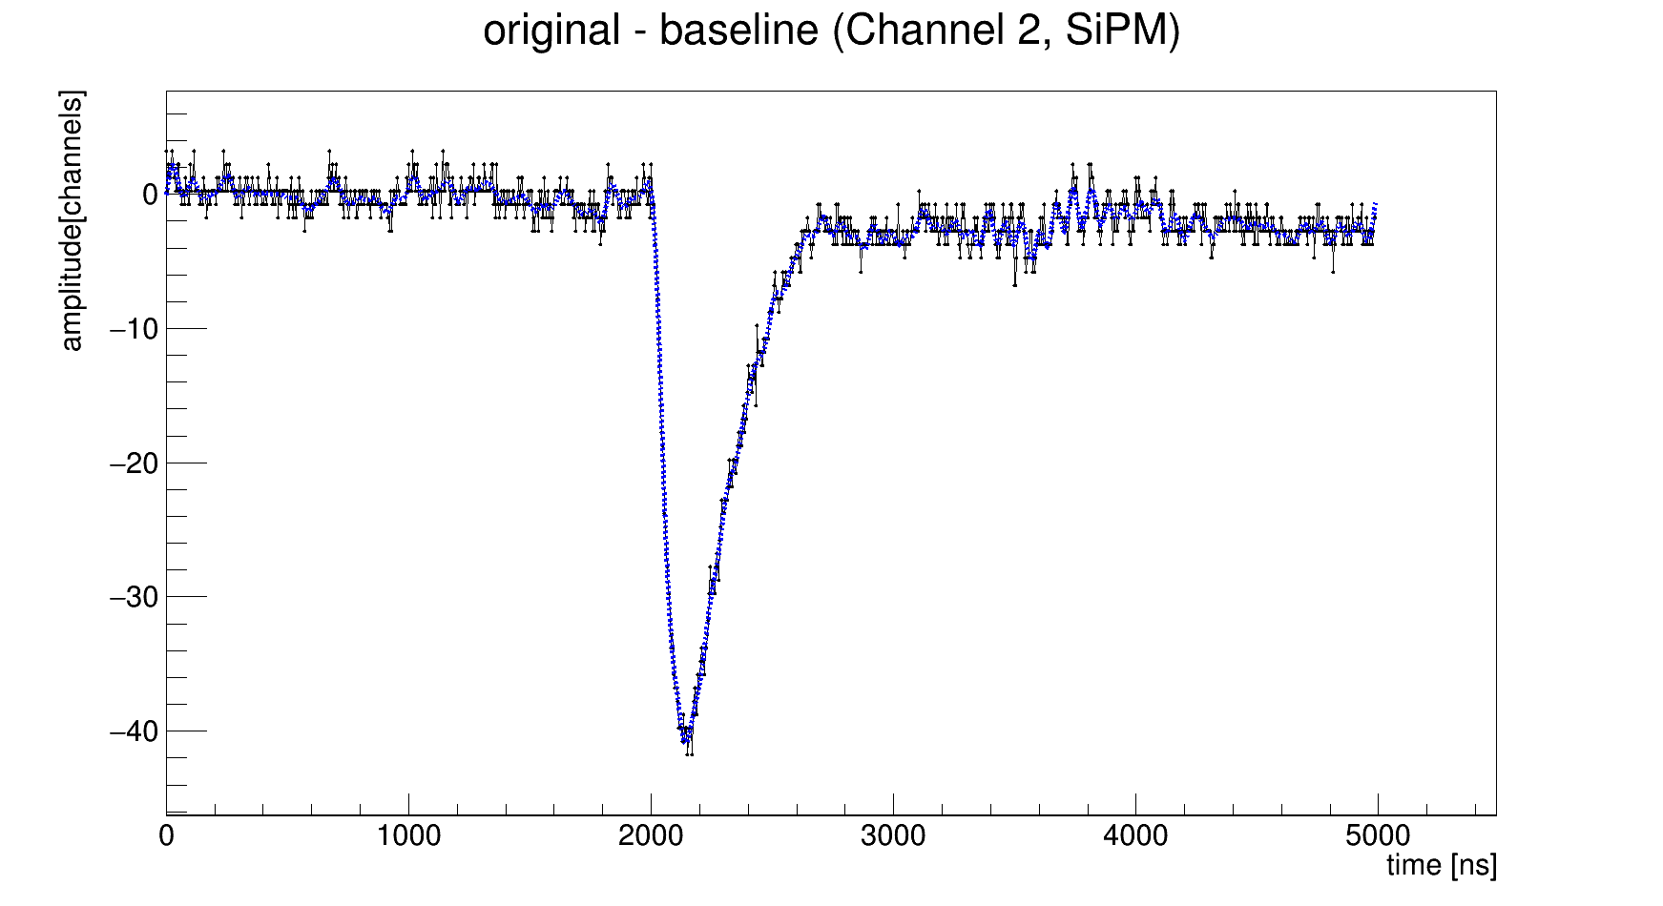
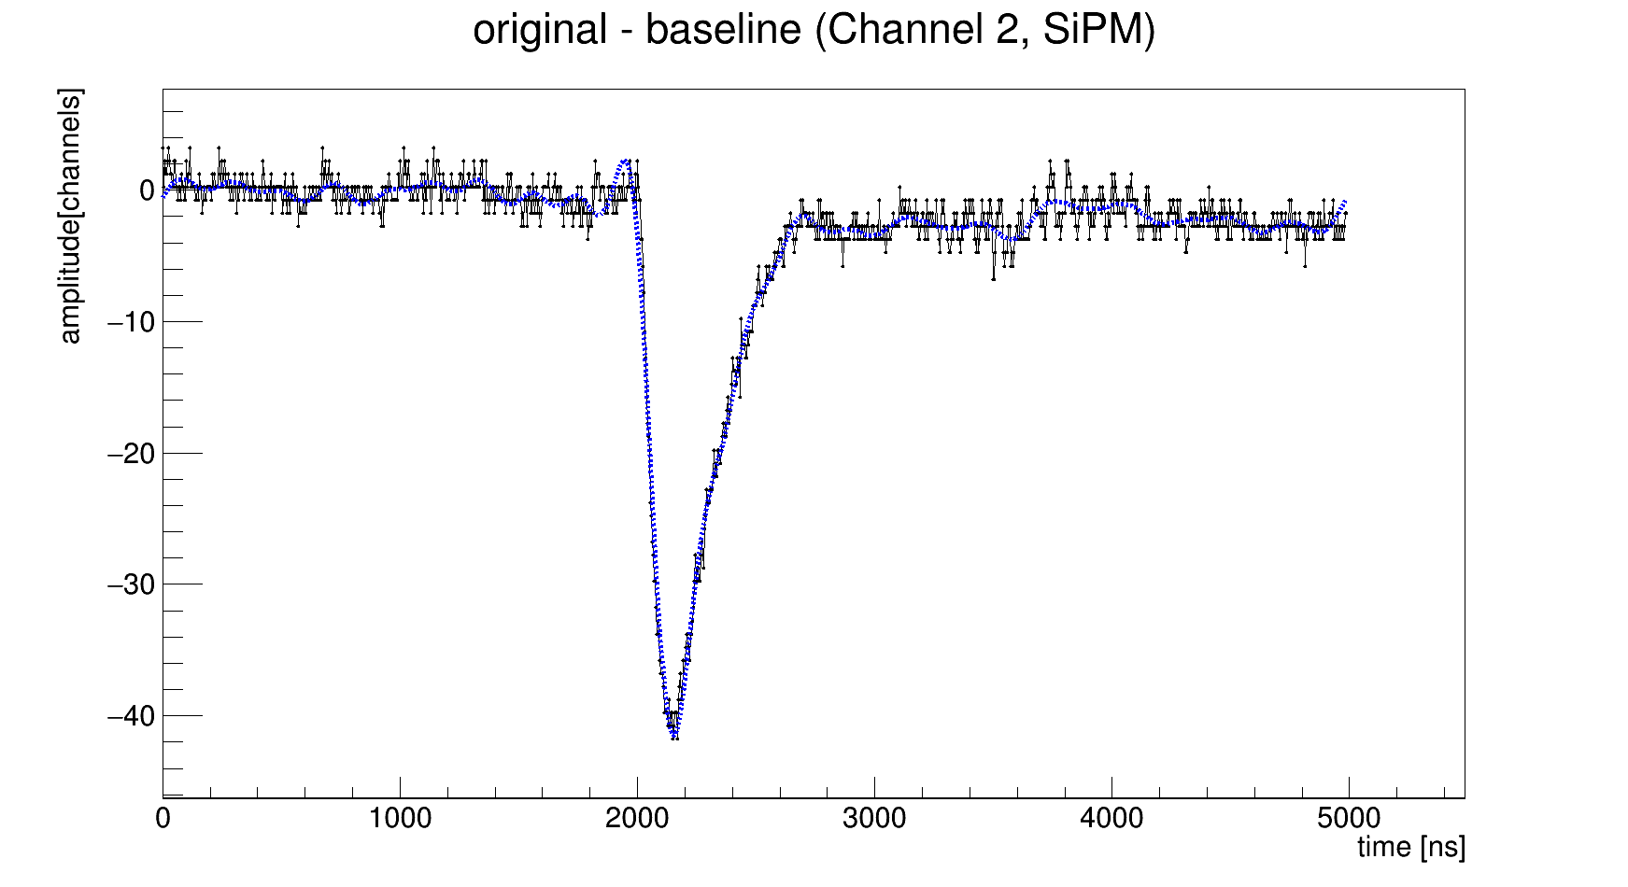
Inverse Fourier transform
Can we cut high frequencies (noise) and save signal?
Yes, but there are no serious advantages, because amplitude spectra of noise and signal are overlapped significantly.
15 MHz cut
5 MHz cut

Slide 23
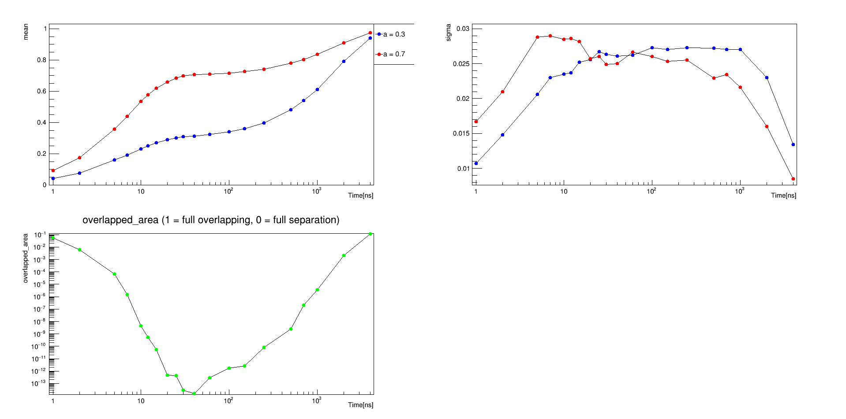
Optimum in theory
Consider the case with delta-function response. N_pe = 300
PDF = A * PDF_fast + (1 – A) * PDF_slow
A = intensity_fast / (intensity_fast + intensity_slow)
A = 0.2308 for e / gamma
A = 0.75 for neutrons
*this pictures for A=0.3 and A=0.7, because I chose wrong parameters.
But I think, that for right parameters the result will be very close to this.

Slide 24
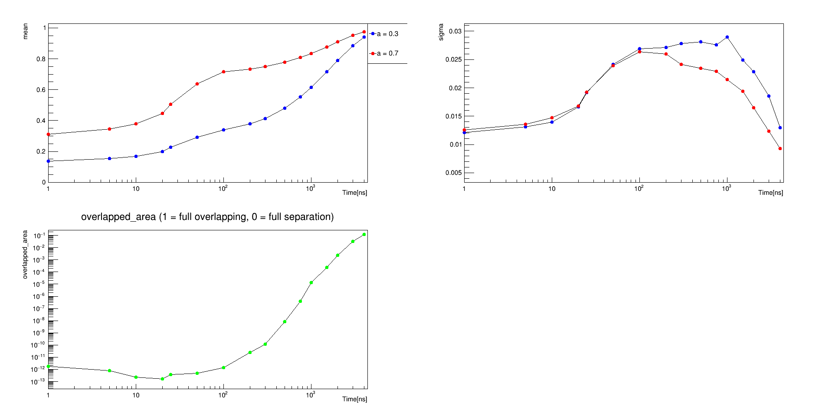
Optimum in theory
Consider the case with gauss response (sigma = 33ns). N_pe = 300
PDF = A * PDF_fast + (1 – A) * PDF_slow
A = intensity_fast / (intensity_fast + intensity_slow)
A = 0.2308 for e / gamma
A = 0.75 for neutrons
*this pictures for A=0.3 and A=0.7, because I chose wrong parameters.
But I think, that for right parameters the result will be very close to this.

Slide 25
Signal reconstruction
We want to find the arrival time for individual photons. This information will help to improve neutron / gamma separation. There are several methods.
Find derivative and identify peaks
Approximation by sum of individual responses
Deconvolution

Slide 26
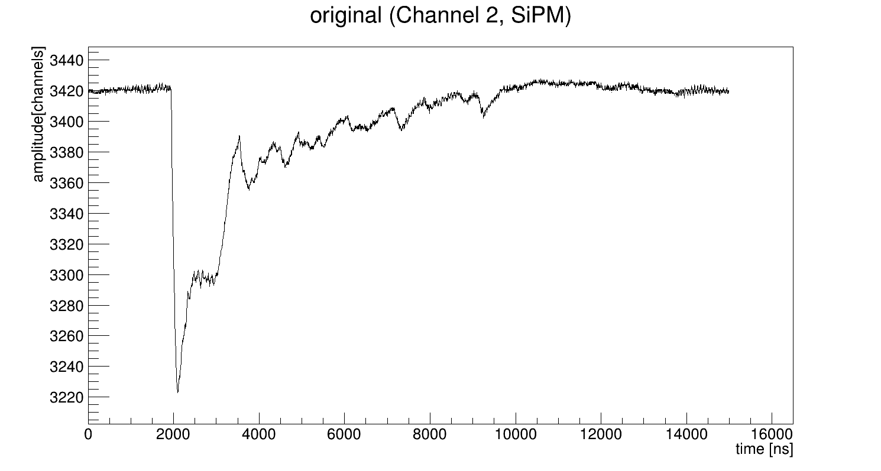
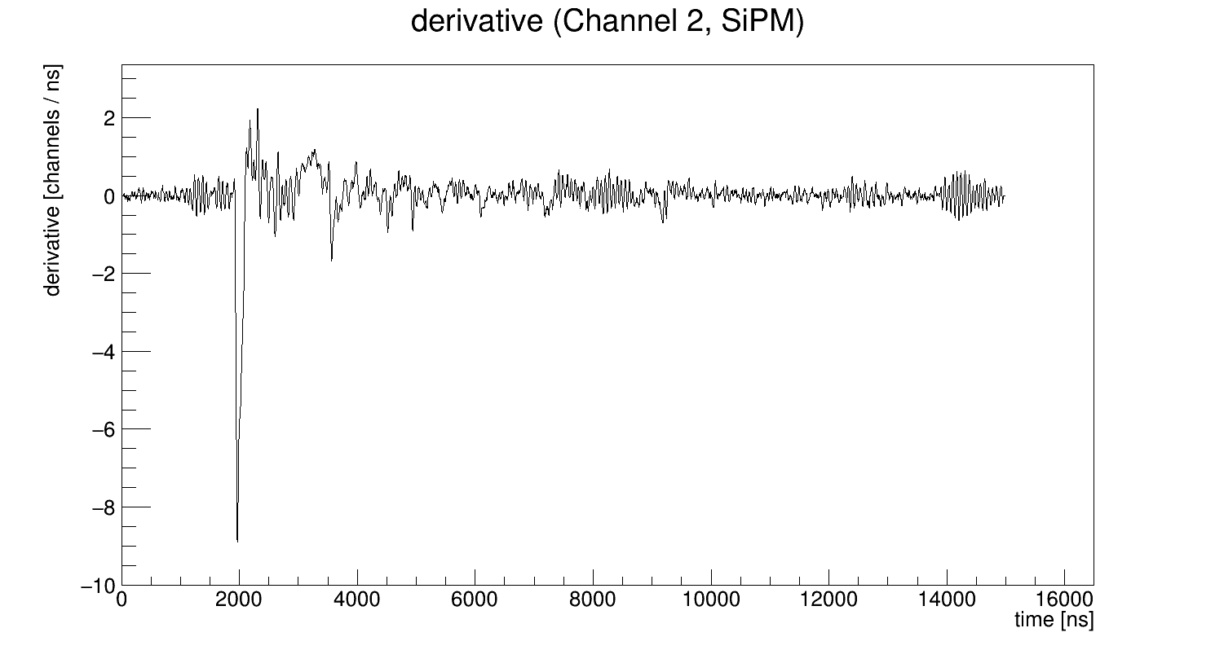
Find derivative and identify peaks
“+” The simplest method
“-” Works incorrect for close signals
Overlapping of negative part of the 1st signal with positive part of the 2nd (for derivative)

Slide 27
Approximation by sum of individual responses
“+”
There are a lot of parameters, which we can change to get the best results for arrival time.
Can separate close peaks.
“-”
High CPU consumption (especially if there are a lot of signals).
It is difficult to find initial parameters for approximation.
A lot of manual work.
Each case is individual and require proper initialization for initial parameters.

Slide 28
Deconvolution
“+”
A variety of methods. Can reconstructs signal close to delta function (narrow peaks).
“-”
High CPU consumption (but independent from number of signals).
There are artifacts of deconvolution.
We should understand how it works in presence of noise.
Some algorithm only for positive data.

Slide 29
Deconvolution algorithms
Strictly speaking, deconvolution is to solve overdetermined linear system. This topic requires a separate presentation
Some realized algorithms
Root CERN TUnfold
Gold deconvolution (Root CERN TSpectrum::Deconvolution)
Richardson–Lucy deconvolution (Root CERN TSpectrum::DeconvolutionRL)

Slide 30
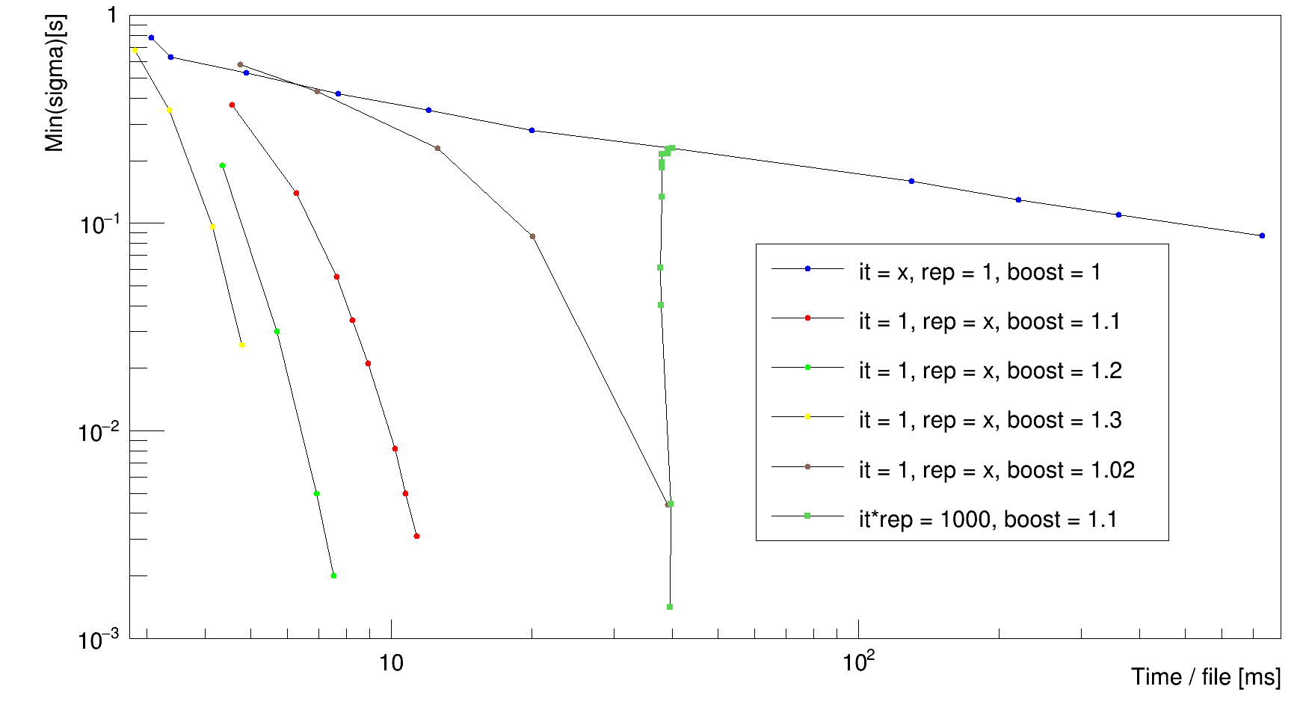
Root CERN TSpectrum::Deconvolution
3 parameters: N_iter, N_rep, boost
1) N_iter >1, N_rep = 1, boost = 1
Works correct, but slowly
2) N_iter >1, N_rep > 1, boost >1
Distorts small signals, but can be very fast
Simulation (in order to measure width correct)

Slide 31
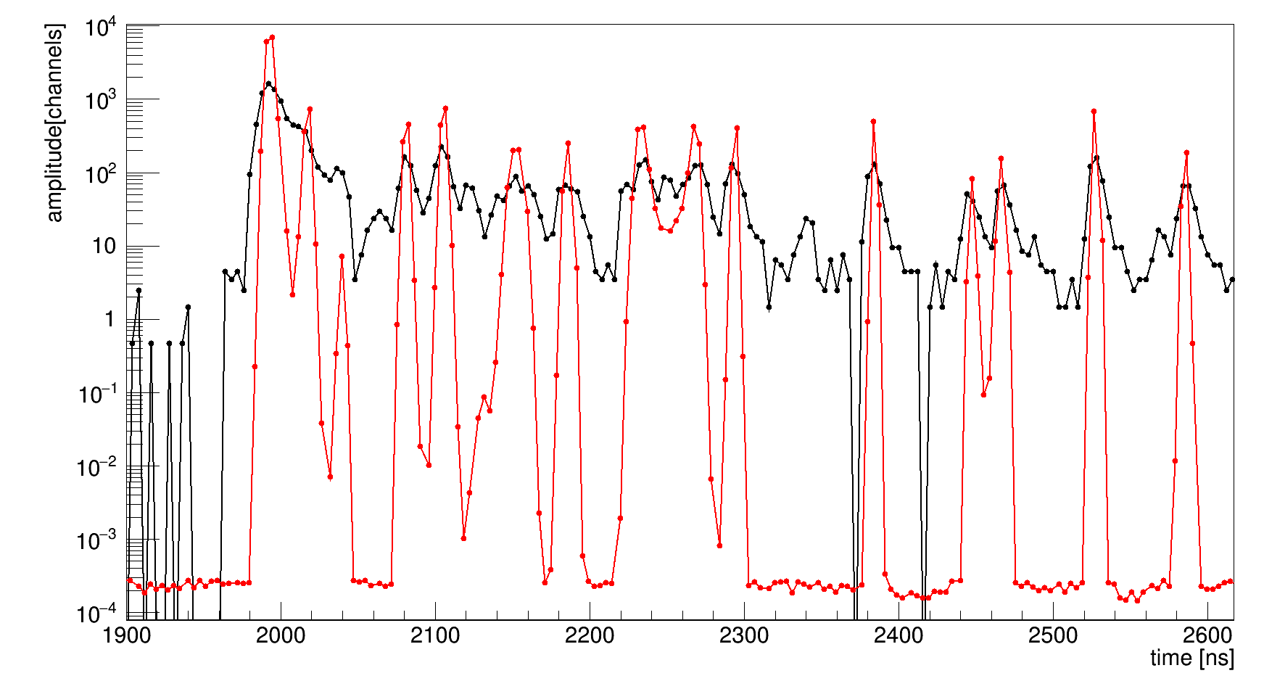
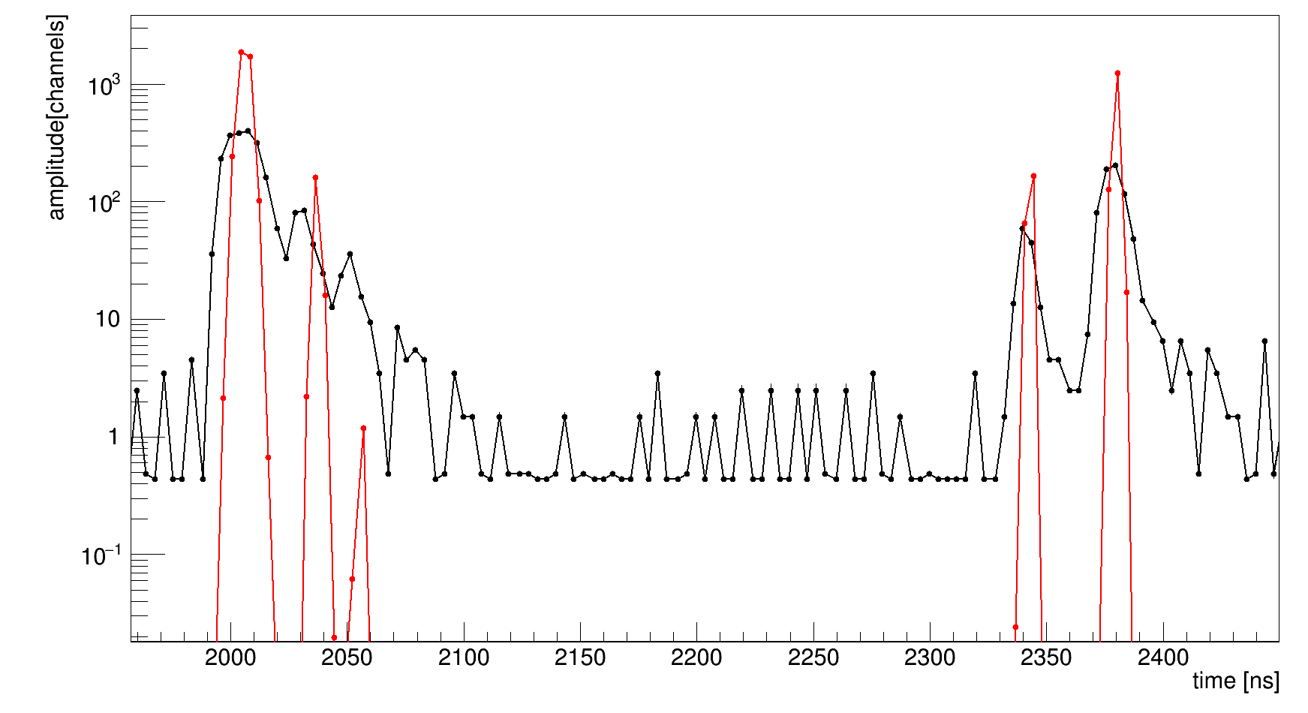
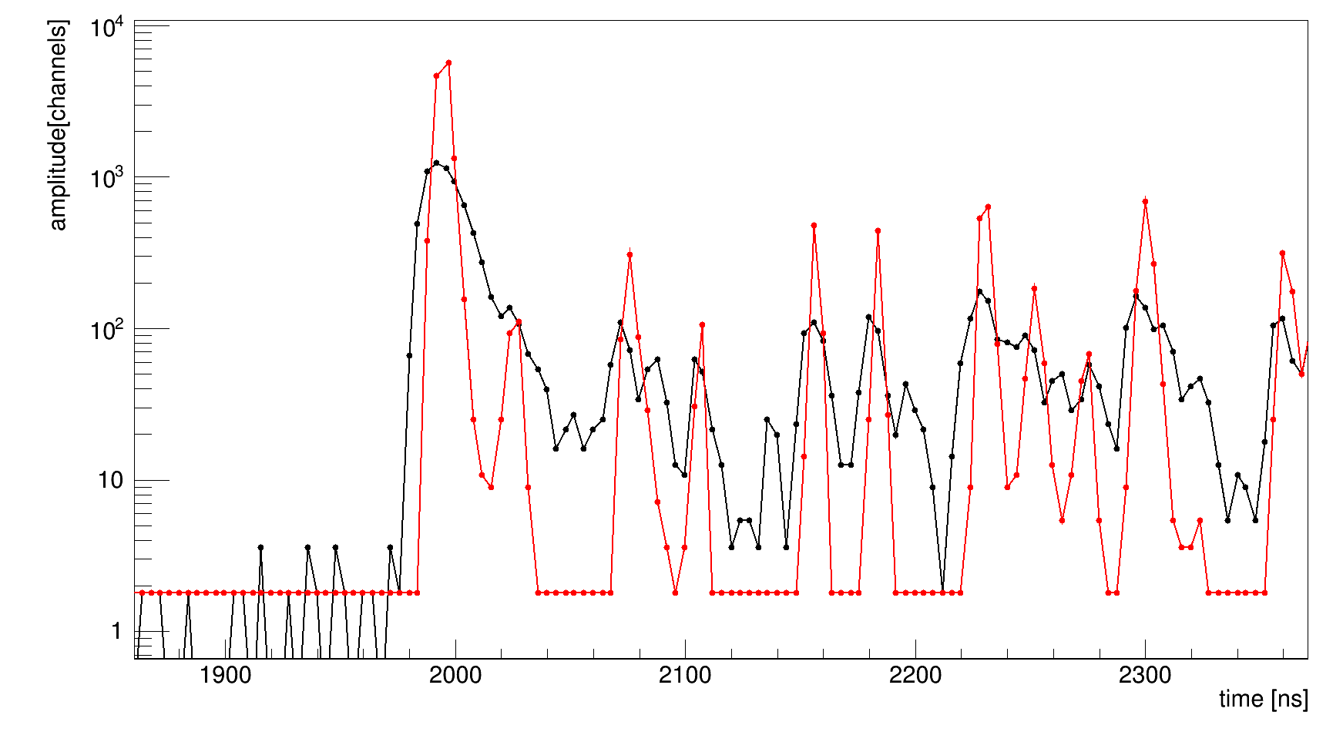

Tspectrum::Deconvolution ch0 results
N_iter = 100, N_rep = 1, boost = 1

Slide 32




Tspectrum::Deconvolution ch2 results
N_iter = 100, N_rep = 1, boost = 1

Slide 33




Ratio vs N_pe (ch 2, SiPM)
Run 6064 Am
Run 6053 bg
The reason of tail above 1200 pe is saturation of electronics

Slide 34


Ratio vs N_pe (ch 2, SiPM)
Run 6064 Am
Run 6053 bg

Slide 35




Ratio vs N_pe (ch 2, SiPM): slices
Let's project 2D histogram to N_pe axis with 10 pe step and make gauss fit (binned fit)
Run 6064 Am

Slide 36

Ratio vs N_pe (ch 2, SiPM): slices
Run 6064 Am

Slide 37

Ratio vs N_pe (ch 2, SiPM): slices
Run 6053 bg

Slide 38


Ratio vs N_pe (ch 2, SiPM)
Let's project 2D histogram to I_fast / I_total axis and make gauss fit (binned fit)
Run 6064 Am
Run 6053 bg

Slide 39

Sigmas comparison
Sigma vs N_pe. Sigma is a param of gauss fit of I_fast / I_slow distribution.
In simulation sigma of gauss response is 33 ns.
PDF = A * PDF_fast + (1 – A) * PDF_slow; A = 0.2308

Slide 40
What are reasons of broadening?
Another PDF in simulation.
May be because of wavelength shifter.
Low frequency noise.
Integration window is 200ns and noise concentrated from 0 to 5 MHz (i.e. period more than 200 ns). So, it is very probable to have non zero integral of noise.
We do not know full information about response.
Length of signal in laser run is 5 us.
It is not enough, because baseline does not return to origin value.
Also, we know only estimation of true response, because of experimental errors.
Consequence of deconvolution algorithm applied to noise data.
In simulation without noise Gold deconvolution algorithm do not change position and total integral, may be the reason of broadening (I should check). Also we should understand what will be in presence of noise.

Slide 41
Further steps
Write laser run with longer period (~20 us)
Understand the reason of non-smooth averaged signal
Simulate signals for real response, add some noise and make deconvolution
Find fast algorithm which will work with positive and negative data correctly
Find optimum of separation algorithm for real data (need neutron run)
You can find source code here
https://github.com/Vlad-ole/s1_fast_slow_separation_darkside

Slide 42
Thank you for your attention!

