Slide 1
Fourier transform

Slide 2
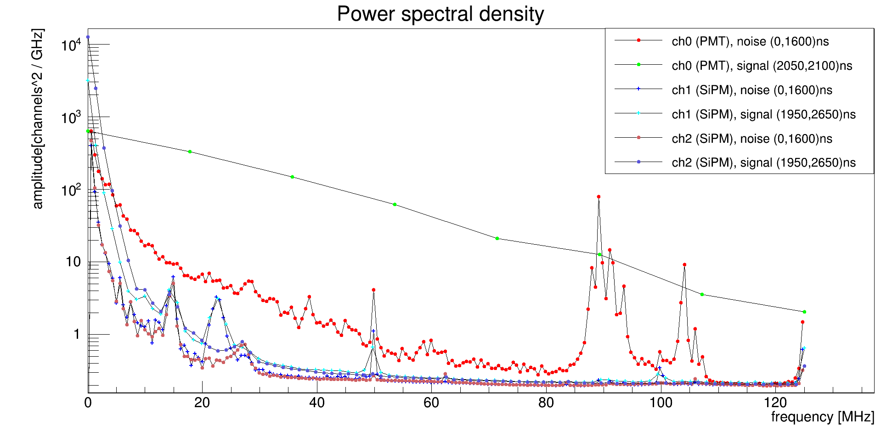
Laser run 6061

Slide 3
Am run 6064

Slide 4
Laser run 6061 vs Am run 6064

